Slide 1
MSACL · DS301 DEEP LEARNING · SEGMENT 3 · LECTURE 7
Sequence models and attention: order, and looking things up
Why order matters · RNNs in pictures · tokens & embeddings · self-attention as a soft lookup
Notes:
Monday morning, the first hour of Segment 3 — we leave images behind and pick up SEQUENCES: chromatograms in time, QC across runs, peptides as strings of amino acids. The promise of the hour: by the end you can read an attention heat map and run one attention head by hand — score with a dot product, soften with softmax, blend the values. Same interactive spine as Lectures 1, 2, 4 and 5: every worked example (I-do) is followed by one you do yourself (you-do), and every you-do IS a Quiz 7 item. Hand out Quiz 7 now, blank — the room fills it in across the hour, so by the recap the whole sheet is done. Quiz 7 has two items and we hit both live: read a heat map (Q1) and run one whole attention head end to end (Q2). The query/key/value roles are defined rigorously and then exercised inside Q2's computation. This hour sets up Lecture 8, where we assemble the full transformer on top of this same lookup.

Slide 2
LECTURE 7 · WHERE THIS HOUR GOES
Four stops, one destination
• Why order matters — sequence data, and RNN/LSTM in pictures (and their limits) · 12 min
• Tokens & embeddings — a peptide is a sentence; words become coordinates · 13 min
• Self-attention — a soft lookup: query / key / value, heat maps, one full attention head by hand · 23 min
• Why attention won — parallel + long-range — setting up the transformer · 7 min
Notes:
Signpost the four stops so people can pace themselves. The middle two blocks are the heart of the hour: tokens/embeddings, then self-attention, which is where both Quiz 7 items live. The self-attention block alone is ~23 minutes because it carries the numeric mechanic (one whole attention head) plus the two heat-map reads. Keep the first block brisk — RNNs are context and a contrast, not the destination. Nothing here needs more than multiply-add; the only new symbol is Σ, and it just means "add up the terms."

Slide 3
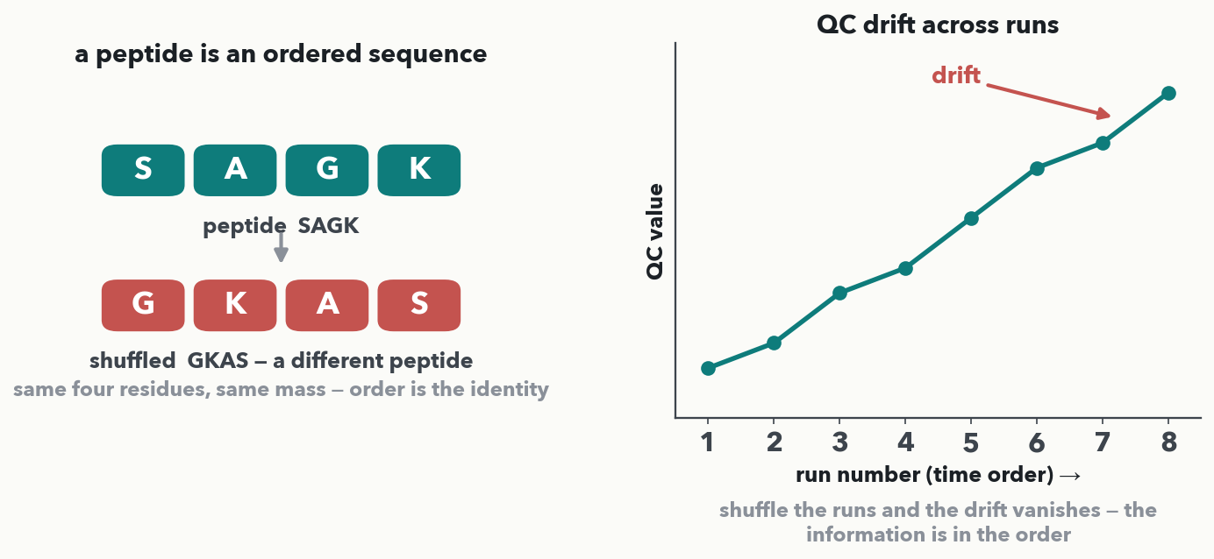
WHY ORDER · 1 OF 3 · THE DATA
Order carries the information
MASS SPEC · The same four residues in a different order are a different peptide — same mass, different sequence, different fragmentation. And a QC trace only means 'drifting' because the runs are in time order. A dense net or a CNN sees a bag of numbers; sequence models are built to respect order.
Notes:
Land the motivating idea with two MS-anchored pictures. Left: SAGK and GKAS have identical amino-acid composition — identical mass — yet they are different molecules with different MS/MS fragment ladders; the ORDER is the identity. Right: a QC value creeping up across runs is only "drift" because run number is time; shuffle the runs and the trend — the thing you'd flag — disappears. The teaching point: for this data the arrangement is not incidental, it is the signal. Lab-1's MLP and Lab-2's CNN both ignore global order (a CNN only sees local windows); the rest of this hour is architecture that reads a sequence as a sequence.

Slide 4
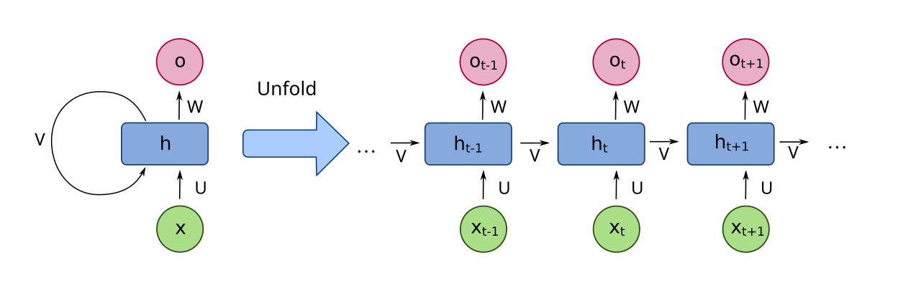
WHY ORDER · 2 OF 3 · THE CLASSIC ANSWER
An RNN reads one token at a time, passing a memory forward
recurrent net, rolled and unrolled · diagram: fdeloche, Wikimedia Commons, CC BY-SA 4.0
Read left to right: at each step the box takes the next token x and the running memory h, and passes an updated h onward. 'Unroll' it (right) and it is the same small network reused at every position — weight sharing along time, just like a CNN shared weights across space.
Notes:
The recurrent neural network (RNN) was the standard sequence model for years. Read the rolled form on the left: one cell with a loop — it feeds its own hidden state h back into itself. Unrolled on the right, it is that same cell copied at every time step, each step taking the next input xₜ and the previous memory hₜ₋₁ and emitting a new memory hₜ and an output oₜ. Two familiar ideas: it is weight sharing (the SAME cell at every step, like one convolution slid along the sequence), and the memory h is how information from early tokens is meant to reach later ones. Hold that "meant to" — it is exactly where the limits come from, two slides on.

Slide 5
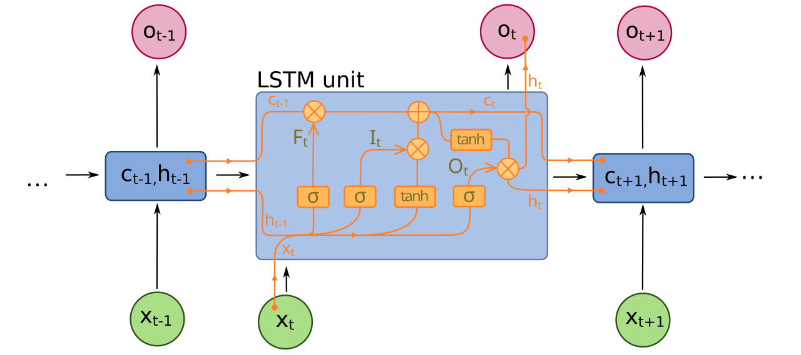
WHY ORDER · 3 OF 3 · GATES, AND THE CATCH
LSTMs added gates — but recurrence stays slow and forgetful
LSTM cell with input/forget/output gates · diagram: fdeloche, Wikimedia Commons, CC BY-SA 4.0
PAIR · The LSTM adds gates (the σ boxes) that learn what to keep, forget, and output, so memory survives longer than a plain RNN. But two problems remain: it is SEQUENTIAL (step t waits for step t−1 — no parallelism), and long-range memory still fades over many steps. 🙋 Show of hands (10 sec): for a 500-residue protein, which bites harder — SLOW or FORGETFUL? Hold that thought — attention fixes both.
Notes:
The Long Short-Term Memory cell (LSTM) is the famous fix to the plain RNN's forgetfulness: the σ ("sigmoid") gates learn, per step, what to add to memory, what to erase, and what to read out — so a signal can ride the cell-state highway cₜ across many steps without being overwritten. Don't teach the gate equations; the picture is enough — gates = learned valves on a memory conveyor. Then the honest catch, the setup for the whole rest of the hour: (1) recurrence is inherently sequential, so it can't exploit a GPU's parallelism — long sequences are slow; (2) even with gates, tying token 1 to token 500 means passing information through 499 hand-offs, and it still degrades. Two problems — slow and forgetful — and attention answers both.

Slide 6
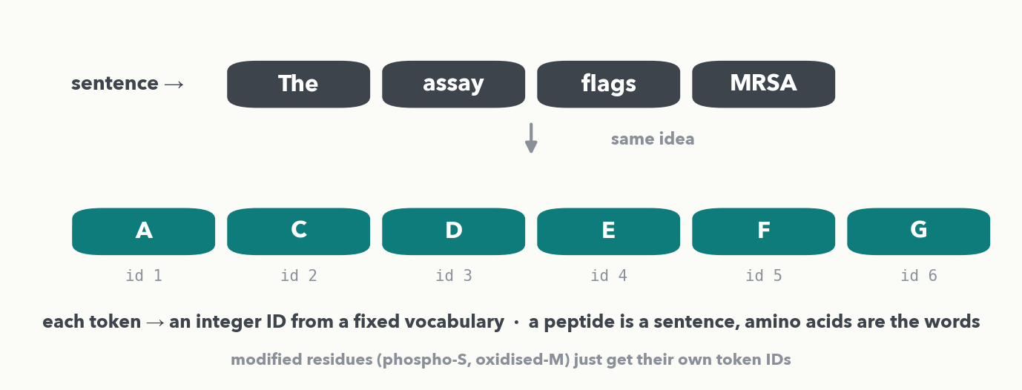
TOKENS & EMBEDDINGS · 1 OF 2 · 💬 PAIR
A peptide is a sentence; amino acids are the words
PAIR · 💬 Two minutes: tokenize ACDEFG into tokens — then, what could the vocabulary be for MODIFIED peptides (phospho-S, oxidised-M, a fixed N-terminus)? Shout out your best vocab.
Notes:
First step for any sequence model: cut the input into TOKENS from a fixed vocabulary and give each an integer ID. For text the tokens are (roughly) words; for a peptide the natural tokens are amino acids — ACDEFG becomes six tokens A,C,D,E,F,G with IDs 1–6. The analogy to carry all hour: a peptide is a sentence and amino acids are its words. The 💬 pair prompt is a genuine hands-on beat (rule 8): tokenizing ACDEFG is trivial, but the real question is what the vocabulary should be once you allow modifications — the clean answer is that each modified residue simply gets its OWN token ID (phospho-S is a different "word" than S), which is exactly how protein language models like ESM handle it, and how the peptide-sequencing transformers we build in Lecture 8 treat residues. Harvest two or three vocabularies; there is no single right answer.

Slide 7
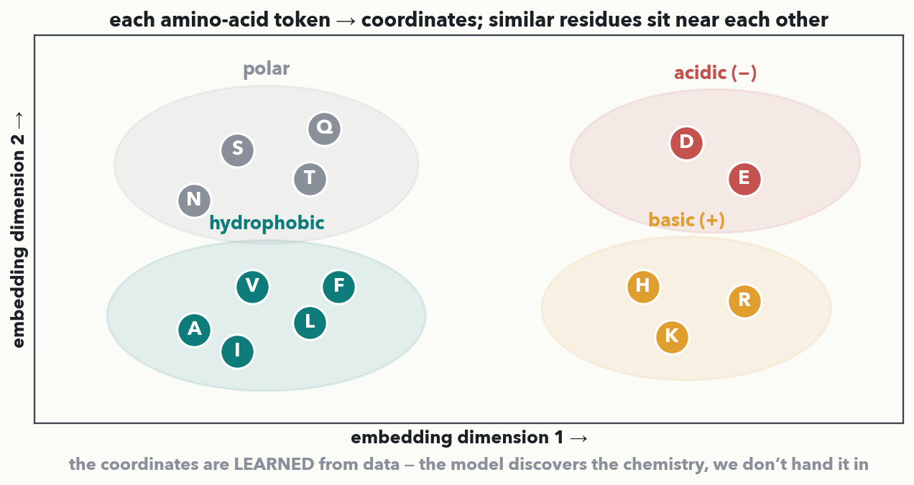
TOKENS & EMBEDDINGS · 2 OF 2
Embedding: each token becomes coordinates
MASS SPEC · A token ID is just a name — it carries no meaning. The EMBEDDING maps each token to a point in space, and the model LEARNS those coordinates so that chemically similar residues land near each other: the acidic pair D/E together, the basic K/R/H together, the hydrophobic cluster together. Meaning becomes geometry.
Notes:
An integer ID (K = 12) says nothing about chemistry — 12 is not "more" than 3. The embedding layer replaces each ID with a short vector of coordinates, and those coordinates are LEARNED during training (they are weights, tuned by the same gradient descent from Lecture 2). The payoff, shown in the picture: residues that behave alike end up near each other — acidic D and E in one corner, basic K/R/H in another, the hydrophobic set clustered — because the model discovers that placing them near each other helps it predict. "Words → coordinates where similar things sit near each other." Two dimensions here for drawing; real embeddings use tens to hundreds. This is the input to attention: attention works on these coordinate vectors, not on raw IDs.

Slide 8
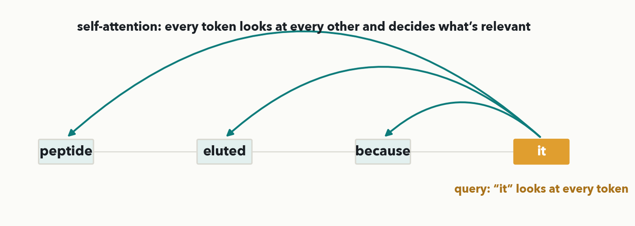
SELF-ATTENTION · THE BIG IDEA
Every token looks at every other, and decides what's relevant
No passing a memory down a chain. Every token sends its question to EVERY token at once and gathers what's relevant back. Here 'it' looks at all four tokens directly — including the far-away 'peptide' — in a single step. That's self-attention: all pairs, in parallel.
Notes:
The core move, before any mechanics. Where an RNN routes information step-by-step, self-attention lets every token attend directly to every other token in one shot. The cartoon: the query token "it" reaches every token — near and far — and pulls back a blend of what's relevant. Two things this buys, which we cash out at the end of the hour: it is parallel (all pairs computed together, GPU-friendly) and long-range (token 1 to token 4 is one hop, not a walk down the chain). Now the obvious question — HOW does a token decide what's relevant? That is the query/key/value lookup, next.

Slide 9
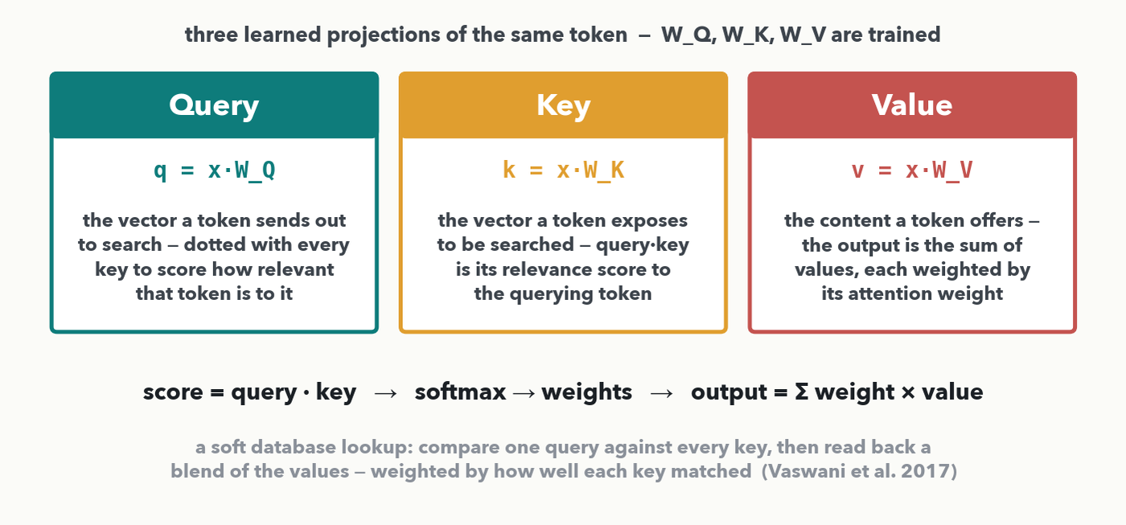
SELF-ATTENTION · THE LOOKUP · I-DO
Query, key, value: three learned projections
Each token is projected into three vectors by trained matrices: query q=x·W_Q, key k=x·W_K, value v=x·W_V. Define each by the operation it does: the QUERY is dotted against every KEY to score relevance (query·key = a compatibility score); softmax turns the scores into weights; the output is Σ weight × VALUE. It is a soft database lookup — match one query to all keys, read back a blend of the values.
Notes:
This replaces the old vague "what I'm looking for" wording with the rigorous definition (Vaswani et al. 2017; d2l.ai). The one thing to say clearly: query, key, and value are not three different things a token "has" — they are three LEARNED linear projections of the same token vector, q = x·W_Q, k = x·W_K, v = x·W_V, and the network learns the three weight matrices. Define each by its job in the computation, not by a feeling: the QUERY is the vector this token dots against every other token's KEY; that dot product query·key is a compatibility / relevance score (bigger = more relevant); softmax turns the row of scores into weights that sum to 1; the output is the sum of the VALUE vectors, each weighted by its attention weight. The honest analogy is a database key-value lookup made soft: a hard lookup returns the one value whose key matches; attention returns a weighted blend of ALL values, weighted by how well each key matched the query. Real attention also divides the scores by √d_k before softmax so they don't blow up (we skip that in the hand example). The heat map next IS the query-vs-keys scoring step; the weighted average after it is the value-mixing step — and Quiz 7 Q2 has you run one whole head end to end.

Slide 10
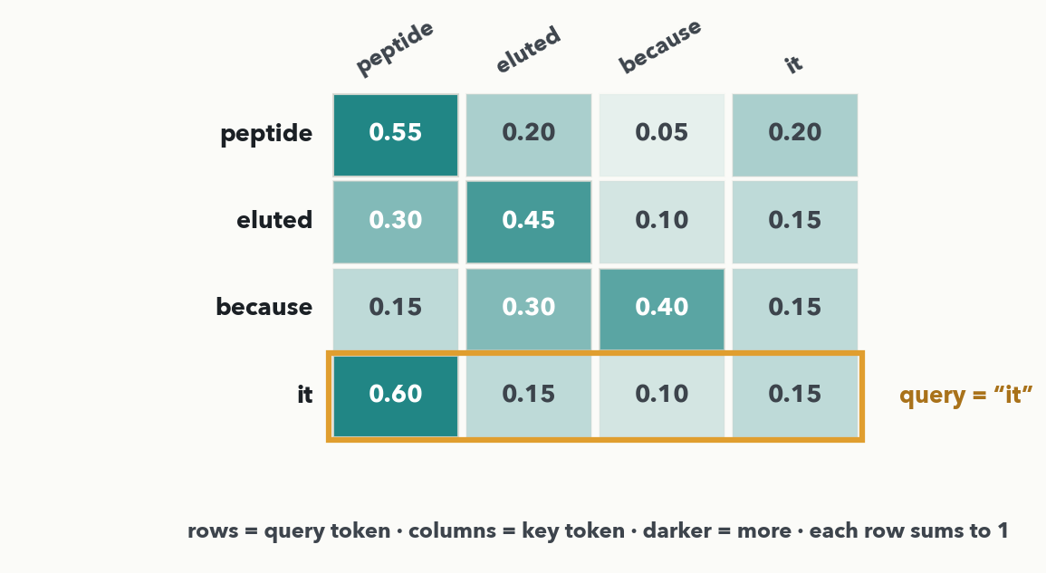
SELF-ATTENTION · HEAT MAP · I-DO
Reading a heat map: which token does 'it' look at?
Each row is one query token's attention over all key tokens; darker = more; every row sums to 1. Read the 'it' row (ringed): its darkest cell is 'peptide' (0.60). The model has learned that 'it' refers back to 'peptide' — coreference, straight off the picture.
Notes:
The heat map is how attention is visualized and debugged. Rows are query tokens, columns are key tokens, and cell (r,c) is how much token r attends to token c — darker means more, and because the weights are a softmax each row sums to 1. Work the ringed "it" row out loud: 0.60 on "peptide", 0.10–0.15 on the rest (0.15, 0.10, 0.15) — so "it" is attending mostly to "peptide". That is coreference resolution falling out of attention: the model links the pronoun to its referent. This is exactly the query-vs-keys step from the lookup slide, drawn. Next slide the room reads a heat map on a peptide (Quiz 7 Q1).

Slide 11
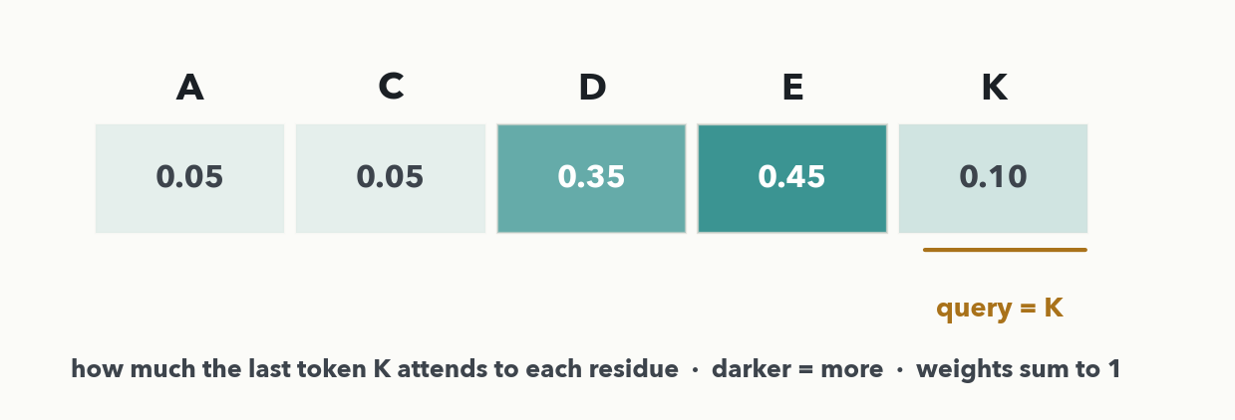
SELF-ATTENTION · HEAT MAP · YOUR TURN (YOU-DO = Q1)
Your heat map: which residue does K attend to most?
CHECKPOINT · Your turn → Quiz 7, Q1. A peptide A-C-D-E-K, tokenized one residue at a time; the row shows how much the last token K attends to each residue (weights sum to 1). (a) Which does K attend to most? (b) Why is that chemically sensible? Worked answer in the notes.
Notes:
YOU-DO = Quiz 7 Q1 (same "read the darkest cell" skill, now on a peptide; it assesses the heat-map-reading outcome). The five weights are A 0.05, C 0.05, D 0.35, E 0.45, K 0.10 — they sum to 1. (a) K attends MOST to E (0.45, the darkest cell), with D (0.35) a close second. (b) Chemically sensible because K (lysine) is positively charged (basic) while D and E are negatively charged (acidic) — opposite charges attract, the makings of a salt bridge — so a model trained on real sequences plausibly learns K to "look at" the acidic residues. These numbers are identical to the Quiz 7 Q1 figure and key. Take one answer from the floor, then have them fill Q1(a) and (b).

Slide 12
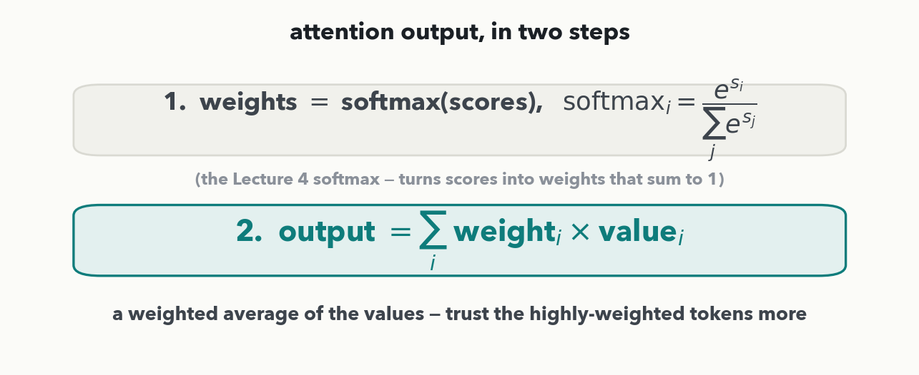
SELF-ATTENTION · THE MECHANIC · THE RULE
The attention output, in two steps
Written before you use it (so every number is computable): 0) score sᵢ = q·kᵢ — the dot product of the query with each key (multiply matching components, add). 1) weights = softmax(scores) — the SAME softmax you defined in Lecture 4, turning scores into weights that sum to 1. 2) output = Σ weightᵢ × valueᵢ — a weighted average of the values. That Σ just means 'add the terms.'
Notes:
State both rules explicitly before any exercise asks for a number (rule 3). Step 1 is softmax — the exact function from Lecture 4, which we already used and quizzed: it takes real-valued scores and returns positive weights that sum to 1, softmaxᵢ = e^{sᵢ} / Σⱼ e^{sⱼ}. Step 2 is the new, hand-computable piece: the output is Σ over tokens of weightᵢ × valueᵢ — literally a weighted average of the value numbers, where a bigger weight means you trust that token's value more. Reassure the room: Σ is just shorthand for "sum the terms," and with three tokens it's three multiply-adds. Next slide we work one all the way through.

Slide 13
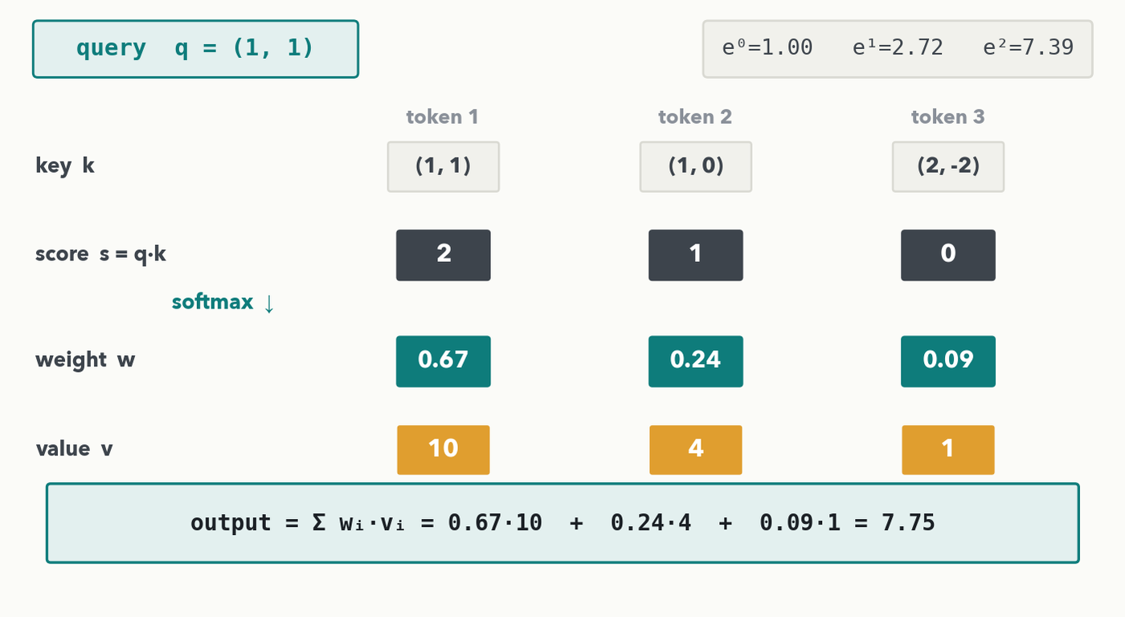
SELF-ATTENTION · THE MECHANIC · I-DO
One attention head, worked end to end
Query q=(1,1). Score each token by the dot product q·k: (1,1)·(1,1)=2, (1,1)·(1,0)=1, (1,1)·(2,-2)=0. Softmax(2,1,0) with e²=7.39, e¹=2.72, e⁰=1.00 (sum 11.11) → weights 0.67, 0.24, 0.09. Values 10, 4, 1. output = 0.67·10 + 0.24·4 + 0.09·1 = 7.75 — pulled toward token 1, the highest-weight token.
Notes:
The centerpiece, worked cell by cell — a whole attention head, not just the blend. Step 0, scores are DOT PRODUCTS of the query against each key: q·k₁=(1)(1)+(1)(1)=2, q·k₂=(1)(1)+(1)(0)=1, q·k₃=(1)(2)+(1)(-2)=0. Step 1 is the Lecture 4 softmax on s=(2,1,0): e²=7.39, e¹=2.72, e⁰=1.00, sum 11.11, so 7.39/11.11=0.67, 2.72/11.11=0.24, 1.00/11.11=0.09 (sum 1.00) — the e^x table is on the slide so it is fully hand-computable. Step 2, the weighted average of the values v=(10,4,1): 0.67·10 + 0.24·4 + 0.09·1 = 6.7 + 0.96 + 0.09 = 7.75. Intuition: token 1 scored highest (2) → got the most weight (0.67) → the output sits near its value (10). That is all "paying attention" is. Next slide the room runs a whole head themselves with a new set of keys (Quiz 7 Q2).

Slide 14
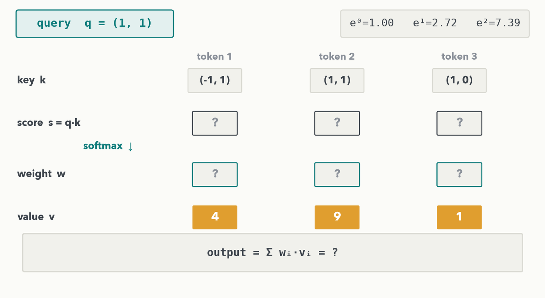
SELF-ATTENTION · THE MECHANIC · YOUR TURN (YOU-DO = Q2)
Your turn — run a whole head, start to finish
CHECKPOINT · Your turn → Quiz 7, Q2. Same query q=(1,1), new keys. (a) Score each token, sᵢ = q·kᵢ. (b) Softmax the three scores into weights — use e⁰=1.00, e¹=2.72, e²=7.39. (c) output = Σ wᵢ·vᵢ with values 4, 9, 1. Worked answer in the notes.
Notes:
YOU-DO = Quiz 7 Q2 — a whole head, the same shape as the I-do with new keys. (a) Scores are dot products with q=(1,1): q·(-1,1)=0, q·(1,1)=2, q·(1,0)=1, so s=(0,2,1). (b) Softmax with the e^x table: e⁰=1.00, e²=7.39, e¹=2.72, sum 11.11 → weights 1.00/11.11=0.09, 7.39/11.11=0.67, 2.72/11.11=0.24 (sum 1.00). (c) Values v=(4,9,1): output = 0.09·4 + 0.67·9 + 0.24·1 = 0.36 + 6.03 + 0.24 = 6.63 — pulled toward token 2 (value 9), the highest-weight token. Matches the Quiz 7 Q2 key. Give the room ~3 minutes (this is the whole head), take scores then weights then output from volunteers, then have them fill Q2. That is both Quiz 7 items now worked live.

Slide 15
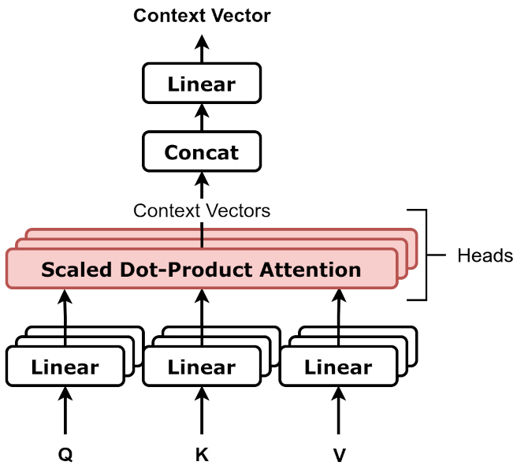
SELF-ATTENTION · MORE HEADS
Multi-head = several lookups in parallel
multi-head attention · diagram: dvgodoy, Wikimedia Commons, CC BY 4.0
One lookup catches one kind of relationship. Do several in parallel — each 'head' gets its own Query/Key/Value projection (the Linear boxes), runs the same scaled-dot-product attention we just computed, and the results are concatenated and mixed. One head might track charge pairings, another chain position.
Notes:
Real attention runs several lookups at once — "heads." Read the diagram bottom to top: the same Q, K, V are each passed through their own small Linear projection per head, every head runs the identical scaled dot-product attention we just did by hand (scores → softmax → weighted values), and the heads' outputs are concatenated and passed through a final Linear to mix them. Why bother: a single set of weights can only express one notion of "relevant," but language and chemistry have many at once — in a peptide one head might learn charge complementarity (the K↔E pairing from Q1), another might track sequence distance or hydrophobic neighbors. "Scaled" just means the scores are divided by a constant before softmax to keep them well-behaved — a detail, not a new idea. This is a real published diagram; hand-drawn mechanics were ours, canonical architecture is sourced.

Slide 16
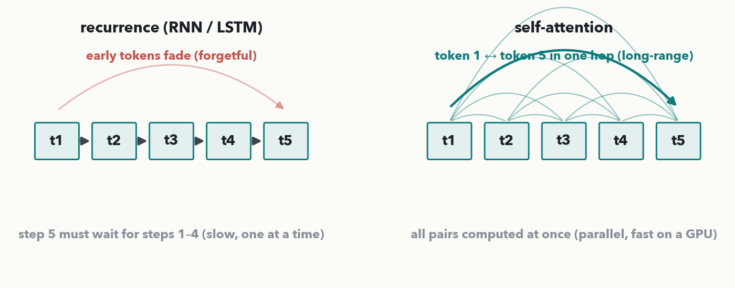
WHY ATTENTION WON
Parallel and long-range — that's why attention replaced recurrence
MASS SPEC · Recurrence (left): token 5 must wait for tokens 1–4 (slow), and early tokens fade over the chain (forgetful). Self-attention (right): all pairs at once (parallel — fast on a GPU) and any two tokens are one hop apart (long-range). Same two problems from the LSTM slide — both solved.
Notes:
Close the loop opened on the LSTM slide. Left: recurrence is sequential (the hand-offs must happen in order, so no parallelism — long sequences are slow) and long-range signal degrades over many steps (forgetful). Right: self-attention computes every token-pair interaction simultaneously — which maps perfectly onto GPU parallelism and is why transformers train on far more data — and every pair is directly connected, so token 1 and token 500 interact in a single step with no fading. Parallel + long-range: those two wins are the whole reason "Attention Is All You Need" (2017) replaced RNNs and launched the transformer era. Next hour (Lecture 8) we bolt the missing pieces onto this lookup — positions, normalization, the encoder/decoder — and the full transformer falls out.

Slide 17
LECTURE 7 · WHAT YOU CAN DO NOW
You can now…
• Say why order matters for sequence data, and what RNNs/LSTMs did — a memory passed along the sequence — and their two limits (slow, forgetful)
• Explain tokens and embeddings — a peptide is a sentence; each token becomes learned coordinates where similar things sit near each other
• Define query, key and value rigorously — three learned projections, where query·key is a relevance score — and read an attention heat map (Quiz 7 Q1)
• Run one attention head by hand — dot-product scores → softmax → weighted sum of the values (Quiz 7 Q2)
You have now worked both items on Quiz 7 live — the heat-map read (Q1) and one full attention head, scores → softmax → weighted values (Q2). The query/key/value roles you exercised inside Q2 are exactly what Lecture 8 assembles into the full transformer.
Notes:
Recap = the Lecture 7 outcomes, and each was already a you-do this hour that maps to a Quiz 7 item: Q1 the heat-map read (which residue K attends to most, and why), and Q2 the full attention head (scores = query·key, softmax to weights, output = Σ weight×value = 6.63). The query/key/value roles are defined rigorously on the lookup slide and then exercised inside Q2, so there is no separate role-match item. There is no end-of-class quiz block — they've done both across the hour. Have them keep the sheet; it's the on-ramp to Lecture 8. Then the closing bridge on the last slide.

Slide 18
LECTURE 7 · NEXT
Next hour — the transformer, assembled
• Positional encoding — attention is order-blind, so positions must be injected (fixes the one thing today's lookup ignores)
• Layer norm and the encoder/decoder — every remaining block, made familiar
• How a spectrum becomes tokens — patch it, CNN-encode it, or peak-as-token
• Transfer learning — borrow a pretrained body, retrain a small head — why 500 labeled spectra can be enough
CHECKPOINT · 2 minutes to finish Quiz 7 solo → we mark it together as Lecture 8 opens. Notice one gap we left on purpose: our lookup never used token ORDER — the weighted average is the same if you shuffle the tokens. Fixing that is the first slide next hour.
Notes:
Hand the last minutes to finishing Quiz 7, then sell Lecture 8. Plant the cliffhanger honestly: the attention we built is order-BLIND — nothing in "output = Σ weight×value" depends on which token came first, so shuffling the inputs gives the same output. That's a problem for sequences (recall slide 3 — order is the identity!), and the fix, positional encoding, is exactly where Lecture 8 begins. From there we assemble the full transformer from blocks the room already owns — attention (today), softmax (Lecture 4), residual skips and normalization (Lecture 5) — and then turn it loose on spectra and, in Lab 3, fine-tune a real pretrained model. Then Colab boots and we mark Quiz 7 together.

