Slide 1
FINM3422 — Tutorial 7, Group 1
Multi-Asset Risk & Derivatives Platform
A3 — Risk & Derivatives Platform
Indigo Hill – 47057465 Jordan Westerberg – 48917258 Elizabeth Kvyatkovska – 48426983 Math Al-Abudi
May 2026

Slide 2
Platform Overview
How the three modules connect
Yield Curve
Derivatives Pricing
Portfolio Risk
RBA F17 data 41 maturities (0–10yr) Linear & cubic interpolation Continuous compounding Risk-free rate r(T)
Black-Scholes (Merton) Binomial CRR tree Monte Carlo (100k paths) American early exercise Closed-form Greeks
3 strategies (hedge/income/spec) Historical & Parametric VaR Multi-asset correlated MC VaR Scenario analysis Max Drawdown
▶
▶
Platform workflow: yield curve → derivative pricing → portfolio risk analytics
2

Slide 3
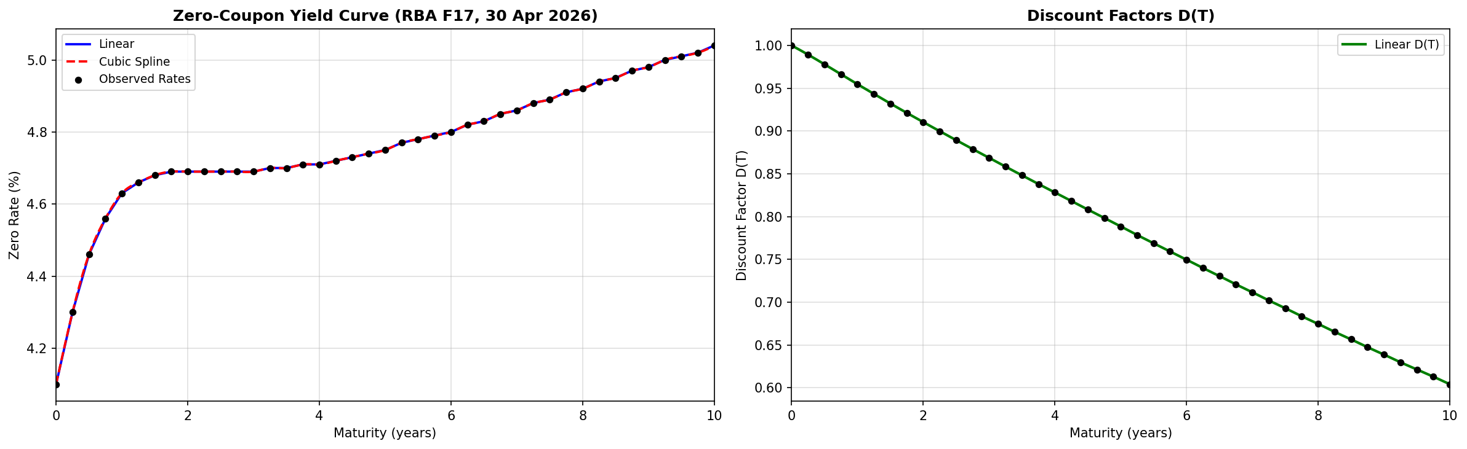
Yield Curve Construction
RBA F17 Zero-Coupon Rates — as of 30 April 2026
Data Source
Source: RBA F17 zero-coupon rates Date: 30-04-2026 | 41 maturities (0–10yr, 0.25yr steps) Period: 2017-01-03 to 2026-04-30
Risk-Free Rates r (continuous, from zero-coupon strip)
Maturity | r (%) | D(T)
3 months | 4.30 | 0.9893
6 months | 4.46 | 0.9779
1 year | 4.63 | 0.9548
2 years | 4.69 | 0.9105
3

Slide 4
Yield Curve Construction
Linear vs Cubic Spline — Interpolation Comparison
Comparison at 7 non-observed maturities. Maximum difference: 0.56bp — immaterial for 6-month option pricing.
Maturity (yr) | Linear Rate (%) | Cubic Rate (%) | Difference (bp)
0.6 | 4.408 | 4.404 | +0.04
1.3 | 4.641 | 4.643 | −0.02
2.8 | 4.712 | 4.715 | −0.03
4.2 | 4.762 | 4.766 | −0.04
6.3 | 4.803 | 4.808 | −0.05
8.5 | 4.831 | 4.837 | −0.06
9.1 | 4.843 | 4.843 | +0.00
Cubic spline selected for long-dated instruments; linear sufficient for 6m equity options.
4

Slide 5
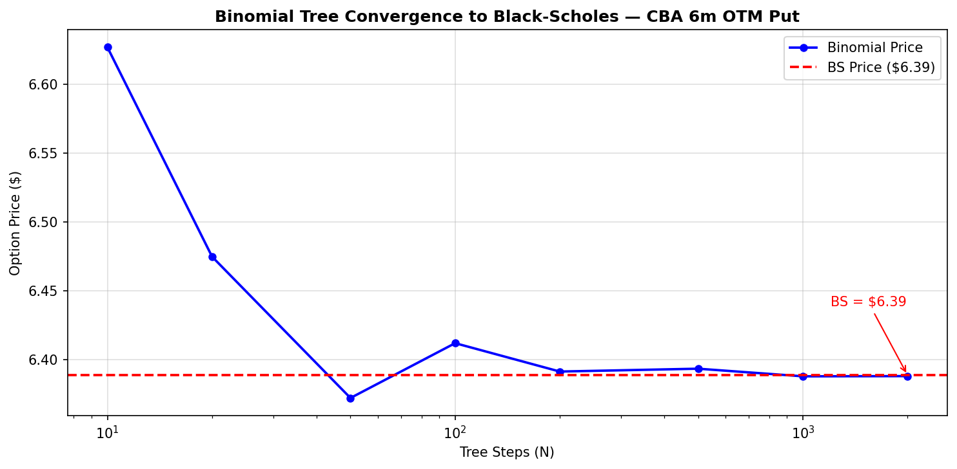
Derivatives Pricing
Black-Scholes · Binomial CRR · Monte Carlo · American Tree
Position | Spot($) | σ(%pa) | q(%) | BS Price($) | Binomial($) | MC 100k($) | American($) | Am. Prem.(%)
CBA 6m 5%OTM put | 164.29 | 23.37 | 2.99 | 6.39 | 6.39 | 6.39 | 6.46 | 1.15
BHP 6m 5%OTM call | 60.35 | 24.95 | 3.28 | 3.09 | 3.09 | 3.09 | 3.09 | −0.02
CSL 6m ATM call | 98.40 | 30.91 | 4.27 | 8.42 | 8.42 | 8.43 | 8.45 | 0.30
CSL 6m ATM put | 98.40 | 30.91 | 4.27 | 8.33 | 8.33 | 8.33 | 8.37 | 0.45
5

Slide 6
Option Greeks
Closed-Form (Black-Scholes) per Portfolio Position
Position | Δ Delta | Γ Gamma | V Vega($) | Θ Theta($/day) | ρ Rho($)
CBA 6m OTM put | −0.326 | 0.0132 | 4.81 | −1.79 | −0.68
BHP 6m OTM call | 0.431 | 0.0365 | 1.69 | −1.04 | 0.40
CSL 6m ATM call | 0.534 | 0.0180 | 16.82 | −5.64 | 0.70
CSL 6m ATM put | −0.447 | 0.0180 | 16.65 | −4.49 | −0.58
Portfolio Net Aggregates
Δ = +2,415 (equity-equivalent exposure) Γ = −36.0 (net short gamma — short BHP call dominates) V = +$238 per 1% vol (net long vega — CSL straddle drives this) Θ = −$16/day (modest time decay) ρ = −$395 per 1% rate move
Key Insight:
FD Greeks sit on the Derivative base class using type(self); every subclass (Binomial, MC) automatically inherits a complete set of numerical Greeks.
6

Slide 7
Portfolio Construction
Three Strategies — Hedging · Income · Speculation
Position | Qty | Unit Val($) | Pos. Val($) | Unit Δ | Pos. Δ
CBA equity (long, hedged) | 600 | 164.30 | 98,577 | 1.000 | 600.00
CBA 6m 5% OTM put (protective) | 600 | 6.39 | 3,834 | −0.326 | −195.58
BHP equity (long, covered) | 1,700 | 60.35 | 102,587 | 1.000 | 1,700.00
BHP 6m 5% OTM call (short) | −1,700 | 3.09 | −5,251 | −0.431 | −733.26
CSL equity (long, core) | 1,000 | 98.40 | 98,400 | 1.000 | 1,000.00
CSL 6m ATM call (straddle) | 500 | 8.42 | 4,212 | 0.534 | 267.00
CSL 6m ATM put (straddle) | 500 | 8.33 | 4,165 | −0.447 | −223.50
TOTAL |  |  | 306,524 |  | 2,415.43
CBA:
Long equity + protective put → hedging. Reduces directional exposure by ~$32k
BHP:
Long equity + short covered call → income. Caps upside, collects $5,251 premium
CSL:
Long equity + ATM straddle → vol speculation. Net delta ≈+0.09, pure vega bet
7

Slide 8
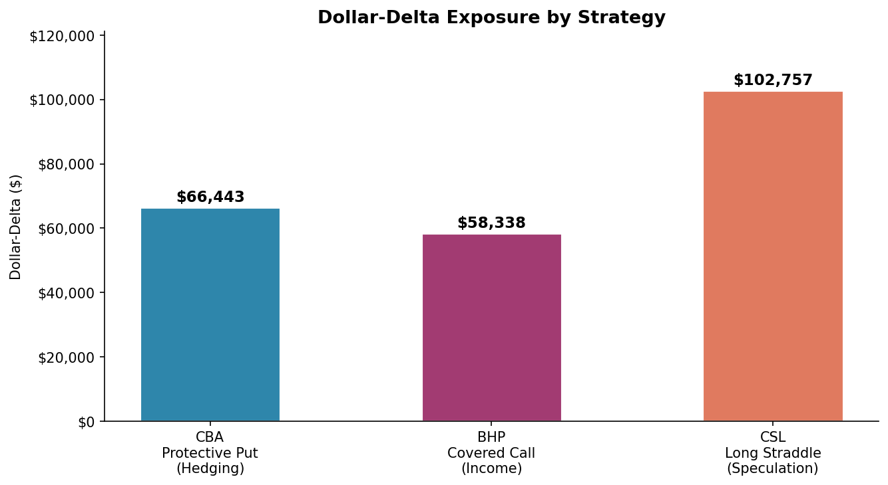
Portfolio Risk Exposures
Dollar-Delta Decomposition by Strategy
Ticker | Strategy | Dollar-Delta($) | % of Total
CBA | Hedging (protective put) | 66,443 | 29.2%
BHP | Income (covered call) | 58,338 | 25.6%
CSL | Speculation (long straddle) | 102,757 | 45.2%
TOTAL |  | 227,538 | 100.0%
Key Observations
• Total equity: $299,564 • Net option premium: −$6,961 • Portfolio vol: 18.22% (annualised) • CBA put reduces $99k → $66k delta • BHP short call caps upside • CSL straddle = pure vol view
8

Slide 9
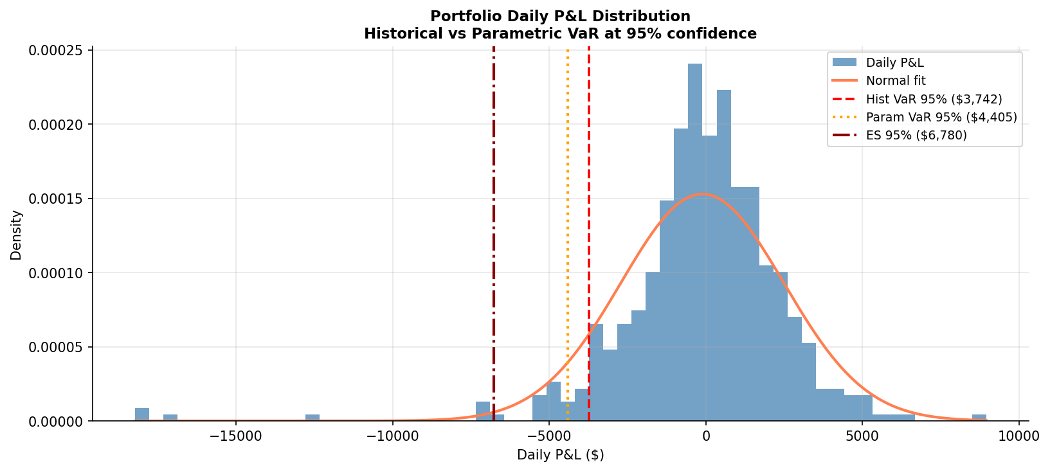
Value at Risk
Historical · Parametric · Multi-Asset MC — 95% confidence, 10-day horizon
Method | 95% VaR ($)
Historical VaR | 11,825
Parametric VaR | 13,583
MC correlated | 12,775
ES (Hist) | 21,431
ES (MC) | 15,599
Interpretation:
Hist VaR < Param VaR — real returns are leptokurtic (fat tails). Empirical 5th pctl is more extreme than −1.645σ implies. Ann. Vol: 18.22% Skewness: Negative Kurtosis: Leptokurtic
9

Slide 10
Value at Risk — Leptokurtosis Effect
Why Historical VaR < Parametric VaR
Return Distribution
VaR Comparison
Daily P&L distribution has fatter tails than a normal distribution predicts.
• Historical VaR ($11,825) < Parametric VaR ($13,583)
Metric | Value
Daily Std Dev | 1.15%
Skewness | Negative (left tail)
Excess Kurtosis | > 0 (leptokurtic)
Is Leptokurtic? | Yes
• This is unusual — normally hist > param for leptokurtic distributions.
• Our portfolio’s diversification across 3 sectors dampens tail extremity.
Fat tails: large losses occur more often than the normal model predicts.
• Expected Shortfall ($21,431) is 81% above Historical VaR — confirming fat tails exist beyond the threshold.
Per-Ticker VaR Bounds
Ticker | Dollar-Delta | 10-day VaR($)
CBA | 66,443 | 5,089
BHP | 58,338 | 4,770
CSL | 102,757 | 10,407
Indep: $12,528 | Perf.corr: $20,265 | Empirical: $13,583
10

Slide 11
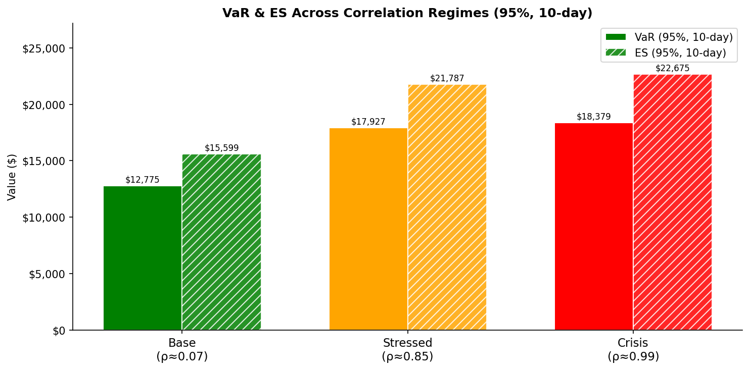
Stress Correlation Analysis
Multi-Asset MC VaR Across Three Correlation Regimes
Cross-sector correlations rise sharply in crises (GFC 2008, quant crash 2007), undermining diversification precisely when it is most needed.
Empirical Correlation Matrix
 | CBA | BHP | CSL
CBA | 1.00 | 0.07 | 0.14
BHP | 0.07 | 1.00 | 0.10
CSL | 0.14 | 0.10 | 1.00
Key observation: A risk dashboard ignoring correlation regimes systematically underestimates crisis-period losses.
11

Slide 12
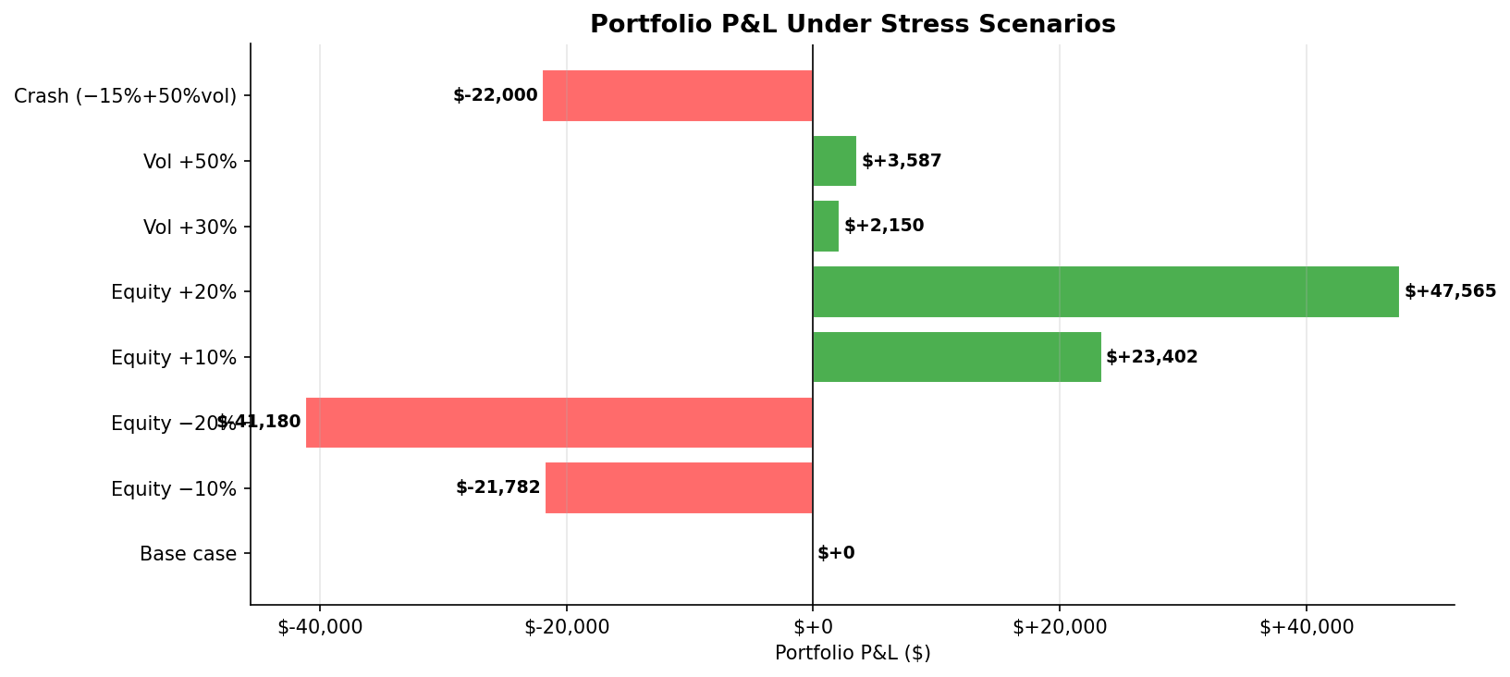
Scenario Analysis
Portfolio P&L Under Spot & Volatility Shocks (full repricing)
Scenario | P&L ($) | P&L (%)
Base case | $0 | 0.00%
Equity −10% | −$21,782 | −7.11%
Equity −20% | −$41,180 | −13.43%
Equity +10% | +$23,402 | +7.64%
Equity +20% | +$47,565 | +15.52%
Vol shock +30% | +$2,150 | +0.70%
Vol shock +50% | +$3,587 | +1.17%
Crash (−15%+50%vol) | ≈−$22,000 | ≈−7.2%
• Equity shocks dominate P&L: ±20% spot ≈ ±$40–48k P&L • Vol shocks alone are minimal — long CSL straddle offset by short BHP call
12

Slide 13
Scenario Analysis
Yield Curve Shocks — Rate Sensitivity Analysis
Scenario | Short Shift | Long Shift | P&L ($) | P&L (%)
Base case | +0bp | +0bp | $0 | 0.000%
Parallel rates +50bp | +50bp | +50bp | −$197 | −0.064%
Parallel rates +100bp | +100bp | +100bp | −$392 | −0.128%
Parallel rates −50bp | −50bp | −50bp | +$198 | +0.065%
Steepener (−50bp short, +50bp long) | −50bp | +50bp | small | small
Flattener (+50bp short, −50bp long) | +50bp | −50bp | small | small
Bear flattener (+100bp short, +25bp) | +100bp | +25bp | ≈−$295 | ≈−0.10%
Key Observations
• Rate sensitivity is modest (~$197–392 per 50–100bp) — no fixed-income positions, short-dated options • Equity risk dominates; rate risk is second-order for this portfolio • Rho = −$395 per 1% rate move; yield curve scenarios are consistent with per-position rho • A real fixed-income overlay or duration-bearing position would change this significantly
13

Slide 14
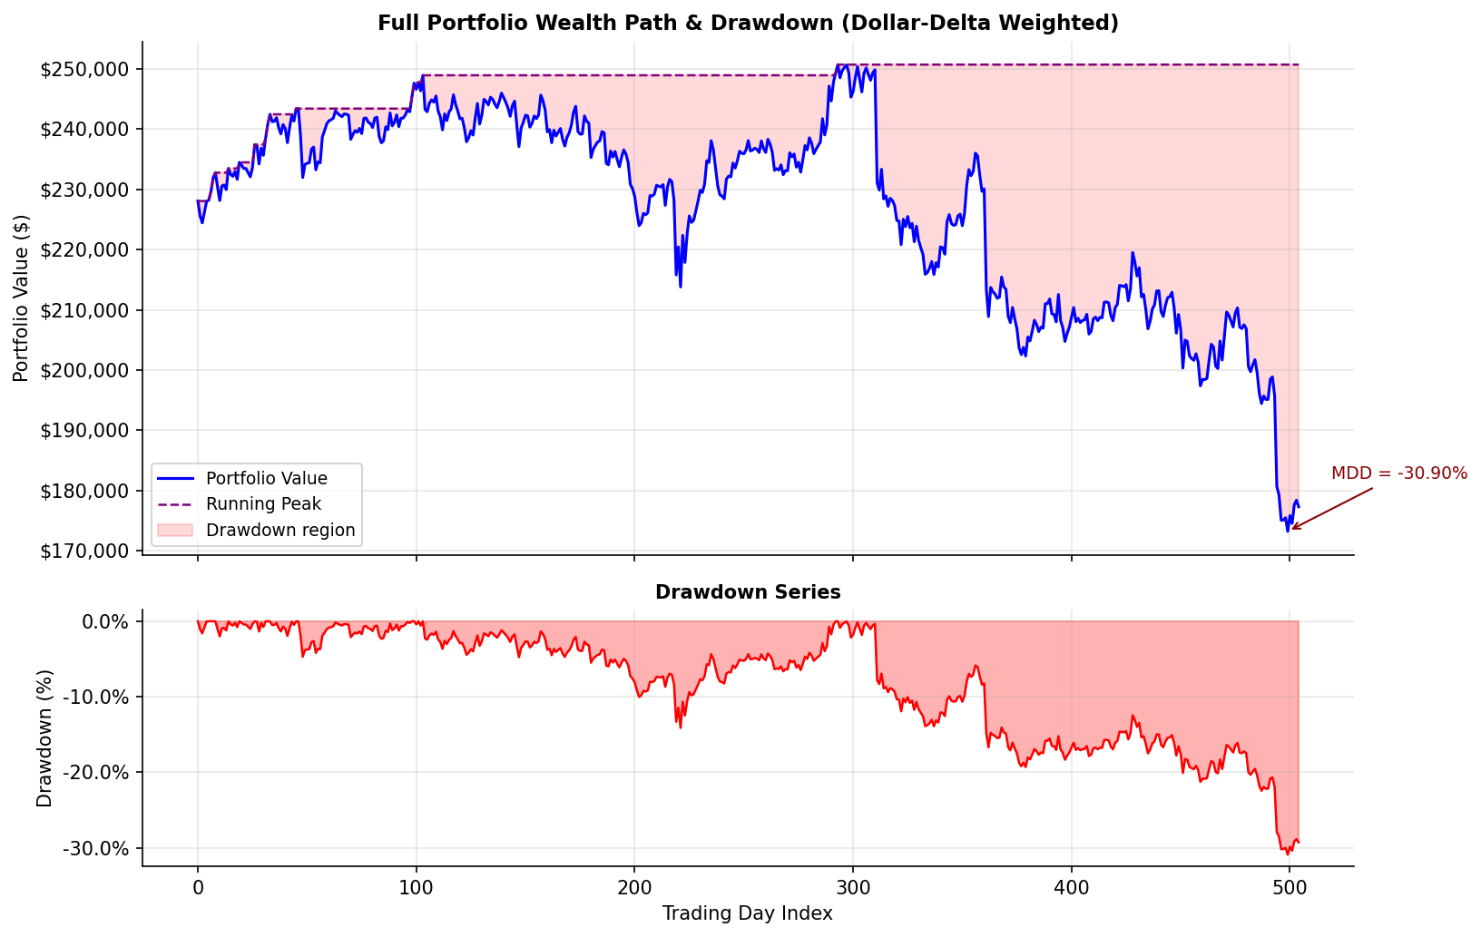
Maximum Drawdown
Path-Dependent Portfolio Revaluation vs Equity Equivalent
Method | MDD (%) | Dollar MDD ($) | Options?
Equity-equivalent (delta-weighted) | 30.86% | 70,224 | No
Full-portfolio (path-dependent repricing) | 11.89% | 36,460 | Yes
Reduction | 61.5% | 33,764 | —
14

Slide 15
Limitations & Extensions
LIMITATIONS
FUTURE EXTENSIONS
1. Sqrt-time VaR scaling
1.
GARCH(1,1) model for time-varying volatility and better multi-day VaR scaling
Assumes i.i.d. returns. Real returns exhibit volatility clustering. Effect: underestimates multi-day VaR in stressed regimes.
2.
Volatility smile / local vol surface (Dupire) for OTM option pricing accuracy
2. Static volatility (no smile)
Black-Scholes assumes constant σ. Real vol is time-varying and mean-reverting. 2-year historical σ may lag regime changes.
3.
Fixed-income overlay (interest rate swaps, bond futures) to manage rate risk
4.
Real-time data pipeline — replace cached CSV with live RBA / Bloomberg feed
3. Single-underlying MC VaR
Portfolio contains three underlyings; the single-asset MC in Portfolio.monte_carlo_var() misses cross-asset correlation. Addressed in Section 7 via multi-asset MC.
5.
Stress-testing framework aligned with APRA/Basel III 10-day 99% VaR standard
15

