Slide 1
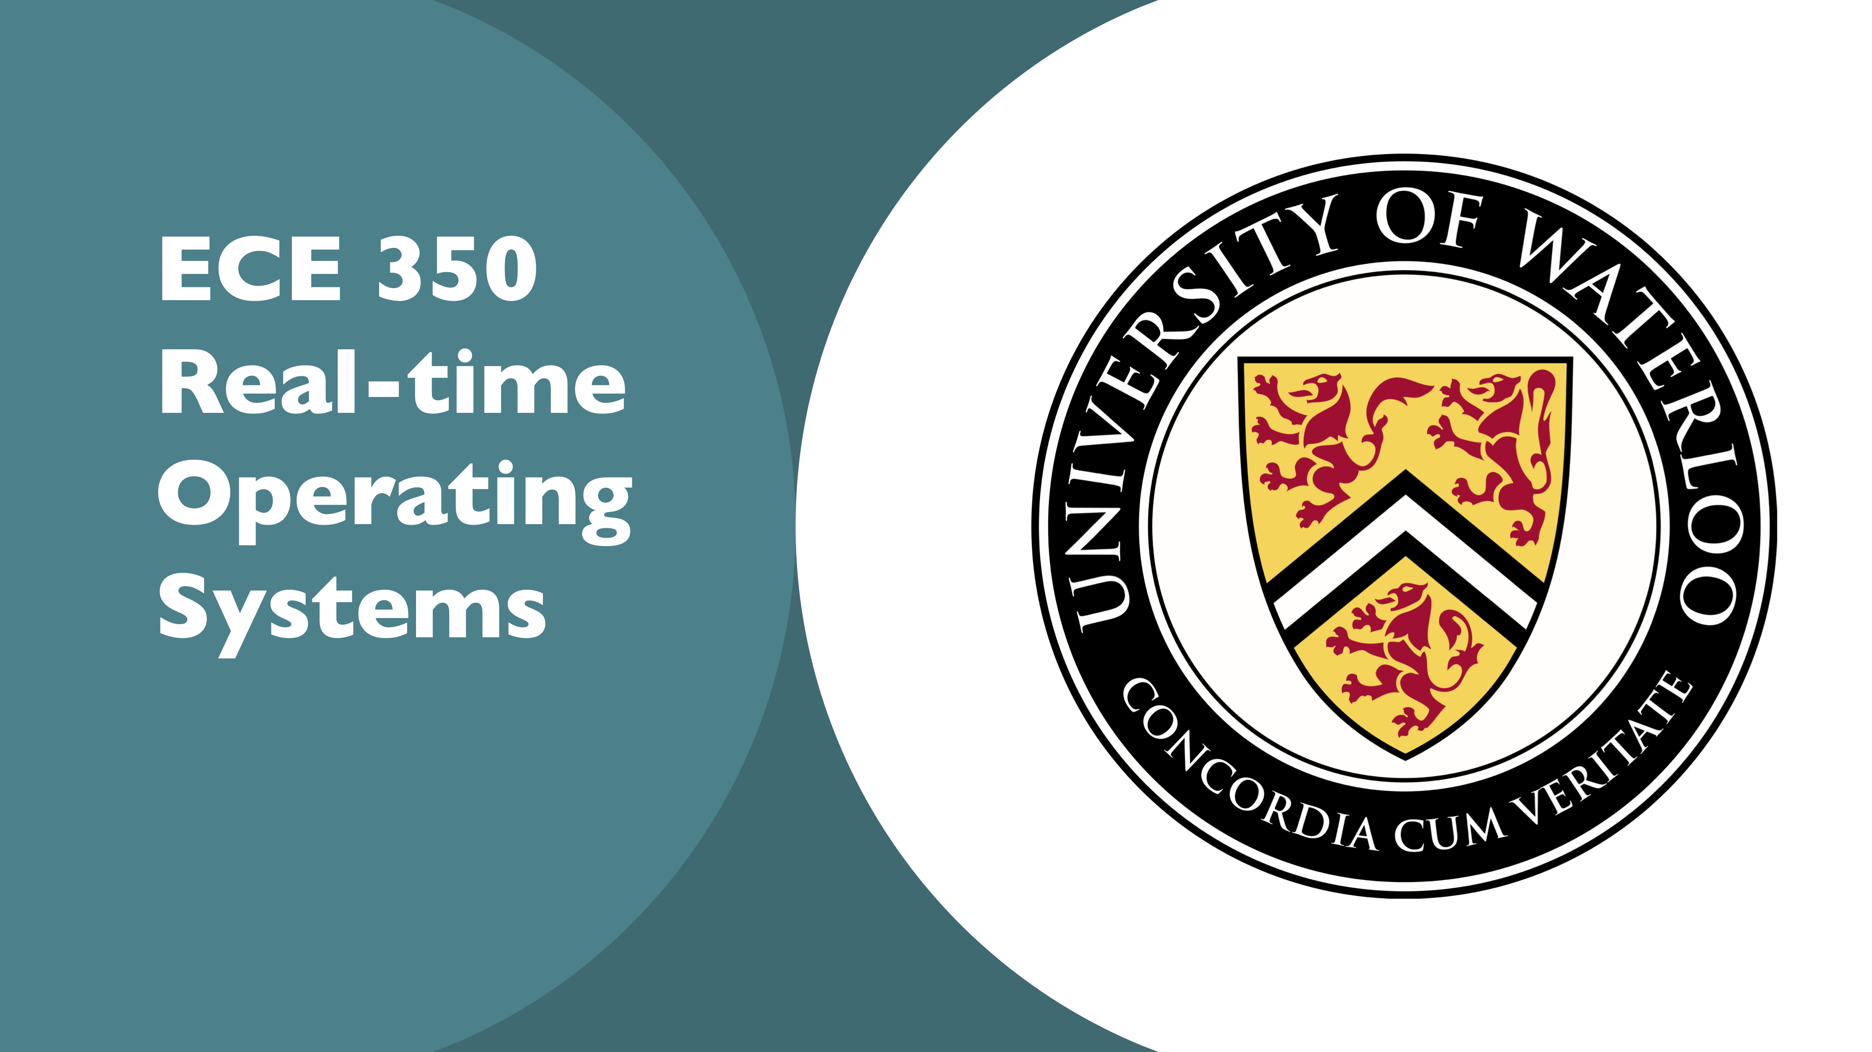

Slide 2
Lecture 2: OS Concepts
Prof. Seyed Majid Zahedi
https://ece.uwaterloo.ca/~smzahedi

Slide 3
Outline
Brief history of OS’s
Four fundamental OS concepts
Thread
Address space
Process
Dual-mode operation/protection

Slide 4
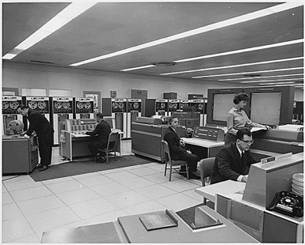
Very Brief History of OS
Several distinct phases:
Hardware expensive, humans cheap
Eniac, … Multics
“I think there is a world market for maybe five computers.” – Thomas Watson, chairman of IBM, 1943
Thomas Watson was often called “the worlds greatest salesman” by the time of his death in 1956
Notes:
Gone from people serving computers to computers serving people.
Except for the odd outlier like Pleo, that people need to take care of, virtually feed and play with.

Slide 5
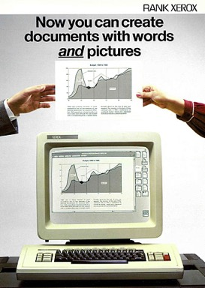

Very Brief History of OS
Several distinct phases:
Hardware expensive, humans cheap
Eniac, … Multics
Hardware cheaper, humans expensive
PCs, workstations, rise of GUIs
Hardware very cheap, humans very expensive
Ubiquitous devices, widespread networking
Notes:
Gone from people serving computers to computers serving people.
Except for the odd outlier like Pleo, that people naeed to take care of, virtually feed and play with.

Slide 6
Very Brief History of OS
Several distinct phases:
Hardware expensive, humans cheap
Eniac, … Multics
Hardware cheaper, humans expensive
PCs, workstations, rise of GUIs
Hardware very cheap, humans very expensive
Ubiquitous devices, widespread networking
Rapid change in hardware leads to changing OS
Batch ⇒ multiprogramming ⇒ timesharing ⇒ GUI ⇒ ubiquitous devices
Gradual migration of features into smaller machines
Today
Small OS: 100K lines / Large: 20M lines (10M browser!)
100-1000 people-years

Slide 7
OS Archaeology
Due to high cost of building OS from scratch, most modern OS’s have long lineage
Multics ⇒ AT&T Unix ⇒ BSD Unix ⇒ Ultrix, SunOS, NetBSD,…
Mach (micro-kernel) + BSD ⇒ NextStep ⇒ XNU ⇒ Apple OS X, iPhone iOS
MINIX ⇒ Linux ⇒ Android, Chrome OS, RedHat, Ubuntu, Fedora, Debian, Suse,…
CP/M ⇒ QDOS ⇒ MS-DOS ⇒ Windows 3.1 ⇒ NT ⇒ 95 ⇒ 98 ⇒ 2000 ⇒ XP ⇒ Vista ⇒ 7 ⇒ 8 ⇒ 10 ⇒ …
Notes:
Multics: MIT, GE, Bell Labs, 1969
Revolutionary but “bloated” at 135kB
Famous “failures”: Multics, Mach, NextStep: innovative but too flawed to succeed.
Microsoft established itself by writing an OS to compete with CP/M which IBM couldn’t negotiate with its author. They instead bought QDOS from a small code author who had written it from the CP/M manual.
Interestingly, there were some other OSes that didn’t have such a long lineage (e.g. IBM OS/2)

Slide 8
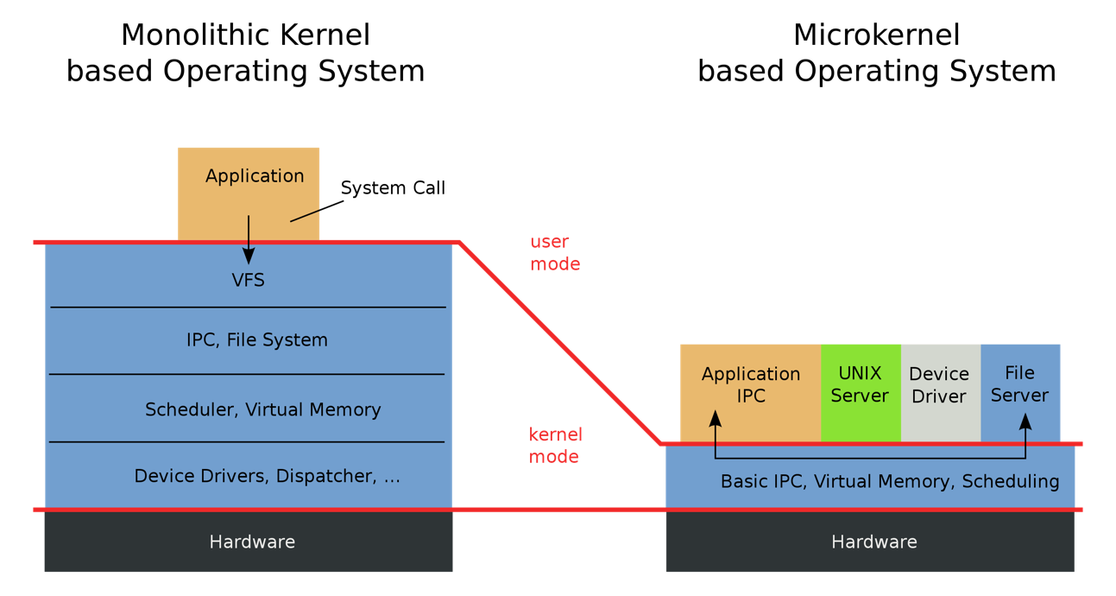
Monolithic vs Microkernel OS
en.wikipedia.org

Slide 9
Influence of Microkernels
Microkernels provide better modularity, security, and fault tolerance, but they introduce higher communication overhead
Too many context switches
Many OSes provide some services externally, like microkernels
OS X and Linux: Windowing (graphics and UI)
Some currently monolithic OSes started as microkernels
Windows family originally had microkernel design
OS X is hybrid of Mach microkernel and FreeBSD monolithic kernel

Slide 10
Today: Four Fundamental OS Concepts
Thread
Single unique execution context which fully describes program state
Program counter, registers, execution flags, stack
Address space (with translation)
Address space which is distinct from machine’s physical memory addresses
Process
Instance of executing program consisting of address space and 1+ threads
Dual-mode operation/protection
Only “system” can access certain resources
OS and hardware are protected from user programs
User programs are isolated from one another by controlling translation from program virtual addresses to machine physical addresses

Slide 11
Booting OS
Physical Memory
Disk
(1) BIOS copies bootloader
BIOS
In most x86 systems, BIOS is stored on Boot ROM
Expensive and writing to it is slow
Why not storing kernel on Boot ROM?
Hard to update (OS updates are frequent)
Why does BIOS load bootloader not OS?
Might have multiple OSes installed
BIOS needs to read raw bytes from disk, whereas bootloader needs to know how to read from filesystem
Bootloader instructions and data
Bootloader
(2) Bootloader copies OS kernel
OS kernel instructions and data
OS kernel
Login app
(3) OS kernel copies login application
Login app instructions and data

Slide 12

OS Bottom Line: Run Programs
0xFFF…F
Source Code
Executable Image
Edits
Compiler
OS
learnworthy.net
Data
Instructions
OS Loads
Stack
Load instruction and data segments of executable file into memory
Create stack and heap
“Transfer control to program”
Provide services to program
While protecting OS and program
Heap
Memory
Data
Instructions
OS Starts Execution
0x000…0
PC
Processor Registers

Slide 13
Instruction Cycle: Fetch, Decode, Execute
Memory
Data
ALU
Execute
Registers
Decode
Instruction fetch
Instructions
PC
Next

Slide 14
What Happens During Program Execution?
Memory
Data
ALU
Registers
Decode
Execution sequence:
Fetch instruction at PC
Decode
Execute (possibly using registers)
Write results to registers/memory
PC ← Next(PC)
Repeat
Instructions
PC
Next
Next instruction or jump to new address …

Slide 15
Thread (1st OS Concept)
Thread is single unique execution context
Program counter (PC), registers, execution flags, stack
Thread is executing on processor when it resides in processor’s registers
Registers hold root state of thread (the rest is “in memory”)
Registers are defined by instruction set architecture (ISA) or by compiler
Stack pointer (SP) holds address of top of stack
Other conventions: frame pointer, heap pointer, data
PC register holds the address of executing instruction in the thread

Slide 16
Address Space (2nd OS Concept)
Address space: set of accessible addresses and their state
Physical memory: data storage medium
Physical addresses: addresses available on physical memory
For 4GB of memory: 2³²B ~ 4 billion addresses
Virtual addresses: addresses generated by program
For 64-bit processor: 2⁶⁴ > 18 quintillion (10¹⁸) addresses

Slide 17
Virtual Address Space Layout of C Programs
0xFFFF…F
Command line args and environment vars
#include <stdio.h>
#include <stdlib.h>
int x;
int y = 15;
int main(int argc, char *argv[]) {
int *values;
int I;
values = (int *)malloc(sizeof(int)*5);
for (i = 0; i < 5; i++)
values[i] = i;
return 0;
}
Stack
Heap
Uninitialized Data
Initialized Data
Binary Code
0x0000…0

Slide 18
Stack Example
Stack Pointer
tmp = 1
ret = ext
A0: A(int tmp) {
A1: if (tmp<2)
A2: B();
A3: printf(tmp);
A4: }
B0: B() {
B1: C();
B2: }
C0: C() {
C1: A(2);
C2: }
A(1);
ext:
Stack holds temporary results
Permits recursive execution
Crucial to modern languages

Slide 19
Stack Example
Stack Pointer
tmp = 1
ret = ext
A0: A(int tmp) {
A1: if (tmp<2)
A2: B();
A3: printf(tmp);
A4: }
B0: B() {
B1: C();
B2: }
C0: C() {
C1: A(2);
C2: }
A(1);
ext:
Stack holds temporary results
Permits recursive execution
Crucial to modern languages

Slide 20
Stack Example
Stack Pointer
tmp = 1
ret = ext
A0: A(int tmp) {
A1: if (tmp<2)
A2: B();
A3: printf(tmp);
A4: }
B0: B() {
B1: C();
B2: }
C0: C() {
C1: A(2);
C2: }
A(1);
ext:
Stack holds temporary results
Permits recursive execution
Crucial to modern languages

Slide 21
Stack Example
tmp = 1
ret = ext
A0: A(int tmp) {
A1: if (tmp<2)
A2: B();
A3: printf(tmp);
A4: }
B0: B() {
B1: C();
B2: }
C0: C() {
C1: A(2);
C2: }
A(1);
ext:
Stack Pointer
ret = A3
Stack holds temporary results
Permits recursive execution
Crucial to modern languages

Slide 22
Stack Example
tmp = 1
ret = ext
A0: A(int tmp) {
A1: if (tmp<2)
A2: B();
A3: printf(tmp);
A4: }
B0: B() {
B1: C();
B2: }
C0: C() {
C1: A(2);
C2: }
A(1);
ext:
ret = A3
Stack Pointer
ret = B2
Stack holds temporary results
Permits recursive execution
Crucial to modern languages

Slide 23
Stack Example
tmp = 1
ret = ext
A0: A(int tmp) {
A1: if (tmp<2)
A2: B();
A3: printf(tmp);
A4: }
B0: B() {
B1: C();
B2: }
C0: C() {
C1: A(2);
C2: }
A(1);
ext:
ret = A3
ret = B2
Stack Pointer
tmp = 2
ret = C2
Stack holds temporary results
Permits recursive execution
Crucial to modern languages

Slide 24
Stack Example
tmp = 1
ret = ext
A0: A(int tmp) {
A1: if (tmp<2)
A2: B();
A3: printf(tmp);
A4: }
B0: B() {
B1: C();
B2: }
C0: C() {
C1: A(2);
C2: }
A(1);
ext:
ret = A3
ret = B2
Stack Pointer
tmp = 2
ret = C2
> 2
Stack holds temporary results
Permits recursive execution
Crucial to modern languages

Slide 25
Stack Example
tmp = 1
ret = ext
A0: A(int tmp) {
A1: if (tmp<2)
A2: B();
A3: printf(tmp);
A4: }
B0: B() {
B1: C();
B2: }
C0: C() {
C1: A(2);
C2: }
A(1);
ext:
ret = A3
ret = B2
Stack Pointer
tmp = 2
ret = C2
> 2
Stack holds temporary results
Permits recursive execution
Crucial to modern languages

Slide 26
Stack Example
tmp = 1
ret = ext
A0: A(int tmp) {
A1: if (tmp<2)
A2: B();
A3: printf(tmp);
A4: }
B0: B() {
B1: C();
B2: }
C0: C() {
C1: A(2);
C2: }
A(1);
ext:
ret = A3
Stack Pointer
ret = B2
> 2
Stack holds temporary results
Permits recursive execution
Crucial to modern languages

Slide 27
Stack Example
tmp = 1
ret = ext
A0: A(int tmp) {
A1: if (tmp<2)
A2: B();
A3: printf(tmp);
A4: }
B0: B() {
B1: C();
B2: }
C0: C() {
C1: A(2);
C2: }
A(1);
ext:
Stack Pointer
ret = A3
> 2
Stack holds temporary results
Permits recursive execution
Crucial to modern languages

Slide 28
Stack Example
Stack Pointer
tmp = 1
ret = ext
A0: A(int tmp) {
A1: if (tmp<2)
A2: B();
A3: printf(tmp);
A4: }
B0: B() {
B1: C();
B2: }
C0: C() {
C1: A(2);
C2: }
A(1);
ext:
> 21
Stack holds temporary results
Permits recursive execution
Crucial to modern languages

Slide 29
Stack Example
Stack Pointer
tmp = 1
ret = ext
A0: A(int tmp) {
A1: if (tmp<2)
A2: B();
A3: printf(tmp);
A4: }
B0: B() {
B1: C();
B2: }
C0: C() {
C1: A(2);
C2: }
A(1);
ext:
> 21
Stack holds temporary results
Permits recursive execution
Crucial to modern languages

Slide 30
Stack Example
A0: A(int tmp) {
A1: if (tmp<2)
A2: B();
A3: printf(tmp);
A4: }
B0: B() {
B1: C();
B2: }
C0: C() {
C1: A(2);
C2: }
A(1);
ext:
> 21
Stack holds temporary results
Permits recursive execution
Crucial to modern languages

Slide 31
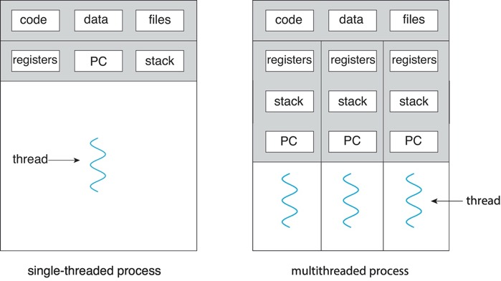
Process (3rd OS Concept)
Process: execution environment with restricted rights
Address space with one or more threads
Owns memory (address space)
Owns file descriptors, file system context, …
Why processes?
Fundamental tradeoff between protection and efficiency
Communication easier within a process
Communication harder between processes

Slide 32
What Does it Take to Create Process?
Must construct new PCB
Inexpensive
Must set up new page tables for address space (more on this later)
More expensive
Copy data from parent process? (Unix fork() )
With Unix fork(), child process gets copy of parent’s memory and I/O state
Originally very expensive
Much less expensive with “copy on write” (more on this later)
Copy I/O state (file handles, etc.)
Medium expense

Slide 33

Multithreaded Processes
bbci.co.uk
Threads encapsulate concurrency and are active components
Address spaces encapsulate protection and are passive part
Keeps buggy program from trashing system
Why have multiple threads per address space?
Processes are expensive to start, switch between, and communicate between

Slide 34
Memory Footprint of Multiple Threads
How do we position stacks relative to each other?
What maximum size should we choose for stacks?
8KB for kernel-level stacks in Linux on x86
Less need for tight space constraint for user-level stacks
What happens if threads violate this?
“… program termination and/or corrupted data”
How might you catch violations?
Place guard values at top and bottom of each stack
Check values on every context switch
Stack 1
Stack 2
Address Space
Heap
Global Data
Code

Slide 35
Multiprogramming: Running Multiple Processes
Physical memory
Proc 1
Proc 2
…
Proc n
Stack
OS
Heap
Data
Code
Stack
Heap
Data
Code
Virtual address spaces
Stack
Heap
Data
Code

Slide 36
Time Sharing
Process 1
Process 2
Process 3
Process 1
Process 2
Process 3
Process 1
Process 2
CPU
Time
Illusion: Infinite number of processors
Each thread runs on dedicated virtual processor
Reality: few processors, multiple threads running at variable speed
How can we give illusion of infinite number of processors?
Multiplex in time!
How do we switch from one process to next?
Save PC, SP, and registers in current PCB
Load PC, SP, and registers from new PCB
What triggers switch?
Timer, voluntary yield, I/O interrupts, …

Slide 37
How Do We Multiplex Processes?
Scheduling: OS decides which process uses CPU time
Only one process is “running” on each CPU at any time
Scheduler could give more time to important processes
Protection: OS divides non-CPU resources among processes
E.g., give each process their own address space
E.g., multiplex I/O through system calls

Slide 38

Scheduling
Kernel scheduler decides which processes/threads receive CPU
There are variety of scheduling policies for …
Fairness or
Realtime guarantees or
Latency optimization or …
Kernel scheduler maintains data structure containing PCBs
if (readyProcesses(PCBs)) {
nextPCB = selectProcess(PCBs);
run(nextPCB);
} else {
run_idle_process();
}

Slide 39
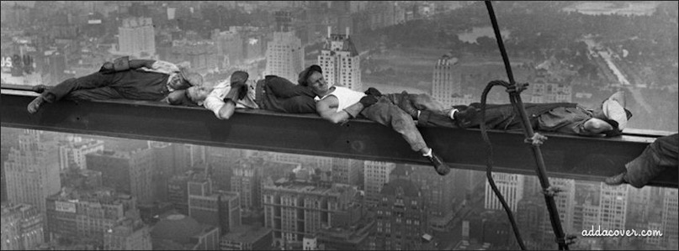
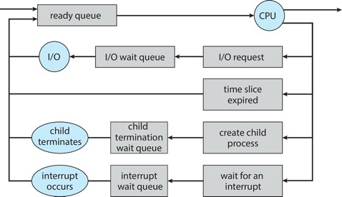
Ready Queue
PCBs move from queue to queue as they change state
Decisions about which order to remove from queues are scheduling decisions
Many algorithms possible (more on this in a few weeks)

Slide 40
Ready Queue And I/O Device Queues
Process not running ⇒ PCB is in some scheduler queue
Separate queue for each device/signal/condition
Each queue can have different scheduler policy
Ready
Queue
Head
Link
Link
Link
Tail
Registers
Registers
Registers
Other State
PCB₉
Other State
PCB₆
Oher State
PCB₁₆
USB
Unit 0
Head
Tail
Disk
Unit 0
Head
Link
Link
Tail
Registers
Registers
Disk
Unit 2
Other State
PCB₂
Other State
PCB₃
Head
Tail
Ether
Netwk 0
Head
Link
Tail
Registers
Other State
PCB₈

Slide 41
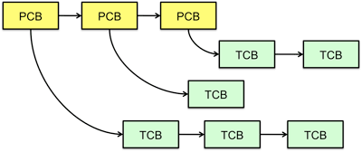
Multithreaded Processes
PCBs could point to multiple TCBs
Switching threads within one block is simple thread switch
Switching threads across blocks requires changes to memory and I/O address tables

Slide 42

Protection
OS must protect itself from user programs
Reliability: prevent OS from crashing
Security: limit scope of what processes can do
Privacy: limit data each process can access
Fairness: enforce appropriate share of HW
It must protect user programs from one another
Main method is to limit translation from virtual to physical address space

Slide 43
How to Protect Processes from One Another?
Protection of memory
Every process does not have access to all memory
Protection of I/O devices
Every process does not have access to every device
Protection of access to processor
Preemptive switching from process to process
Use of timer
Must not be possible to disable timer from user code

Slide 44
Address Translation Maps: Illusion of Separate Address Space
Physical Address Space
Code 2
Stack
Code 1
Stack
Heap
Data 2
Heap
Data
Data 1
Data
Translation Map 1
Translation Map 2
Code
Stack 2
Code
Stack 1
Process 1
Virtual Address Space 1
Heap 2
Process 2
Virtual Address Space 2
Heap 1
OS code
OS data
OS heap &
Stacks

Slide 45
Putting it Together: Process
(Unix) Process
A(int tmp) {
if (tmp<2)
B();
printf(tmp);
}
B() {
C();
}
C() {
A(2);
}
A(1);
…
Memory
Stack
Resources
Sequential stream of instructions
I/O State
(e.g., file, socket contexts)
CPU state (PC, SP, registers..)
Stored in OS

Slide 46
Putting it Together: Processes
Process 1
Process 2
Process N
Switch overhead: high
CPU state: low
Memory/IO state: high
Process creation: high
Protection
CPU: yes
Memory/IO: yes
Sharing overhead: high (involves at least one context switch)
Mem.
Mem.
Mem.
IO
state
IO
state
…
IO
state
CPU
state
CPU
state
CPU
state
CPU scheduler
OS
1 process at a time
CPU
(1 core)

Slide 47
Putting it Together: Threads
Process 1
Process N
threads
threads
Switch overhead: medium
CPU state: low
Thread creation: medium
Protection
CPU: yes
Memory/IO: no
Sharing overhead: low(ish) (thread switch overhead low)
Mem.
Mem.
…
IO
state
…
…
IO
state
CPU
state
CPU
state
CPU
state
CPU
state
CPU scheduler
OS
1 thread at a time
CPU
(1 core)

Slide 48
Putting it Together: Multi-cores
Process 1
Process N
threads
threads
Switch overhead: low (only CPU state)
Thread creation: low
Protection
CPU: yes
Memory/IO: no
Sharing overhead: low (thread switch overhead low, may not need to switch at all!)
Mem.
Mem.
…
IO
state
…
…
IO
state
CPU
state
CPU
state
CPU
state
CPU
state
CPU scheduler
OS
4 threads at a time
Core 1
Core 2
Core 3
Core 4
CPU

Slide 49
Hyperthreading
Superscalar Architecture
Multi-processor
Architecture
Fine-grained
Multithreading
Simultaneous
Multithreading
Colored blocks show executed instructions
Thread 1
Thread 2
Time (cycles)
Superscalar processors can execute multiple instructions that are independent
Multiprocessors can execute multiple independent threads
Fine-grained multithreading executes two independent threads by switches between them
Hyperthreading duplicates register state to make second (hardware) “thread” (virtual core)
From OS’s point of view, virtual cores are separate CPUs
OS can schedule as many threads at a time as there are virtual cores (but, sub-linear speedup!)
See: http://www.cs.washington.edu/research/smt/index.html

Slide 50
Putting it Together: Hyperthreading
Process 1
Process N
threads
threads
Switch overhead between hardware-threads: very-low (done in hardware)
Contention for ALUs/FPUs may hurt performance
Mem.
Mem.
…
IO
state
…
…
IO
state
CPU
state
CPU
state
CPU
state
CPU
state
hardware-threads
(VCores)
CPU scheduler
OS
8 threads at a time
PCore 1
PCore 2
PCore 3
PCore 4
CPU

Slide 51
Dual-mode Operation (4th OS Concept)
Hardware provides at least two modes
Kernel mode (or “supervisor” or “protected”)
User mode, which is how normal programs are executed
How can hardware support dual-mode operation?
Single bit of state (user/system mode bit)
Certain operations/actions only permitted in system/kernel mode
In user mode they fail or trap
User to kernel transition sets system mode AND saves user PC
OS code carefully puts aside user state then performs necessary actions
Kernel to user transition clears system mode AND restores user PC
E.g., rfi: return-from-interrupt

Slide 52
Three Types of Mode Transfer
Interrupt
External asynchronous event triggers context switch, e. g., Timer, I/O device
Independent of user process
Syscall
Process requests system service, e.g., exit
Like function call, but outside process
Process does not have address of system function to call
Like a Remote Procedure Call (RPC) – for later
OS marshalls syscall id and args in registers and exec syscall
Trap or exception
Internal synchronous event in process triggers context switch, e.g., protection violation (segmentation fault), divide by zero, …
All 3 are UNPROGRAMMED CONTROL TRANSFER
How do we get address of unprogrammed control transfer?

Slide 53

Interrupt Vector
Table set up by OS pointing to code to run on different events

Slide 54
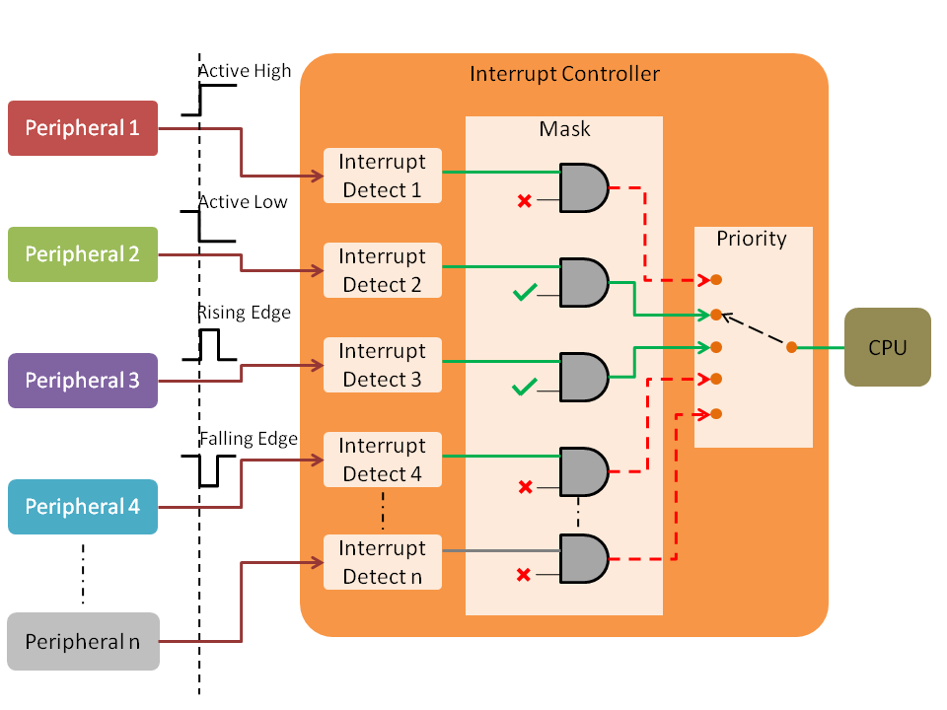
Interrupt Controller
Interrupts invoked with interrupt lines from devices
Interrupt controller chooses interrupt request to honor
Mask enables/disables interrupts
Priority picks highest enabled interrupt
Software interrupt set/cleared by SW
Interrupt identity specified with ID line
CPU can disable all interrupts with internal flag
Non-maskable interrupt line (NMI) cannot be disabled
www.embien.com

Slide 55
Interrupt Masking
Interrupt handler runs with interrupts off
Re-enabled when interrupt completes
OS kernel can also turn interrupts off
E.g., when determining next process/thread to run
On x86
cli: disable interrupts
sti: enable interrupts
Only applies to current CPU (on a multicore)
We will need this to implement synchronization (more on this later)
Notes:
Instructions to enable or disable interrupts must be privileged

Slide 56
Kernel System Call Handler
Vector through well-defined syscall entry points!
Table mapping system call number to handler
Locate arguments
In registers or on user (!) stack
Copy arguments (copy before check)
From user memory into kernel memory
Protect kernel from malicious code evading checks
Validate arguments
Protect kernel from errors in user code
Copy results back
Into user memory

Slide 57
Implementing Safe Mode Transfers
It should be impossible for buggy or malicious user program to cause kernel to corrupt itself
Controlled transfer into kernel (e.g., interrupt vector table)
Separate kernel stack
Carefully constructed kernel code should pack up user process state and set it aside
Details depend on the machine architecture

Slide 58
Need for Separate Kernel Stacks
Kernel cannot put anything on user stack (Why?)
Reliability: what if user program’s SP is not valid?
Security: what if other threads in user process change kernel’s return address?
Two-stack model
Kernel keeps separate stack for each thread in kernel memory (in addition to user stack in user memory)

Slide 59
Two-Stack Model
Running
Handling syscall
Ready to run
main
main
main
Proc1
Proc1
Proc1
User stack
Proc2
Proc2
Proc2
syscall
syscall
user CPU state
user CPU state
syscall handler
Kernel stack
I/O driver

Slide 60
Atomic Transfer of Control
Kernel
handler() {
pushad;
…
}
Processor Registers
PC
SP
Kernel stack
foo() {
while (…) {
x = x + 1;
y = y – 2;
}
}
EFLAGS
User-level process
Other Regs EAX, EXB,
…
User stack
foo
…

Slide 61
Atomic Transfer of Control (cont.)
Kernel
Single instruction to
Save some registers (e.g., SP, PC)
Change PC and SP
Switch Kernel/user mode
handler() {
pushad;
…
}
Processor Registers
PC
SP
Kernel stack
foo() {
while (…) {
x = x + 1;
y = y – 2;
}
}
EFLAGS
User-level process
Other Regs EAX, EXB,
…
Error
User stack
PC
foo
EFLAGS
…
SP

Slide 62
Atomic Transfer of Control (cont.)
Kernel
Single instruction to save all registers
Why is stack pointer saved twice?
Hint: are they the same?
handler() {
pushad;
…
}
Processor Registers
PC
SP
Kernel stack
foo() {
while (…) {
x = x + 1;
y = y – 2;
}
}
EFLAGS
User-level process
Other Regs EAX, EXB,
…
…
EXB
EXA
SP
All Regs
Error
User stack
PC
foo
EFLAGS
…
SP

Slide 63
Kernel to User Mode Switch
New process/new thread start
Jump to first instruction in program/thread
Return from interrupt, exception, system call
Resume suspended execution
Process/thread context switch
Resume some other process
User-level upcall (UNIX signal)
Asynchronous notification to user program
Preemptive user-level threads
Asynchronous I/O notification
Interprocess communication
User-level excepting handling
User-level resource allocation

Slide 64
Example: User/Kernel Mode Transfers
User Mode
rtn
interrupt
exception
syscall
rfi
Kernel Mode
exit
exec
Hardware
Limited HW access
Full HW access

Slide 65


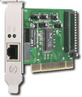
System Call Interface: Access Point to Hardware Resources
The System Call Interface
Process
Management
Memory Management
Filesystems
Device Control
Networking
Concurrency, multitasking
Virtual memory
Files and dirs: the VFS
TTYs and device access
Connectivity
Architecture
Dependent
Code
Memory Manager
File System Types
Device Control
Network Subsystem
Block Devices
IF drivers

Slide 66
Device Drivers
Device-specific code in kernel that interacts directly with device hardware
Supports standard, internal interface
Same kernel I/O system can interact easily with different device drivers
Special device-specific configuration supported with ioctl() syscall
Device drivers are typically divided into two pieces
Top half: accessed in call path from system calls
implements a set of standard, cross-device calls like open(), close(), read(), write(), ioctl(), etc.
This is kernel’s interface to device driver
Top half will start I/O to device, may put thread to sleep until finished
Bottom half: run as interrupt routine
Gets input or transfers next block of output
May wake sleeping threads if I/O now complete

Slide 67
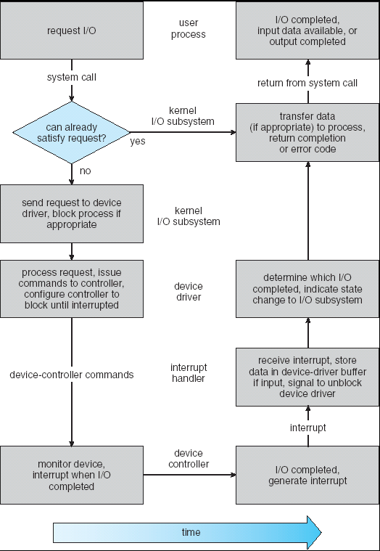
Life Cycle of an I/O Request
User
Program
Kernel I/O
Subsystem
Device Driver
Top Half
Device Driver
Bottom Half
Device
Hardware

Slide 68
I/O Data Transfer
Programmed I/O
Each byte transferred via processor in/out or load/store
Pro: Simple hardware, easy to program
Con: Consumes processor cycles proportional to data size
Direct memory access (DMA)
Give controller access to memory bus
Ask it to transfer data blocks to/from memory directly

Slide 69
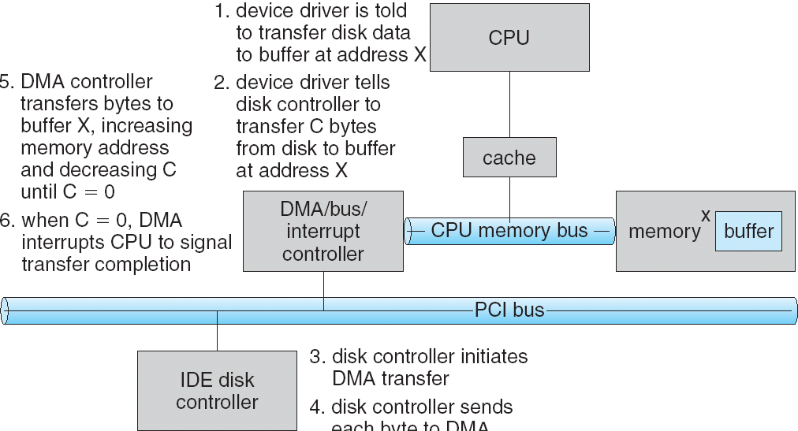
DMA Transfer
1
6
5
2
4
3
Device driver is told to transfer disk data to buffer at address x
Device driver tells disk controller to transfer C bytes from disk to buffer at address x
Disk controller initiates DMA transfer
Disk controller send each byte to DMA controller
DMA controller transfers bytes to buffer x, increasing address and decreasing C
When C = 0, DMA interrupts CPU to signal transfer completion

Slide 70
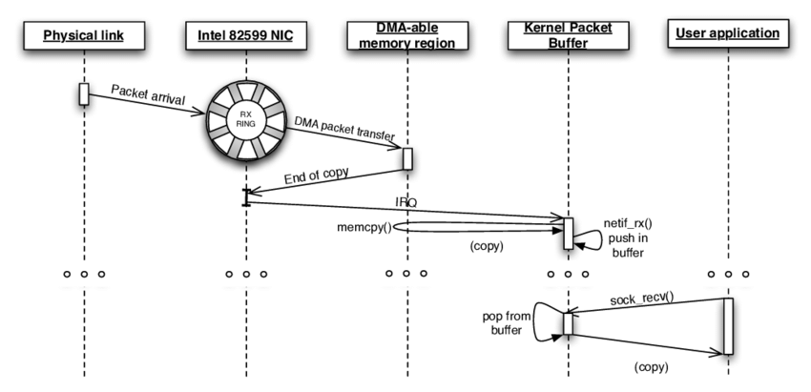
DMA Example: Network Stack in Linux Kernels before 2.6
García-Dorado, José Luis, et al. "High-performance network traffic processing systems using commodity hardware." Data traffic monitoring and analysis. Springer, Berlin, Heidelberg, 2013. 3-27.

Slide 71

How Does Kernel Provide Services?
You said that applications request services from OS via syscall, but …
I’ve been writing all sorts of applications, and I never ever saw a “syscall” !!!
That’s right!
It was buried in the programming language runtime library (e.g., libc.a)
… Layering

Slide 72


















OS Run-time Library
Proc 1
Proc 2
…
Proc n
OS
Proc 1
Proc 2
Proc n
…
OS Library
OS Library
OS Library
OS

Slide 73
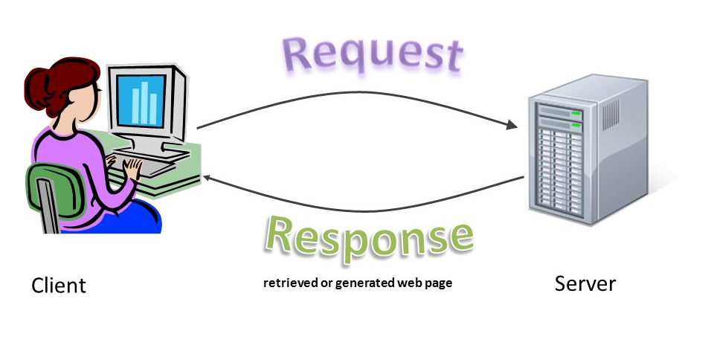
Putting it Together: Web Server
Request
Reply
(retrieved by web server)
Client
Web Server

Slide 74
Putting it Together: Web Server (cont.)
Server
4. parse request
9. format reply
request
buffer
reply
buffer
network
socket
read
3. kernel
copy
10. network
socket
write
5. file
read
8. kernel
copy
syscall
syscall
Kernel
wait
RTU
11. kernel copy
from user buffer
to network buffer
RTU
interrupt
interrupt
2. copy arriving
packet (DMA)
12. format outgoing
packet and DMA
6. disk
request
7. disk data
(DMA)
Hardware
Network
interface
Disk interface
Request
Reply

Slide 75
Summery: Four Fundamental OS Concepts
Thread
Single unique execution context which fully describes program state
Program counter, registers, execution flags, stack
Address space (with translation)
Address space which is distinct from machine’s physical memory addresses
Process
Instance of executing program consisting of address space and 1+ threads
Dual-mode operation/protection
Only “system” can access certain resources
OS and hardware are protected from user programs
User programs are isolated from one another by controlling translation from program virtual addresses to machine physical addresses

Slide 76

Questions?
globaldigitalcitizen.org

Slide 77
Acknowledgment
Slides by courtesy of Anderson, Culler, Stoica, Silberschatz, Joseph, and Canny

