Slide 1

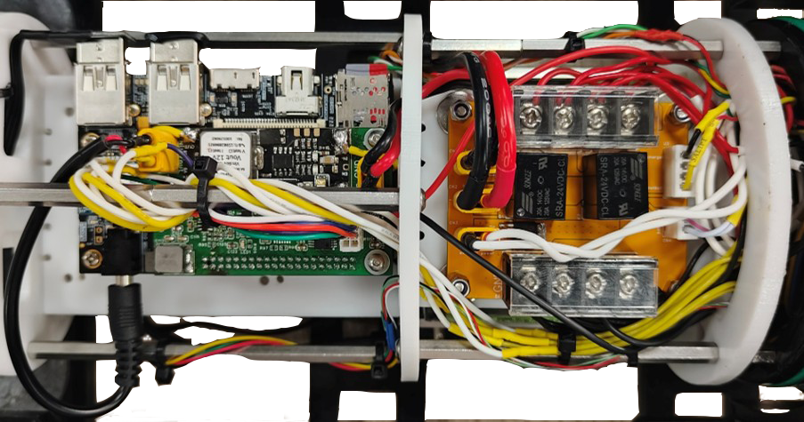
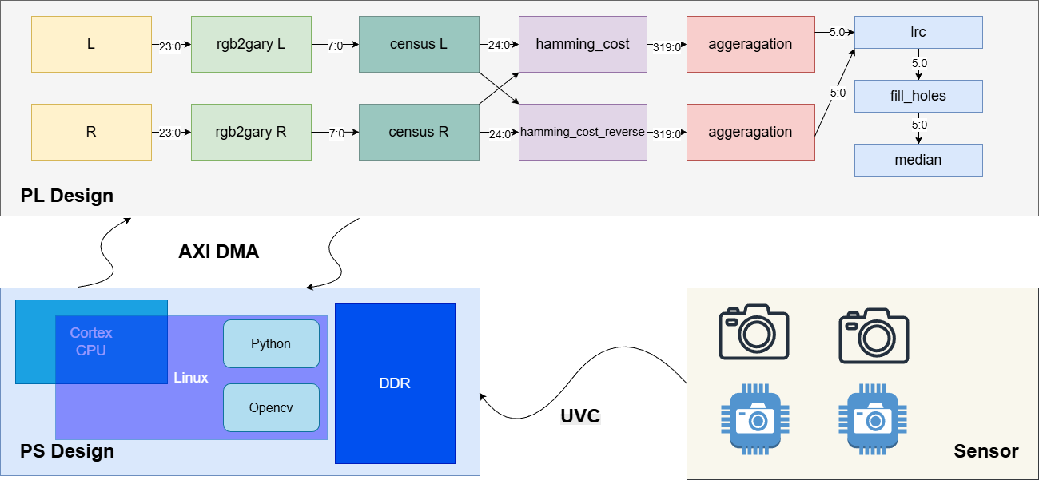
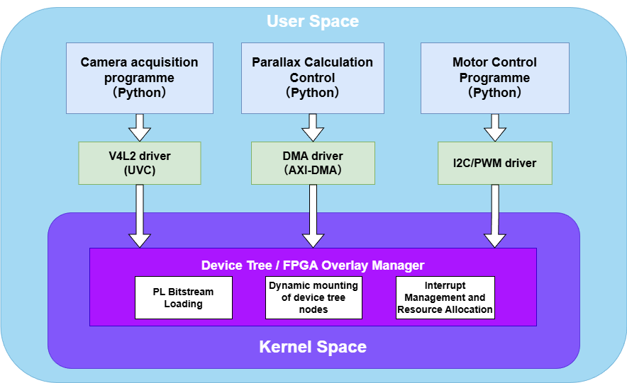
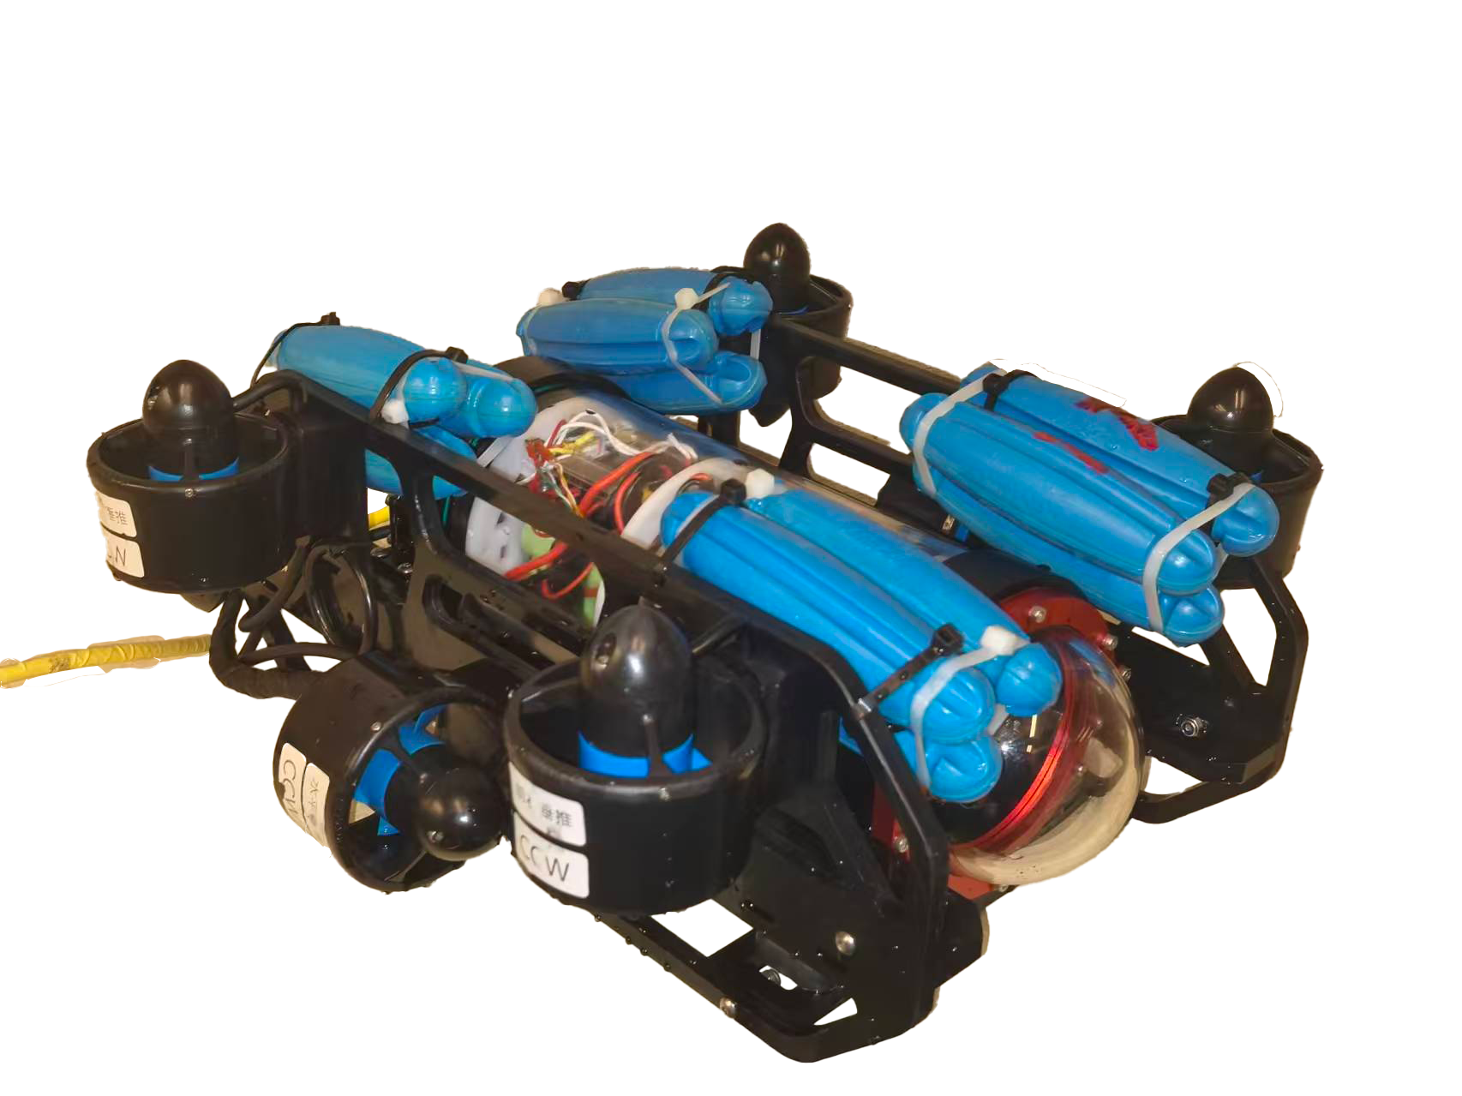
INTRODUCTION
OpenHW2025
Underwater Archaeology Platform
C
An underwater archaeology platform integrates imaging sensors, navigation, 3D reconstruction, and data management to locate, document, analyze, and protect submerged cultural heritage with real-time mapping and decision support.
A typical underwater archaeological platform consists of a binocular stereo vision system, an FPGA-based depth processing unit, and a data transmission system. Most current platforms can perform real-time disparity calculation and depth map generation, but cannot integrate image enhancement preprocessing or retain raw color information, lost crucial spectral characteristics for artifact identification.
Key technical issues addressed:
Image acquisition, High-performance dual MIPI-CSI camera interface for underwater low-visibility scenes.
Stereo processing and matching, AMD-Xilinx Zynq UltraScale+ MPSoC (xczu3eg) with dual-clock domain architecture (15MHz/150MHz).
Data transmitting, AXI-DMA (Direct Memory Access) interface with dual-channel MM2S/S2MM for <1ms latency.
Result visualization, PS-based Linux system with OpenCV integration and real-time disparity map display.
R
On board test by AMD Ultra96 –v2
E
Linux Host System (PS):
1. Managing camera drivers and system services;
2. Receiving depth results and performing visualization;
3. Coordinating underwater platform motion control;
A
V
I
T
E
D
Verified Performance:
• 30fps @ 640×480 | Latency: <50ms | Power: <1W (PL)
• Depth Error: <3% | Disparity: 64px (6-bit)
• 50× lower power vs. GPU | Real-time vs. CPU
Future Work:
• 720p resolution | DPU-based image enhancement
• Lightweight object detection | Extended 10m range
• Integrated vision-navigation-control platform
E
R
Typical application case
S
E
System Architecture
I
S
N
U
Camera Interface Module:
1. Synchronizing dual-camera capture for stereo imaging;
2. Transmitting RGB frame pairs to FPGA via high-speed DMA;
3. Providing clock synchronization and exposure control;
G
L
T
FPGA Accelerator (PL):
1 Executing SGBM stereo matching in hardware pipeline;
2. Processing 640×480 resolution at 30fps with <1W power;
3. Generating dense disparity maps with 64-pixel range;

