Slide 1
Chapter 4. combinational logic technologies

Slide 2
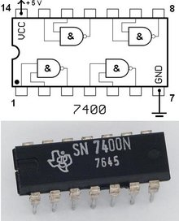
Combinational Logic Technologies
Standard gates (random logic)
  gate packages
  cell libraries
Regular logic
  multiplexers
  decoders
Two-level programmable logic
  PALs
  PLAs
  ROMs
The simplest way to implement logic circuits would be using standard gates. However, as more complicated and diverse logic systems are getting required, a wealth of implementation techniques are proposed. There are three major categories in logic implementation technologies.

Slide 3
Random logic
Transistors quickly integrated into logic gates (1960s)
Catalog of common gates (1970s)
  Texas Instruments Logic Data Book – the yellow bible
  all common packages listed and characterized (delays, power)
  typical packages:
    in 14-pin IC: 6-inverters, 4 NAND gates, 4 XOR gates
Today, very few parts are still in use
However, parts libraries exist for chip design
  designers reuse already characterized logic gates on chips
  same reasons as before
  difference is that the parts don’t exist in physical inventory – created as needed
Again it is easy and simple to use standard gates such as NAND and AND, called random logic. Since a single gate is not good to sell and buy, a few or several gates are packed into a package. Right now, it is not widely used for economical reasons since there are a lot of IC packages in the catalog.

Slide 4
Random logic
Too hard to figure out exactly what gates to use
  map from logic to NAND/NOR networks
  determine minimum number of packages
    slight changes to logic function could decrease cost
Changes to difficult to realize
  need to rewire parts
  may need new parts
  design with spares (few extra inverters and gates on every board)
As the number of types of logic packages increases and the required functions of a logic system becomes complicated, it is more and more difficult to realize the design with standard gates or IC packages. Also, once the implementation is fixed, it is hard to re-configure its design. Moreover, the whole part of each IC package may not be used.

Slide 5
Regular logic
Need to make design faster
Need to make engineering changes easier to make
Simpler for designers to understand and map to functionality
  harder to think in terms of specific gates
  better to think in terms of a large multi-purpose block
MUX and DEMUX
Unlike random logic, regular logic refers to a flexible component that performs a specific high-level function compared to primitive logic gates. Design becomes easier with these regular logic components since each component performs a specific function. Sometimes we can flexibly exploit the regular logic components for other purposes than its original one.

Slide 6
Making connections
Direct point-to-point connections between gates
  wires we've seen so far
Route one of many inputs to a single output - multiplexer (MUX)
Route a single input to one of many outputs - demultiplexer (DEMUX)
control
control
multiplexer
demultiplexer
4x4 switch
Two popular regular logic components are MUX and DEMUX. A MUX selects one of its data inputs to the output by the control inputs; a MUX is also called a selector. The diagram on the left shows a 4-input MUX. Can you guess the relation between the number of data inputs and the number of control lines? A DEMUX performs the reverse function, often called a decoder. We can clearly see that these components perform higher-level functions compared to logic gates

Slide 7
Mux and demux
Switch implementation of multiplexers and demultiplexers
  can be composed to make arbitrary size switching networks
  used to implement multiple-source/multiple-destination interconnections
A
Y
A
Y
B
Z
B
Z
When we combine MUXs and DEMUXs, a switching network can be implemented. Note that control lines are skipped here.
In this slide, there are 2X2 switching networks. By using control variables (which are skipped), A and B can be routed to either Y or Z.

Slide 8
Mux and demux (cont'd)
Uses of multiplexers/demultiplexers in multi-point connections
A0
A1
B0
B1
Sa
MUX
MUX
Sb
multiple input sources
A
B
Sum
Ss
DEMUX
multiple output destinations
S0
S1
Let’s see how MUX and DEMUX can be used for a logic system design. Here is a 1-bit adder, a V-shape polygon. There are two sources for each input and two destinations for the resulting sum. So there are total three control variables.

Slide 9
Multiplexers (MUXs)/selectors
Multiplexers/selectors: general concept
  2^{n} data inputs, n control inputs (called "selects"), 1 output
  used to connect 2^{n} points to a single point
  control signal pattern forms binary index of input connected to output
I₁ I₀ A Z
0 0 0 0
0 0 1 0
0 1 0 1
0 1 1 0
1 0 0 0
1 0 1 1
1 1 0 1
1 1 1 1
A Z
0 I₀
1 I₁
Z = A' I₀ + A I₁
functional form
two alternative forms
for a 2:1 Mux truth table
logical form
Let’s look at how a MUX function can be described as a boolean expression or a truth table. We will start with the simplest one, 2:1 MUX. There are two inputs I0 and I1 and the control input is A. Then Z will select I0 or I1 depending on A’s value. If we tabulate all the cases of I0 and I1, the final truth table is the one on the right.

Slide 10
Multiplexers/selectors (cont'd)
2:1 mux: Z = A'I₀ + AI₁
4:1 mux: Z = A'B'I₀ + A'BI₁ + AB'I₂ + ABI₃
8:1 mux: Z = A'B'C'I₀ + A'B'CI₁ + A'BC'I₂ + A'BCI₃ +
AB'C'I₄ + AB'CI₅ + ABC'I₆ + ABCI₇
In general: Z = Σ (m_{k}I_{k})
  in minterm shorthand form for a 2^{n}:1 Mux
n
I0
I1
I2
I3
I4
I5
I6
I7
2 -1
k=0
8:1
mux
Z
I0
I1
I2
I3
4:1
mux
Z
I0
I1
2:1
mux
Z
A B C
A
A B
How can we express the output in a general form, regardless of the # of inputs? First of all, n is the # of control wires. So there are total 2**n inputs. Here m_k is the k-th minterm from the control variables.

Slide 11
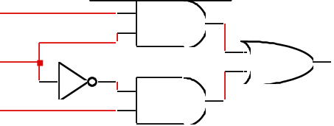
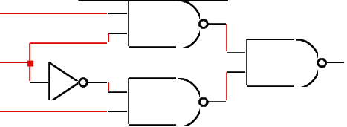
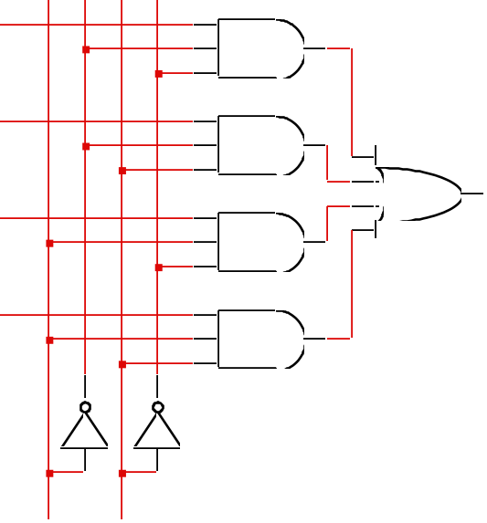
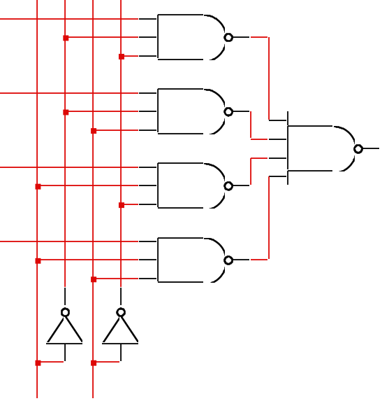
Gate level implementation of muxes
2:1 mux
4:1 mux
At the top left, an AND-OR realization of a 2:1 MUX is shown. What are the 2 data inputs and what is the control input?

Slide 12
Cascading multiplexers
Large multiplexers can be made by cascading smaller ones
I0
I1
I2
I3
8:1
mux
alternative
implementation
4:1
mux
I0
I1
2:1
mux
8:1
mux
2:1
mux
Z
I4
I5
I6
I7
I2
I3
2:1
mux
4:1
mux
4:1
mux
Z
I4
I5
2:1
mux
B C
A
I6
I7
2:1
mux
control signals B and C simultaneously choose
one of I0, I1, I2, I3 and one of I4, I5, I6, I7
control signal A chooses which of the
upper or lower mux's output to gate to Z
C
A B
You can build a large scale MUX in two ways. One option is just to use a single conventional MUX for 2**n inputs and n control lines. Or you can combine small scale MUXs. This slide shows two cases of building an 8:1 MUX from small scale MUXs.

Slide 13
Multiplexers as general-purpose logic
A 2^{n}:1 multiplexer can implement any function of n variables
  with the variables used as control inputs and
  the data inputs tied to 0 or 1
  in essence, a lookup table
Example:
  F(A,B,C) = m0 + m2 + m6 + m7
  = A'B'C' + A'BC' + ABC' + ABC
1
0
1
0
0
0
1
1
0
1
2
3
4
5
6
7
Z
8:1 MUX
F
  = A'B'C'(1) + A'B'C(0)
  + A'BC'(1) + A'BC(0)
  + AB'C'(0) + AB'C(0)
  + ABC'(1) + ABC(1)
S2
S1
S0
A
B
C
F = A'B'C'I₀ + A'B'CI₁ + A'BC'I₂ + A'BCI₃ + AB'C'I₄ + AB'CI₅ + ABC'I₆ + ABCI₇
This slide is very important. Actually a MUX can do more than just selection. Suppose each input wire (one of 2**n inputs) is fixed to either 0 or 1. Depending on the control inputs (here A,B,C), the corresponding bit will be popped up to F. This is kind of a lookup table.
Now look at the system with a different viewpoint. Forget this is a MUX. Suppose A,B,C are the input variables of a logic function F. When will F be true?

Slide 14
Multiplexers as general-purpose logic (cont’d)
A 2^{n-1}:1 multiplexer can implement any function of n variables
  with n-1 variables used as control inputs and
  the data inputs tied to the last variable or its complement
Example:
  F(A,B,C) = m0 + m2 + m6 + m7
  = A'B'C' + A'BC' + ABC' + ABC
  = A'B' (C') + A'B (C') + AB' (0) + AB (1)
1
0
1
0
0
0
1
1
0
1
2
3
4
5
6
7
A B C F
0 0 0 1
0 0 1 0
0 1 0 1
0 1 1 0
1 0 0 0
1 0 1 0
1 1 0 1
1 1 1 1
C'
C'
0
1
C'
C'
0
1
0
1
2
3
8:1 MUX
F
F
4:1 MUX
S1
S0
S2
S1
S0
A
B
A
B
C
The reality is that a MUX can implement any function of n variables. Here is another example of implementing the same logic function in a simplified way. In this variation, one of the control variable is used as a data input of a 4:1 MUX. Now we have two control variables A and B. Meanwhile C becomes some of the data inputs. Overall, we have 4 cases instead 8 cases by considering F as a function of C

Slide 15
Multiplexers as general-purpose logic (cont’d)
I₀ I₁ . . . I_{n-2} I_{n-1} F
. . . . 0 0 0 1 1
. . . . 1 0 1 0 1
0 I_{n-1} I_{n-1}' 1
four possible
configurations
of truth table
rows can be
expressed as
a function of I_{n-1}
Generalization
Example:
G(A,B,C,D)
can be realized
by an 8:1 MUX
n-1 mux control
variables
  single mux data
  variable
A B C D G
0 0 0 0 1
0 0 0 1 1
0 0 1 0 0
0 0 1 1 1
0 1 0 0 0
0 1 0 1 0
0 1 1 0 1
0 1 1 1 1
1 0 0 0 1
1 0 0 1 0
1 0 1 0 0
1 0 1 1 1
1 1 0 0 1
1 1 0 1 0
1 1 1 0 1
1 1 1 1 0
1
D
0
1
D'
D
D’
D’
1
D
0
1
D’
D
D’
D’
0
1
2
3
4
5
6
7
8:1 MUX
choose A,B,C as
control variables
S2
S1
S0
A
B
C
Here is the generalized n-input logic function by a (n-1)-input MUX.
Depending on the output of two cases of the singled-out variable, a different data input is attached to each minterm of the (n-1) input MUX. Reducing the MUX size is economical.

Slide 16
Demultiplexers (DEMUXs)/decoders
Decoders/demultiplexers: general concept
  single data input, n control inputs, 2^{n} outputs
  control inputs (called “selects” (S)) represent binary index of output to which the input is connected
  data input usually called “enable” (G)
1:2 Decoder:
O0 = G • S’
O1 = G • S
3:8 Decoder:
O0 = G • S2’ • S1’ • S0’
O1 = G • S2’ • S1’ • S0
O2 = G • S2’ • S1 • S0’
O3 = G • S2’ • S1 • S0
O4 = G • S2 • S1’ • S0’
O5 = G • S2 • S1’ • S0
O6 = G • S2 • S1 • S0’
O7 = G • S2 • S1 • S0
2:4 Decoder:
O0 = G • S1’ • S0’
O1 = G • S1’ • S0
O2 = G • S1 • S0’
O3 = G • S1 • S0
There is only one data input in DEMUXs, often denoted by G, which will be carried to one of the outputs. The control inputs are often denoted by S and the index of the control wires. Again, for n control inputs, we have 2**n outputs.

Slide 17
Gate level implementation of demultiplexers
1:2 decoders
2:4 decoders
active-high
enable
active-low
enable
G
O0
\G
O0
S
S
O1
O1
G
O0
\G
O0
active-high
enable
active-low
enable
O1
O1
O2
O2
O3
O3
S1
S0
S1
S0
This slide shows a few DEMUXs implemented by logic gates. We can add two bubbles for each input. The reason for inserting two bubbles is to implement the DEMUX by NOR gates

Slide 18
Demultiplexers as general-purpose logic
A n:2^{n} decoder can implement any function of n variables
  with the variables used as control inputs
  the enable input is tied to 1 and
  the appropriate minterms summed to form the function
0
1
2
3
4
5
6
7
A'B'C'
A'B'C
A'BC'
A'BC
AB'C'
AB'C
ABC'
ABC
demultiplexer generates appropriate
minterm based on control signals
(it "decodes" control signals)
“1”
3:8 DEC
S2
S1
S0
A
B
C
Like a MUX, a DEMUX can also perform a logic function of n variables. Here n variables are used for the control wires of the DEMUX. Depending on the values of control wires, a specific minterm will be asserted. Then what we need to do is ORing the relevant minterms for each output function F.

Slide 19
Demultiplexers as general-purpose logic (cont’d)
F1 = A'BC'D + A'B'CD + ABCD
F2 = ABC'D' + ABC
F3 = (A' + B' + C' + D')
0 A'B'C'D'
1 A'B'C'D
2 A'B'CD'
3 A'B'CD
4 A'BC'D'
5 A'BC'D
6 A'BCD'
7 A'BCD
8 AB'C'D'
9 AB'C'D
10 AB'CD'
11 AB'CD
12 ABC'D'
13 ABC'D
14 ABCD'
15 ABCD
F1
4:16
DEC
Enable
F2
DEMUX is a minterm generator!
F3
A
B
C
D
By using a single 4:16 DEMUX, we can implement three functions of 4 variables, with a few more gates.

Slide 20
Cascading decoders
0 A'B'C'D'E'
1
2
3
4
5
6
7
0
1
2 A'BC'DE'
3
4
5
6
7
5:32 decoder
  1 x 2:4 decoder
  4 x 3:8 decoders
3:8 DEC
3:8 DEC
S2
S1
S0
S2
S1
S0
0
1
2
3
F
2:4 DEC
S1
S0
0
1
2
3
4
5
6
7 ABCDE
0 AB'C'D'E'
1
2
3
4
5
6
7 AB'CDE
A
B
3:8 DEC
3:8 DEC
S2
S1
S0
S2
S1
S0
C
D
E
C
D
E
By combining small scale decoders or demuxes, we can build a larger-scale demux.
Here, we have 5 control lines (A,B,C,D,E) to route the enable line, F, to one of 32 output lines

Slide 21
Fixed logic vs. programmable logic
Logic devices can be classified into two broad categories - fixed and programmable
circuits in a fixed logic device are permanent, they perform one function or set of functions - once manufactured, they cannot be changed.
programmable logic devices (PLDs) are standard, off-the-shelf parts that offer customers a wide range of logic functions
  Regular logic is close to PLDs
  some devices can be changed to perform other functions

Slide 22
Programmable logic arrays (PLAs)
Pre-fabricated building block of many AND/OR gates
  actually NOR or NAND
  "personalized" by making/breaking connections among the gates
  programmable array block diagram for sum of products form
• • •
inputs
Sum of
AND
array
OR
array
product
terms
products
outputs
• • •
A PLA is a general implementation of sum of products of a logic function. We first implement each product term (not necessarily minterm). Then the product terms will be ORed in the next stage. So we have two generic logic arrays. Programming means configuring connections in two arrays.

Slide 23
Enabling concept
Shared product terms among outputs
F0 = A + B' C'
F1 = A C' + A B
F2 = B' C' + A B
F3 = B' C + A
example:
input side:
personality matrix
1 = uncomplemented in term
0 = complemented in term
– = does not participate
product inputs outputs
term A B C F0 F1 F2 F3
AB 1 1 – 0 1 1 0
B'C – 0 1 0 0 0 1
AC' 1 – 0 0 1 0 0
B'C' – 0 0 1 0 1 0
A 1 – – 1 0 0 1
output side:
1 = term connected to output
0 = no connection to output
reuse of terms
Let’s take some logic functions for example to illustrate how we can use an PLA for logic implementation. There are 4 functions of three input variables. To use an PLA systematically, it is good to write a personality matrix. The middle section indicates how input variables are combined in the AND array and the right section shows how those product terms are combined in the OR array.

Slide 24
Before programming
All possible connections are available before "programming"
  in reality, all AND and OR gates are NANDs
A
B
C
AB
We have to look at two cross-connects: one is between inputs and AND gates and the other is between AND gates and OR gates. We can make or break connections in those two cross-connects.

Slide 25
After programming
Unwanted connections are "blown"
  fuse (normally connected, break unwanted ones)
  anti-fuse (normally disconnected, make wanted connections)
A
B
C
AB
B'C
AC'
B'C'
A
F0
F1
F2
F3
Then we have to do programming, which is the process of enabling or disabling each cross-point. If fuses are used for each cross point, we break unwanted ones. If anti-fuses are used, we enable the wanted ones.

Slide 26
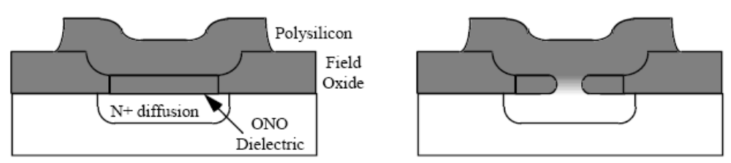
Anti-Fuse Technology
Dielectric that prevents current flow
Applying a voltage melts the dielectric
One time programmable – not really reconfigurable computing
* ONO: Oxide/Nitride/Oxide

Slide 27
Alternate representation for high fan-in structures
Short-hand notation so we don't have to draw all the wires
  x signifies a connection is present and perpendicular signal is an input to gate
notation for implementing
F0 = A B + A' B'
F1 = C D' + C' D
A
B
C
D
AB
A'B'
CD'
C'D
AB+A'B'
CD'+C'D
For simplicity, let’s assume a fuse exists for each crosspoint, and a connected fuse is denoted by x. Before programming, the PLA will look like the one on the left. After programming for the required functions, the PLA will become the one on the right. All the unwanted crosspoints are broken.

Slide 28
PLA example
Multiple functions of A, B, C
  F1 = A B C
  F2 = A + B + C
  F3 = A' B' C'
  F4 = A' + B' + C'
  F5 = A xor B xor C
  F6 = A xnor B xnor C
full decoder as for memory address
bits stored in memory
A
B
C
A'B'C'
A'B'C
A'BC'
A'BC
AB'C'
AB'C
ABC'
ABC
A B C F1 F2 F3 F4 F5 F6
0 0 0 0 0 1 1 0 0
0 0 1 0 1 0 1 1 1
0 1 0 0 1 0 1 1 1
0 1 1 0 1 0 1 0 0
1 0 0 0 1 0 1 1 1
1 0 1 0 1 0 1 0 0
1 1 0 0 1 0 1 0 0
1 1 1 1 1 0 0 1 1
F1
F2
F3
F4
F5
F6
Here are the six functions of three variables.
As there are three variables, total 8 minterms exist. Then all the relevant minterms of each function will be connected to its OR gate.

Slide 29
PALs and PLAs
Programmable logic array (PLA)
  unconstrained fully-general AND and OR arrays
Programmable array logic (PAL)
  constrained topology of the OR array
  faster and smaller OR plane
a given column of the OR array
has access to only a subset of
the possible product terms
A little bit less programmable but faster version is PAL. In PALs, the cross-connects between AND gates and OR gates are already fixed; the transistor logic is much simpler. What we can control is the cross-connects between inputs and AND gates, denoted by x. So, there is less flexibility in PALs compared to PLAs.

Slide 30
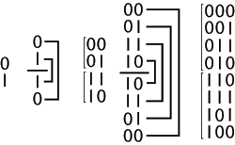
PALs and PLAs: design example
BCD to Gray code converter
A B C D W X Y Z
0 0 0 0 0 0 0 0
0 0 0 1 0 0 0 1
0 0 1 0 0 0 1 1
0 0 1 1 0 0 1 0
0 1 0 0 0 1 1 0
0 1 0 1 1 1 1 0
0 1 1 0 1 0 1 0
0 1 1 1 1 0 1 1
1 0 0 0 1 0 0 1
1 0 0 1 1 0 0 0
1 0 1 – – – – –
1 1 – – – – – –
minimized functions:
W = A + BD + BC
X = BC'
Y = B + C
Z = A'B'C'D + BCD + AD' + B'CD'
Suppose we have to design a BCD to GRAY code converter. And simplified functions are shown in the above. Unfortunately, there are no common product terms among outputs.
Gray code: the reflected binary code,
One bit change in adjacent values

Slide 31
PALs and PLAs: design example (cont’d)
Code converter: programmed PLA
A B C D
minimized functions:
W = A + BD + BC
X = B C'
Y = B + C
Z = A'B'C'D + BCD + AD' + B'CD'
A
BD
BC
BC'
B
C
A'B'C'D
BCD
AD'
BCD'
not a particularly good
candidate for PAL/PLA
implementation since no terms
are shared among outputs
however, much more compact
and regular implementation
when compared with discrete
AND and OR gates
W X Y Z
Here, 4 functions are implemented by a single PLA. Total 10 product terms are needed to be represented. In this case, there is no common product term that can be shared by multiple outputs, which means PLA is not an attractive option.

Slide 32
PALs and PLAs: (cont’d)
A B C D
A
BD
BC
0
BC'
0
0
0
B
C
0
0
A'B'C'D
BCD
AD'
B'CD'
Code converter: programmed PAL
Could be a limiting factor
4 product terms
per each OR gate
Let’s consider a PAL where exactly 4 AND gates
are ORed for each function. Note that the maximum # of product terms of outputs is 4
W X Y Z
As there are 4 functions, total 16 AND gates are required. For some functions, they don’t need up to 4 product terms. Then, a FALSE term is connected to surplus AND gates. To make a false term, just leave all the fuses intact.

Slide 33
PALs and PLAs: design example (cont’d)
Code converter: NAND gate implementation
  loss or regularity, harder to understand
  harder to make changes
Fig. 4.37
A
A
B
C
B
W
D
D
B
B
C
C
D
Z
A
B
\D
X
\B
C
C
\D
Y
B
As we have seen before, an AND-OR combination is easily converted to NAND logic. Just add two bubbles (inverters) in the middle and push them to the opposite directions. So PALs and PLAs are actually implemented by NAND gates.

Slide 34
Activity
Map the following functions to the PLA below:
  W = AB + A’C’ + BC’
  X = ABC + AB’ + A’B
  Y = ABC’ + BC + B’C’
A
B
C
W
X
Y

Slide 35
Activity (cont’d)
9 terms won’t fit in a 7 term PLA
  can apply concensus theorem
  to W to simplify to:
  W = AB + A’C’
8 terms wont’ fit in a 7 term PLA
  observe that AB = ABC + ABC’
  can rewrite W to reuse terms:
  W = ABC + ABC’ + A’C’
Now it fits
  W = ABC + ABC’ + A’C’
  X = ABC + AB’ + A’B
  Y = ABC’ + BC + B’C’
This is called technology mapping
  manipulating logic functions
  so that they can use available
  resources
A
B
C
ABC
ABC’
A’C’
AB’
A’B
BC
B’C’
W
X
Y

Slide 36
Read-only memories (ROMs)
Two dimensional array of 1s and 0s
  entry (row) is called a "word"
  width of row = word-size
  index is called an "address"
  address is input
  selected word is output
word lines (only one
is active – decoder is
just right for this)
1
1
1
1
n
2 -1
i
word[i] = 0011
word[j] = 1010
decoder
j
internal organization
0
0 n-1
  Address
bit lines (normally pulled to 1 through
resistor – selectively connected to 0
by word line controlled switches)
Let’s look at the simplified structure of a ROM. A ROM is just like a look-up table whose structure is similar to that of a DEMUX. Actually, all the minterms are present in ROMs. Instead of the ``enable’’ wire, the bits for outputs are programmed. When an address is coming in, its stored data (bits) should be brought up. An address to retrieve each stored word is equal to a minterm in the decoder.

Slide 37
ROMs and combinational logic
Combinational logic implementation (two-level canonical form) using a ROM
F0 = A' B' C + A B' C' + A B' C
F1 = A' B' C + A' B C' + A B C
F2 = A' B' C' + A' B' C + A B' C'
F3 = A' B C + A B' C' + A B C'
A B C F0 F1 F2 F3
0 0 0 0 0 1 0
0 0 1 1 1 1 0
0 1 0 0 1 0 0
0 1 1 0 0 0 1
1 0 0 1 0 1 1
1 0 1 1 0 0 0
1 1 0 0 0 0 1
1 1 1 0 1 0 0
ROM
8 words x 4 bits/word
A B C F0 F1 F2 F3
address
outputs
truth table
block diagram
So, a number of functions can be implemented together by using a single ROM. Here, total 32 bits are stored and 4 bits constitute a word. Actually, we don’t need those boolean expressions. We just need to fill in the ROM by the truth table and that’s it.

Slide 38
ROM structure
Similar to a PLA structure but with a fully decoded AND array
  completely flexible OR array (unlike PAL)
n address lines
• • •
inputs
memory
array
(2^{n} words
by m bits)
decoder
2^{n} word
lines
outputs
• • •
m data lines
A ROM is similar to a PLA, but for n inputs, there are always 2**n AND gates. Depending on the output values, what we need to do is to activate the corresponding transistors of crosspoints (or bits)

Slide 39
ROM vs. PLA/PAL
ROM approach advantageous when
  design time is short (no need to minimize output functions)
  most input combinations are needed (e.g., code converters)
  little sharing of product terms among output functions
ROM problems
  size doubles for each additional input
  can't exploit don't cares
PLA approach advantageous when
  design tools are available for multi-output minimization
  there are relatively few unique minterm combinations
  many minterms are shared among the output functions
PAL problems
  constrained fan-ins on OR plane
By using ROMs, we can implement a number of functions quickly at the cost of large size (e.g. 2**n AND gates). Also, we cannot utilize DC terms. We can say that if we have to use many minterms, the ROM approach is the best. If there are many shared product terms among outputs, PLA may be good. If the number of product terms for each output is small, PAL may be the best approach

Slide 40
Regular logic structures for two-level logic
ROM – full AND plane, general OR plane
  cheap (high-volume component)
  can implement any function of n inputs
  medium speed
PAL – programmable AND plane, fixed OR plane
  intermediate cost
  can implement functions limited by number of terms
  high speed (only one programmable plane that is much smaller than ROM's decoder)
PLA – programmable AND and OR planes
  most expensive (most complex in design, need more sophisticated tools)
  can implement any function up to a product term limit
  slow (two programmable planes)
This slide shows a pro-con list of ROM, PAL, PLA technologies. ROMs may be the cheapest due to mass production. In PALs, the OR array is fixed; it takes less time in the OR array. However, no shared product terms is supported in PALs. PLA is the most flexible and expensive option among logic implementation technologies.

Slide 41
Regular logic structures for multi-level logic
Difficult to devise a regular structure for arbitrary connections between a large set of different types of gates
  efficiency/speed concerns for such a structure
  field programmable gate arrays (FPGAs) are programmable multi-level structures
    programmable multiplexers for wiring
    lookup tables for logic functions (programming fills in the table)
    multi-purpose cells (utilization is the big issue)
Use multiple levels of PALs/PLAs/ROMs
  output intermediate result
  make it an input to be used in further logic
For simplicity, we have seen regular logic structures such as ROM, PLA, PAL only for two level logic functions.
For multi-level logic functions, it is not easy to devise a simple programmable structure. FPGA is one solution for the problem, which is out of scope of this class. Multi-level implementation will be briefly mentioned later.

Slide 42
Combinational logic technology summary
Random (fixed) logic
  Single gates or in groups
  conversion to NAND-NAND and NOR-NOR networks
  transition from simple gates to more complex gate building blocks
  reduced gate count, fan-ins, potentially faster
  more levels, harder to design
Time response in combinational networks
  gate delays and timing waveforms
  hazards/glitches (what they are and why they happen)
Regular logic
  multiplexers/decoders
  ROMs
  PLAs/PALs
  advantages/disadvantages of each
In chapter 4, we looked at a few programmable structures that facilitate the implementations of two-level logic functions. Each structure has its own pros and cons.

