Slide 1
Combined Object Categorization and Segmentation with an Implicit Shape Model
Slides/images sourced off:
http://crcv.ucf.edu/courses/CAP5415/Fall2012/Lecture-4-Harris.pdf
Leibe et al. Combined Object Categorization and Segmentation with an Implicit Shape Model
Leibe et al. Interleaved Object Categorization and Segmentation
http://www.cse.psu.edu/~rtc12/CSE598G/introMeanShift_6pp.pdf
Bastian Leibe
Ales Leonardis
Bernt Schiele
Presented by:
Mukul Sati
2/18/2016

Slide 2
Combined Object Categorization and Segmentation with an Implicit Shape Model
Traditionally (back then), no segmentation information used in object categorization.
Segmentation done primarily on low level features in an unsupervised setting.
Human vision - object recognition is intertwined with segmentation.

Slide 3
Overview
Goal – object categorization and segmentation in the wild.
Steps:
Training:
Learn a code-book of local appearance for each object class.
Learn implicit shape model for the object classes using the local code-books.
Object Detection:
Extract test image patches and match them to code-book entries for each object.
Each “activated” code-book entry votes for the object and the object’s center.
Segmentation:
Segmentation mask + per-pixel confidence estimate for segmentation.

Slide 4
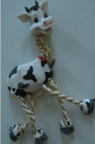
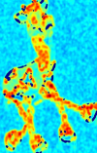
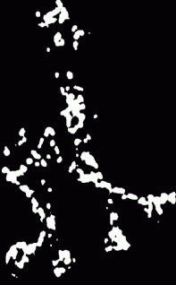
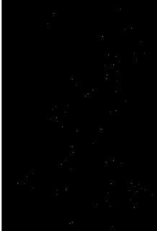

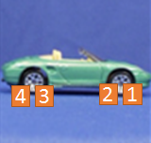
Local code-book creation – Interest Point Detection
First, detect interest points using Harris detectors
Compute sample covariance matrix M for (2D) intensity gradient at each pixel.
Compute corner response (C = f(EigenVals(M))).
Interest points – maxima of thresholded C.
Take 25X25 pixel patches.
5
6

Slide 5










Local code-book creation – Agglomerative Clustering
For a pair of patches (p,q): Normalized Grayscale correlation =
NGC = 0.9
NGC = 0.4
Start with each patch as a separate cluster. Merge two clusters if they are similar.
(Average of pair-wise NGCs of each pair in C1 X C2. t = 0.7 for their experiments)
C1
NGC_{0,0} = 0.9
Similarity(C1, C2) = 0.85
(C1 and C2 will be merged)
Similarity = 0.4
C2
When no more clustering possible, average patches in each cluster to obtain representative patch for each cluster.

Slide 6
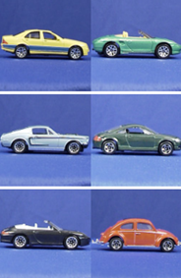
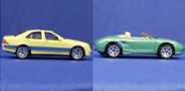


Local code-book creation: Input => Output
8
7
6
5
4
3
2
1
Interest Point Patches
Car
Training images +
Labels (object categories)
Object centers??
Per object class code-book

Slide 7
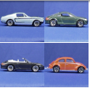
Implicit Shape Model creation from local code-book
For all training images, match codebook entries to interest point image patches using the similarity measure.
Activate all entries whose similarity is above threshold ‘t’.
For each activated entry, store positions it was activated in wrt. object center.
Output: one Implicit model per object class (encoding spatial locations of code-book entries)
={<x1, y1>, <x2, y2>, <x3, y3>, <x4, y4>}
5
6
7
={<x1, y1>, <x7, y7>, …}
={<Car, x1, y1>,…}
1
={<Car, x9, y9>,…}
9

Slide 8
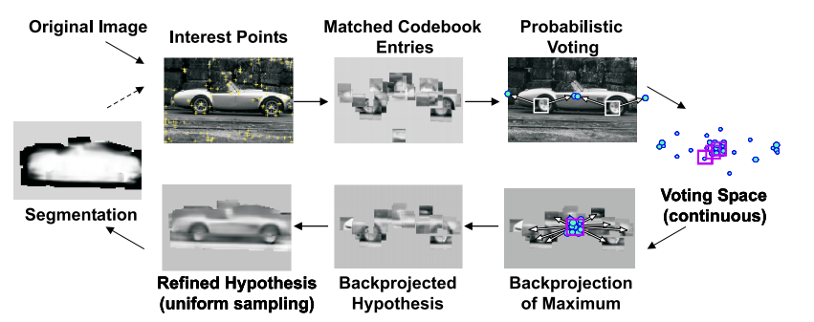
Image Recognition at a glance
For a given image, find interest points and match against all code-book entries for all classes to find
activated code-book entries. Note – each image patch can match multiple code-book entries, even across
object code-books.

Slide 9
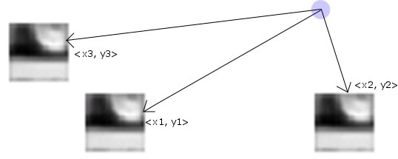
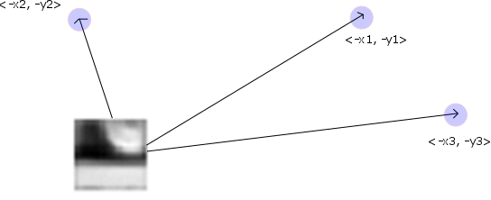
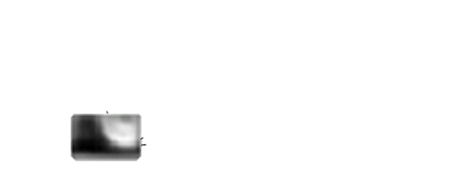

Generalized Hough Transform / patch voting
Implicit Shape Model: = {<Object, x1, y1>,…}. This is the same info as:
= =
Each matched code-book entry for each Harris detected image-patch makes votes for objects & their centers
Car center
Car center
Car center
Car center
Car center
Cow center
Car center
Car center

Slide 10
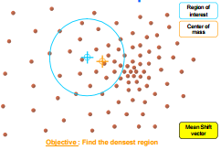
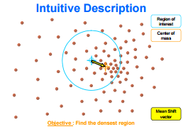
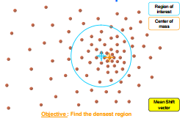
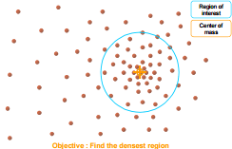


Mean-shift Mode estimation for maxima in continuous voting space
The object centers would concentrate at valid hypothesized object centers.
Mean-shift mode estimation - non-parametric way of finding mode(s) of the probability density function from discrete samples.

Slide 11

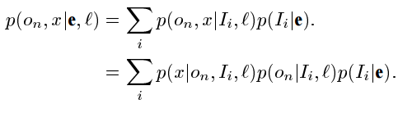

Probabilistic Interpretation of the voting scheme
Given an image patch e, at location l, it activates a set {I_{i}} of code-book entries. The contribution of each entry will be weighted by p(I_{i}|e,l).
An activated entry casts its vote for its object o_{n} at multiple positions x.
Mean-shift search corresponds to a Parzen window density estimate of the object center.
Matching is location
agnostic
Once I is known, independent of e
Quality of patch match with
code-book entry
Hough vote
Confidence code-book
entry is a foreground patch

Slide 12
Object Segmentation – Per pixel foreground / background estimates
From the voting – Hypothesis - p(o_{n}, x).
Want p(p = figure | o_{n}, x) for each pixel p.

Slide 13
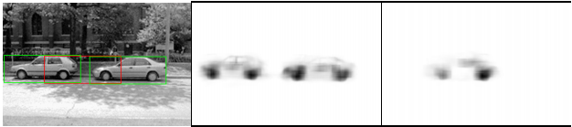
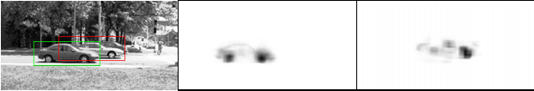
Reducing false positives / Handling multiple objects
Matching is done via local patches, with global structure enforced through voting.
Large number of false positives due to secondary hypothesis
Bounding boxes based rejection (if two hypothesis bounding boxes intersect, keep the one which is stronger)
solves above case. Bounding boxes may actually intersect due to occlusion. So, local matches are desired.

Slide 14


Reducing false positives / Handling multiple objects
Minimum descriptor length – information theoretic measure.
Describe image: We can explain away a pixel as belonging to an object or we have to encode its grayscale value. We “save” on description length if we explain away S_{area} pixels due to an object. However, subtract model complexity – prefer low number of objects, and penalize explaining away a pixel as object when segmentation says it is background.
For overlapping hypotheses h₁ and h₂ consider the “savings” made by combined hypotheses. Select overlapping hypothesis is +ve.

Slide 15
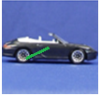
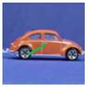
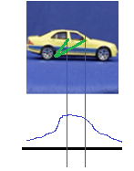
Potential discussion topics
Articulated objects – interpolation across different types of objects
Votes made by patches from different training images and continuous voting space. Disadvantages?
Training Testing
Invariances in the matching?
Non-rigid articulations / soft body deformations.
Statistical issues in the use of per frame snapshots of videos for analysis.
Category independent code-books – bag of visual words type?

