Slide 1
Combined Object Categorization and Segmentation with an Implicit Shape Model
Slides/images sourced off:
http://crcv.ucf.edu/courses/CAP5415/Fall2012/Lecture-4-Harris.pdf
Leibe et al. Combined Object Categorization and Segmentation with an Implicit Shape Model
Leibe et al. Interleaved Object Categorization and Segmentation
Bastian Leibe
Ales Leonardis
Bernt Schiele
Presented by:
Mukul Sati
2/18/2016

Slide 2
Overview
Goal – object categorization and segmentation in the wild.
Steps:
Training:
Learn a code-book of local appearance for each object class.
Learn implicit shape model for the object classes using the local code-books.
Object Detection:
Extract test image patches and match them to code-book entries for each object.
Each “activated” code-book entry votes for the object and the object’s center.

Slide 3
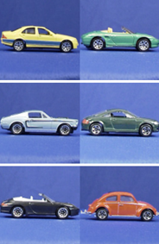
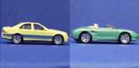




Local code-book creation
6
5
4
3
1
7
8
2
…
8
7
6
5
4
3
2
1
Interest Point Detection
(Harris Detector)
25 X 25 px patches
Patch Clustering
Car
Training images +
Labels (object categories)

Slide 4
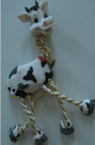
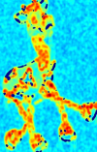
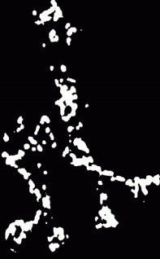
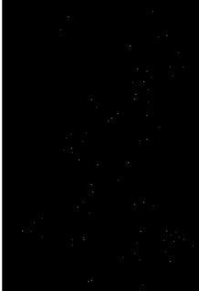

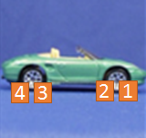
Local code-book creation – Interest Point Detection
First, detect interest points using Harris detectors
Compute sample covariance matrix M for (2D) intensity gradient at each pixel.
Compute corner response (C = f(EigenVals(M))).
Interest points – maxima of thresholded C.
Take 25X25 pixel patches.
5
6

Slide 5








Local code-book creation – Agglomerative Clustering
For a pair of patches (p,q): Normalized Grayscale correlation =
NGC = 0.9
NGC = 0.4
Start with each patch as a separate cluster. Merge two clusters if they are similar.
(Average of pair-wise NGCs of each pair in C1 X C2. t = 0.7 for their experiments)
C1
NGC_{0,0} = 0.9
Similarity(C1, C2) = 0.85
(C1 and C2 will be merged)
Similarity = 0.4
C2
When no more clustering possible, average patches in each cluster to obtain representative patch for each cluster.

Slide 6


Local code-book creation: Input => Output
8
7
6
5
4
3
2
1
Interest Point Patches
Car
Training images +
Labels (object categories)
Per object code-book

Slide 7
Implicit Shape Model creation from local code-book
For all training images, match codebook entries to interest point image patches using the similarity measure.
Activate all entries whose similarity is above threshold ‘t’.
For each activated entry, store positions it was activated in wrt. object center.
={<x1, y1>, <x2, y2>, <x3, y3>, <x4, y4>}
5
6
={<x6, y6>}

Slide 9
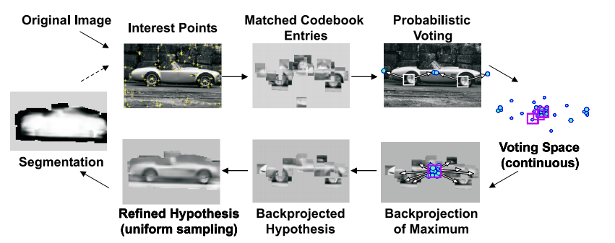
At a glance

Slide 10
Potential discussion topics
Invariances in the matching?
Category independent code-books?

