Slide 1
CNN Applications - 3D Mesh Labeling via CNNs
Images and materials sourced off:
3D Mesh Labeling via Deep CNNs – Guo et al.
The Princeton Shape Benchmark – Shilane et al.
Learning 3D Mesh Segmentation and Labeling – Kalogerakis et al.
Shape matching and recognition using shape contexts – Belongie et al.
Consistent Mesh Partitioning and Skeletonisation using SDFs – Shapira et al.
Guo et al.
Presented by:
Mukul Sati
2/22/2016

Slide 2
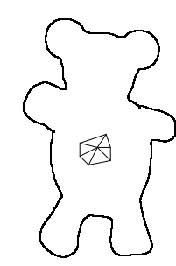
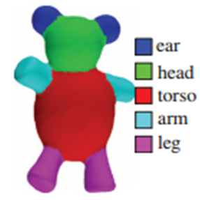
The 3D Mesh Labeling Problem
Triangle Mesh

Slide 3
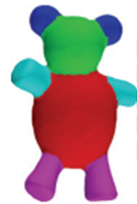
Slightly different from the 3D Mesh segmentation problem
Segmentation
Labeling
Triangle Mesh
Labeling – Segmentation + Recognize as instances of known part types

Slide 4
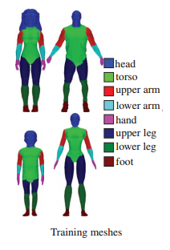

Requires set of labeled “learning” examples
Novel Input Mesh

Slide 5


Labels are object category specific

Slide 6
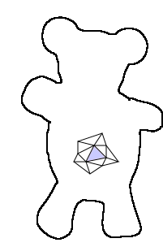

Possible approach - Learn a way of labeling each triangle
From the training data, find a way to estimate p(label | triangle):
5%
4%
85%
4%
2%

Slide 7
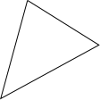
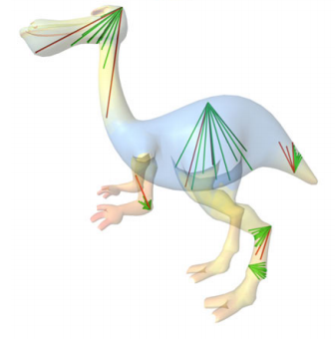
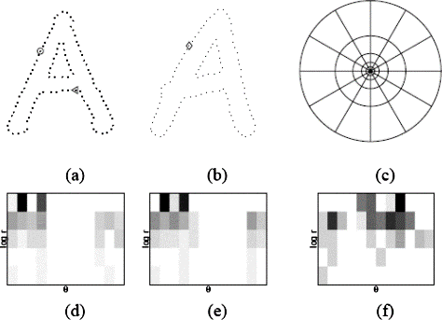
Learning triangle labeling
Describe triangle by extracting relevant features.
Extract some number(s) representative of the geometric configuration for each triangle – extract some geometric features.
Curvature
Shape Diameter
Shape Context
R^{n} {x₁, x₂, … x_{n}}

Slide 8
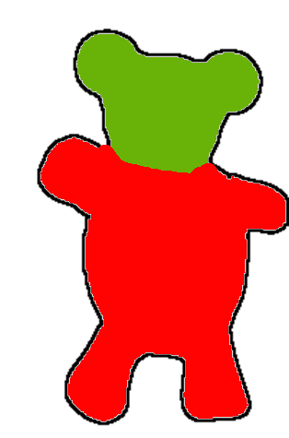
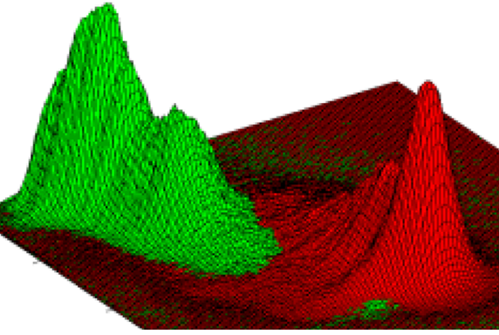
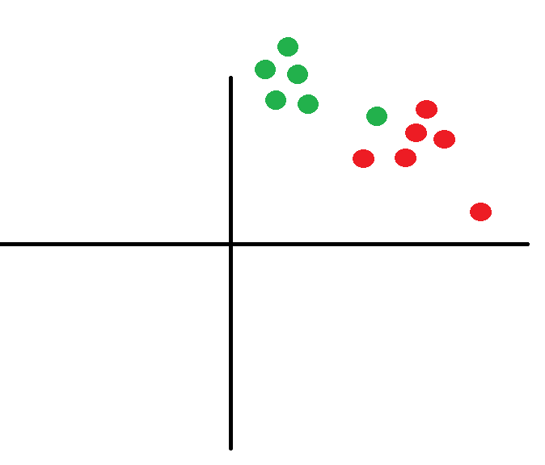

Learning triangle labeling – Training process – assuming one v/s all
Triangles t is transformed to vector v in R^{n}.
p(label | t) => p(label | v).
Model the probability distribution of each label: p(label | v) = f(Ѳ, v). (Or use a non-parameteric prob. density estimation technique).
Learn parameters Ѳ from input data for each label.
R^{n}
R^{n}
p(head | v)
User provided training labeling
p(torso | v)

Slide 9
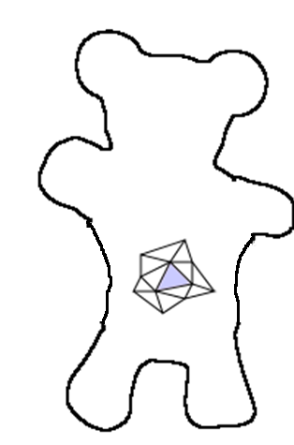
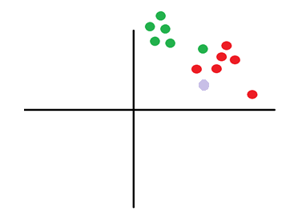
Learning triangle labeling – Handling novel data
Transform triangle t_{i} to feature space v_{i}.
Compute the probability of each label l_{k} p(l_{k} | v_{i}) from the learned probability distribution.
p(head | v)
p(torso | v)
p(head | vi) = 0.05
p(torso | v_{i}) = 0.95
Novel Mesh

Slide 10
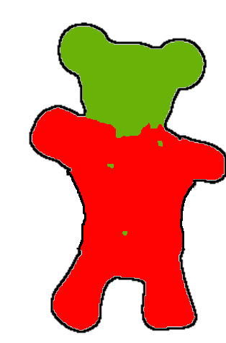

Additional step - Label optimization
Obtained a labeled novel mesh. However, there may be slight inconsistencies, as decisions were taken for each triangle separately.
“Smoothen” the labeling by optimizing an appropriate energy function.
Label Optimization

Slide 11

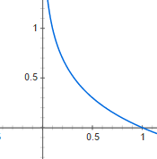
Label Optimization
For each triangle t (equivalently its feature vector v):
Term to minimize inconsistency between label k and p(t | k):
Penalize if this t is being assigned a head label: –log(p(k)).
p(head | v) = 0.05
p(torso | v) = 0.95
Penalty if t was labeled head
-log p(x)
Penalty if t was labeled torso
p(x)

Slide 12
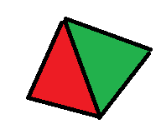
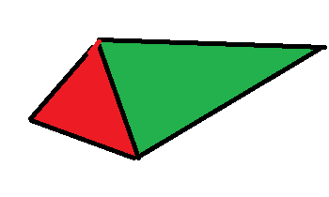
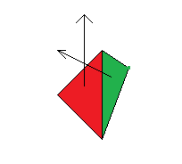
Label Optimization
For each triangle t (equivalently its feature vector v):
Term to minimize inconsistency between label k and p(t | k).
Term to ensure smoothness amongst neighboring triangles.
0 penalty if the labels are the same.
Penalize otherwise based on distance between centroids and dihedral angles.
-log(k * dist * dihedral angle) (k – tunable constant)
-log p(x)
p(x)
High penalty Low penalties (High dist * dihedral)

Slide 13



Label Optimization

Slide 14
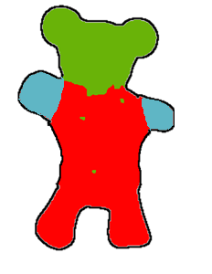
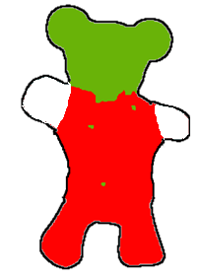
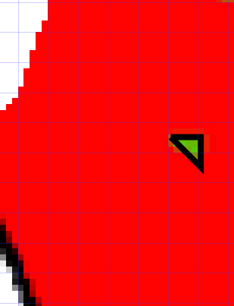
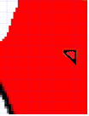
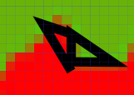
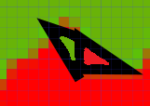

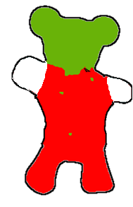
Label Optimization – (Local) Objective minimization using multi-label graph-cuts
Fast Approximate Energy Minimization via Graph Cuts – Boykov et al.
Start with the labels obtained using
Consider each pair of labels and find the corresponding triangle sets.
For each triangle set, allow two types of moves for optimization of objective:
Label-swap: The labels of two triangles are swapped.
Label-expansion: The label of a triangle is switched to the other label.
The authors frame finding optimal swap and expansion moves as finding a minimium cut in an appropriate graph.
Initial Labels
Considering torso and
head triangles
Find and execute
optimal swap moves
Find and execute
optimal expansion moves

Slide 15

One feature-set to rule them all
Many different meshes.
A particular feature f_{i} that works for one class of meshes may not work for another.
Some approaches learn a linear combination of features for each class of mesh: f:t -> R^{n} = a₁f₁ + a₂f₂ + …
The approach using CNNs learns a non-linear combination of features.

Slide 16
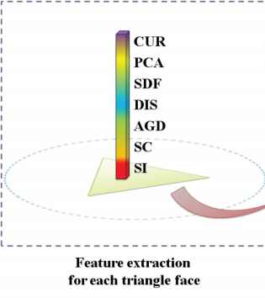
CNNs for 3D Mesh Labeling
Extract geometry features for each triangle face.

Slide 17
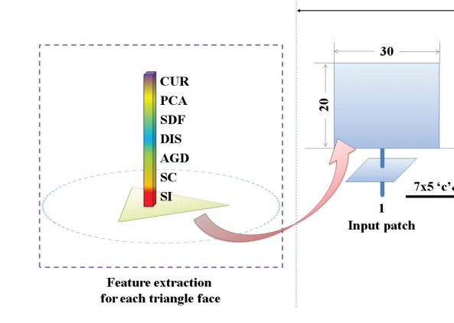
CNNs for 3D Mesh Labeling
Place the features in a 2D grid that will serve as the input to the CNN.
A key experiment in the work is showing that any mapping from the 1D set of features to the 2D grid leads to a performant labeler.

Slide 18
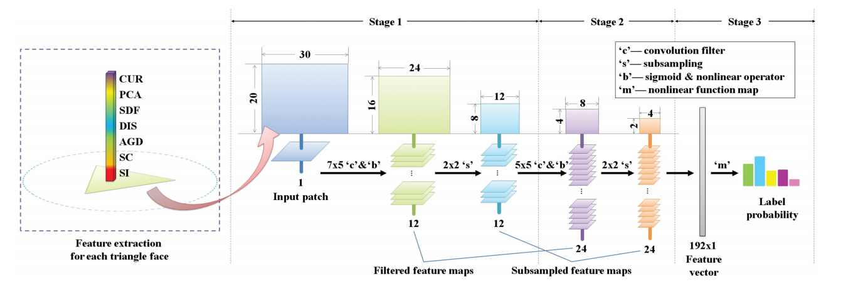
CNN structure

Slide 19
CNN training
For each training triangle, for an indicator vector for its label.
g = [0, 1, 0, 0, 0]^{T}
g = [0, 0, 1, 0, 0]^{T}

Slide 20
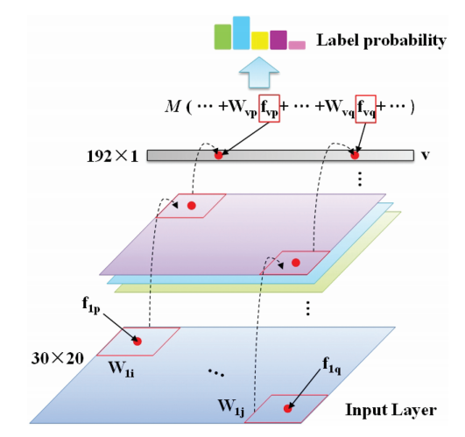

CNN training
Drive the squared error between the label probabilities and the indicator matrix to 0
prob = [0.0, 0.5, 0.5, 0.0, 0.0
sigmoid
Indicator vector
g = [0, 1, 0, 0, 0]

Slide 21
Visualization of learned features
After each stage of the CNN, the feature maps (learned weights W_{i} = {w_{i1}, w_{i2},…w_{in}}) can be used to transform each triangle’s feature vector into some d-dimensional space.
Forward propagate feature vector v for triangle t upto a layer to get input P to the layer P = {p₁, p₂, ….p_{n}}
For feature map W_{i}, compute W_{i}^{T}p.
Stack the above to get the transformed vector at each stage (input – X, final labels – p, intermediate – Y, v)
p
v
Y
X

Slide 22
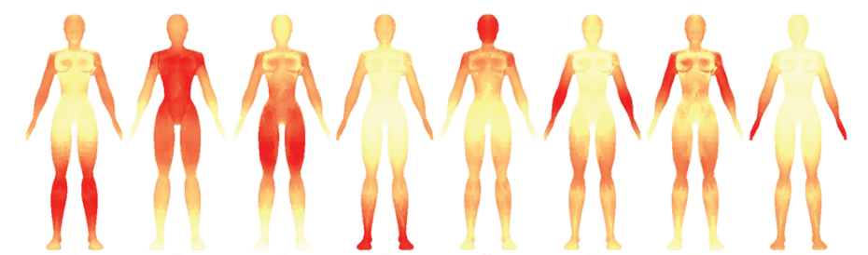
Visualization of learned features
At each CNN layer, compute a representative feature vector for each label at by averaging all the feature vectors of triangles with the label.
Compute and visualize the distance between the feature vector for a triangle and the average feature vector for its label.
X
(Geometry features)
Lower Leg Torso Upper leg Foot Head Lower Arm Upper Arm Hand

Slide 23
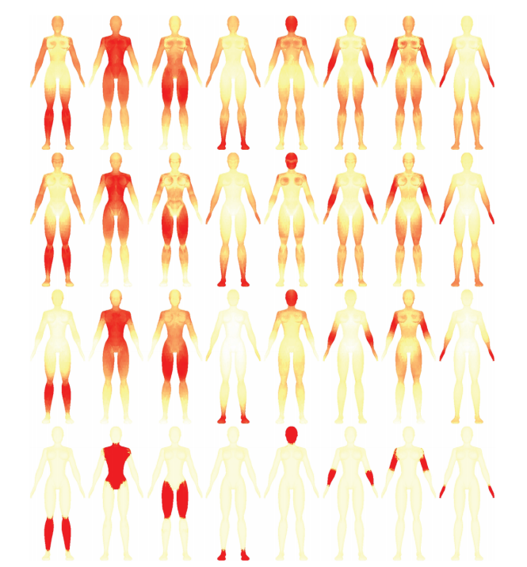
Visualization of learned features
p
v
Y
X
Lower Leg Torso Upper leg Foot Head Lower Arm Upper Hand
Arm

Slide 24
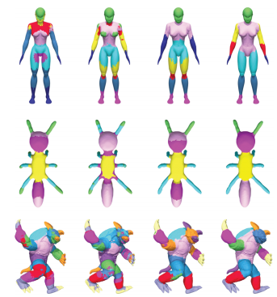
Visualization of learned features – Approach 2
K-Means cluster the vectors and color each triangle based on cluster it belongs to
X Y p v

Slide 25
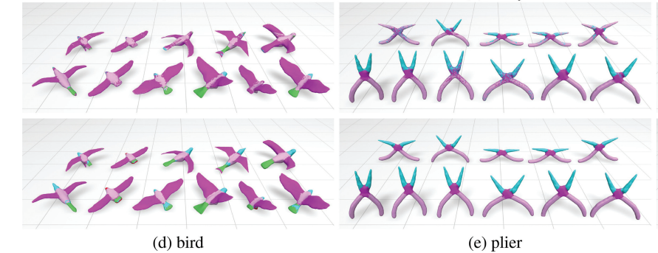
Comparison with learning a linear combination of features
Linear
CNN

Slide 26
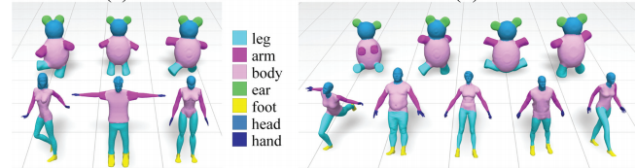
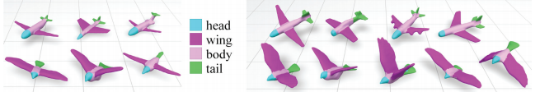
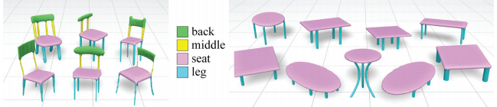
Blended categories and transfer of learning
Blended Categories
Training Testing
Learning
Transfers to
similar, but
novel object
classes

Slide 27
Briefly - Learning to Generate Chairs, Tables and Cars with CNNs
Training – Take object O_{i}, a known camera viewpoint and transformation vector (rotation, translation, zoom, change hue, etc). Create image and segmentation mask for O_{i}
Runtime - Given object indicator vector ([0,…,1,…0]), novel viewpoint and transformation, generate an image of the object.

Slide 28
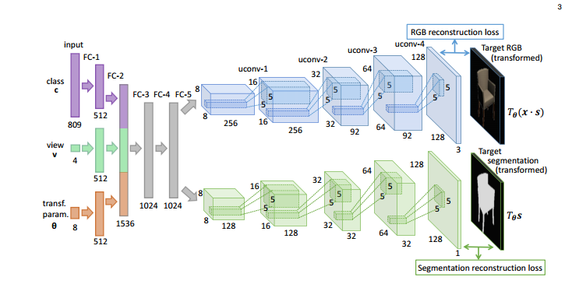
Learning to Generate Chairs, Tables and Cars with CNNs
Reverse a CNN – start with input as the class, view and transformation.
Uconv = Unpool + Convolve
Unpool – create an s X s block ‘B’ from a 1 X 1 block ‘A’ =>
B[0,0] = A[0,0].
B[i,j !(i=0&j=0)] = 0
The segmentation mask is used to render a white background around the generated image.
809 chairs in database

Slide 29

Training
Minimize error between generated images by the network + masks and the images + masks generated using the same parameters
by a rendering engine.

Slide 30
Training
This learns a mapping f(object, view, transformation) = <image pixels, segmentation pixels>
It essentially blends between objects in the training set (non-linearly). However, these may be “random” blends – without any information of the “shared” structure between different transforms and views of the same object.
Hand-wave:
In graphics, for spatial transformations, this ties with the notion of aligning all the objects before blending.
The shared structure is captured and learned by assuming that there exists a probability distribution that corresponds to the manifold of chair images and by using some dense probability tricks ☺.

Slide 31


Runtime
Extrapolate novel views (green)
Feature Arithmetic (done in feature space and visualized in image space)

Slide 32
Thanks!

