Slide 1
Non-Linear Shape Optimization using Local Subspace Projections
Przemyslaw Musialski, Christian Hafner, Florian Rist, Michael Birsak, Michael Wimmer, Leif Kobbelt
GEOM meeting 2016 – 10/19
Presenter – Mukul Sati

Slide 2
Motivation
Digital Fabrication
Optimize shape geometry to achieve user desired goal.
http://www.youtube.com/watch?v=Kxk63ljYxEY&t=1m20s

Slide 3
Contributions (and agenda for the talk)
Generic characterization of the shape optimization problem
Offset surface parameterization using manifold harmonics
Parameter reduction using local sub-space projection
Box constraint elimination
Grounding application – optimize shape for static stability.

Slide 4
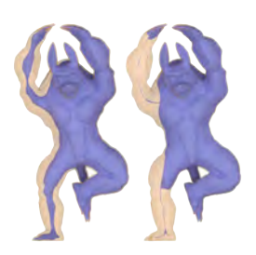
Optimize shape for static stability
Hollow
Filled with material

Slide 5
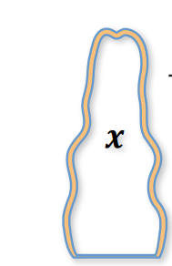
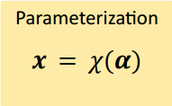
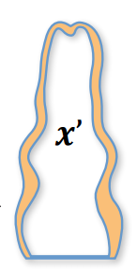

Shape Optimization
In this paper:
Shape is considered to be represented by an interior and exterior surface. The shape is the “gap” (closure of set of points in the volume between the two bounding surfaces)
The outer surface is represented by a mesh that provides vertex positions and normal. The outer surface is fixed during the optimization.
The inner surface is parameterized (as a normal offset – details to follow) with respect to the outer surface, and the optimum parameter space point specifies the inner surface, and thus the shape.

Slide 6
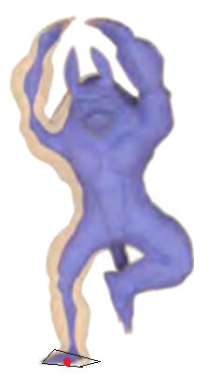
Shape Optimization
In any shape optimization problem:
The user provides material properties of the shape.
For the static stability problem, assume the material has homogeneous volumetric mass density.
The user provides a (set) of values of some shape properties (which are abstractly, some function of the shape).
For static stability, the user would specify that the center of mass (which, given a shape is calculable), projects onto the base of support (convex hull of ground contact points of outer surface).
Additionally, the user would want the center of mass to be as low as possible.
We drive the optimization so that the optimized shape’s properties minimize (summed least-squares) the user desired values.
There are constraints on the shape geometry (self-intersection free, etc).
Center of mass should project onto the base of support

Slide 7
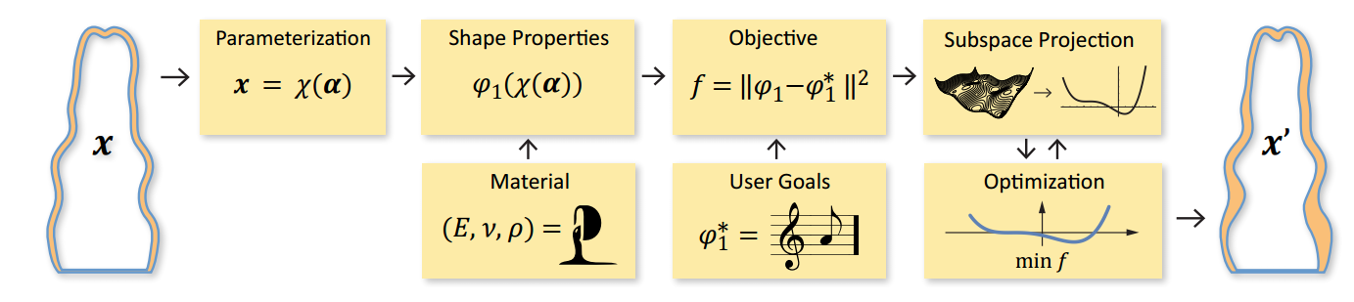




A generic shape optimization pipeline

Slide 8
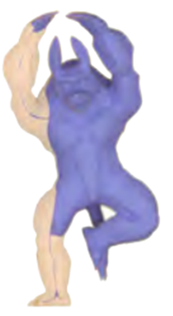
A specialized shape optimization pipeline for static stability
If the coordinate frame
is such that the object
is assumed to placed in
the manner it is desired
to stand, and the center
of base is at zero, then,
user desired center of
mass c* – (c*_{x}, c*_{y}) = 0.
For additional stability,
c*_{z} = 0
At any state of the optimization, let the parameters be α (vector).
The center of mass depends on the shape, and thus on α.
Objective f:
w₁(c_{x}²(α) + c_{y}²(α)) + w₂|c_{z}(α)|
Optimize
Offset parameterized
inner surface

Slide 9
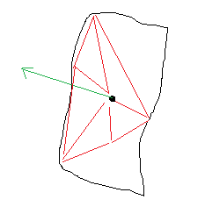
Offset surface parameterization
x_{i} = x_{i} + 𝛿_{i}v_{i}
Per vertex normal remains constant.
The inner surface is parameterized by 𝛿 = (𝛿₀,… 𝛿_{n}).
Optimize over 𝛿.
Add constraints: 𝛿_{i} ∈ (0,b_{i}) (or (a_{i}, b_{i}) to enforce minimum wall thickness).
(outward normal)
-v_{i}
x_{i}
𝛿_{i}
x_{i}

Slide 10
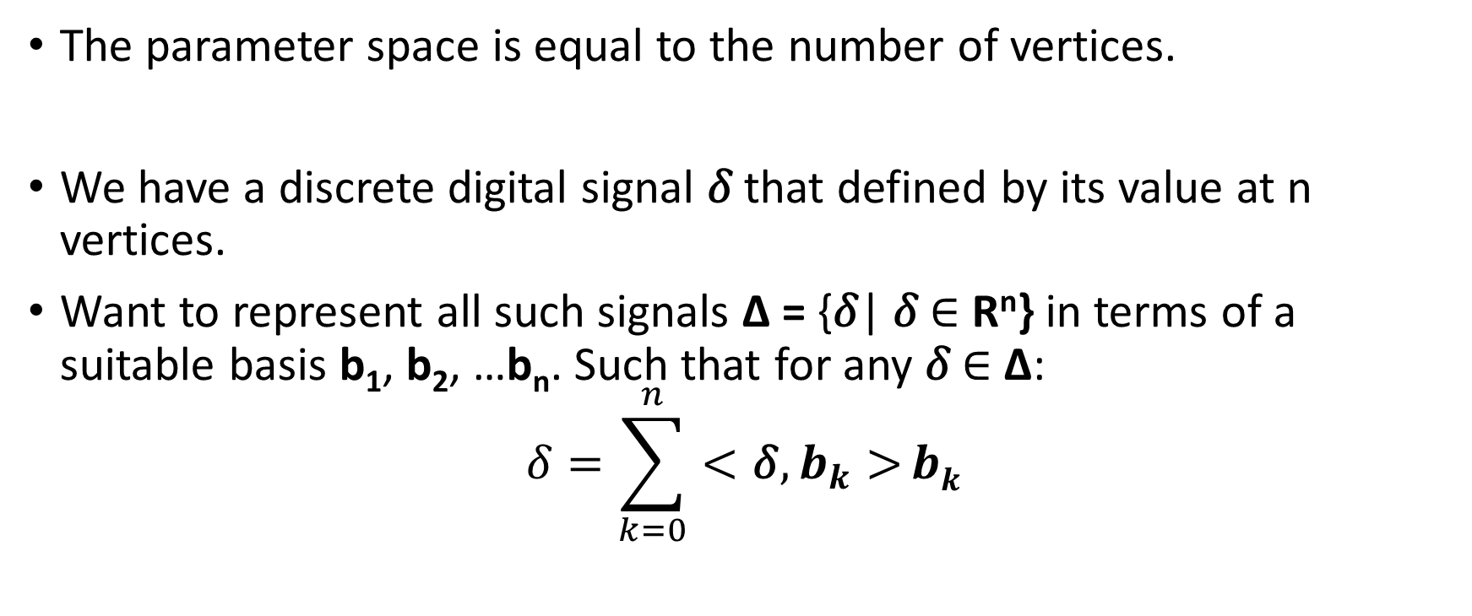
Manifold harmonics parameterization
The parameter space is equal to the number of vertices.
We have a discrete digital signal 𝛿 that defined by its value at n vertices.
Want to represent all such signals Δ = {𝛿| 𝛿 ∈ R^{n}} in terms of a suitable basis b₁, b₂, …b_{n}. Such that for any 𝛿 ∈ Δ:
$$\text{δ}=\sum_{k=0}^{n}{<\text{δ}, b_{k}>}bk$$

Slide 11
Manifold harmonics parameterization
If the basis has a suitable frequency interpretation, analogous to the Fourier transform, we can just use the first m basis vectors (low frequency) to obtain a transformation R^{m}->R^{n} as: Γ = [b₁ b₂ b₃ … b_{m}]
Note Γ is a nXm matrix that encodes the R^{m}->R^{n} transformation in a “good” basis.
Then, we can use a m dimension vector α and obtain parameterization of offset surface using a lower dimensional parameter vector:
𝛿_{i} = Γ α
x_{i} = x_{i} + 𝛿_{i}v_{i}

Slide 12
Manifold harmonics
The cosine transform represents the even extension of a compactly supported real signal as the linear combination of cosine functions with increasing frequencies (in general, expresses a signal as the linear combination of complex exponentials).
Higher correlation with a particular particular frequency is captured by the integral based dot product.
The key to extending this to arbitrary domains is to realize that the complex exponentials are the eigen-functions (/eigen-values) of the Laplace operator d²/dx.
This definition generalizes to any dimension using the generalization of the Laplace operator – the Laplace-Beltrami operator:

Slide 13
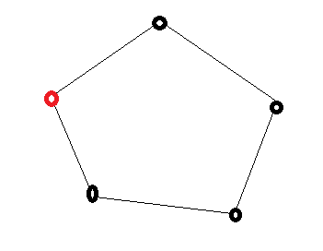

Manifold harmonics
To extend the concept to arbitrary domains, define an analogous Laplace operator, and extract its eigen-functions (eigen-values).
Laplacian: ∆: v_{ix} -> (v_{(i+1)x} – v_{ix})/2 – (v_{(i-1)x} – v_{ix})/2
In matrix form: ∆v_{x} = -Kv_{x} where
v_{i-1}
v_{i}
V_{i+1}

Slide 14
Manifold harmonics
Can be extended to triangulated domains (and general graphs) similarly by defining:
∆v_{ix} = Σ w_{ij}(v_{jx} – v_{ix})
for some neighborhood of v_{i.}
One easy choice of neighborhood is the 1-ring neighborhood, and one easy choice of weights is to equally weigh all the neighbors.
Can incorporate geometry into the weights as well, to get an operator that is influenced by both the geometry and connectivity.

Slide 15
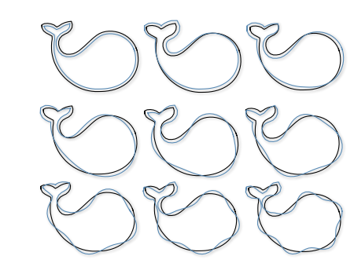
Manifold harmonics
The above discrete operator is representable as a nXn matrix for a mesh with n vertices. One can extract the eigen-values.
For a particular 𝛿 = (k,k,….k), we can visualize the offset surface obtained by projecting onto just one of the basis =>
𝛿^{j} = <b_{j}, 𝛿>b_{j}
We have a frequency domain representation of any scalar function defined on a graph.

Slide 16
Where we stand

Slide 17
Optimization using local subspace projection
Take m manifold harmonic bases. The parameter space is now m dimensional. Typically, m is around 64. Still too many parameters.
The shape properties space is low dimensional however.
Surmise that locally, at parameter value α, there exists a lower dimensional subspace of dimension d (typically just 3-4) and a parameter vector β where each dimension β_{k} dominantly controls one of the shape properties and does not influence other shape properties much (want to find a local parameter space where the local variation of shape properties is decorrelated). We will find the best linear transform B (around α) such that:
B^{mXd}:R^{d}->R^{m} such that α = Bβ

Slide 18
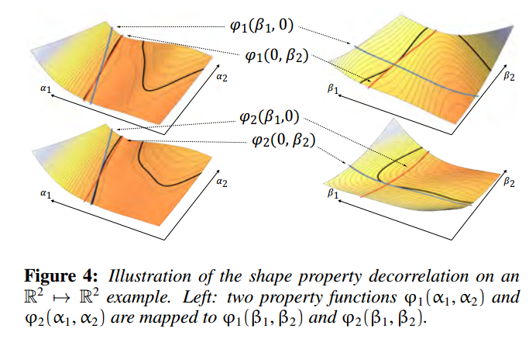

Slide 19



Optimization using local subspace projection
= x(α(β)); α = Bβ
The differential should be a diagonal matrix for maximum de-correlation of new shape parameters. Regularized least norm solution for B.

Slide 20
Optimization using local subspace projection
The iterative numerical optimization scheme runs two nested loops. In the outer loop, the shape parameter transform matrix B is computed for the current design space location α (or, equivalently, for the current intermediate shape χ(α)). In the inner loop, gradient-based iterations are applied to optimize the new (local) shape parameters β. The inner loop stops if either a local minimum is found or if the diagonal dominance of the gradient matrix falls below a certain threshold τ.

Slide 21
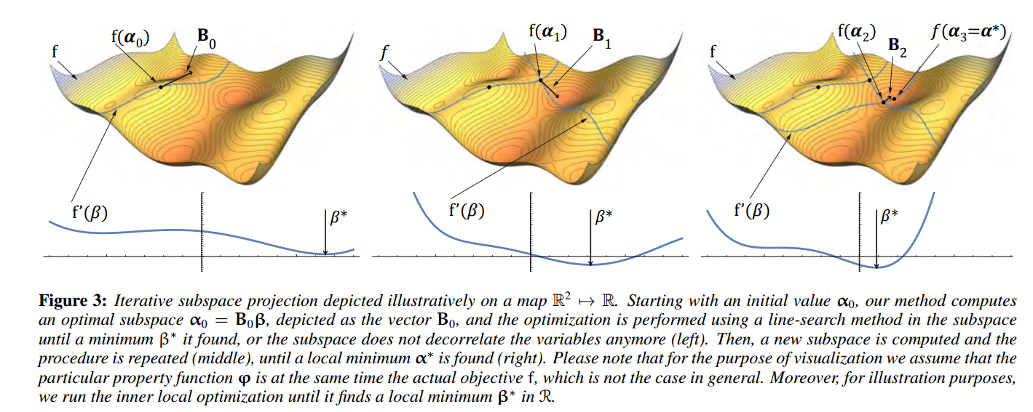
Optimization using local subspace projection

Slide 22
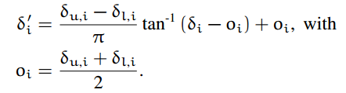
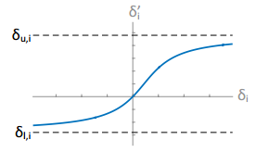

Constraint removal using constraint mapping
A number of geometric constraints are box constraints to prevent self-intersection of shape:
δ_{l,i} < δ_{i} < δ_{u,I}
Clamp the current value within bound using a tan⁻¹ function.
Now, the internal surface:

Slide 23
Thanks!

