Slide 1
Combined Object Categorization and Segmentation with an Implicit Shape Model
Slides/images sourced off:
http://crcv.ucf.edu/courses/CAP5415/Fall2012/Lecture-4-Harris.pdf
Leibe et al. Combined Object Categorization and Segmentation with an Implicit Shape Model
Leibe et al. Interleaved Object Categorization and Segmentation
http://www.cse.psu.edu/~rtc12/CSE598G/introMeanShift_6pp.pdf
Bastian Leibe
Ales Leonardis
Bernt Schiele
Presented by:
Mukul Sati
2/18/2016

Slide 2
Combined Object Categorization and Segmentation with an Implicit Shape Model
Traditionally (back then), no segmentation information used in object categorization.
Segmentation done primarily on low level features in an unsupervised setting.
Human vision - object recognition is intertwined with segmentation.

Slide 3
Overview
Goal – object categorization and segmentation in the wild.
Steps:
Training:
Learn a code-book of local appearance for each object class.
Learn implicit shape model for the object classes using the local code-books.
Object Detection:
Extract test image patches and match them to code-book entries for each object.
Each “activated” code-book entry votes for the object and the object’s center.
Segmentation:
Per object segmentation masks + per-pixel confidence estimate for segmentation.

Slide 4
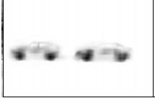
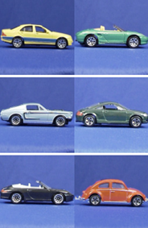
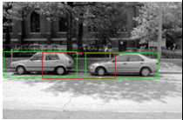

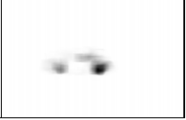
Overview
Input Output
Training Testing
Car
Segmentations
Object Labels
+ Perhaps
object centers
Novel Image
(ignore bounding
boxes)
Object Hypotheses +
Per pixel background / foreground estimate
Training images

Slide 5
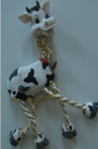
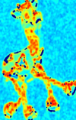
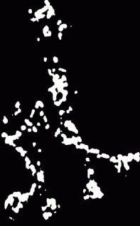
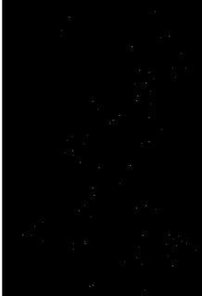

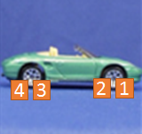
Local code-book creation – Interest Point Detection
First, detect interest points using Harris detectors
Compute sample covariance matrix M for (2D) intensity gradient at each pixel.
Compute corner response (C = f(EigenVals(M))).
Interest points – maxima of thresholded C.
Take 25X25 pixel patches.
5
6

Slide 6










Local code-book creation – Agglomerative Clustering
For a pair of patches (p,q): Normalized Grayscale correlation =
NGC = 0.9
NGC = 0.4
Start with each patch as a separate cluster. Merge two clusters if they are similar.
(Average of pair-wise NGCs of each pair in C1 X C2. t = 0.7 for their experiments)
C1
NGC_{0,0} = 0.9
Similarity(C1, C2) = 0.85
(C1 and C2 will be merged)
Similarity = 0.4
C2
When no more clustering possible, average patches in each cluster to obtain representative patch for each cluster.

Slide 7
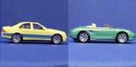


Local code-book creation: Input => Output
8
7
6
5
4
3
2
1
Interest Point Patches
Car
Training images +
Labels (object categories)
Object centers??
Per object class code-book

Slide 8
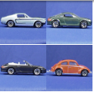
Implicit Shape Model creation from local code-book
For all training images, match codebook entries to interest point image patches using the similarity measure.
Activate all entries whose similarity is above threshold ‘t’.
For each activated entry, store positions it was activated in wrt. object center.
Output: one Implicit model per object class (encoding spatial locations of code-book entries)
={<x1, y1>, <x2, y2>, <x3, y3>, <x4, y4>}
5
6
7
={<x1, y1>, <x7, y7>, …}
={<Car, x1, y1>,…}
1
={<Car, x9, y9>,…}
9

Slide 9
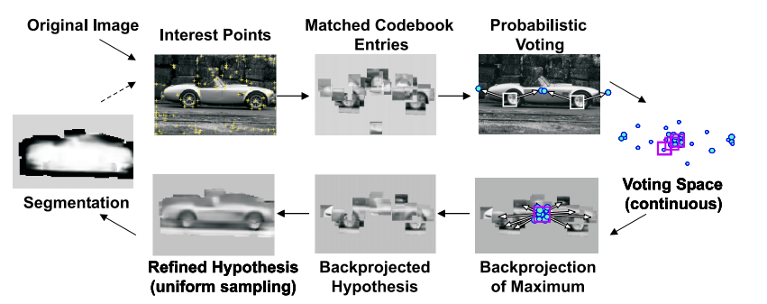
Image Recognition at a glance
For a given image, find interest points and match against all code-book entries for all classes to find
activated code-book entries. Note – each image patch can match multiple code-book entries, even across
object code-books.

Slide 10
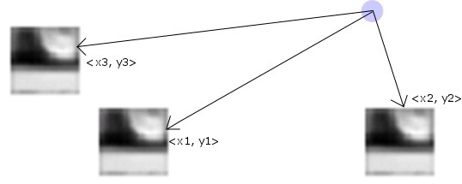
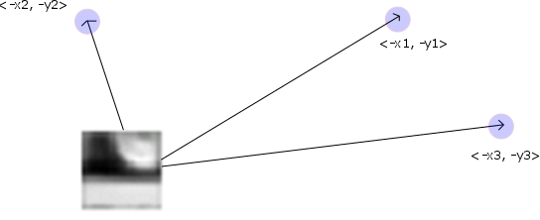
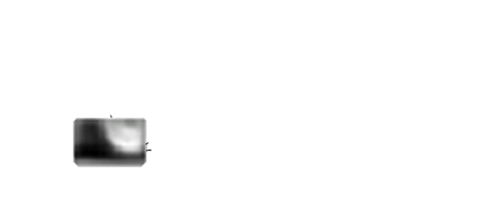

Generalized Hough Transform / patch voting
Implicit Shape Model: = {<Object, x1, y1>,…}. This is the same info as:
= =
Each matched code-book entry for each Harris detected image-patch makes votes for objects & their centers
Car center
Car center
Car center
Car center
Car center
Cow center
Car center
Car center

Slide 11
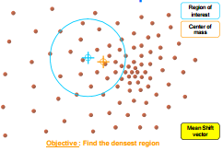
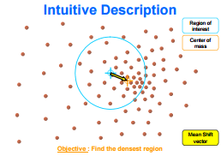
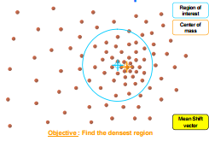
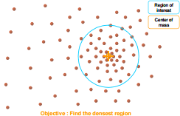


Mean-shift Mode estimation for maxima in continuous voting space
The object centers would concentrate at valid hypothesized object centers.
Mean-shift mode estimation - non-parametric way of finding mode(s) of the probability density function from discrete samples.

Slide 12

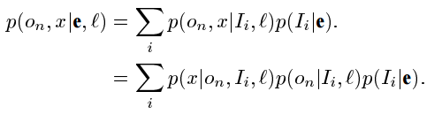

Probabilistic Interpretation of the voting scheme
Given an image patch e, at location l, it activates a set {I_{i}} of code-book entries. The contribution of each entry will be weighted by p(I_{i}|e,l).
An activated entry casts its vote for its object o_{n} at multiple positions x.
Mean-shift search corresponds to a Parzen window density estimate of the object center.
Matching is location
agnostic
Once I is known, independent of e
Quality of patch match with
code-book entry
Hough vote
Confidence code-book
entry is a foreground patch

Slide 13
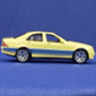
Category Specific object Segmentation – per pixel foreground / background estimates
From the voting – Hypothesis - p(o_{n}, x).
Want p(p = figure | o_{n}, x) for each pixel p, given a hypothesis – category specific.
Each patch detected in training images has a p(figure) segmentation mask. Each code-book entry stores mask of matched patch as well along with its location in the object. Gives p(p =figure|o_{n},x,I,l)
={<x1, y1>, <x2, y2>,….}
1
2
Images
Segmentation

Slide 14


Category Specific object Segmentation – per pixel foreground / background estimates
Single pixel
Each pixel belongs to interest patches that are matched to multiple code-book entries that each have the
segmentation mask assigned to them.

Slide 15


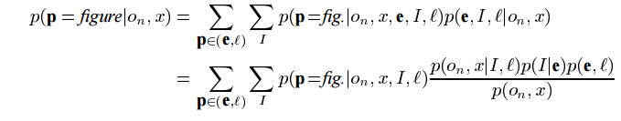
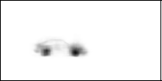

Probabilistic formulation
Influence of patch ‘e’ on a particular hypothesis Bayes Accumulate over constituent code-book entries
Consider each image interest
patch overlapping pixel ‘p’
Split each patch into
contributions of code-book
entries
Resolve into code-
book entries (like
last time)

Slide 16
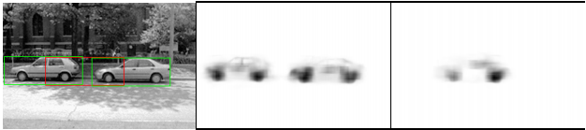
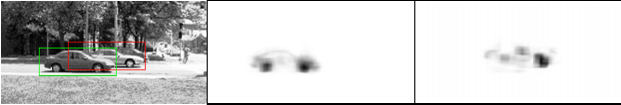
Reducing false positives / Handling multiple objects
Matching is done via local patches, with global structure enforced through voting.
Large number of false positives due to secondary hypothesis
Bounding boxes based rejection (if two hypothesis bounding boxes intersect, keep the one which is stronger)
solves above case. Bounding boxes may actually intersect due to occlusion.
So, when do we combine report the weaker hypothesis as well, and when not?

Slide 17


Hypothesis set selection based on Min Descriptor Length
Describe image: We can explain away a pixel as belonging to an object or we have to encode its grayscale value. We “save” on description length if we explain away S_{area} pixels due to an object. However, we subtract model complexity – prefer low number of objects, and penalize explaining away a pixel as object when segmentation says it is background.
For overlapping hypotheses h₁ and h₂ consider the “savings” made by combined hypotheses. Select overlapping hypothesis if +ve.

Slide 18
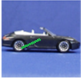
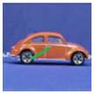
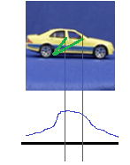
Potential discussion topics
Articulated objects – interpolation across different types of objects
Votes made by patches from different training images and continuous voting space. Disadvantages?
Training Testing
Invariances in the matching?
Non-rigid articulations / soft body deformations.
Statistical issues in the use of per frame snapshots of videos for analysis.
Category independent code-books – bag of visual words type?

