Slide 1
CNN Applications - 3D Mesh Labeling via CNNs
Images and materials sourced off:
3D Mesh Labeling via Deep CNNs – Guo et al.
The Princeton Shape Benchmark – Shilane et al.
Learning 3D Mesh Segmentation and Labeling – Kalogerakis et al.
Shape matching and recognition using shape contexts – Belongie et al.
Consistent Mesh Partitioning and Skeletonisation using SDFs – Shapira et al.
Guo et al.
Presented by:
Mukul Sati
2/22/2016

Slide 2
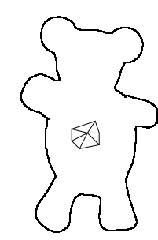
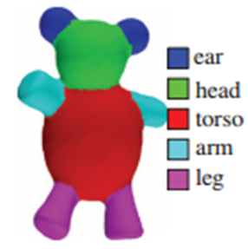
The 3D Mesh Labeling Problem
Triangle Mesh

Slide 3
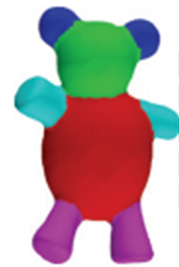
Slightly different from the 3D Mesh segmentation problem
Segmentation
Labeling
Triangle Mesh
Labeling – Segmentation + Recognize as instances of known part types

Slide 4
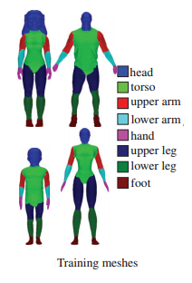

Requires set of labeled “learning” examples
Novel Input Mesh

Slide 5


Labels are object category specific

Slide 6
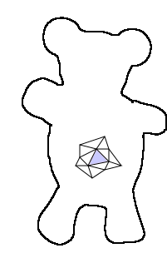

Possible approach - Learn a way of classifying each triangle
From the training data, find a way to estimate p(label | triangle):
5%
4%
85%
4%
2%

Slide 7
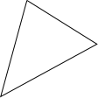
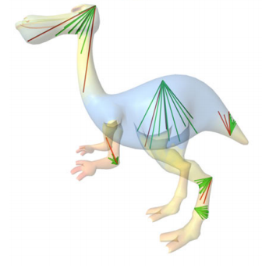
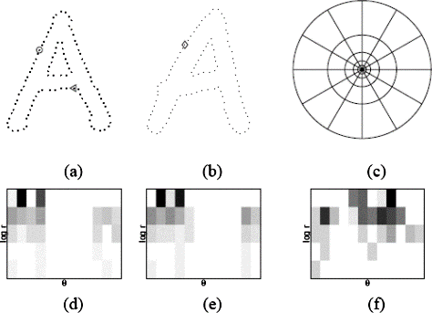
Learning triangle labeling
Describe triangle by extracting relevant features.
Extract some number(s) representative of the geometric configuration for each triangle – extract some geometric features.
Curvature
Shape Diameter
Shape Context
R^{n} {x₁, x₂, … x_{n}}

Slide 8
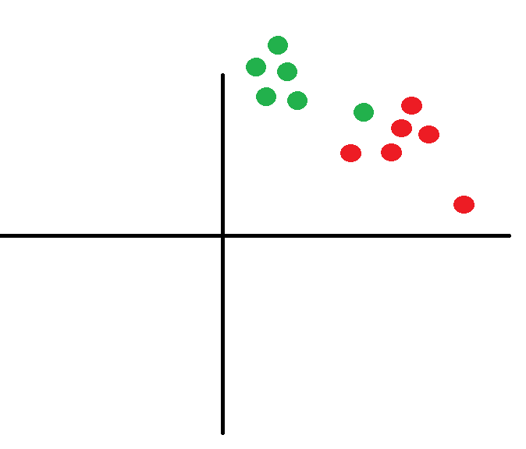
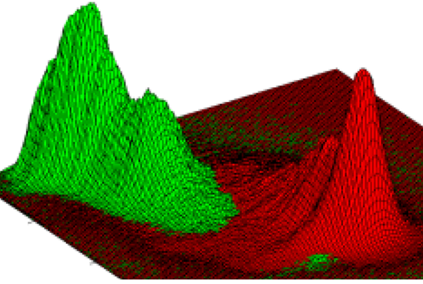
Learning triangle labeling – Training process
Triangles t is transformed to vector v in R^{n}.
p(label | t) => p(label | v).
Model the probability distribution of each label: p(label | v) = f(Ѳ, v).
Learn parameters Ѳ from input data for each label.
R^{n}
R^{n}
p(head | v)
User provided training labeling
p(torso | v)

Slide 9
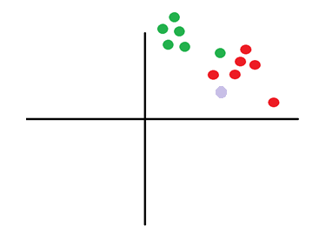
Learning triangle labeling – Handling novel data
Transform triangle t_{i} to feature space v_{i}.
Compute the probability of each label l_{k} p(l_{k} | v_{i}) from the learned probability distribution.
p(head | vi)
p(torso | v_{i}) =

Slide 10
One feature-set to rule them all
The set of features

