Slide 1
Combined Object Categorization and Segmentation with an Implicit Shape Model
Slides/images sourced off:
http://crcv.ucf.edu/courses/CAP5415/Fall2012/Lecture-4-Harris.pdf
Leibe et al. Combined Object Categorization and Segmentation with an Implicit Shape Model
Leibe et al. Interleaved Object Categorization and Segmentation
Bastian Leibe
Ales Leonardis
Bernt Schiele
Presented by:
Mukul Sati
2/18/2016

Slide 2
Overview
Goal – object categorization and segmentation in the wild.
Steps:
Training:
Learn a code-book of local appearance for each object class.
Learn implicit shape model for the object classes using the local code-books.
Object Detection:
Extract test image patches and match them to code-book entries for each object.
Each “activated” code-book entry votes for the object and the object’s center.

Slide 3
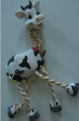
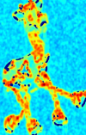
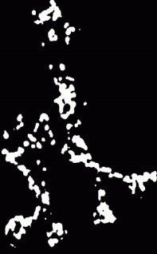
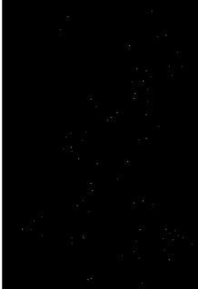

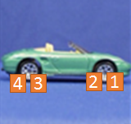
Local code-book creation – Interest Point Detection
First, detect interest points using Harris detectors
Compute sample covariance matrix M for (2D) intensity gradient at each pixel.
Compute corner response (C = f(EigenVals(M))).
Interest points – maxima of thresholded C.
Take 25X25 pixel patches.
5
6

Slide 4










Local code-book creation – Agglomerative Clustering
For a pair of patches (p,q): Normalized Grayscale correlation =
NGC = 0.9
NGC = 0.4
Start with each patch as a separate cluster. Merge two clusters if they are similar.
(Average of pair-wise NGCs of each pair in C1 X C2. t = 0.7 for their experiments)
C1
NGC_{0,0} = 0.9
Similarity(C1, C2) = 0.85
(C1 and C2 will be merged)
Similarity = 0.4
C2
When no more clustering possible, average patches in each cluster to obtain representative patch for each cluster.

Slide 5
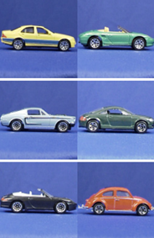
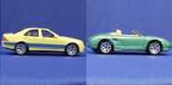


Local code-book creation: Input => Output
8
7
6
5
4
3
2
1
Interest Point Patches
Car
Training images +
Labels (object categories)
Per object class code-book

Slide 6
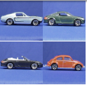
Implicit Shape Model creation from local code-book
For all training images, match codebook entries to interest point image patches using the similarity measure.
Activate all entries whose similarity is above threshold ‘t’.
For each activated entry, store positions it was activated in wrt. object center.
Output: one Implicit model per object class (encoding spatial locations of code-book entries)
={<x1, y1>, <x2, y2>, <x3, y3>, <x4, y4>}
5
6
7
={<x1, y1>, <x7, y7>, …}
={<Car, x1, y1>,…}
1
={<Car, x9, y9>,…}
9

Slide 7
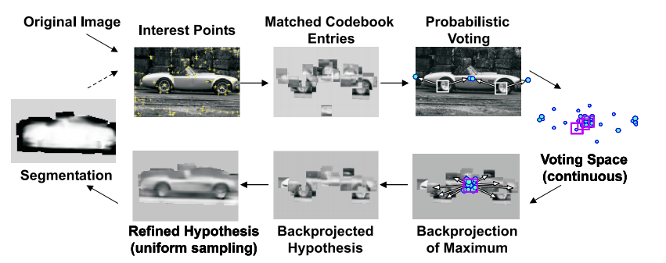
Image Recognition at a glance
For a given image, find interest points and match against all code-book entries for all classes to find
activated code-book entries. Note – each image patch can match multiple code-book entries, even across
object code-books.

Slide 8
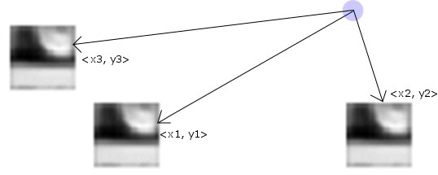
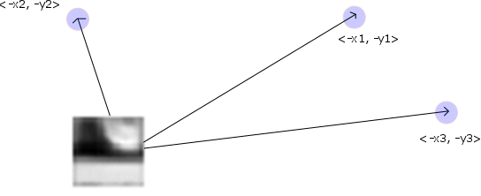
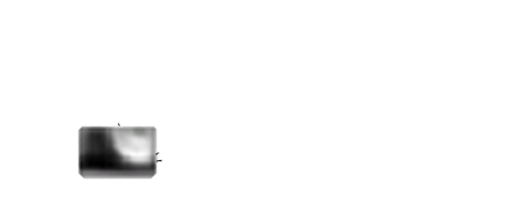

Generalized Hough Transform - Voting
Implicit Shape Model: = {<Object, x1, y1>,…}. This is the same info as:
= =
Each matched code-book entry for each Harris detected image-patch makes votes for objects & their centers
Car center
Car center
Car center
Car center
Car center
Cow center
Car center
Car center

Slide 9
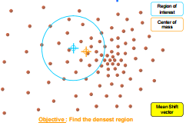
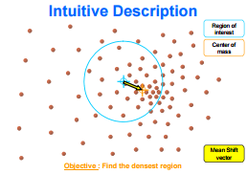
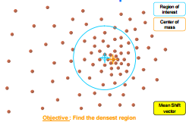
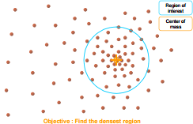


Mean-shift Mode estimation for maxima in continuous voting space
The object centers would concentrate at valid hypothesized object centers.
Mean-shift mode estimation - non-parametric way of finding mode(s) of the probability density function from which the object centers could have been drawn.

Slide 10

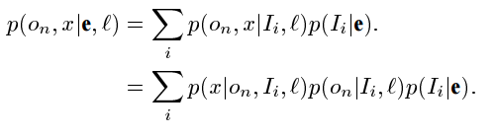

Probabilistic Interpretation of the voting scheme
Given an image patch e, at location l, it activates a set {I_{i}} of code-book entries. The contribution of each entry will be weighted by p(I_{i}|e,l).
An activated entry casts its vote for its object o_{n} at multiple positions x.
Mean-shift search corresponds to a Parzen window density estimate.

Slide 11
Reducing false positives

Slide 13
Object Segmentation

Slide 14
Potential discussion topics
Invariances in the matching?
Category independent code-books?

