Slide 1
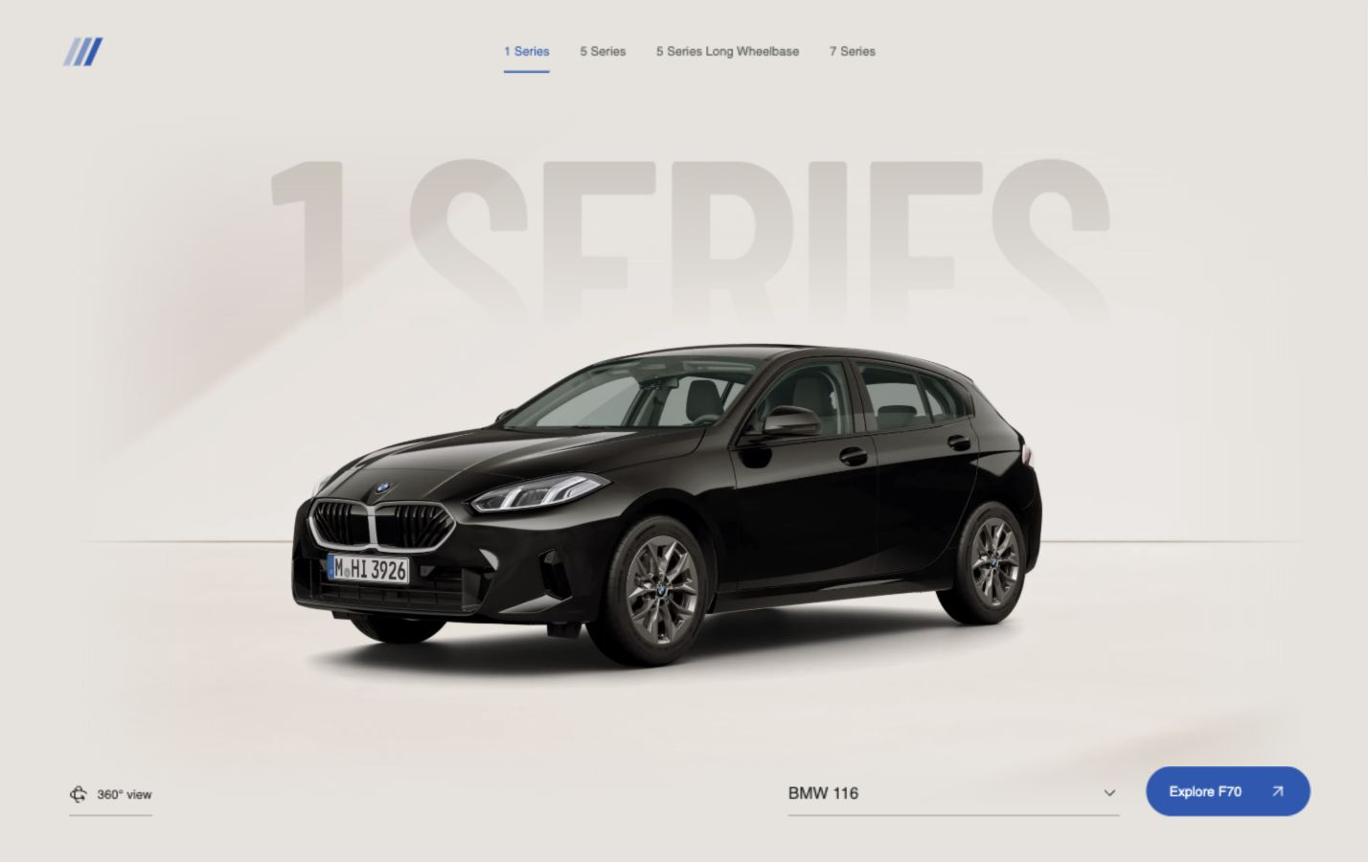
FWD
AI vehicle
requirements
Customer evidence →
PM decisions
Notes:
Background is a screenshot of the actual FWD vehicle-selection page, doc/frontend/evidence/landing-desktop.png, with 1 Series selected. Its vehicle image is representative front-page imagery, not proof of a particular equipment variant or an approved BMW asset.

Slide 2
FWD
//
VEHICLE REQUIREMENTS
THE CHALLENGE
One G60 complaint. Three possible needs.
Check feedback against study, equipment and market evidence.
What needs to change?
01
02
03
Capability
Availability
Usability
Add a missing function
Offer it in the right variant
Make it easier to use
The cited record points to usability; US equipment fit is still unverified.
02 / 11
Notes:
BMW source package includes G60 feedback, a US_2025 customer study, and a G60 option list. The supplied option list is not a validated US equipment baseline. The three categories are distinct interpretation paths, not four evidence boxes or conclusions already proven by the cited record. See doc/frontend/MODEL-COVERAGE.md and doc/googledrive/F70_G60_G68_G70_customer_studies.xlsx.

Slide 3

FWD
//
VEHICLE REQUIREMENTS
THE SOLUTION
One application. A traceable decision path.
The frontend and backend now work as one product.
CORE PIPELINE
01
Scope + upload
Vehicle context and source files
02
Analyze evidence
Normalize records; link findings to sources
03
Build proposals
Check baseline; derive and prioritize changes
04
PM decision
Edit, decide, preserve versions and export
Deep Dive and Reimagine are optional steps.
03 / 11
Notes:
Pipeline verified against plan.md, backend_plan.md and the implemented API/workflow. The actual product interface screenshot is from doc/frontend/evidence/workshop-desktop.png; this visual crop removes the synthetic suggestion sidebar requested in review. Remaining visible vehicle/viewer context is fixture-based, so the screenshot is not evidence of a live BMW analysis. Core path: upload and freeze run/source scope; parse and normalize; extract source-linked findings; check baseline and optionally run Deep Dive; create versioned proposals; PM edits/decides; optional Reimagine uses a bound proposal version; export preserves selected versions and audit data.

Slide 4
FWD
//
VEHICLE REQUIREMENTS
HOW FWD WORKS
Evidence-to-decision workflow
Analysis runs autonomously; the PM owns changes and decisions.
01
02
03
04
05
Scope + ingest
Normalize
Analyze
Propose
PM review
Vehicle, market
and source files
Deduplicate; keep
source locations
Group findings; check
baseline; research if selected
Alternatives, requirements
and explained priority
Edit, decide, version
and export
Optional: Deep Dive research during analysis; Reimagine after proposals. PM edits create a new version; prior versions stay inspectable.
04 / 11
Notes:
Cross-checked against the supplied BMW challenge in doc/more.md, plan.md, backend_plan.md, backend/TESTING_HANDOFF.md and backend/app/workflows.py. The core pipeline covers heterogeneous upload and source snapshot; parsing, normalization and deduplication; source-linked findings and baseline checks; optional Deep Dive; versioned requirements/proposals with explainable scoring; PM edits/decisions; optional exact-version Reimagine; and exact-version export with audit. Research failures yield explicit gaps, and renderer failure does not block proposals. AI does not approve requirements.

Slide 5
FWD
//
VEHICLE REQUIREMENTS
BMW FEEDBACK
G60 feedback on screen access
“The screen layout is not very intuitive for accessing some functions.”
US · G60-0248 · Feedback_Explorer, row 313
05 / 11
Notes:
Source: doc/googledrive/G60_feedback_hackathon.xlsx, worksheet Feedback_Explorer, row 313. ID G60-0248, country US, derivative code G60, engine type ICE, category Operating concept, operating system. The former visible label “Difficult to Use” has been removed. This single source row does not establish prevalence, trim applicability, or exact feature availability.

Slide 6
FWD
//
VEHICLE REQUIREMENTS
ALTERNATIVES
One task. More than one plausible design.
A
Shorter digital path
CUSTOMER TASK
Favorites or shortcuts for frequent tasks.
Reach frequent
vehicle functions
with fewer steps
B
Tactile access for selected tasks
Test whether some controls need a more direct interaction.
06 / 11
Notes:
Evidence anchor: G60-0248, row 313, requests simpler or click-type access. Counterpoint: G60-0105, row 129, says the customer is enjoying the screen interface. These are distinct records; they do not prove directly comparable customer groups or validate either proposed design.

Slide 7
FWD
//
VEHICLE REQUIREMENTS
SETTING PRIORITIES
Priority waits for matched evidence.
REAL G60 CASE · NOT SCORED
CUSTOMER IMPACT
TARGET-GROUP REACH
CURRENT OFFERING GAP
FUTURE RELEVANCE
Not rated
Not established
Unknown
Assumption
PRIORITY
A few source records and an unmatched vehicle baseline cannot support a defensible case score.
Not scored
Scoring workflow exists. Weights remain a project policy, not BMW guidance.
07 / 11
Notes:
The previous 75-to-67 example and its factor ratings were synthetic. This slide deliberately withholds a score because the cited feedback records do not establish customer impact, target-group reach, matched feature availability, or successor relevance. Weights are project policy, not BMW-prescribed.

Slide 8
FWD
//
VEHICLE REQUIREMENTS
THE OUTPUT
A candidate requirement, pending review.
SOURCE-BASED DRAFT · NOT APPROVED
FWD
REQ-DRAFT-01
SCOPE
Drivers can reach frequently used functions through clear, consistent paths with fewer steps.
BMW 5 Series G60
US feedback records
Review
workspace
OPEN CHECKS
Evidence
Requirements
Versions
Evidence
Exact trim, current feature baseline, reach and successor relevance.
G60-0248 · row 313
G60-0635 · row 797
Two source examples. Not a prevalence estimate.
PROPOSED WORDING · NEEDS PM REVIEW
08 / 11
Notes:
Draft language based on BMW G60 feedback workbook, Feedback_Explorer rows 313 (G60-0248) and 797 (G60-0635). This is a manually prepared candidate for the pitch deck, not a stored backend proposal or PM-approved requirement. It does not claim population prevalence.

Slide 9
FWD
//
VEHICLE REQUIREMENTS
REIMAGINE
A design hypothesis for faster access.
TODAY · REPORTED FRICTION
CONCEPT · FEWER STEPS
Vehicle settings
Vehicle home
Home / Vehicle / Function
Frequent functions
Find function through several screens
Saved action A
Saved action B
UI concept only. Current Reimagine proof supports a bounded front-seat resize, not dashboard redesign.
09 / 11
Notes:
The before/after is an editable UI concept based on G60 feedback, not an app-generated artifact. Repo documentation states current downloaded BMW geometry supports a bounded resize of one independently separated front seat. It does not establish touchscreen redesign or engineering validation. See README.md and doc/reimagine-assets.md.

Slide 10
FWD
//
VEHICLE REQUIREMENTS
STATUS AND NEXT STEP
Integrated prototype. Scoped proof still needed.
TODAY
NEXT
Connected application
One coherent BMW case
01
Frontend and backend are combined.
01
Match US feedback to the relevant baseline.
02
Real-source runs exercised on bounded samples.
02
Show exact source and a reviewed requirement.
03
Current UI screenshots use fixture content.
03
Record PM decision on the exact version.
04
Vehicle and part catalog still synthetic for G60 run.
04
Export the decision trace.
10 / 11
Notes:
Repo evidence: frontend and backend are connected. Backend handoff records a real three-record G60 run with three findings and three changes; the vehicle/part catalog was synthetic, so exact derivative and equipment applicability remain unverified. Combined frontend verification used synthetic UI harness content; no live service was running during this deck update. References: README.md, backend/TESTING_HANDOFF.md, doc/frontend/COMBINED-VERIFICATION.md.

Slide 11
FWD
//
AI VEHICLE REQUIREMENTS LAB
Next proof: one scoped
G60 case.
Scope
US G60 family; exact trim open
Trace
A finding to its source row
Review
A candidate requirement
Decide
A PM-owned version and export
11 / 11
Notes:
Close with the bounded next proof. Do not claim one-record feedback validates broad market need, exact derivative fit, a BMW-approved score, or generated dashboard geometry.

