Slide 1

FWD
//
VEHICLE REQUIREMENTS
FWD
From customer evidence
to clear requirements.
Explainable proposals.
Product manager owns decision.
BMW VEHICLE REQUIREMENTS CHALLENGE
Illustrative vehicle image; exact derivative not verified.
01 / 11
Notes:
Source image extracted from user-supplied FWD_BMW_Pitch_Clean.pdf. It is retained as an illustration and is not used as evidence of exact trim or derivative.

Slide 2
FWD
//
VEHICLE REQUIREMENTS
THE CHALLENGE
One G60 complaint. Three possible needs.
Check feedback against study, equipment and market evidence.
CUSTOMER FEEDBACK
CUSTOMER STUDY
VEHICLE BASELINE
MARKET CONTEXT
G60 source row
Exact complaint and locator
US 2025 workbook
G60 included
G60 option list
US trim fit still open
US feedback sample
Exact derivative unresolved
What needs to change?
01
Missing capability
02
Availability gap
03
Usability problem
Add it
Make it available
Make it easier to use
This record points to usability. Feature availability still needs a matched US baseline.
02 / 11
Notes:
BMW source package includes G60 feedback, a US_2025 customer study, and a G60 option list. The supplied option list is not a validated US equipment baseline. See doc/frontend/MODEL-COVERAGE.md and doc/googledrive/F70_G60_G68_G70_customer_studies.xlsx.

Slide 3
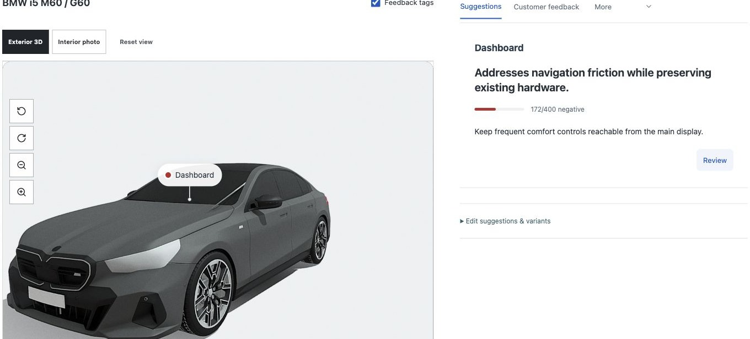
FWD
//
VEHICLE REQUIREMENTS
THE SOLUTION
The evidence and proposal, together.
One workspace connects findings, sources, review and decisions.
CURRENT PRODUCT UI
IN ONE WORKSPACE
01
Findings
Open source evidence
02
Proposals
Inspect wording and rationale
03
PM review
Decide on an exact version
04
History + export
Keep the decision trace
Prototype screen shown with synthetic fixture content.
03 / 11
Notes:
Screenshot source: doc/frontend/evidence/workshop-desktop.png. This is the actual product interface, but the captured workspace is synthetic. Do not describe the screenshot contents as an analysis of BMW source files. Product capabilities and current fixture limits are documented in frontend/README.md.

Slide 4
FWD
//
VEHICLE REQUIREMENTS
HOW FWD WORKS
From feedback to a reviewed requirement.
AI prepares a proposal. The product manager owns the decision.
01
02
03
04
Scope the case
Inspect evidence
Draft a requirement
Review and decide
Vehicle, market
and source files
Finding linked to
source location
Explain change,
assumptions and gaps
PM acts on an
exact version
Earlier versions stay inspectable after a PM edit or decision.
04 / 11
Notes:
Product workflow described by the connected application and its API contracts. This slide describes system behavior; it does not claim a completed BMW production pilot.

Slide 5
FWD
//
VEHICLE REQUIREMENTS
TRACEABLE EVIDENCE
One record. Exact source.
BMW 5 SERIES · G60 · US
WHAT THIS SUPPORTS
CUSTOMER FEEDBACK · DIFFICULT TO USE
Usability friction
in screen access
“The screen layout is not very intuitive for accessing some functions.”
WHAT IT DOES NOT ESTABLISH
How common the issue is, which G60 trim applies, or whether a feature is missing.
Customer prefers simpler access instead of several menu layers.
ONE SOURCE RECORD · NOT PREVALENCE
Source: Feedback_Explorer · row 313 · G60-0248
05 / 11
Notes:
Source: doc/googledrive/G60_feedback_hackathon.xlsx, worksheet Feedback_Explorer, row 313. ID G60-0248, country US, derivative code G60, engine type ICE, feedback type Difficult to Use, category Operating concept, operating system. Full source text includes preference for simpler access or click-type controls. This single record does not establish prevalence, trim applicability, or exact feature availability.

Slide 6
FWD
//
VEHICLE REQUIREMENTS
ALTERNATIVES
One task. More than one plausible design.
A
Shorter digital path
CUSTOMER TASK
Favorites or shortcuts for frequent tasks.
Reach frequent
vehicle functions
with fewer steps
B
Tactile access for selected tasks
Test whether some controls need a more direct interaction.
Design hypotheses. BMW feedback does not validate either solution.
06 / 11
Notes:
Evidence anchor: G60-0248, row 313, requests simpler or click-type access. Counterpoint: G60-0105, row 129, says the customer is enjoying the screen interface. These are distinct records; they do not prove directly comparable customer groups or validate either proposed design.

Slide 7
FWD
//
VEHICLE REQUIREMENTS
SETTING PRIORITIES
Priority waits for matched evidence.
REAL G60 CASE · NOT SCORED
CUSTOMER IMPACT
TARGET-GROUP REACH
CURRENT OFFERING GAP
FUTURE RELEVANCE
Not rated
Not established
Unknown
Assumption
PRIORITY
A few source records and an unmatched vehicle baseline cannot support a defensible case score.
Not scored
Scoring workflow exists. Weights remain a project policy, not BMW guidance.
07 / 11
Notes:
The previous 75-to-67 example and its factor ratings were synthetic. This slide deliberately withholds a score because the cited feedback records do not establish customer impact, target-group reach, matched feature availability, or successor relevance. Weights are project policy, not BMW-prescribed.

Slide 8
FWD
//
VEHICLE REQUIREMENTS
THE OUTPUT
A candidate requirement, pending review.
SOURCE-BASED DRAFT · NOT APPROVED
FWD
REQ-DRAFT-01
SCOPE
Drivers can reach frequently used functions through clear, consistent paths with fewer steps.
BMW 5 Series G60
US feedback records
Review
workspace
OPEN CHECKS
Evidence
Requirements
Versions
Evidence
Exact trim, current feature baseline, reach and successor relevance.
G60-0248 · row 313
G60-0635 · row 797
Two source examples. Not a prevalence estimate.
PROPOSED WORDING · NEEDS PM REVIEW
08 / 11
Notes:
Draft language based on BMW G60 feedback workbook, Feedback_Explorer rows 313 (G60-0248) and 797 (G60-0635). This is a manually prepared candidate for the pitch deck, not a stored backend proposal or PM-approved requirement. It does not claim population prevalence.

Slide 9
FWD
//
VEHICLE REQUIREMENTS
REIMAGINE
A design hypothesis for faster access.
TODAY · REPORTED FRICTION
CONCEPT · FEWER STEPS
Vehicle settings
Vehicle home
Home / Vehicle / Function
Frequent functions
Find function through several screens
Saved action A
Saved action B
UI concept only. Current Reimagine proof supports a bounded front-seat resize, not dashboard redesign.
09 / 11
Notes:
The before/after is an editable UI concept based on G60 feedback, not an app-generated artifact. Repo documentation states current downloaded BMW geometry supports a bounded resize of one independently separated front seat. It does not establish touchscreen redesign or engineering validation. See README.md and doc/reimagine-assets.md.

Slide 10
FWD
//
VEHICLE REQUIREMENTS
STATUS AND NEXT STEP
Integrated prototype. Scoped proof still needed.
TODAY
NEXT
Connected application
One coherent BMW case
01
Frontend and backend are combined.
01
Match US feedback to the relevant baseline.
02
Real-source runs exercised on bounded samples.
02
Show exact source and a reviewed requirement.
03
Current UI screenshots use fixture content.
03
Record PM decision on the exact version.
04
Vehicle and part catalog still synthetic for G60 run.
04
Export the decision trace.
10 / 11
Notes:
Repo evidence: frontend and backend are connected. Backend handoff records a real three-record G60 run with three findings and three changes; the vehicle/part catalog was synthetic, so exact derivative and equipment applicability remain unverified. Combined frontend verification used synthetic UI harness content; no live service was running during this deck update. References: README.md, backend/TESTING_HANDOFF.md, doc/frontend/COMBINED-VERIFICATION.md.

Slide 11
FWD
//
AI VEHICLE REQUIREMENTS LAB
Next proof: one scoped
G60 case.
Scope
US G60 family; exact trim open
Trace
A finding to its source row
Review
A candidate requirement
Decide
A PM-owned version and export
Illustrative vehicle image; not an exact G60 trim reference.
11 / 11
Notes:
Close with the bounded next proof. Do not claim one-record feedback validates broad market need, exact derivative fit, a BMW-approved score, or generated dashboard geometry. Vehicle art is an illustration retained from the source PDF.

