Slide 1
Prototype Presentation
Presented By: Suresh S

Slide 2
CWorks CXF
A data exchange format between AutoCAD system and CWorks CAD system.

Slide 3
Application Overview
A console application for CAD file processing.
Application will convert AutoCAD files from various versions to TXF & CXF files.
Application will support reverse conversion from CXF files to AutoCAD files.
CXF output file generated from our proposed system will be used as the input of CWorks CAD System.
TXF file generated from the system will be used as reference for other properties and objects which are not in CXF format, which is required for reverse conversion process.
CWorks CAD system will process this neutral CXF format to create scaffolding drawings.
Reverse conversion from CXF files to AutoCAD files should be version specific.

Slide 4
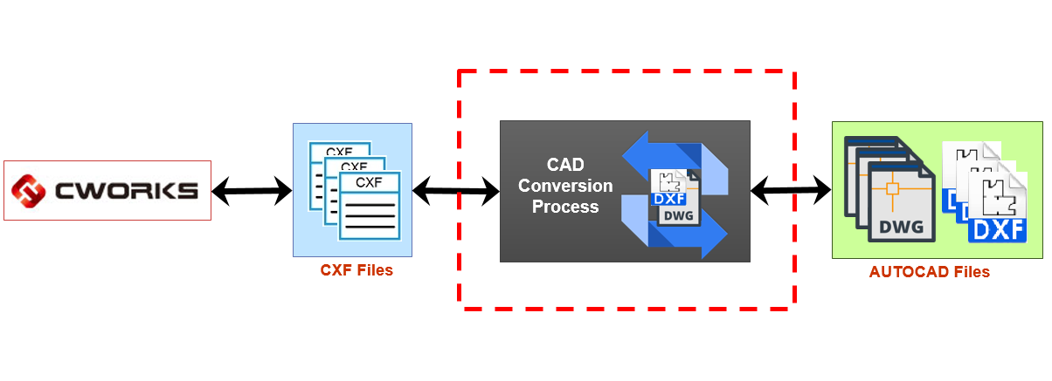
Process Flow
&
TXF Files
Notes:
May require more than one slide

Slide 5
Process Flow - Description
CAD Conversion Process will convert the drawing files to CXF format and vice versa.
Input path and Output path will be specified as parameters.
System will support following conversions:
  DWG to TXF & CXF
  DXF to TXF & CXF
  CXF to DWG with reference of TXF file.
  CXF to DXF with reference of TXF file.
Optional parameters like Version, Paper size, Font etc required for CXF to drawing file conversions.
Notes:
May require more than one slide

Slide 6
Thank You All

