Slide 1
Walmart Business Problems

Slide 2
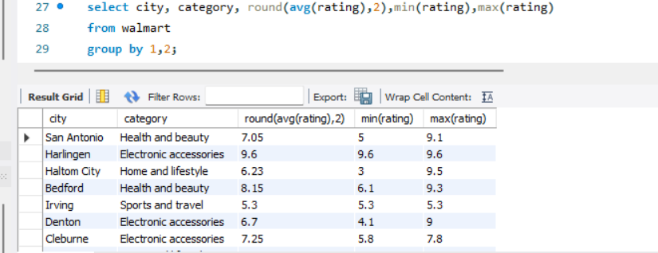
Determine the average, minimum,maximum rating of category for each city

Slide 3
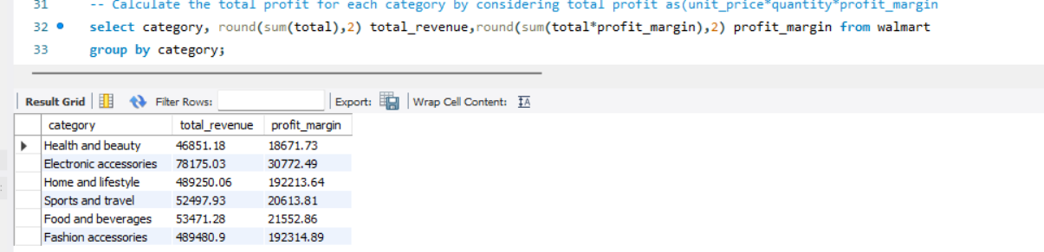
Calculate the total profit for each category by considering total profit as(unit_price*quantity*profit_margin

Slide 4
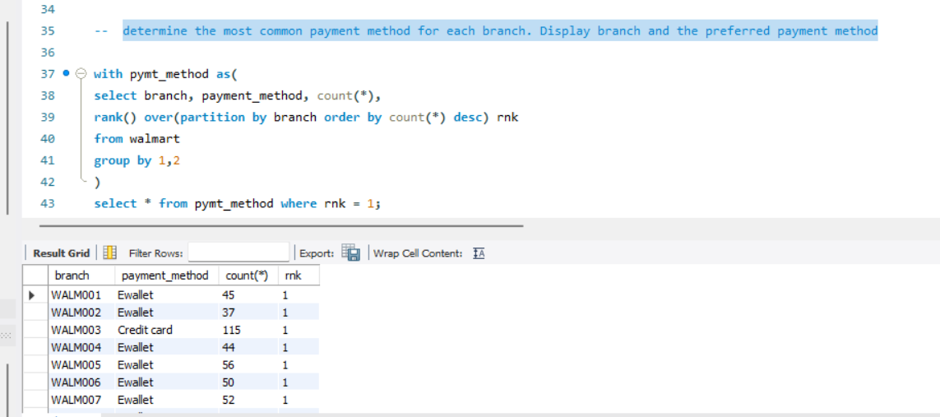
Determine the most common payment method for each branch. Display branch and the preferred payment method

Slide 5
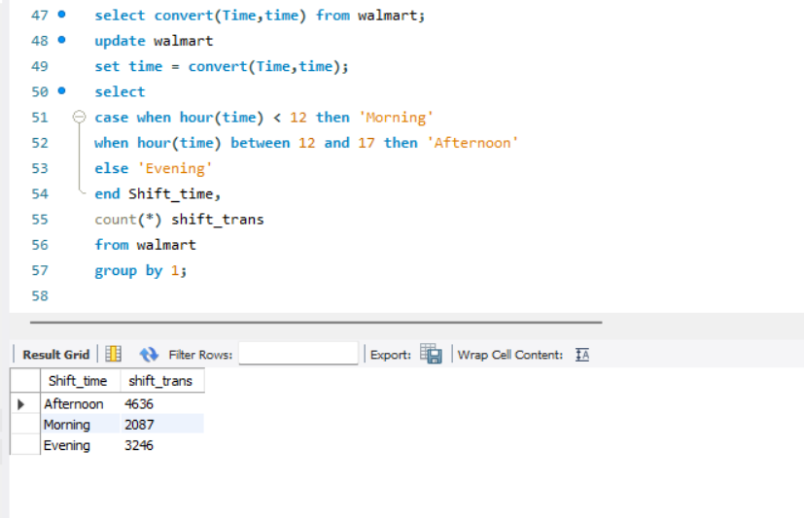
Categorize sales into 3 groups Morning, Afternoon,Evening and find out which of the-- shift and number of invoices

Slide 6
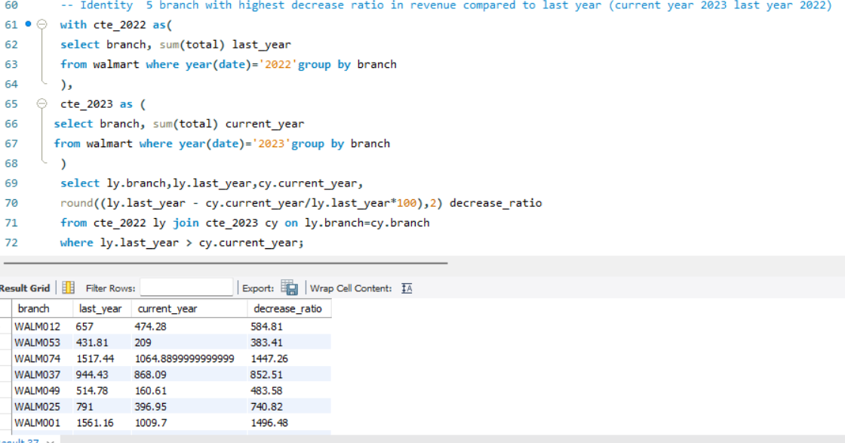
Identity 5 branch with highest decrease ratio in revenue compared to last year (current year 2023 last year 2022)

