Slide 1
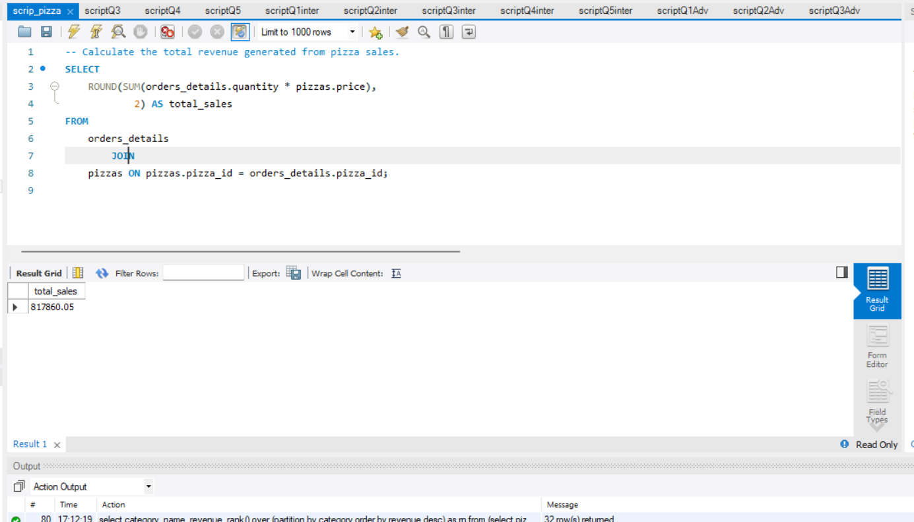
Calculate the total revenue generated from pizza sales.

Slide 2
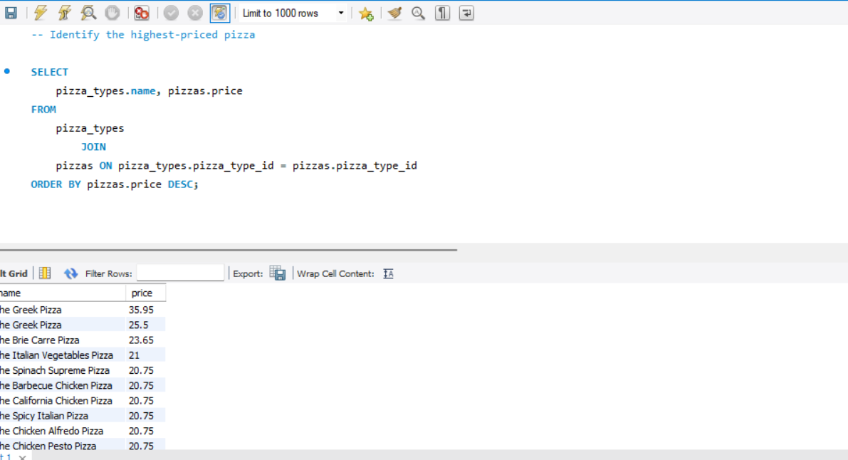
Identify the highest-priced pizza

Slide 3
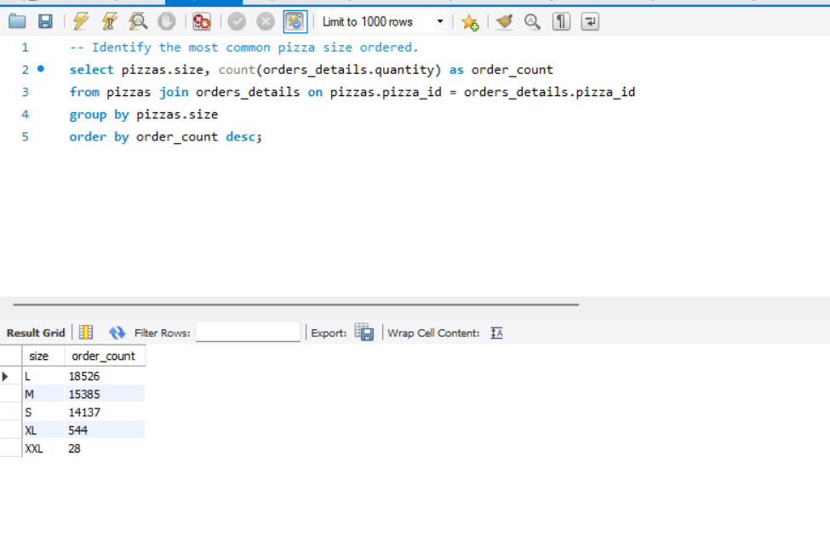
Identify the most common pizza size ordered.

Slide 4
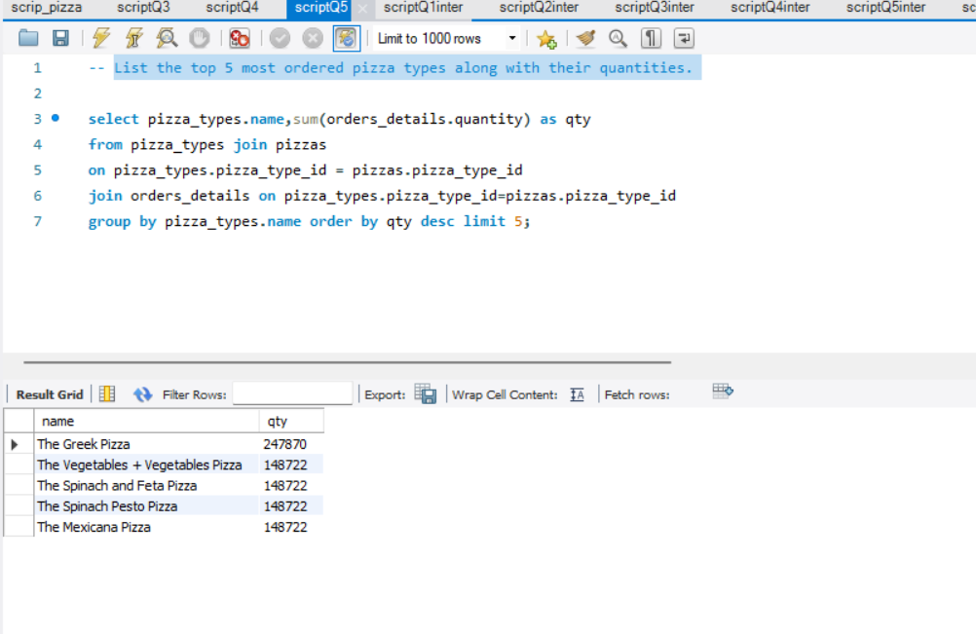
List the top 5 most ordered pizza types along with their quantities.

Slide 5
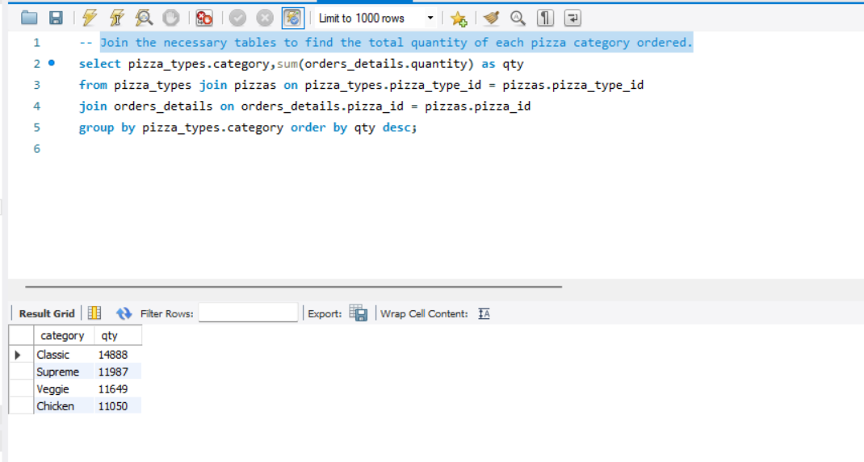
Join the necessary tables to find the total quantity of each pizza category ordered.

Slide 6
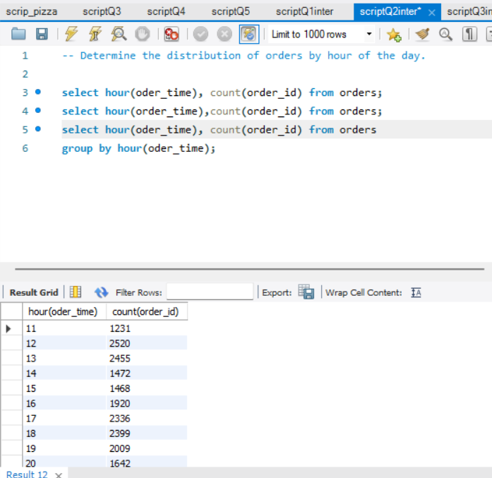
Determine the distribution of orders by hour of the day.

Slide 7
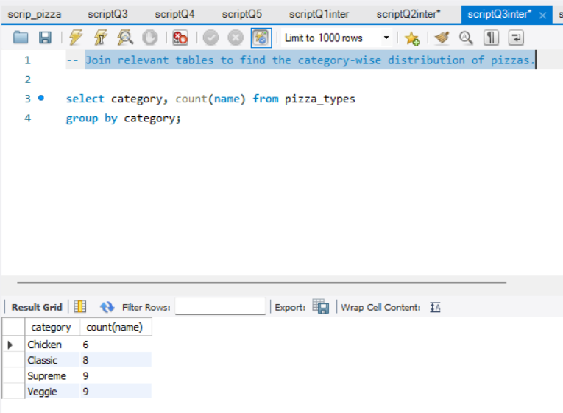
Join relevant tables to find the category-wise distribution of pizzas.

Slide 8
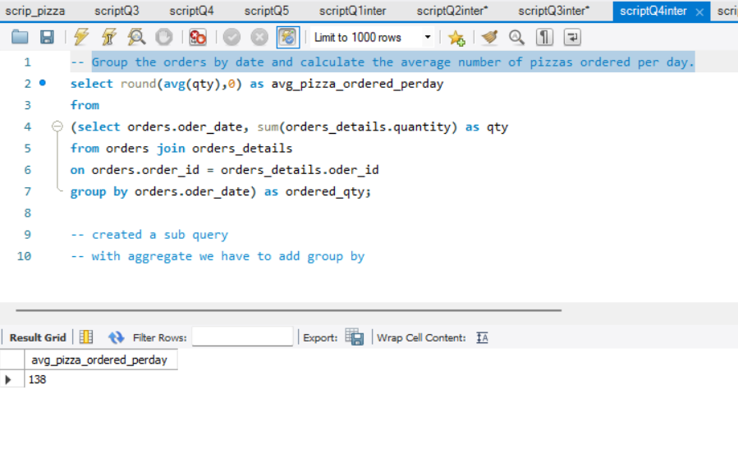
Group the orders by date and calculate the average number of pizzas ordered per day.

Slide 9
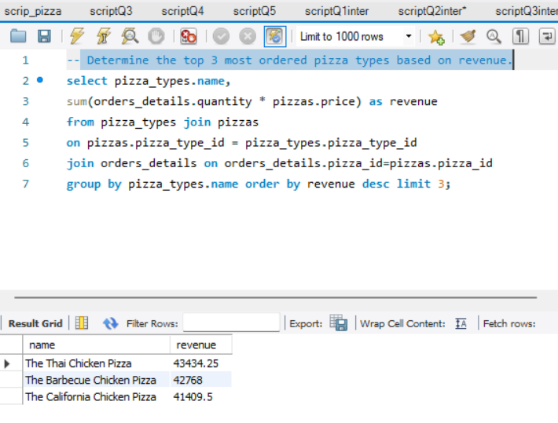
Determine the top 3 most ordered pizza types based on revenue.

Slide 10
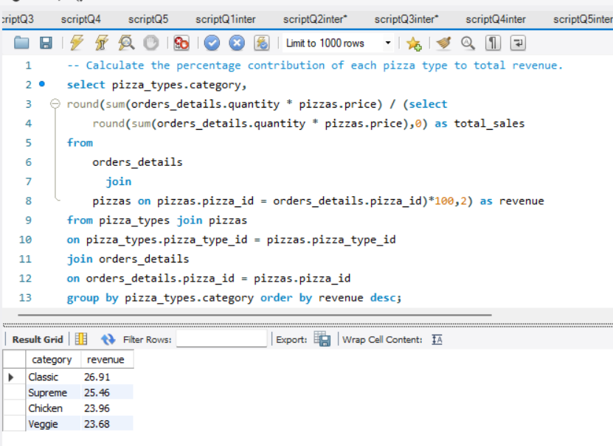
Calculate the percentage contribution of each pizza type to total revenue.

Slide 11
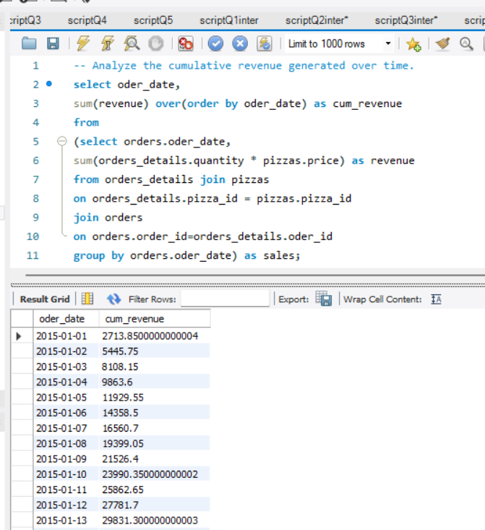
Analyze the cumulative revenue generated over time.

Slide 12
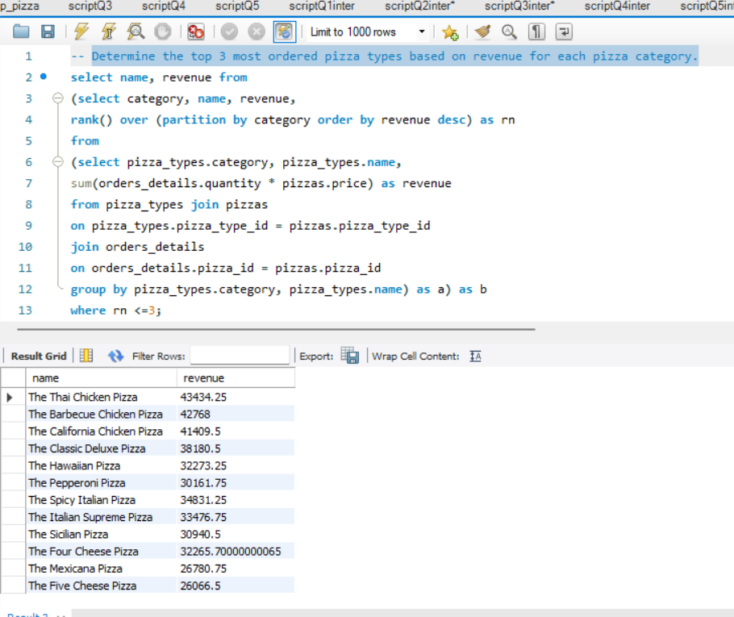
Determine the top 3 most ordered pizza types based on revenue for each pizza category.

