Slide 1
Netflix
13 Business Problems

Slide 2
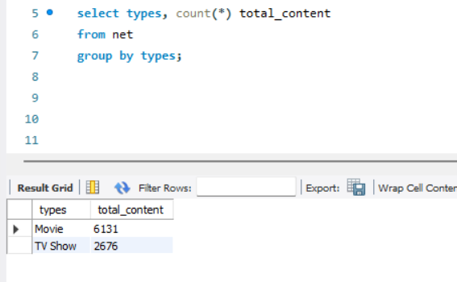
Count the number of Movies vs TV Shows

Slide 3
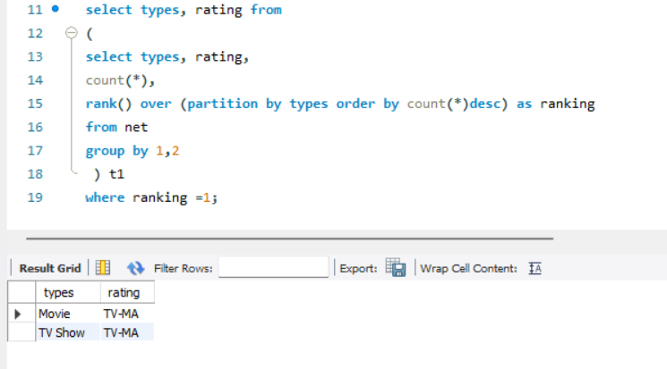
Find the most common rating for movies and tv shows

Slide 4
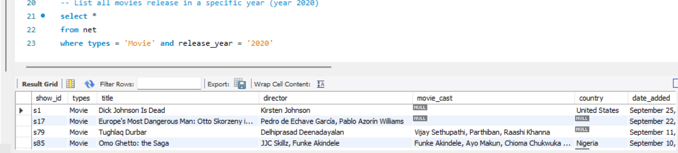
List all movies release in a specific year (year 2020)

Slide 5
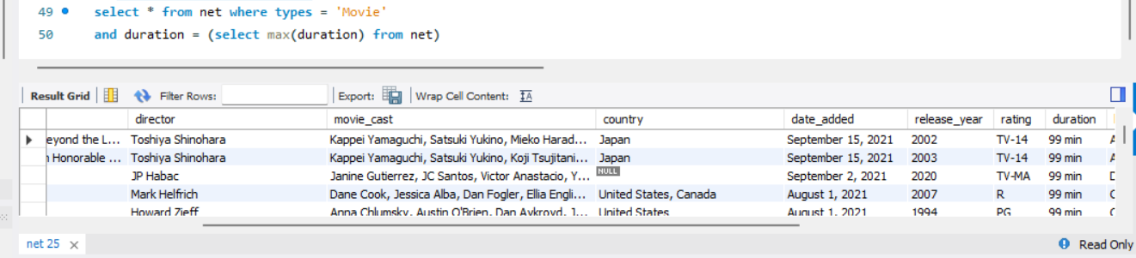
Identify the longest movie

Slide 6
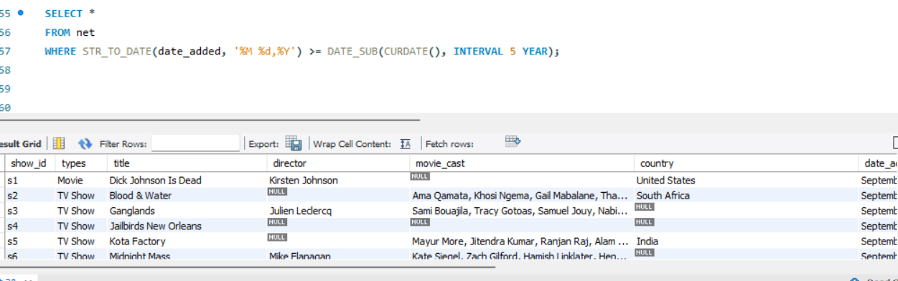
Find content added in last 5 years-- changed the date format using str_to_date function

Slide 7
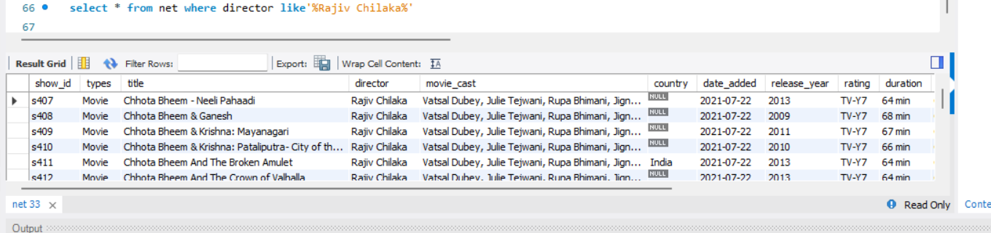
Find all the movies/TV shows by director Rajiv Chilaka
multiple director names found in one column

Slide 8
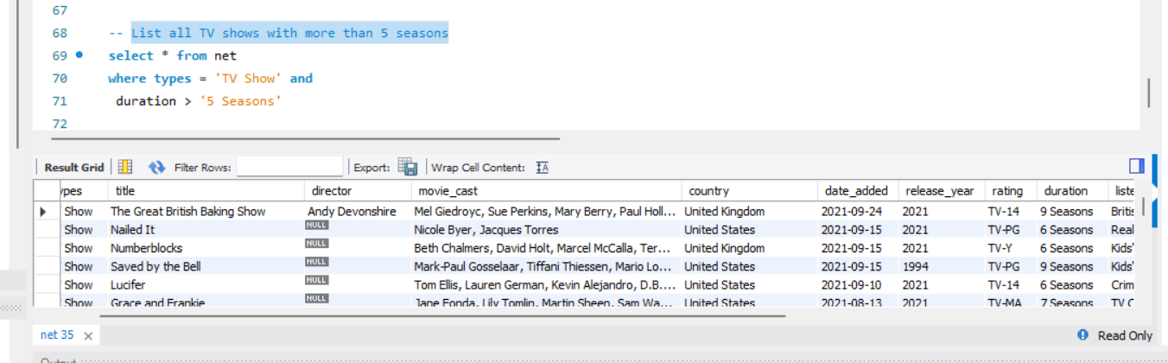
List all TV shows with more than 5 seasons

Slide 9
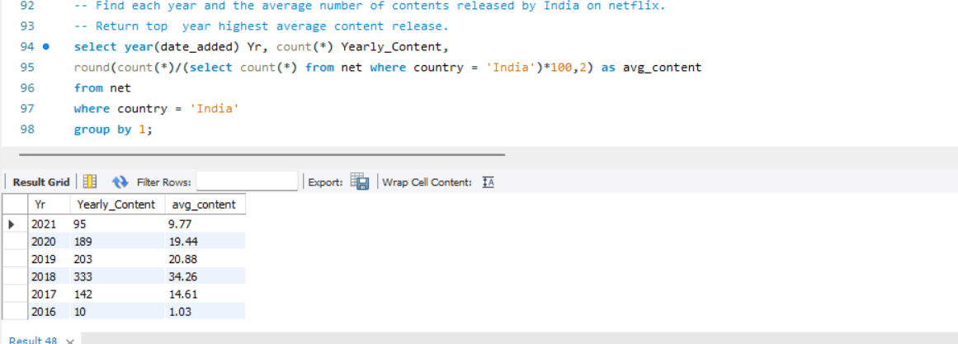
Find each year and the average number of contents released by India on netflix.

Slide 10
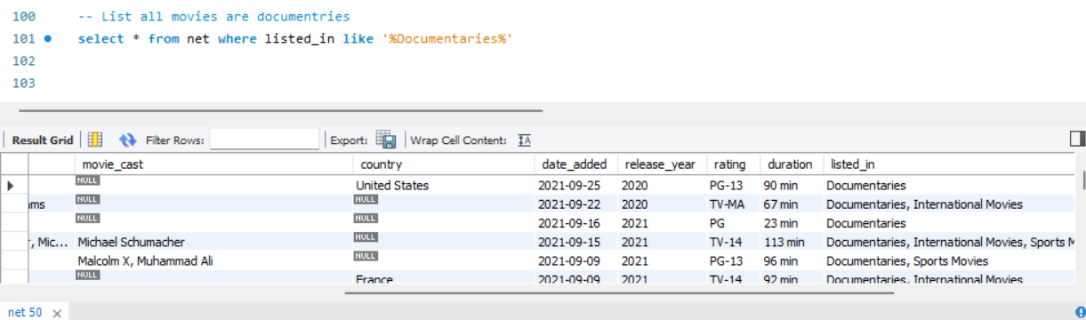
List all movies are documentaries

Slide 11
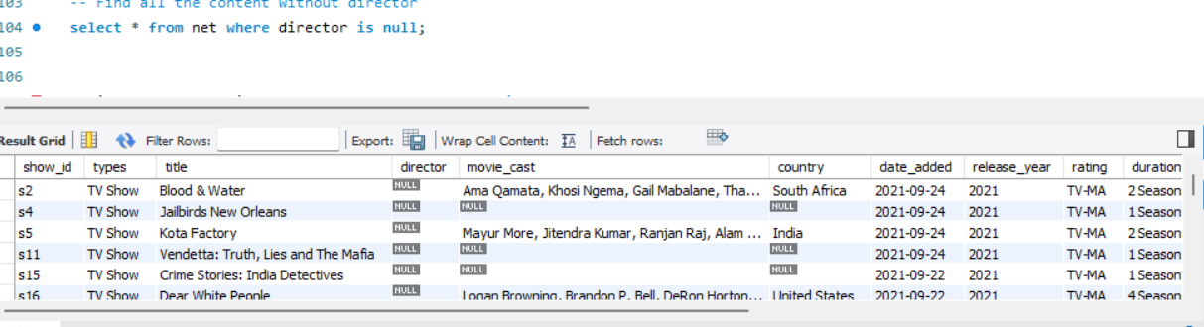
Find all the content without director

Slide 12
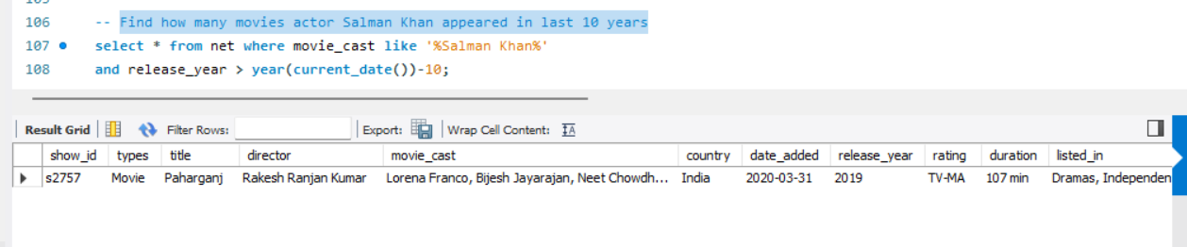
Find how many movies actor Salman Khan appeared in last 10 years

Slide 13
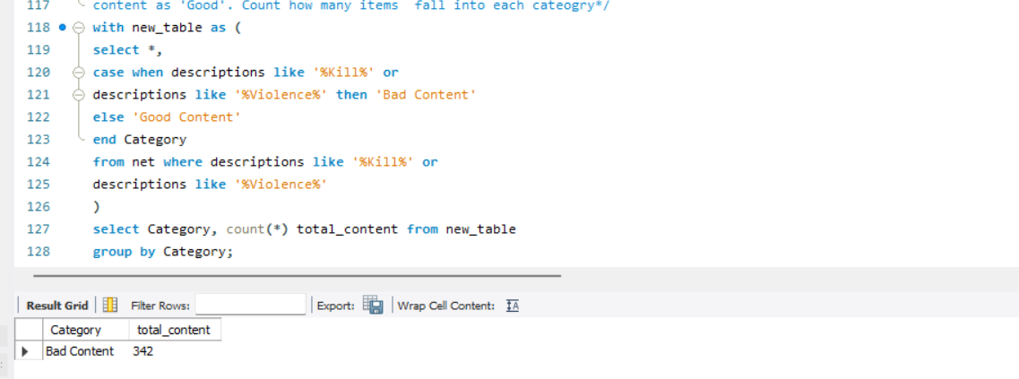
Categorize the content based on the presence of the keywords kill and violence in the description field. Label content containing these keywords as 'Bad' and all other content as 'Good'. Count how many items fall into each category

