Slide 1
Change the abreviations of item_fat_content
update blinkt
set Item_Fat_Content =
case when Item_Fat_Content in ('LF','low fat') then 'Low Fat'
when Item_Fat_Content = 'reg' then 'Regular'
else Item_Fat_Content
end;

Slide 2
KPI's Requirements
Total Sales
Average Sales
Number of items
Average ratings

Slide 3
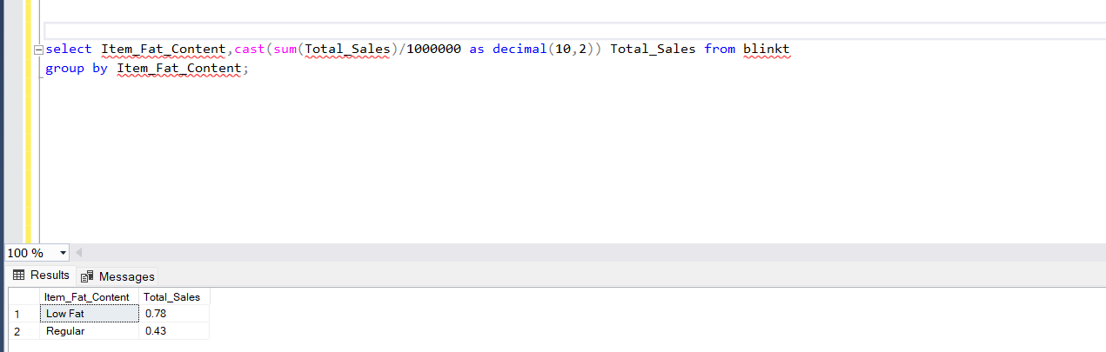

Slide 4
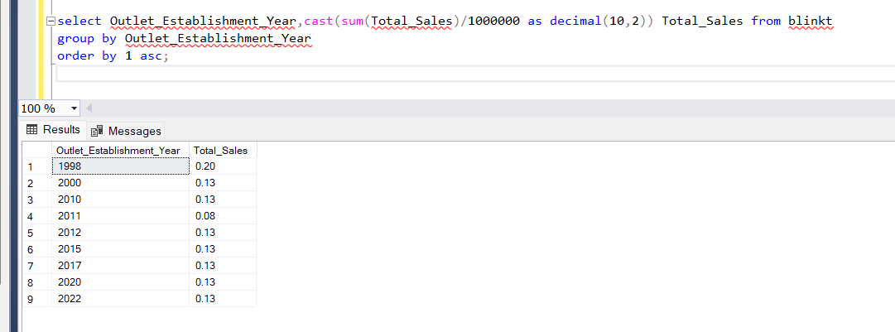

Slide 5
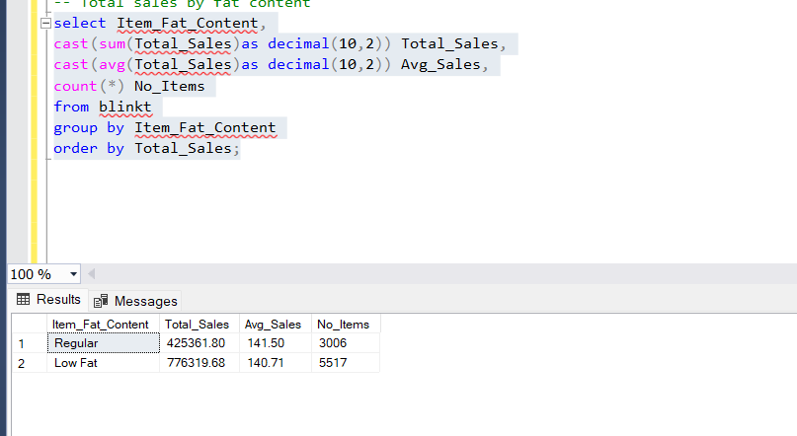
Granular Requirements
Total sales by fat content

Slide 6
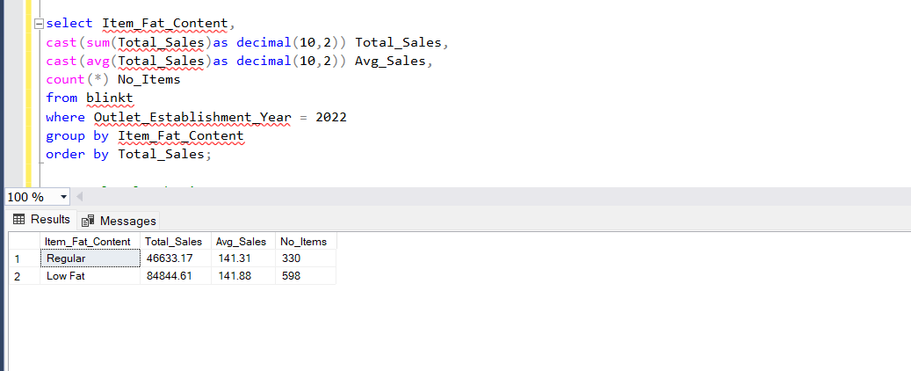
The above we need it for the outlet establishment year 2022

Slide 7
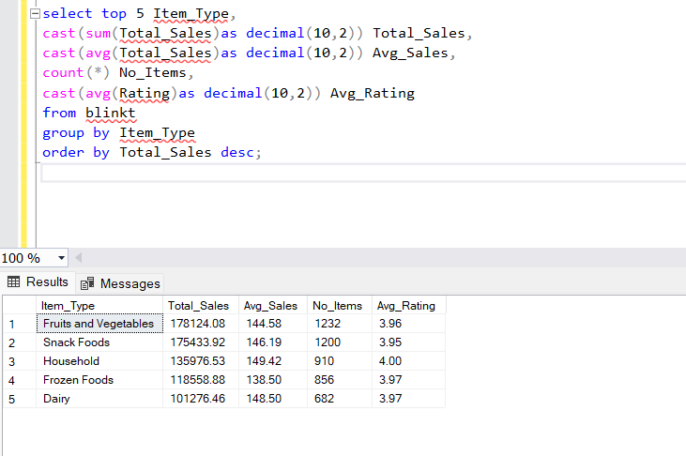
Top 5 items type

Slide 8
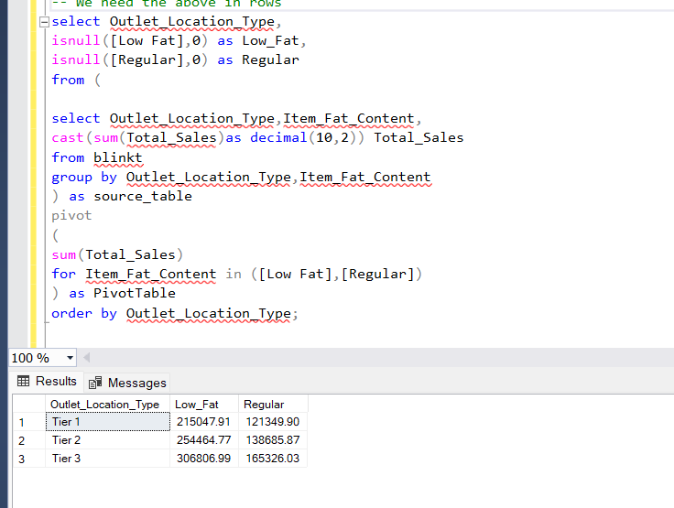

Slide 9
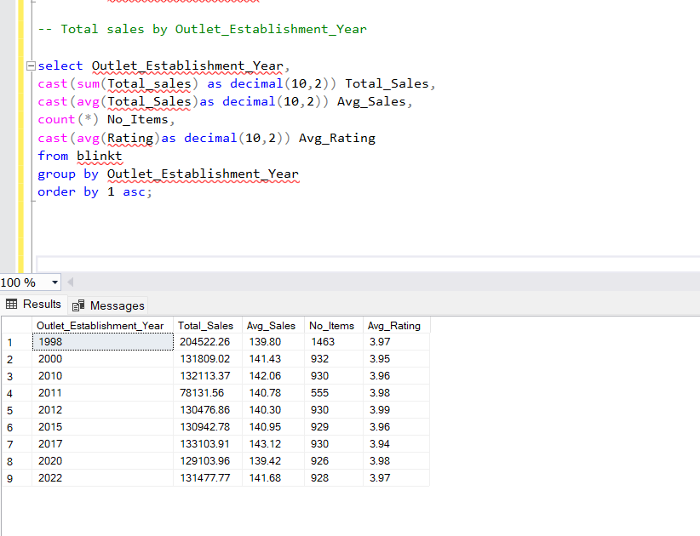

Slide 10
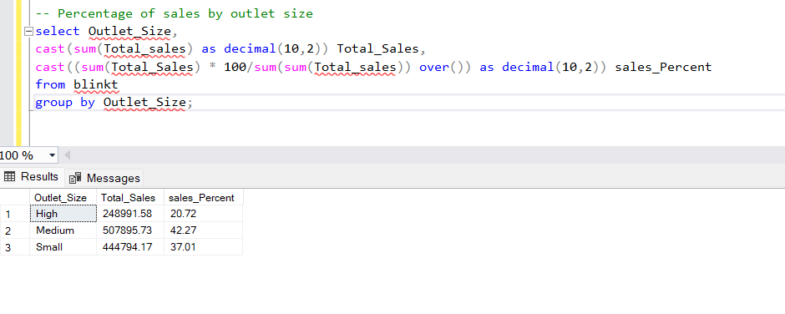

Slide 11
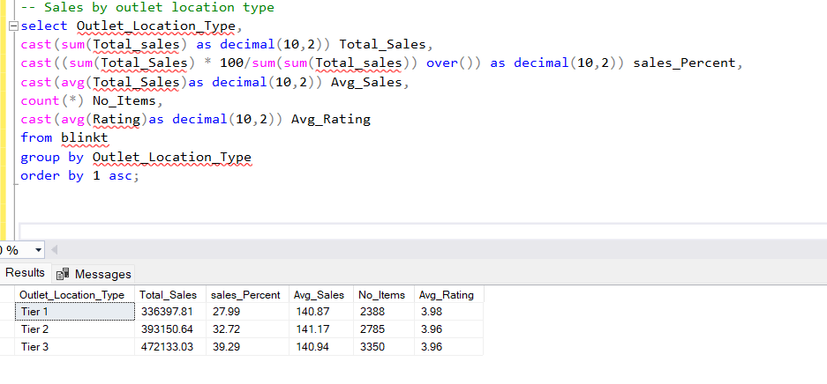

Slide 12
