Slide 1
Data Cleaning on World Layoffs

Slide 2
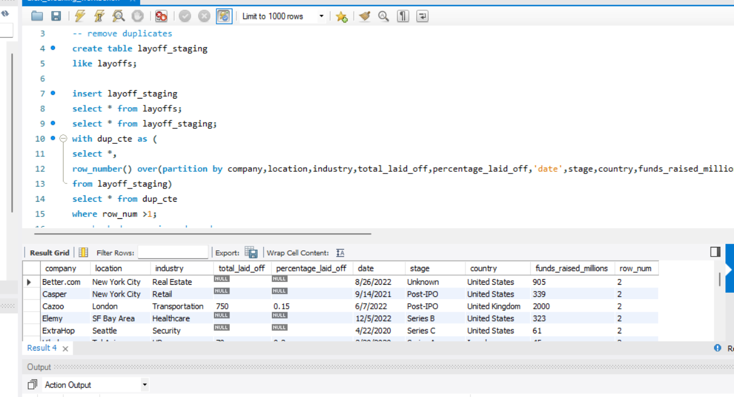
I created a duplicate table named layoff_staging and inserted the data from the original table layoffs

Slide 3
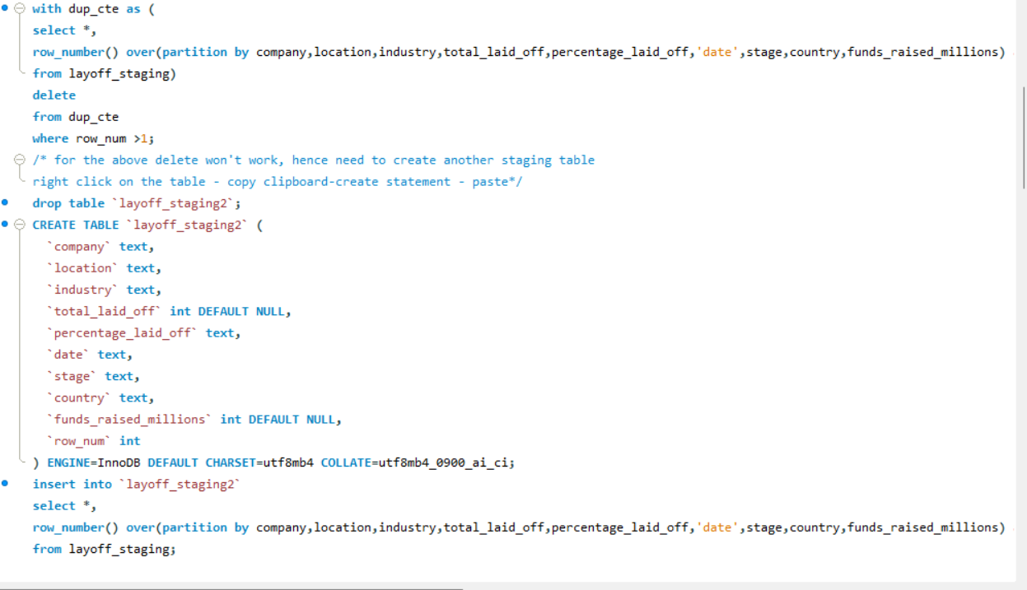

Slide 4
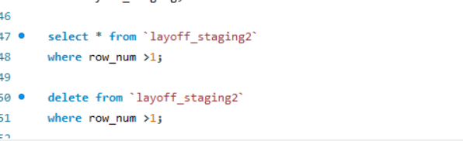
Using window function removed duplicates

Slide 5
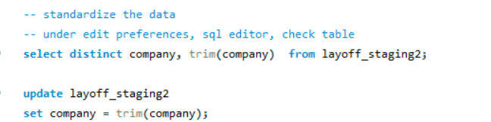
Standardized the data

Slide 6
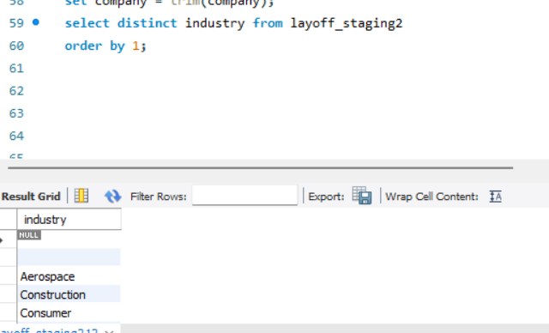
Standardized the data

Slide 7
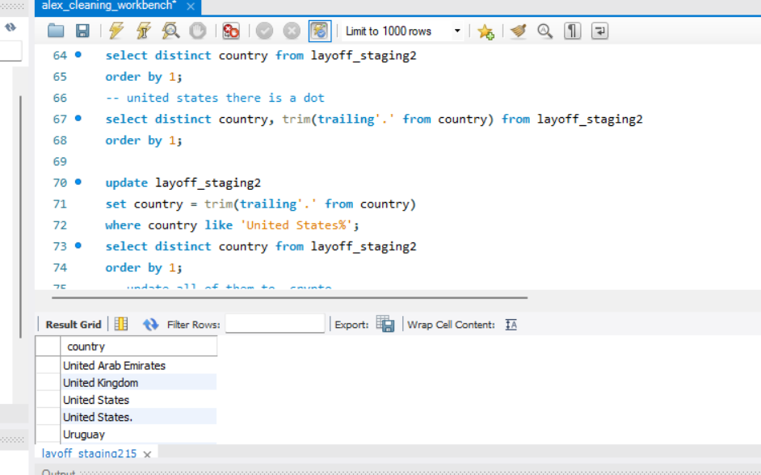
Standardized the data

Slide 8
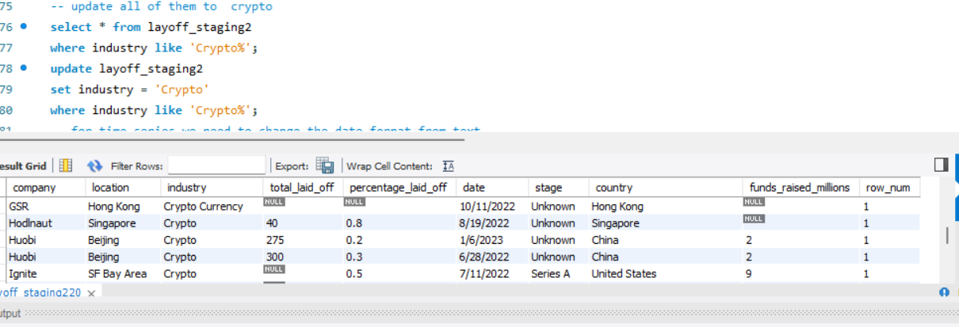
Standardized the data

Slide 9
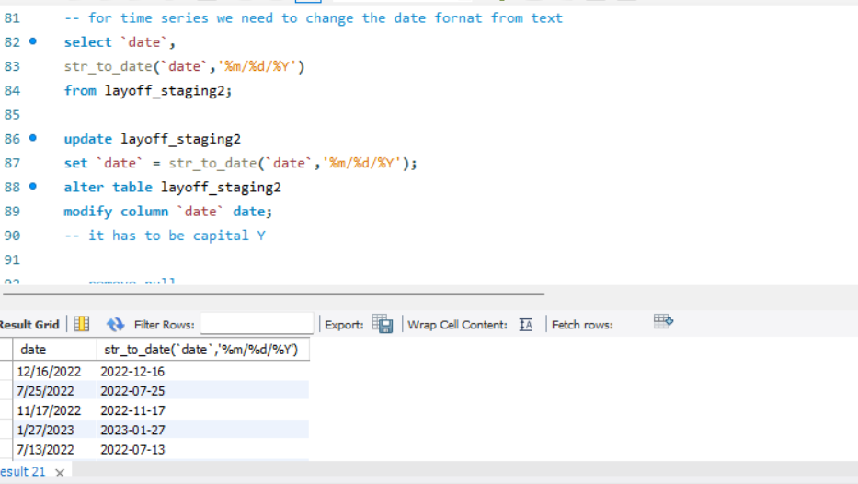
Changed the date format from text to date

Slide 10
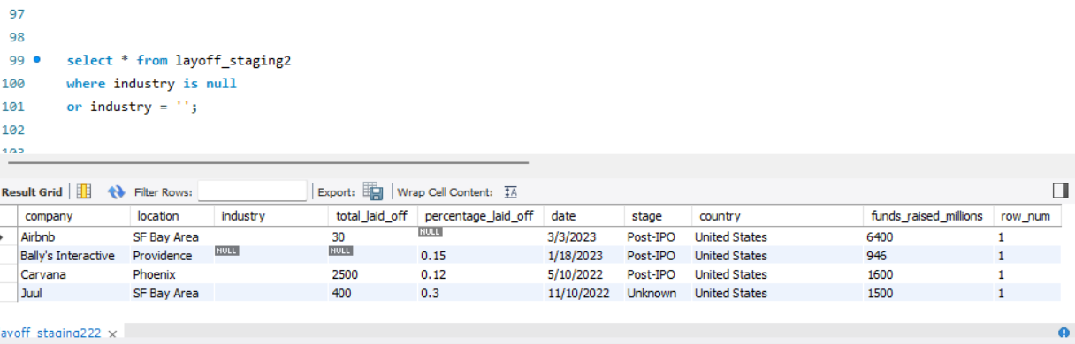
Removed Nulls

Slide 11
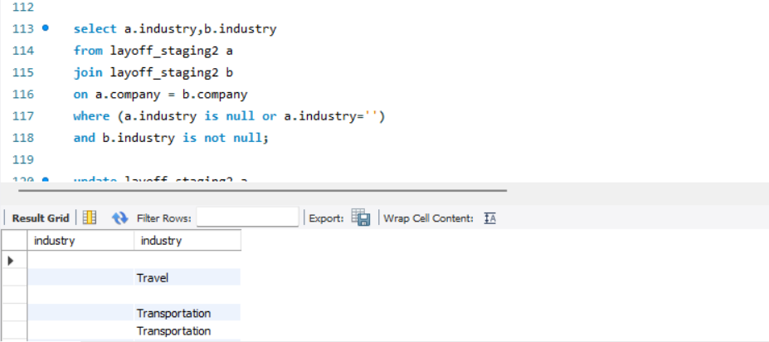
Removed Nulls

Slide 12
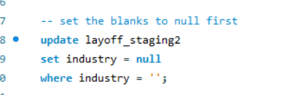
Removed Nulls

Slide 13
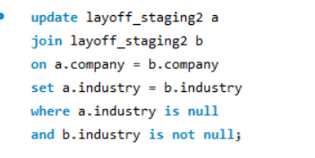
Removed Nulls

Slide 14
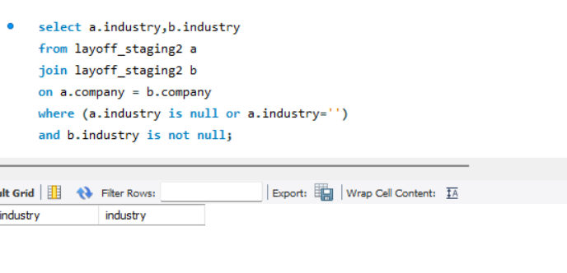

Slide 15
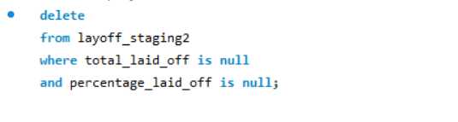

Slide 16
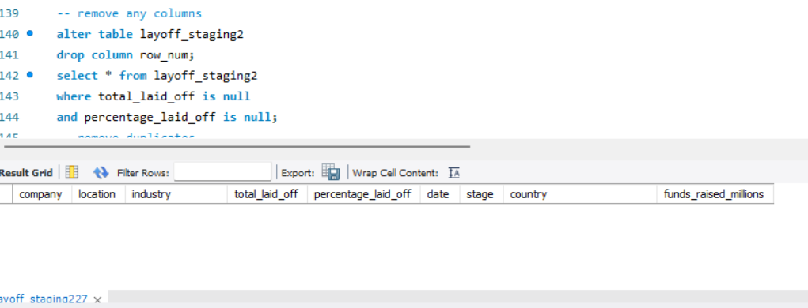
Remove any columns or rows

