Slide 1
NINJA Rockstars
PMPO: Subhadra ganti
TeaM Lead: Poornima Devasahayam
Nirupa Muthumani
Kalyani Kurakula
swarnameena

Slide 2
EXTRA FUNCTIONS
DATE FUNCTIONS
1. EXTRACT() - Extracts parts from a date.
2. DATE_PART() - Returns part of the date and time.
3. TO_DATE() - Converts string to a date.
4. CURRENT TIMESTAMP/NOW – Returns the current date and time with time zone. (TIMESTAMPZ)
5. AGE() - Returns the number of years/months/days/hours between two dates.
MATHEMATICAL FUNCTIONS
6. CEIL() - Returns a value rounded up to the next whole number.
7. FLOOR() - Returns a value rounded down to the nearest whole number.
8. ROUND() - Returns a number rounded to a certain number of decimal places.
CONDITIONAL EXPRESSIONS & OPERATORS
9. CASE - Uses IF-THEN-ELSE logic within a single statement.
10. CAST – To convert one data type into another.
11. IN – Used with the WHERE clause to check against a list of values.
SET OPERATIONS
12. UNION ALL – Combine the results of two SELECT statements.
Query Optimization
We used Joins for merging two or more tables.
We used IN to reduce the use of multiple OR statements.
Used Age() function to simplify age calculation.

Slide 3
EXTRA FUNCTIONS
CLAUSES
13. LIMIT – Constrains the number of rows.
14. OFFSET – Offset clause is used to skip specified number of rows.
15. PARTITION BY clause with OVER clause – divides the rows into groups.
TABLE FUNCTION
16. CROSSTAB() – Used to produce 'pivot' displays, where data is listed across rather than down.
17. CREATE EXTENSION - we need to install the table_func extension to enable Crosstab function.
STRING FUNCTION
18. SUBSTRING() - Extract a part of the string.
19. TO_CHAR() - Converts a number or date to a string.
20. CONCAT - To concatenate two or more strings.
21. REPLACE() - Replace existing string with a new one.
22. SPLIT_PART() - Split a string based on the specified delimiter.
WINDOW FUNCTION
23. PERCENT_RANK - Returns the relative rank of the current row.
Query Optimization
Used CTE s in place of Sub-queries, to avoid complexity in queries.
Used UNION ALL to avoid complex queries.

Slide 4
triggers
TRIGGER UPON INSERT COMMAND
Created Trigger & Trigger Function.
TRIGGER UPON UPDATE COMMAND
Created Trigger & Trigger Function.
TRIGGER UPON DELETE COMMAND
Created Trigger & Trigger Function.
Trigger – becomes active AFTER INSERTION.
Event_name : INSERT
Table Name: “Patients”
Trigger – becomes active AFTER UPDATION.
Event_name : UPDATE
Table Name: “AmbulatoryVisits”
Trigger – becomes active AFTER DELETION.
Event_name : DELETE
Table Name: “ReAdmissionRegistry”

Slide 5
FUNCTIONS USED IN EXTRA QUERIES
STRING MANIPULATION FUNCTION
OVERLAY() - Replaces a substring starting at the specified position and having the specified length.
WINDOW FUNCTION
DENSE_RANK() - Assigns a rank to every row in each partition of a result.
MATHEMATICAL FUNCTION
TRUNC() - To truncate a number to particular decimal place.
CONDITIONAL CLAUSE
FILTER – To filter aggregations outside of WHERE clause.
JOINS/GROUP BY &HAVING CLAUSE
24.
25.
26.
27.
Used CASE statements & OVERLAY() to display the patient names as Mr. & Ms., according to Gender.
Used CTE & Dense_Rank() to segregate the Transferred patients based on their diagnosis and ranked them.
Used TRUNC & CAST to get the MAX LOS and the category of Primary Diagnosis it belonged to.
Used FILTER clause to find out which Department had more death rate.
Mortality Distribution in ICU based on Primary Diagniosis.

Slide 6
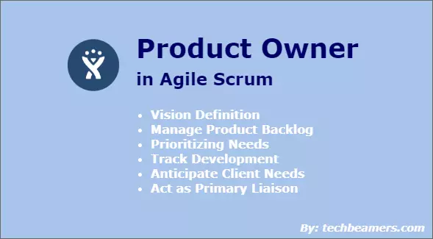
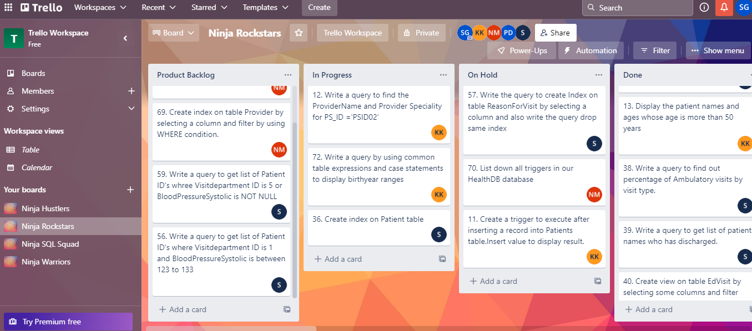
AGILE METHODOLOGY
DAILY STAND-UP CALLS – UPDATES & PROGRESS
TRELLO BOARD – TRACKING OUR WORK
DAILY MEETINGS WITH TEAM MEMBERS
SLACK - COMMUNICATION

Slide 7
THANK YOU!

