Slide 1
PRESENTATION ON THE SYNOPSIS OF dual axis rotating solar panel
UNDER THE GUIDANCE OF:
MR. SANJAY YADAV
GROUP NAME:-
INDRAJEET KUMAR
RAMKRIT CHAUHAN
PUSHPENDRA KUMAR
RAHUL KUMAR

Slide 2
CONTENTS
INTRODUCTION
MARKET SOLUTION
COMPONENTS
SOFTWARE & HARDWARE
APPLICATION
FUTURE ENHANCEMENT

Slide 3
INTRODUCTION
Solar panels are used to convert the light energy to electrical energy
Efficient solar power generation system using moving panel is efficient power generating system using sun light
Two sensors in two directions to sense the direction of max intensity of light
The difference b/w the output of the sensors is given to the microcontroller unit

Slide 4
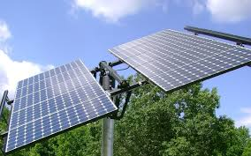

Slide 5
COMPONENTS
Microcontroller
555 timer
Stepper motor
Lead acid battery
LCD
Solar panel
L293D IC
Voltages regulator

Slide 6
SOFTWARE /HARDWARE
Microcontroller kit
Keil micro vision integrated development environment
C51 C compiler,A51 Assembler
BASCOM (AVR)
PROTEUS

Slide 7
APPLICATION
Heating the water
Electric fence
Battery charger
Emergency battery backup
Solar cooker

Slide 8
THANKING YOU

