Slide 1
File Organizer
Operating Systems Project | Concept: File System
Team Members
Indrajeet
Hemant Jangid
Aditya Tiwari
Nishu

Slide 2
About the Project
Item | Details
Project name | File Organizer
Subject | Operating Systems
OS concept | File System
Learning outcome | Learn file handling
Topics studied | 8 project ideas in the File System area
Selected topic | File System Explorer: A Visual File Management System
Team members | Indrajeet, Hemant Jangid, Aditya Tiwari, Nishu
File Organizer
2
Notes:
Introduce the project name, the concept, and the team.

Slide 3
What is a File Organizer?
Definition
A File Organizer is a system or program that arranges files and folders in a proper order so that they are easy to find and use. It does this by sorting, grouping, moving, renaming or deleting files. In an operating system it works with the file system, which is the part of the OS that stores and manages files on the disk.
Why it is needed
Files pile up over time. Without proper organization it is hard to find a file, storage is wasted and important files can get lost.
Real life example
A cupboard with labelled shelves for clothes, books and documents. A phone gallery that groups photos, videos and screenshots into albums.
3
Notes:
Say the definition in your own words and give the cupboard example.

Slide 4
The 8 Topics at a Glance
No. | Topic | What it does | OS concept
1 | File System Explorer | Browse and manage files and folders in a tree | Directory structure and inode
2 | Auto File Organizer | Sorts files into folders by extension | File handling and file extension
3 | Recycle Bin Simulator | Delete moves a file to a bin | Soft delete and permanent delete
4 | Duplicate File Finder | Finds files with the same content | Hashing
5 | File Allocation Simulator | Shows how files are placed on disk blocks | File allocation methods
6 | File Permission Manager | Controls who can read, write, execute | Access control and permissions
7 | Disk Space Analyzer | Shows which folders use most space | Disk usage
8 | Mini File System (shell) | Command line to manage files | Shell and system calls
4
Notes:
Quick table. Each topic is explained on the next slides.

Slide 5
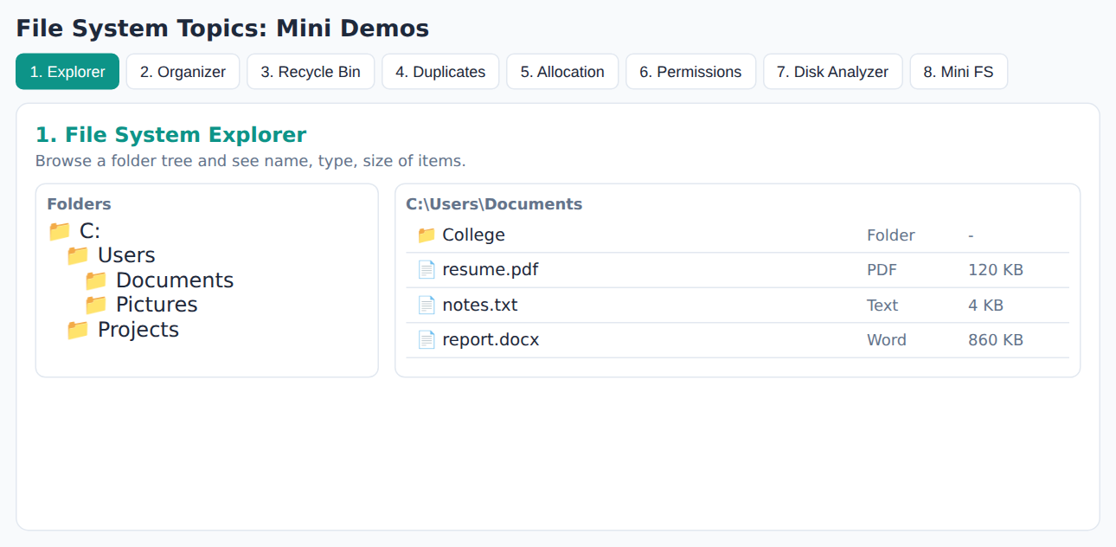
1. File System Explorer
Definition
A program that lets the user view and manage files and folders in a tree structure. The user can create, rename, delete, search and see the details of each item.
OS concept: Directory structure and inode
A directory is a special file that stores the names of other files. An inode (index node) stores information about a file such as its size, time and the disk blocks it uses.
Real life example
Windows File Explorer, or the Files app on a phone.
How it works
Folders and files are stored as a tree.
Each operation updates the tree.
A disk grid shows which blocks are used.
An inode panel shows file details.
5
Notes:
Explain the definition, the OS concept, and the real life example. Then show the screenshot.

Slide 6
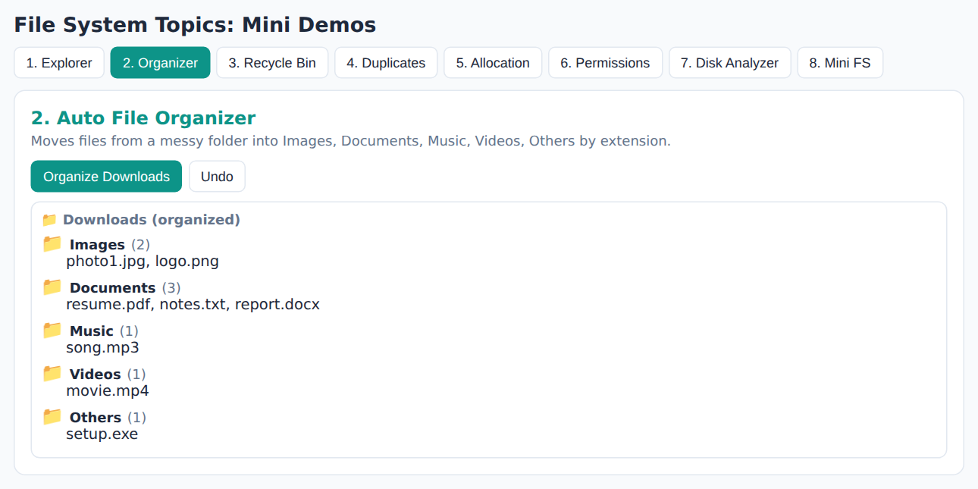
2. Auto File Organizer
Definition
A program that scans a folder and automatically moves each file into a suitable subfolder, for example by file type.
OS concept: File handling and file extension
File handling means creating, reading, writing, moving and deleting files through the OS. A file extension (like .pdf or .jpg) is the part after the dot that tells the OS the type of the file.
Real life example
Phone gallery grouping photos, videos and screenshots into albums.
How it works
Read all file names in a folder.
Find the extension of each file.
Create the target folder if missing.
Move the file into that folder.
6
Notes:
Explain the definition, the OS concept, and the real life example. Then show the screenshot.

Slide 7
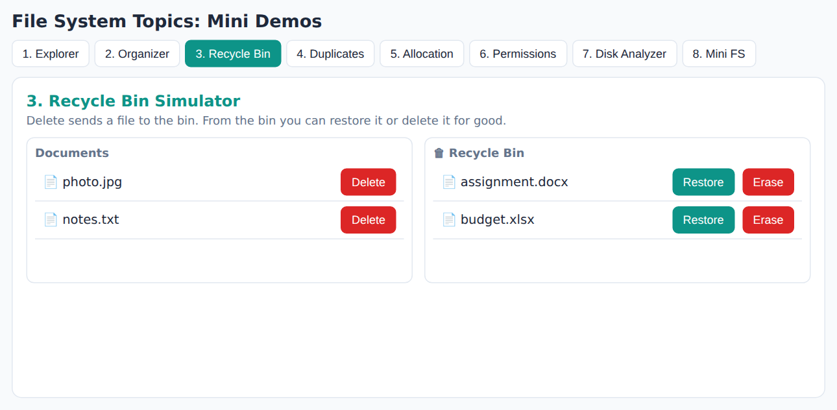
3. Recycle Bin Simulator
Definition
A tool that moves a file to a temporary bin when it is deleted, so that it can be restored later if needed.
OS concept: Soft delete and permanent delete
Soft delete only marks or moves the file, the data stays on the disk. Permanent delete frees the disk blocks of the file so that the space can be used again.
Real life example
Recycle Bin in Windows, or the Recently Deleted album on a phone.
How it works
Delete moves the file to a bin list.
The original location is remembered.
Restore puts the file back.
Erase removes it for good.
7
Notes:
Explain the definition, the OS concept, and the real life example. Then show the screenshot.

Slide 8
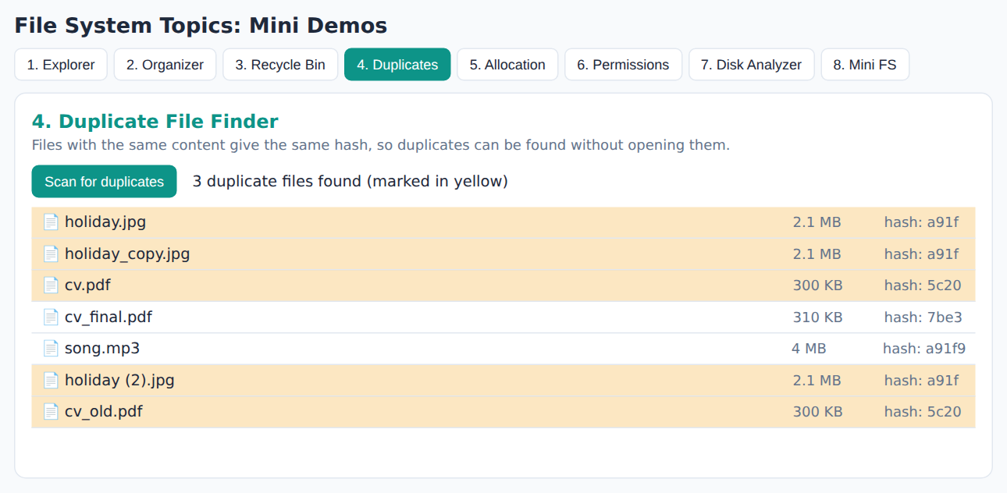
4. Duplicate File Finder
Definition
A tool that finds files having identical content, even if their names are different, so that extra copies can be removed to save space.
OS concept: Hashing
A hash function converts the content of a file into a short fixed value (like MD5 or SHA-256). Files with the same content give the same hash, so they can be compared using hash values instead of every byte.
Real life example
The same photo downloaded twice on a phone and using double storage.
How it works
Read each file and compute its hash.
Same hash means same content.
Group files by hash value.
Show groups having 2 or more files.
8
Notes:
Explain the definition, the OS concept, and the real life example. Then show the screenshot.

Slide 9
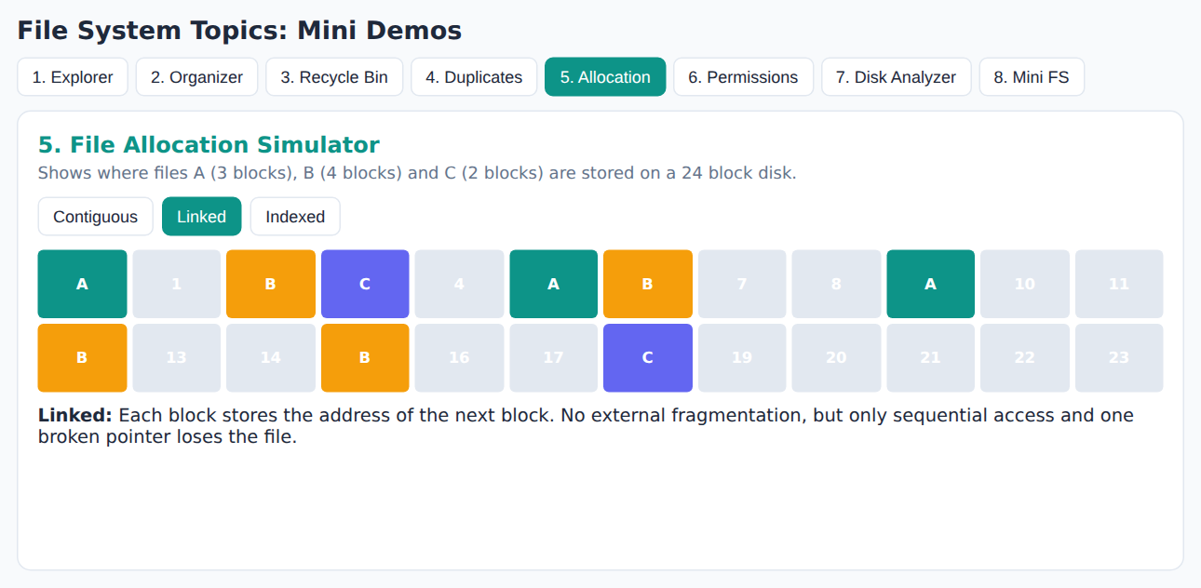
5. File Allocation Simulator
Definition
A tool that shows how an operating system places the blocks of a file on the disk using different allocation methods.
OS concept: File allocation methods
Contiguous: blocks are stored side by side. Linked: each block points to the next one. Indexed: one index block lists all the blocks. Fragmentation means free space broken into small unusable pieces.
Real life example
Books of one series kept together on a shelf (contiguous), a treasure hunt where each clue points to the next (linked), a library catalogue (indexed).
How it works
The disk is an array of blocks.
Each method places files differently.
Compare speed and fragmentation.
9
Notes:
Explain the definition, the OS concept, and the real life example. Then show the screenshot.

Slide 10
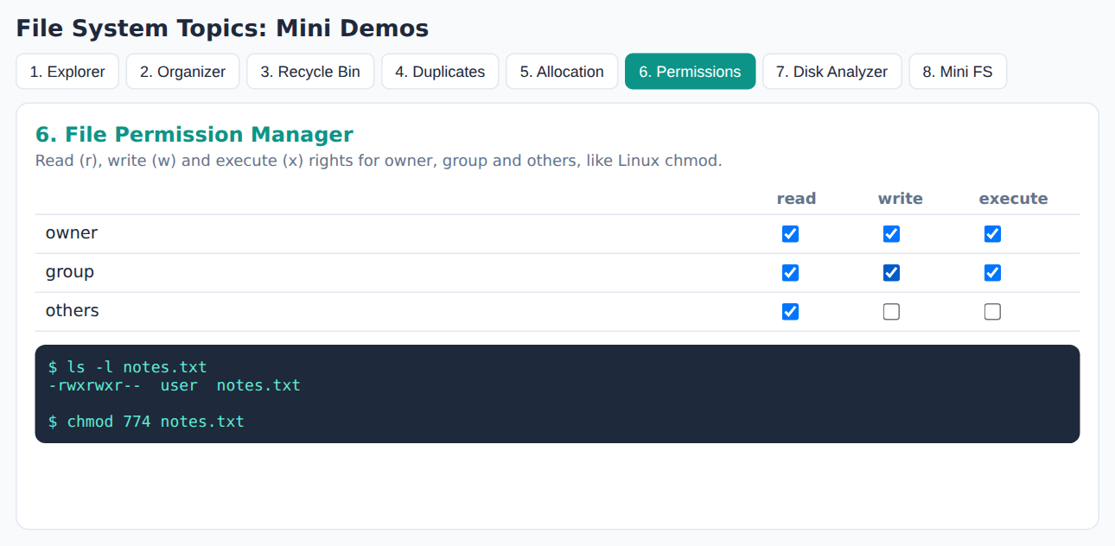
6. File Permission Manager
Definition
A tool that decides which users can read, write or run a file, so that files are protected from wrong use.
OS concept: Access control and permissions
Permissions are rules that decide what a user can do with a file. In Linux they are r (read), w (write) and x (execute) for owner, group and others, set using the chmod command.
Real life example
Google Docs sharing: viewer, commenter and editor.
How it works
9 bits: 3 each for owner, group, others.
r = 4, w = 2, x = 1.
Add them to get the chmod number.
Example: rwxr-xr-- is 754.
10
Notes:
Explain the definition, the OS concept, and the real life example. Then show the screenshot.

Slide 11
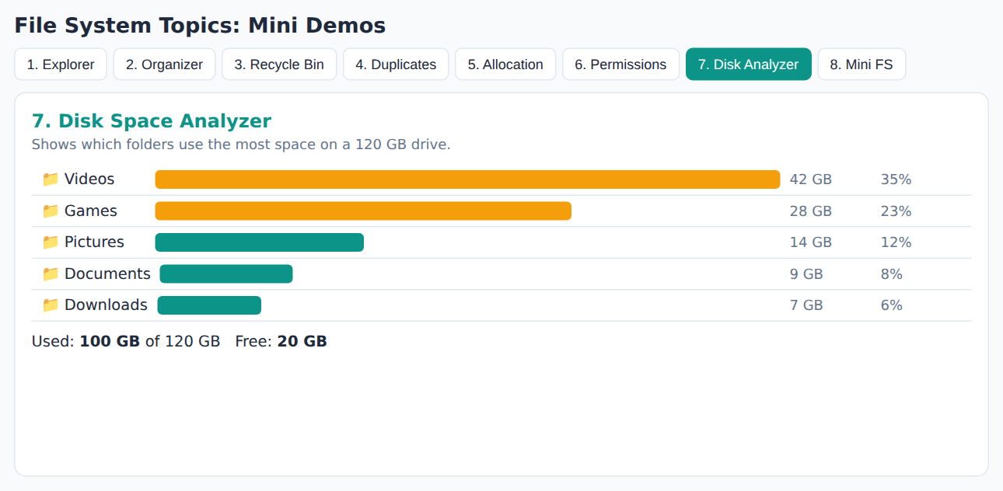
7. Disk Space Analyzer
Definition
A tool that shows how much space each folder and file uses, to find out what is filling the disk.
OS concept: Disk usage
Disk usage is the amount of storage used by files and folders. The OS finds the size of a folder by adding the sizes of everything inside it, again and again for each sub folder (the du command in Linux).
Real life example
Storage settings on a phone showing photos, apps and videos.
How it works
Go through every folder one by one.
Add up the size of all files.
Draw bars and percentages.
Highlight the biggest folders.
File Organizer
11
Notes:
Explain the definition, the OS concept, and the real life example. Then show the screenshot.

Slide 12
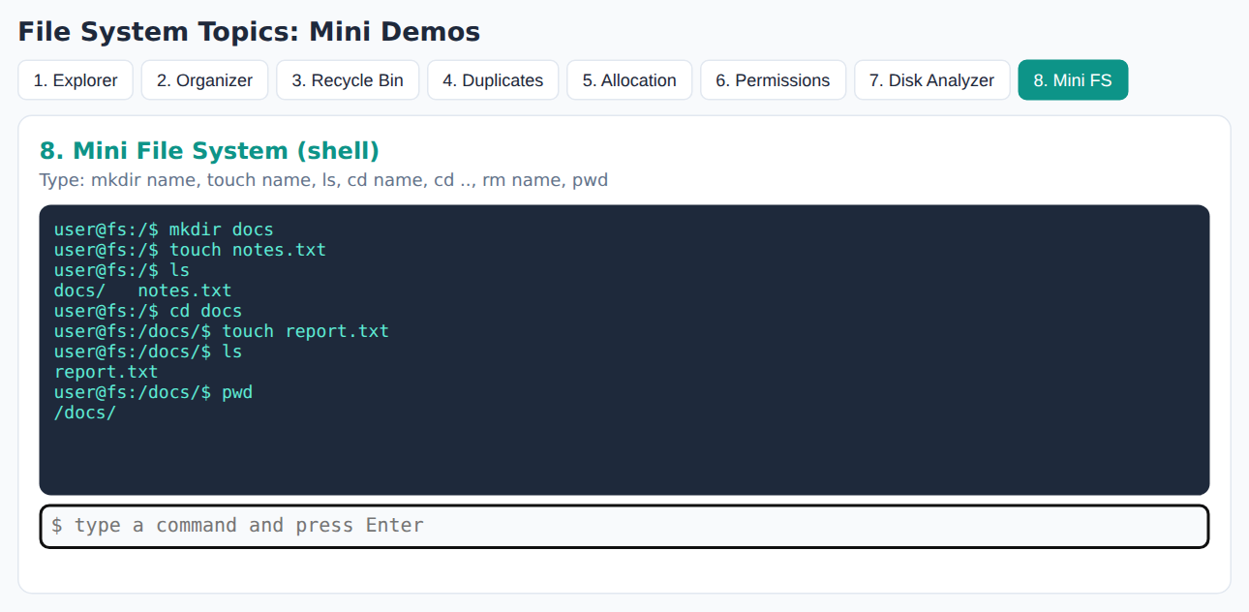
8. Mini File System (shell)
Definition
A small command line program where the user types commands like mkdir, ls and cd to manage files in a virtual file system.
OS concept: Shell and system calls
A shell is a program that takes commands from the user and passes them to the OS. A system call is the way a program asks the OS kernel for a service, such as creating a file.
Real life example
Command Prompt in Windows or Terminal in Linux.
How it works
Read the command typed by the user.
Split it into command and name.
Update the folders and files stored.
Print the result on screen.
12
Notes:
Explain the definition, the OS concept, and the real life example. Then show the screenshot.

Slide 13
Our Selected Topic: File System Explorer
Definition
File System Explorer is a software tool that lets a user browse and manage the files and folders of a file system in a tree structure. The user can create, open, edit, rename, delete and search files, and can also see the details of every item such as name, type, size and path.
Our approach
The file system is simulated in memory, so no real file of the computer is changed. The project also shows how the disk blocks are used and what an inode contains.
Real life example
Windows File Explorer, the Files app on a phone, and Finder on a Mac.
Objectives
Understand how files and directories are stored
Perform create, rename, delete, search
Visualise disk block allocation
Show internal data such as inode
Make file system concepts easy to explain
File Organizer
13
Notes:
This is our project. Read the definition slowly.

Slide 14
Key Terms and Definitions
Term | Definition | Example
File | A named collection of related data stored on a disk | notes.txt
Directory (folder) | A special file that holds the list of other files and folders | Documents
Root directory | The top most directory from which all other directories start | /
Path | The address that shows the route to a file from the root | /Documents/notes.txt
inode | A structure that stores information about a file such as size, time and disk blocks (not the name) | inode of notes.txt
Disk block | A fixed size unit of storage on the disk; a file uses one or more blocks | 1 block = 20 characters
Metadata | Data about data, such as name, size and dates | File properties
File Organizer
14
Notes:
Learn these terms. Teachers usually ask them in viva.

Slide 15
How the Project Works
Workflow
Operation | System call
Create folder | mkdir()
Create file | creat() / open()
Edit file | write()
Read file | read()
Rename | rename()
Delete file | unlink()
Delete folder | rmdir()
Start with an empty root folder "/"
User creates a folder or a file
Name is checked for duplicates
Free disk blocks are found and given to the file
The node is added to the tree
Screen shows the tree, disk grid and inode
15
Notes:
Explain the steps in order. Then the table of system calls.

Slide 16
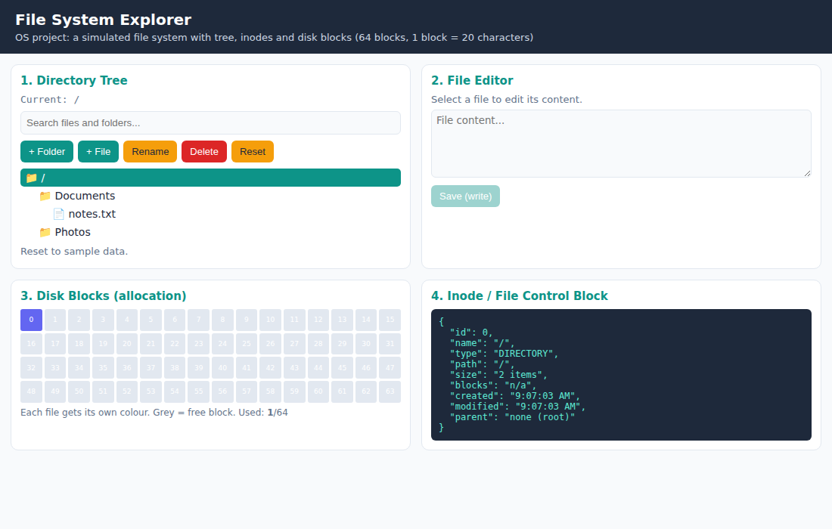
Output: Main Screen
Directory tree with Documents and Photos.
Search box above the tree.
Disk grid shows blocks used by notes.txt.
Inode panel shows details of the selected item.
16
Notes:
Explain the screen in your own words.

Slide 17
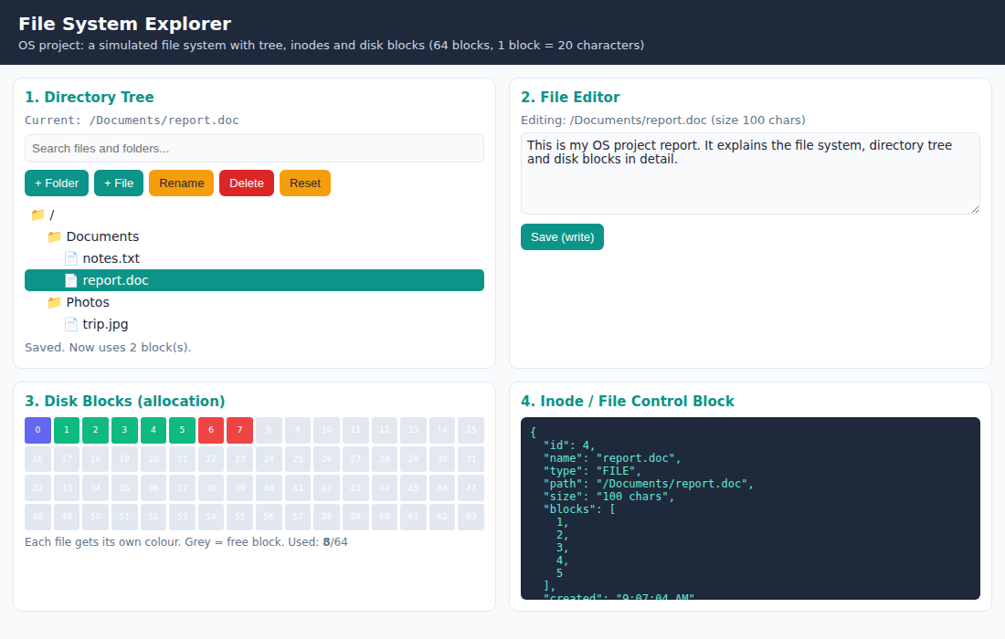
Output: Creating and Saving Files
report.doc and trip.jpg are created.
Longer content needs more blocks.
Each file has its own colour in the grid.
Inode lists the exact block numbers.
17
Notes:
Explain the screen in your own words.

Slide 18
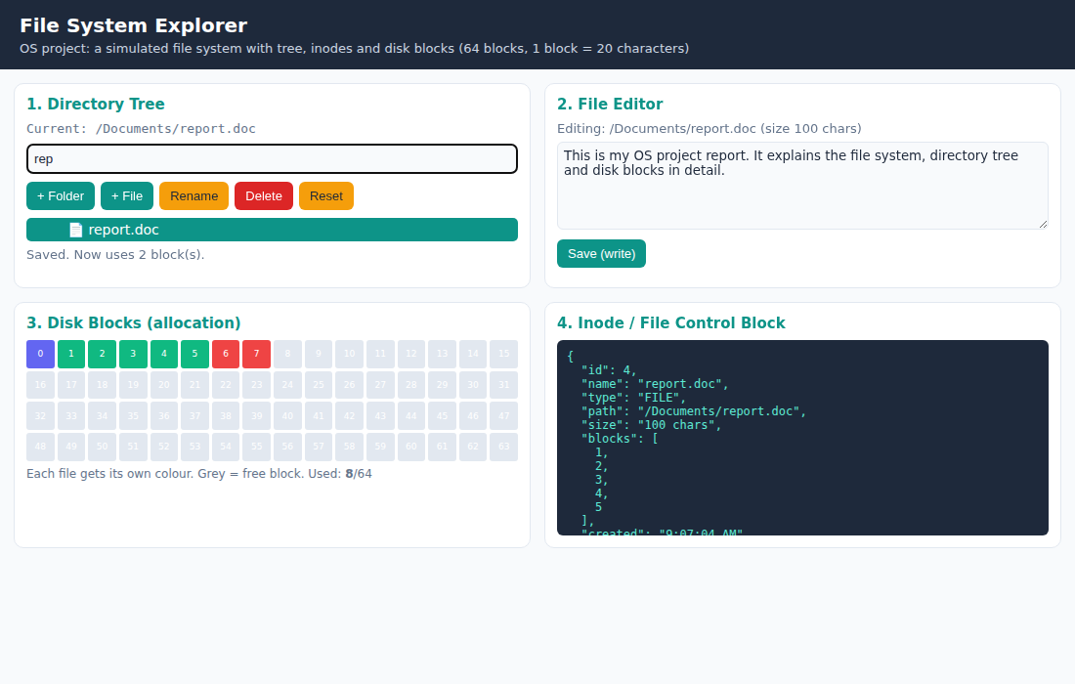
Output: Search
Typing "rep" in the search box.
Only matching files and folders are shown.
Useful when there are many files.
18
Notes:
Explain the screen in your own words.

Slide 19
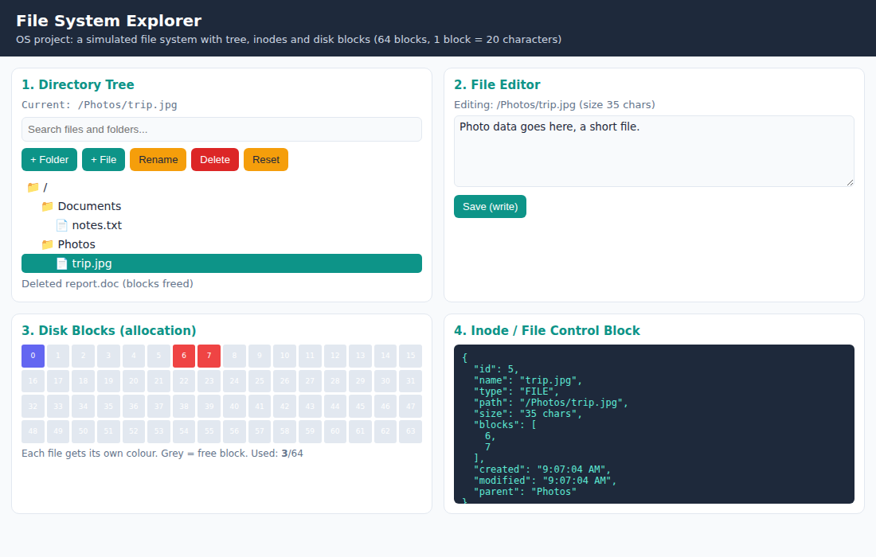
Output: After Deleting a File
report.doc is deleted.
Its blocks are grey again, so they are free.
Only the other files still use blocks.
File Organizer
19
Notes:
Explain the screen in your own words.

Slide 20
Conclusion
File Organizer topics help us learn how an OS handles files.
We studied 8 ideas: Explorer, Organizer, Recycle Bin, Duplicate Finder, Allocation, Permissions, Disk Analyzer and Mini File System.
We selected File System Explorer and built a working simulator for it.
It shows directories, inodes and disk blocks in a simple visual way.
File Organizer
20

Slide 21
Thank You
Questions?
Indrajeet | Hemant Jangid | Aditya Tiwari | Nishu

