Slide 1
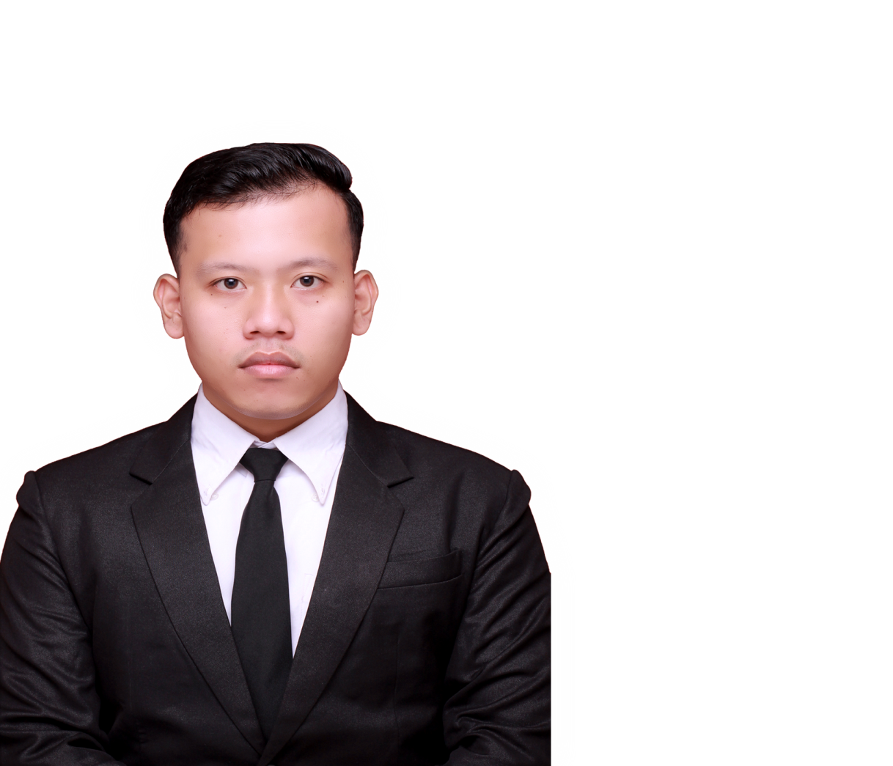

Agenda
Company Overview
Product and Services
Achievements
Short Video
Question Session
Conclusion
Question Ses…
Company Over...
Conclusion
Product and S…
Achievements
Short Video
Indra Alfendi Purba, ST
Bukalapak Ambassador
Notes:
https://pixabay.com/en/entrepreneur-startup-start-up-man-593358/

Slide 2


Company Overview
Agenda
Company Overview
Product and Services
Achievements
Short Video
Question Session
Conclusion
PT Bukalapak.com
Question Ses…
Company Over...
Product and S…
Conclusion
Achievements
Short Video
Ecommerce (Electronic Commerce)
[January 2010 – Now]
Plaza City View
No. 22, East Kemang Street,
Sunday Market
West Pejaten
Jakarta, Indonesian 12510
Indra Alfendi Purba, ST
Ambasador of Bukalapak
Notes:
https://pixabay.com/en/entrepreneur-startup-start-up-man-593358/

Slide 3

Company Overview
Agenda
Company Overview
Product and Services
Achiements
Short Video
Question Session
Conclusion
Achmad Zaky
Question Ses…
Company Over...
Product and S…
Conclusion
Achievements
Short Video
(Founder and CEO)
Vision :
“Become the number 1 online
Marketplace in Indonesian.”
Mission :
“Empowering all Small and Medium-sized
Enterprises (SME) in all parts of Indonesian”
Indra Alfendi Purba, ST
Ambasador of Bukalapak
Notes:
https://pixabay.com/en/entrepreneur-startup-start-up-man-593358/

Slide 4

Product and Services
Platform
Agenda
Based on Android and iOS
Sent / Chat Message
Company Overview
Product and Services
Achiements
Short Video
Question Session
Conclusion
Communication with each other between Users, both Seller and Buyer
Payment System
Bank Transfer, Credit Card Installments, Virtual Account Non-Credit Card Installments, etc
Achmad Zaky
Question Ses…
Company Over...
Product and S…
Conclusion
Achievements
Short Video
Delivery
Expedition
Ninja Xpress, TIKI, J&T, Go-Send, Pos Indonesia, etc
(Founder and CEO)
Vision :
“Become the number 1 online
Marketplace in Indonesian.”
Mission :
“Empowering all Small and Medium-sized
Enterprises (SME) in all parts of Indonesian”
Buka
Bantuan
24 hours live support
Indra Alfendi Purba, ST
Balance
BukaDompet and Dana
Ambasador of Bukalapak
Notes:
https://pixabay.com/en/entrepreneur-startup-start-up-man-593358/

Slide 5

Product and Services
Agenda
Platform
Based on Android
Company Overview
Product and Services
Achiements
Short Video
Question Session
Conclusion
Access
Provider
Purchase physical goods, virtual products, tickets, and wholesale goods
Payment System
Bank Transfer, Credit Card Installments, Virtual Account Non-Credit Card Installments, etc
Question Ses…
Company Over...
Product and S…
Conclusion
Achievements
Short Video
Buka
Bantuan
24 hours live support
Balance
BukaDompet and Dana
Indra Alfendi Purba, ST
Ambasador of Bukalapak
Notes:
https://pixabay.com/en/entrepreneur-startup-start-up-man-593358/

Slide 6

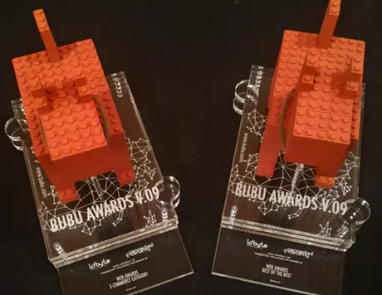


Achievements
Agenda
Platform
Based on Android
Company Overview
Product and Services
Achiements
Short Video
Question Session
Conclusion
Access
Provider
Purchase physical goods, virtual products, tickets, and wholesale goods
Majalah Selular
Majalah Warta
Ekonomi
Top 5 Corporate Reputation In
E-Commerce Sector
Payment System
Best E-Commerce 2016
Bank Transfer, Credit Card Installments, Virtual Account Non-Credit Card Installments, etc
Question Ses…
Company Over...
Achievements
Conclusion
Product and S…
Short Video
Bubu
Arwards
Tangrams Awards
Buka
Bantuan
24 hours live support
Best of the best
E-commerce Asia Pacific
Balance
BukaDompet and Dana
Indra Alfendi Purba, ST
Ambasador of Bukalapak
October
2015
2016
2017
January
2018
Notes:
https://pixabay.com/en/entrepreneur-startup-start-up-man-593358/

Slide 7

Short Video
Agenda
Company Overview
Product and Services
Achiements
Short Video
Question Session
Conclusion
Majalah Selular
Majalah Warta
Ekonomi
Question Ses…
Company Over...
Achievements
Conclusion
Short Video
Product and S…
Bubu
Arwards
Tangrams Awards
Indra Alfendi Purba, ST
Ambasador of Bukalapak
October
2015
2016
2017
January
2018
Notes:
https://pixabay.com/en/entrepreneur-startup-start-up-man-593358/

Slide 8

Question Session
Agenda
Company Overview
Product and Services
Achiements
Short Video
Question Session
Conclusion
Company Over...
Achievements
Conclusion
Short Video
Product and S…
Question Ses…
Indra Alfendi Purba, ST
Ambasador of Bukalapak
Notes:
https://pixabay.com/en/entrepreneur-startup-start-up-man-593358/

Slide 9
Conclusion
Agenda
Company Overview
Product and Services
Achiements
Short Video
Question Session
Conclusion
“We are not only care about the progress of our company, but also care about the comfort and loyalty of our employees”
Company Over...
Achievements
Short Video
Product and S…
Question Ses…
Conclusion
Indra Alfendi Purba, ST
Ambasador of Bukalapak
Notes:
https://pixabay.com/en/entrepreneur-startup-start-up-man-593358/

