Slide 1
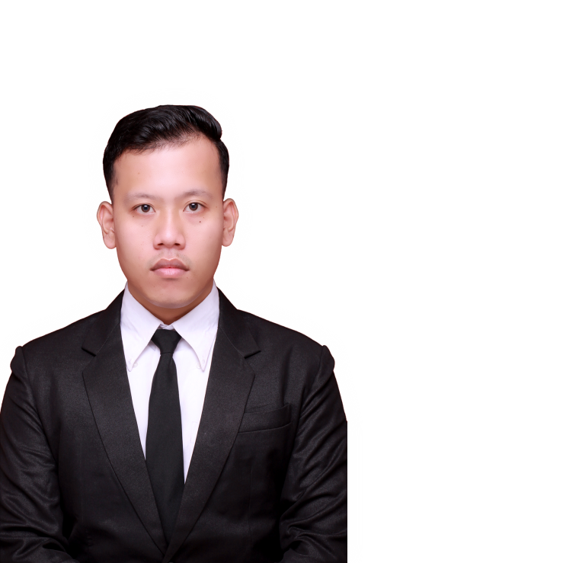

INDRA ALFENDI PURBA, ST
Advertiser

Slide 2

PT Bukalapak.com
Agenda
Agenda
Company
Information
About Company
Positioning
Company Information
Product
Description
About Product
Positioning
Product Description
Benefits
Successes
Benefits
Successes
Question and
Answer Session
Discussion
Closing
Argument
Question and answer session

Slide 3
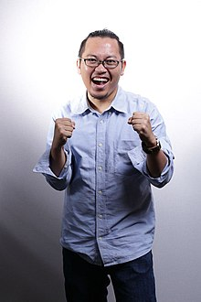
PT Bukalapak.com
Agenda
Company Information
Company
Information
Profile of Establishment
Positioning
Founded (Achmad Zaky)
Launched (January 2010)
Product
Description
Vision :
“Become the number 1 online
Marketplace in Indonesian.”
Mission :
“Empowering all Small and Medium-sized
Enterprises (SME) in all parts of Indonesian”
Benefits
Successes
Question and
Answer Session
Closing
Argument

Slide 4

PT Bukalapak.com
Agenda
Company Information
Company
Information
Profile of type
Positioning
E-commerce
Product
Description
www.bukalapak.com
Benefits
Successes
Question and
Answer Session
Closing
Argument

Slide 5
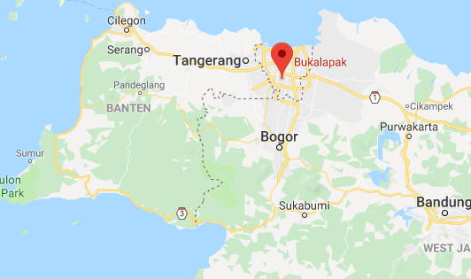
PT Bukalapak.com
Agenda
Company Information
Company
Information
Profile of Location
Positioning
Product
Description
Plaza City View
No. 22, East Kemang Street,
Sunday Market
West Pejaten
Jakarta, Indonesian 12510
Benefits
Successes
Question and
Answer Session
Closing
Argument

Slide 6
PT Bukalapak.com
Agenda
Company Information
Company
Information
Awards
Positioning
Product
Description
Achmad Bakrie Anward XVI 2018 – Technology and Entrepreneurship
YouTube Pulse 2018 – Best Ads – Nego Cincai
Citra Pariwara 2017 – Bronze – Digital Viral and Email Marketing
Tangrams Awards – E-commerce Asia Pasific
etc.
Benefits
Successes
Question and
Answer Session
Closing
Argument

Slide 7
PT Bukalapak.com
Agenda
Positioning
Company
Information
Little capital
Easy and safe transactions
Bonus points
More promotion voucher
Positioning
Product
Description
Benefits
Successes
Question and
Answer Session
Closing
Argument

Slide 8

PT Bukalapak.com
Agenda
Product Description
Company
Information
Name of product
Positioning
“Mitra Bukalapak”
Product
Description
About of product
Benefits
Kind of product : Software of application
Released : October 2018
Created for : Agent of store
Successes
Question and
Answer Session
Closing
Argument

Slide 9
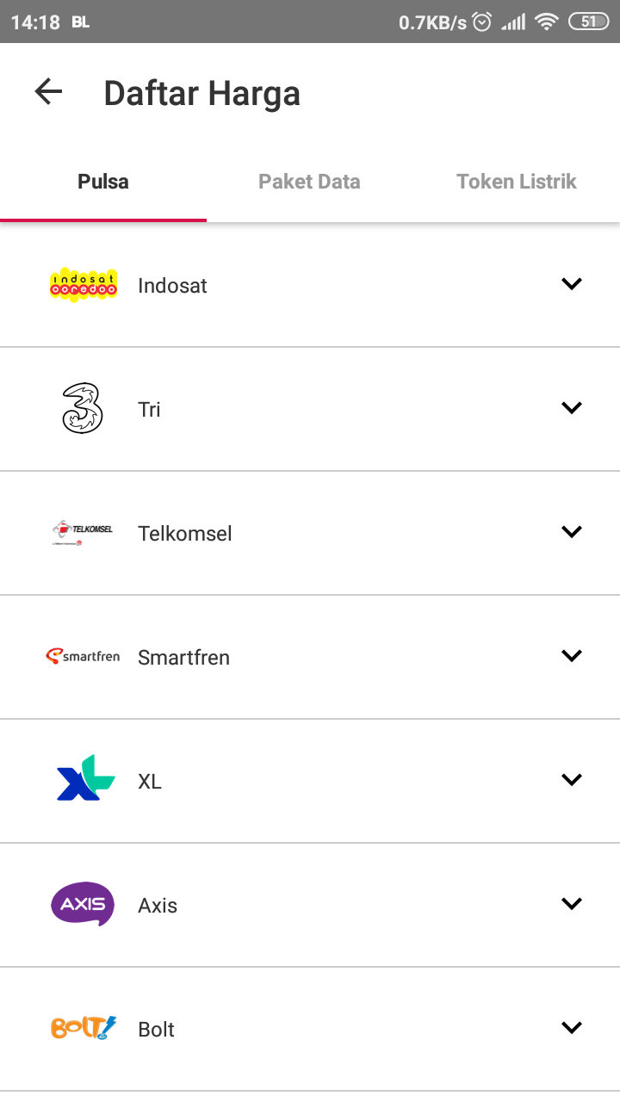
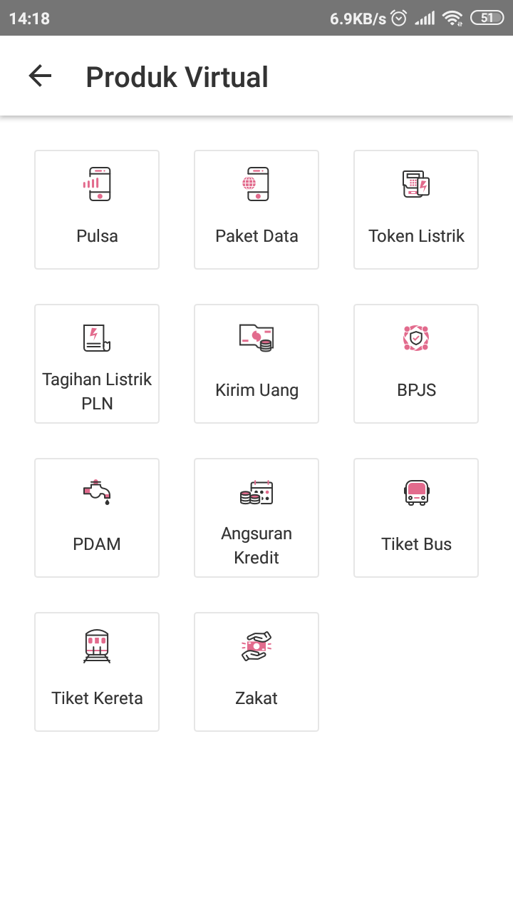
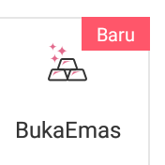
PT Bukalapak.com
Agenda
Product Description
Company
Information
Detail of product
Positioning
Product
Description
Benefits
Successes
Question and
Answer Session
Closing
Argument

Slide 10
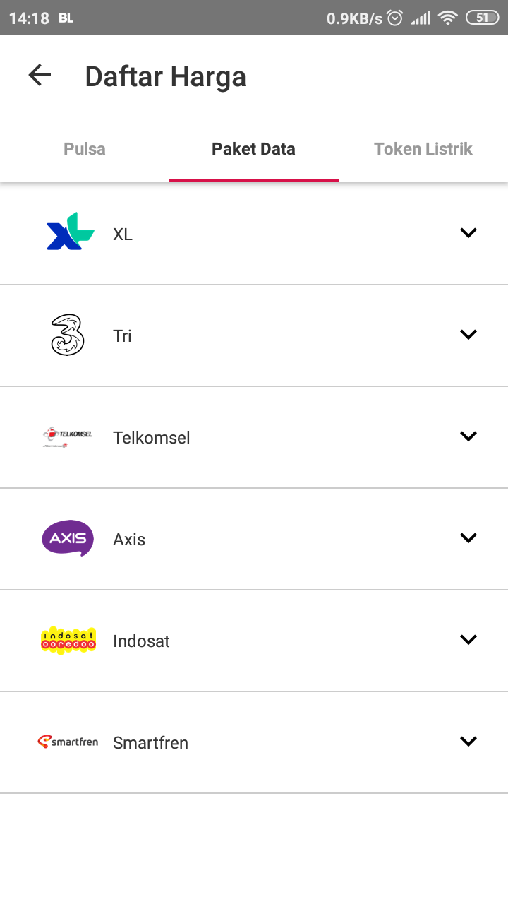
PT Bukalapak.com
Agenda
Product Description
Company
Information
Detail of product
Positioning
Product
Description
Benefits
Successes
Question and
Answer Session
Closing
Argument

Slide 11
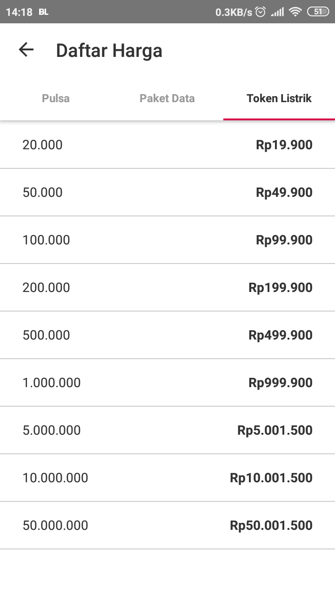
PT Bukalapak.com
Agenda
Product Description
Company
Information
Detail of product
Positioning
Product
Description
Benefits
Successes
Question and
Answer Session
Closing
Argument

Slide 12
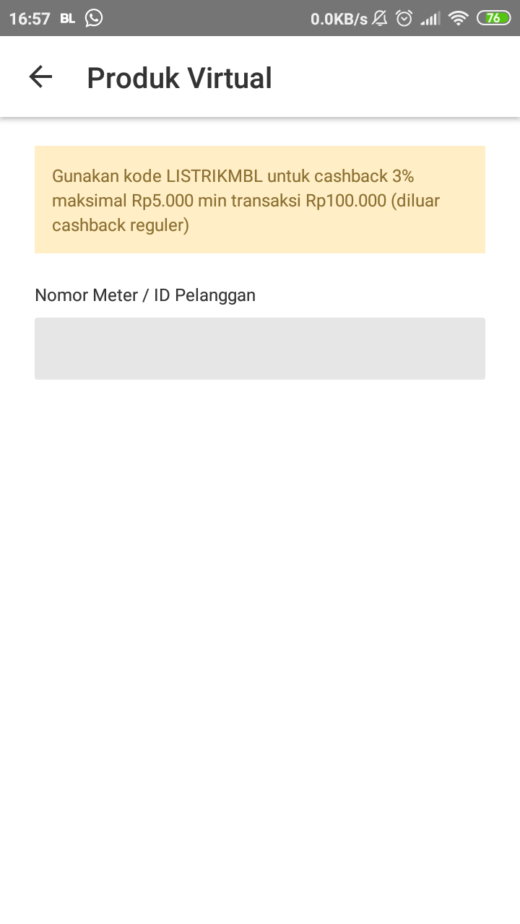
PT Bukalapak.com
Agenda
Product Description
Company
Information
Detail of product
Positioning
Product
Description
Benefits
Successes
Question and
Answer Session
Closing
Argument

Slide 13
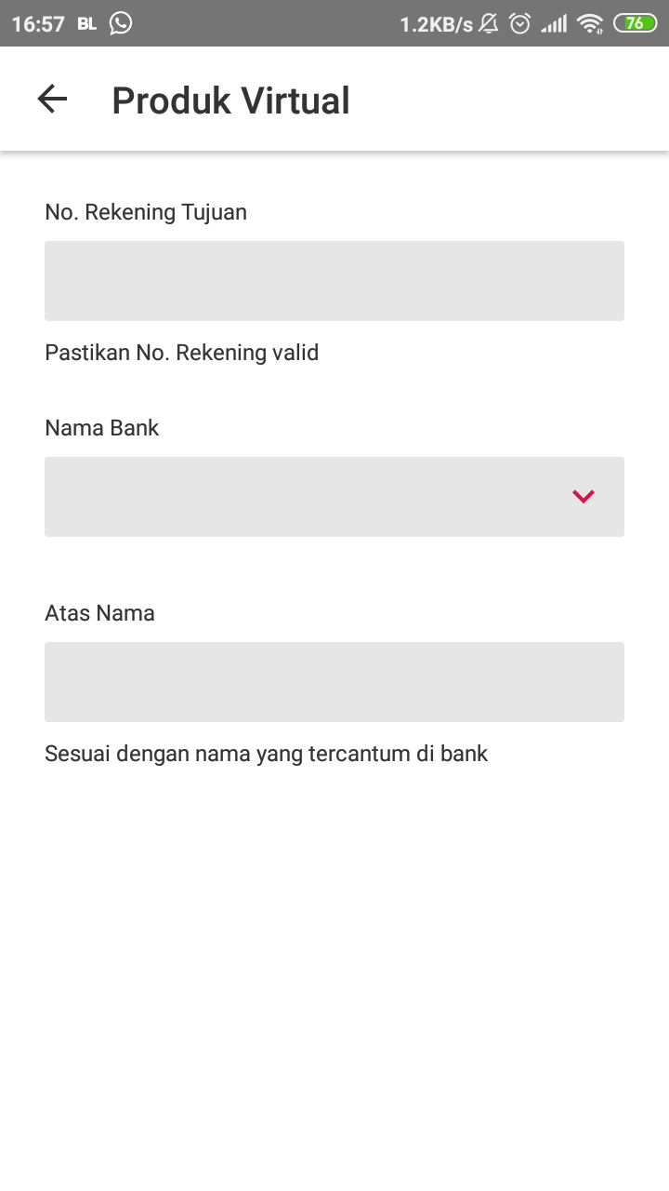
PT Bukalapak.com
Agenda
Product Description
Company
Information
Detail of product
Positioning
Product
Description
Benefits
Successes
Question and
Answer Session
Closing
Argument

Slide 14
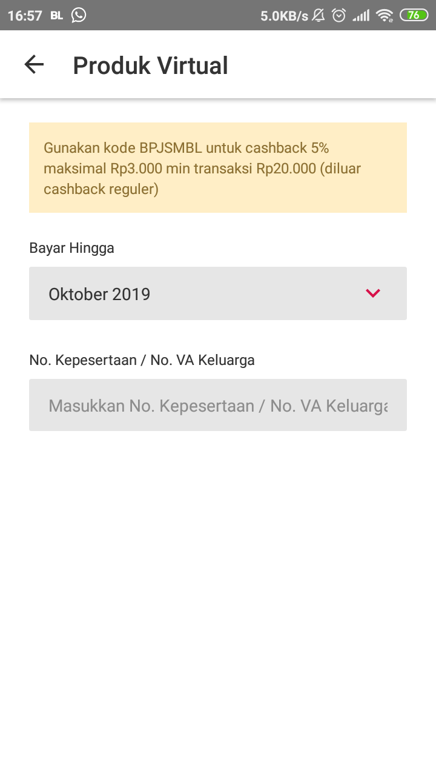
PT Bukalapak.com
Agenda
Product Description
Company
Information
Detail of product
Positioning
Product
Description
Benefits
Successes
Question and
Answer Session
Closing
Argument

Slide 15
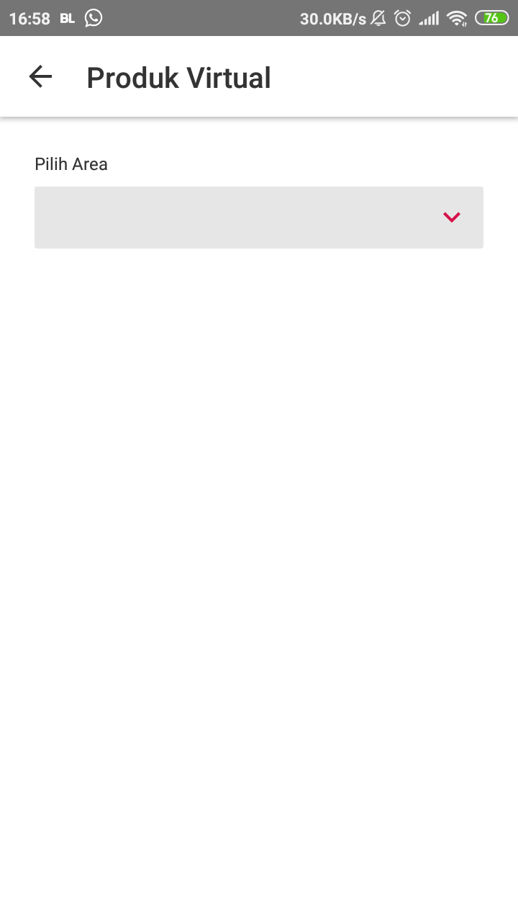
PT Bukalapak.com
Agenda
Product Description
Company
Information
Detail of product
Positioning
Product
Description
Benefits
Successes
Question and
Answer Session
Closing
Argument

Slide 16
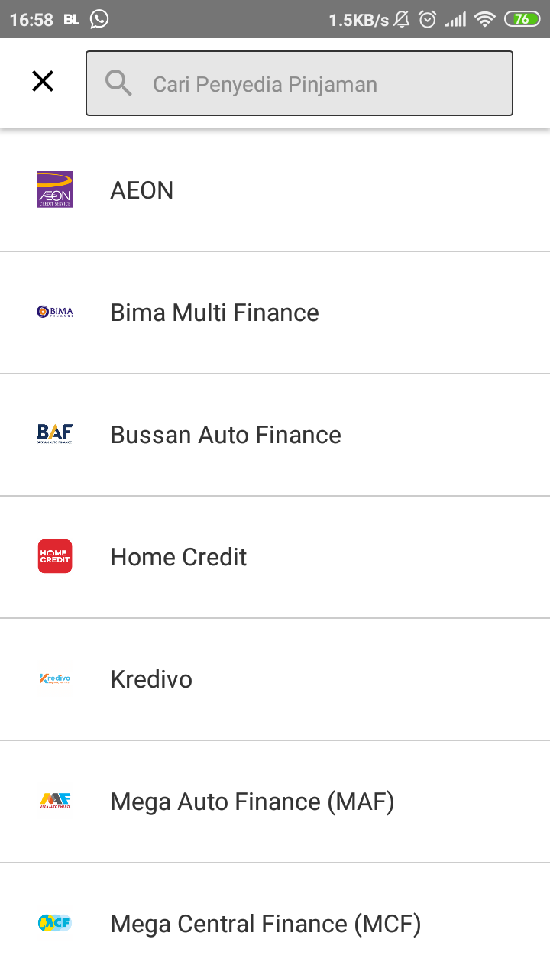
PT Bukalapak.com
Agenda
Product Description
Company
Information
Detail of product
Positioning
Product
Description
Benefits
Successes
Question and
Answer Session
Closing
Argument

Slide 17
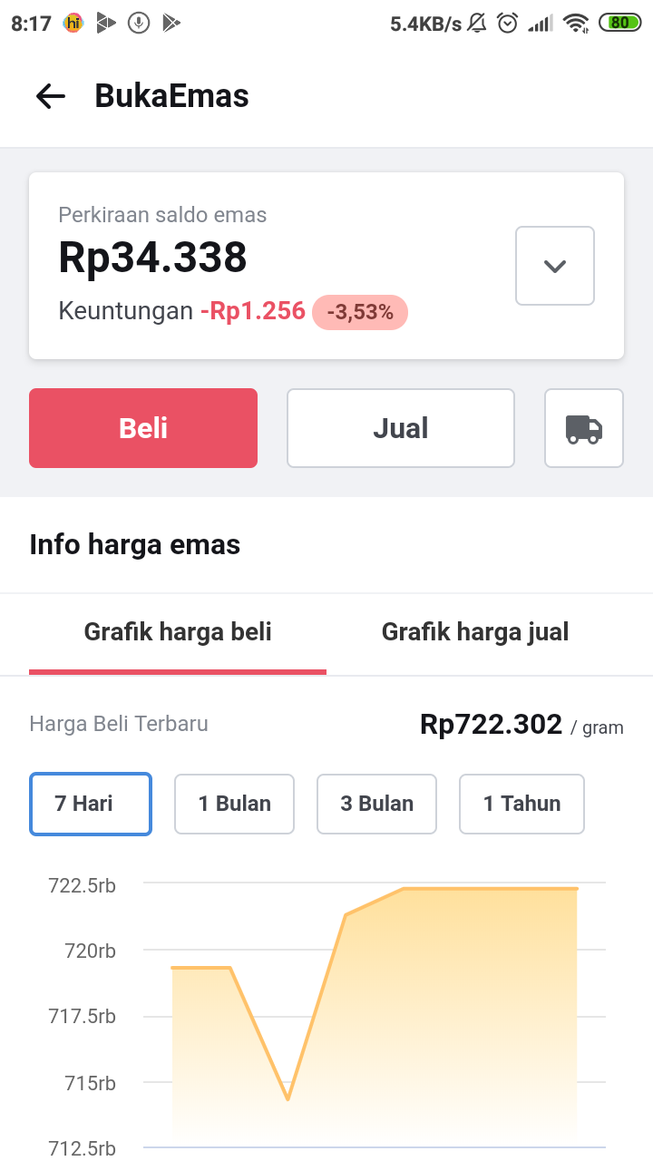
PT Bukalapak.com
Agenda
Product Description
Company
Information
Detail of product
Positioning
Product
Description
Benefits
Successes
Question and
Answer Session
Closing
Argument

Slide 18
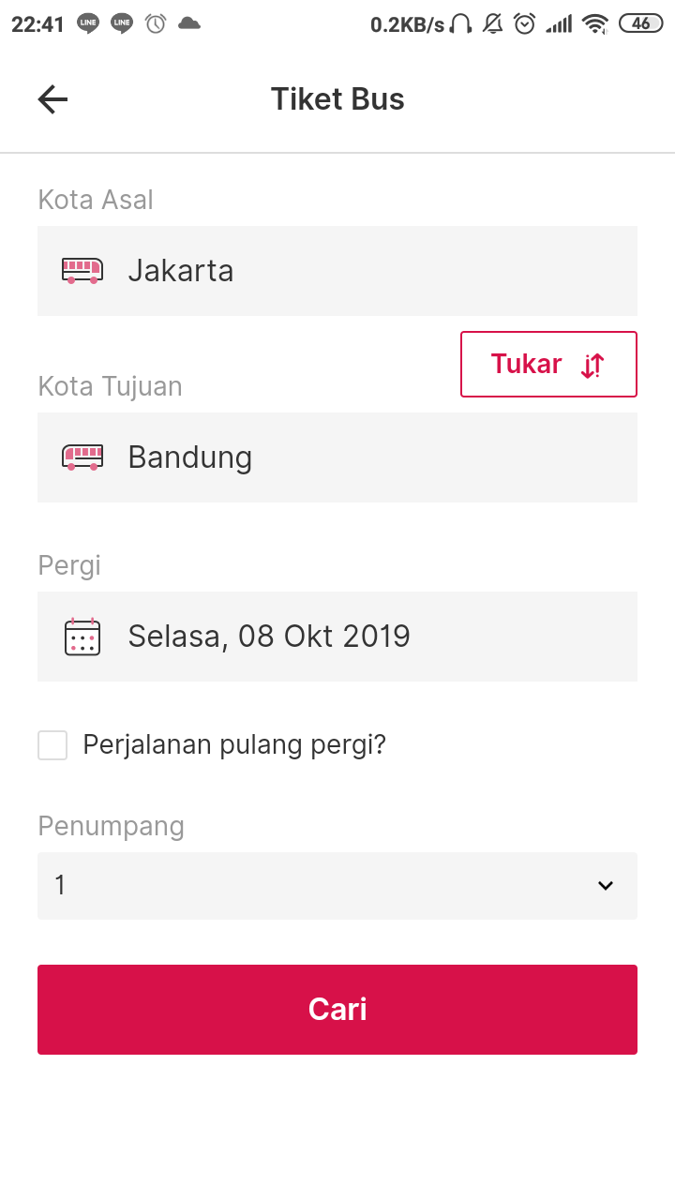
PT Bukalapak.com
Agenda
Product Description
Company
Information
Detail of product
Positioning
Product
Description
Benefits
Successes
Question and
Answer Session
Closing
Argument

Slide 19
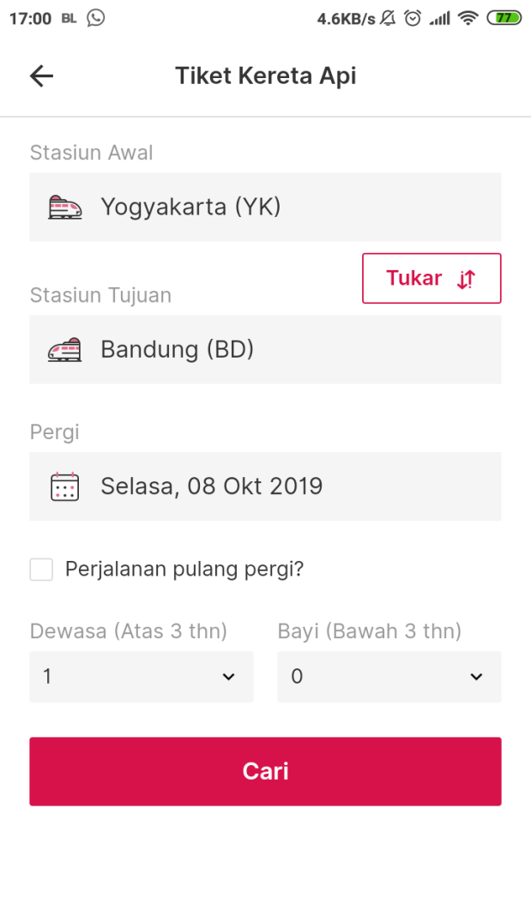
PT Bukalapak.com
Agenda
Product Description
Company
Information
Detail of product
Positioning
Product
Description
Benefits
Successes
Question and
Answer Session
Closing
Argument

Slide 20
PT Bukalapak.com
Agenda
Benefits
Company
Information
For personal
Positioning
The price is cheap (Ex. Pulsa IDR 5k = IDR 5,8k)
Take it easy in emergency (no need go to the store)
Help others
Product
Description
Benefits
For commercial
Get profits (Ex. Pulsa IDR 5k = IDR 7k)
Help to manage stuffs for sell
Profit Monitoring
Improve service
Successes
Question and
Answer Session
Closing
Argument

Slide 21
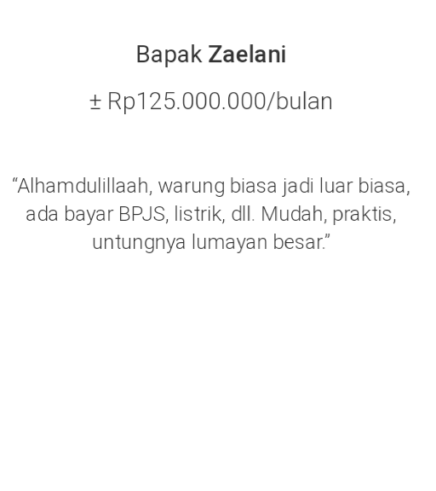
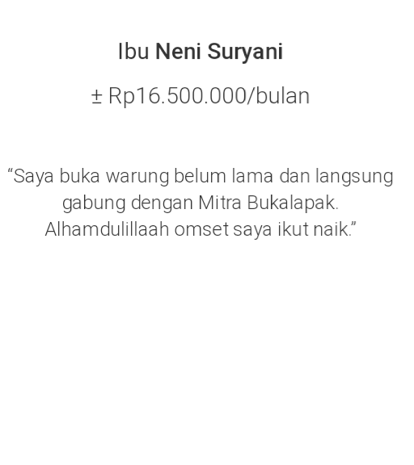

PT Bukalapak.com
Agenda
Successes
Company
Information
Application
Positioning
Ratings on Playstore = 4,3
Number of downloaders =
> 1.000.000
Product
Description
User
Benefits
Mrs. Zaelni
(income = +/- IDR 125.000k)
Ms. Neni Suryani
(income = +/- IDR 16.000k)
Ms. Lia Subono
(income = +/- IDR 10.000k)
Successes
Question and
Answer Session
Closing
Argument

Slide 22

PT Bukalapak.com
Agenda
Question and Answer Session
Company
Information
Positioning
Product
Description
Benefits
Successes
Question and
Answer Session
Closing
Argument

Slide 23
PT Bukalapak.com
Agenda
Closing Argument
Company
Information
Positioning
“If you want to make a profit with small capital,
you can get it from this application ”
Product
Description
Benefits
Successes
Question and
Answer Session
Closing
Argument

