Slide 1
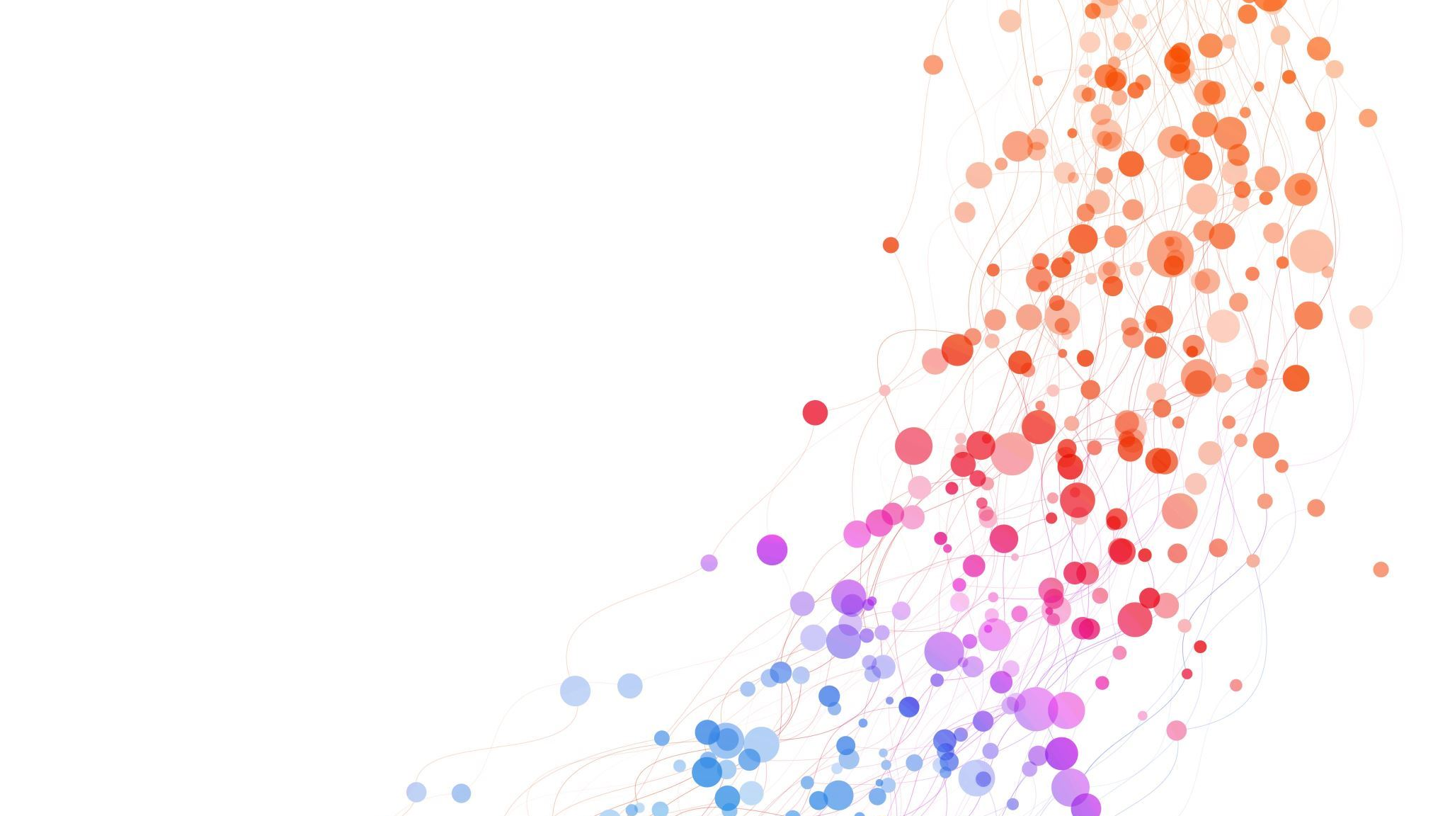
QUARTERLY REVIEW
OCT - 2023
Indraja Lakshmi Tirumalanadhuni

Slide 2
Testing Insights
Synopsis in mobile App.
New Coupon code flow.
One course page in web, mobile browser and App.
User profile in web and mobile browser.
MCQ post-test analysis in web and mobile browser.
Klass dashboard.
Q&A in app.

Slide 3
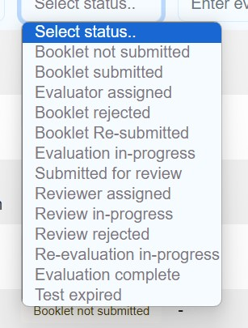
Synopsis in mobile App.
Tested all the 13 Flows from the admin panel and front end (Student side). Front end (Student side) Admin panel To be uploaded Submitted Rejected Evaluation in-progress Evaluation completed Test expired

Slide 4
.
Tested using Master evaluator and 2 step evaluator.
Tested the PDF scanner.
Tested in Admin panel, mobile and web browser as well.

Slide 5
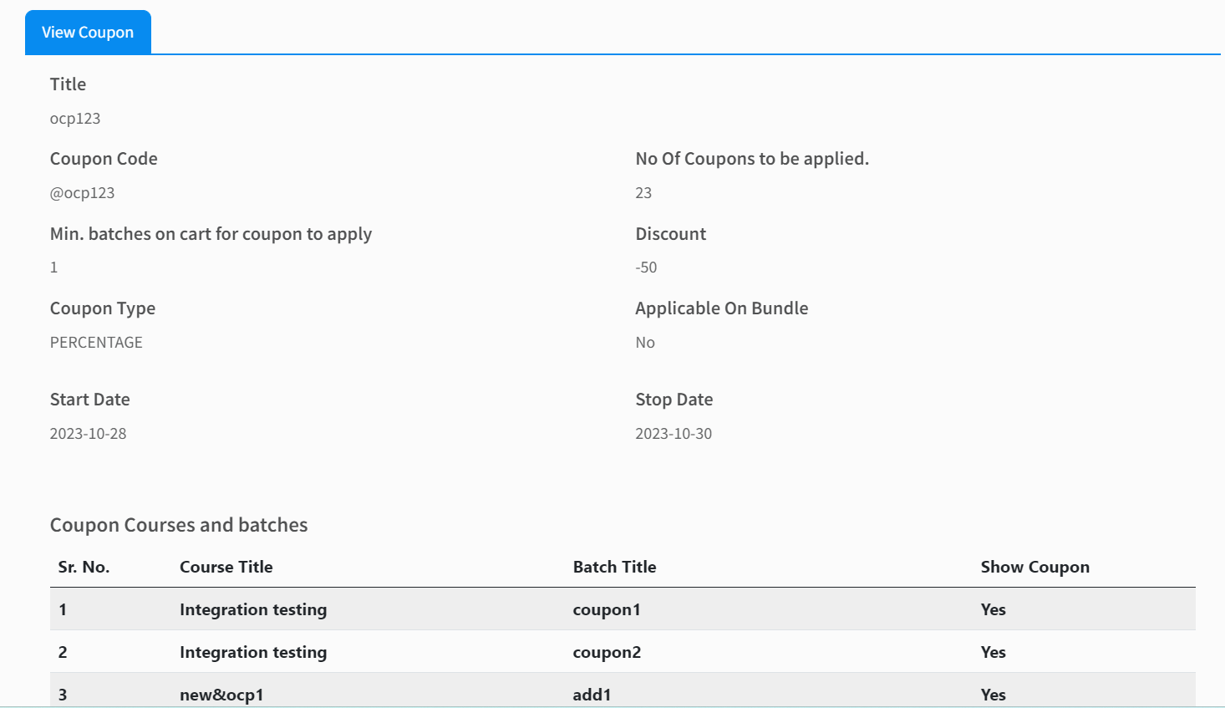
New coupon code flow
Tested code flow by adding multiple batches to cart.
Tested using adding old and new courses.
Tested many flows like when the student applied the coupon later if we made any changes in coupon what happens
What if coupon is invalid.

Slide 6
One course page web, mobile browser and app
Tested for both Klass and Ecomm.

Slide 7
Klass
Tested many features like creating more courses using OCP and tested the flows like class as primary content, pdf as primary content, MCQ test flow, korrecto with master and 2 step evaluator and Synopsis with master and 2step evaluator all 13 states.
Tested out app downloads for notes with watermarks.
Tested import, linked, delinked with and without content.
Tested validity extension.

Slide 8
Ecomm
Ecomm I tested some flows like: i, Admission counsellor ii, Coupon codes and iii, course page. iv, Checked all the payment methods.

Slide 9
User profile in web and mobile browser
Developed a feature for students, to create their profile I tested all the flows like adding details, education and upsc attempts.

Slide 10
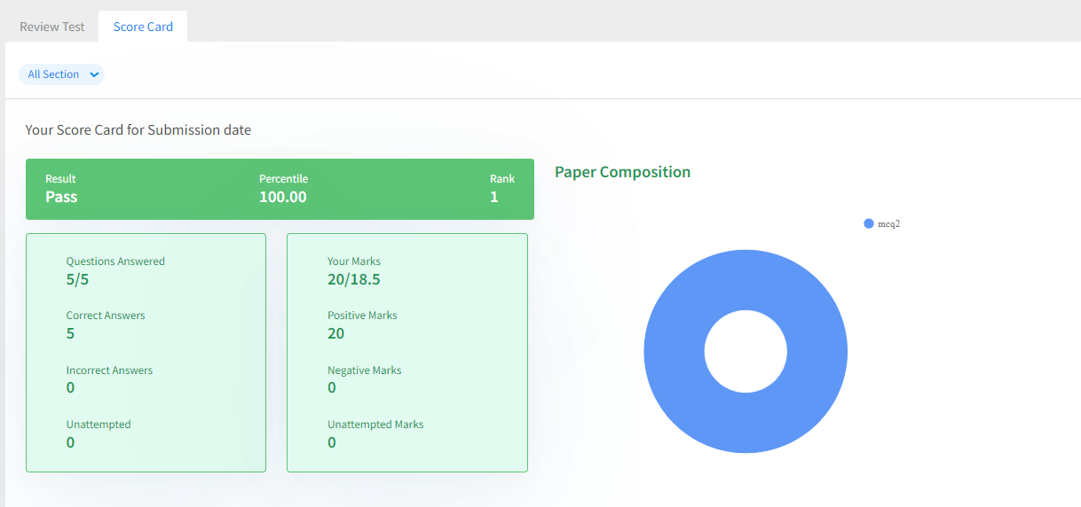
Mcq post-test analysis in web and mobile browser
Created more than 300 questions and more than 5 tests and attempted the test and checked how all the values are populating in score card screen.
Tested score card, paper composition, module level performance and Attempt test analysis table.
Tested all the old tested.

Slide 11
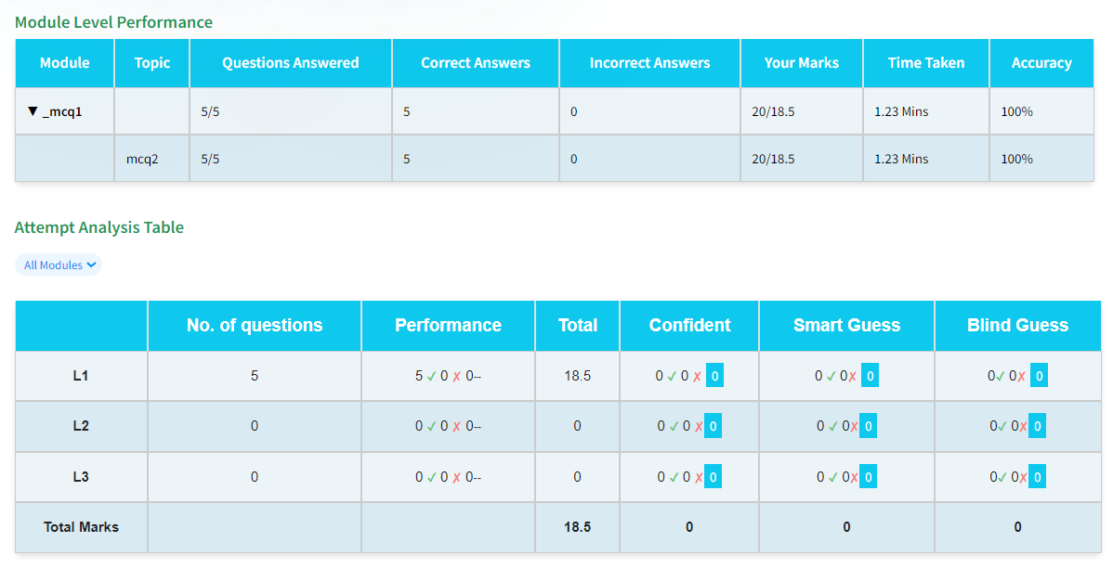
.
module level performance and Attempt test analysis table

Slide 12

Thank you

