Slide 1

Automated Question Generation for Data Structures
Revolutionizing DSA Learning with AI-Powered Quizzes
VP
by Vedant Patil
Page 1
Page No : 01

Slide 2
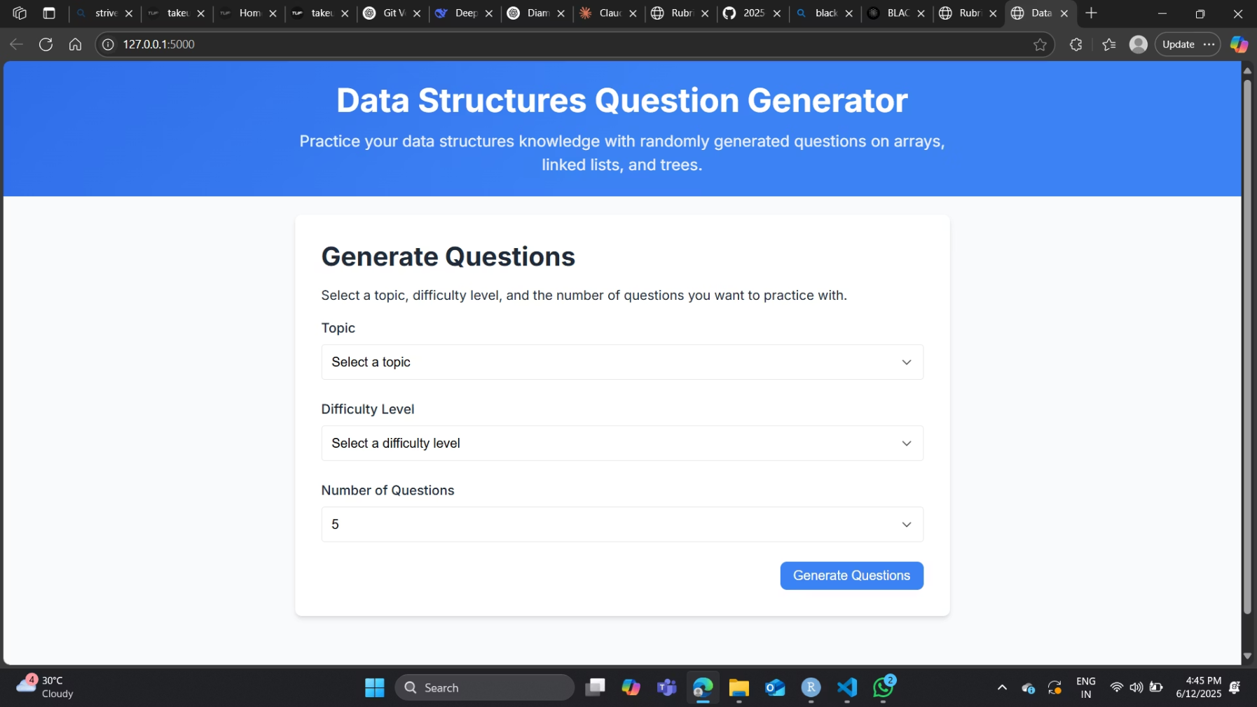
Project Overview
Quiz Design
Key Topics
Subtypes Included
For professionals learning data structures.
Arrays, Linked Lists, and Trees.
Comprehensive coverage of all data structure subtypes.
Page No : 02

Slide 3
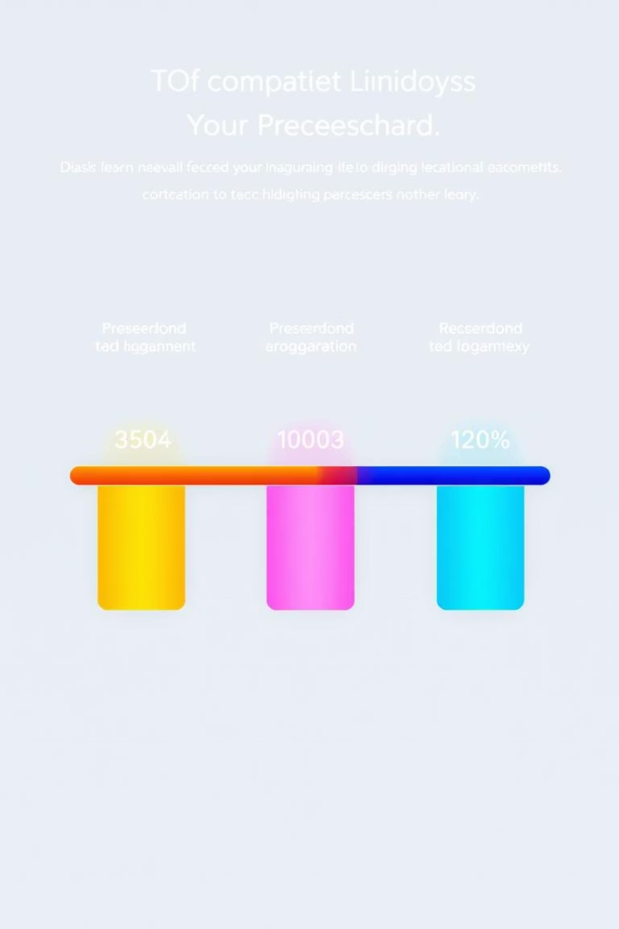
Difficulty Levels
1
Level 1
Beginner-friendly questions.
2
Level 2
Intermediate challenges.
3
Level 3
Advanced problem-solving.
Page No : 03

Slide 4




Question Types
MCQs
Multiple Choice Questions for quick assessment.
Implementation Codes
Practical coding challenges.
Foundational Knowledge
Essential theoretical concepts.
Page No : 04

Slide 5
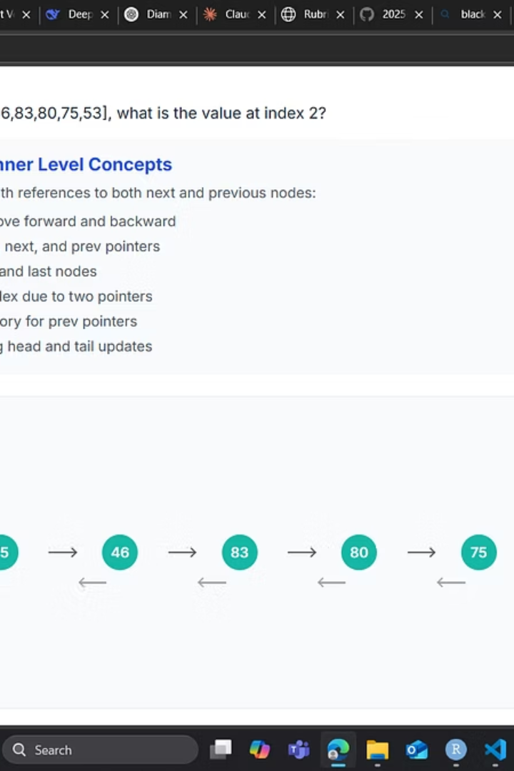



Visual Learning
Trees
Visualizations for tree structures.
Linked Lists
Dynamic linked list representations.
Arrays
Clear array visual displays.
Page No : 05

Slide 6

Technology Stack
Python
Used for Data Structures and Algorithms.
DSA Focus
Tailored for efficient DSA learning.
Page No : 06

Slide 7

User Experience
Interactive Quizzes
Engaging and dynamic learning.
Clear Visuals
Enhanced understanding through visualization.
Progressive Learning
Levels adapt to user's skill.
Page No : 07

Slide 8
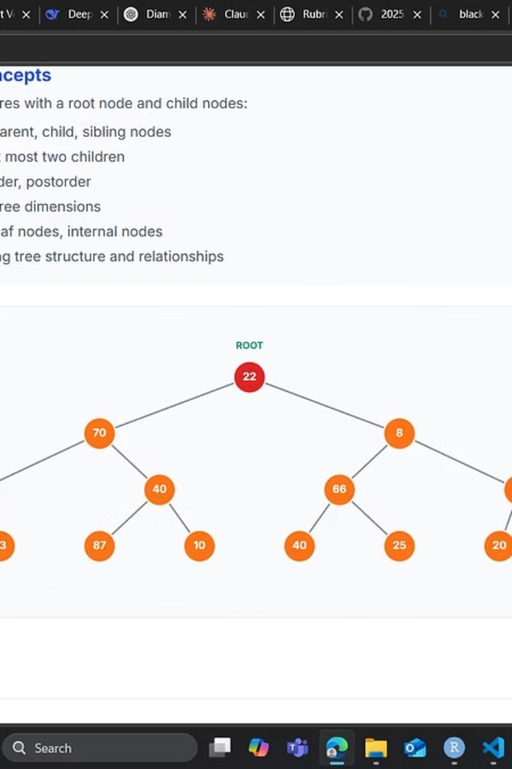
Future-Proofing Your Skills
This project aims to provide a robust and engaging platform for mastering data structures.
3
3
2
Data Structures
Difficulty Levels
Question Types
Arrays, Linked Lists, Trees.
From beginner to advanced.
MCQs and Implementation.
Page No : 08

