Slide 1
Annotations and Java Beans
Module-3

Slide 2
Contents
Creating Packages
Creating Packages that have subpackages
Interfaces
Creating a JAR file
Annotations
The core java API package,
New java.Lang Sub package
Built-in Annotations with examples.

Slide 3
Creating Packages

Slide 4
Packages
What is a package
A java package is a collection of
classes, interfaces, sub-packages, exceptions, enums, etc.
Why to use packages (Advantages)
avoid name collision.
Encapsulate more than one class.
Helps categorize the classes and interfaces.
Easy to maintain.

Slide 5
Types of Packages
Package types
Built-in package
User-defined package

Slide 6
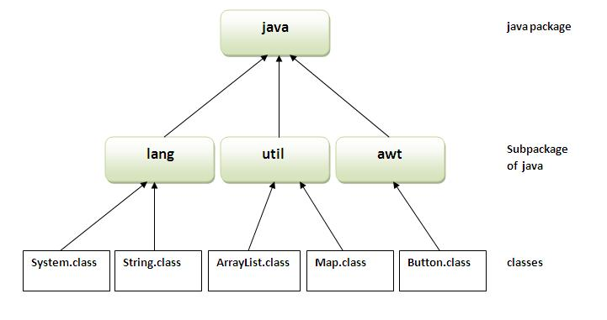
Built-in Packages

Slide 7
User defined Packages
Creating a package:
Compiling a package:
importing a package:

Slide 8
2. User-defined package
2.1. Creating a package
2.2. Compiling a package
2.3. importing a package
Syntax
package mypackage;
public class someClass {
// code
}

Slide 9
2. User-defined package
2.1. Creating a package
2.2. Compiling a package
2.3. importing a package
SomeClass.java
After compilation,
A new directory created with name mypackage under specified path.
“.class” file generated will be added under directory mypackage.
package mypackage;
public class someClass {
// code
}
d:\javaTest>
javac -d path SomeClass.java

Slide 10
2. User-defined package
Example
myComputer
C :
D :
Rectangle.java
javaList
JavaTest
package mypackage;
public class Rectangle {
// code
}
Rectangle.java
mypackage
Rectangle.class
d:\javaTest>
javac -d D:\javaList Rectangle.java

Slide 11
2. User-defined package
Example
2.2. Compiling a package
myComputer
C :
D :
someClass.java
javaList
JavaTest
package mypackage;
public class someClass {
// code
}
SomeClass.java
mypackage
SomeClass.class
d:\javaTest>
javac -d . someClass.java

Slide 12
2. User-defined package
importing a package:
import mypackage.className ;
public class DemoClass {
// main method that use package classes
}

Slide 13
interfaces

Slide 14
Basics
What is a concrete method?
A method that has body is called concrete method
Example:
void show() {
System.out.println(“Hello”);
}

Slide 15
Basics
What is a abstract method?
A method that has No body and ends with semicolon
Example:
abstract void show() ;

Slide 16
1. Interface: Fundamemntals
Why to use interface
to achieve fully abstraction.
to achieve multiple inheritance.
Syntax
In interface by default
All methods are : public & abstract
All variables are: public, static & final
interface InterfaceName {
// [public abstract] methods
// [public static final] variables
}

Slide 17
1. Interface: Fundamemntals
Can also be defined as :
interface Stack {
void push();
int pop();
int STACKSIZE= 3;
}
// default public and abstract
// default public and abstract
// default public, static and final

Slide 18
1. Interface: Fundamemntals
we can create reference to interface.
We cannot instantiate an interface.
interface Stack {
---
}
class Demo {
public static void main ( String [] args ) {
Stack mystack ; // reference allowed
mystack = new Stack() ; // not allowed.
}
}

Slide 19
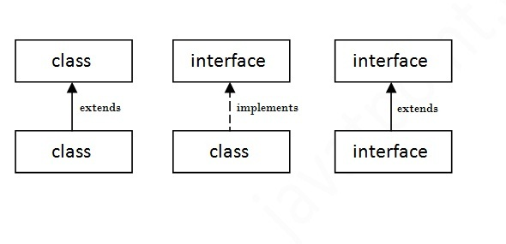
Relationship between classes and interface
class extends a class
class always implements an interface
Interfaces always extends an interfaces.
An interface cannot implement another interface or class.
Class cannot extend an interface

Slide 20
2. Implementing Interfaces:
Sub Class that implements interface
Subclass
must provide definition(body) to all abstract methods of a interface.

Slide 21
JAR – Java Archive

Slide 22
JAR files
The Java™ Archive (JAR) file format enables you to bundle multiple files into a single archive file.
Typically a JAR file contains
the class files
auxiliary resources (applets, images, audio)
An archive file is a file that is composed of one or more computer files along with metadata.
Archive files are used to collect multiple data files together into a single file for easier portability and storage.
It can be digitally sign the jar file to prove their origin.

Slide 23
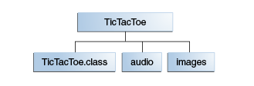
Contd..,
Example:
mysql-connector-java-5.1.5-bin.jar
Java poi jar

Slide 24
Contd..,
Example
File contains class files, audio files, and images having this structure
The audio and images subdirectories contain sound files and GIF images used by applet.
jar cf TicTacToe.jar TicTacToe.class audio images

Slide 25
The jar file Benefits
Security: You can digitally sign the contents of a JAR file.
Decreased download time: If your applet is bundled in a JAR file, the applet's class files and associated resources can be downloaded to a browser in a single HTTP transaction without the need for opening a new connection for each file.
Compression: efficient storage.

Slide 26
The jar file Benefits
Packaging for extensions: extend JVM (example Java3D)
Package Sealing: enforce version consistency
All classes defined in the package must be found in same JAR file
Package Versioning: A JAR file can hold data about the files it contains, such as vendor and version information.
Portability: The mechanism for handling JAR files is a standard part of the Java platform's core API.

Slide 27
JAR Creating a JAR file
Basic command for creating a JAR file:
jar cf jar-file input-file(s)
Options
c : create a JAR file
f : output jar file
v : produce verbose output
jar-file : the name of the resulting JAR file
can use any filename for a JAR file
by convention, JAR filenames are given a .jar extension
input-file(s) : a space-separated list of one or more files to be placed in the JAR file.
can contain the wildcard * symbol
can be directory names; directories are added recursively

Slide 28
JAR – Viewing a JAR file
Basic command for viewing the contents of a JAR file:
jar tf jar-file
Options
t : show table of contents
f : jar file
v : produce additional information like file sizes and dates
This command will display the table of contents of the JAR file to stdout.

Slide 29
Options for creating JAR
The jar tool provides many switches, some of them are as follows:
Options | Descriptions
-c | creates new archive file
-v | generates verbose output. It displays the included or extracted resource on the standard output
-m | includes manifest information from the given mf file.
-f | specifies the archive file name
-x | extracts files from the archive file
-t | To view the contents of a JAR file

Slide 30
Using JAR file
To perform basic tasks with JAR files, you use the Java Archive Tool provided as part of the Java Development Kit (JDK).
Operation | Command
To create a JAR file | jar cf jar-file input-file(s)
To view the contents of a JAR file | jar tf jar-file
To extract the contents of a JAR file | jar xf jar-file
To extract specific files from a JAR file | jar xf jar-file archived-file(s)
To run an application packaged as a JAR file (requires the Main-class manifest header) | java -jar app.jar
To invoke an applet packaged as a JAR file | <applet code=AppletClassName.class archive="JarFileName.jar" width=width height=height></applet>

Slide 31
DEMO

Slide 32
@annotation

Slide 33
Annotations
Java annotations is a tag that represents metadata.
i.e. attached with class, interface, methods or fields to indicate some additional information which can be used by java compiler and JVM.
Java annotations were added to Java from Java 5
Annotations are used by tools to produce derived files
Tools:Compiler, IDE, Runtime tools
Derived files: New java code, deployment descriptor, class files

Slide 34
Built-In Java Annotations
There are several built-in annotations in java. Some annotations are applied to java code and some to other annotations.
Built-In Java Annotations used in java code
@Override
@SuppressWarnings
@Deprecated
Built-In Java Annotations used in other annotations
@Target
@Retention
@Inherited
@Documented

Slide 35
Example
class Animal{
void eatSomething(){
System.out.println("eating something");}
}
class Dog extends Animal{
@Override
void eatsomething(){
System.out.println("eating foods");
}
}
class TestAnnotation1{
public static void main(String args[]){
Animal a=new Dog();
a.eatSomething();
}
}
Output: Compile time error

Slide 36
Java Annotation Purpose
Java annotations are typically used for the following purposes:
Compiler instructions
Build-time instructions
Runtime instructions
Java annotations can be used at build-time, when you build your software project.
Building the software is typically done by an automatic build tool like Apache Ant or Apache Maven.
Build tools may scan your Java code for specific annotations and generate source code or other files based on these annotations.

Slide 37
Annotation Basics
A Java annotation in its shortest form looks like this:
Syntax: @Entity
Where,
the @ character signals to the compiler that this is an annotation.
the name following the @ character is the name of the annotation.

