Slide 1
Servlets
Module-1

Slide 2
Module 1
Servlet
Servlet Structure,
Servlet packaging,
HTML building utilities,
Lifecycle,
SingleThreadModel interface,
Handling Client Request: Form Data,
Handling Client Request: HTTP Request Headers.
Generating server Response: HTTP Status codes,
Generating server Response: HTTP Response Headers,
Handling Cookies,
Session Tracking.
JSP
Overview of JSP: JSP Technology, Need of JSP, Benefits of JSP, Advantages of JSP, Basic syntax,

Slide 3
Basic Servlet Structure
import java.io.*;
import javax.servlet.*;
import javax.servlet.http.*;
public class ServletTemplate extends HttpServlet {
public void doGet(HttpServletRequest request, HttpServletResponse response)
throws ServletException, IOException {
// Use "request" to read incoming HTTP headers
// Use "response" to specify the HTTP response status
PrintWriter out = response.getWriter();
// Use "out" to send content to browser
}
}

Slide 4
Contd..
A servlet is a class should extend HttpServlet and override doGet or doPost.
It takes two arguments:
HttpServletRequest and an HttpServletResponse.
The HttpServletRequest has methods to find out about incoming information such as form data, HTTP request headers, and the client’s hostname.
The HttpServletResponse lets you specify outgoing information such as HTTP status codes (200, 404, etc.), response headers (Content-Type, Set-Cookie, etc.,)
lets can get PrintWriter from the response object. Use the PrintWriter object to send document content to the browser

Slide 5
Example of Servlet
Import servlet and http packages
Servlet class should extend HttpServlet to handle get and post method
Override method doGet or doPost method
Use the response object getWriter( ) to send it to cilent
import java.io.*;
import javax.servlet.*;
import javax.servlet.http.*;
public class HelloWorld extends HttpServlet {
public void doGet(HttpServletRequest request, HttpServletResponse response) throws ServletException, IOException {
PrintWriter out = response.getWriter( );
out.println("Hello World");
}
}

Slide 6
Servlet Packaging
In a production environment, multiple programmers may be developing servlets for the same server.
So, placing all the servlets in the top-level servlet directory results in a massive hard-to-manage directory and risks name conflicts when two developers accidentally choose the same servlet name.
Packages are the natural solution to this problem.
Creating Packages
1. Move the files to a subdirectory that matches the intended package name.
2. Insert a package statement in the class file

Slide 7
HTML Building Utilities
An HTML document is structured as follows:
<!DOCTYPE ...>
<HTML>
<HEAD><TITLE>...</TITLE>...</HEAD>
<BODY >
...
</BODY>
</HTML>
The advantage of DOCTYPE line is that it tells HTML validators which version of HTML you are using so they know which specification to check your document against.

Slide 8
Contd..,
These validators are very valuable debugging services, helping you catch HTML syntax errors.
The two most popular on-line validators are:
The World Wide Web Consortium (http://validator.w3.org/)
The Web Design Group (http://www.htmlhelp.com/tools/validator/)
You submit a URL, then they retrieve the page, and report any errors to you in the HTML syntax specification.

Slide 9
ServletUtilities.java
HelloWWW3.java
package coreservlets;
import javax.servlet.*;
import javax.servlet.http.*;
public class ServletUtilities {
public static final String DOCTYPE =
"<!DOCTYPE HTML PUBLIC \"-//W3C//DTD HTML 4.0 " +
"Transitional//EN\">";
public static String headWithTitle(String title) {
return(DOCTYPE + "\n" +
"<HTML>\n" +
"<HEAD><TITLE>" + title + "</TITLE></HEAD>\n");
}
...
}
package coreservlets;
import java.io.*;
import javax.servlet.*;
import javax.servlet.http.*;
public class HelloWWW3 extends HttpServlet {
public void doGet(HttpServletRequest req,
HttpServletResponse res)
throws ServletException, IOException {
response.setContentType("text/html");
PrintWriter out = response.getWriter();
out.println(ServletUtilities.headWithTitle("Hello WWW") +
"<BODY>\n" +
"<H1>Hello WWW</H1>\n" +
"</BODY></HTML>");
}
}

Slide 10
Servlet life cycle
A servlet life cycle can be defined as the entire process from its creation till the destruction. The following are the paths followed by a servlet.
The servlet is initialized by calling the init( ) method.
The servlet calls service( ) method to process a client's request.
The servlet is terminated by calling the destroy( ) method.
Finally, servlet is garbage collected by the garbage collector of the JVM.

Slide 11
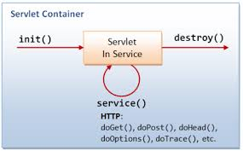
Contd..,

Slide 12
Contd..,
The init( ) method
The init method is called only once.
It is used for one-time initializations, just as with the init method of applets.
The servlet can be created when a user first invokes a URL corresponding to the servlet or when the server is first started depending on how you have registered the servlet with the Web server.
It will be created for the first user request
There are two versions of init( ):
One that takes no argument
One that takes a ServletConfig object as an argument

Slide 13
Contd..,
One that takes no arguments: it is used when the servlet does not need to read any settings that vary from server to server.
The method definition looks like:
Where init is used to preallocate multiple database connections.
public void init () throws ServletException{
// initialization code…..
}

Slide 14
Contd..
The second version of init is used when the servlet needs to read server-specific settings before it can complete the initialization.
For example, the servlet might need to know about database settings, password files, server-specific performance parameters, hit count files, or serialized cookie data from previous requests.
The second version of init looks like this:
public init(ServletConfig config ) throws ServletException {
super.init(config);
//initialization code . . .
}

Slide 15
Contd..,
First, the init method takes a ServletConfig as an argument.
ServletConfig has a getInitParameter method with which you can look up initialization parameters associated with the servlet.
Just as with the getParameter method used in the init method of applets, both the input (the parameter name) and the output (the parameter value) are strings.
The second thing to note about the second version of init is that the first line of the method body is a call to super.init.
The ServletConfig object is used elsewhere in the servlet, and the init method of the superclass registers it where the servlet can find it later.

Slide 16
Contd..,
Service method
The service( ) method is the main method to perform the actual task.
Each time the server receives a request for a servlet, the server spawns a new thread and calls service.
public void service(HttpServletRequest request, HttpServletResponse response)
throws ServletException, IOException {
// Servlet Code
}
Note: if you have a servlet that needs to handle both POST and GET requests identically, you may be tempted to override service directly as below, rather than implementing both doGet and doPost

Slide 17
Contd..,
The service method checks the HTTP request type (GET, POST, PUT, DELETE, etc.) and calls doGet, doPost, doPut, doDelete
doGet( )
doPost( )
public void doGet(HttpServletRequest request, HttpServletResponse response)
throws ServletException, IOException {
// Servlet Code
}
public void doPost(HttpServletRequest request, HttpServletResponse response)
throws ServletException, IOException {
//code
}

Slide 18
Contd..,
The destroy method
The destroy() method is called only once at the end of the life cycle of a servlet.
This method gives your servlet a chance to close database connections, halt background threads, write cookie lists or hit counts to disk, and perform other such cleanup activities.
After the destroy() method is called, the servlet object is marked for garbage collection. The destroy method definition looks like this-
public void destroy( ) {
// code...
}

Slide 19
The SingleThreadModel Interface
The servlet programmer should implement SingleThreadModel interface to ensure that servlet can handle only one request at a time.
It does so either by queuing up all the requests and passing them one at a time to a single servlet instance, or by creating a pool of multiple instances, each of which handles one request at a time.
This means that you don’t have to worry about simultaneous access to regular fields (instance variables) of the servlet.

Slide 20
Contd..,
Syntax:
Note: This interface is currently deprecated since Servlet API 2.4 because it doesn't solves all the thread-safety
So it is recommended to use other means to resolve these thread safety issues such as synchronized block etc.
public class YourServlet extends HttpServlet implements SingleThreadModel {
...
}

Slide 21
Handling the client request: form data
Handling client request
Whenever we want to send an input to a servlet that input must be passed through html form.
Every form will accept client data and it must send to a servlet which resides in server side
Since html is a static language which cannot validate the client data. Hence, in real time applications client data will be accepted with the help of html tags by developing form and every form must call a servlet.

Slide 22
Contd..,
What is form data
Parameter name
Parameter values
http://host/path?user=Marty+Hall
user=Marty+Hall.
Form data or query data
GET Request : form data can be attached to the end of the URL after question mark for GET request
POST Request : sent to server on a separate line

Slide 23
Contd..,
http://host/path?user=Marty+Hall&origin=bwi&dest=lax.
& is used to attach more number of parameters

Slide 24
Contd..,
Extracting the needed information from this form data using CGI programming.
First, Read the data according to this request method (get or post)
Second, To chop the pairs at the ampersands, then separate the parameter names (left of the equal signs) and the parameter values (right of the equal signs)
Third, To URL-decode the values. Alphanumeric characters are sent unchanged, but spaces are converted to plus signs and other characters are converted to %XX
Fourth, parsing form data is tedious is that values can be omitted or a parameter can have more than one value
(“parm1=val1&param2=val2&param3=val3”)
Parsing code needs special cases for these situation.

Slide 25
Contd..,
Reading form data from Servlets
One of the nice features of servlets is that all of this form parsing is handled automatically.
Single Servlet handles both GET and POST requests
Servlet methods to read data are:
Method Name | Description
getParamater( ) | to read single values from prespecified parameters in the form data
getParameterValues() | To read multiple values
getParameterNames() | to get this list in the form of Enumeration

Slide 26
Contd..,
getParameter()
You call request.getParameter( ) method to get the value from HTML Page.
Null is returned if data is not sent.
Syntax:
public String getParameter(String name)
Example:
String variableName = requset.getParameter(“UserName");
getParameter( ) returns single string
Parameter names are case sensitive

Slide 27
In html: <input type=“text” name=“n1”>
In Java: String val=request.getParameter(“n1”);
If a client send the data to the servlet, that data will be available in the object of HttpServletRequestinterface.
In case of getParameter() method we have to pass input parameter name and it will give the value.
If you are not aware of input parameter name ? or if you have 50+ input values its really tedious to use getParameter() method.
That’s why this getParameterNames() came into picture

Slide 28
Contd..,
getParameterValues()
If the parameter could potentially have more than one value, eg: checkbox
which returns an array of strings
General form:
String[] values = getParameterValues(“Input Parameter”);

Slide 29
Contd..,
getParameterNames()
to get a full list
to get this list in the form of an Enumeration, each entry of which can be cast to a String and used in a getParameter or getParameterValues call.
General form
Enumeration en=request.getParameterNames( );
Note: Parameter names are case sensitive so, for example, request.getParameter("Param1") and request.getParameter("param1") are not interchangeable.

Slide 30
Handling the Client Request: HTTP Request Headers
HTTP request headers are distinct from the form data.
Form data results directly from user input and is sent as part of URL for GET requests and on a separate line for POST request.
Request headers are indirectly set by the browser and are sent immediately following the initial GET or POST request line.
GET /Search?keywords=servlets+jsp HTTP/1.1
Accept: image/gif, image/jpg, */*
Accept-Encoding: gzip
Connection: Keep-Alive
Cookie: userID=id456578
Host: www.somebookstore.com
Referer: http: //www.somebookstore.com/findbooks.html
User-Agent: Mozilla/4.7 [en] (Win98; U)

Slide 31
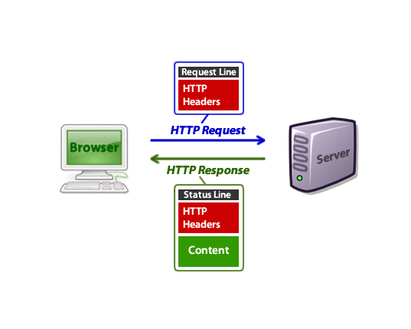
HTTP Request and HTTP Response

Slide 32
Reading Request Headers from Servlets
Reading headers is straightforward
getHeader method of HttpServletRequest, which returns a String if the specified header was supplied on this request, null otherwise.
Header names are not case sensitive.
Although getHeader is the general-purpose way to read incoming headers, there are a couple of headers that are so commonly used that they have special access methods in HttpServletRequest.

Slide 33
Contd..,
getCookies
returns the contents of the Cookieheader, parsed and stored in an array of Cookie objects.
getAuthType and getRemoteUser
The getAuthType and getRemoteUser methods break the Authorization header into its component pieces.
getContentLength
returns the value of the Content-Length header (as an int).
getContentType
returns the value of the Content-Type header (as a String).

Slide 34
Contd..,
getDateHeader and getIntHeader
Reads the specified header and then convert them to Date and int values, respectively.
getHeaderNames
Rather than looking up one particular header, you can use the getHeaderNames method to get an Enumeration of all header names received on this particular request.
getHeaders
In most cases, each header name appears only once in the request. Occasionally, however, a header can appear multiple times.
If a header name is repeated in the request, version 2.1 servlets cannot access the later values without reading the raw input stream, since getHeader returns the value of the first occurrence of the header only.
In version 2.2, however, getHeaders returns an Enumeration of the values of all occurrences of the header.

Slide 35
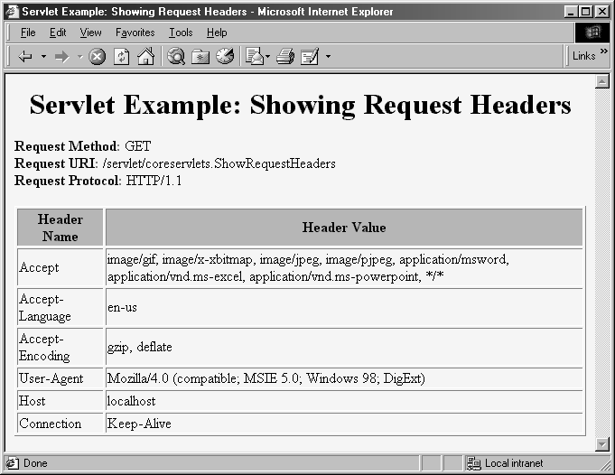
Request Headers

Slide 36
HTTP 1.1 Request Headers
Accept
This header specifies the MIME types that the browser or other client can handle. A servlet that can return a resource in more than one format can examine the Accept header to decide which format to use.
For example, images in PNG format have some compression advantages over those in GIF, but only a few browsers support PNG.
If you had images in both formats, a servlet could call request.getHeader("Accept"), check for image/png
Accept-Charset
This header indicates the character sets (e.g., ISO-8859-1) the browser can use.

Slide 37
Contd..,
Accept-Encoding
If it receives this header, the server is free to encode the page by using the format specified, sending the Content-Encoding response header to indicate that it has done so.
Consequently, it is critical that you explicitly check the Accept-Encoding header before using any type of content encoding. Values of gzip or compress are the two standard possibilities.

Slide 38
Contd..,
Accept-Language
This header specifies the client’s preferred languages, in case the servlet can produce results in more than one language. The value of the header should be one of the standard language codes such as en, en-us, da, etc
Authorization
This header is used by clients to identify themselves when accessing password-protected Web pages.

Slide 39
Contd..,
Connection
This header tells whether or not the client can handle persistent HTTP connections.
These let the client or other browser retrieve multiple files (e.g., an HTML file and several associated images)
Content-Length
This header is only applicable to POST requests and gives the size of the POST data in bytes.
Cookie
This header is used to return cookies to servers that previously sent them to the browser.

Slide 40
Contd..,
From
This header gives the e-mail address of the person responsible for the HTTP request.
Referer
This header indicates the URL of the referring Web page.
For example, if you are at Web page 1 and click on a link to Web page 2, the URL of Web page 1 is included in the Referer header when the browser requests Web page 2. All major browsers set this header, so it is a useful way of tracking where requests came from.

Slide 41
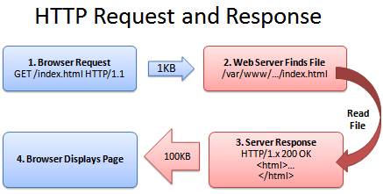
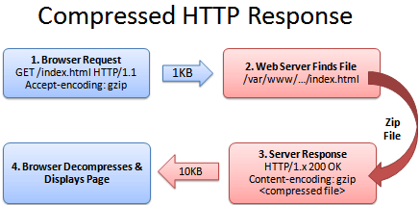
Sending Compressed Web Pages
Http Request and Response
Compresses HTTP Response

Slide 42
Sending Compressed Web Pages
Implementing compression is straight forward since gzip format is built in to the Java programming languages via classes in java.util.zip.
The servlet first checks the Accept-Encoding header to see if it contains an entry for gzip. If so, it uses a GZIPOutputStream to generate the page, specifying gzip as the value of the Content-Encoding header.
Compression could be suppressed by including ?encoding=none at the end of the URL.

Slide 43
Contd..,
public class EncodedPage extends HttpServlet {
public void doGet(HttpServletRequest request, HttpServletResponse response)
throws ServletException, IOException {
String encodings = request.getHeader("Accept-Encoding");
String encodeFlag = request.getParameter("encoding");
PrintWriter out;
String title;
if ((encodings != null) &&(encodings.indexOf("gzip") != -1) &&
!"none".equals(encodeFlag)) {
title = "Page Encoded with GZip";
OutputStream out1 = response.getOutputStream();
out = new PrintWriter(new GZIPOutputStream(out1), false);
response.setHeader("Content-Encoding", "gzip");
} else {
title = "Unencoded Page";
out = response.getWriter();
}

Slide 44
Restricting Access to Web
Many Web servers support standard mechanisms for limiting access to designated Web pages.
These mechanisms can apply to static pages as well as those generated by servlets, so many authors use their server-specific mechanisms for restricting access to servlets.
The steps involved for “basic” authorization.
Step1:
Check whether there is an Authorization header. If there is no such header, go to Step 2.
If there is, skip over the word “basic” and reverse the base64 encoding of the remaining part.
This results in a string of the form username:password. Check the username and password against some stored set. If it matches, return the page. If not, go to Step 2.
Step 2:
Return a 401 (Unauthorized) response code and a header of the following form:
WWW-Authenticate: BASIC realm="some-name" This response instructs the browser to pop up a dialog box telling the user to enter a name and password for some-name, then to reconnect with that username and password embedded in a single base64 string inside the Authorization header.

Slide 45
Generating Server Response
HTTP Status code
HTTP Response Header
Content

Slide 46
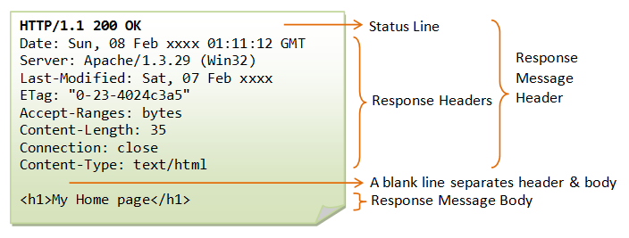
Generating Server Response: HTTP Status codes
When a web server responds to a request from a browser or other when client, the response typically consists of a status line, some response headers, a blank line, and the document.

Slide 47
When a Web server responds to a request from a browser or other Web client,
The response consists of a status line, some response headers, a blank line, and the document.
Example:
HTTP Version
Status Code
Message
HTTP/1.1 200 OK
Content-Type: text/plain
Hello World
Status Line
Response Header

Slide 48
Contd..,
Specifying Status codes
The HTTP response status line consists of an HTTP version, a status code, and an associated message.
The general method of setting status code is simply to call response.setStatus(int)
Takes int has an argument
There are two common cases where a shortcut method in HttpServletResponse is provided. just be aware that both of these methods throw IOException.
public void sendError(int code, String message)
public void sendRedirect(Sritng url)

Slide 49
Contd..,
public void sendError(int code, String message)
The sendError method sends a status code (usually 404) along with a short message that is automatically formatted inside an HTML document and sent to the client.
public void sendRedirect(String url)
The sendRedirect method generates a 302 response along with a Location header giving the URL of the new document. With servlets version 2.1, this must be an absolute URL.
In version 2.2, either an absolute or a relative URL is permitted and the system automatically translates relative URLs into absolute ones before putting them in the Location header.

Slide 50
Contd..,
These codes fall into five general categories:
Status Code | Description
100-199 | Codes in the 100s are informational, indicating that the client should respond with some other action.
200-299 | Values in the 200s signify that the request was successful
300-399 | Values in the 300s are used for files that have moved and usually include a Location header indicating the new address.
400-499 | Values in the 400s indicate an error by the client.
500-599 | Codes in the 500s signify an error by the server.

Slide 51
Common HTTP 1.1 Status Code
Status code & Message | Constant Name | Description
200 | SC_OK | A value of 200 means that everything is fine.
204 | SC_NO_CONTENT | Browser should keep displaying previous document, no new document is available
400 | SC_BAD_REQUEST | status indicates bad syntax in the client request.
401 | SC_UNAUTHORIZED | signifies that the client tried to access a password-protected page without proper identifying information in the Authorization header. The response must include a WWW-Authenticate header.
404 | SC_NOT_FOUND | This value is the standard “no such page” response.
503 | SC_SERVICE_UNAVAILABLE | signifies that the server cannot respond because of maintenance or overloading
504 | SC_GATEWAY_TIMEOUT | is used by servers that act as proxies or gateways;.

Slide 52
Generating server response: HTTP Response Headers
The most general way to specify headers is to use the setHeader method of HttpServletResponse.
This method takes two strings: the header name and the header value.
Example: response.setHeader(“Refresh”, 5);
You must set the headers before the first use of the PrintWriter or OutputStream that transmits the document content
public void setHeader(string headername, int headervalue)

Slide 53
Contd..,
There is another two special methods to set headers that contain dates and integers:
setDateHeader(String header, long milliseconds)
setIntHeader(String header, int headerValue)
If you want to add a new header rather than replace any existing header with the same name.
addHeader(string headername, int headervalue) //add header regardless of whether a header name already exists
addDateHeader(String header, long milliseconds)
addIntHeader(String header, int headerValue)
Finally, HttpServletResponse also supplies a number of methods for specifying common headers.

Slide 54
Contd..,
Finally, HttpServletResponse also supplies a number of methods for specifying common headers.
Methods | Meaning
setContentType() | sets the Content-Type header(MIME) used by the majority of servlets
setContentLength() | sets the Content-Length header used for persistent (keep-alive) HTTP connections.
addCookie() | Adds a value to the Set-Cookie header
sendRedirect() | Sets Location header (plus changes status code)

Slide 55
HTTP 1.1 Response Headers and Their Meaning
The possible HTTP1.1 response headers along with a brief summary.
Header Name | Meaning
Accept-Ranges | tells the client whether or not you accept Range request headers.
Age | is used by proxies to indicate how long ago the document was generated by the original server.
Allow | specifies the request methods (GET, POST, etc.)
Cache-Control Pragma | the circumstances in which the response document can safely be cached. It can have values public, private or no-cache. Public means document is cacheable, Private means document is for a single user and can only be stored in private caches no-cache means document should never be cached.
Connection | instructs the browser whether to use persistent in HTTP connections or not.
Content-Encoding | indicates the way in which the page was encoded during transmission.

Slide 56
Contd..,
Header Name | Meaning
Content-Language | This header signifies the language in which the document is written. Example: en, en-us, ru, etc.
Content-Length | indicates the number of bytes in the response.
Content-Location | supplies an alternative address for the requested document. Content-Location is informational;
Content-Range | is sent with partial-document responses and specifies how much of the total document was sent
Content-Type | gives the MIME type of the response document. The default MIME type for servlets is text/plain Example: application/zip:- Zip archive image/gif:- GIF image text/html:- HTML document video/mpeg:- MPEG video clip
Date | specifies the current date in GMT format.

Slide 57
Contd..,
Header Name | Meaning
ETag | gives names to returned documents so that they can be referred to by the client later
Expires | The time at which document should be considered out-of-date and thus should no longer be cached. Use setDateHeader() to set this header
Last-Modified | When time document was last changed.
Location | should be included with all responses that have a status code in the 300s. The URL to which browser should reconnect. Use sendRedirect instead of setting this directly
Refresh | The number of seconds until browser should reload page. Can also include URL to connect to.
Set-Cookie | This header specifies a cookie associated with the page.
Server, Retry –After, Trailer, Transfer- Encoding, WWW-Authenticate

Slide 58
GET vs POST
 | Get | Post
HTTP Request | The request contains only the request line and HTTP header | Along with request line and header it also contains HTTP body.
Parameter Passing | The form elements are passed to the server by appending at the end of the URL | The form elements are passed in the body of the HTTP request.
Size | The parameter data is limited(the limit depends on the container) | Can send huge amount of data to the server.
Usage | Generally used to fetch some information from the host. | Generally used to process the sent data.

Slide 59
Handling Cookies
Cookies are small bits of textual information that a web server sends to a browser and that browser returns unchanged when later visiting the same website or domain.
Cookies are text files stored on the client computer and they are kept for various information tracking purpose.
Java Servlets transparently supports HTTP cookies.

Slide 60
Contd..,
Benefits of cookies
Identifying a user during an e-commerce
Avoiding username and password
Customizing a site
Focusing advertising

Slide 61
Contd..,
Problems with cookies
Cookies are not a serious security threat
they can present a significant threat to privacy
Cookies are never interpreted or executed in any way and thus cannot be used to insert viruses or attack your system.
Since browsers generally only accept 20 cookies per site and 300 cookies total and since each cookie can be limited to 4 kilobytes, cookies cannot be used to fill up someone’s disk or launch other denial of service attacks.

Slide 62
Contd..,
Problems
First, Some people don’t like the fact that search engines can remember that they’re the user who usually does searches on certain topics.
Second, privacy problem occurs when sites rely on cookies for overly sensitive data.

Slide 63
Cookie API
Creating Cookie
Call the Cookie constructor with a cookie name and a cookie value, both of which are strings
javax.servlet.http.Cookie class provides the functionality of using cookies.
Constructor of Cookie class
Constructors | Description
Cookie( ) | Construct cookie
Cookie(String name, String value) | Constructs a cookie with a specified name and value

Slide 64
Contd..,
Syntax:
Example:
Cookie ck = new Cookie(“User name”, “value”);
Neither the name nor the value should contain white space or any of the following characters: [ ] ( ) = , " / ? @ : ;
Cookie obj_name= new Cookie(“name”, “value”);

Slide 65
Cookie Attribute
Before adding the cookie to the outgoing headers, you can set various characteristics of the cookie by using one of the following
setXxx methods
getXxx method to retrieve the attribute value.
where Xxx is the name of the attribute you want to specify.

Slide 66
Contd..,
Methods | Description
public String getComment( ) public void setComment(String comment) | These methods look up or specify a comment associated with the cookie. The comment is used purely for informational purposes on the server; it is not sent to the client
public String getDomain( ) public void setDomain(String domainPattern) | These methods get or set the domain to which the cookie applies. the browser only returns cookies to the exact same hostname that sent them.
public int getMaxAge( ) public void setMaxAge(int lifetime) | These methods tell how much time (in seconds) should elapse before the cookie expires. A negative value, which is the default, indicates that the cookie will last only for the current session and will not be stored on disk. value of 0 instructs the browser to delete the cookie.
public String getName( ) public void setName(String cookieName) | This pair of methods gets or sets the name of the cookie.

Slide 67
Contd..,
Methods | Description
public String getPath( ) public void setPath(String path) | These methods get or set the path to which the cookie applies. If you don’t specify a path, the browser returns the cookie only to URLs in or below the directory containing the page that sent the cookie.
public boolean getSecure( ) public void setSecure(boolean secureFlag) | This pair of methods gets or sets the Boolean value indicating whether the cookie should only be sent over encrypted (i.e., SSL) connections. The default is false; the cookie should apply to all connections.
public String getValue( ) public void setValue(String cookieValue) | The getValue method looks up the value associated with the cookie; The setValue method specifies it.
public int getVersion( ) public void setVersion(int version) | These methods get/set the cookie protocol version the cookie complies with. Version 0, the default, follows the original Netscape specification Version 1, not yet widely supported

Slide 68
Creating cookie and placing in response headers
Creating a new Cookie
Cookie ck = new Cookie(“username”, value);
Setting up lifespan for cookie
ck.setMaxAge(30*60);
Sending the cookie to the client
response.addCookie(ck);
Getting cookies from client request
Cookie ck[ ] = request.getCookies();

Slide 69
Contd..,
Iterating through the array of cookies
Removing Cookies
Cookie[ ] ck = request.getCookies( );
for(int i=0;i<ck.length;i++){
out.print("<br>"+ck[i].getName()+" "+ck[i].getValue();
}
Cookie ck=new Cookie("user","");//deleting value of cookie
ck.setMaxAge(0);//changing the maximum age to 0 seconds
response.addCookie(ck);//adding cookie in the response

Slide 70
Session Management
Session: interval of time
Session Tracking : is a way to maintain state (data) of an user.
HTTP is a stateless protocol.
All requests and responses are independent.
But sometimes you need to keep track of client's activity across multiple requests.
For e.g.: When a User logs in to website, no matter on which web page he visits after logging in, his credentials will be with the server, until he logs out. So this is managed by creating a session.
Session Management is a mechanism used by the Web container to store session information for a particular user.

Slide 71
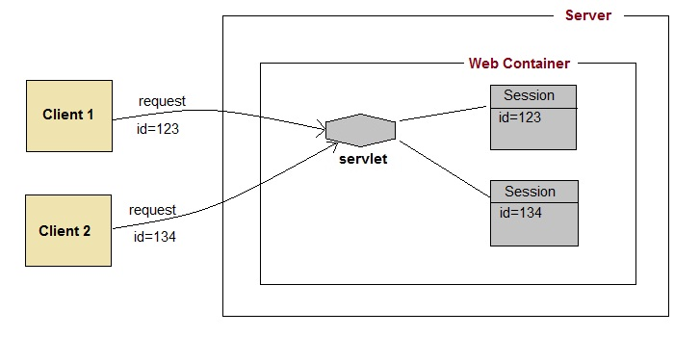
Sessions Management: How Session works

Slide 72
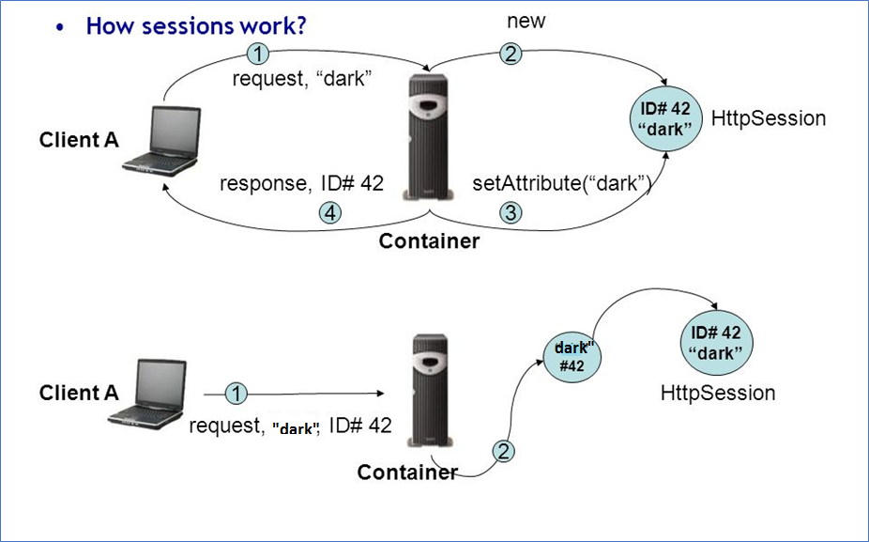
How Session Works
Initial Request
Next Request

Slide 73
Session Management
There are four different techniques used by Servlet application for session management.
1. Cookies
2. URL- Rewriting
3. Hidden form fields
4. HttpSession

Slide 74
Cont..,
Cookies
Cookies are small pieces of information that are sent in response from the web server to the client.
Cookies are stored on client's computer. They have a lifespan and are destroyed by the client browser at the end of that lifespan.
Advantage of cookie
Simplest technique of maintaining the state
Cookies are maintained at client side.
Disadvantage
It will not work if cookie is disabled from the browser.
Only textual information can be set in Cookie object

Slide 75
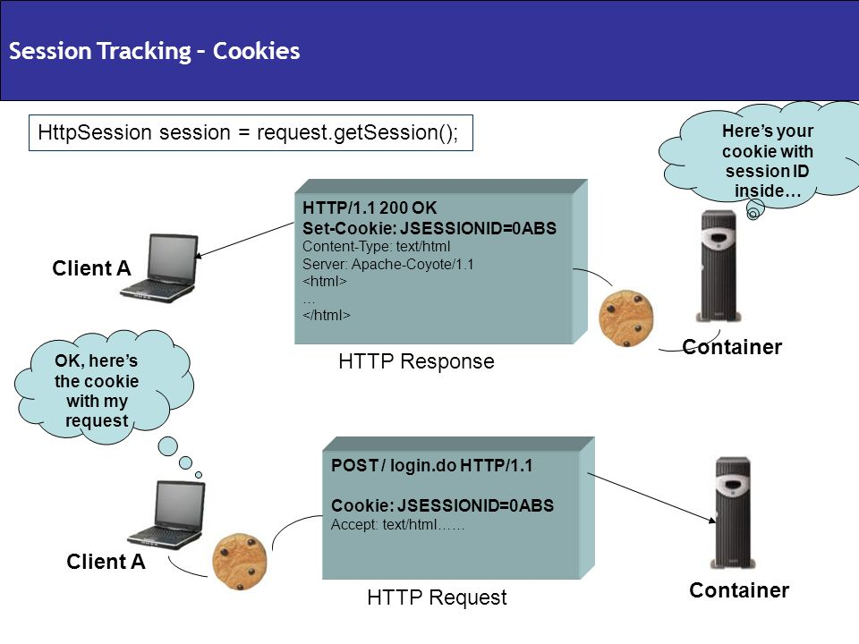
Session Tracking - Cookies

Slide 76
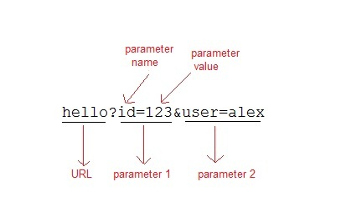
Contd..,
URL-rewriting
If the client has disabled cookies in the browser then session management using cookie wont work. In that case URL Rewriting can be used as a backup. URL rewriting will always work.
In URL rewriting, a token(parameter) is added at the end of the URL. The token consist of name/value pair separated by an equal(=) sign.

Slide 77
Contd..,
When the User clicks on the URL having parameters, the request goes to the Web Container with extra bit of information at the end of URL. The Web Container will fetch the extra part of the requested URL and use it for session management.
The getParameter() method is used to get the parameter value at the server side.
Advantage of URL-Rewriting
It will always work whether cookie is disabled or not (browser independent).
Extra form submission is not required on each pages.
Disadvantage of URL-Rewriting
It will work only with links.
It can send Only textual information.

Slide 78
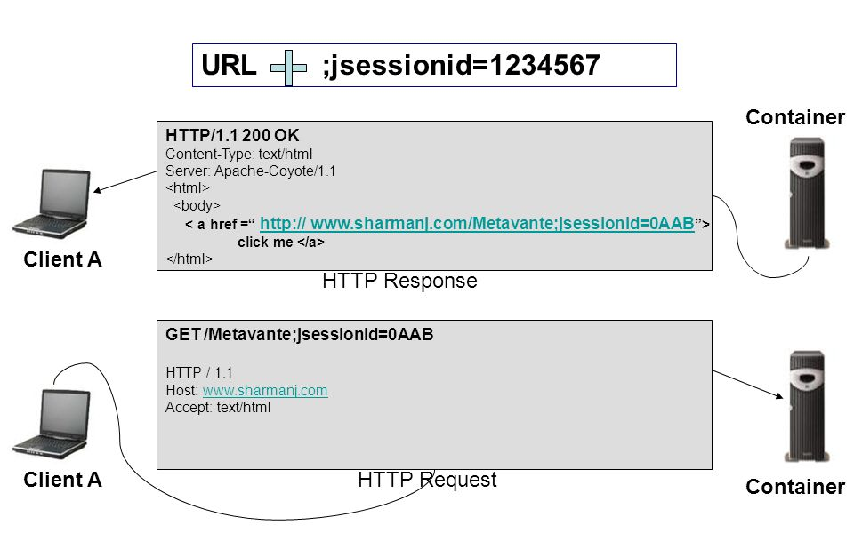
URL-Rewriting

Slide 79
Contd..,
Hidden form fields
Hidden form field can also be used to store session information for a particular client.
User information is stored in hidden field value and retrieved from another servlet.
<INPUT TYPE="HIDDEN" NAME="session" VALUE=“username">
Advantage
Does not have to depend on browser whether the cookie is disabled or not.
Inserting a simple HTML Input field of type hidden is required. Hence, its easier to implement.
Disadvantage
Extra form submission is required on every page. This is a big overhead.

Slide 80
Contd..,
HttpSession
Servlets provide an outstanding technical solution: the HttpSession API.
This high-level interface is built on top of cookies or URL-rewriting

Slide 81
The Session Tracking API
HttpSession object is used to store entire session with a specific client.
We can store
retrieve and
remove attribute from HttpSession object.
Any servlet can have access to HttpSession object throughout the getSession() method of the HttpServletRequest object.

Slide 82
Creating a new Session
Creating a session
HttpSession session =request.getSession();
// getsession() method returns a session. If the session already exists, it returns the existing session else create a new session
HttpSession session = request.getSession(true);
// getsession(true) always returns new session
Getting a pre-existing session
HttpSession session = request.getSession(false); //getSession(false)will check existence of session, If session exists, then it returns the reference of that session object, if not, this methods will return null
Destroying a session
session.invalidate( ); //destroy a session

Slide 83
Methods Available in HTTP Session class
1 | public Object getValue(String name) public Object getAttribute(String name) These methods extract a previously stored value from a session object. They return null if there is no value associated with the given name. getAttribute is preferred and getValue is deprecated.
2 | public void putValue(String name, Object value) public void setAttribute(String name, Object value) These methods associate a value with a name. Use putValue with servlets and either setAttribute (preferred) or putValue (deprecated) with version 2.2 servlets.
3 | public void removeValue(String name) public void removeAttribute(String name) These methods remove any values associated with the designated name. If the value being removed implements HttpSessionBindingListener, its valueUnbound method is called.

Slide 84
Contd..,
4 | public String[ ] getValueNames() public Enumeration getAttributeNames() These methods return the names of all attributes in the session. Use getValueNames in version 2.1 of the servlet specification. In version 2.2, getValueNames is supported but deprecated; use getAttributeNames instead.
5 | public String getId() This method returns the unique identifier generated for each session. It is sometimes used as the key name when only a single value is associated with a session, or when information about sessions is being logged.
6 | public int getMaxInactiveInterval() public void setMaxInactiveInterval(int seconds) These methods get or set the amount of time, in seconds, that a session should go without access before being automatically invalidated. A negative value indicates that the session should never time out

Slide 85
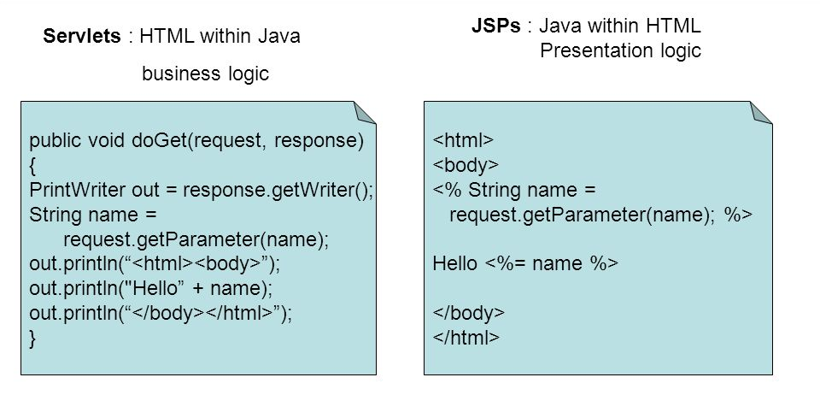
JSP Overview

Slide 86
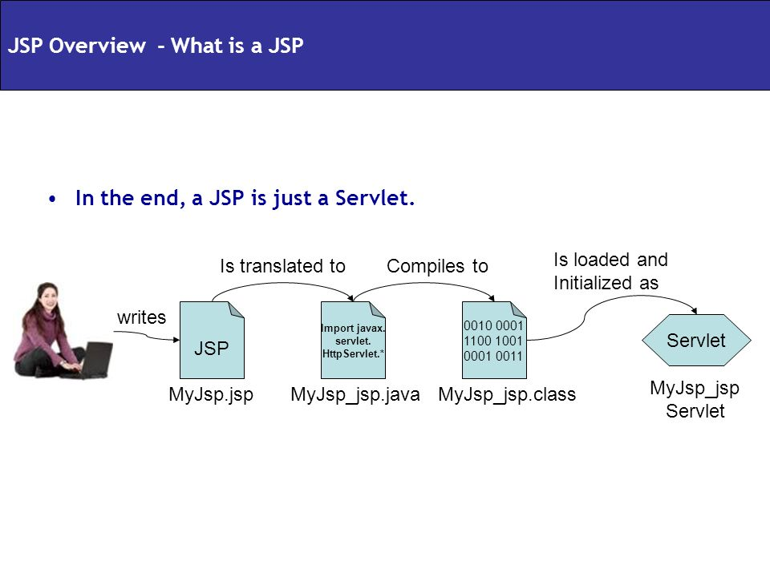
JSP - Technology

Slide 87
JSP
JSP technology is used to create dynamic web applications.
A JSP page is a text document that contains two types of text:
static data, which can be expressed in any text-based format (such as HTML, SVG, WML, and XML),
JSP elements, which construct dynamic content.
The recommended file extension for the source file of a JSP page is .jsp
The JSP elements in a JSP page can be expressed in two syntaxes, standard and XML

Slide 88
Phases in JSP
Whenever we write in a JSP page, that JSP page will undergo the following phases:
Translation phase: converts .jsp program into .java program internally by the container.
Compilation phase: .java program into .class file
Execution or Running phase: It is the process of executing .class file by the container.
Note: When we make very first request to a JSP page, translation phase, compilation phase and execution phase will be taken place.
From second request to further sub sequent requests only execution phase taking place provided when we are not modifying JSP page.

Slide 89
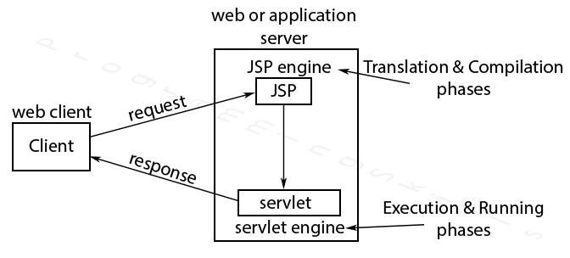
JSP Architecture

Slide 90
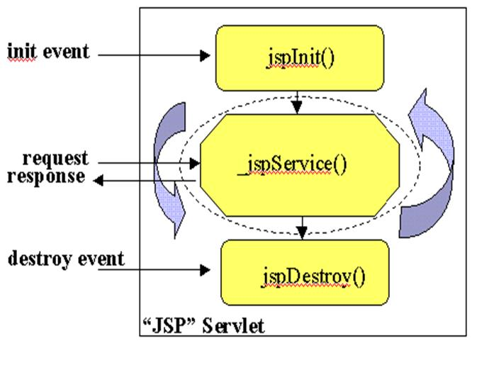
Life-Cycle of JSP

Slide 91
Need for JSP
JSP provides an easier way to code dynamic web pages.
JSP does not require additional files like, java class files, web.xml etc
Any change in the JSP code is handled by Web Container(Application server like tomcat), and doesn't require re-compilation.
JSP pages can be directly accessed, and web.xml mapping is not required like in servlets.

Slide 92
Advantage of JSP
Easy to maintain and code.
High Performance and Scalability.
JSP, so it is platform independent.
is built on Java technology

Slide 93
JSP Elements (Basic Syntax)
Scriplets
<% int i =10; %>
<% Student sob = new Student(); %>
Expression
<%= i; %>
<%= sob.getName(); %>
Declarations
<%! Int i=10; %>
<%! void display() { System.out.println(“Hello”);} %>
Directives
pages : <%@ import =“foo.*” %>
include: <%@ include file =“/foo/myjsp.jsp” %>
taglib : <%@taglib uri =“Tags” prefix=“cool” %>
= out.println(i);
= out.println(sob.getName());

Slide 94
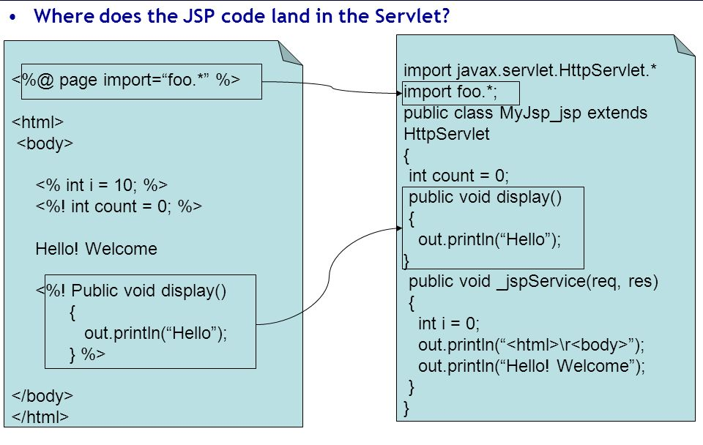
JSP Elements- JSP to Servlet

