Slide 1
Module 2
JSP and Controlling the Structure of generated Servlets

Slide 2
Invoking java code with JSP scripting elements
Creating Template Text
Invoking java code from JSP
Limiting java code in JSP
Using jsp expressions
Comparing servlets and jsp
Writing scriptlets
For example Using Scriptlets to make parts of jsp conditional
Using declarations
Declaration example

Slide 3
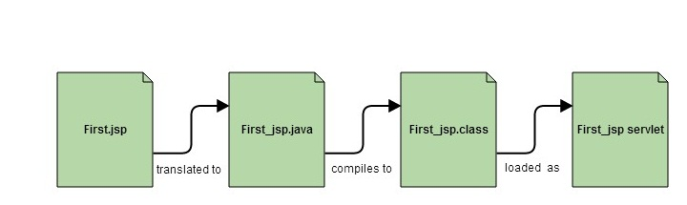
JSP as Servlet

Slide 4
Invoking java code with JSP scripting elements
JSP Scripting element are written inside <% %> tags.
These code inside <% %> tags are processed by the JSP engine during translation of the JSP page.
Any other text in the JSP page is considered as HTML code or plain text.

Slide 5
Creating Template Text
JSP document consists of static text (usually HTML), known as template text.
There are two minor exceptions to the “template text is passed straight through” rule.
First, if you want to have <% or %> in the output, you need to put <\% or %\> in the output, you need to put <\% or %\> in the template text.
Second, if you want a comment to appear in the JSP page but not in the resultant document, use
<%-- JSP COMMENTS --%>
HTML comments of the form are passed through to the client normally
<!-- HTML COMMENTS -->

Slide 6
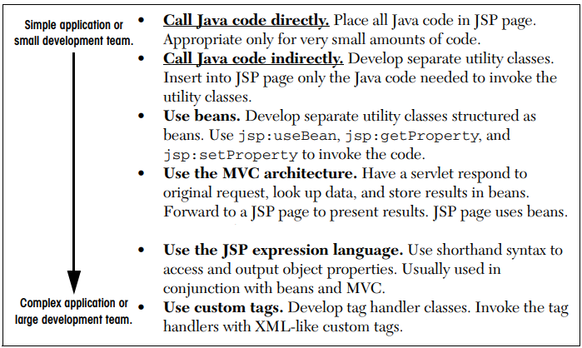
Invoking java code from JSP
There are a number of different ways to generate dynamic content from JSP, as illustrated in the below figure.

Slide 7
Types of JSP Scripting Elements
JSP scripting elements allows to insert Java code into the servlet that will be generated from the JSP page. There are three forms:
Expressions of the form, which are evaluated and inserted into the servlet’s output.
Scriptlets of the form, which are inserted into the servlet’s _jspService method (called by service).
Declarations of the form, which are inserted into the body of the servlet class, outside any existing methods.
Directive is used to provide instructions to the container.

Slide 8
Limiting java code in JSP
There are two options
Put 25 lines of Java code directly in the JSP page
Put those 25 lines in a separate Java class and put 1 line in the JSP page that invokes it

Slide 9
Contd..,
Why is the second option much better?
Development- Write the separate class in a Java environment (editor or IDE), not an HTML environment
Compilation. To compile a regular Java class, you press the Build button in your IDE or invoke javac.
Debugging- If there are syntax errors, it is immediately seen at compile time.
Testing. You can write a test routine with a loop that does 10,000 tests and reapply it after each change.
Reuse. You can use the same class from multiple pages

Slide 10
Using jsp expressions
A JSP expression is used to insert values directly into the output. It has the following form.
<%= Java Expression %>
The expression is evaluated, converted to a string, and inserted in the page.
This evaluation is performed at runtime (when the page is requested) and thus has full access to information about the request.
For example, the following shows the date/time that the page was requested.
Current time: <%= new java.util.Date( ) %>

Slide 11
Predefined Variables (or implicit objects)
To simplify these expressions, a number of predefined variables (or “implicit objects”). are used.
These Objects are the Java objects that the JSP Container makes available to the developers in each page and the developer can call them directly without being explicitly declared.
For example you can retrieve HTML form parameter data by using request variable, which represent the HttpServletRequest object.

Slide 12
Contd..,
<%
String user = request.getParameter(“user”);
%>
Hello, <% out.println(user); %>
The “request” object is implicit here, associated with HttpServletRequest object
The ”out” object is implicit in JSP, associated with JspWriter object

Slide 13
Contd..,
Following are the JSP implicit object:
Implicit Object | Description
request | The HttpServletRequest object associated with the request.
response | The HttpServletResponse object associated with the response that is sent back to the browser
session | The HttpSession object associated with the session for the given user of request.
out | The JspWriter object associated with the output stream of the response.
application | The ServletContext object for the web application.
exception | The exception object represents the Throwable object that was thrown by some other JSP page.

Slide 14
Contd..,
Jsp/Servlet Correspondence
Example: Sample JSP Expression: Random Number
<H1>A Random Number</H1>
<%= Math.random() %>
Resulting Servlet Code: Random Number
public void _jspService(HttpServletRequest request, HttpServletResponse response) throws ServletException, IOException {
HttpSession session = request.getSession();
JspWriter out = response.getWriter();
out.println("<H1>A Random Number</H1>");
out.println(Math.random());
...

Slide 15
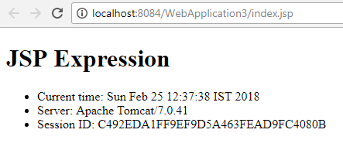
Example: JSP Expression
<!DOCTYPE html>
<html>
<head><title>JSP Page</title></head>
<body> <h1>JSP Expression</h1>
<UL>
<li>Current time: <%= new java.util.Date() %> </li>
<li>Server: <%= application.getServerInfo() %> </li>
<li>Session ID: <%= session.getId() %> </li>
</UL>
</body> </html>

Slide 16
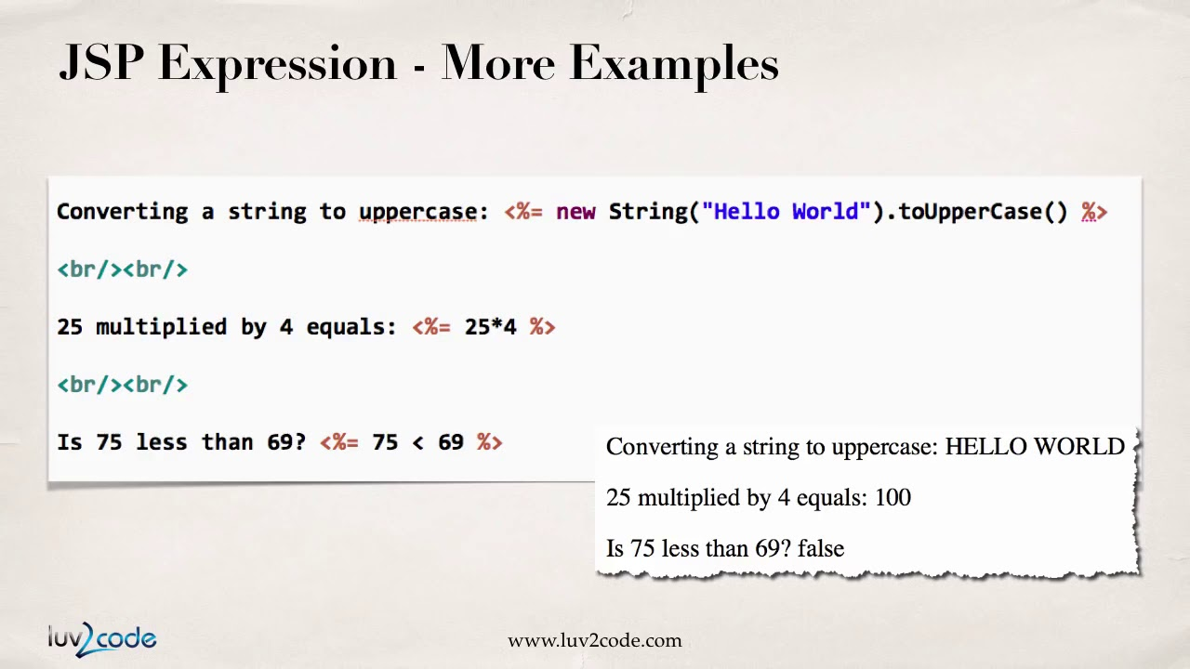
Contd..,

Slide 17
Comparing JSP and Servlets
JSP | Servlet
JSP is a web page scripting language that can generate dynamic content | Servlets are already compiled which also creates dynamic web content
JSP runs slower compared to servlet as it takes compilation time to convert into java Servlets | Servlets run faster compared to JSP.
It’s easier to code in JSP than in Java Servlets. | Its little much code to write here.
In MVC, jsp act as a view. | In MVC, servlet act as a controller.
JSP are generally preferred when there is not much processing of data required. | servlets are best for use when there is more processing and manipulation involved.
The advantage of JSP programming over servlets is that we can build custom tags which can directly call Java beans. | There is no such custom tag facility in servlets.
We can achieve functionality of JSP at client side by running JavaScript at client side. | There are no such methods for servlets.

Slide 18
Example in Servlet :ThreeParams.java
public class ThreeParams extends HttpServlet {
public void doGet(HttpServletRequest request, HttpServletResponse response)
throws ServletException, IOException {
PrintWriter out = response.getWriter();
String title = "Reading Three Request Parameters";
out.println("<HTML>\n" +
"<HEAD><TITLE>" + title + "</TITLE></HEAD>\n" +
"<BODY BGCOLOR=\"#FDF5E6\">\n" +
"<H1 ALIGN=\"CENTER\">" + title + "</H1>\n" +
"<UL>\n" +
" <LI><B>param1</B>: "
+ request.getParameter("param1") + "\n" +
" <LI><B>param2</B>: "
+ request.getParameter("param2") + "\n" +
" <LI><B>param3</B>: "
+ request.getParameter("param3") + "\n" +
"</UL>\n" +
"</BODY></HTML>"); } }

Slide 19
JSP
<!DOCTYPE HTML PUBLIC "-//W3C//DTD HTML 4.0 Transitional//EN">
<HTML>
<HEAD>
<TITLE>Reading Three Request Parameters</TITLE> </HEAD>
<BODY>
<H1>Reading Three Request Parameters</H1>
<UL>
<LI><B>param1</B>:
<%= request.getParameter("param1") %>
<LI><B>param2</B>:
<%= request.getParameter("param2") %>
<LI><B>param3</B>:
<%= request.getParameter("param3") %>
</UL>
</BODY></HTML>

Slide 20
Writing Scriptlets
Scriptlet Tag allows to write java code inside JSP page
Scriptlet tag implements the _jspService method functionality by writing script/java code.
Scriptlets have the following form:
Scriptlets have access to the same automatically defined variables as do expressions (request response, session, out, etc.). explicitly sending output to the resultant page, out variable is used
<% Java Code %>

Slide 21
Example of scriptlet( )
<html>
<head>
<title>My First JSP Page</title>
</head>
<% int count = 0; %>
<body>
Page Count is
<% out.println(++count); %>
</body>
</html>

Slide 22
Using Scriptlets to make parts of jsp conditional
Insert 1 to many lines of java code
Key to this approach are the facts that
(a) code inside a scriptlet gets inserted into the resultant servlet’s _jspService method (called by service) exactly as written and
(b) that any static HTML (template text) before or after a scriptlet gets converted to print statements.

Slide 23
Using Declaration
A JSP declaration lets you define methods or fields that get inserted into the main body of the servlet class (outside the _jspService method)
Declaration is made inside the servlet class but outside the service method.
A declaration has the following form:
<%! Field or Method Definition %>

Slide 24
Contd..,
<BODY>
<% if (Math.random() < 0.5) { %>
<H1>Have a <I>nice</I> day!</H1>
<% } else { %>
<H1>Have a <I>lousy</I> day!</H1>
<% } %>
</BODY>
if (Math.random() < 0.5) {
out.println("<H1>Have a <I>nice</I> day!</H1>");
} else {
out.println("<H1>Have a <I>lousy</I> day!</H1>");
}
Overuse of this approach can lead to JSP code that is hard to understand and maintain.

Slide 25
Contd..,
<html>
<head> <title>My First JSP Page</title>
</head>
<%! int count = 0; %>
<body>
Page Count is:
<% out.println(++count); %>
</body>
</html>

Slide 26
Contd..,
JSP declarations can contain field (instance variable) definitions, method definitions, inner class definitions, or even static initializer blocks: anything that is legal to put inside a class definition but outside any existing methods.
Declarations almost always contain field or method definitions.
<H1>Some Heading</H1>
<%!
private String randomHeading() {
return("<H2>" + Math.random() + "</H2>");
}
%>
<%= randomHeading() %>

Slide 27
Declaration Example
<%! private int accessCount = 0; %>
Accesses to page since server reboot:
<%= ++accessCount %>

Slide 28
Controlling the Structure of generated servlets

Slide 29
The JSP page directive
JSP directive affects the overall structure of the servlet that results from the JSP page.
The jsp directives are messages that tells the web container how to translate a JSP page into the corresponding servlet.
Syntax:
i) <%@ directive attribute="value" %>
ii) <%@ directive attribute1="value1" attribute2="value2"
. . . . . . . . . . . . . . . .
attributeN="valueN" %>

Slide 30
Contd..,
In JSP, there are three types of directives:
page,
include, and
taglib

Slide 31
The JSP page directive
The page directive
controls the structure of the servlet by importing classes,
customizing the servlet superclass,
setting the content type
page directive can be placed anywhere within the document

Slide 32
The JSP page directive
The include directive
inserts a file into the servlet class at the time the JSP file is translated into a servlet.
An include directive should be placed in the document at the point at which you want the file to be inserted.
The taglib directive
which can be used to define custom markup tags;

Slide 33
Contd..,
The page directive lets you define one or more of the following case-sensitive attributes:
import,
contentType,
isThreadSafe,
session,
buffer,
autoflush,
extends,
info,
errorPage,
isErrorPage, and language

Slide 34
import attribute
The import attribute is used to import class, interface or all the members of a package.
It is similar to import keyword in java class or interface.
Use of the import attribute takes one of the following two forms:
<%@ page import="package.class" %>
2. <%@ page import="package.class1,...,package.classN" %

Slide 35
Contd..,
Example:
<html>
<body>
<%@ page import="java.util.Date" %>
Today is: <%= new Date() %>
</body>
</html>
The import attribute is the only page attribute that is allowed to appear multiple times within the same document
Although page directives can appear anywhere within the document, it is traditional to place import statements either near the top of the document

Slide 36
contentType Attribute
The contentType attribute sets the character encoding for the JSP page and for the generated response page. The default content type is text/html, charset=ISO-8859-1" which is the standard content type for HTML pages
<html>
<body>
<%@ page contentType=application/msword %>
Today is: <%= new java.util.Date() %>
</body>
</html>

Slide 37
session Attribute
The session attribute controls whether or not the page participates in HTTP sessions.
Use of this attribute takes one of the following two forms:
<%@ page session="true" %> <%-- Default --%>
<%@ page session="false" %>
A value of true indicates that the predefined variable session (of type HttpSession) should be bound to the existing session if one exists; otherwise, a new session should be created and bound to session.
A value false means that no sessions will be used automatically and attempts to access session variable

Slide 38
Contd..,
<%@ page session="true" %>
<html>
<head><title>session </title></head>
<body>
<h3>Hello this is a session page directive example.</h3>
<%
out.print("Session id:" + session.getId());
%>
</body>
</html>

Slide 39
isThreadSafe
The isThreadSafe attribute controls whether or not the servlet that results from the JSP page will implement the SingleThreadModel interface.
Use of the isThreadSafe attribute takes one of the following two forms:
<%@ page isThreadSafe="true" %> <%!-- Default --%>
<%@ page isThreadSafe="false" %>

Slide 40
Contd..,
isThreadSafe="true", creates multiple objects for the same JSP file when requested by multiple clients. Each client is served with a separate _jspService() method
isThreadSafe="false", allows the container to create one Servlet object for each client requesting the same JSP.

Slide 41
buffer attribute
The buffer attribute specifies the size of the buffer used by the out variable, which is of type JspWriter (a subclass of PrintWriter). Use of this attribute takes one of two forms:
<%@ page buffer="sizekb" %>
<%@ page buffer="none" %>
Servers can use a larger buffer than you specify, but not a smaller one.

Slide 42
Contd..,
For example, <%@ page buffer="32kb" %> means the document content should be buffered and not sent to the client until at least 32 kilobytes have been accumulated or the page is completed.
The default buffer size is server specific, but must be at least 8 kilobytes.

Slide 43
autofulsh attribute
The autoflush attribute controls whether the output buffer should be automatically flushed when it is full or whether an exception should be raised when the buffer overflows.
Use of this attribute takes one of the following two forms:
<%@ page autoflush="true" %> <%-- Default --%>
<%@ page autoflush="false" %>
A value of false is illegal when also using buffer="none".

Slide 44
extends
The extends attribute specifies a superclass that the generated servlet must extend.
For example, the following directive directs the JSP translator to generate the servlet such that the servlet extends somePackage.SomeClass
<%@ page extends="package.class" %>

Slide 45
info
The info attribute defines a string that can be retrieved from the servlet by means of the getServletInfo method.
Use of info takes the following form:
<%@ page info="Some Message" %>

Slide 46
errorPage
The errorPage attribute specifies a JSP page that should process any exceptions (i.e., something of type Throwable) thrown but not caught in the current page.
It is used as follows:
<%@ page errorPage="Relative URL" %>
The exception thrown will be automatically available to the designated error page by means of the exception variable.

Slide 47
iserrorPage and language
Any JSP file declared with isErrorPage (and set to a value of true), is capable to receive exceptions from other JSP pages. Implicit object exception is available to these pages only (set with true).
Default value is false.
<%@ page isErrorPage="true" %>
<%@ page isErrorPage="false" %> <%!-- Default --%>
It should be noted that errorPage and isErrorPage are used in combination with "exception" object.

Slide 48
language
The language attribute is intended to specify the scripting language being used, as below
<%@ page language="java" %>
since java is both the default and the only legal choice

Slide 49
isElignore attribute
The isELIgnored attribute takes boolean value of true or false as input.
If isELIgnored is true, then any Expression Language in JSP is ignored.
The default value of isELIgnored is false.
The example below illustrates the usage of isELIgnored attribute of page directive.
<%@ page isELIgnored="false" %>
<%@ page isELIgnored="true" %>

Slide 50
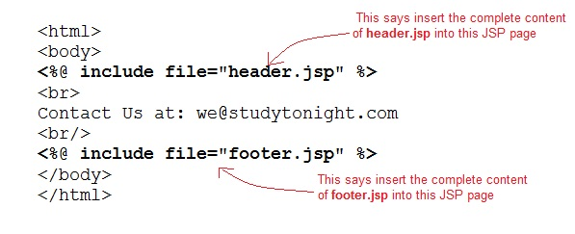
include directive
The include directive tells the Web Container to copy everything in the included file and paste it into current JSP file.
Syntax: <%@ include file="filename.jsp" %>

Slide 51
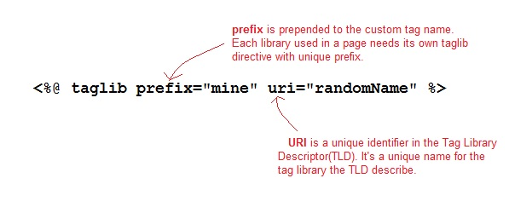
taglib directive
The taglib directive is used to define tag library that the current JSP page uses. A JSP page might include several tag library
JavaServer Pages Standard Tag Library (JSTL), is a collection of useful JSP tags, which provides many commonly used core functionalities.

Slide 52
Action Tags

Slide 53
Action tags
The action tags are used to control the flow between pages and to use Java Bean.
These tags are used to remove or eliminate scriptlet code from JSP page because scriplet code are technically not recommended nowadays.
It's considered to be bad practice to put java code directly inside your JSP page.
Standard tags begin with the jsp: prefix.
There are many JSP standard Action tag which are used to perform some specific task.

Slide 54
JSP action tags
JSP Action Tags | Description
jsp:forward | forwards the request and response to another resource.
jsp:include | includes another resource.
jsp:useBean | creates or locates bean object.
jsp:setProperty | sets the value of property in bean object.
jsp:getProperty | prints the value of property of the bean.
jsp:plugin | embeds another components such as applet.
jsp:param | sets the parameter value. It is used in forward and include mostly.
jsp:fallback | can be used to print the message if plugin is working. It is used in jsp:plugin.
Uses Bean Class

Slide 55
include action tag
Definition
Includes a page at the given location in the main page
Syntax:
<jsp:include page =“{ page_to _include}” flush=“true” />

Slide 56
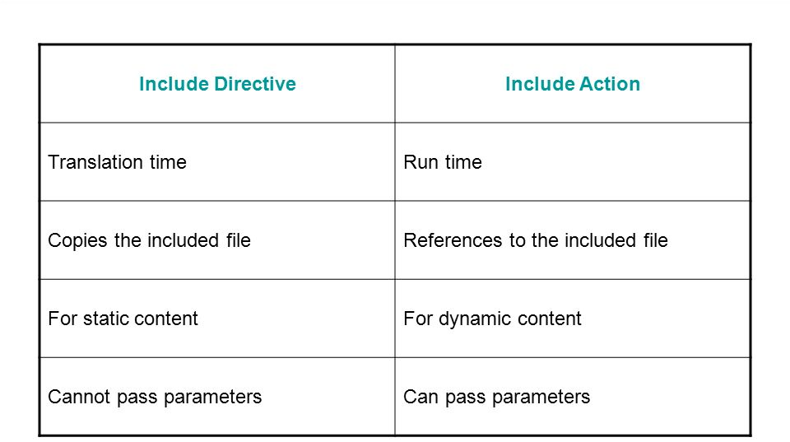
Jsp action: include directive vs include action

Slide 57
jsp:forward
The jsp:forward action tag is used to forward the request to another resource it may be jsp, html or another resource.
Syntax of jsp:forward action tag without parameter
Syntax of jsp:forward action tag with parameter
<jsp:forward page="relativeURL />
<jsp:forward page="relativeURL ">
<jsp:param name="param_name" value="param_value />
</jsp:forward>

Slide 58
jsp:param and jsp:params Elements
Definition
Pass parameters to the included/forwarded page
Syntax:
<jsp:include page =“{page_to_include}” flush=“true”>
<jsp:param name=“{param_name}" value=“{param_value }”/>
</jsp:include>
<jsp:forward page =“{page_to_forward}” flush=“true”>
<jsp:param name=“{param_name}" value=“{param_value }”/>
</jsp:forward>

Slide 59
Contd..,
<jsp:include page =“{page_to_include}” flush=“true”>
<jsp:params>
<jsp:param name=“{param_name}" value=“{param_value }”/>
<jsp:param name=“{param_name}" value=“{param_value }”/>
</jsp:params>
</jsp:include>

Slide 60
jsp:fallback Element
jsp:fallback element provides alternative text to browsers that do not support OBJECT or EMBED.
This element is used the same way as alternative text placed within an APPLET element
<jsp:plugin type=“applet”
code=“MyApplet.class” width=“450” height=“350”>
<jsp:fallback>
<B>Error: this example requires java.</B>
</jsp:fallback>
</jsp:plugin>

Slide 61
Including Applets for the Java Plug-In
The jsp:plugin element instructs the server to build a tag appropriate for applets that use the plug-in.
The jsp:plugin Element
The simplest way to use jsp:plugin is to supply four attributes
type
code
width
height
The attribute names are case sensitive, and single or double quotes are always required around the attribute values.

Slide 62
Contd..,
<APPLET CODE=“MyAppplet.class”
WIDTH=475 HEIGHT=350>
</APPLET>
With
<jsp:plugin type=“applet”
code=“MyApplet.class”
width=“475” height=“350”>
</jsp:plugin>

Slide 63
Contd..,
The jsp:plugin element has a number of other optional attribute
type
code
width
height
codebase
align
hspace
vspace
archive
name
title
jreversion
iepluginurl
nspluginurl

Slide 64
Why Use Beans
Using separate Java classes instead of embedding large amounts of code directly in JSP pages.
Beans are regular Java classes that follow some simple conventions defined by the JavaBeans specification; beans extend no particular class, are in no particular package, and use no particular interface.
Use of JavaBeans components provides three advantages over scriptlets and JSP expressions that refer to normal Java classes.
No Java syntax
Simpler object sharing
Convenient correspondence between request parameters and object properties.

Slide 65
JavaBean
A JavaBeans component is a Java class with the following features.
A no-argument constructor.
Properties defined with accessors and mutators(getter and setter method).
Class must not define any public instance variables.
The class must implement the java.io.Serializable interface.

Slide 66
jsp:useBean
Using a javaBean in JSP Page
Javabeans can be used in any JSP page using the <jsp:usebean> tag
For example:
<jsp:useBean id=“bean name”
class=“qualified path of bean”
scope=“page | request | application |session”>

Slide 67
Contd..,
The <jsp:useBean> is a way of declaring and initializing the actual bean object.
Syntax:
<jsp:useBean
<jsp:useBean id = "beanName" class = "className"
scope = "page | request | session | application">

Slide 68
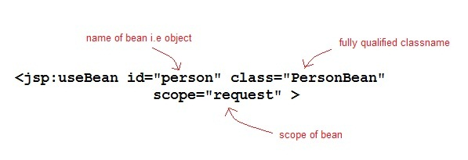
Contd..,

Slide 69
jsp:getProperty
jsp:getProperty. This element reads and outputs the value of a bean property. Reading a property is a shorthand notation for calling a method of the form
getXxx. This element is used as follows:
<jsp:getProperty name=“beanName”
property=“propertyName” />

Slide 70
jsp:setProperty
jsp:setProperty. This element modifies a bean property (i.e., calls a method of the form setXxx).
It is normally used as follows:
<jsp:setProperty name="beanName"
property="propertyName"
value="propertyValue" />
There are several ways to use jsp:setProperty, but the best is with property =“*”

Slide 71
Scope (Visibility)
Application (Most Visible)
Session
Request
Page
(Least Visible)

Slide 72
Scope
<jsp:useBean ... scope="page" />
‘page’ scope means, the jsp object can be accessed only from within the same page where it was created.
Jsp implicit objects out, exception, response, have page scope
<jsp:useBean … scope=“request”/>
Can access from any page
<jsp:useBean ... scope="session" />
Accessible from pages that belong to the same session.
<jsp:useBean ... scope="application" />
Can be accessed from any pages across the application

Slide 73
Including external file
JSP has three main capabilities for including external pieces into a JSP document:
The jsp:include action
The include directive
The jsp:plugin action

Slide 74
Including Pages at Request Time: The jsp:include Action
Enter jsp:include, a portable mechanism that lets you insert any of the following into the JSP output:
The content of an HTML page.
The content of a plain text document.
The output of JSP page.
The output of a servlet
The jsp:include action includes the output of a secondary page at the time the main page is requested.

Slide 75
Contd..,
The jsp:include action
include the output of a page at request time.
Advantage
it saves you from changing the main page when the included pages change.
Disadvantage
is that since it includes the output of the secondary page, not the secondary page’s actual code

Slide 76
Contd..,
The include directive
insert JSP code into the main page before that main page is translated into a servlet.
Advantage
Powerful
the included code can contain JSP constructs such as field definitions and content-type settings that affect the main page as a whole.
Disadvantage
hard to maintain

Slide 77
Contd..,
The jsp:plugin action
server-side Java, client-side Java in the form of Web-embedded
applets continues to play a role, especially within corporate intranets.

Slide 78
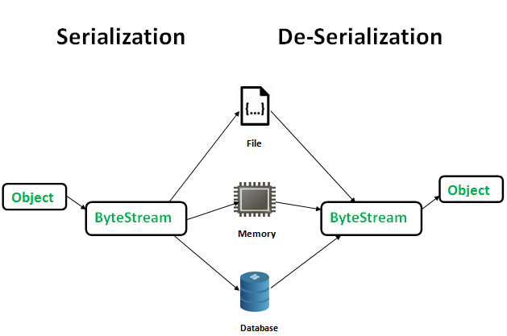
Serialization

