Slide 1

Customer Shopping Behavior Analysis
3,900 purchases • 18 columns • Goal: uncover spending patterns, segments, product & subscription insights

Slide 2
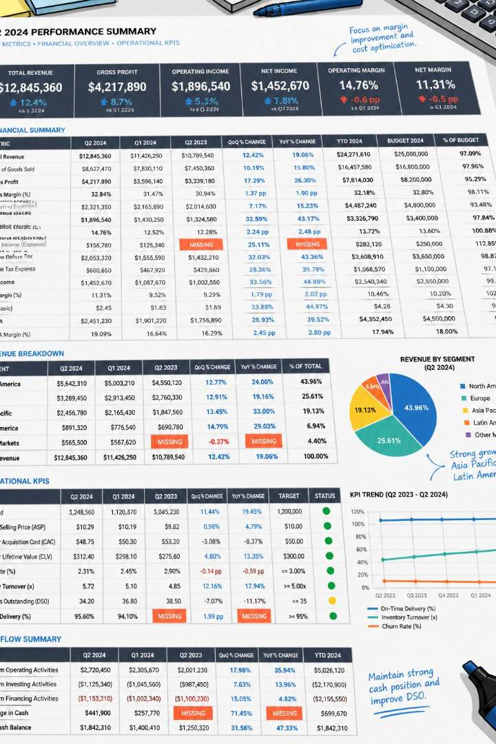
Dataset Summary
Rows & Columns
Key Features
3,900 rows • 18 columns
Demographics, purchase details, behavior, shipping, discounts
Missing Data
37 missing values in Review Rating

Slide 3

Exploratory Data Analysis (Python)
01
Load & Inspect
Used pandas: df.info(), .describe()
02
Clean & Impute
Imputed Review Rating by category median
03
Engineer Features
age_group, purchase_frequency_days; dropped promo_code_used
04
DB Integration
Loaded cleaned DataFrame to PostgreSQL

Slide 4
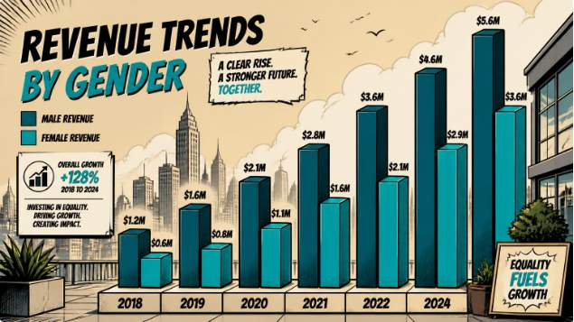
Revenue by Gender
Female
Male
$75,191 total revenue
$157,890 total revenue

Slide 5
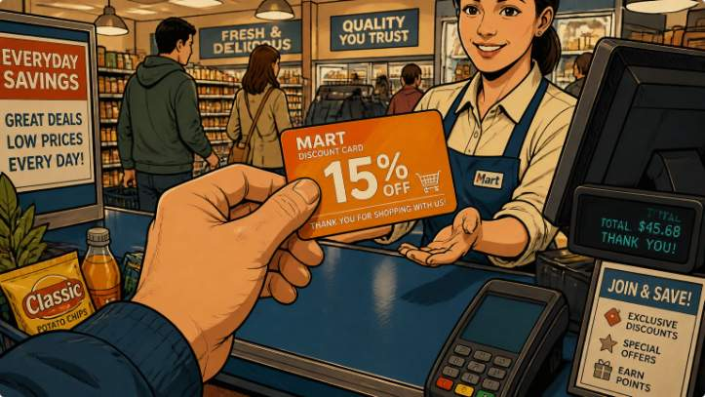


Discounts & High-Spenders
839 rows: customers who used discounts but spent above average
Examples
Insight
customer_id 2 → $64; 3 → $73; 4 → $90 ...
Discount users can still drive above-average spends

Slide 6
Discount-Dependent Products
Hat
Sneakers
Coat
50.00% discounted purchases
49.66%
49.07%
Sweater
Pants
48.17%
47.37%

Slide 7
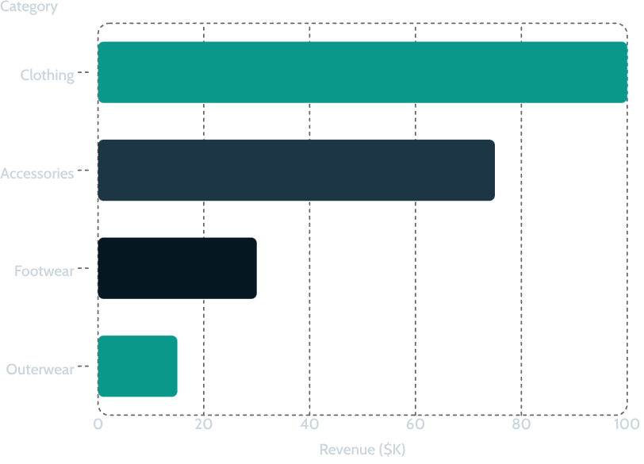



Top Categories
Clothing
Highest revenue & sales (1,800 orders)
Accessories
Strong performer (Jewelry, Sunglasses, Belt)
Footwear
Sandals, Shoes, Sneakers

Slide 8
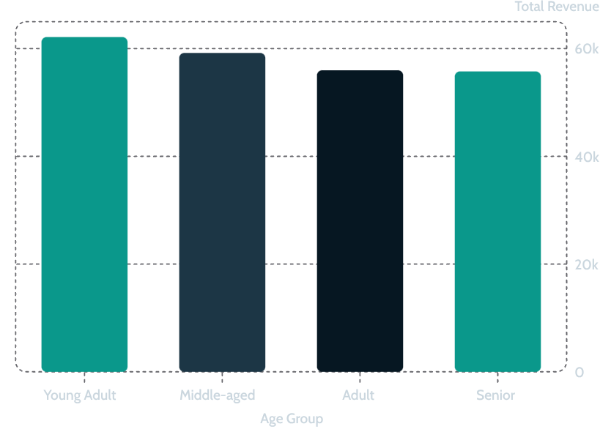
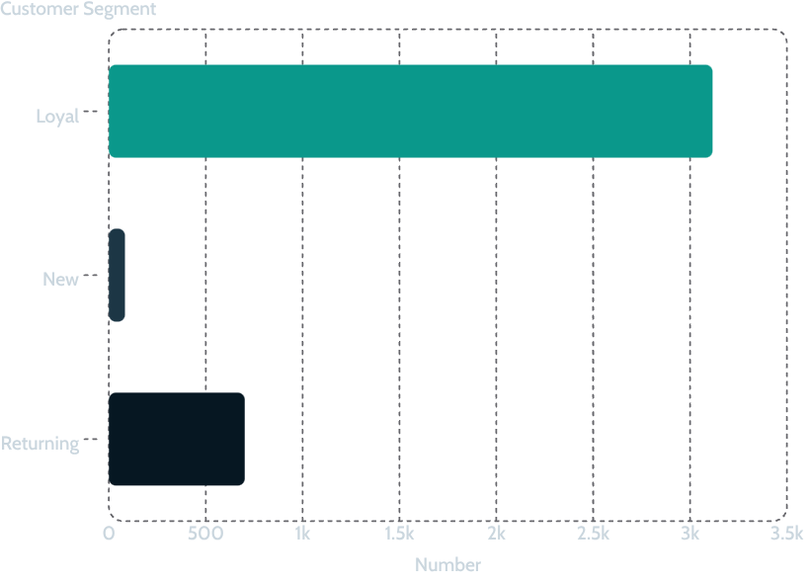
Revenue by Age Group
Focus marketing on Young Adult & Middle-aged groups
Segmentation: Loyal (majority), Returning, New

Slide 9
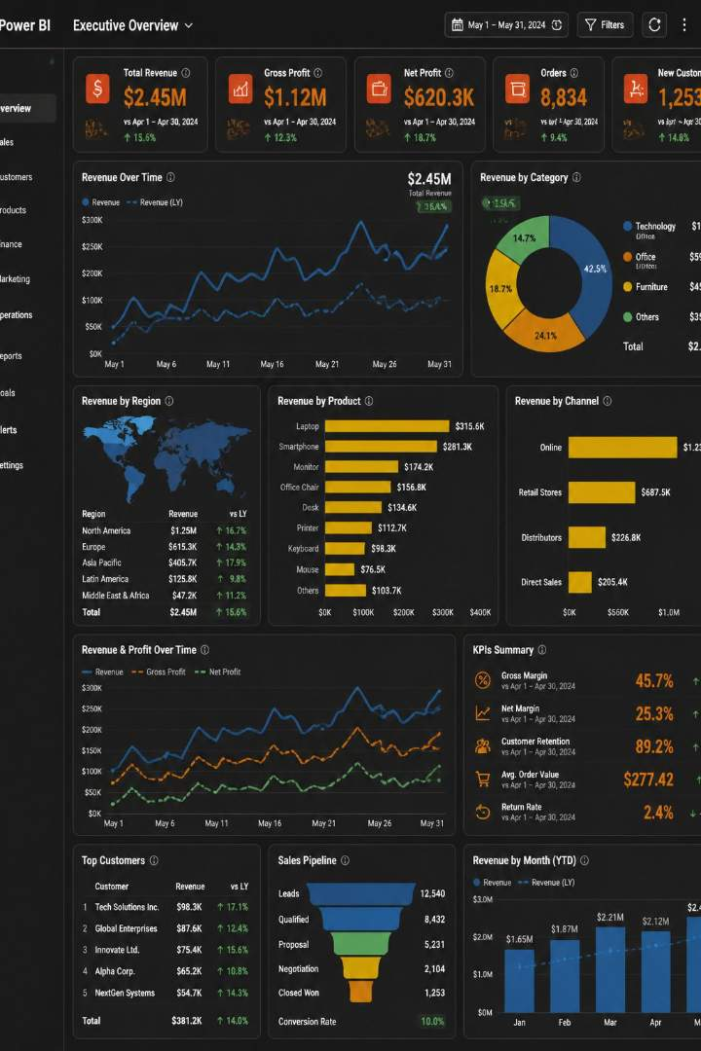
Power BI Dashboard Highlights
Key Metrics
3.9K customers • Avg purchase $59.76 • Avg rating 3.75
Subscription Split
27% Yes • 73% No (donut)
Sales & Revenue Charts
Clothing leads revenue & sales; visualize age & shipping breakdowns

Slide 10



Business Recommendations
Boost Subscriptions
Loyalty Programs
Review Discount Policy
Promote exclusive subscriber benefits
Reward repeat buyers to grow Loyal segment
Balance sales lift with margin protection
Product Positioning
Targeted Marketing
Highlight top-rated & best-selling items
Focus on high-revenue age groups & express-shipping users
Next steps: operationalize recommendations via targeted campaigns and pricing experiments

