Slide 1
AEROSTACK: An Architecture and Open-Source Software Framework for Aerial Robotics
By Indrajeet Saravanan

Slide 2
Classification of Software Components
Firmware: the time critical management of the hardware
Middleware: the time-critical control of the system
Operative System: the computer intensive non time-critical control and management of the system

Slide 3
Other Architecture Frameworks for UAS
“astec_mav_framework”
“hector_quadrotor” framework
“telekyb” framework
“Paparazzi” project
“Twirre” architecture
PX4 Flight Stack
APM Flight Stack

Slide 4
Why Aerostack?
Compared to other architectures and frameworks, the main contributions of Aerostack are twofold:
A complete multi-layered architectural organization to support fully autonomous flights
Versatile framework for multiple uses

Slide 5
Aerostack System Architecture
Follows the hybrid reactive/deliberative paradigm
Robotic paradigm can be described by the relationship between the three primitives of robotics: Sense Plan Act
Hierarchical/deliberative paradigm
The reactive paradigm
Hybrid deliberative/reactive paradigm

Slide 6
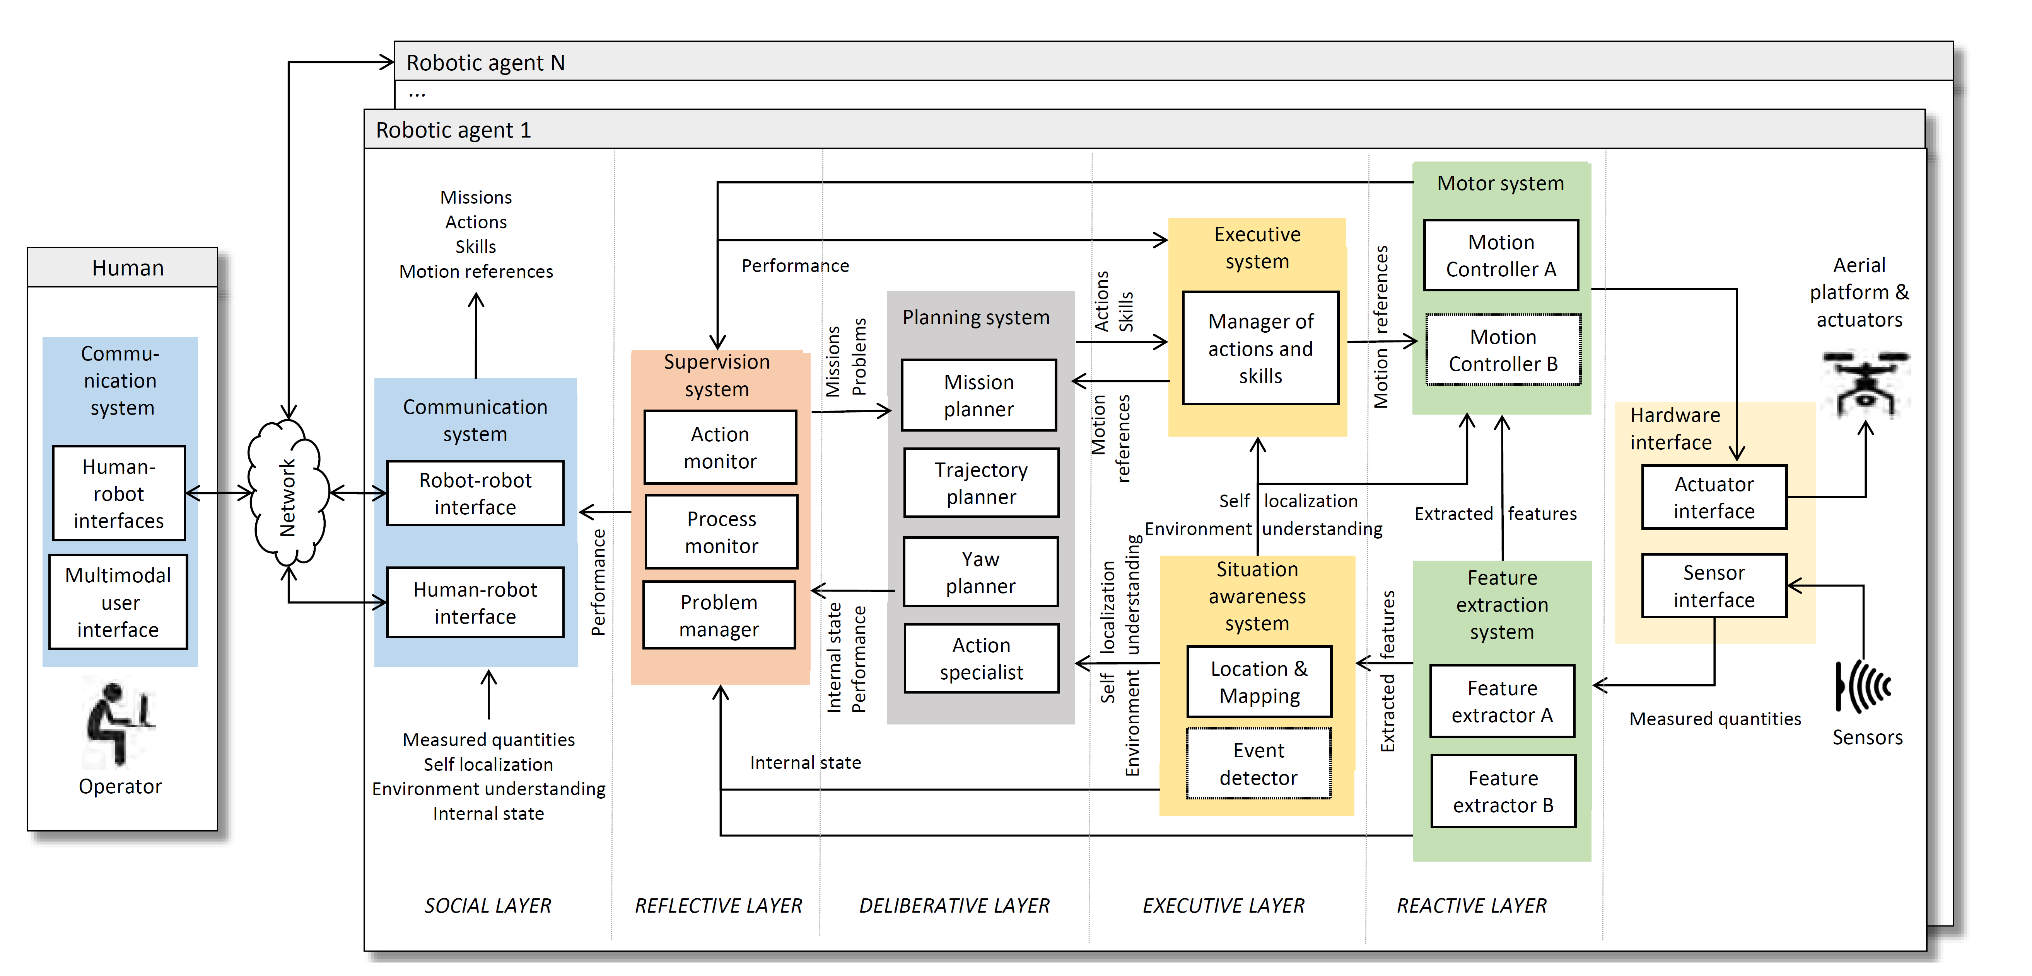
Components of Aerostack

Slide 7
Ontology of Aerial Robotics
To facilitate semantic interoperability of different components
Concepts are classified according to the input/output categories
Why? Skills – Action
Other concepts: Measured Quantity, Extracted Feature, Environmental Understanding, Self localization, Internal State, Mission, Action, Skill, Motion Reference, Problem and Performance

Slide 8
Autonomy and Self Adaptation in complex environments
Dimensions of autonomy
Human Independence: Does not require highly specialized operators
Dynamic Environment: Self-adaptation, threat avoidance, self-diagnosis, fault tolerance, etc.
Complex Missions: Situation awareness, complex planning, etc.

Slide 9
Autonomy and Self Adaptation in complex environments
Components related to levels of autonomy
Planning System: Generates goals to accomplish the mission. Increases autonomy in terms of human independence, complex missions and self adaptation in dynamic environments
Executive System: Translates requested actions and behaviors into specific orders. Increases autonomy in terms of human independence and complex missions
Supervision System: Ensures correct behavior of robot. Three steps: failure detection, notification, and recovery. Increases autonomy in dynamic environments

Slide 10
Taxonomy of Abnormal Situations
Unachievable Goal: Requested action cannot be performed under a correct operation
Software Error: Invalid input data, process down unexpectedly, safeguard software error, process taking more time than expected
Hardware Malfunction: Hardware components are broken or are working partially. Classified into: (a) actuator faults (b) sensor faults and (c)component faults

Slide 11
Features of Aerostack Software Framework
Fully Autonomous Operation
Multi-robot swarming possibilities
Modularity
Scalability
Versatility
Distributed processing
Compatibility
Flight-proven and ready-to-use components

Slide 12
Multi-process modular organization
Allows to create independent modules with specific functionalities
Allows the individual testing of modules, easing the project progress
Process: Acts through time to change parameters of objects, consuming resources to covert inputs to outputs
Computational support of a process is designed as an atomic executable unit

Slide 13
Multi-process modular organization
System: a complex module that includes a set of interconnected processes that provides a common functionality.
Aerostack is implemented in ROS. Communication Methods available in ROS:
Topics
Services
Aerostack can perform distributed processing

Slide 14
Division in groups of software packages

Slide 15
Use Cases
Tele-operated flights controlled by user commands using HMI
Tracking a selected object by visual contact
Following a specific mission plan
Flying within a specific spatial area
UAS with different sensors, different physical platform, substitute software components with same I/O, new functionalities

Slide 16
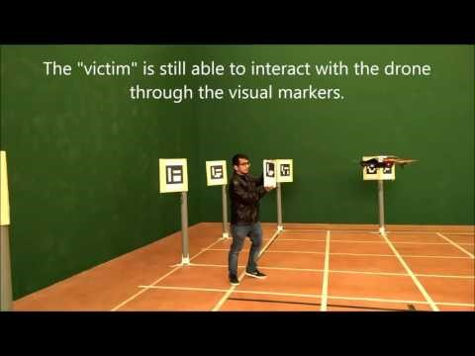
Example of Real Operation

