Slide 1

SOCIAL MEDIA SENTIMENT & BRAND STRATEGY
Spider-Man: Brand New Day Sentiment Tracker
Power BI sentiment tracking, topic analysis, and actionable marketing strategies
Slide 1 | Power BI Social Media Analytics Project | October 2026

Slide 2
1. PROBLEM STATEMENT & EXECUTIVE KPIS
67.27% Positive Reception Across 1,500 Posts & 151K Likes
Project Objective
Mandate: Track social sentiment for Brand New Day.
Visual Goal: Monitor positive and negative shifts in Power BI.
Brand Focus: Deliver data-backed marketing strategies.
Dataset Scale
Post Volume: 1,500 posts generating 1,722 aspect tags.
Engagement: 151.4K likes tracked across three platforms.
Timeline: Five release phases from March to October 2026.
Headline Metrics
Positivity: 67.27% positive vs. 32.67% negative share.
Net Score: +34.60 Net Sentiment Score overall.
Top Driver: Tom Holland's acting drove 327 positive tags.
Slide 2 | Source: Spider-Man: Brand New Day Sentiment Tracker Dataset (2026)

Slide 3
2. POWER BI WORKFLOW & DATA ARCHITECTURE
Structured CSV Datasets Power Relational BI Analytics
1. Data Import
Platforms: Covered Reddit (36.5%), X (31.8%), YouTube (31.7%).
Clean Schema: Imported main comments and topic bridge CSVs.
Milestones: Grouped dates into five campaign windows.
2. Sentiment & Topics
Score Scale: Sentiment scores range from -1.0 to +1.0.
Categories: Classified into Positive, Negative, and Neutral.
Topic Tags: Mapped 1,722 mentions across nine film aspects.
3. BI Data Model
Fact Table: 1,500 rows with post dates, likes, and scores.
Bridge Link: 1,722 rows linking Post_ID to film topics.
DAX Measures: Built KPI formulas for % splits and Net Score.
Slide 3 | Source: Power BI Desktop Data Import & Modeling Workflow

Slide 4
3. CAMPAIGN LIFECYCLE DESIGN
Five Release Milestones Structure Time-Series Tracking
Campaign Phase | Date Window | Posts | Dominant Fan Discussion & Sentiment Driver
1. Teaser Drop | Mar 18 – Apr 15, 2026 | 250 | Street-level Peter Parker tone & classic fabric suit praise
2. Official Trailer | Jun 18 – Jul 25, 2026 | 350 | Action choreography excitement vs. $25+ ticket pre-sale backlash
3. Opening Weekend | Jul 27 – Aug 03, 2026 | 450 | Peak volume (500 July posts); Tom Holland praised, Act 1 pacing debated
4. Theatrical Run & WOM | Aug 04 – Sep 15, 2026 | 300 | Repeat viewings, soundtrack appreciation, and $1B+ box office buzz
5. Digital / Home Release | Sep 16 – Oct 23, 2026 | 150 | 4K HDR easter egg breakdowns vs. $19.99 home rental pricing complaints
Slide 4 | Source: spiderman_bnd_sentiment_main.csv (1,500 total posts across 5 milestones)

Slide 5

4. POWER BI MODEL & UI THEME
Bridge Schema Powers Aspect Filtering
One-to-Many Link: Main table (1,500 posts) connects to Bridge table (1,722 tags) via Post_ID.
Cross-Filter Direction: Both-direction filtering syncs topic bars with time-series trends.
Net Sentiment DAX: [% Positive] (67.27%) minus [% Negative] (32.67%) yields +34.60 NSS.
Custom UI Canvas: Electric blue hero container paired with crimson red glassmorphism frames.
Slide 5 | Right: Custom Spider-Man Widescreen UI Canvas Template

Slide 6
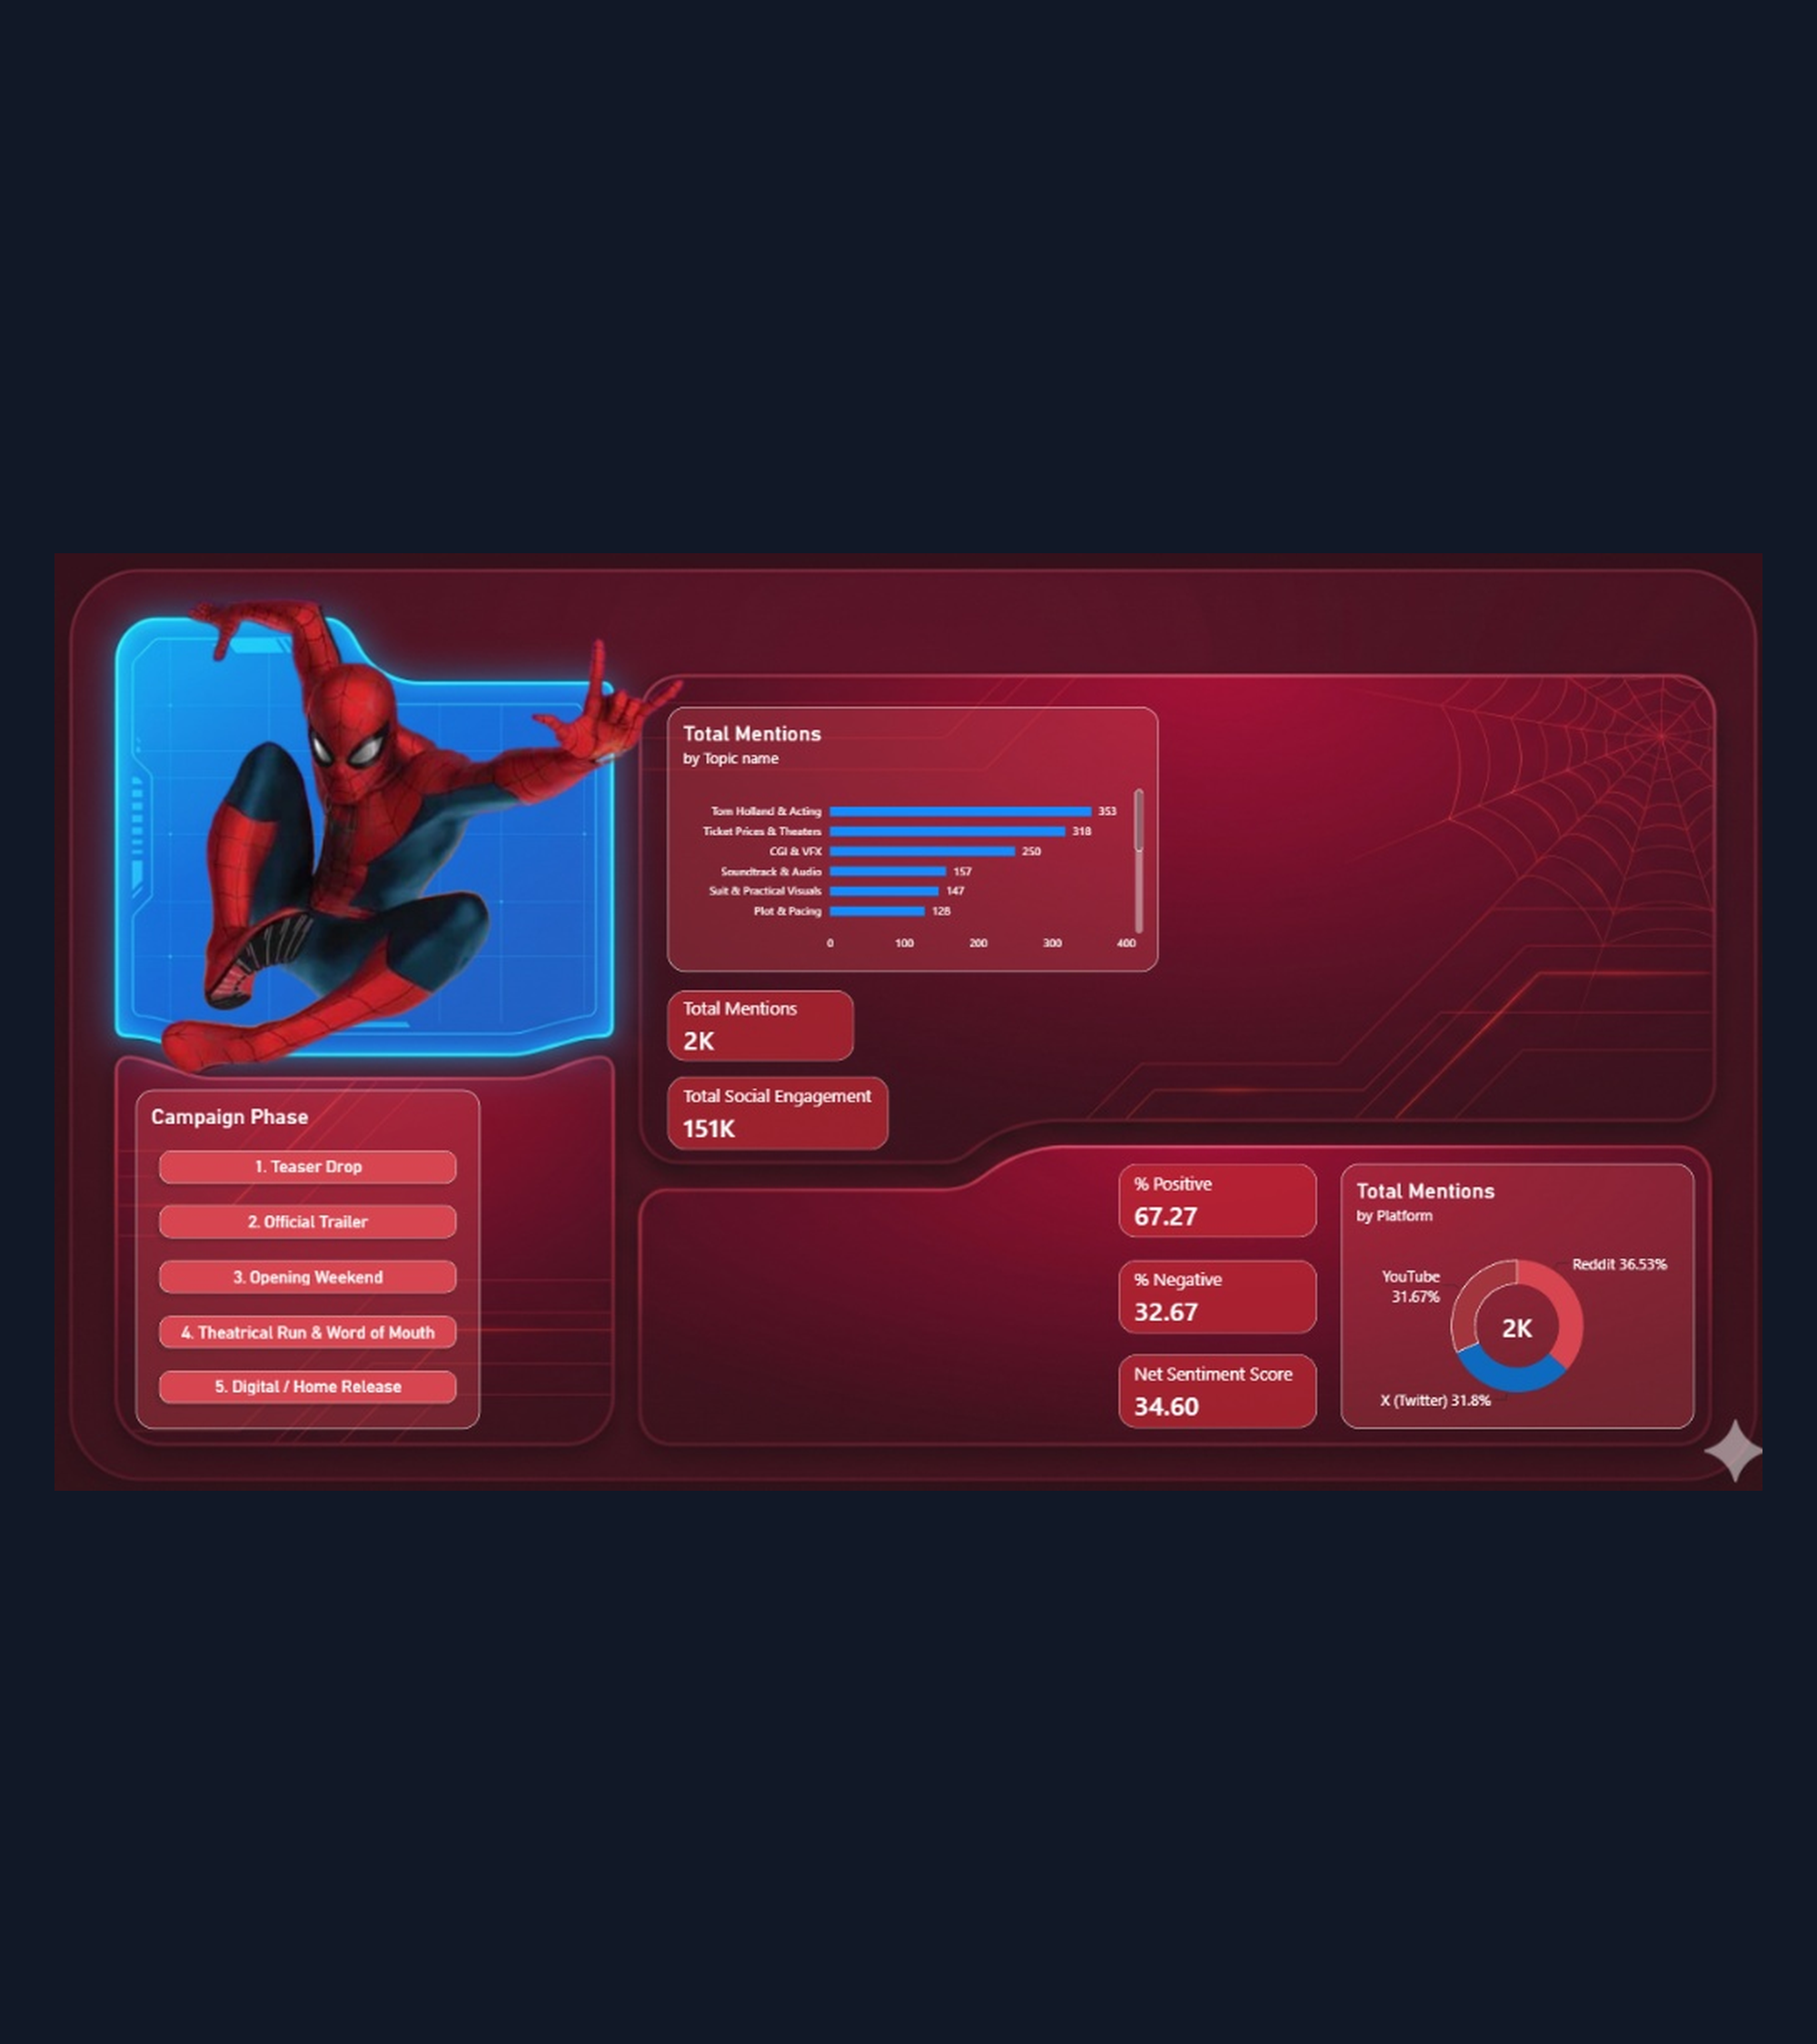
5. DASHBOARD EVOLUTION
Prototype Revealed Key Visual Gaps
3D Character Breakout: Layered Spider-Man render over the top-left electric blue frame.
Slicer & KPI Foundation: Established 5 Campaign Phase buttons, 2K mentions, and 151K engagement.
Prototype Limitation: Counted total topic volume without showing positive vs. negative splits.
Missing Time-Series: Right canvas lacked monthly trend tracking and platform sentiment stacks.
Slide 6 | Right: Stage 1 Dashboard Prototype (Oct 24, 2026)

Slide 7
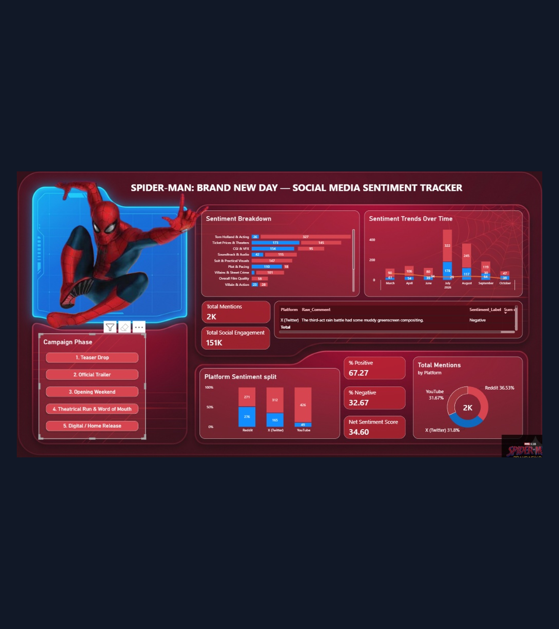
6. COMPLETED POWER BI INTERFACE
Final UI Unifies Six Analytics Zones
Sentiment Breakdown: Stacked bars compare positive (red) vs. negative (blue) counts per topic.
Trends Over Time: Monthly columns & NSS line capture the July release spike (322 Pos / 178 Neg).
Voice-of-Fan Table: Interactive drill-through table surfaces raw comments and sentiment labels.
Platform Split & KPIs: 100% stacked platform chart paired with 67.27% Positive and 34.60 NSS cards.
Slide 7 | Right: Final Power BI Dashboard Interface (Oct 26, 2026)

Slide 8
7. TEMPORAL SENTIMENT ANALYSIS
Premiere Window Drove Peak Buzz of 500 Posts in July 2026
Teaser Momentum: March–April generated 196 positive vs. 53 negative mentions.
July Premiere Spike: Volume surged to 322 positive and 178 negative posts during launch.
August Sustain: Word-of-mouth held 245 positive vs. 117 negative posts in August.
Home Release Dip: October narrowed to 47 positive vs. 39 negative over $19.99 rental fees.
Slide 8 | Source: Dashboard 'Sentiment Trends Over Time' Visual (March–October 2026)

Slide 9
8. INFLUENTIAL TOPIC BREAKDOWN
Acting & Suit Design Led Praise While Pricing Drove Backlash
#1 Praise Driver: Tom Holland & Acting achieved 327 positive vs. only 26 negative tags.
Unanimous Wins: Practical Suit (147 Pos, 0 Neg) and Soundtrack (115 Pos, 42 Neg) excelled.
Pricing Friction: Ticket Prices generated 173 negative vs. 145 positive mentions.
Technical Critique: CGI & VFX (154 Neg) and Plot & Pacing (110 Neg) drew scrutiny.
Slide 9 | Source: Dashboard 'Sentiment Breakdown' Visual (spiderman_bnd_topics_bridge.csv)

Slide 10
9. CROSS-PLATFORM SENTIMENT SPLIT
YouTube Skews 89.7% Positive While Reddit Debates Pacing
YouTube Enthusiasm: 426 positive vs. 49 negative posts (89.7% positive) from trailer and score fans.
X Real-Time Buzz: 312 positive vs. 165 negative posts (65.4% positive) across opening week.
Reddit Critical Lens: 271 positive vs. 276 negative posts (49.5% positive) on pacing and VFX.
Slide 10 | Source: Dashboard 'Platform Sentiment split' & 'Total Mentions by Platform' Visuals

Slide 11
10. ACTIONABLE BRAND & MARKETING STRATEGY
Three Targeted Marketing Pillars Convert Insights Into Action
1. Creative Ad Pivot
Data Trigger: Tom Holland (327 Pos) & Suit (147 Pos) lead praise.
Ad Shift: Focus TV/Reels spend on emotional character drama.
VFX Reels: Share practical stunt clips to counter CGI critiques.
2. Exhibitor Pricing
Data Trigger: Ticket Prices caused 173 negative mentions.
Discounts: Launch 'Brand New Tuesday' deals with theater chains.
Home Bonus: Include deleted scenes to justify $19.99 digital price.
3. Platform Strategy
Data Trigger: Reddit is 50.5% negative; YouTube is 89.7% positive.
Reddit AMA: Host director AMA on r/marvelstudios on Act 1 pacing.
Audio Push: Promote official soundtrack across YouTube & Spotify.
Slide 11 | Source: Strategic Synthesis of Power BI Sentiment & Aspect Findings

Slide 12
SPIDER-MAN: BRAND NEW DAY — POWER BI ANALYTICS
Grounded Storytelling Drives Lasting Brand Equity.
Thank You | Questions & Interactive Power BI Walkthrough

