Slide 1

SENTIMENTAL ANALYSIS ON YELP REVIEWS Presented by, ROHIT & PAWAN

Slide 2

How Does Yelp Work?
Users create their profile and post reviews on businesses
Businesses register and can manage their profile
Yelp filters out “Untrustworthy Reviews”

Slide 3
Overview
Task 1 - Visualize business review over a period of time with the help of Sentimental analysis.
Task 2 - Extracting tips from reviews
Task 3 - Location analysis based on business category from yelp dataset

Slide 4
Challenges (Task 1)
Feature selection
Unigram
Unigram + Bigram
Trigram

Slide 5
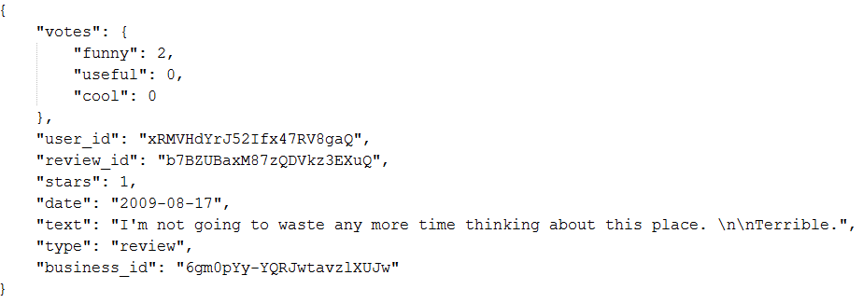
Data (Review)

Slide 6
Data cont..
There are 1569264 reviews.
Using randomly selected 15000 reviews.
Out of which 5027 are negative (less than 3.5 rating)
Remaining 9973 are positive (greater than or equal to 3.5 rating), but we are randomly selecting 5027 from these positive reviews

Slide 7
Evaluation (Task 1)
We are using ratings of the reviews to evaluate each method.
Reviews with rating of 3.5 and above are considered as Positive reviews
Less than 3.5 are considered as Negative reviews

Slide 8
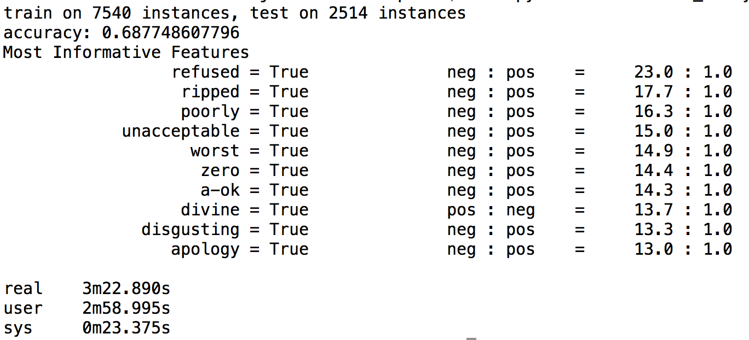
Unigram model accuracy

Slide 9
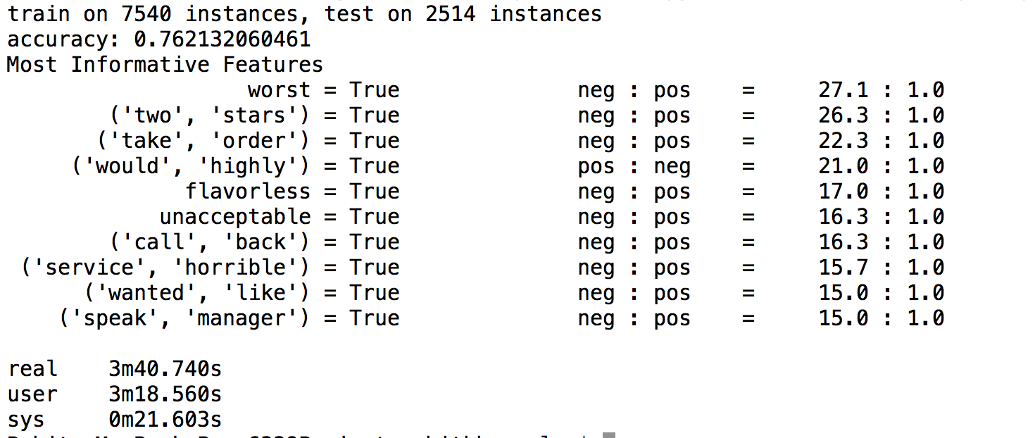
Unigram + Bigram accuracy

Slide 10
Unigram + Bigram accuracy

Slide 11
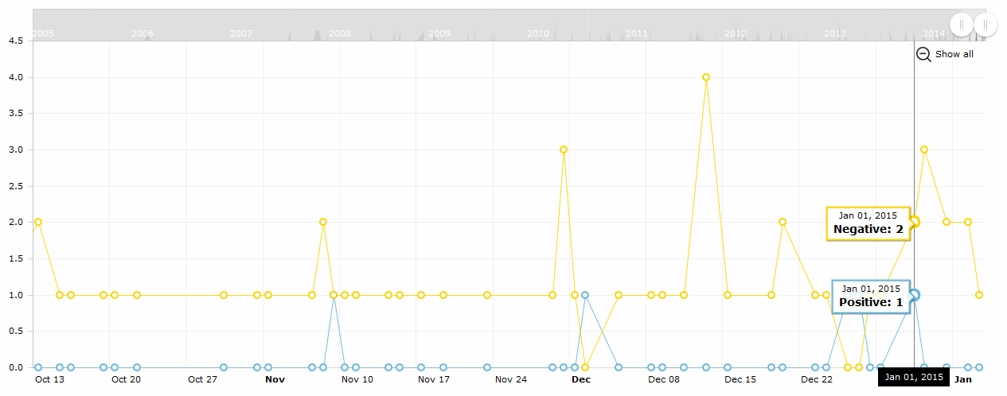
Result (Task 1)

Slide 12
Challenges (Task 2)
Extracting menu items from web
Extracting food items from the review text

Slide 13
Challenges (Task 3)
Extracting menu items from web
Extracting food items from the review text

Slide 14
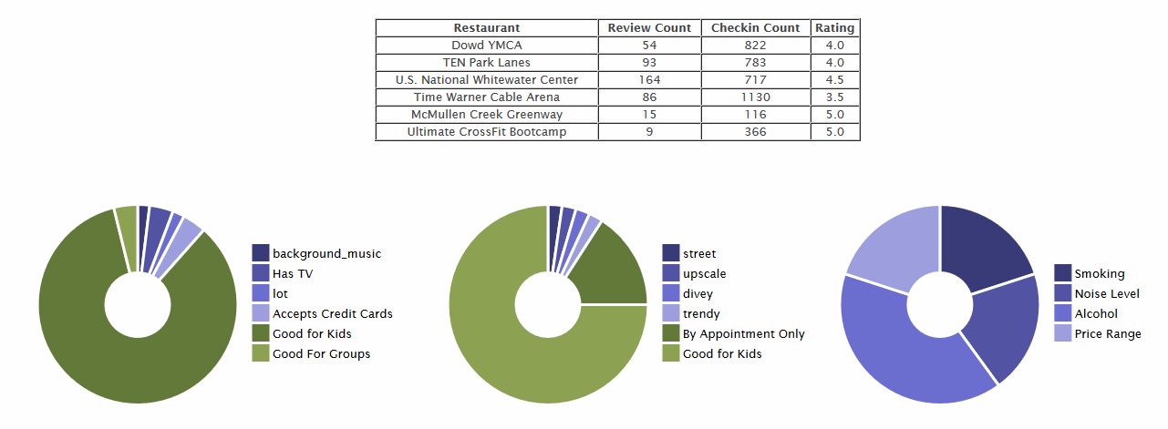
Result (Task 3)

Slide 15
References
[1] http://www.nltk.org
[2] https://pypi.python.org/pypi/textblob

