Slide 1

PHD Defense Seminar on Deep learning-based adaptive land cover monitoring by analyzing remotely sensed images
Presented by
Indrajit Kalita
Roll No.: 1703007
Under the guidance of
Dr. Moumita Roy
Department of Computer Science and Engineering
Indian Institute of Information Technology Guwahati (IIIT Guwahati)
Assam, India

Slide 2
Outline
Land Cover Classification
Definition of the Domain Adaptation Problem
Objective of the proposed thesis
Contribution of the thesis
Conclusion and future scope
References
9/14/2022
Defense Seminar
2
Notes:
vghfhghghg

Slide 3
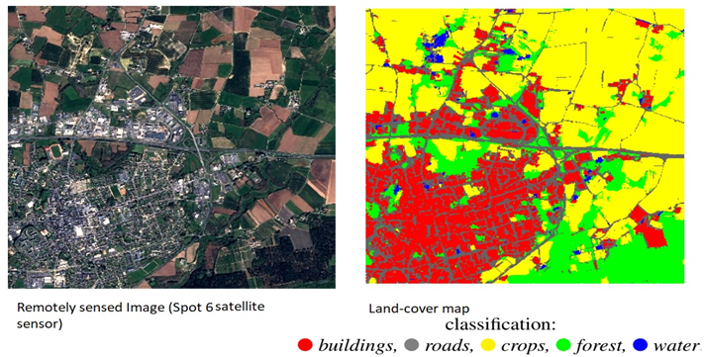
Land-cover Classification (LCC)
Land cover: The observed physical cover on the earth surface
Land cover classification: Identifying different land cover classes using remote sensing images and producing land cover maps for monitoring Earth and eco-systems
T. Postadjian, A. Le Bris, C. Mallet, and H. Sahbi. Superpixel Partitioning of Very High Resolution Satellite Images for Large-Scale Classification Perspectives with Deep Convolutional Neural Networks. IGARSS 2018 - 2018 IEEE International Geoscience and Remote Sensing Symposium, (ii):1328–1331, 2018.
9/14/2022
Defense Seminar
3
Notes:
3

Slide 4
Application and Approaches of LCC
Applications:
Forest and crop monitoring
Deforestation monitoring
Thermal mapping
Bio-geochemical cycling
Soil erosion monitoring
Water pollution
Approaches
Manual approach: Generate land cover maps by field survey (expensive)
Machine learning: Automatic approach using spectral characteristics of remote sensing images (no spatial relation)
Deep neural network: Automatic approach based on very-high resolution remote sensing images in scene-level
S. K. Meher and D. A. Kumar, "Ensemble of Adaptive Rule-Based Granular Neural Network Classifiers for Multispectral Remote Sensing Images," in IEEE Journal of Selected Topics in Applied Earth Observations and Remote Sensing, vol. 8, no. 5, pp. 2222-2231, May 2015.
L. Gómez-Chova, D. Tuia, G. Moser and G. Camps-Valls, "Multimodal Classification of Remote Sensing Images: A Review and Future Directions," in Proceedings of the IEEE, vol. 103, no. 9, pp. 1560-1584, Sept. 2015.
M. Marconcini, D. Fernandez-Prieto and T. Buchholz, "Targeted Land-Cover Classification," in IEEE Transactions on Geoscience and Remote Sensing, vol. 52, no. 7, pp. 4173-4193, July 1 2014.
9/14/2022
Defense Seminar
4

Slide 5
Problem of domain adaptation in LCC
Classifiers perform satisfactorily when samples in training and test sets have the same probability distribution.
Labeled samples are available from a known region (source domain), whereas a severe crisis of the same in unknown region (target domain).
Classifier model trained on source distribution fails in predicting target samples (due to insufficient labeled target data).
This problem is known as domain adaptation (DA)
There exist two scenario in DA
Common class with different probability distribution (Homogeneous DA)
Extra and missing class in source-target domain (Heterogeneous DA)
D. Tuia, C. Persello, and L. Bruzzone. Domain adaptation for the classification of remote sensing data: An overview of recent advances. IEEE Geoscience and Remote Sensing Magazine, 4(2):41–57, 2016.
9/14/2022
Defense Seminar
5

Slide 6
Situation where DA is required (Homogeneous DA)
Scenario 1: Both the domains have the same class labels, but the probability distribution of test sample (Target domain) is different with respect to the training sample (Source domain)
Figure1: Scatter plots of Merced dataset vs. ASCD dataset
9/14/2022
Defense Seminar
6

Slide 7
Situation where DA is required (Heterogeneous DA)
Scenerio2: Extra and missing class problem in source – target domain
Example :
Source Classes : Railway, Forest
Target Classes : Forest, River,
Extra Class : River (in target region w.r.t. source region)
Missing Class: Railway (in target region w.r.t source region)
This scenario is termed as heterogeneous source-target DA problem.
9/14/2022
Defense Seminar
7

Slide 8
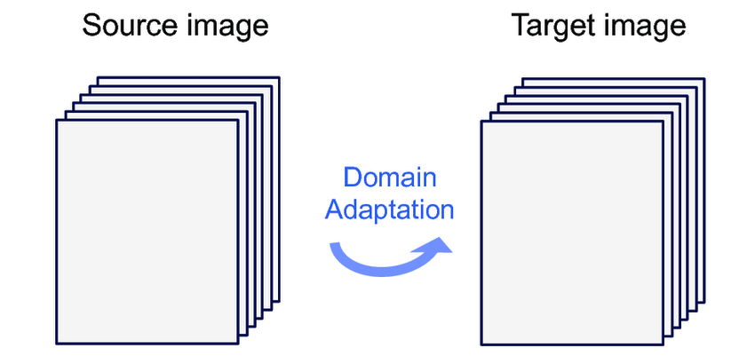
Solution to DA
Collect new training sample for the new target domain.
Problem: Expensive, time consuming and mostly infeasible.
Solution: Adapt the classifier trained on source sample/ domain for predicting the land cover classes for target region (domain).
9/14/2022
Defense Seminar
8

Slide 9
Literature Review
Two fundamental categories of DA techniques in LCC are:
Pixel-based DA in pixel-level
Data transformation based DA [1]
No spatial information and ignores unique target characteristics
Clustering based DA [2]
Unable to handle heterogeneous DA problem.
Instance re-weighting based DA [3]
Expensive to get labeled target patterns
DNN based DA in pixel level [4]
Missing Spatial features
Object-based DA in scene-level (DNN based DA).
DA without pre-trained architecture [5]
Large dataset and huge computation cost
DA with pre-trained architecture [6]
Unavailability of pre-trained models using remotely sensed images
9/14/2022
Defense Seminar
9

Slide 10
Motivation
Automatic LCC traditionally uses shallow ANN trained with hand-crafted features extracted pixel-by-pixel from the dataset.
Pixel-by-pixel approaches is purely based on spectral information without even considering neighbouring pixels (spatial) information.
Solution: Switch from pixel-level to an scene-level classification system.
Scene-level techniques have extract hand-crafted features like texture, shape etc. of the object.
DNNs can extract robust features from complex input samples automatically by considering spectral, spatial and temporal information.
Failure: Train (source) and test (target) samples are from different distributions.
Domain adaptation (DA) is necessary for predicting the land cover classes for an unknown region (target domain) using source information
9/14/2022
Defense Seminar
10

Slide 11
Scope of the Research work
Development of scene-level LCC technique under homogeneous DA scenario.
Development of scene-level LCC technique under heterogeneous DA scenario.
Designing of scene-level LCC techniques using multi-temporal VHR images under DA scenario.
Designing of LCC technique using multi-sensor remotely sensed images under DA scenario.
Designing of deep learning models for (adaptive/non-adaptive) agriculture monitoring using UAV-based VHR images (as an application of scene-level LCC)
9/14/2022
Defense Seminar
11

Slide 12
Development of scene-level LCC technique under homogeneous DA scenario
A solution to the practical problem of DA in scene-level LCC by analysing remotely sensed images
Explore a semi-automatic threshold selection along with graph-based technique to identify ‘most-confident’ target samples
A novel Siamese neural network has been explored to handle the data shift problem based on the class label in the source-target region.
Conduct experiments on three aerial image datasets to assess the performance
I. Kalita and M. Roy, “Deep siamese neural network-based adaptive land cover classification under unsupervised framework using remotely sensed images”, in Transactions on Neural Networks and Learning Systems, IEEE, 2022, Pages 1-12.
9/14/2022
Defense Seminar
12

Slide 13
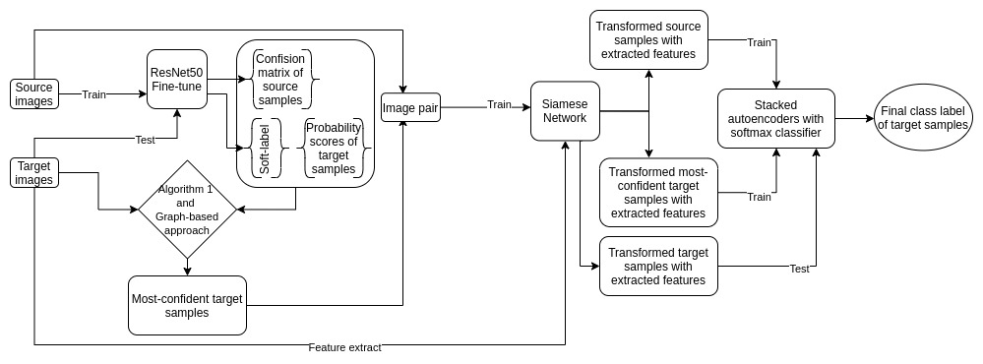
Development of scene-level LCC technique under homogeneous DA scenario
Figure 1.1: Graphical representation of the proposed methodology
9/14/2022
Defense Seminar
13

Slide 14
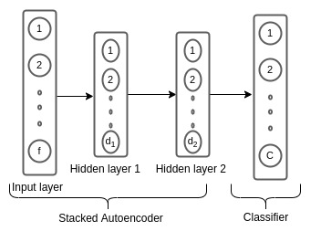
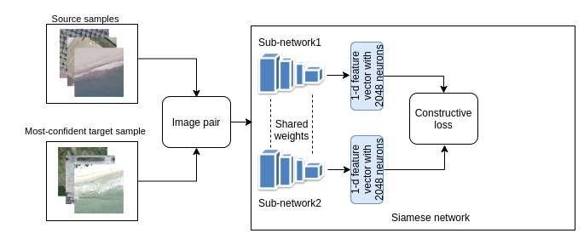
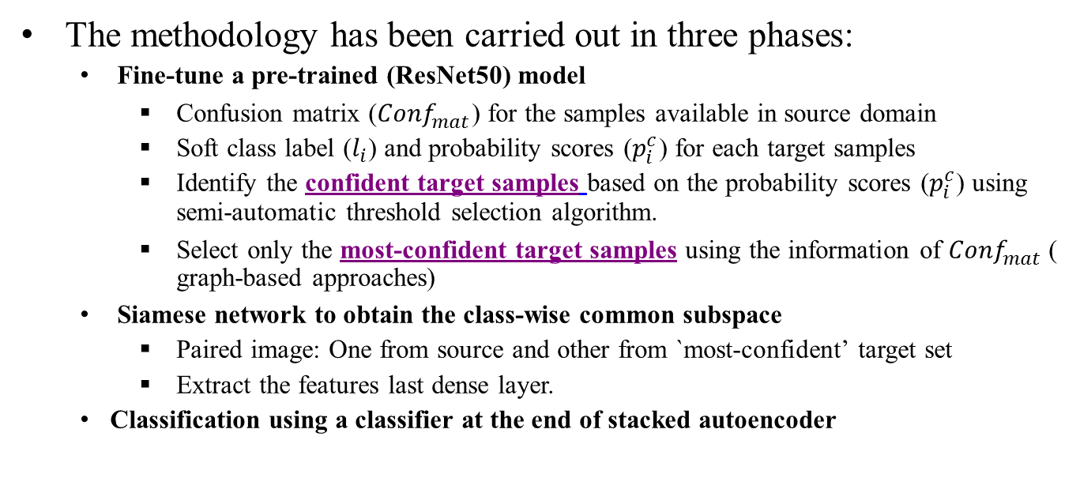
Development of scene-level LCC technique under homogeneous DA scenario
The methodology has been carried out in three phases:
Fine-tune a pre-trained (ResNet50) model
Confusion matrix (${Conf}_{mat}^{}$) for the samples available in source domain
Soft class label ($l_{i}$) and probability scores ($p_{i}^{c}$) for each target samples
Identify the confident target samples based on the probability scores ($p_{i}^{c}$) using semi-automatic threshold selection algorithm.
Select only the most-confident target samples using the information of ${Conf}_{mat}^{}$( graph-based approaches)
Siamese network to obtain the class-wise common subspace
Paired image: One from source and other from `most-confident’ target set
Extract the features last dense layer.
Classification using a classifier at the end of stacked autoencoder
Figure 1.3: Graphical abstract for the Classifier (phase 3)
Defense Seminar
Figure 1.2: Graphical abstract for the Siamese network (phase 2)
9/14/2022
14

Slide 15
Development of scene-level LCC technique under homogeneous DA scenario
Details of experimentations
Name of the parameter | Model | Range/ fixed value | Optimal value | Tuning Procedure
Epoch | Fine-tuning of pre-trained CNN | 100 | 50 | The model is trained for a fixed number of epochs multiple times by observing the early stopping criteria. The epoch that satisfies early stopping criteria is considered the optimal one.
 | Siamese Network | 1000 | 500
 | Stacked autoencoder and classifier | 2000 | 1000
Learning rate | Fine-tuning of pre-trained CNN | 0.1-0.0001 | 0.0001 | The model is trained with varying learning rates in the considered range with a decremental heuristic fashion. The learning rate producing minimum loss function is selected as the optimal one
 | Siamese Network | 0.1-0.0001 | 0.001
 | Stacked autoencoder and classifier | 0.1-0.0001 | 0.001
Minibatch size | Fine-tuning of pre-trained CNN | 50-10 | 10 | The model is attempted to be trained for varying mini-batch sizes by observing the memory bound of system. The mini-batch size that suits the memory bound of the system is selected for training
 | Siamese Network | 256-128 | 128
 | Stacked autoencoder and classifier | 256-100 | 100
Margin | Siamese Network | 2 | 2 | The fixed value is decided considering the state-of-the-art work explained by Hadsell et al [33]
Table 1.1: The hyperparameters and their tuning procedure used in the proposed methodology
9/14/2022
Defense Seminar
15

Slide 16
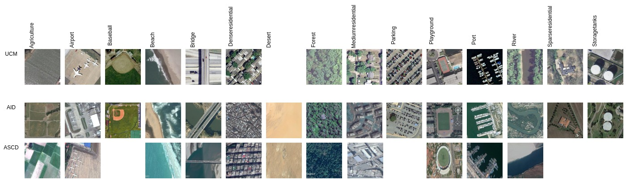
Development of scene-level LCC technique under homogeneous DA scenario
Dataset Description:
University of California Merced (UCM) [7]
No of class: 21
Images in each class: 100
Total images: 2100
Aerial Image Dataset (AID) [8]
No of class: 30
Images in each class: 220-424
Total images: 10000
Asian Sub-Continent Dataset (ASCD)
No of class: 14
Images in each class: 100-204
Total images: 1674
Figure1.4: Some remotely sensed images of common classes collected from UCM, AID, and ASCD datasets

Slide 17
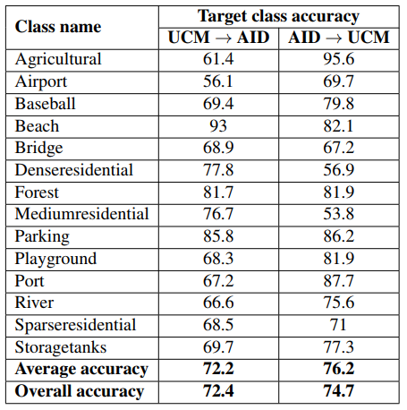
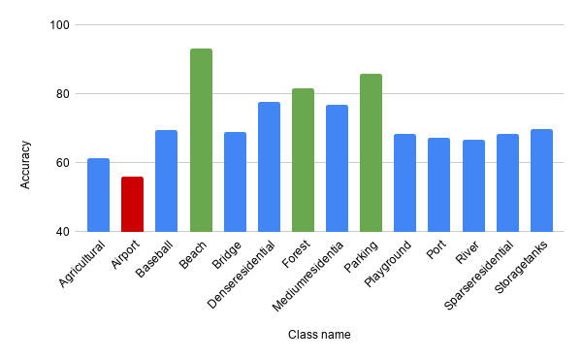
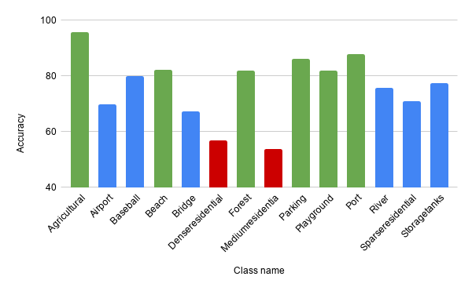
Development of scene-level LCC technique under homogeneous DA scenario
Result and analysis: (a) Class-wise analysis of results using three datasets
Table1.2: Class-wise accuracy of UCM → AID and AID → UCM scenarios
Figure 1.5: Bar Graph in terms of classwise accuracy

Slide 18
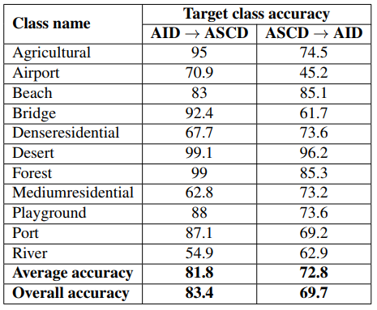
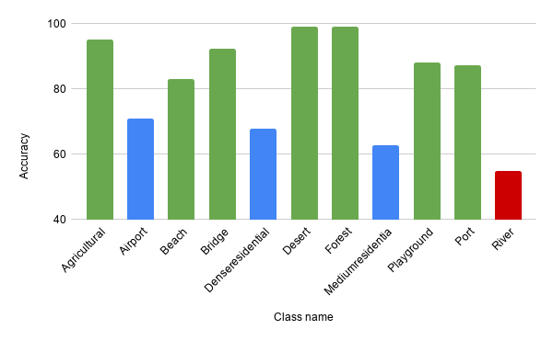
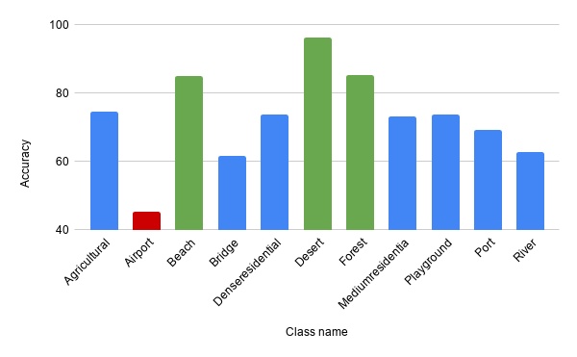
Development of scene-level LCC technique under homogeneous DA scenario
Result and analysis: (a) Class-wise analysis of results using three datasets
Table1.3: Class-wise accuracy of AID → ASCD and ASCD → AID scenarios
Figure 1.6: Bar Graph in terms of classwise accuracy

Slide 19
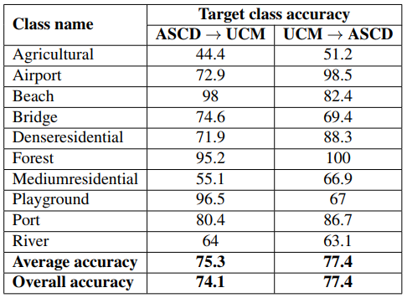
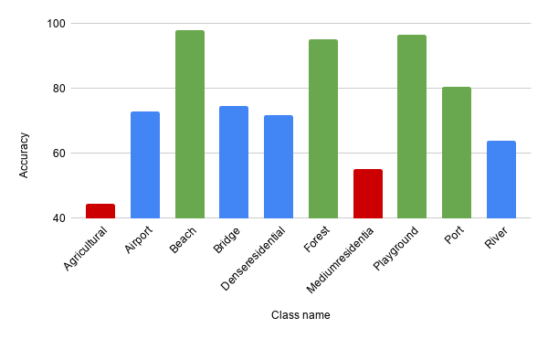
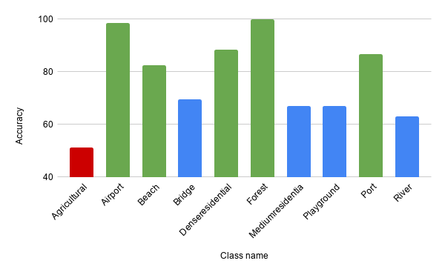
Development of scene-level LCC technique under homogeneous DA scenario
Result and analysis: (a) Class-wise analysis of results using three datasets
Table1.4: Class-wise accuracy of ASCD → UCM and
UCM → ASCD scenarios
Figure 1.6: Bar Graph in terms of classwise accuracy

Slide 20
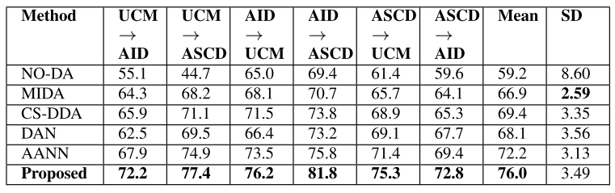
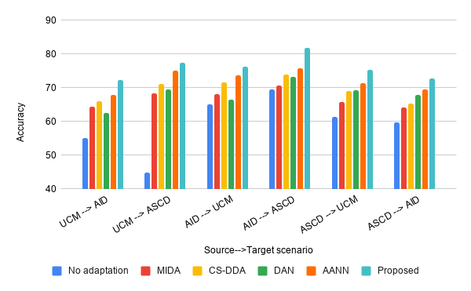
Development of scene-level LCC technique under homogeneous DA scenario
Result and analysis: (b) Comparative analysis of average accuracy in percentage
Table1.5: COMPARATIVE RESULTS IN TERMS OF AVERAGE ACCURACY IN PERCENTAGE (OVERALL CLASSES) USING AID, UCM, AND ASCD OBTAINED USING A NO-DA (NO-ADAPTATION TECHNIQUE), MIDA [9], CS-DDA [10], DAN [11], AANN [12], AND PROPOSED APPROACH
Figure1.7: Bar graph representation of the results in terms of average accuracy in percentage (overall classes) using AID (AI), UCM (U), and ASCD (S) obtained using a no-adaptation technique, MIDA [9], CS-DDA [10], DAN [11], AANN [12] and proposed approach

Slide 21
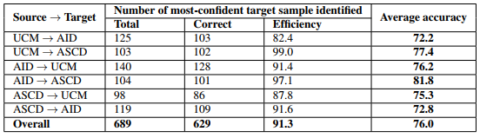
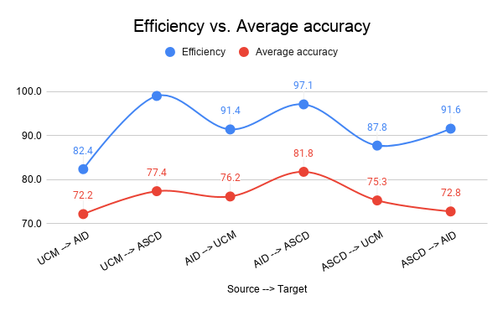
Development of scene-level LCC technique under homogeneous DA scenario
Result and analysis: (c) Sensitivity of proposed ‘most-confident’ target sample identification technique
Table1.6: Sensitivity of proposed ‘most-confident’ target sample identification technique and their impact on the final average accuracy (in percentage)
Figure1.8: Graph representation to visualize the relation between the efficiency of ‘most-confident’ target sample identification algorithm vs. average accuracy (in percentage) by considering the six source → target scenarios

Slide 22
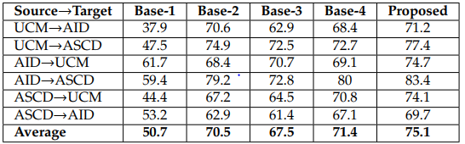
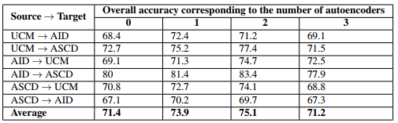
Development of scene-level LCC technique under homogeneous DA scenario
Results and Analysis: Ablation analysis of the proposed model
Most-confident target sample selection technique:
Random selection of ‘most-confident’ target sample (Base-1)
Semi-automatic threshold selection techniques (Base-2)
Impact of the Siamese network:
Eliminate the network and bypass the outcome of phase1 to phase3 (Base-3)
Impact of the Autoencoder
Eliminate the network (Base-4)
Table1.7: Ablation study of all the component of proposed architecture based on overall accuracy index
Table1.8: Impact of number of hidden layers in the stacked autoencoder on the final overall accuracies

Slide 23
Development of scene-level LCC technique under homogeneous DA scenario
Discussion and conclusion
Cost effective unsupervised scheme for homogeneous DA scenario
Selection technique strategy of the ‘most-confident’ target sample is highly reliable
Stacked autoencoder with two hidden layers delivers better performance
Unable to handle the heterogeneous DA problem
Investigation is based on the spectral and spatial characteristics of remote sensing images

Slide 24
Development of scene-level LCC technique under heterogeneous DA scenario.
A solution to the practical problem of heterogeneous DA in scene-level LCC by analyzing aerial images
Use ensemble of pre-trained convolutional neural networks for adaptive classification
Explore a semi-automatic threshold selection technique to identify common classes
Explore a novel bucket based active learning strategy to obtain extra target classes
Conduct experiments on three aerial image datasets to assess the performance
I. Kalita and M. Roy, “Deep Neural Network based Heterogeneous Domain Adaptation using Ensemble Decision in Land-Cover Classification”, in Transactions on Artificial Intelligence, IEEE, Vol. 1(2), 2020, Pages 167-180.

Slide 25
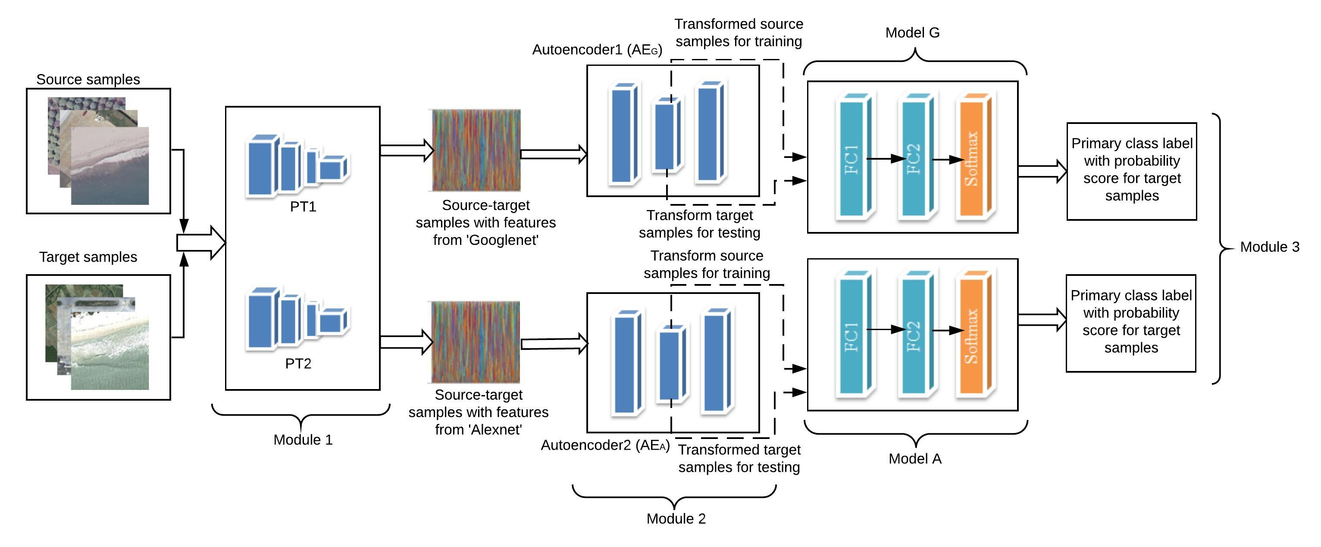
Development of scene-level LCC technique under heterogeneous DA scenario.
Step 1: Predication of primary class label and maximum probability score of each target samples
Figure2.1: Graphical representation of the three modules (i.e., Module 1, Module 2, and Module 3) used in the proposed methodology

Slide 26
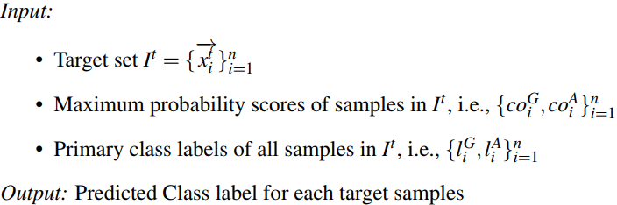
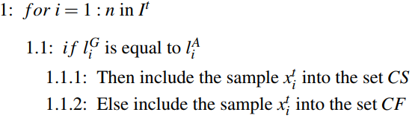
Development of scene-level LCC technique under heterogeneous DA scenario.
Step 2: Implementation of all the algorithms and final predictions

Slide 27
Development of scene-level LCC technique under heterogeneous DA scenario.
Step 2: Implementation of all the algorithms and final predictions
Identify the common source classes by applying a semi-automatic threshold selection strategy on the set CS
Identify the confusing target samples by applying a semi-automatic threshold selection strategy on the set CF
Execute a bucket-based active learning strategy on the set of ‘most-confusing’ target sample and identify the extra target classes
Merge the set of source samples in common classes and actively labeled target samples to generate the final training set
Incorporate the data augmentation strategy on the samples of extra target classes in the final training set to create the balanced final training set
Fine-tune the pre-trained ‘GoogLeNet’ using the balanced final training set and predict the class label of the unlabeled target sample using the trained model

Slide 28
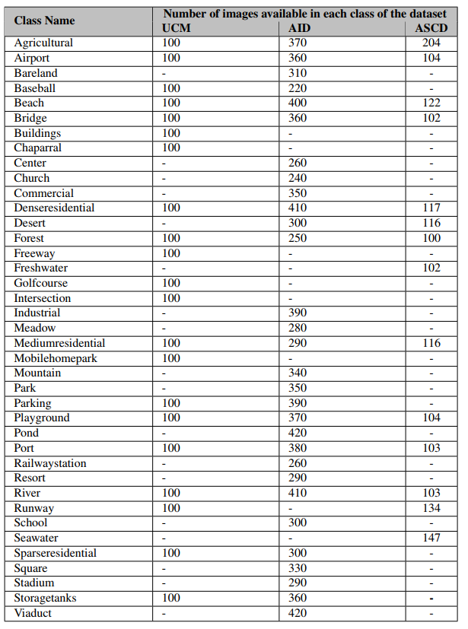
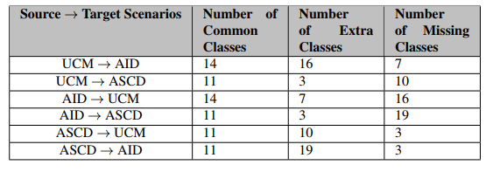
Development of scene-level LCC technique under heterogeneous DA scenario.
Dataset description
Table2.1: Number of common, extra and missing
class present in six Source → target scenarios
Table 2.2: Description of the datasets

Slide 29
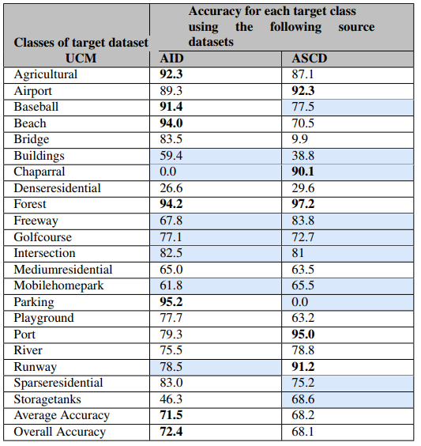
Development of scene-level LCC technique under heterogeneous DA scenario.
Result and analysis: (a) Class-wise accuracy
Scenario1: AID → UCM
Scenario2: ASCD → UCM
Blue color represents
the extra class present in UCM dataset
Scenario1: 6 identified out of 7
Scenario2: 9 identified out of 10
Table 2.3: Results of classwise accuracy (in percentage) for UCM target dataset using AID and ASCD source datasets (accuracies of extra target classes w.r.t. the source domain are highlighted in blue color)

Slide 30
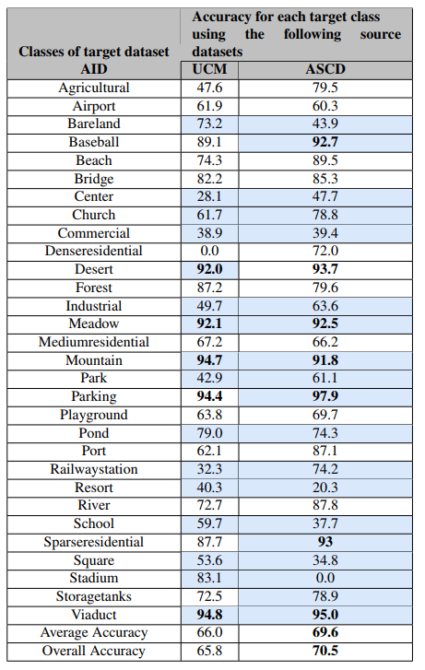
Development of scene-level LCC technique under heterogeneous DA scenario.
Result and analysis: (a) Class-wise accuracy
Scenario3: UCM → AID
Scenario4: ASCD → AID
Blue color represents
the extra class present in AID dataset
Scenario3: All 16 identified
Scenario4: 18 identified out of 19
Table 2.4: Results of classwise accuracy (in percentage) for AID target dataset using UCM and ASCD source datasets (accuracies of extra target classes w.r.t. the source domain are highlighted in blue color)

Slide 31
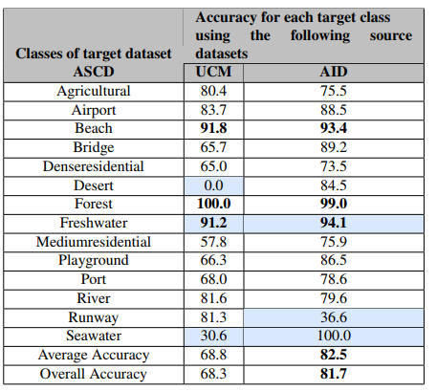
Development of scene-level LCC technique under heterogeneous DA scenario.
Result and analysis: (a) Class-wise accuracy
Scenario5: UCM → ASCD
Scenario6: AID → ASCD
Blue color represents
the extra class present in ASCD dataset
Scenario5: 2 identified out of 3
Scenario6: All 16 identified
Table 2.5: Results of classwise accuracy (in percentage) for ASCD target dataset using UCM and AID source datasets (accuracies of extra target classes w.r.t. the source domain are highlighted in blue color)

Slide 32

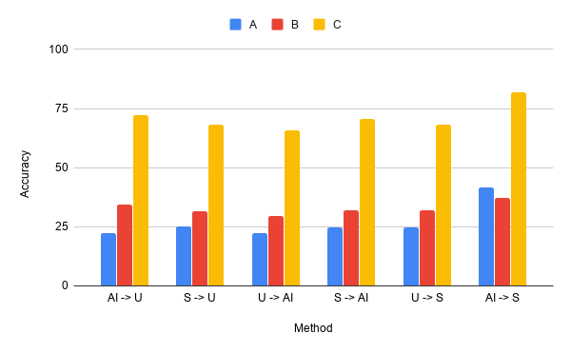
Development of scene-level LCC technique under heterogeneous DA scenario.
Result and analysis: (b) Comparative analysis
Table2.6 and Figure2.2: Comparison of the results in terms of average accuracy in percentage (over all
classes) using AID (AI), UCM (U), and ASCD (S) obtained using the technique without adaptation (A), the AANN method [12] (B), and the proposed approach (C)

Slide 33
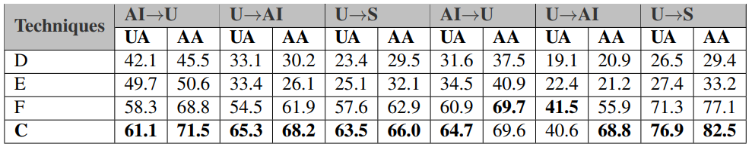
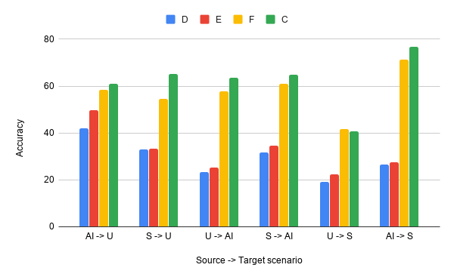
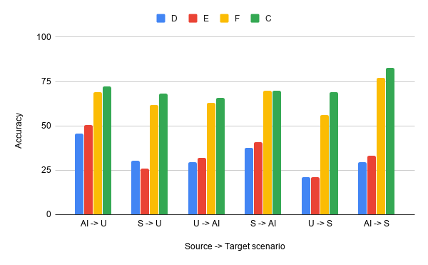
Development of scene-level LCC technique under heterogeneous DA scenario.
Result and analysis: (b) Comparative analysis (Open-set DA)
Table2.8 and Figure2.3: Comparison of the results in terms of average accuracy in percentage (AA) over all classes and average accuracy for unknown target samples in percentage (UA) considering AID (AI), UCM (U) and ASCD (S) obtained using the techniques in Busto et al. [13] (D), Saito et al. [14] (E), Liu et al. [15] (F), and the proposed approach (C)

Slide 34

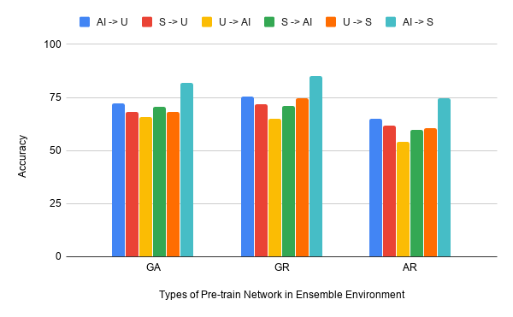
Development of scene-level LCC technique under heterogeneous DA scenario.
Result and analysis: (b) Sensitivity analysis in terms of different pretrained networks
Table2.9 and Figure2.4: Sensitivity analysis for the proposed approach in terms of average accuracy (AA) in percentage over all target classes using AID (AI), UCM (U), and ASCD (S) with respect to the three pairs of pretrained models: GoogLeNet with AlexNet (GA), GoogLeNet with ResNet50 (GR), and AlexNet with ResNet50 (AR)

Slide 35
Development of scene-level LCC technique under heterogeneous DA scenario.
Discussion and conclusion
A heterogeneous domain adaptation technique for automatic land cover classification has been investigated
A significant improvement has been seen especially considering the heterogeneous DA scenario
The investigated techniques try to mimic only the visual interpretation ability of human beings on observation of a single image (spectral and spatial characteristics)
It is necessary to create more detailed and adaptive LCC approaches that take into account the temporal characteristics of remotely sensed images

Slide 36
Designing of scene-level LCC techniques using multi-temporal VHR images under DA scenario
Investigate a new end-to-end firm land cover annotation mechanism for geographical areas using multi-temporal images through hybrid integration of attention, CNN, and RNN deep learning technologies
Design domain adaptation technique for multi-temporal LCC using a novel domain neutralizer network to reduce the cross-domain distribution difference of the features extracted from the source-target time-series image
Dataset preparation: A solution to the data scarcity in multi-temporal LCC by providing two new easily accessible multi-temporal datasets captured over the Indian sub-continent using Google Earth freely available images
I. Kalita, S. Chakraborty , T. Reddy, and M. Roy, “A deep learning-based technique for firm annotation and domain adaptation in land cover classification using time-series aerial images”, in Transactions on Neural Networks and Learning Systems, IEEE. (Under review)
9/14/2022
Defense Seminar
36

Slide 37
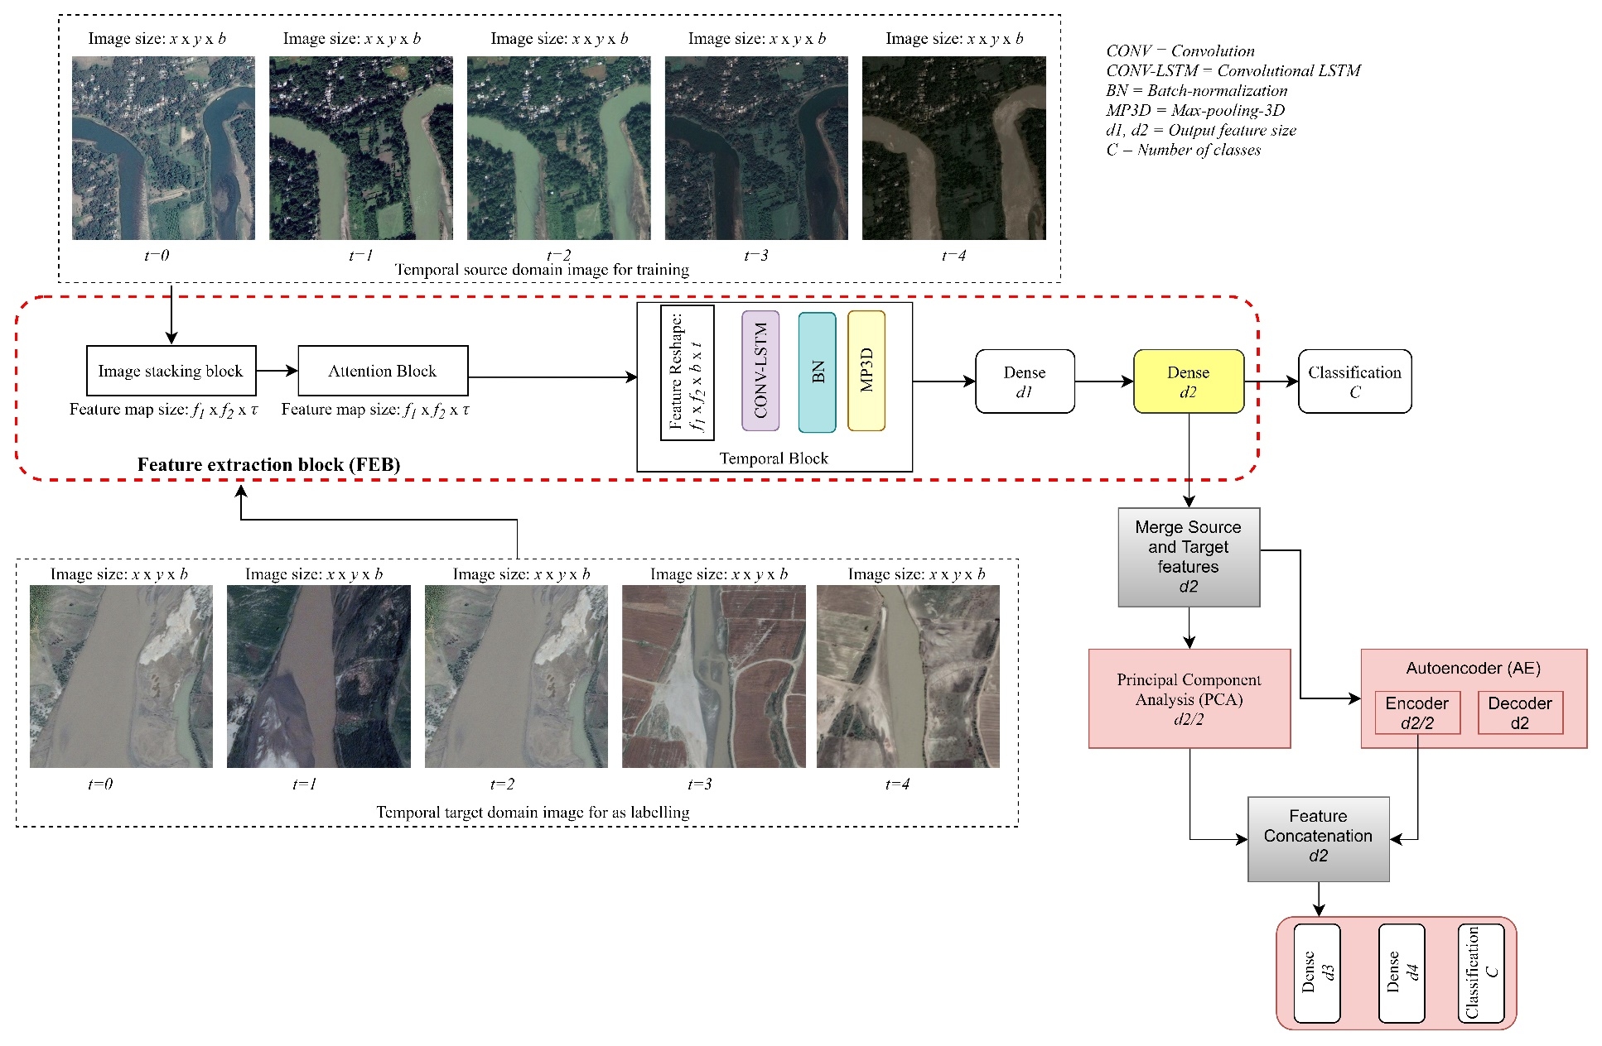
Designing of scene-level LCC techniques using multi-temporal VHR images under DA scenario
Figure 3.1: Final architecture
9/14/2022
Defense Seminar
37

Slide 38
Designing of scene-level LCC techniques using multi-temporal VHR images under DA scenario
The work under this scope has two phases:
Phase 1: LCC under non-adaptive scenario
Image stacking block:
Image pre-processing on the input images and reduce its size
Attention block:
To capture focused information using interpolation and max-pooling operation
Temporal block:
To learn the temporal relationship using the CONV-LSTM architecture
Classification:
To obtain the final class label using dense and classification layer
Phase 2: LCC under adaptive scenario
Feature extraction using feature extraction block (FEB)
Image stacking block, Attention block, Temporal block, Dense layers
Common subspace generation using domain neutralizer
Autoencoder and Principal Component Analysis
Classification
9/14/2022
Defense Seminar
38

Slide 39
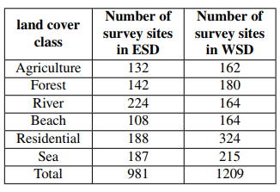
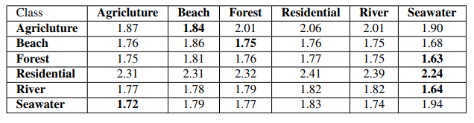
Designing of scene-level LCC techniques using multi-temporal VHR images under DA scenario
Dataset description
Satellite images captured over the Indian sub-continent
Eastern sub-continent dataset (ESD): Eastern India and Bangladesh
Western sub-continent dataset (WSD): Western India and Pakistan
Five temporal images taken at a different time of a year (between 2016-18)
Analysis of ESD and WSD
KL divergence to measure the distribution difference among the classes
Table 3.1: Description of the datasets
Table 3.2: KL divergence amongst the extracted features from each class
9/14/2022
Defense Seminar
39

Slide 40
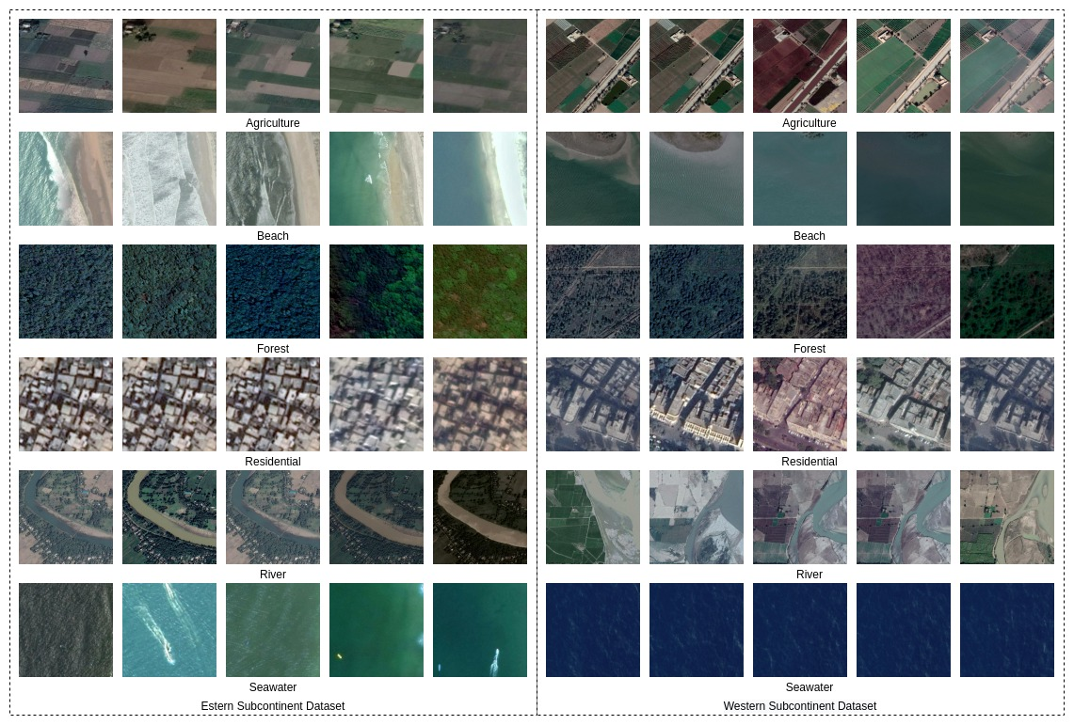
Designing of scene-level LCC techniques using multi-temporal VHR images under DA scenario
Figure 3.2: Example images
9/14/2022
Defense Seminar
40

Slide 41
Designing of scene-level LCC techniques using multi-temporal VHR images under DA scenario
Result and analysis of the non-adaptive scenario: Class-wise accuracy
Result and analysis of the non-adaptive scenario: Performance comparison
Result and analysis of the adaptive scenario: Class-wise accuracy
Result and analysis of the adaptive scenario: Performance comparison
9/14/2022
Defense Seminar
41

Slide 42
Designing of scene-level LCC techniques using multi-temporal VHR images under DA scenario
Discussion and conclusion:
The aim of the investigation is to firmly annotate a geographical region based on the time-series images captured across multiple seasons
Experimentation on two generated Indian sub-continent multi-temporal VHR datasets reveals the effectiveness as compared to state-of-the-art approaches
The problem of DA has been investigated considering the images of similar remotely sensed devices
Further investigation is required for more complex DA scenario in multi-sensor environment
9/14/2022
Defense Seminar
42

Slide 43
Designing of LCC technique using multi-sensor remotely sensed images under DA scenario
A solution for the multi-sensor DA problem (in pixel-level and scene-level) in LCC has been investigated.
A sample selection technique (stacking of sample) have been explored to balance the number of sample images under a cross-sensor environment.
A standard deviation-based AL technique have been investigated to identify ‘most-informative’ target samples.
I. Kalita, R. N. S. Kumar, and M. Roy, “Deep learningbased cross-sensor domain adaptation under active learning for land cover classification”, in Geoscience and Remote Sensing Letters, IEEE, Vol. 19, 2021, Pages 1-5.
9/14/2022
Defense Seminar
43

Slide 44
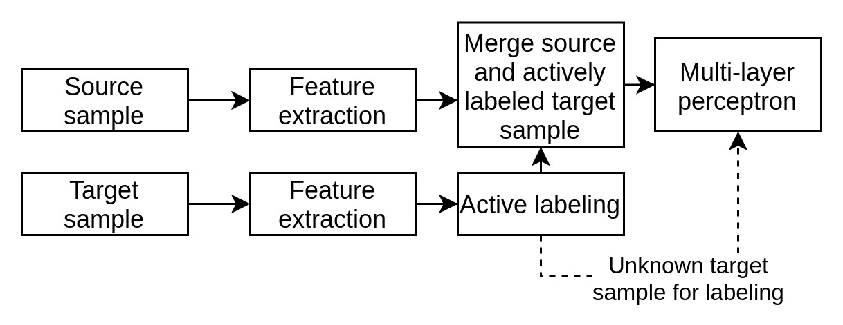
Designing of LCC technique using multi-sensor remotely sensed images under DA scenario
The methodology has been carried out in three phases:
Feature extraction
H→A scenario (H: Hyperspectral, A: Aerial)
A→H scenario
Active learning
To Identify the ‘most informative’ target samples
Training of the final classification model
To predict the final class label of the target samples
Figure4.1: Block diagram of the proposed methodology
9/14/2022
Defense Seminar
44

Slide 45
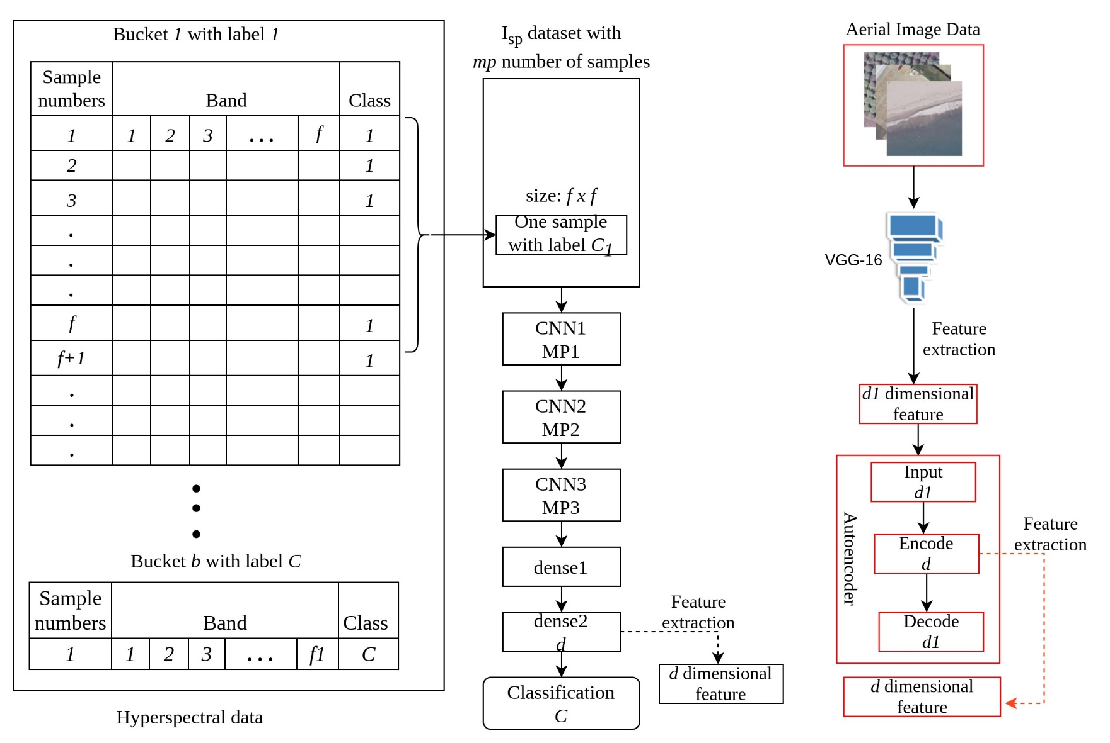
Designing of LCC technique using multi-sensor remotely sensed images under DA scenario
Figure 4.2: Feature extraction of H→A Scenario
9/14/2022
Defense Seminar
45

Slide 46
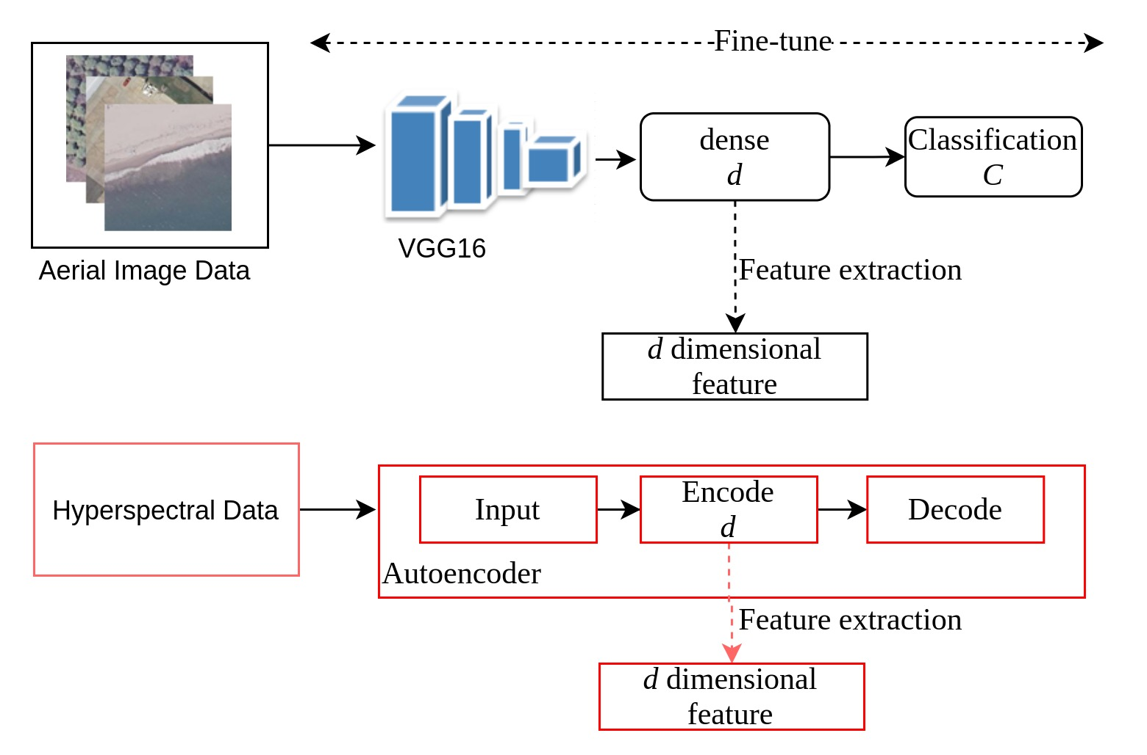
Designing of LCC technique using multi-sensor remotely sensed images under DA scenario
Figure 4.3: Feature extraction of A→H Scenario
9/14/2022
Defense Seminar
46

Slide 47
Designing of LCC technique using multi-sensor remotely sensed images under DA scenario
Active learning:
Standard deviation-based active learning algorithm
Training of the final classification model
Merge the source and actively labeled target samples to form the final training set
Train a Multi-Layer Perceptron (MLP) model to predict the final class label of the target samples
9/14/2022
Defense Seminar
47

Slide 48
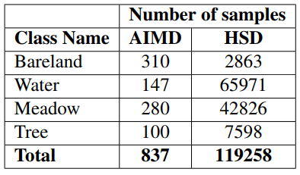
Designing of LCC technique using multi-sensor remotely sensed images under DA scenario
Dataset description:
Aerial Image Merge Dataset (AIMD):
Combination of AID (Bareland and Meadow), and ASCD (Trees and Water)
Hyperspectral Image Dataset (HID):
University of Pavia (Water, Tree, Meadow, and Bareland)
Table4.1: Description of datasets
AID: G. Xia, J. Hu, F. Hu, B. Shi, X. Bai, Y. Zhong, L. Zhang, and X. Lu. Aid: A benchmark data set for performance evaluation of aerial scene classification. IEEE Transactions on Geoscience and Remote Sensing, 55(7):3965–3981, 2017
ASCD: I. Kalita and M. Roy. Deep neural network-based heterogeneous domain adaptation using ensemble decision making in land cover classification. IEEE Transactions on Artificial Intelligence, 1(2):167–180, 2020.
9/14/2022
Defense Seminar
48

Slide 49
Designing of LCC technique using multi-sensor remotely sensed images under DA scenario
Results and Analysis:
Results are reported in terms of Precision (P), Recall (R), F1-score (F), and Overall accuracy (OA)
Analysis of H→A and A→H scenarios
Comparative analysis of H→A and A→H scenarios
9/14/2022
Defense Seminar
49

Slide 50
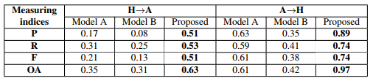
Designing of LCC technique using multi-sensor remotely sensed images under DA scenario
Results and Analysis: Ablation analysis of the proposed model
Model A:
Feature extraction of HID dataset: Autoencoder to reduce the features for both the scenario
Feature extraction of AIMD dataset: Pre-trained VGG16 as features extractor followed by autoencoder for both the scenario
Model B:
Updated version of Model A
Data augmentation for AIMD dataset to balance the sample ratio between the cross-domain scenario
Table4.5: Ablation analysis of all the component of proposed architecture based on P, R, F, and OA measuring indices with the active learning cost = 20
9/14/2022
Defense Seminar
50

Slide 51
Designing of LCC technique using multi-sensor remotely sensed images under DA scenario
Discussion and conclusion:
The investigation has provided a solution for the complex problem of multi-sensor DA in LCC using the pixel-level and scene-level datasets
The active learning strategy is highly stable as compared to the random selection approach
In future a cost-effective techniques in unsupervised DA framework can be investigated
9/14/2022
Defense Seminar
51

Slide 52
Designing of deep learning models for (adaptive/non-adaptive) agriculture monitoring using UAV-based VHR images (as an application of scene-level LCC)
An autonomous approach (non-adaptive and adaptive) has been investigated to identify Indian crops by analyzing drone (UAV) images.
A new MFMS-DCNN architecture has been investigated for the identification of the crop type in the scene-level.
An ensemble of proposed MFMS-DCNN and a pre-trained DCNN model has been explored to enhance classification performance for precise agriculture monitoring
Heterogeneous DA problem has been investigated for in agriculture monitoring
Two new drone-based datasets for the Indian crops (aerial images) are prepared. In the literature, such investigations on real-life aerial crop image datasets have not been reported earlier.
1. I. Kalita, G. P. Singh, and M. Roy, “Crop classification using aerial images by analyzing an ensemble of DCNNs under multi-filter & multiscale framework”, in Multimedia Tools and Applications, Springer. (Accepted)
2. I. Kalita and M. Roy, “MFMS-DCNN for domain adaptation in agriculture monitoring using aerial images”, in IEEE Region 10 Symposium (TENSYMP- 2022, IEEE) (Accepted)
9/14/2022
Defense Seminar
52

Slide 53
Designing of deep learning models for (adaptive/non-adaptive) agriculture monitoring using UAV-based VHR images (as an application of scene-level LCC)
The work under this scope has two phases:
Phase 1: Crop classification under non-adaptive scenario
Fine-tuning of pre-trained Inception-V3 architecture
Training of Multi-filter Multi-Scale (MFMS) DCNN architecture
Ensemble decision making using mean and product rule
Phase 2: Crop classification under adaptive scenario
Training of MFMS-DCNN architecture
Bucket-based active learning strategy to obtain the extra target classes
9/14/2022
Defense Seminar
53

Slide 54
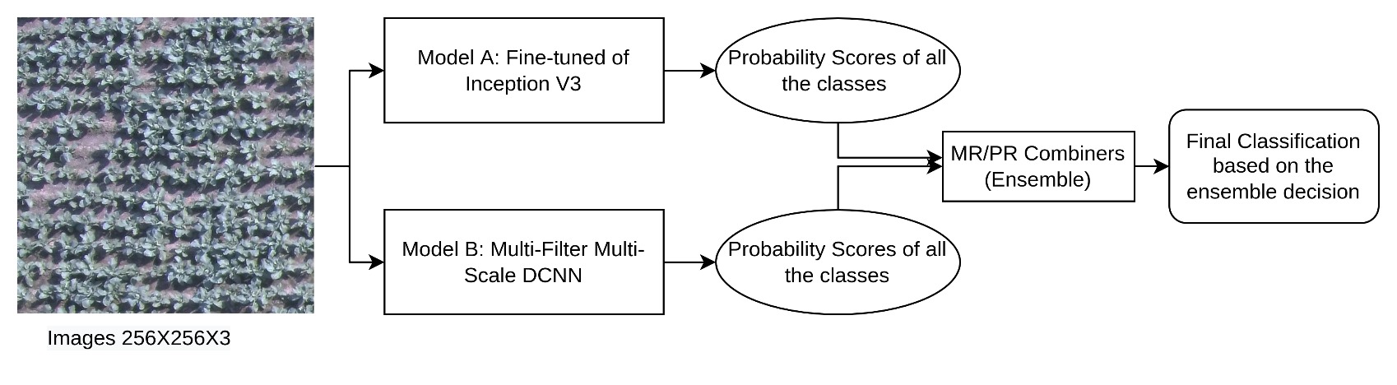
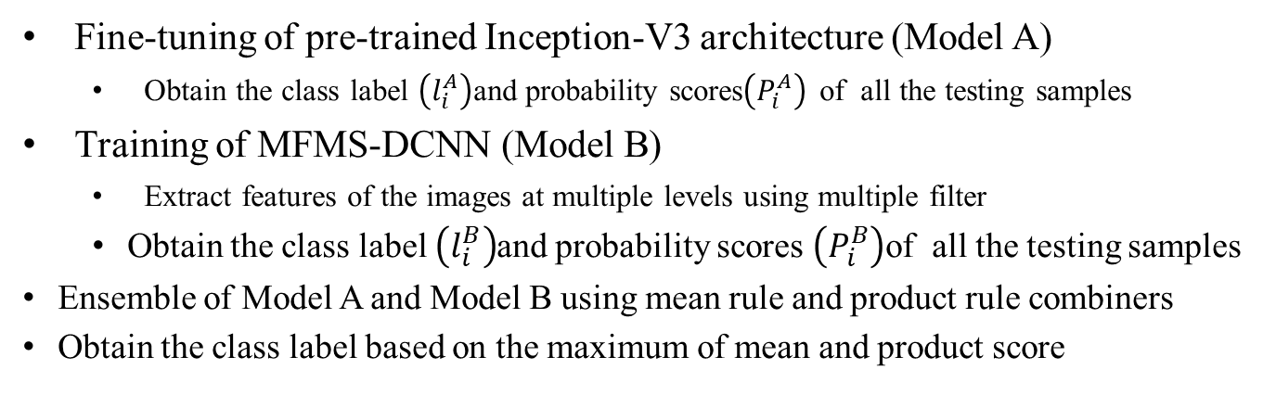
Designing of deep learning models for (adaptive/non-adaptive) agriculture monitoring using UAV-based VHR images (as an application of scene-level LCC)
Phase 1: Crop classification under non-adaptive scenario
Fine-tuning of pre-trained Inception-V3 architecture (Model A)
Obtain the class label $\left(l_{i}^{A}\right)$and probability scores$\left(P_{i}^{A}\right)$ of all the testing samples
Training of MFMS-DCNN (Model B)
Extract features of the images at multiple levels using multiple filter
Obtain the class label $\left(l_{i}^{B}\right)$and probability scores $\left(P_{i}^{B}\right)$of all the testing samples
Ensemble of Model A and Model B using mean rule and product rule combiners
Obtain the class label based on the maximum of mean and product score
Figure 5.1: Graphical representation of the proposed ensemble approach
9/14/2022
Defense Seminar
54

Slide 55
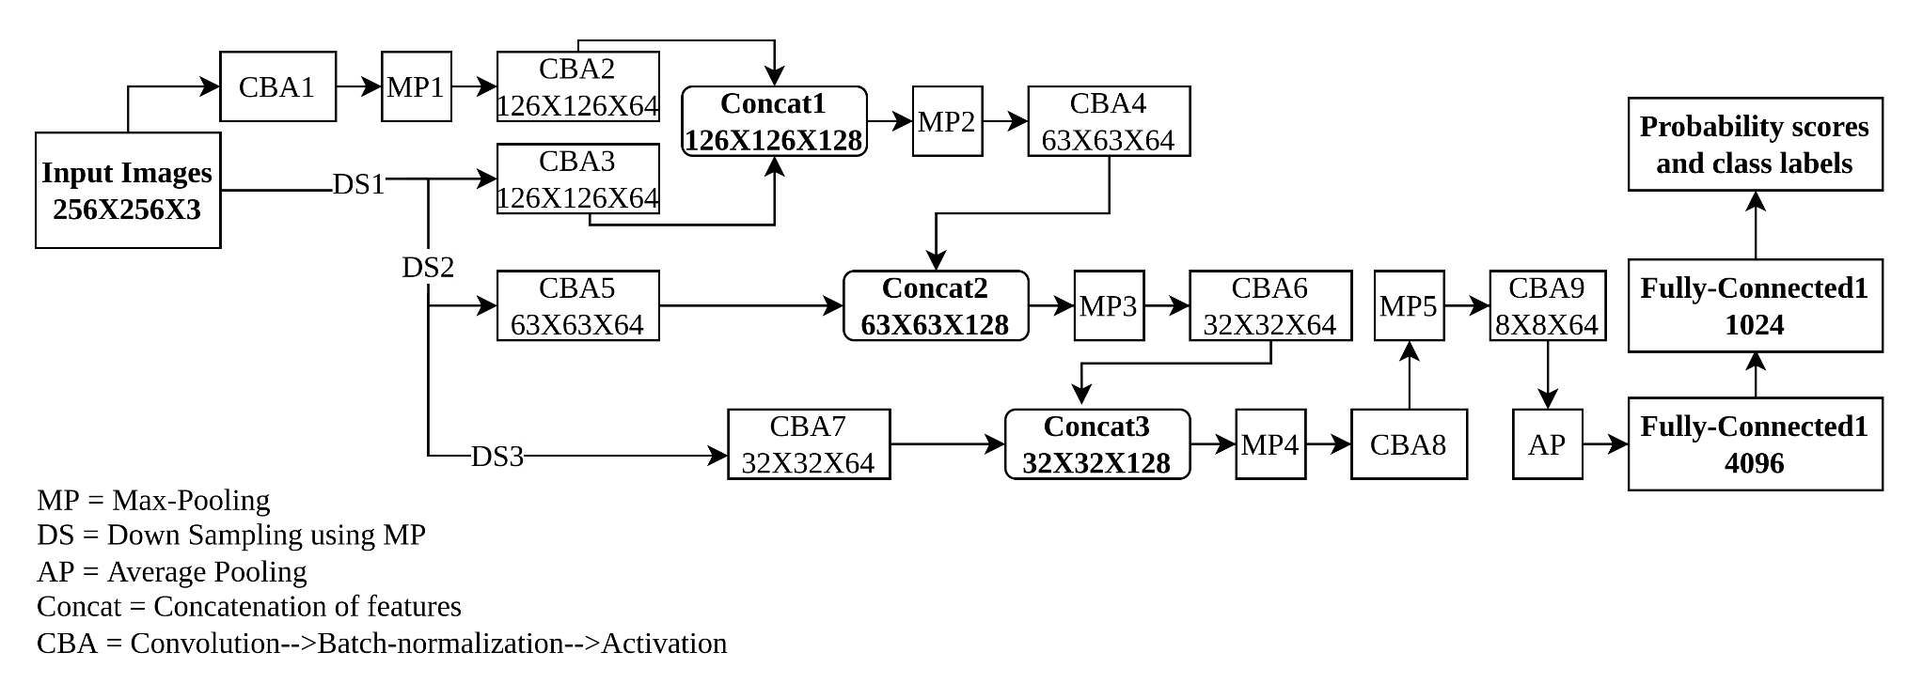
Designing of deep learning models for (adaptive/non-adaptive) agriculture monitoring using UAV-based VHR images (as an application of scene-level LCC)
Phase 1: Crop classification under non-adaptive scenario
Figure 5.2: The architecture of the Multi-Filter Multi-Scale DCNN Model
9/14/2022
Defense Seminar
55

Slide 56
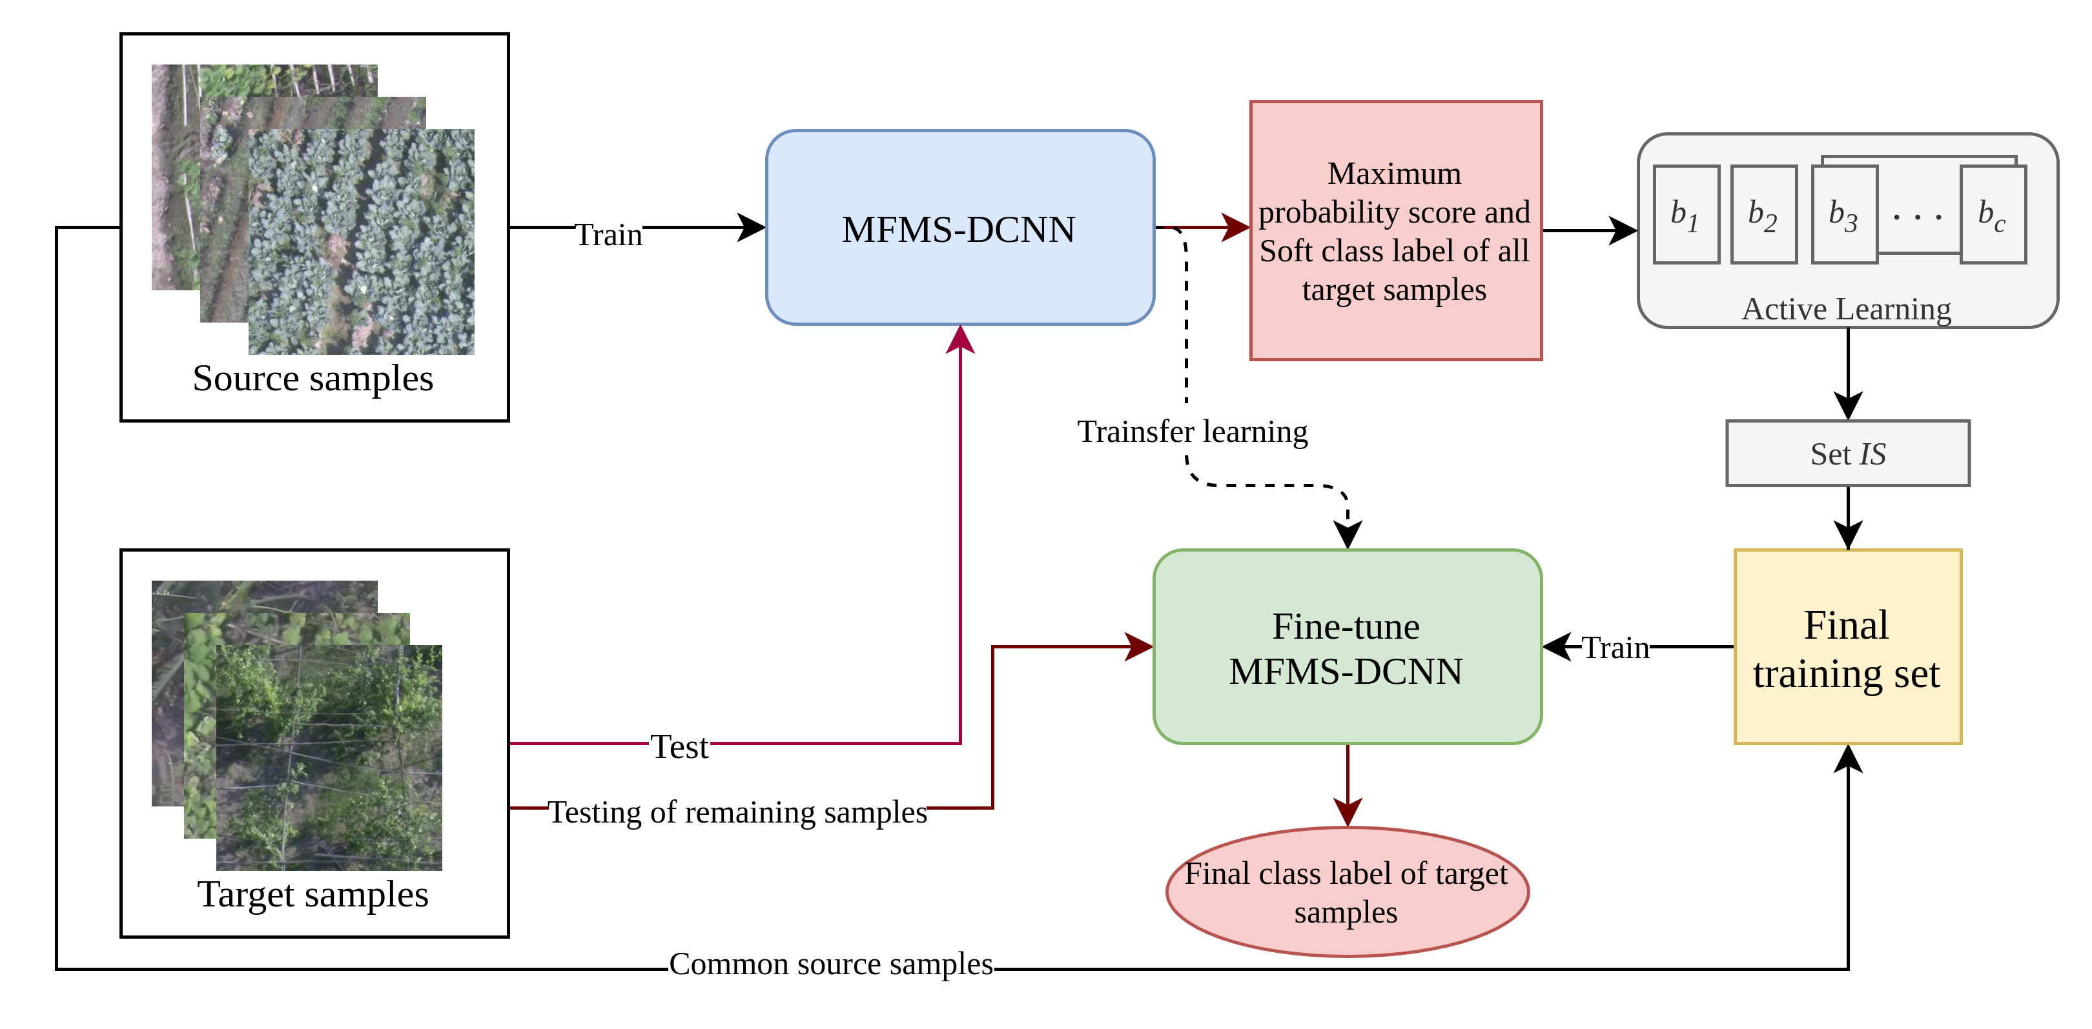
Designing of deep learning models for (adaptive/non-adaptive) agriculture monitoring using UAV-based VHR images (as an application of scene-level LCC)
Phase 2: Crop classification under adaptive scenario
Training of MFMS-DCNN architecture (Model B)
Obtain the soft-class label and maximum probability score of all the target domain samples
Algorithm for the bucket-based active learning strategy to obtain the extra target classes
Fine-tuning of MFMS-DCNN architecture using the final training set
Figure 5.3: The architecture of the adaptive model
9/14/2022
Defense Seminar
56

Slide 57
Designing of deep learning models for (adaptive/non-adaptive) agriculture monitoring using UAV-based VHR images (as an application of scene-level LCC)
Dataset description:
Data collection:
UAV (drone) has been flown over Indian farmland
Kolkata agricultural region crop dataset (KARC): 12 classes
Bongaon, near the city of Kolkata, in West Bengal, India
Assam agricultural region crop dataset (AARC): 12 classes
Bartari and Kharupetia in the state of Assam, India
Plant seedling dataset: 12 classes
Plant seedling dataset: Thomas Mosgaard Giselsson, Rasmus Nyholm Jørgensen, Peter Kryger Jensen, Mads Dyrmann, and Henrik Skov Midtiby. A public image database for benchmark of plant seedling classification algorithms. arXiv preprint arXiv:1711.05458, 2017
9/14/2022
Defense Seminar
57

Slide 58
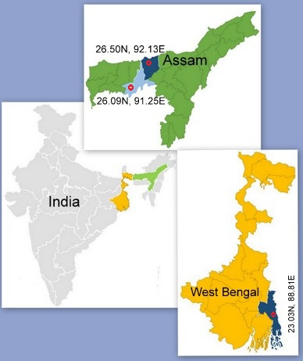
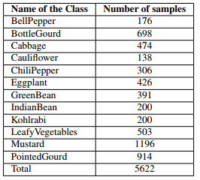


Designing of deep learning models for (adaptive/non-adaptive) agriculture monitoring using UAV-based VHR images (as an application of scene-level LCC)
Dataset description:
(a)
(b)
(c)
Table5.1: Dataset description
KARC, (b) AARC,
(c) Plant seedling
Figure5.4: The regions (marked as red dot) for agricultural field survey using drone (UAV) in the state of West Bengal (Bongaon in North 24 Parganas district) and Assam (Bartari in Kamrup Rural and Kharupetia in Darrang district), India. The districts are marked as blue (Kamrup Rural) and dark blue color (Darrang Assam and North 24 Parganas)
9/14/2022
Defense Seminar
58

Slide 59



Designing of deep learning models for (adaptive/non-adaptive) agriculture monitoring using UAV-based VHR images (as an application of scene-level LCC)
(a)
(b)
(c)
Figure5.5: Example images. (a) Plant seedling, (b) KARC, (c) AARC
9/14/2022
Defense Seminar
59

Slide 60
Designing of deep learning models for (adaptive/non-adaptive) agriculture monitoring using UAV-based VHR images (as an application of scene-level LCC)
Result and analysis: Non-adaptive scenario
Performance evaluation measures: Average Accuracy (AA), Overall Accuracy (OA), Precision (P), Recall (R), F1-score (F), and Kappa stats (K)
Analysis of the class-wise accuracy: Plant seedling, KARC, AARC
Comparative analysis: Four proposed models
C: Fine-tuned Inception V-3
D: MFMS-DCNN
MR: Ensemble decision based on mean rule
PR: Ensemble decision based on product rule
Comparative analysis: Using other UAV-based public dataset
9/14/2022
Defense Seminar
60

Slide 61

Designing of deep learning models for (adaptive/non-adaptive) agriculture monitoring using UAV-based VHR images (as an application of scene-level LCC)
Result and analysis: Non-adaptive scenario
Performance improvement statistics:
Statistical evaluation of different ensemble approaches
Paired T-test: To check whether the means of two groups differ significantly
Coefficient of Determination: To check the correlation between the two schemes, MR and PR
9/14/2022
Defense Seminar
61

Slide 62
Designing of deep learning models for (adaptive/non-adaptive) agriculture monitoring using UAV-based VHR images (as an application of scene-level LCC)
Result and analysis: Adaptive scenario
Analysis of the class-wise accuracy:
K→A scenario
A→K scenario
Comparative analysis:
Analysis in terms of average accuracy (overall classes) and number of parameters
9/14/2022
Defense Seminar
62

Slide 63
Designing of deep learning models for (adaptive/non-adaptive) agriculture monitoring using UAV-based VHR images (as an application of scene-level LCC)
Result and analysis: Error analysis in adaptive scenario (AARC → KARC)
KARC AARC | Bananatree​ | Bittergourd​ | Bottlegourd​ | Cabbage​ | Cauliflower​ | Corn​ | Jujube​ | Kohlrabi​ | Pointedgourd​ | Sesame​ | Spongegourd​ | Yardlongbean​
BellPepper​ | 0.52​ | 0.18​ | 0.33​ | 0.21​ | 0.30​ | 0.62​ | 0.69​ | 0.28​ | 0.25​ | 0.43​ | 0.38​ | 0.56​
BottleGourd​ | 0.31​ | 0.18​ | 0.19​ | 0.17​ | 0.19​ | 0.40​ | 0.51​ | 0.18​ | 0.18​ | 0.32​ | 0.26​ | 0.40​
Cabbage​ | 0.73​ | 0.23​ | 0.39​ | 0.22​ | 0.40​ | 0.74​ | 1.00​ | 0.35​ | 0.33​ | 0.67​ | 0.43​ | 0.75​
Cauliflower​ | 0.33​ | 0.13​ | 0.14​ | 0.19​ | 0.15​ | 0.25​ | 0.32​ | 0.20​ | 0.16​ | 0.23​ | 0.21​ | 0.32​
ChiliPepper​ | 0.29​ | 0.14​ | 0.25​ | 0.31​ | 0.19​ | 0.17​ | 0.25​ | 0.26​ | 0.24​ | 0.31​ | 0.17​ | 0.18​
Eggplant​ | 0.23​ | 0.08​ | 0.15​ | 0.15​ | 0.14​ | 0.25​ | 0.32​ | 0.12​ | 0.10​ | 0.21​ | 0.15​ | 0.22​
GreenBean​ | 0.33​ | 0.14​ | 0.23​ | 0.22​ | 0.18​ | 0.26​ | 0.29​ | 0.21​ | 0.18​ | 0.23​ | 0.17​ | 0.29​
IndianBean​ | 0.20​ | 0.24​ | 0.24​ | 0.25​ | 0.21​ | 0.19​ | 0.12​ | 0.30​ | 0.24​ | 0.32​ | 0.21​ | 0.18​
Kohlrabi​ | 0.34​ | 0.29​ | 0.27​ | 0.32​ | 0.21​ | 0.18​ | 0.17​ | 0.29​ | 0.17​ | 0.17​ | 0.24​ | 0.20​
LeafyVegetables​ | 0.38​ | 0.20​ | 0.24​ | 0.29​ | 0.24​ | 0.34​ | 0.48​ | 0.19​ | 0.26​ | 0.27​ | 0.29​ | 0.37​
Mustard​ | 0.17​ | 0.14​ | 0.23​ | 0.23​ | 0.16​ | 0.20​ | 0.13​ | 0.23​ | 0.21​ | 0.25​ | 0.18​ | 0.13​
PointedGourd​ | 0.26​ | 0.12​ | 0.15​ | 0.18​ | 0.13​ | 0.23​ | 0.25​ | 0.15​ | 0.17​ | 0.24​ | 0.20​ | 0.21​
Table 5.2: KL divergence amongst the extracted features from each source-target class for AARC → KARC scenario
9/14/2022
Defense Seminar
63

Slide 64
Designing of deep learning models for (adaptive/non-adaptive) agriculture monitoring using UAV-based VHR images (as an application of scene-level LCC)
Result and analysis: Error analysis in adaptive scenario (AARC → KARC)
Case A: Confusion samples in common classes:
The same-class divergence values for a set of classes are minimum/nearby minimum.
The same-class value is similar to majority of other class divergence values.
Example: For the class `BottleGourd the same class divergence value is 0.19 (similar with Cabbage (0.17), Cauliflower (0.19), Kohlrabi (0.18), and Pointedgourd (0.18)) and number of active labeling samples is 4
Case B: Confusion samples in extra target classes:
The same class divergence value for the extra class is not available.
The minimum divergence value is the same/similar to the divergence values of other classes.
Example: For the class Mustard, the minimum divergence value is 0.13 with the class Jujube and Yardlongbean (similar with Bittergourd (0.14), Cauliflower (0.16), Bananatree (0.17), and Spongegourd (0.18)). The number of active labeled samples identified is 7
Class Name​ | Number of active labeling samples​ | Accuracy​
BellPepper​ | 3​ | 89.77​
BottleGourd​ | 8​ | 96.27​
Cabbage​ | 3​ | 97.25​
Cauliflower​ | 3​ | 97.82​
ChiliPepper​ | 4​ | 97.38​
Eggplant​ | 2​ | 73.94​
GreenBean​ | 1​ | 35.29​
IndianBean​ | 0​ | 0​
Kohlrabi​ | 9​ | 99​
LeafyVegetables​ | 1​ | 56.26​
Mustard​ | 7​ | 99.33​
PointedGourd​ | 7​ | 98.79​
Total​ | 48​ | ​
Table 5.3: Number of active labeled samples identified for each class along with the corresponding class-wise accuracy using AARC → KARC scenario
9/14/2022
Defense Seminar
64

Slide 65
Designing of deep learning models for (adaptive/non-adaptive) agriculture monitoring using UAV-based VHR images (as an application of scene-level LCC)
Result and analysis: Error analysis in adaptive scenario (AARC → KARC)
Case C: Confident samples in Common classes:
The same-class divergence value for a set of the classes is minimum whereas the same value for other classes are high.
The same-class value is/maybe similar to a few (only one or two) of other class divergence values.
Example: For the class Cabbage the same class divergence value is 0.22 (similar with Bittergourd only).
Case D: Confident samples in extra target classes:
The same class divergence value for the extra class is not available.
The minimum divergence value is very small as compared to the other set of divergence values. This kind of scenario tend to misclassify the extra-class samples to some common classes with high confidence.
Example: For the class Indianbean, the minimum divergence value is 0.12 with the class Jujube. However, the divergence values with the other classes are high (the nearest value is 0.18)
Class Name​ | Number of active labeling samples​ | Accuracy​
BellPepper​ | 3​ | 89.77​
BottleGourd​ | 8​ | 96.27​
Cabbage​ | 3​ | 97.25​
Cauliflower​ | 3​ | 97.82​
ChiliPepper​ | 4​ | 97.38​
Eggplant​ | 2​ | 73.94​
GreenBean​ | 1​ | 35.29​
IndianBean​ | 0​ | 0​
Kohlrabi​ | 9​ | 99​
LeafyVegetables​ | 1​ | 56.26​
Mustard​ | 7​ | 99.33​
PointedGourd​ | 7​ | 98.79​
Total​ | 48​ | ​
Table 5.3: Number of active labeled samples identified for each class along with the corresponding class-wise accuracy using AARC → KARC scenario
9/14/2022
Defense Seminar
65

Slide 66
Conclusions
A problem of DA for LCC has been solved using deep learning-based scene-level approaches by analyzing remotely sensed images
An unsupervised approach has been investigated for the problem of DA considering the common classes across the cross-domains
A heterogeneous DA problem has been solved under the ensemble learning and active learning frameworks
A LCC methods (adaptive and non-adaptive) has been developed using the spectral, spatial, and temporal relationships
An active learning-based solutions for the problem of DA has been developed considering two different sensor datasets
LCC techniques (adaptive and non-adaptive) have been implemented on the UAV-based aerial images for precise agricultural monitoring.
9/14/2022
Defense Seminar
66

Slide 67
Future scope
The investigated DA techniques also can be applied in the field of medical images.
The issue of class imbalance problem is inherent in LCC and techniques need to be investigated to deal with this problems
The upgraded version of DA techniques for multi-temporal images need to be investigated for the problem of heterogeneous DA
The multi-sensor investigation can also be carried out using the multispectral images
Collecting the temporal images using UAV and then obtaining the land cover maps can play a vital to identify the changes in the environment
9/14/2022
Defense Seminar
67

Slide 68
List of publications: International journals
Indrajit Kalita and Moumita Roy, “Deep siamese neural network-based adaptive land cover classification under unsupervised framework using remotely sensed images”, in Transactions on Neural Networks and Learning Systems, IEEE, 2022, Pages 1-12.
Indrajit Kalita and Moumita Roy, “Deep Neural Network based Heterogeneous Domain Adaptation using Ensemble Decision in Land-Cover Classification”, in Transactions on Artificial Intelligence, IEEE, Vol. 1(2), 2020, Pages 167-180.
Indrajit Kalita, Tala Giridhara Ganesh Reddy, Shounak Chakraborty, and Moumita Roy, “A deep learning-based technique for firm annotation and domain adaptation in land cover classification using time-series aerial images”, in Transactions on Neural Networks and Learning Systems, IEEE. (Under review)
Indrajit Kalita, Runku Nikhil Sai Kumar, and Moumita Roy, “Deep learningbased cross-sensor domain adaptation under active learning for land cover classification”, in Geoscience and Remote Sensing Letters, IEEE, Vol. 19, 2021, Pages 1-5
Indrajit Kalita, Gyan Prakash Singh, and Moumita Roy, “Crop classification using aerial images by analyzing an ensemble of DCNNs under multi-filter & multiscale framework”, in Multimedia Tools and Applications, Springer. (Accepted)
9/14/2022
Defense Seminar
68

Slide 69
List of publications: International conferences (related to thesis)
Indrajit Kalita and Moumita Roy, “MFMS-DCNN for domain adaptation in agriculture monitoring using aerial images”, in IEEE Region 10 Symposium (TENSYMP-2022, IEEE) (Accepted).
Indrajit Kalita and Moumita Roy, “Inception time DCNN for land cover classification by analyzing multi-temporal remotely sensed images”, in Geoscience and Remote Sensing Symposium (IGARSS-2022, IEEE),(Accepted).
Indrajit Kalita, Nikhil Mugganawar, and Moumita Roy, “Unsupervised crosssensor domain adaptation using adversarial network for land cover classification”, in Geoscience and Remote Sensing Symposium (IGARSS-2022, IEEE),(Accepted).
Indrajit Kalita, Shounak Chakraborty, and Moumita Roy, “Deep Ensemble Network for handling class-imbalance problem in land-cover classification”, in International Conference on Information Technology (ICIT, IEEE), 2019, Pages 505-509.
Shounak Chakraborty, Indrajit Kalita, and Moumita Roy, “An adversarial learning mechanism for dealing with the class-imbalance problem in land-cover classification”, in International Conference Hybrid Intelligent Systems (HIS, Springer), 2019, Pages 188-196.
Shounak Chakraborty, Indrajit Kalita, and Moumita Roy, “Unsupervised domain adaptation in land-cover classification under neural approach using featurelevel ensemble”, in Geoscience and Remote Sensing Symposium (IGARSS, IEEE), 2019, Pages 724-727.
9/14/2022
Defense Seminar
69

Slide 70
References
[1] M. Baktashmotlagh, M. T. Harandi, B. C. Lovell, and M. Salzmann. Unsupervised domain adaptation by domain invariant projection. In International Conference on Computer Vision, pages 769–776. IEEE, 2013.
[2] S. Sharma, K. M. Buddhiraju, and B. Banerjee. An ant colony optimization based inter domain cluster mapping for domain adaptation in remote sensing. In International Geoscience and Remote Sensing Symposium (IGARSS), pages 2158–2161. IEEE, 2014.
[3] Q. Shi, B. Du, and L. Zhang. Domain adaptation for remote sensing image classification: A low-rank reconstruction and instance weighting label propagation inspired algorithm. IEEE Transactions on Geoscience and Remote Sensing, 53(10):5677–5689, 2015.
[4] A. G. Roy and D. Sheet. Dasa: Domain adaptation in stacked autoencoders using systematic dropout. In IAPR Asian Conference on Pattern Recognition (ACPR), pages 735–739. IEEE, 2015.
[5] L. Bruzzone E. Riz, B. Demir. Domain adaptation based on deep denoising autoencoders for classification of remote sensing images. In Image and Signal Processing for Remote Sensing (SPIE), volume 10004, page 100040K. International Society for Optics and Photonics, 2016.
[6] E. Othman, Y. Bazi, F. Melgani, H. Alhichri, N. Alajlan, and M. Zuair. Domain adaptation network for cross-scene classification. IEEE Transactions on Geoscience and Remote Sensing, 55(8):4441–4456, 2017.
9/14/2022
Defense Seminar
70

Slide 71
References (Continued …)
[7] G. Xia, J. Hu, F. Hu, B. Shi, X. Bai, Y. Zhong, L. Zhang, and X. Lu. Aid: A benchmark data set for performance evaluation of aerial scene classification. IEEE Transactions on Geoscience and Remote Sensing, 55(7):3965–3981, 2017
[8] Y. Yang and S. Newsam. Bag-of-visual-words and spatial extensions for land-use classification. In SIGSPATIAL International Conference on Advances in Geographic Information Systems, pages 270–279. ACM, 2010
[9] K. Yan, L. Kou, and D. Zhang. Learning domain-invariant subspace using domain features and independence maximization. IEEE transactions on cybernetics, 48(1):288–299, 2017
[10] J. Zhang, J. Liu, B. Pan, and Z. Shi. Domain adaptation based on correlation subspace dynamic distribution alignment for remote sensing image scene classification. IEEE Transactions on Geoscience and Remote Sensing, 58(11):7920–7930, 2020.
[11] E. Othman, Y. Bazi, F. Melgani, H. Alhichri, N. Alajlan, and M. Zuair. Domain adaptation network for cross-scene classification. IEEE Transactions on Geoscience and Remote Sensing, 55(8):4441–4456, 2017
[12] N. Ammour, L. Bashmal, Y. Bazi, M. M. Al Rahhal, and M. Zuair. Asymmetric adaptation of deep features for cross-domain classification in remote sensing imagery. IEEE Geoscience and Remote Sensing Letters, 15(4):597–601, 2018.
9/14/2022
Defense Seminar
71

Slide 72
References (Continued …)
[13] P. P. Busto and J. Gall. Open set domain adaptation. In International Conference on Computer Vision, pages 754–763, 2017.
[14] K. Saito, S. Yamamoto, Y. Ushiku, and T. Harada. Open set domain adaptation by backpropagation. In Proceedings of the European Conference on Computer Vision, pages 153–168, 2018.
[15] H. Liu, Z. Cao, M. Long, J. Wang, and Q. Yang. Separate to adapt: Open set domain adaptation via progressive separation. In Proceedings of the IEEE Conference on Computer Vision and Pattern Recognition, pages 2927–2936, 2019.
[16] Y. Zhu, C. Geiß, E. So, and Y. Jin. Multitemporal relearning with convolutional lstm models for land use classification. IEEE Journal of Selected Topics in Applied Earth Observations and Remote Sensing, 14:3251–3265, 2021..
[17] G. J. Scott, M. R. England, W. A. Starms, R. A. Marcum, and C. H. Davis. Training deep convolutional neural networks for land-cover classification of high-resolution imagery. IEEE Geoscience and Remote Sensing Letters, 14(4):549–553, 2017.
[18] K. Bakhti, K. Djerriri, M. E. A. Arabi, S. Chaib, and M. S. Karoui. Improvememt of multi-temporal vegetation modeling using hybrid deep neural networks of multispectral remote sensing images. In IEEE International Geoscience and Remote Sensing Symposium, pages 1–4. IEEE, 2019
9/14/2022
Defense Seminar
72

Slide 73
References (Continued …)
[19] K. Yan, L. Kou, and D. Zhang. Learning domain-invariant subspace using domain features and independence maximization. IEEE transactions on cybernetics, 48(1):288–299, 2017.
[20] E. Othman, Y. Bazi, F. Melgani, H. Alhichri, N. Alajlan, and M. Zuair. Domain adaptation network for cross-scene classification. IEEE Transactions on Geoscience and Remote Sensing, 55(8):4441–4456, 2017.
[21] N. Ammour, L. Bashmal, Y. Bazi, M. M. Al Rahhal, and M. Zuair. Asymmetric adaptation of deep features for cross-domain classification in remote sensing imagery. IEEE Geoscience and Remote Sensing Letters, 15(4):597–601, 2018.
[22] J. Zhang, J. Liu, B. Pan, and Z. Shi. Domain adaptation based on correlation subspace dynamic distribution alignment for remote sensing image scene classification. IEEE Transactions on Geoscience and Remote Sensing, 58(11):7920–7930, 2020.
[23] L. Duan, D. Xu, and I. Tsang. Learning with augmented features for heterogeneous domain adaptation. arXiv preprint arXiv:1206.4660, 2012.
[24] M. Xiao and Y. Guo. Semi-supervised subspace co-projection for multi-class heterogeneous domain adaptation. In Joint European Conference on Machine Learning and Knowledge Discovery in Databases, pages 525–540. Springer, 2015.
[25] L. Zhou and L. Ma. Extreme learning machine-based heterogeneous domain adaptation for classification of hyperspectral images. IEEE Geoscience and Remote Sensing Letters, 16(11):1781–1785, 2019.
9/14/2022
Defense Seminar
73

Slide 74
References (Continued …)
[26] N. Ammour, L. Bashmal, Y. Bazi, M. M. Al Rahhal, and M. Zuair. Asymmetric adaptation of deep features for cross-domain classification in remote sensing imagery. IEEE Geoscience and Remote Sensing Letters, 15(4):597–601, 2018.
[27] I. Kalita and M. Roy. Deep neural network-based heterogeneous domain adaptation using ensemble decision making in land cover classification. IEEE Transactions on Artificial Intelligence, 1(2):167–180, 2020.
[28] N. Kussul, M. Lavreniuk, S. Skakun, and A. Shelestov. Deep Learning Classification of Land Cover and Crop Types Using Remote Sensing Data. IEEE Geoscience and Remote Sensing Letters, 14(5):778–782, 2017.
[29] C. R. Alimboyong and A. A. Hernandez. An improved deep neural network for classification of plant seedling images. In International Colloquium on Signal Processing & Its Applications (CSPA), pages 217–222. IEEE, 2019.
[30] T Tran, J Choi, T. H. Le, and J. Kim. A comparative study of deep cnn in forecasting and classifying the macronutrient deficiencies on development of tomato plant. Applied Sciences, 9(8):1601, 2019
[31] R. Chew, J. Rineer, R. Beach, M. O’Neil, N. Ujeneza, D. Lapidus, T. Miano, M. Hegarty-Craver, J. Polly, and D. S. Temple. Deep neural networks and transfer learning for food crop identification in uav images. Drones, 4(1):7, 2020
[32] R. Hadsell, S. Chopra, and Y. LeCun. Dimensionality reduction by learning an invariant mapping. In Computer Society Conference on Computer Vision and Pattern Recognition (CVPR), volume 2, pages 1735–1742. IEEE, 2006. 3.2.3, 3.3
9/14/2022
Defense Seminar
74

Slide 75
Thank You

