Slide 1
Device to Device Communications and Adhoc Networks
Shwetha Parthiban
Pallavi Joshi
Indraneel Sanyal

Slide 2
Device to Device (D2D) Communications

Slide 3
Need for D2D communication
Tremendous growth of mobile communications, smartphones, tablets etc. resulted in growth of high-rate multimedia wireless services.
D2D communications are highly preferred in 3GPP and LTE to reduce the investment for the infrastructure for this high growth in mobile communications.

Slide 4
What is D2D communication?
Traditional cellular network:
All communications go through the BS irrespective of each other’s range.
May be suitable for MSs that are not usually in range within each other.
But due to the increase in data rate, MS involved in communications are mostly in range with each other.
Device to Device Communication:
Direct link and communication between two mobile stations (MS) without involving the Base Station (BS).
Can occur on cellular spectrum or unlicensed spectrum.

Slide 5
Improvements from D2D communication
D2D communication can bring about an improvement in the following aspects:
Spectral efficiency
Energy efficiency
Reduced transmission delay
Offload traffic for the BS
Alleviation of congestion in the cellular core networks

Slide 6
History of D2D
D2D communication was first proposed to enable multi-hop relays in cellular networks.
Further investigation was the potential of D2D communications for improving spectral efficiency of cellular networks.
Later, potential D2D use-cases were investigated in the following fields:
Multicasting
peer-to-peer communication
video dissemination
machine-to-machine (M2M) communication
cellular offloading

Slide 7
Representative use-cases of D2D communications in cellular networks^{[1]}.

Slide 8
D2D communications in HetNets and its applications^{[2]}

Slide 9
Taxonomy of D2D communications
D2D Communications
Inband D2D
Underlay
Overlay
Outband D2D
Controlled
Autonomous

Slide 10
Categorization is based on spectrum in which D2D communication occurs.
Inband D2D:
Underlay inband D2D: use of cellular spectrum for both D2D and cellular communications.
Causes problems of interference between D2D and cellular communications.
Overlay inband D2D: Dedicated part of the cellular resources used only for D2D communications.
Resource allocation should be taken care of to avoid wastage of dedicated cellular resources.
Outband D2D: Exploit unlicensed spectrum for D2D communications where the coordination between radio interfaces is either controlled by the BS (controlled) or the users themselves (autonomous).
challenges in coordinating the communication over two different bands.

Slide 11
Setup requirement for D2D
The most crucial steps aspects of D2D communication are:
D2D peer device discovery:
User’s perspective: Restricted discovery and Open discovery.
Network’s perspective: Tight BS control and Light BS control.
D2D session setup
IP-based detection
Dedicated D2D signaling
Resource allocation and QoS guarantee
D2D mode switch
D2D interference management
Performance and signaling overhead trade-off

Slide 12
Advantages and Disadvantages
Inband D2D communications
Advantages:
Underlay D2D increases the spectral efficiency of cellular spectrum.
Any cellular device is capable of using inband D2D communication.
QoS management is easy.
Disadvantages:
Cellular resources might be wasted in overlay D2D.
Interference management among D2D and cellular transmission in underlay is very challenging.
Power control and interference management solutions usually resort to high complexity resource allocation methods.
User cannot have simultaneous cellular and D2D transmissions

Slide 13
Advantages and Disadvantages
Outband D2D communications
Advantages:
There is no interference between cellular and D2D users.
There is no need for dedicating cellular resources to D2D spectrum like overlay inband D2D.
The resource allocation becomes easier because the scheduler does not require to take the frequency, time, and location of the users into account.
Simultaneous D2D and cellular communication is feasible.
Disadvantages:
The interference in unlicensed spectrum is not in the control of the BS.
Only cellular devices with two radio interfaces can use outband D2D communications.
The efficient power management between two wireless interfaces is crucial.
Packets need to be decoded and encoded.

Slide 14
D2D in 5G systems
Hybrid of conventional cellular and ad hoc designs
5G systems rely upon a two-tier architecture consisting of
A macrocell tier for base station to device communication
A second device tier for device to device (D2D) communications.
D2D architecture taxonomy
Device relaying with operator controlled link establishment (DR-OC)
Direct D2D communication with operator controlled link establishment (DC-OC)
Device relaying with device controlled link establishment (DR-DC)
Direct D2D communication with device controlled link establishment (DC-DC)

Slide 15
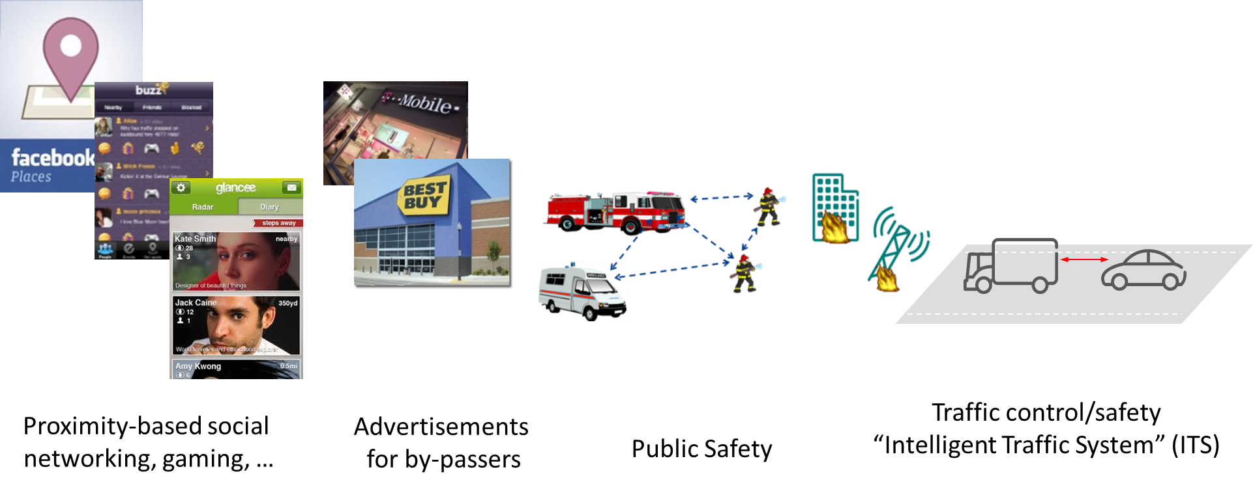
D2D in 5G
As predicted by Ericsson:

Slide 16
The potential gains include: • Capacity gain: due to the possibility of sharing spectrum resources between cellular and D2D users. • User data rate gain: due to the close proximity and potentially favorable propagation conditions high peak rates may be achieved. • Latency gain: when devices communicate over a direct link, the end-to-end latency may be reduced.
However, D2D communication implies new challenges for devices design, interference management, security, mobility management and other aspects. In addition, the success of this technology largely depends on the scenarios in which users in the proximity of each other communicate and the applications that will be developed in the coming years.

Slide 17
Adhoc Networks

Slide 18
Adhoc Networks
Adhoc networks form the base of D2D communications
A network connection established for a single session and does not require a router or a base station.
Distributed system -Each node plays the role of a router and maintains necessary routing information for multi-hop routing.
Self-organizing network without infrastructure network
The topology of the network continuously changes

Slide 19
Adhoc Networks in various scenarios:
Adhoc scenarios
Mobile Adhoc networks
Wireless Sensor networks
Vehicular Adhoc networks

Slide 20
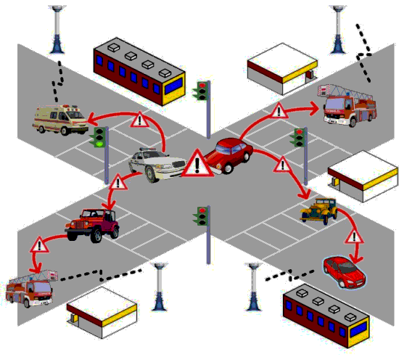
Vehicular Adhoc Networks (VANET)
uses cars as mobile nodes in a MANET to create a mobile network., allowing cars approximately 100 to 300 meters of each other to connect and, in turn, create a network with a wide range.
As cars fall out of the signal range and drop out of the network, other cars can join in, connecting vehicles to one another so that a mobile Internet is created.
VANETs collect and distribute safety information to massively reduce the number of accidents by warning drivers about the danger before they actually face it.
Architecture:
comprise of sensors and On Board Units (OBU) installed in the car as well as Road Side Units (RSU).
The data collected from the sensors on the vehicles can be displayed to the driver, sent to the RSU or even broadcasted to other vehicles depending on its nature and importance.
^{[3]}

Slide 21
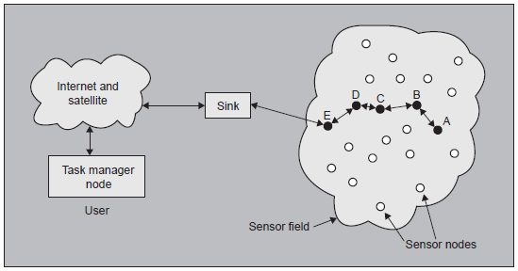
Wireless Sensor Networks
Contains a large number of tiny sensor nodes
Sensors are densely deployed either inside the phenomenon to be sensed or very close to it
Sensor nodes consist of sensing, data processing, and communicating components.
The position of sensor nodes need not be engineered or predetermined. They must possess self-organizing capabilities.
Sensor networks require adhoc networking since they sensor nodes are very densely deployed

Slide 22
How are they different from traditional adhoc networks?
Sensor nodes are prone to failure.
The topology of a wireless sensor network changes very frequently
Sensor nodes may not have global identification because of the large amount of overhead and large number of sensors.
the end goal is the detection/estimation of some event(s) of interest, and not just communication.
The large number of sensing nodes may congest the network with information. Therefore, some sensors, such as cluster heads, can aggregate the data, perform some computation and then broadcast the summarized new information.
multihop communication in wireless sensor networks is expected to consume less power than traditional single hop communication.

Slide 23
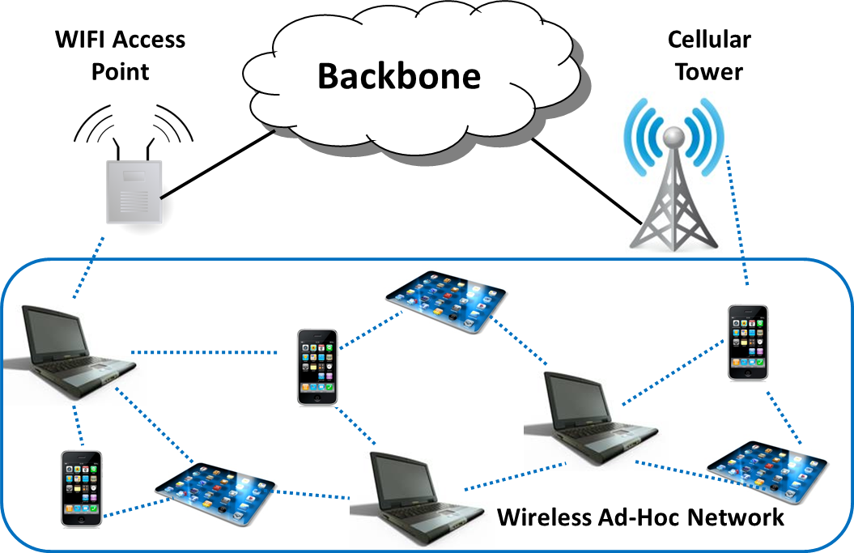
Mobile Adhoc Networks
Traditional Wireless Adhoc network
All mobile nodes in MANET are able to send and receive network packets within its limited transmission range.
In multi-hop method network nodes required support of their neighbors and other nodes to send packets to destination node which enables the communication with outside world.
^{[6]}

Slide 24
QoS Provisioning for Adhoc Networks
Network Layer --Routing
Unipath
Multipath
Cross Layer
Multi-rate
Scheduling
Resource allocation
MAC Layer
802.11
TDMA
CDMA
Quality of Service (QoS) means that the network should provide some kind of guarantee or assurance about the level or grade of service provided to an application. The actual form of QoS and the QoS parameter to be considered depends upon speciﬁc requirements of an application.

Slide 25
Issues in Wireless Adhoc Networks
Need for self-organization:
Neighbor discovery + topology organization and reorganization
End to end delays:
there maybe multiple hops from a given source to a destination in an adhoc network and at each hop nodes may contend for the channel.
Due to channel contention, it is difﬁcult to provide any hard guarantees about the end-to-end delays.
Resource consumption:
Energy depletion: deplete the battery power of nodes
so a mechanism has to be devised to make sure that nodes battery lasts longer which implies the network lasts longer- defined by the network lifetime, residual energy, node degree
Energy depletion occurs due to overhearing and packet transmissions
Buffer overflow: flooding the routing table or consuming the data packet buffer space
Bandwidth utilized for control data

Slide 26
Routing approaches may be table driven(proactive) or demand driven(reactive).
Link State Routing:
Two steps:
Flooding :To tell every node about the topology of the network
Shortest path calculated at every node: Based on Dijkstra’s algorithm
Optimized Link State Routing(OLSR):
Table driven and proactive routing protocol developed for mobile ad hoc networks.
Functionality :
communication of HELLO and Topology Control (TC) messages.
Such messages are periodically send in the network by all nodes and allow recipient nodes to update their related tables using related information.

Slide 27
OLSR and Modified OLSR

Slide 28
Scope of D2D Networks in our paper
Our paper concerns with the D2D networks use in efficient energy utilization.
Increasing the network lifetime.
D2D network with modified OLSR and MANET increases spectrum utilization, increased throughput and efficient energy.
OLSR is modified on the basis of routing metrics.
Performance of the network is evaluated on the basis of performance metrics parameters.

Slide 29
Network Lifetime
Network Lifetime is defined as the time until which the battery of the mobile adhoc node is depleted.
For defining and signifying network lifetime, following parameters are used:
Network congestion
Residual energy of mobile nodes
Network topology
Modify OLSR to make routing decisions according to these parameters and measure the performance improvement of our approach compared with the standard OLSR, using various performance parameters.

Slide 30
Optimized Link State Routing (OLSR)
It is an optimization of link state routing protocol, which inherits the stability of a traditional link state algorithm and it enhances its proactive routing nature.
In OLSR, like in all proactive routing protocols, the nodes periodically broadcast control packets (HELLO and topology control packets (TC)) to ﬁnd their 1-hop neighbors and advertise a subset of their links.
Upon receipt of these packets, each node calculates and updates routes to each known destination.
The key concept of reducing the overhead in OLSR is the multipoint relays (MPR).

Slide 31
The multipoint relays of a mobile node are nodes in its 1-hop neighborhood that are selected in order to forward the node’s topology control (TC) packet.
Every node maintains a set of these nodes which constitutes its MPR Selectors set. MPRs are used as intermediate nodes to form a route from a given node to any destination.
Selection Criteria of MPR:
It should have a bi-directional link with the node.
Second, the MPR set should cover all nodes that are in the 2-hop neighborhood of the given node.

Slide 32
MODIFIED Optimized Link State Routing(OLSR)
OLSR is modified in the paper using the following parameters:
1) TC Packet Format- It is crucial to ﬁnd a way to propagate nodes weights to the network without increasing network overhead. An effective way is to embed this information to the TC packets that are periodically generated by each node.
2) MPR Selection- MPR set should cover all the nodes that are two hops away (two-hop neighborhood).
3) Routing Table Compilation- The update of routing tables should be based on the path costs computed from the nodes weights and not on the number of hops

Slide 33
Routing Metrics
Our paper proposes three routing parameters as a set of routing metrics and to estimate the cost of the link and decide about routing path.
Parameters for the Routing Scheme:
MAC queue utilization-Signified congestion in the network. Priority should be given to networks with high MAC queue utilization.
Residual energy-Determines the next hop. Traffic should be prioritized as to nodes which have enough residual energy to transmit.
Node Degree-No. of nodes that belong to one-hop neighborhood. Signifies the overall energy depletion.

Slide 34
Performance Metrics
To evaluate the performance of the above mentioned protocols and the routing scheme, the following parameters are considered:
Packet Delivery Ratio-Ratio of no. of packets received by the destination node to no. of packets transmitted by the source node.
Network Lifetime-Time until the battery of one of the mobile ad-hoc nodes depletes.
Average Node Residual Energy v/s Time-Details how the average energy consumption varies with time.
Distribution of node residual energy-Describes how the energy is consumed in the adhoc network.

Slide 35
Simulation Setup
We will simulate our project in various static and dynamic scenarios to bring out the performance of Modified OLSR and compare it with Standard OLSR.
Simulation parameters are summarized as follows:
No. of nodes-30
Transmission Rate- 2Mbps
Packet Size-512 bytes.

Slide 36
Setup- 1
The scope of this setup is to gauge the performance of Modified OLSR using the performance metrics as described in the earlier slides.
In this setup, we will consider the Average Residual Energy v/s Time and Distribution of Node Residual Energy parameters of the performance metrics.
This performance is used to give us the clear picture of the energy consumption and network lifetime.
Setup- 2
The scope of the setup is to evaluate the performance of Modified OLSR and compare it with Standard OLSR in static as well as mobile scenarios.
In this setup, we will consider the Network Lifetime and Packet Delivery Ratio as the parameters of performance metrics.
This performance is used to give us the mobility model and clears the picture about network lifetime and packet delivery rate.

Slide 37
References
[1] Arash Asadi, Qing Wang and and Vincenzo Mancuso, A Survey on Device-to-Device Communication in Cellular Networks, April 2014, Pages: 1801 – 1819.
[2] Daquan Feng, Lu Lu, Yi Yuan-Wu, Geoffrey Ye Li, Shaoqian Li, and Gang Feng, Device-to-Device Communications in Cellular Networks, April 2014, Pages: 49 – 55
[3] http://www.cs.sjtu.edu.cn/~fwu/res/fig-NSFC11.png
[4] Abdalla,G.M.T., Abu-Rgheff,M.A.and Senouci,S.M.Current trends in vehicular ad-hoc networks, IEEE Global Information Infrastructure Symposium, 2007, Pages: 1−7
[5] Sensor Networks: Wireless Communications and Networking,Vijay K.Garg
[6] http://www.ics.uci.edu/~keldefra/manet.htm
[7] Evripidis Paraskevas, Kyriakos Manousakis, Subir Das and John S. Baras, “Multi-Metric Energy Efficient Routing in Mobile Ad-Hoc Networks”, 2014 IEEE Military Communication Conference”, 2014, Pages-1146-1151.
[8] http://www.ericsson.com/research-blog/5g/device-device-communications/
[9]Ash Mohammed Abbas,oivind Kure,”Quality of service in mobile Adhoc Networks:A survey”,International Journal Adhoc and Ubiquitous computing.

Slide 38
THANK YOU

