Slide 1
Inheritance

Slide 2
Is-A relationship Specialisation:
To illustrate the concept we can consider an Account which can be of various types like “Savings”, ”Credit card”, ”Fixed Deposit” and ”Loan”.
The process is depicted by a triangle component labelled ISA.
The attributes of the parent Entity set “Account” is inherited by the child sub Entities and is common to all the Entities “Savings”, ”Credit_card”, ”Fixed_Deposit” and “Loan”.
But besides these general attributes, each sub entity has some specialized attributes which distinguishes that Entity from the others.

Slide 4
Constraints in specialisation
There are several constraints which can be imposed on specialization which controls the level and degree of sharing of attributes among the parent and the child entities.
The importance of inheritance lies in data abstraction and data reusability.
The specialization can be categorized into two types Attribute-dependant specialization and User-defined Specialization.

Slide 5
Attribute defined
If there exists a constraint which differentiate or categorize a parent class into subclasses, the specialization is called predicate defined specialization.
If the predicate or condition is based on the value of some specific attribute the specialization is called Attribute Defined Specialization.

Slide 6
User-Defined
When there is no attribute or condition present in the parent entity by which we can categorize it into child entities it is called User Defined Specialization.
Membership in such a subclass is determined by the database users who add records to the individual Entities or Relations.
For example, Over the years, typographers and scholars of typography have categorized the Font typefaces into various groups like Serif, Sans Serif, Script and Decorative .
All of them will have the same sets of attributes like size, color, family, styles etc.

Slide 7
Color
Effects
Size
Character_spacing
Style
Font
Family
ISA
Serif
Sans-Serif
Script
Decorative

Slide 8
disjointedness constraint
which imposes a rule that the subclasses of the specialization must be either disjoint
which signifies that an entity can only belong to any one of the sub class
or overlapping in which an entity can belong to more than one sub class.

Slide 9
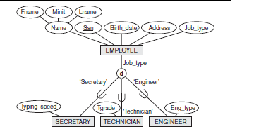

Slide 10
Completeness
The second constraint on specialization is called the completeness (or totalness) constraint,
which may be total or partial.
A total specialization constraint specifies
that every entity in the superclass must be a member of at least one subclass in the
specialization.
A partial specialisation which allows an entity not to belong to any of the subclasses.

Slide 11
Generalization
We can think of a reverse process of abstraction in which we suppress the differences
among several entity types, identify their common features, and generalize them
into a single superclass of which the original entity types are special subclasses.

Slide 12
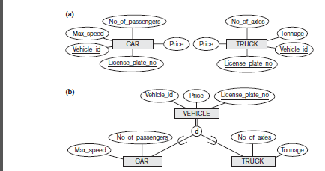

Slide 13
In Crow’s Foot model the representation of a parent child relationship is different.
We place the supertype entity set above the subtype entity sets, and use a circle with a line beneath it to denote a supertype-subtype relationship.
We use a solid line to represent an ID-dependent subtype entity, since each subtype is ID-dependent on the supertype.
There are two types of sub Entities:

Slide 14
Inclusive: The absence of an “X” in the circle denotes “inclusive” i.e., the supertype can relate to any of the subtypes. For example, a teacher can be either a full time teacher or part time teacher or both.

Slide 16
Exclusive:
The “X” in the circle denotes “exclusive” i.e., the supertype is “related” to at most one subtype.
For example, a particular shape can be any one of the Circle, Triangle or Rectangle.
Similarly an Account can be either a Savings or Credit_Card or Fixed_Deposit or Loan Account.
A particular Account Number cannot belong to more than one types of Account.

Slide 18
Inheritence
A class can inherit another class, which means that it includes all the members, public and private, of the original class,
plus the additional members that it defines.
The original class is called the base class and the new class is called the derived class.
we create a derived class to represent something that is a more specialized kind of the base class.
For example, we could define a class Cat that inherits from Animal.
A Cat can do everything an Animal can do, plus it can perform one additional unique action.

Slide 19
Types of inheritence
Single Inheritence:only one base class,one derived class
Hierarchial Inheritence:one base class,multiple derived classes
Multilevel Inheritence:derived classes again become base classes of derived classes
Multiple Inheritence:multiple base classes
Containment Inheritence:one class is contained in another class

Slide 20
Single Inheritence
class stud
{
int roll=1;
int age=20;
String name="Sunami";
}
class phys_stud extends stud
{
float height=5.6f;
float weight=(float)60.4;
}
A
B

Slide 21
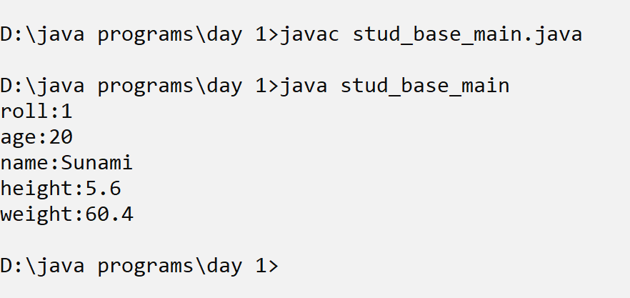
Single inheritance
class stud_base_main{
public static void main(String [] args){
phys_stud p=new phys_stud();
System.out.println("roll:"+p.roll);
System.out.println("age:"+p.age);
System.out.println("name:"+p.name);
System.out.println("height:"+p.height);
System.out.println("weight:"+p.weight);
}
}

Slide 22
Hierarchial Inheritence
shape
class Shape
{
int id=1;
String name="Shape";
}
class Circle extends Shape
{
int radius=4;
void areacirc(){
System.out.println("area circle:"+3.142*radius*radius);
}
}
circle
rectangle
square

Slide 23
class Rectangle extends Shape
{
int l=10,b=20;
void arearec(){
System.out.println("area rectangle:"+(l*b));
}
void perirec(){
System.out.println("perimeter recatngle:"+2*(l+b));
}
}

Slide 24
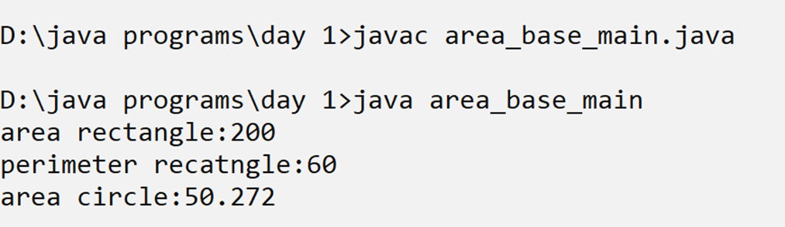
class Square extends Rectangle
{ int side;
void areasqr(){
System.out.println("area square:"+(side*side));
}}
class area_base_main{
public static void main(String [] args){
Rectangle r=new Rectangle();
r.arearec();
r.perirec();
Circle c=new Circle();
c.areacirc();
}
}

Slide 25
Multilevel Inheritence
class employee
{
int empid;
String name;
String addr;
}
class teacher extends employee
{
String qualification;
int exp;
String subject;
}
A
B
C

Slide 26
class full_time_teacher extends teacher
{
long salary;
}
class part_time_teacher extends teacher
{
int clock_hrs;
int pay_clock_hrs;
}

Slide 27
Multiple Inheritence
C# does not support multiple inheritence through classes.
We have to declare interface which will contain only the signatures or prototypes of methods or events.
The methods will be implemented by classes

Slide 28
Multiple Inheritence
Interface basic_info
{
Int roll;
String name;
Int age;
}
Interface physical_fit
{
Float height;
Float weight;
}
Class academic_info:basic_info,physical_fit
{
String course;
String sem;
Int rank;
}
A
B
C
D

