Slide 1
Iteration in Java

Slide 2
Iteration Statements
Java’s iteration statements are for, while, and do-while.
These statements create what we commonly call loops.
As you probably know, a loop repeatedly executes the same set of
instructions until a termination condition is met.
As you will see, Java has a loop to fit any
programming need.

Slide 3
Iteration or repetition
This control flow is used to repeat the execution of a block of instructions (code) until a special condition is encountered. The cycle of this repetitive execution is also called a loop. The Iteration lets a programmer define its code to be repeated in definite steps.
Example
Programmer wants to print usernames around 100 times so iteration/repetition control flow is used or input names of 100 customers.

Slide 4
Iteration or repetition cont’d
The concept of looping can be divided into:
Count Controlled Loop
Condition Controlled Loop

Slide 5
Iteration or repetition cont’d
Count Controlled Loop
We define the repetition or iteration by a counter variable (its initialisation instruction, termination criteria, and increment instruction).
‘For’ Loop is a count-controlled loop:
Suppose print a name 10 times
We define the counter as ‘count=0’ and the termination condition is 10 with an increment of 1 every step. So this will repeat 10 times.

Slide 6
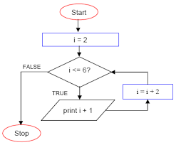
Iteration or repetition cont’d
Count Controlled Loop

Slide 7
Iteration or repetition cont’d
Condition Controlled Loop
Iteration or repetition continuously happens until a condition is met.
The program checks the condition, if it is found to be true, the program executes a command, otherwise false and the program goes back or exit.
The two concepts ‘while’ and ‘do while’ are used for condition-controlled looping.

Slide 8
While Loop
It is another pre-test sloop to check whether a condition is true or false. The ‘while’ loop executes when the condition is true and when the condition becomes false, the loop execution ends.
Example
int a=1;
while (a<=10){
print (a);
a=a+1; }
Output 1 2 3 4 5 6 7 8 9 10

Slide 9
While loop /*to find the sum of first n natural numbers*/
class sum_n{
public int sum(int n){
int i=1;
int sum=0;
while (i<=n){
sum=sum+i;
i++;
}//end while
return sum;
}//end function
public static void main(String [] args){
sum_n s=new sum_n();
System.out.println("The sum of n numbers="+s.sum(10));
}
}

Slide 10
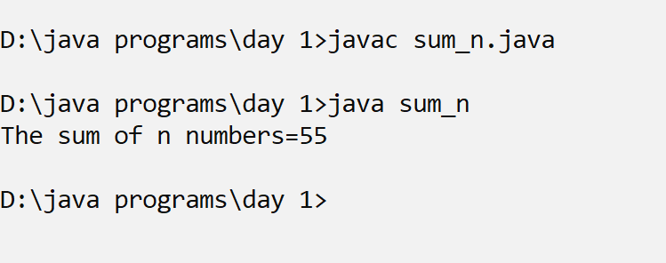
output

Slide 11
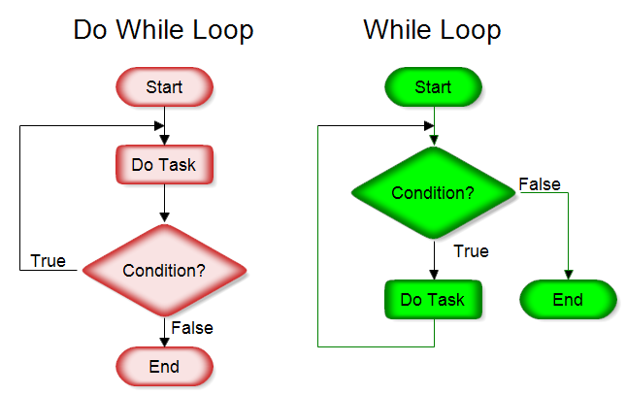
Iteration or repetition
Condition Controlled Loop
(www.rff.com, n.d)

Slide 12
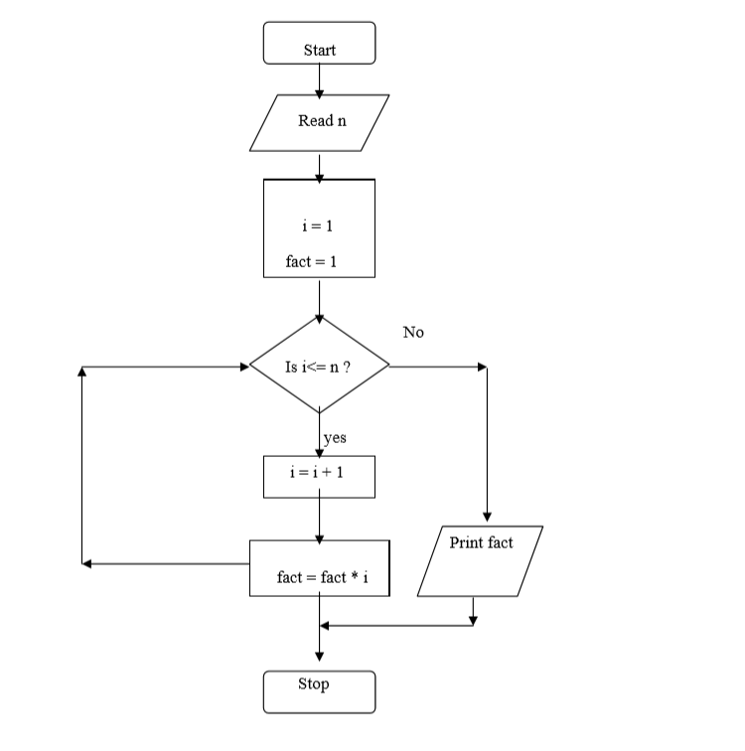
Find the factorial of a number

Slide 13
To find the factorial of a number
/*to find the factorial of a number */
import java.io.*;
class fact{
int f(int n){
int i=1;
int prod=1;
while(i<=n){
prod=prod*i;
i++;
}
return prod;
}
}
class fact_main {
public static void main(String [] args) throws Exception{
fact fobj=new fact();
DataInputStream in=new DataInputStream(System.in);
int n=Integer.parseInt(in.readLine());
System.out.println("The factorial is:"+fobj.f(n));
}
}

Slide 14
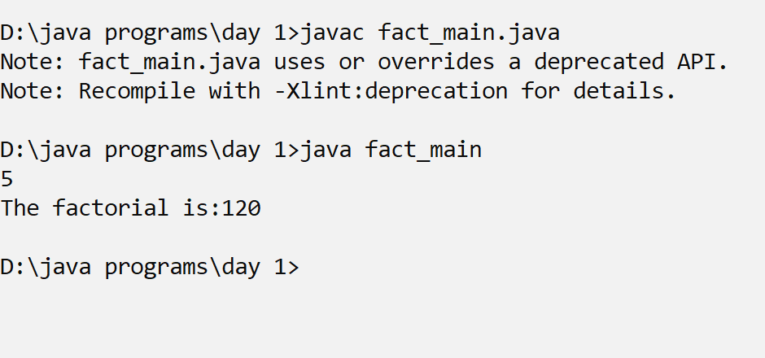

Slide 15
‘For’ Loop in Java
For Loop iterate to a definite set of repetitions.
A simple for loop is the same as C/C++. It consists of four parts:
Initialization:
It is the initial condition which is executed once when the loop starts.
Here, we can initialize the variable, or we can use an already initialized variable. It is an optional condition.
Condition:
It is the second condition which is executed each time to test the condition of the loop.
It continues execution until the condition is false.
It must return boolean value either true or false.
It is an optional condition.
Increment/Decrement:
It increments or decrements the variable value. It is an optional condition.
Statement:
The statement of the loop is executed each time until the second condition is false.

Slide 16
/*print multiplication table using for loop*/
import java.io.*;
class mult_tab{
public static void main(String [] args) throws Exception{
int x;
DataInputStream in=new DataInputStream(System.in);
System.out.println("Enter the number:");
x=Integer.parseInt(in.readLine());
for (int i=1;i<=10;i++){
System.out.println(x +"x "+ i+ " = "+ x*i);
}
}
}

Slide 17
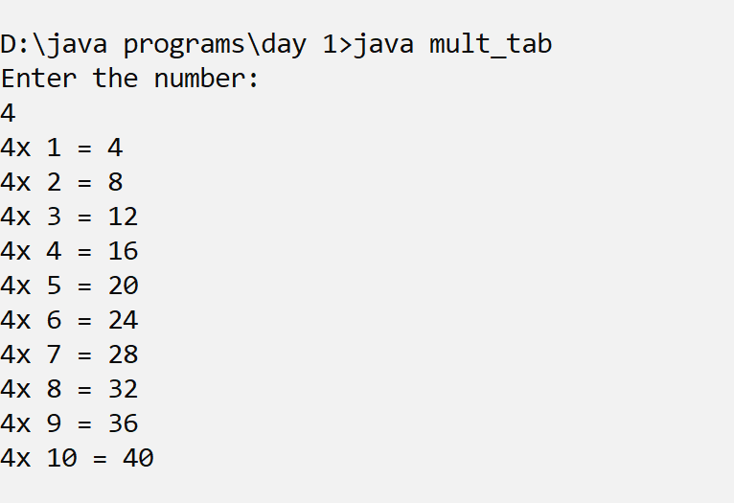
output

Slide 18
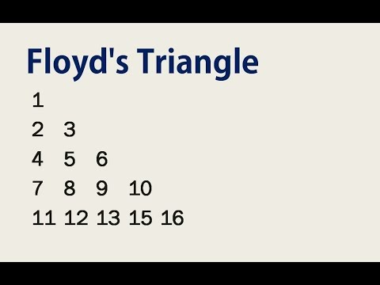
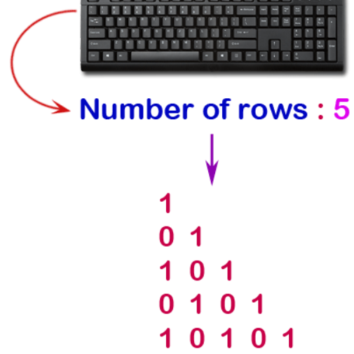
Java Nested for Loop
If we have a for loop inside the another loop, it is known as nested for loop. The inner loop executes completely whenever outer loop executes.

Slide 19
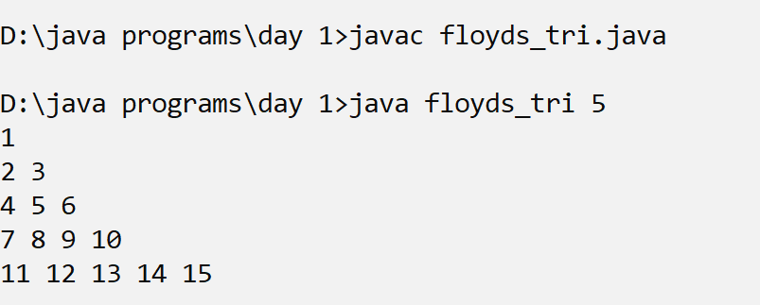
/*print floyds triangle*/
class floyds_tri{
public static void main(String [] args){
int x=1;
for(int i=1;i<=Integer.parseInt(args[0]);i++)
{
for(int j=1;j<=i;j++)
{
System.out.print(x+" ");
x++;
}
System.out.println();
}
}
}

Slide 20
Java for-each Loop
The for-each loop is used to traverse array or collection in Java.
It is easier to use than simple for loop because we don't need to increment value and use subscript notation.
It works on the basis of elements and not the index. It returns element one by one in the defined variable.

Slide 21
Syntax:
for(data_type variable : array_name)
{
//code to be executed
}

Slide 22
//Java For-each loop example which prints the elements of the array
public class foreachexmp {
public static void main(String[] args) {
int arr[]={10,20,30, 40,50};
for(int i:arr){
System.out.println(i);
}
}
}

Slide 23
Class practice
Print multiplication TABLE
Print odd natural number series
Print Floyd triangle
1
10
101
1010

Slide 24
main keywords used in loop are.
Break:
The break statement in java is used to terminate from the loop immediately.
When a break statement is encountered inside a loop, the loop iteration stops there, and control returns from the loop immediately to the first statement after the loop.
Continue:
The continue statement in Java is used to skip the current iteration of a loop.
We can use continue statement inside any types of loops such as for, while, and do-while loop.
Basically continue statements are used in the situations when we want to continue the loop but do not want the remaining statement after the continue statement.

Slide 25
Java Labeled For Loop
We can have a name of each Java for loop.
To do so, we use label before the for loop.
It is useful while using the nested for loop as we can break/continue specific for loop.

Slide 26
//Java print prime numbers
public class prime {
public static void main(String[] args) {
outer_loop:
for (int i=1;i<=Integer.parseInt(args[0]);i++){
int flag=0;
inner_loop:
for(int j=2;j<=i-1;j++){
if (i%j==0){
flag=1;
break inner_loop;
}//if
}//end for
if (flag==0){
System.out.println("prime:"+i);
}//end if
}//end for
}//main
} //class

Slide 27
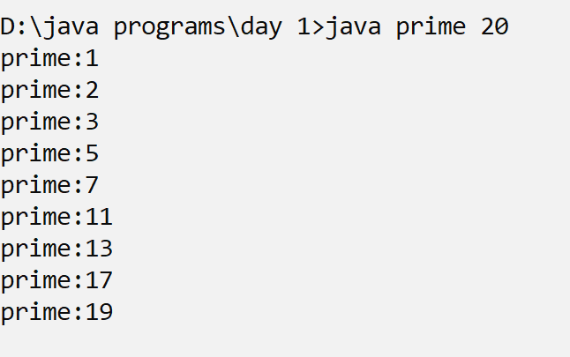
output

Slide 28
Java Infinitive for Loop
If you use two semicolons ;; in the for loop, it will be infinitive for loop.
Syntax:
for(;;){
//code to be executed
}

Slide 29
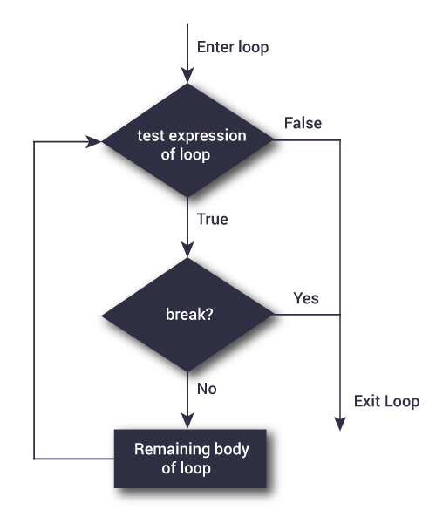

Slide 30
Do while loop
The Java do-while loop is used to iterate a part of the program repeatedly, until the specified condition is true.
If the number of iteration is not fixed and you must have to execute the loop at least once, it is recommended to use a do-while loop.
Java do-while loop is called an exit control loop.
Therefore, unlike while loop and for loop, the do-while check the condition at the end of loop body.
The Java do-while loop is executed at least once because condition is checked after loop body.

Slide 31
Syntax: do while loop
do{
//code to be executed / loop body
//update statement
}while (condition);

Slide 32
Class practice What will be the output of the following code snippet?
Public static void main(String [] args){
Int num_sum = 0;
Int count = 0;
while(count<10){
num_sum = num_sum + count;
count = count + 1
if (count== 5)
continue;
System.out.println("Sum of first ",count,"integers is: ", num_sum)}
}

Slide 33
Class practice What will be the output of the following code snippet?
Int num[]={1 , 2,3,4,5,6,7};
for (int x:num){
if (x == 3 or x==6):
continue;
System.out.println(x);
}

Slide 34
Thank you

