Slide 1
Collections

Slide 2
topics
Generics and Collection Framework
Creating a collection by using generics
Implementing an ArrayList
Iteration and Sorting ArrayList
Comparable, Comparator
Implementing Set
Importance of hashcode() & equals ()methods
Implementing Queue
Implementing Map
Properties

Slide 3
Collections Overview
The Java Collections Framework standardizes the way in which groups of objects are handled by your programs.
The Collections Framework was designed to meet several goals.
high-performance.
The implementations for the fundamental collections (dynamic arrays, linked lists, trees, and hash tables) are highly efficient.
Interoperability between different collections.
Extending and/or adapting a collection had to be easy.

Slide 4
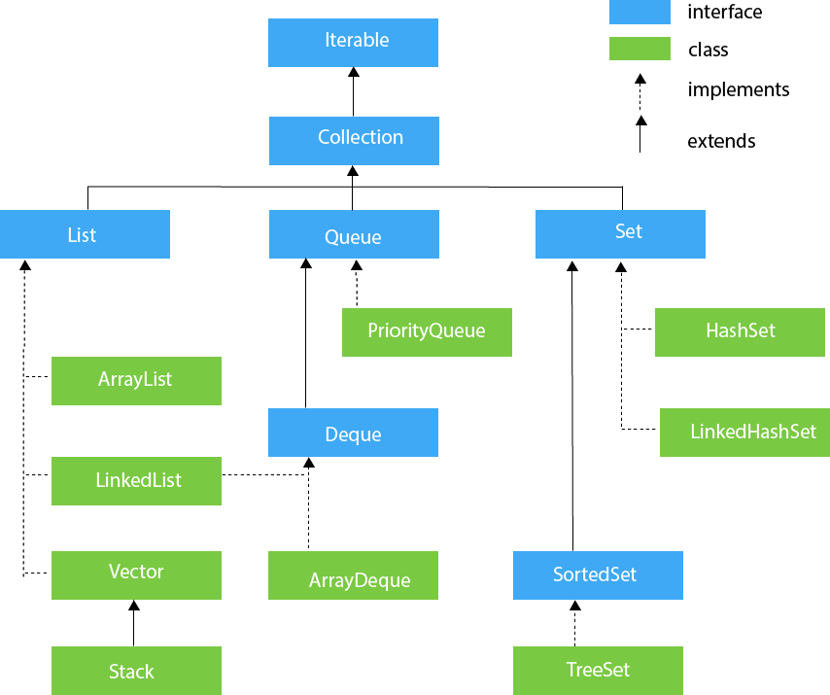

Slide 5
Collection Interface
The Collection interface is the interface which is implemented by all the classes in the collection framework.
It declares the methods that every collection will have.

Slide 6
generics

Slide 7
Generics in Java
The Java Generics programming is introduced to deal with type-safe objects.
It makes the code stable by detecting the bugs at compile time.
Before generics, we can store any type of objects in the collection, i.e., non-generic.
Now generics force the java programmer to store a specific type of objects.
In 1998, Gilad Bracha, Martin Odersky, David Stoutamire and Philip Wadler created Generic Java, an extension to the Java language to support generic types.

Slide 8
Advantage of Java Generics
There are mainly 3 advantages of generics.
They are as follows:
1) Type-safety: We can hold only a single type of objects in generics. It doesn’t allow to store other objects.
2) Type casting is not required: There is no need to typecast the object.
3) Compile-Time Checking: It is checked at compile time so problem will not occur at runtime.
The good programming strategy says it is far better to handle the problem at compile time than runtime.

Slide 9
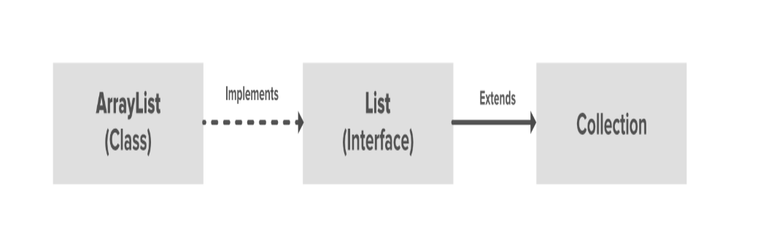
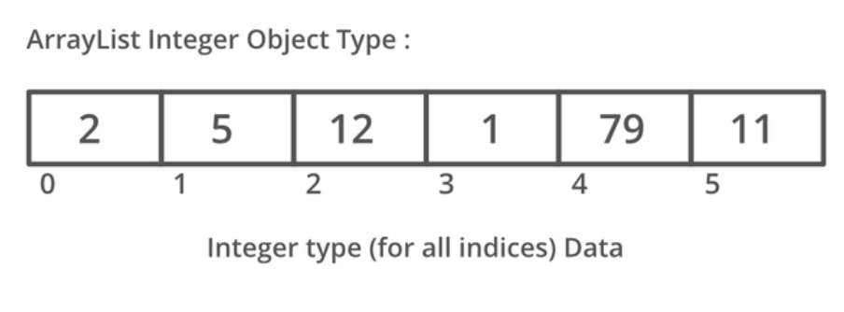

Slide 10
List Interface
List interface is the child interface of Collection interface.
It inhibits a list type data structure in which we can store the ordered collection of objects.
It can have duplicate values.
List interface is implemented by the classes ArrayList, LinkedList, Vector, and Stack.

Slide 11
LIST interface without using gEnerics
To instantiate the List interface, we must use :
List list1= new ArrayList();
List list2 = new LinkedList();
List list3 = new Vector();
List list4 = new Stack();

Slide 12
List interface
To instantiate the List interface, we must use :
List <data-type> list1= new ArrayList();
List <data-type> list2 = new LinkedList();
List <data-type> list3 = new Vector();
List <data-type> list4 = new Stack();

Slide 13
ArrayList

Slide 14
ArrayList
The ArrayList class implements the List interface.
It uses a dynamic array to store the duplicate element of different data types.
The ArrayList class maintains the insertion order and is non-synchronized.
The elements stored in the ArrayList class can be randomly accessed.

Slide 15
Java ArrayList Vs Array
In Java, we need to declare the size of an array before we can use it.
Once the size of an array is declared, it's hard to change it.
To handle this issue, we can use the ArrayList class.
It allows us to create resizable arrays.
Unlike arrays, arraylists can automatically adjust their capacity when we add or remove elements from them.
Hence, arraylists are also known as dynamic arrays.

Slide 16
Advantage of ArrayList
Since ArrayList is a dynamic array the size of the array automatically increases when we dynamically add and remove items.
if we try to add an item:
Creates a bigger-sized memory on heap memory (for example memory of double size).
Copies the current memory elements to the new memory.
New item is added now as there is bigger memory available now.
Delete the old memory.

Slide 17
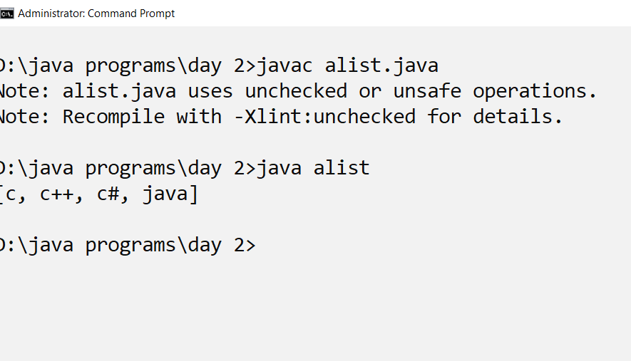
Arraylist without generics
import java.util.*;
class alist{
public static void main(String [] args){
ArrayList a=new ArrayList();
a.add("c");
a.add("c++");
a.add("c#");
a.add("java");
System.out.println(a);
}
}

Slide 18
ArrayList program
import java.util.*;
import java.io.*;
class shopping_list{
void addlist(ArrayList<String> ar,int n) throws Exception {
for (int i=1;i<=n;i++){
DataInputStream in=new DataInputStream(System.in);
System.out.println("Enter the item to add:");
String item=in.readLine();
ar.add(item);
}
}

Slide 19
Arraylist program
public static void main(String [] args) throws Exception{
ArrayList <String> l1=new ArrayList <String>();
System.out.println("Acepting the items from the user:");
shopping_list s1=new shopping_list();
s1.addlist(l1,10);
System.out.println("Displaying the items:");
Iterator it=l1.iterator();
while(it.hasNext()){
System.out.println(it.next());
}
}
}

Slide 20
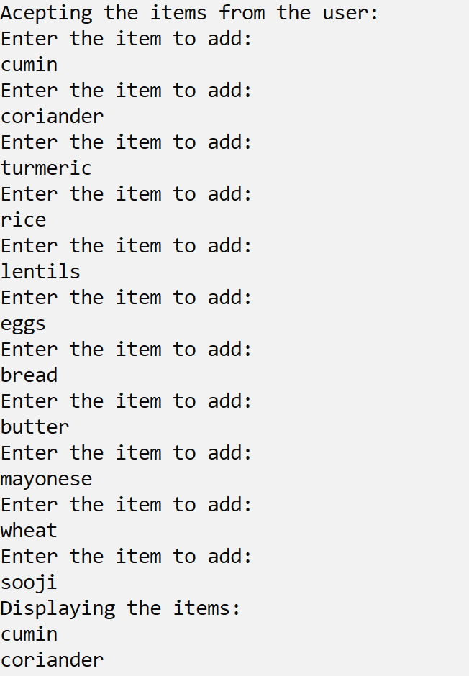
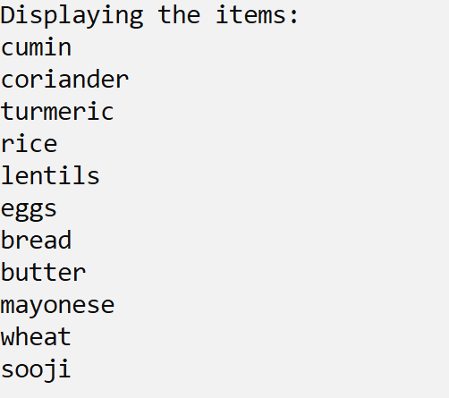
Output

Slide 21
ArrayList functions
Java ArrayList add()
inserts the element to the arraylist
Java ArrayList addAll()
adds all elements of a collection to arraylist
Java ArrayList clear()
removes all the elements from arraylist

Slide 22
ArrayList functions
Java ArrayList clone()
makes a copy of the array list
Java ArrayList contains()
checks if the element is present in the arraylist
Java ArrayList get()
returns the element present in the specified index
Java ArrayList indexOf()
returns the position of the specified element

Slide 23
Creating an ArrayList from array object
import java.util.*;
import java.io.*;
import java.util.Arrays;
class arraylist_num{
public static void main(String [] args) throws Exception{
Integer[] num={10,20,30, 45,1,67,89,20,102};
List<Integer> numlist=Arrays.asList(num);
Iterator it=numlist.iterator();
while(it.hasNext()){
System.out.println(it.next());
}//while

Slide 24
ArrayList contd.
DataInputStream in=new DataInputStream(System.in);
System.out.println("**Enter the index of the element to be retrieved?**");
int index=Integer.parseInt(in.readLine());
System.out.println("The item is :"+numlist.get(index));
System.out.println("**Enter element to be searched?**");
int item=Integer.parseInt(in.readLine());
if (numlist.contains(item))
System.out.println("Item "+item +" found");
else
System.out.println("Item "+item +" not found");

Slide 25
ArrayList contd..
System.out.println("**Enter the index of the element to be updated?**");
index=Integer.parseInt(in.readLine());
System.out.println("**Enter the new value to be updated?**");
item=Integer.parseInt(in.readLine());
numlist.set(index,item);
System.out.println("**The updated list:**");
System.out.println(numlist);
System.out.println("**Enter the item to be removed?**");
item=Integer.parseInt(in.readLine());
int del=numlist.remove(item);
System.out.println("**The updated list:**");
System.out.println(numlist);
}
}

Slide 26
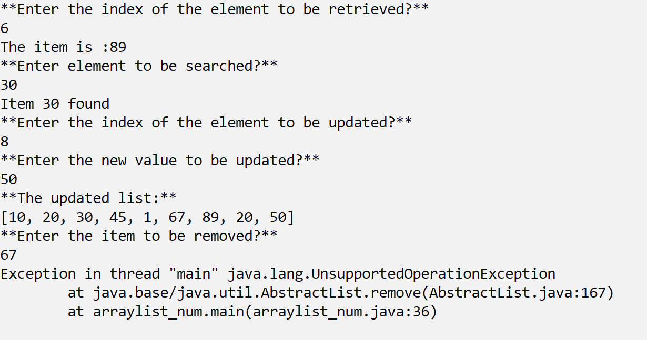
Exception as the ArrayList object is fixed sized

Slide 27
The ArrayList creation code updated
import java.util.*;
import java.io.*;
import java.util.Arrays;
class arraylist_num{
public static void main(String [] args) throws Exception{
Integer[] num={10,20,30, 45,1,67,89,20,102};
List<Integer> numlist=new ArrayList<Integer>(Arrays.asList(num));
Iterator it=numlist.iterator();
while(it.hasNext()){
System.out.println(it.next());
}//while

Slide 28
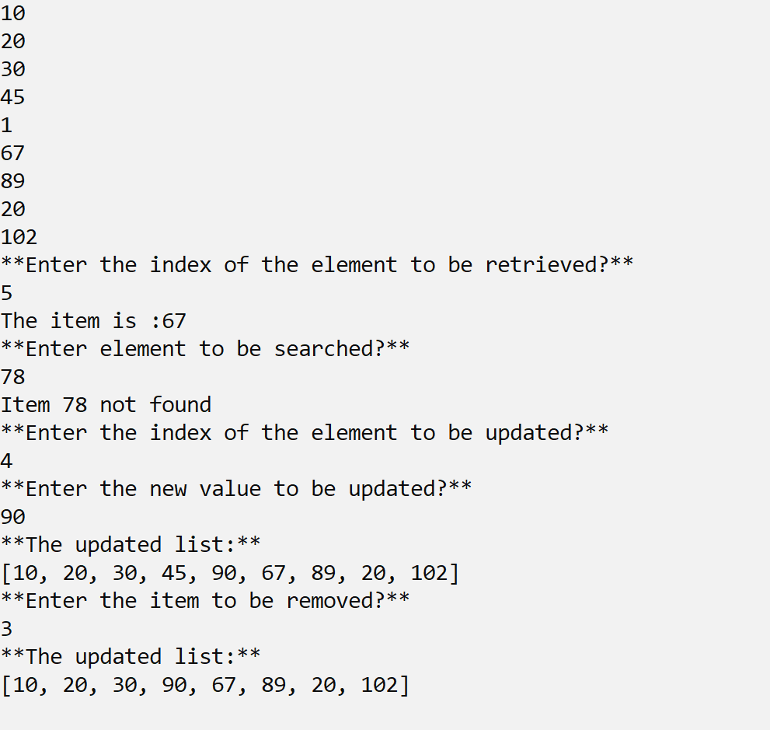
output

Slide 29
Java ArrayList forEach()
The forEach() method performs the specified action on
each element of the arraylist one by one.
System.out.println(numlist);
System.out.println("**Print the item list using foreach**");
numlist.forEach((e)->System.out.println(e));
System.out.println("**Print the square of item list using foreach**");
numlist.forEach((e)->System.out.println(e*e));

Slide 30
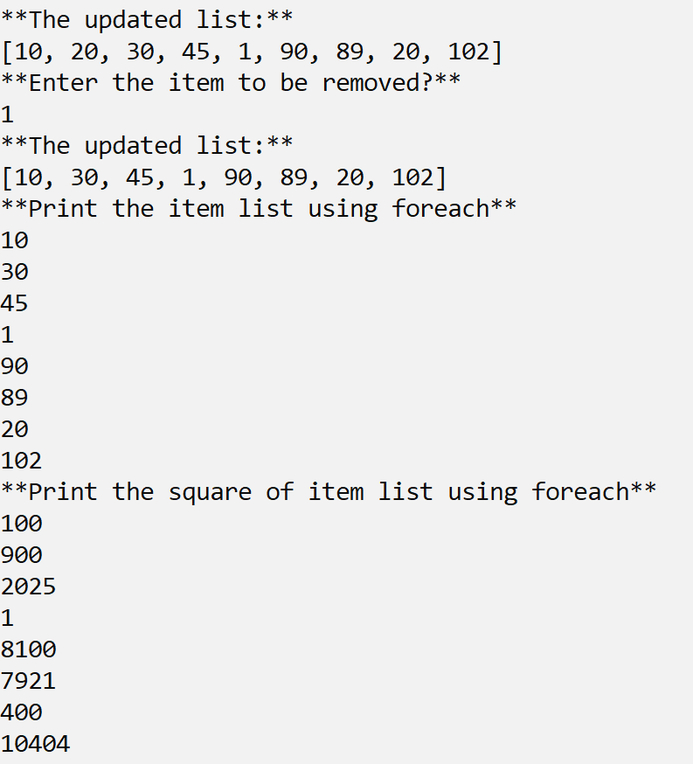
output

Slide 31
Comparator Interface in Java with Examples
A comparator interface is used to order the objects of user-defined classes.
A comparator object is capable of comparing two objects of the same class.
Following function compare obj1 with obj2.
Syntax:
public int compare(Object obj1, Object obj2)
Here, the naturalOrder() method of the Java Comparator Interface specifies that elements are sorted in natural order (i.e. ascending order).
Here, the reverseOrder() method of the Java Comparator Interface specifies that elements are sorted descending order).

Slide 32
Sorting
System.out.println("**Sorting the array list in ascending order**");
numlist.sort(Comparator.naturalOrder());
System.out.println(numlist);
System.out.println("**Sorting the array list in descending order**");
numlist.sort(Comparator.reverseOrder());
System.out.println(numlist);

Slide 33
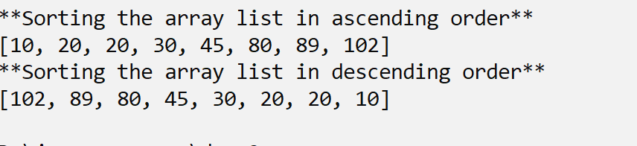
Sorting an ArrayList

Slide 34
Set

Slide 35
Set in Java
Set Interface in Java is present in java.util package.
It extends the Collection interface.
It represents the unordered set of elements which doesn't allow us to store the duplicate items.
We can store at most one null value in Set.
Set is implemented by HashSet, LinkedHashSet, and TreeSet.

Slide 36
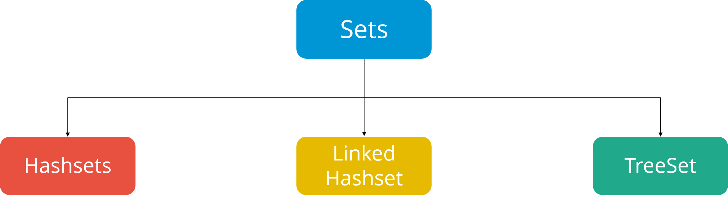
Types of sets
Hash Set does not provide any guarantee about the order of the elements while iterating the set.
LinkedHashSet on the other hand, provides a guarantee about the order of the elements while iterating them.
TreeSet provides guarantee, but the set is sorted according to the natural order, or by a specific comparator implementation.

Slide 37
Set Interface
Set can be instantiated as:
Set<data-type> s1 = new HashSet<data-type>();
Set<data-type> s2 = new LinkedHashSet<data-type>();
Set<data-type> s3 = new TreeSet<data-type>();

Slide 38
HashSet
HashSet class implements Set Interface.
It represents the collection that uses a hash table for storage.
Hashing is used to store the elements in the HashSet.
It contains unique items.

Slide 39
Adding item in a set
import java.util.*;
import java.io.*;
import java.util.Comparator;
class collection_set_add{
public static void main(String [] args){
Set<Integer> s1=new HashSet<Integer>();
s1.add(1);
s1.add(20);
s1.add(5);
s1.add(1);
s1.add(5);
s1.add(5);}
System.out.println(s1);
System.out.println("***iterating the list with iterator***");
Iterator it=s1.iterator();
while (it.hasNext()){
System.out.println(it.next());
}
}

Slide 40
Operations on the Set Interface
The set interface allows the users to perform the basic mathematical operation on the set. Let’s take two arrays to understand these basic operations.
Let set1 = [1, 3, 2, 4, 8, 9, 0] and set2 = [1, 3, 7, 5, 4, 0, 7, 5].
Then the possible operations on the sets are:
Intersection: This operation returns all the common elements from the given two sets. For the above two sets, the intersection would be:
Intersection = [0, 1, 3, 4]
Union: This operation adds all the elements in one set with the other. For the above two sets, the union would be:
Union = [0, 1, 2, 3, 4, 5, 7, 8, 9]
Difference: This operation removes all the values present in one set from the other set. For the above two sets, the difference would be:
Difference = [2, 8, 9]

Slide 41
Set operations
import java.util.Arrays;
import java.util.Set;
import java.util.*;
import java.io.*;
class set_op{
public static void main(String [] args){
Integer [] num1={1, 3, 2, 4, 8, 9, 0};
Integer [] num2={1, 3, 7, 5, 4, 0, 7, 5};
Set<Integer> s1=new HashSet<Integer>(Arrays.asList(num1));
Set<Integer> s2=new HashSet<Integer>(Arrays.asList(num2));
System.out.println("The s1 is"+s1);
System.out.println("The s2 is"+s2);

Slide 42
Set operations
Set<Integer> set_union=new HashSet<Integer>();
set_union.addAll(s1);
set_union.addAll(s2);
System.out.println("The union of s1 and s2 is"+set_union);
Set<Integer> set_intersect=new HashSet<Integer>();
set_intersect.addAll(s1);
set_intersect.retainAll(s2);
System.out.println("The intersection of s1 and s2 is"+set_intersect);

Slide 43
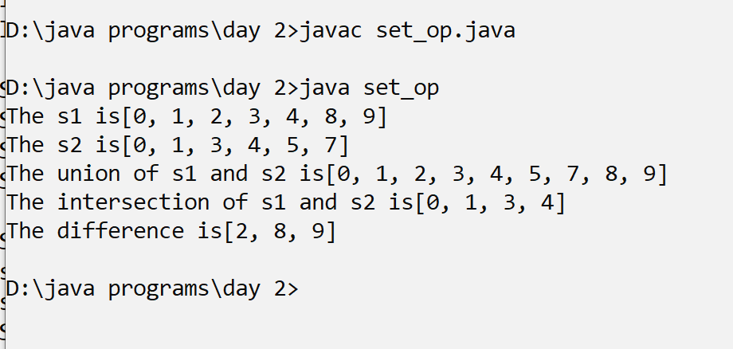
Set operations
Set<Integer> set_diff=new HashSet<Integer>();
set_diff.addAll(s1);
set_diff.removeAll(s2);
System.out.println("The intersection is"+set_diff);
}
}

Slide 44
hashCode()
The hashCode() method of Set in Java is used to get
the hashCode value for this instance of the Set.
It returns an integer value which is the hashCode value for this instance of the Set.
Syntax:
public int hashCode()
Parameters: This function has no parameters.
Returns: The method returns an integer value which is the
hashCode value for this instance of the Set.

Slide 45
What is the importance of hashcode?
hashCode()
Returns the hash code value for this set.
The hash code of a set is defined to be the sum of the hash codes of the elements in the set, where the hash code of a null element is defined to be zero.
This ensures that s1.equals(s2) implies that s1.hashCode()==s2.hashCode()
for any two sets s1 and s2,

Slide 46
Comparing hashcode
import java.util.*;
import java.util.Set;
import java.util.Comparator;
class set_hashcode{
public static void main(String [] args){
Set<Integer>s1=new HashSet<Integer>();
Integer [] n1={1, 3, 2, 4, 8, 9, 0};
s1.addAll(Arrays.asList(n1));
System.out.println("hashcode value of s1"+s1.hashCode());

Slide 47
Comparing hashcode
Integer [] n2={1,1,1,1, 3, 3,2,2, 4,4,4, 8, 9, 0};
Set<Integer>s2=new HashSet<Integer>();
s2.addAll(Arrays.asList(n2));
System.out.println("hashcode value of s2"+s1.hashCode());
if(s1.hashCode()==s2.hashCode())
System.out.println("The two sets are equal");
else
System.out.println("The two sets are not equal");
}
}

Slide 48
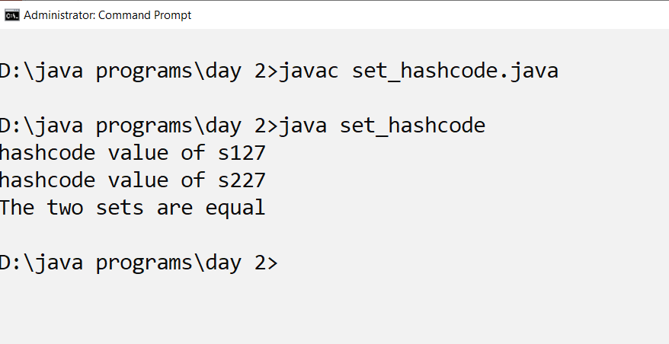
output

Slide 49
QUEUE

Slide 50
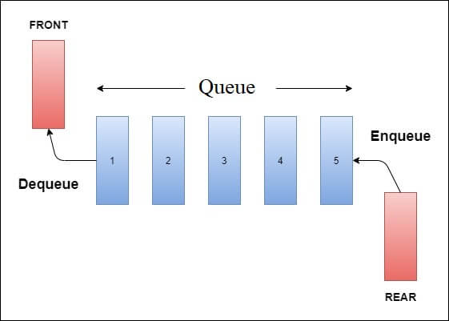
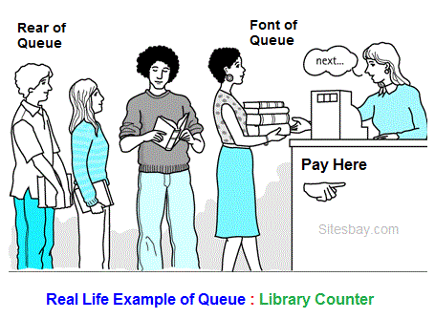
Queue

Slide 51
Use cases of queue
Some other Real Life Examples of Queue are
Queue of processes in OS.
Queue of people at any service point such as ticketing etc.
Queue of packets in data communication.
Queue of air planes waiting for landing instructions.

Slide 52
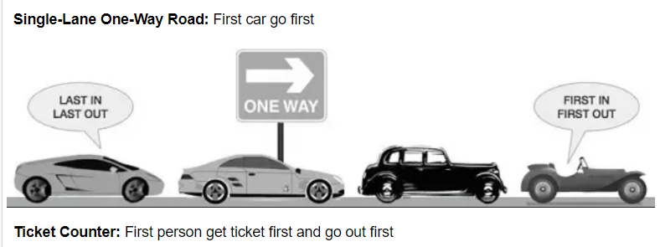
Operation on a queue
The basic operation that can be perform on queue are;
Insert an element in a queue.
Delete an element from the queue.

Slide 53
Insert an element in a queue.

Slide 54
Delete any element from the queue.

Slide 55
Creating Queue Objects:
Since Queue is an interface, objects cannot be created of the type queue.
We always need a class which extends this list in order to create an object.
Being an interface the queue needs a concrete class for the declaration and the most common classes are the PriorityQueue and LinkedList in Java.

Slide 56
What is PriorityQueue in Java?
A PriorityQueue is used when the objects are supposed to be processed based on the priority.
It is known that a Queue follows the First-In-First-Out algorithm,
but sometimes the elements of the queue are needed to be processed according to the priority,
that’s when the PriorityQueue comes into play.
The PriorityQueue is based on the priority heap.
The elements of the priority queue are ordered according to the natural ordering,
or by a Comparator provided at queue construction time

Slide 57
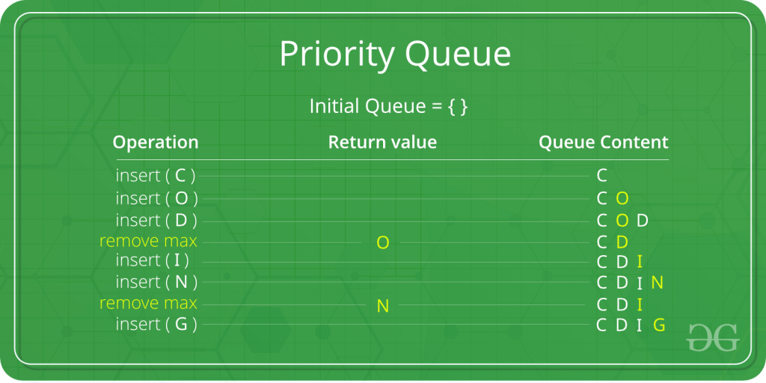

Slide 58
Methods in Priority Queue class
add(E e) Inserts the specified element into this priority queue.
clear() Removes all of the elements from this priority queue.
comparator() Returns the comparator used to order the elements in this queue, or null if this queue is sorted according to the natural ordering of its elements.
contains​(Object o) Returns true if this queue contains the specified element.
forEach​(Consumer<? super E> action) Performs the given action for each element of the Iterable until all elements have been processed or the action throws an exception.

Slide 59
METHOD DESCRIPTION
peek() Retrieves, but does not remove, the head of this queue, or returns null if this queue is empty.
poll() Retrieves and removes the head of this queue, or returns null if this queue is empty.

Slide 60
Program to implement a queue
import java.util.*;
import java.io.*;
class queue_class{
public void enqueue(Queue<String> q, String item){
q.add(item);
}
public String dequeue(Queue<String> q,String item){
if(q.remove(item))
return item;
else
return "item not found";
}

Slide 61
Priority queue
public static void main(String [] args) throws Exception{
Queue<String> cars=new PriorityQueue<String>();
queue_class qobj=new queue_class();
System.out.println("Adding list of cars in queue");
qobj.enqueue(cars,"Mercedes");
qobj.enqueue(cars,"Toyota");
qobj.enqueue(cars,"Audi");
System.out.println(cars);
DataInputStream in=new DataInputStream(System.in);
String item=in.readLine();
System.out.println("The item deleted is :"+qobj.dequeue(cars,item));
System.out.println("Printing list of cars in queue with iterator");

Slide 62
Priority queue
Iterator it=cars.iterator();
while (it.hasNext()){
System.out.println("queue element:"+it.next());
}
System.out.println("Removing the head of the queue");
System.out.println("The head of queue is :"+cars.peek());
System.out.println("The item deleted is :"+cars.poll());
System.out.println("Printing list of cars :");
System.out.println(cars);
}
}

Slide 63
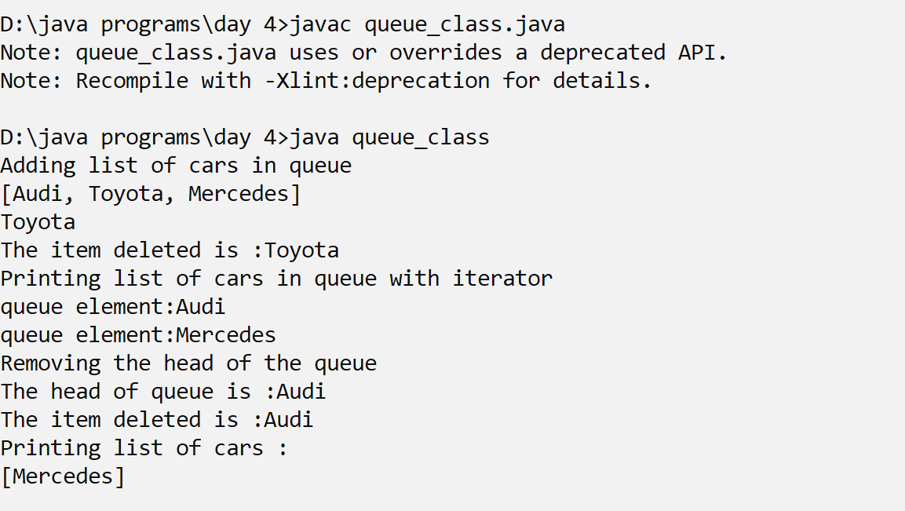

Slide 64
method
iterator() Returns an iterator over the elements in this queue.
remove​(Object o) Removes a single instance of the specified element from this queue, if it is present.
removeAll​(Collection<?> c) Removes all of this collection’s elements that are also contained in the specified collection (optional operation).
removeIf​(Predicate<? super E> filter) Removes all of the elements of this collection that satisfy the given predicate.
retainAll​(Collection<?> c) Retains only the elements in this collection that are contained in the specified collection (optional operation).

Slide 65
Max Priority Queue
In a max priority queue, elements are inserted in the order in which they arrive the queue and the maximum value is always removed first from the queue.
For example, assume that we insert in the order 8, 3, 2 & 5 and they are removed in the order 8, 5, 3, 2.
The following are the operations performed in a Max priority queue...
isEmpty() - Check whether queue is Empty.
insert() - Inserts a new value into the queue.
findMax() - Find maximum value in the queue.
remove() - Delete maximum value from the queue.

Slide 66
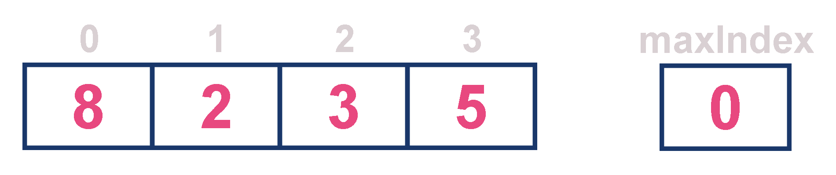
Max priority queue
For example, assume that elements are inserted in the order of 8, 2, 3 and 5. And they are removed in the order 8, 5, 3 and 2.

Slide 67
Max priority queue implementation
import java.util.*;
import java.util.PriorityQueue;
class pq{
Integer findMax(PriorityQueue<Integer> pq){
int max=0;
Iterator<Integer> it=pq.iterator();
while(it.hasNext()){
System.out.println(it.next().intValue());
int x=it.next().intValue();
if(x>max)
max=x;
}
System.out.println("max="+max);
return max;
}

Slide 68
Priority queue implementation
public static void main(String [] args)
{
pq pq1=new pq();
PriorityQueue<Integer> wait_time_min=new PriorityQueue<Integer>();
System.out.println("Add the waiting times in queue");
wait_time_min.add(20);
wait_time_min.add(100);
wait_time_min.add(5);
wait_time_min.add(140);
System.out.println("Displaying the queue with lambda");
wait_time_min.forEach((x)->System.out.println(x));
System.out.println("Displaying the queue with iterator");
Iterator<Integer> it1=wait_time_min.iterator();
while(it1.hasNext()){
System.out.println(it1.next());
}

Slide 69
Priority queue implementation
System.out.println("Removing the element from priority max queue");
int item=pq1.findMax(wait_time_min);
if (wait_time_min.remove(item))
System.out.println("The max item is removed");
else
System.out.println("The item not found");
System.out.println("Displaying the queue ");
System.out.println(wait_time_min);
}
}

Slide 70
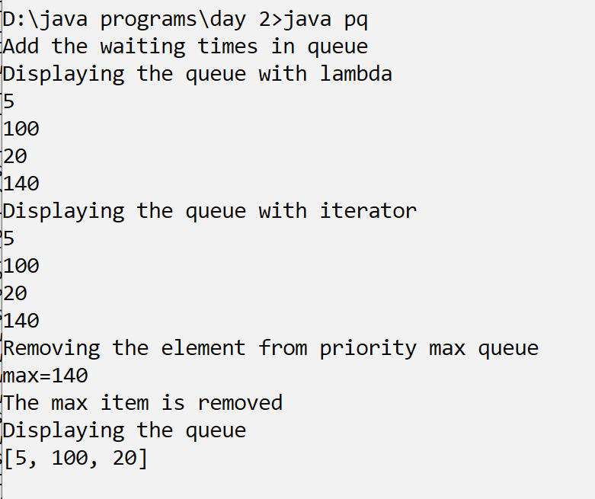
Priority queue output

Slide 71
Exercise
Create a min priority queue

Slide 72
MAP

Slide 73
MAP in java
Working of Map
In Java, elements of Map are stored in key/value pairs.
Keys are unique values associated with individual Values.
A map cannot contain duplicate keys.
And, each key is associated with a single value.

Slide 74
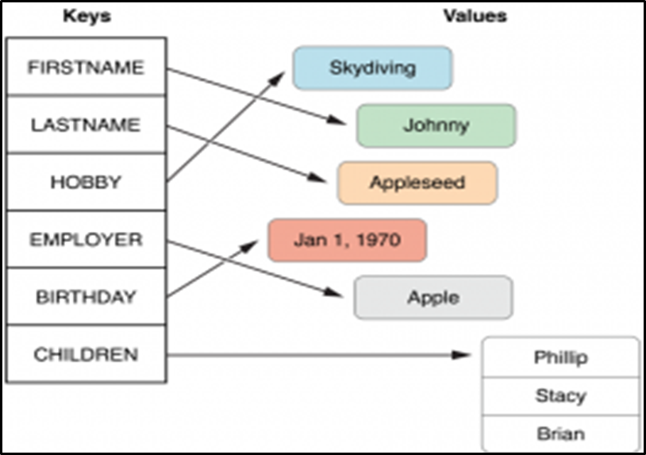
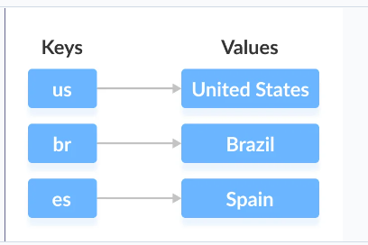

Slide 75
The Map interface maintains 3 different sets:
The set of keys
The set of values
The set of key/value associations (mapping).

Slide 76
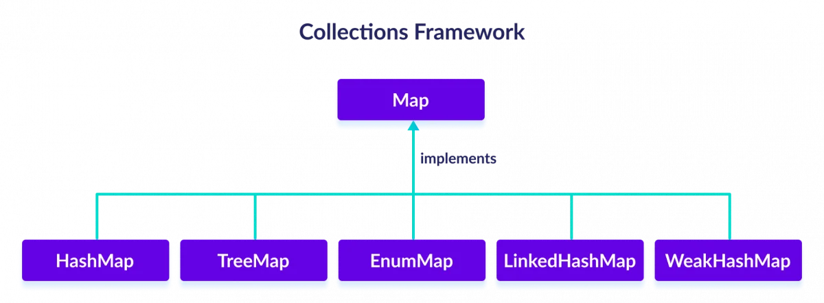

Slide 77
What is a hashtable?
The Hash table data structure stores elements in key-value pairs where
Key- unique integer that is used for indexing the values
Value - data that are associated with keys.

Slide 78
Hashing (Hash Function)
In a hash table, a new index is processed using the keys.
And, the element corresponding to that key is stored in the index.
This process is called hashing.
Let k be a key and h(x) be a hash function.
Here, h(k) will give us a new index to store the element linked with k.

Slide 79
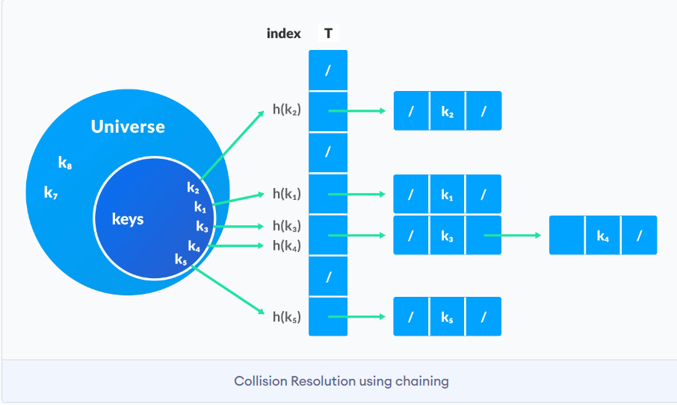
Collision resolution by chaining
In chaining, if a hash function produces the same index for multiple elements,
these elements are stored in the same index by using a doubly-linked list.
If j is the slot for multiple elements, it contains a pointer to the head of the list of elements.
If no element is present, j contains NIL.

Slide 80
Good Hash Functions
A good hash function may not prevent the collisions completely however it can reduce the number of collisions.
Here, we will look into different methods to find a good hash function
Division Method
If k is a key and m is the size of the hash table,
the hash function h() is calculated as:
h(k) = k mod m
For example, If the size of a hash table is 10 and k = 112 then h(k) = 112 mod 10 = 2.
The value of m must not be the powers of 2.
112->2
110->0
102->2

Slide 81
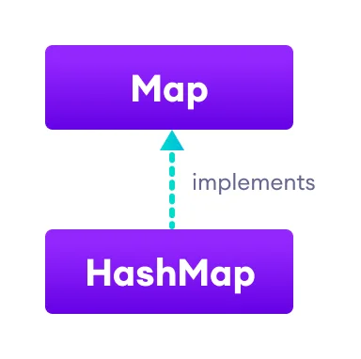
Hashmap
The HashMap class of the Java collections framework provides the functionality of the hash table data structure.
It stores elements in key/value pairs.
Here, keys are unique identifiers used to associate each value on a map.
The HashMap class implements the Map interface.

Slide 82
Create a HashMap
In order to create a hash map, we must import the java.util.HashMap package first.
To understand map operations we will use the following map:
We can access the values within a dictionary using keys and perform various operations on it.

Slide 83
Basic Operations on Java HashMap
The HashMap class provides various methods to perform different operations on hashmaps. We will look at some commonly used arraylist operations in this tutorial:
Add elements
Access elements
Change elements
Remove elements

Slide 84
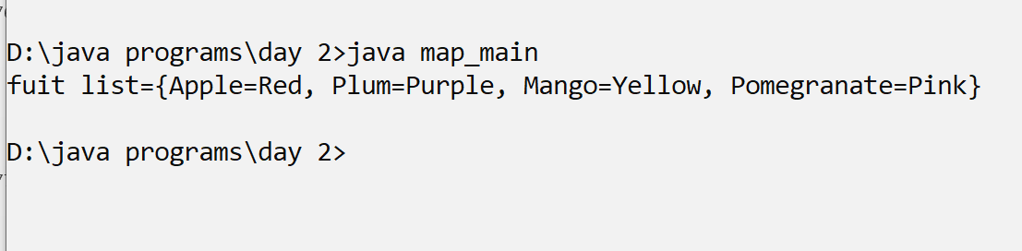
Creating a list of fruits
import java.util.HashMap;
import java.util.*;
class map_main{
public static void main(String [] args){
HashMap<String,String> fruit_map=new HashMap<String,String>();
fruit_map.put("Pomegranate","Pink");
fruit_map.put("Apple","Red");
fruit_map.put("Mango","Yellow");
fruit_map.put("Plum","Purple");
System.out.println("fuit list="+fruit_map);
}
}

Slide 85
Creating a map with the dimension of a apartment
apartment = { 'living' : [400, 450], 'bedroom' : [650, 800], 'kitchen' : [300, 250], 'garage' : [250, 0]}.
Accessing Values in a Dictionary

Slide 86
Creating a HashMap
import java.util.HashMap;
import java.util.*;
class map_flat1{
public static void main(String [] args){
//apartment = { 'living' : [400, 450], 'bedroom' : [650, 800], 'kitchen' : [300, 250], 'garage' : [250, 0]}
HashMap<String,ArrayList<Integer>> hm1=new HashMap<String,ArrayList<Integer>>();
int [] a={400,500};
hm1.put("living",new ArrayList<Integer>());
ArrayList<Integer> list=hm1.get("living");
list.add(400);
list.add(450);
hm1.put("living",list);

Slide 87
Adding the value of a key
hm1.put("bedroom",new ArrayList<Integer>());
list=hm1.get("bedroom");
list.add(650);
list.add(800);
hm1.put("bedroom",list);
hm1.put("kitchen",new ArrayList<Integer>());
list=hm1.get("kitchen");
list.add(300);
list.add(250);
hm1.put("kitchen",list);
hm1.put("garage",new ArrayList<Integer>());
list=hm1.get("garage");
list.add(300);
list.add(250);
hm1.put("garage",list);
System.out.println(hm1);
}
}

Slide 88
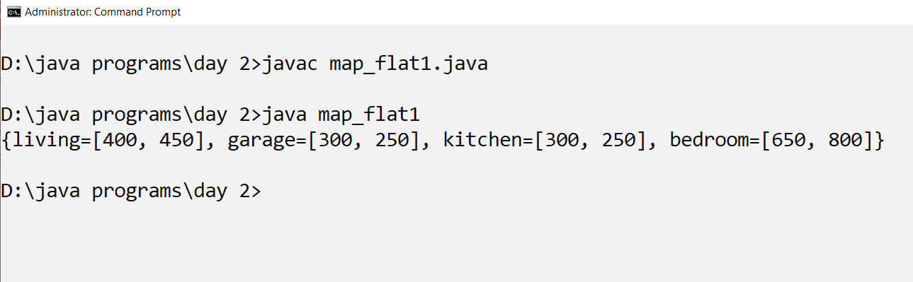
output

Slide 89
Change HashMap Value
//We can use the replace() method to change the value associated with a key in a hashmap.
import java.util.HashMap;
class Main {
public static void main(String[] args) {
HashMap<Integer, String> languages = new HashMap<>();
languages.put(1, "Java");
languages.put(2, "Python");
languages.put(3, "JavaScript");
System.out.println("Original HashMap: " + languages);
// change element with key 2
languages.replace(2, "C++");
System.out.println("HashMap using replace(): " + languages);
}
}

Slide 90
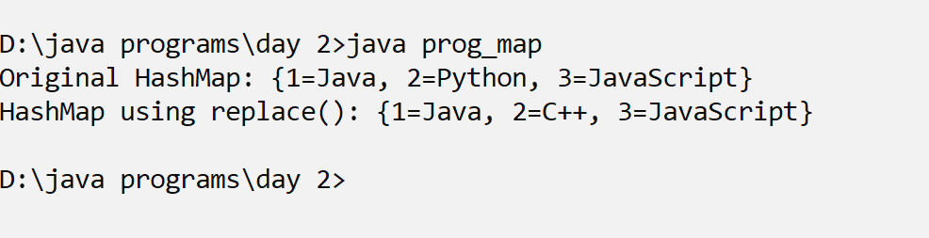
output

Slide 91
Properties

Slide 92
Reading and Writing Properties File in Java
The property file is a file we use in the Java Programming language to keep the configuration parameters.
What are the configuration parameters?
Configuration parameters are the parameters that you use at the time of configuring your database,
or any validation is there in the project you can add them as configuration parameters.

Slide 93
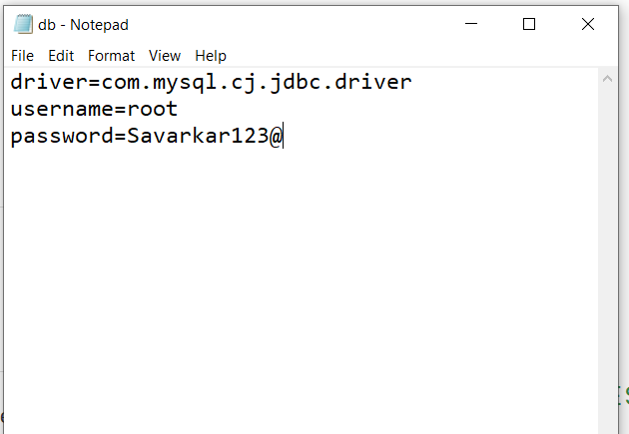
Properties class in Java
The properties object contains key and value pair both as a string.
The java.util.Properties class is the subclass of Hashtable.
It can be used to get property value based on the property key.
The Properties class provides methods to get data from the properties file and store data into the properties file.
Moreover, it can be used to get the properties of a system.

Slide 94
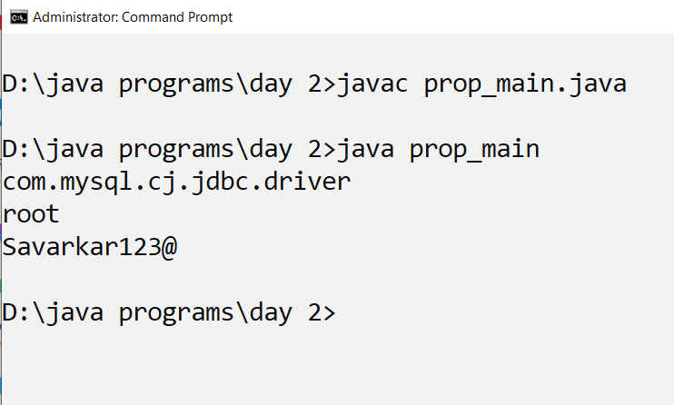
Retrieving properties
import java.util.*;
import java.io.*;
public class prop_main{
public static void main(String [] args) throws Exception{
FileReader reader=new FileReader("db.properties");
Properties p=new Properties();
p.load(reader);
System.out.println(p.get("driver"));
System.out.println(p.get("username"));
System.out.println(p.get("password"));
}
}

Slide 95
Method Description
public void load(Reader r) It loads data from the Reader object.
public void load(InputStream is) It loads data from the InputStream object
public String getProperty(String key) It returns value based on the key.
public void setProperty(String key, String value) It calls the put method of Hashtable.
public void list(PrintStream out) It is used to print the property list out
to the specified output stream.
public void store(Writer w, String comment) It writes the properties in the writer object.
public void store(OutputStream os, String comment) It writes the properties in the OutputStream object.

Slide 96
Streaming and Filtering Collection
Iterating through a collection using lambda syntax
Describing the Stream interface
Filtering a collection using lambda expressions
Calling an existing method using a method reference
Chaining multiple methods together
Defining pipelines in terms of lambdas and collections
Functional Interfaces
Listing the built-in interfaces included in java.util.function
Core interfaces - Predicate, Consumer, Function, Supplier
Lambda Operations
Extracting data from an object using map
Describing the types of stream operations
Sorting a stream
Saving results to a collection using the collect method

Slide 97
Java 8 Stream
Java provides a new additional package in Java 8 called java.util.stream.
You can use stream by importing java.util.stream package.
Stream provides following features:
Stream does not store elements.
It simply conveys elements from a source such as a data structure, an array, etc
Stream is functional in nature.
Operations performed on a stream does not modify it's source.
Stream is lazy and evaluates code only when required.
The elements of a stream are only visited once during the life of a stream.
Like an Iterator, a new stream must be generated to revisit the same elements of the source.

Slide 98
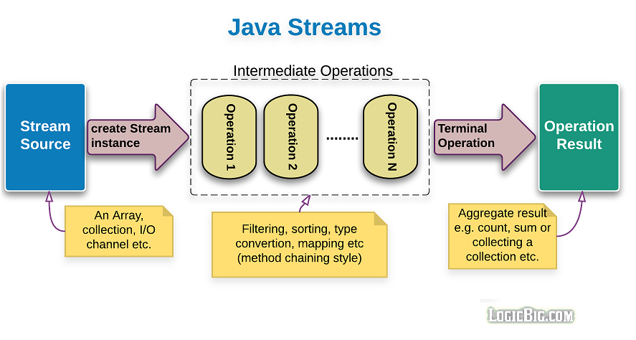

Slide 99
Different Operations On Streams-
map: The map method is used to returns a stream consisting of the results of applying the given function to the elements of this stream.
List number = Arrays.asList(2,3,4,5);
List square = number.stream().map(x->x*x).collect(Collectors.toList());
filter: The filter method is used to select elements as per the Predicate passed as argument.
List names = Arrays.asList("Reflection","Collection","Stream");
List result = names.stream().filter(s->s.startsWith("S")).collect(Collectors.toList());
sorted: The sorted method is used to sort the stream.
List names = Arrays.asList("Reflection","Collection","Stream");
List result = names.stream().sorted().collect(Collectors.toList());

Slide 100
Squaring the elements of a list using stream
import java.util.*;
import java.util.stream.Collectors;
import java.util.stream.*;
class stream1{
public static void main(String [] args){
List<Integer> li=new ArrayList<Integer>();
li.add(10);
li.add(20);
li.add(5);
li.add(4);
List square=li.stream().map(x->x*x).collect(Collectors.toList());
li.forEach((x)->System.out.println(x));
System.out.println(square);
}
}

Slide 101
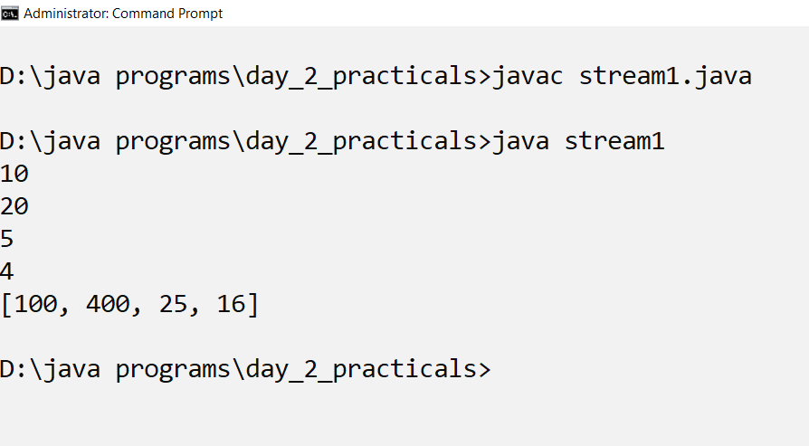
output

Slide 102
Filtering the elements of a list using stream
import java.util.*;
import java.util.stream.*;
import java.util.stream.Collectors;
class stream_filter{
public static void main(String [] args){
Integer [] a={2,4,5,100,75,90,150,300,350,500,600,1000};
List<Integer> numlist=new ArrayList<Integer>(Arrays.asList(a));
List p=numlist.stream().filter(x->x>350).collect(Collectors.toList());
System.out.println("the list more than 350:"+p);
}
}

Slide 103
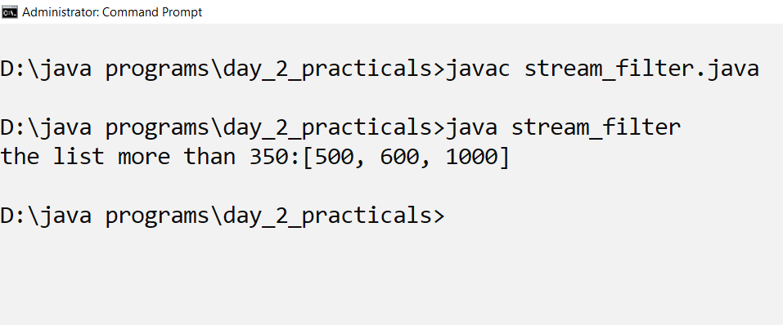
output

Slide 104
Filtering name of students which starts with S
import java.util.*;
import java.util.stream.*;
import java.util.stream.Collectors;
class stream_filter_name{
public static void main(String [] args){
String [] sname={"Anila","Unnati","Vaibhavi","Zara","Sumati","Chinmay","Shobhana"};
List<String> lname=new ArrayList<String>(Arrays.asList(sname));
List filter_name=lname.stream().filter(x->x.startsWith("S")).collect(Collectors.toList());
System.out.println(filter_name);
}
}

Slide 105
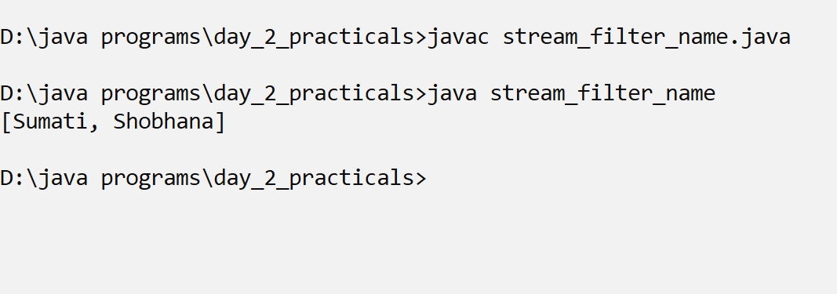
output

Slide 106
Sorting the elements of a list
import java.util.*;
import java.util.stream.*;
import java.util.stream.Collectors;
class stream_sorted{
public static void main(String [] args){
String [] sname={"Anila","Unnati","Vaibhavi","Zara","Sumati","Chinmay","Shobhana"};
List<String> lname=new ArrayList<String>(Arrays.asList(sname));
List filter_name=lname.stream().sorted().collect(Collectors.toList());
System.out.println(filter_name);
}
}

Slide 107
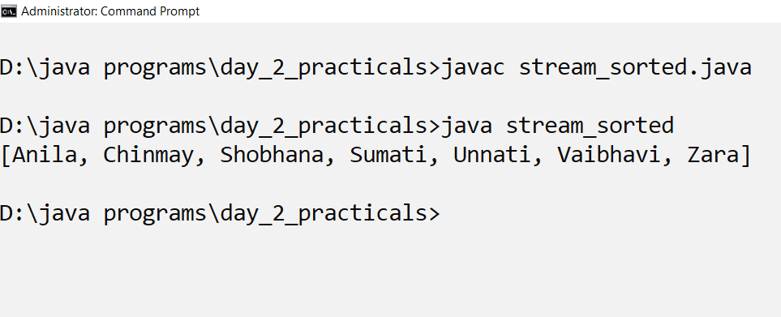
output

Slide 108
Java Example: Filtering Collection using Stream
import java.util.*;
import java.util.stream.Collectors;
class product{
String name;
int price;
public product(String name,int price){
this.name=name;
this.price=price;
}
}

Slide 109
Filtering the product stream
public class prodstream{
public static void main(String [] args){
List<product> plist=new ArrayList<product>();
plist.add(new product("dell inspiron",120000));
plist.add(new product("compaq",200000));
plist.add(new product("hp",50000));
plist.add(new product("hp",30000));
plist.add(new product("Toshiba",40000));
plist.add(new product("Acer",20000));

Slide 110
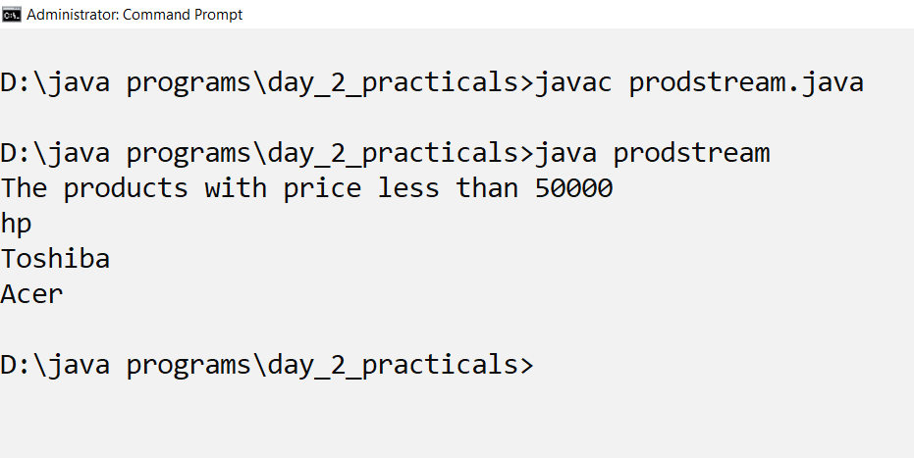
Filtering the product stream
List <product> pstream=plist.stream().filter(x->x.price<50000).collect(Collectors.toList());
System.out.println("The products with price less than 50000 ");
pstream.forEach((x)->System.out.println(x.name));
}
}//class

Slide 111
Terminal Operations:
collect: The collect method is used to return the result of the intermediate operations performed on the stream.
List number = Arrays.asList(2,3,4,5,3);
Set square = number.stream().map(x->x*x).collect(Collectors.toSet());
forEach: The forEach method is used to iterate through every element of the stream.
List number = Arrays.asList(2,3,4,5);
number.stream().map(x->x*x).forEach(y->System.out.println(y));
reduce: The reduce method is used to reduce the elements of a stream to a single value.
The reduce method takes a BinaryOperator as a parameter.
List number = Arrays.asList(2,3,4,5);
int even = number.stream().filter(x->x%2==0).reduce(0,(ans,i)-> ans+i);
Here ans variable is assigned 0 as the initial value and i is added to it .

Slide 112
Reducce operation
import java.util.*;
import java.util.stream.*;
import java.util.stream.Collectors;
class sum_sqr{
public List<Integer> sqr(List<Integer> li){
return li.stream().map(x->(x*x)).collect(Collectors.toList());
}

Slide 113
Reduce operation
public int sum(List<Integer> li_num)
{
return li_num.stream().reduce(0,(x,y)->(x+y));
}
public static void main(String [] args){
Integer [] arr={5,7,2,4,5,8,9};
List<Integer> li=new ArrayList(Arrays.asList(arr));
sum_sqr s=new sum_sqr();
System.out.println("square of list"+s.sqr(li));
System.out.println("sum of elements:"+s.sum(li));
}

Slide 114
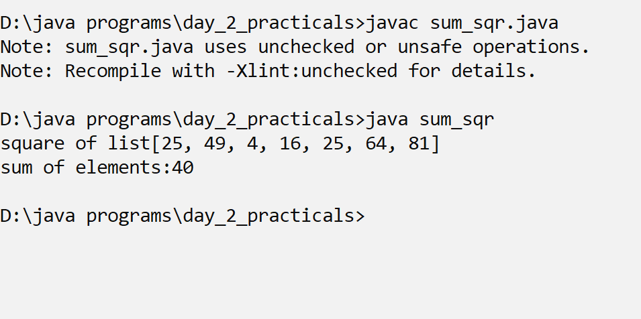
output

Slide 115
Method Chaining In Java with Examples
Method Chaining is the practice of calling different methods in a single line instead of calling other methods with the same object reference separately.
Under this procedure, we have to write the object reference once and then call the methods by separating them with a (dot.).
Method chaining in Java is a common syntax to invoke multiple methods calls in OOPs.
Each method in chaining returns an object.
It violates the need for intermediate variables.
In other words, the method chaining can be defined as if we have an object and we call methods on that object one after another is called method chaining.

Slide 116
Calculating the sum of square of elements in a list using method chaining
import java.util.stream.*;
import java.util.stream.Collectors;
class sum_sqr{
List<Integer> li=new ArrayList<Integer>();
int add;
public sum_sqr sqr(List<Integer> li)
{
this.li= li.stream().map(x->(x*x)).collect(Collectors.toList());
return this;
}

Slide 117
Method chaining
public sum_sqr sum(){
this.add= this.li.stream().reduce(0,(x,y)->(x+y));
return this;
}
void display()
{
System.out.println("Display=" + li + " " + add);
}
public static void main(String [] args){
Integer [] arr={5,7,2,4,5,8,9};
List<Integer> li=new ArrayList(Arrays.asList(arr));
sum_sqr s=new sum_sqr();
System.out.println("square of list"+s.sqr(li).li);
System.out.println("sum of elements:"+s.sum().add);
s.sqr(li).sum().display();
}
}

Slide 118
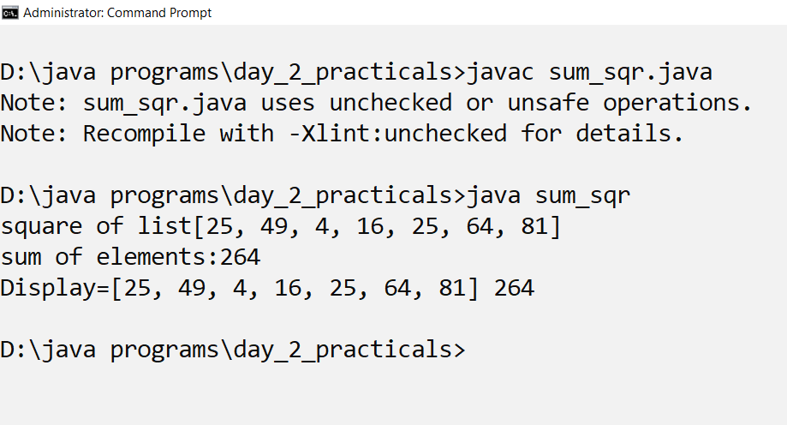
output

Slide 119
extract values from HashMap

