Slide 1
IO programming

Slide 2
IO Streams
Java uses the concept of a stream to make I/O operation fast.
The java.io package contains all the classes required for input and output operations.
Stream
A stream is a sequence of data. In Java, a stream is composed of bytes. It's called a stream because it is like a stream of water that continues to flow.
In Java, 3 streams are created for us automatically.
All these streams are attached with the console.
1) System.out: standard output stream
2) System.in: standard input stream
3) System.err: standard error stream

Slide 3
Types of streams
OutputStream
Java application uses an output stream to write data to a destination; it may be a file, an array, peripheral device or socket.
InputStream
Java application uses an input stream to read data from a source; it may be a file, an array, peripheral device or socket.

Slide 4
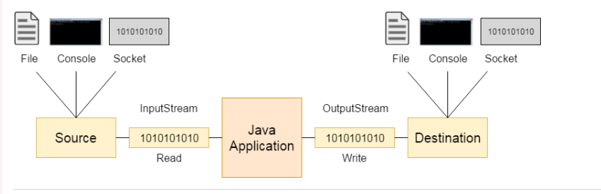

Slide 5
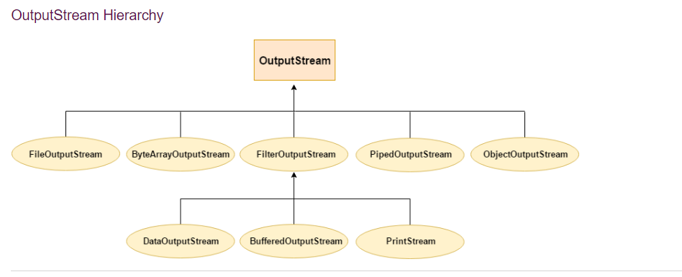
Outputstream hierarchy

Slide 6
Methods of outputstream
Method | Description
1) public void write(int)throws IOException | is used to write a byte to the current output stream.
2) public void write(byte[])throws IOException | is used to write an array of byte to the current output stream.
3) public void flush()throws IOException | flushes the current output stream.
4) public void close()throws IOException | is used to close the current output stream.

Slide 7
InputStream class
InputStream class is an abstract class. It is the superclass of all classes representing an input stream of bytes.
Useful methods of InputStream
Method | Description
1) public abstract int read()throws IOException | reads the next byte of data from the input stream. It returns -1 at the end of the file.
2) public int available()throws IOException | returns an estimate of the number of bytes that can be read from the current input stream.
3) public void close()throws IOException | is used to close the current input stream

Slide 8
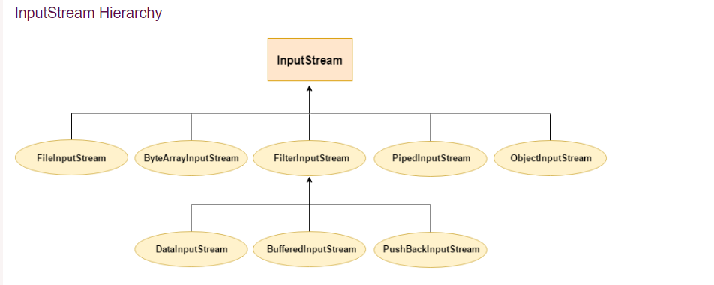
Inputstream

Slide 9
Writing a file
import java.io.FileOutputStream;
public class fs_class {
public static void main(String args[]){
try{
byte [] byte_arr=new byte[100];
String str="Welcome to the class";
byte_arr=str.getBytes();
FileOutputStream fout=new FileOutputStream("myfilewelcome.txt");
fout.write(byte_arr);
fout.close();
System.out.println("success...");
}catch(Exception e){System.out.println(e);}
}
}

Slide 10
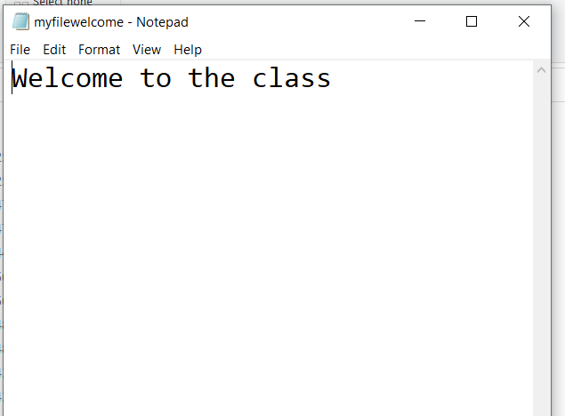
output

Slide 11
Java FileInputStream Class
Java FileInputStream class obtains input bytes from a file.
It is used for reading byte-oriented data (streams of raw bytes) such as image data, audio, video etc.
You can also read character-stream data.
But, for reading streams of characters, it is recommended to use FileReader class.

Slide 12
FileInputStream methods
Method | Description
int available() | It is used to return the estimated number of bytes that can be read from the input stream.
int read() | It is used to read the byte of data from the input stream.
int read(byte[] b) | It is used to read up to b.length bytes of data from the input stream.
int read(byte[] b, int off, int len) | It is used to read up to len bytes of data from the input stream.
long skip(long x) | It is used to skip over and discards x bytes of data from the input stream.
FileChannel getChannel() | It is used to return the unique FileChannel object associated with the file input stream.
FileDescriptor getFD() | It is used to return the FileDescriptor object.
protected void finalize() | It is used to ensure that the close method is call when there is no more reference to the file input stream.
void close() | It is used to closes the stream.

Slide 13
Fileinputstream read
import java.io.FileInputStream;
public class finput{
public static void main(String [] args) throws Exception{
FileInputStream fs=new FileInputStream("myfilewelcome.txt");
int i=0;
while((i=fs.read())!=-1){
System.out.print((char)i);
}
}//main
}

Slide 14
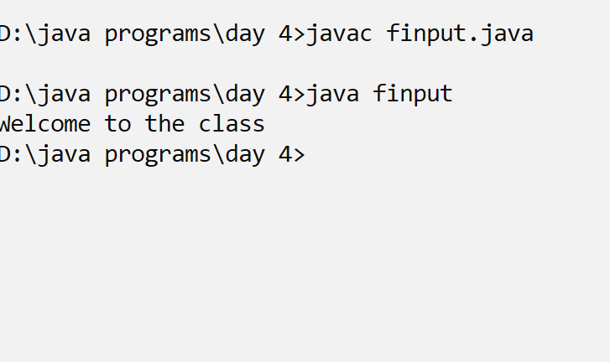
output

Slide 15
Serializable Interface in Java
The Serializable interface is present in java.io package.
It is a marker interface.
A Marker Interface does not have any methods and fields.
Thus classes implementing it do not have to implement any methods.
Classes implement it if they want their instances to be Serialized or Deserialized.

Slide 16
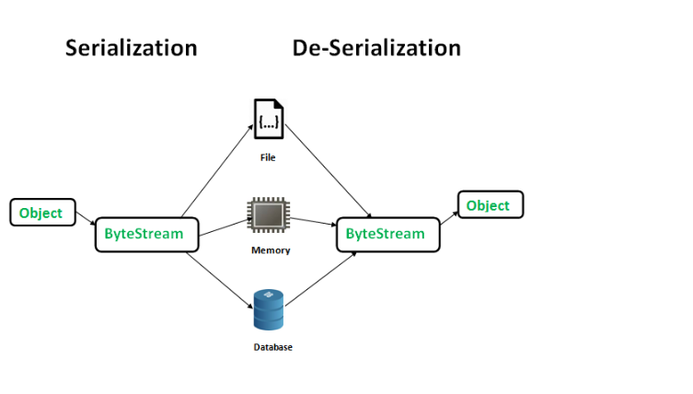

Slide 17
Student records
import java.io.Serializable;
import java.io.*;
class student implements Serializable{
String name="";
int roll=0;
student(int r,String n){
roll=r;
name=n;
}
}

Slide 18
Writing into file
class stud_main_file{
public static void main(String [] args) throws Exception{
student s=new student(102,"Reema");
FileOutputStream fs=new FileOutputStream("student.txt“,true);
ObjectOutputStream f_obj=new ObjectOutputStream(fs);
f_obj.writeObject(s);
f_obj.close();
fs.close();

Slide 19
Reading from file
FileInputStream in=new FileInputStream("student.txt");
ObjectInputStream fin=new ObjectInputStream(in);
student s2=(student)fin.readObject();
System.out.println("roll: "+s2.roll);
System.out.println("name: "+s2.name);
}
}

Slide 20
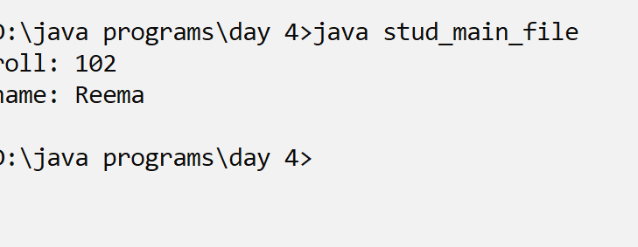
output

