Slide 1
JDBC

Slide 3
Steps involved
The programming involved to establish a JDBC connection is fairly simple. Here are these simple four steps:
Import JDBC Packages: Add import statements to your Java program to import required classes in your Java code.
Register JDBC Driver: This step causes the JVM to load the desired driver implementation into memory so it can fulfill your JDBC requests.
Database URL Formulation: This is to create a properly formatted address that points to the database to which you wish to connect.
Create Connection Object: Finally, code a call to the DriverManager object's getConnection( )method to establish actual database connection.

Slide 4
JDBC Drivers(I,II,II,IV)
JDBC Driver is a software component that enables java application to interact with the database. There are 4 types of JDBC drivers:
JDBC-ODBC bridge driver
Native-API driver (partially java driver)
Network Protocol driver (fully java driver)
Thin driver (fully java driver)

Slide 5
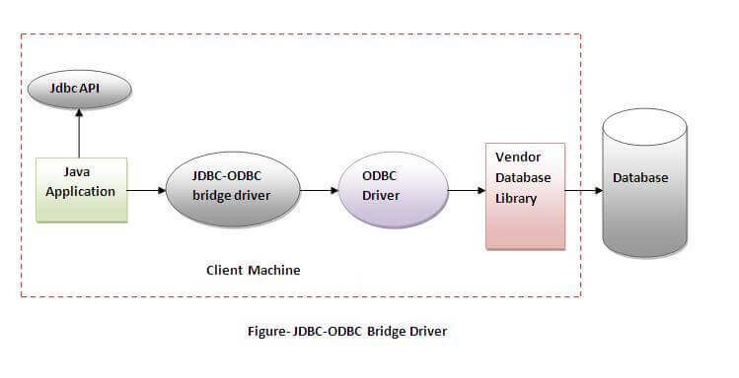
1) JDBC-ODBC bridge driver
The JDBC-ODBC bridge driver uses ODBC driver to connect to the database.
The JDBC-ODBC bridge driver converts JDBC method calls into the ODBC function calls.
This is now discouraged because of thin driver.

Slide 6
Jdbc-odbc driver
Oracle does not support the JDBC-ODBC Bridge from Java 8. Oracle recommends that you use JDBC drivers provided by the vendor of your database instead of the JDBC-ODBC Bridge.
Advantages:
easy to use.
can be easily connected to any database.
Disadvantages:
Performance degraded because JDBC method call is converted into the ODBC function calls.
The ODBC driver needs to be installed on the client machine.

Slide 7
2) Native-API driver
The Native API driver uses the client-side libraries of the database.
The driver converts JDBC method calls into native calls of the database API.
In a Type 2 driver, JDBC API calls are converted into native C/C++ API calls, ... The vendor-specific driver must be installed on each client machine.
It is not written entirely in java.

Slide 8
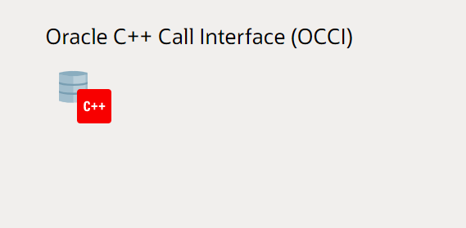
Oracle call interface driver

Slide 9
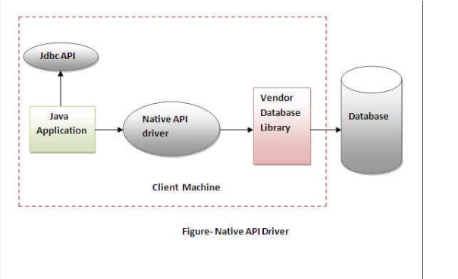
Native API driver
Advantage:
performance upgraded than JDBC-ODBC bridge driver.
Disadvantage:
The Native driver needs to be installed on the each client machine.
The Vendor client library needs to be installed on client machine.

Slide 10
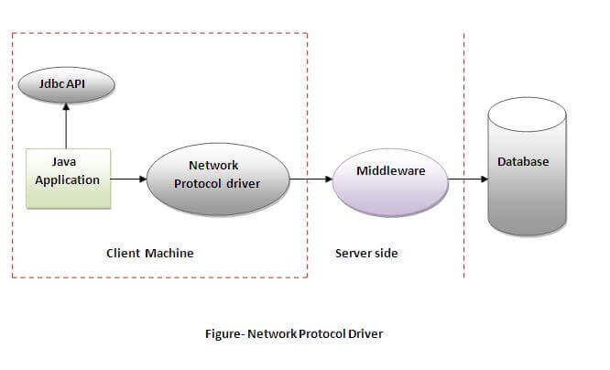
3) Network Protocol driver
The Network Protocol driver uses middleware (application server)
that converts JDBC calls directly or indirectly into the vendor-specific database protocol.
It is fully written in java.

Slide 11
How to install
If we working with type 3 driver then we have to first install the middle ware driver.Example of middle ware driver is IDS driver.We can download IDS software from http://www.idssoftware.com/download.html.
Driver Class name for type 3 is: ids.sql IDS driver
JDBC url: jdbc:ids://localhost:12/conn?dns=sysdnstype3
We need a jar file jdk13drv.jar to set in class path.

Slide 12
Advantage:
No client side library is required because of application server that can perform many tasks like auditing, load balancing, logging etc.
Disadvantages:
Network support is required on client machine.
Requires database-specific coding to be done in the middle tier.

Slide 13
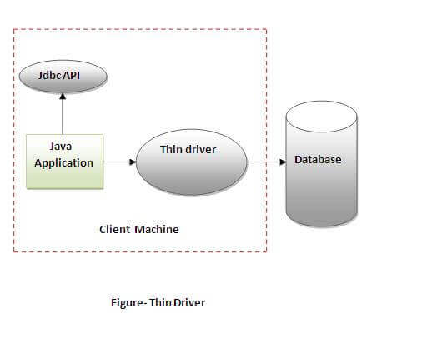
4) Thin driver
The thin driver converts JDBC calls directly into the vendor-specific database protocol.
That is why it is known as thin driver.
It is fully written in Java language.

Slide 14
Thin driver
Advantage:
Better performance than all other drivers.
No software is required at client side or server side.
Disadvantage:
Drivers depend on the Database.

Slide 15
Import JDBC Packages:
The Import statements tell the Java compiler where to find the classes you reference in your code
and are placed at the very beginning of your source code.
To use the standard JDBC package, which allows you to select, insert, update, and delete data in SQL tables,
add the following imports to your source code:

Slide 16
Import JDBC Packages
Import statements tell the Java compiler where to find the classes you reference in your code and are placed at the very beginning of your source code.
To use the standard JDBC package, which allows you to select, insert, update, and delete data in SQL tables,
add the following imports to your source code:
import java.sql.* ; // for standard JDBC programs

Slide 17
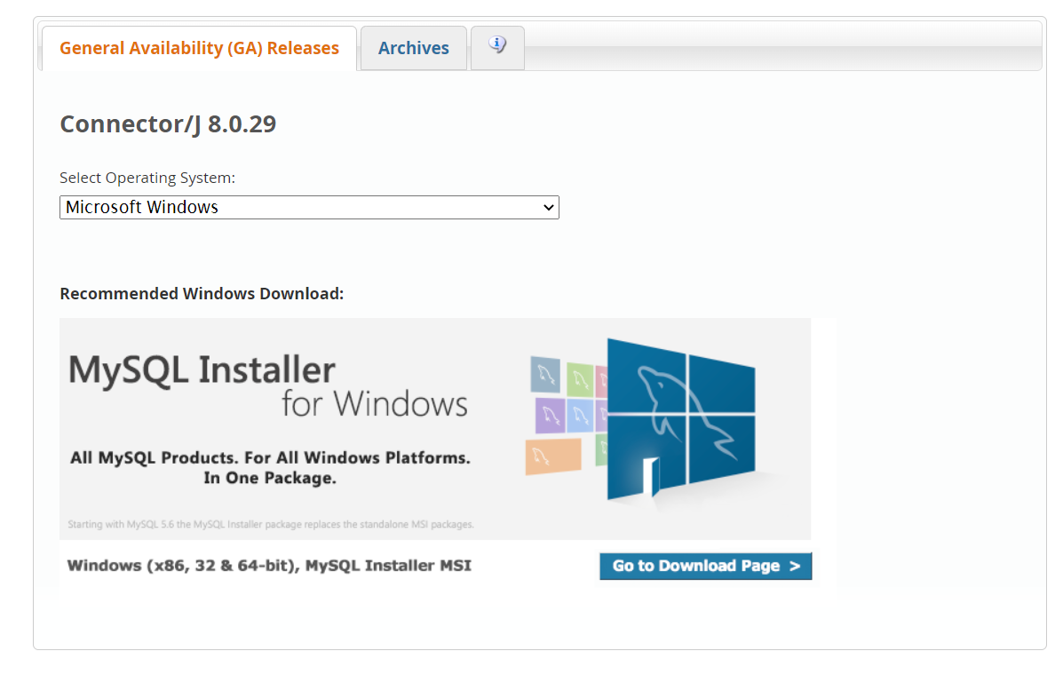
Download driver

Slide 18
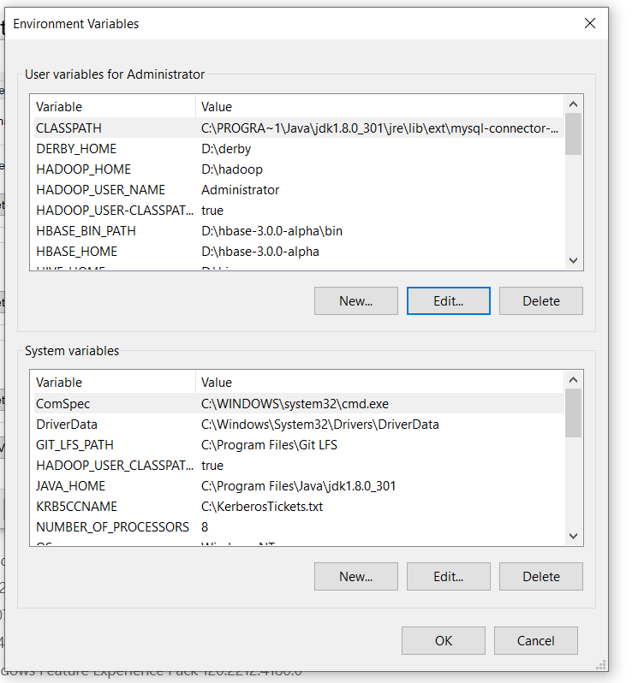
Set classpath

Slide 19
Register JDBC Driver:
You must register the your driver in your program before you use it.
Registering the driver is the process by which the MYSQL or Oracle driver's class file is loaded into memory
so it can be utilized as an implementation of the JDBC interfaces.
You need to do this registration only once in your program.
You can register a driver in one of two ways.

Slide 20
Approach (I) - Class.forName():
The most common approach to register a driver is to use Java's Class.forName() method to dynamically load the driver's class file into memory, which automatically registers it.
This method is preferable because it allows you to make the driver registration configurable and portable.
Class.forName("sun.jdbc.odbc.JdbcOdbcDriver");
Class.forName("com.mysql.cj.jdbc.Driver").newInstance();

Slide 21
Approach (II) - DriverManager.registerDriver():
The second approach you can use to register a driver is to use the staticDriverManager.registerDriver() method.
You should use the registerDriver() method if you are using a non-JDK compliant JVM, such as the one provided by Microsoft.
The following example uses registerDriver() to register the Oracle driver:
try {
Driver myDriver = new oracle.jdbc.driver.OracleDriver(); DriverManager.registerDriver( myDriver );
} catch(ClassNotFoundException ex) { System.out.println("Error: unable to load driver class!"); System.exit(1); }

Slide 22
Database URL Formulation:
After you've loaded the driver, you can establish a connection using theDriverManager.getConnection() method.
For easy reference, let me list the three overloaded DriverManager.getConnection() methods:
getConnection(String url)
getConnection(String url, String user, String password)
Connection c=DriverManager.getConnection("jdbc:odbc:img1","system","Suresh2003");

Slide 23
Java Database Connectivity with MySQL
To connect Java application with the MySQL database, we need to follow 5 following steps.
In this example we are using MySql as the database. So we need to know following informations for the mysql database:
Driver class: The driver class for the mysql database is com.mysql.jdbc.Driver.
Connection URL: The connection URL for the mysql database is jdbc:mysql://localhost:3306/college where jdbc is the API, mysql is the database, localhost is the server name on which mysql is running, we may also use IP address, 3306 is the port number and college is the database name.
Username: The default username for the mysql database is root.
Password: It is the password given by the user at the time of installing the mysql database. In this example, we are going to use root as the password.

Slide 24
Mysql connectivity
import java.sql.*;
public class mycon {
public static void main(String[] args) {
System.out.println("MySQL Connect Example.");
Connection conn = null;
String url = "jdbc:mysql://localhost:3306/";
String dbName = "telecom";
String driver = "com.mysql.cj.jdbc.Driver";
String userName = "root";
String password = "Savarkar123@";

Slide 25
Mysql connectivity
try {
Class.forName(driver).newInstance();
conn = DriverManager.getConnection(url+dbName,userName,password);
System.out.println("Connected to the database");
conn.close();
System.out.println("Disconnected from database");
} catch (Exception e) {
e.printStackTrace();
}
}
}

Slide 26
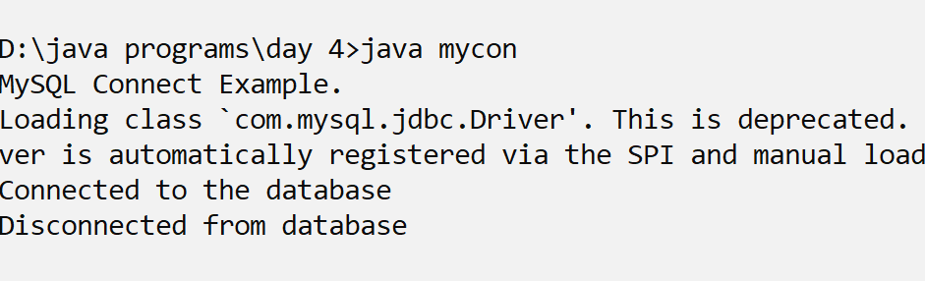
output

Slide 27
Statement interface
The Statement interface provides methods to execute queries with the database.
The statement interface is a factory of ResultSet
i.e. it provides factory method to get the object of ResultSet.
Commonly used methods of Statement interface:
The important methods of Statement interface are as follows:

Slide 28
createStatement ()
Creates a SQLServerStatement object
for sending SQL statements to the database.

Slide 29
Methods to execute query
1) public ResultSet executeQuery(String sql): is used to execute SELECT query. It returns the object of ResultSet.
2) public int executeUpdate(String sql): is used to execute specified query, it may be create, drop, insert, update, delete etc.
3) public boolean execute(String sql): is used to execute queries that may return multiple results.
4) public int[] executeBatch(): is used to execute batch of commands.

Slide 30
Retrieving records from mysql
import java.sql.*;
import java.sql.Statement;
class mysql_con{
public static void main(String [] args) throws Exception{
Class.forName("com.mysql.jdbc.Driver");
Connection con=DriverManager.getConnection("jdbc:mysql://localhost:3306/telecom","root","Savarkar123@");
Statement stmt=con.createStatement();
ResultSet rs=stmt.executeQuery("select * from call_register");
while (rs.next())
{
System.out.println(rs.getString(2)+rs.getString(3)+rs.getString(4)+rs.getString(1)+rs.getString(5));
}
con.close();
}
}

Slide 31
PreparedStatement interface
The PreparedStatement interface is a subinterface of Statement. It is used to execute parameterized query.
Let's see the example of parameterized query:
String sql="insert into emp values(?,?,?)";

Slide 32
Methods of PreparedStatement interface
Method | Description
public void setInt(int paramIndex, int value) | sets the integer value to the given parameter index.
public void setString(int paramIndex, String value) | sets the String value to the given parameter index.
public void setFloat(int paramIndex, float value) | sets the float value to the given parameter index.
public void setDouble(int paramIndex, double value) | sets the double value to the given parameter index.
public int executeUpdate() | executes the query. It is used for create, drop, insert, update, delete etc.
public ResultSet executeQuery() | executes the select query. It returns an instance of ResultSet.

Slide 33
Preparing statement dynamically
import java.sql.*;
import java.sql.Statement;
class mysql_prepare{
public static void main(String [] args) throws Exception{
Class.forName("com.mysql.jdbc.Driver");
Connection cn=DriverManager.getConnection("jdbc:mysql://localhost:3306/telecom","root","Savarkar123@");
PreparedStatement st=cn.prepareStatement("insert into employee values(?,?,?)");
st.setInt(1,101);
st.setString(2,"Sohail");
st.setInt(3,50000);
int x=st.executeUpdate();
cn.close();
}
}

Slide 34
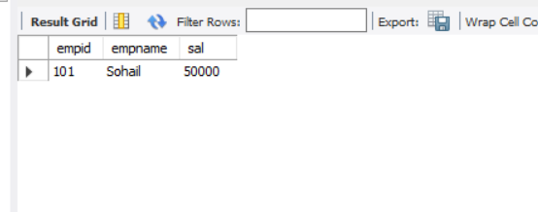
output

Slide 35
Java ResultSetMetaData Interface
The metadata means data about data i.e. we can get further information from the data.
If you have to get metadata of a table like total number of column, column name, column type etc. ,
ResultSetMetaData interface is useful because it provides methods to get metadata from the ResultSet object.

Slide 36
Commonly used methods of ResultSetMetaData interface
Method | Description
public int getColumnCount()throws SQLException | it returns the total number of columns in the ResultSet object.
public String getColumnName(int index)throws SQLException | it returns the column name of the specified column index.
public String getColumnTypeName(int index)throws SQLException | it returns the column type name for the specified index.
public String getTableName(int index)throws SQLException | it returns the table name for the specified column index.

Slide 37
connection
import java.sql.*;
import java.sql.Statement;
class mysql_con_metadata{
public static void main(String [] args) throws Exception{
Class.forName("com.mysql.jdbc.Driver");
Connection con=DriverManager.getConnection("jdbc:mysql://localhost:3306/telecom","root","Savarkar123@");
Statement stmt=con.createStatement();
ResultSet rs=stmt.executeQuery("select * from call_register");

Slide 38
Getting metadata
while (rs.next())
{
System.out.println(rs.getString(2)+rs.getString(3)+rs.getString(4)+rs.getString(1)+rs.getString(5));
}
ResultSetMetaData md=rs.getMetaData();
System.out.println("Total columns: "+md.getColumnCount());
for(int i=1;i<=md.getColumnCount();i++){
System.out.println("Column Name of 1st column: "+md.getColumnName(i));
System.out.println("Column Type Name of 1st column: "+rsmd.getColumnTypeName(i));
}
con.close();
}
}

Slide 39
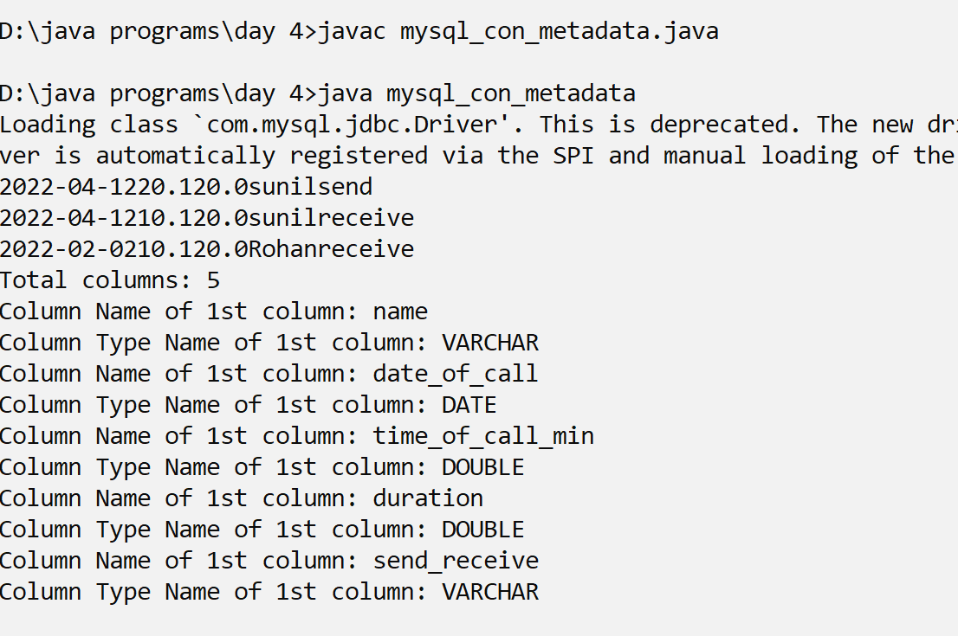
output

Slide 40
Java DatabaseMetaData interface
DatabaseMetaData interface provides methods to get meta data of a database such as
database product name, database product version, driver name, name of total number of tables, name of total number of views etc.

Slide 41
Commonly used methods of DatabaseMetaData interface
public String getDriverName()throws SQLException: it returns the name of the JDBC driver.
public String getDriverVersion()throws SQLException: it returns the version number of the JDBC driver.
public String getUserName()throws SQLException: it returns the username of the database.
public String getDatabaseProductName()throws SQLException: it returns the product name of the database.
public String getDatabaseProductVersion()throws SQLException: it returns the product version of the database.
public ResultSet getTables(String catalog, String schemaPattern, String tableNamePattern, String[] types)throws SQLException: it returns the description of the tables of the specified catalog. The table type can be TABLE, VIEW, ALIAS, SYSTEM TABLE, SYNONYM etc.

Slide 42
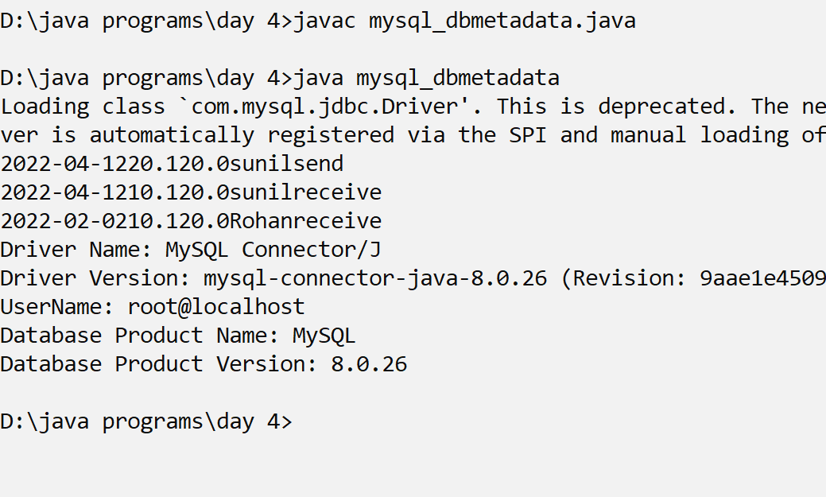
output

