Slide 1
Inheritance

Slide 2
Is-A relationship Specialisation:
To illustrate the concept we can consider an Account which can be of various types like “Savings”, ”Credit card”, ”Fixed Deposit” and ”Loan”.
The process is depicted by a triangle component labelled ISA.
The attributes of the parent Entity set “Account” is inherited by the child sub Entities and is common to all the Entities “Savings”, ”Credit_card”, ”Fixed_Deposit” and “Loan”.
But besides these general attributes, each sub entity has some specialized attributes which distinguishes that Entity from the others.

Slide 4
Constraints in specialisation
There are several constraints which can be imposed on specialization which controls the level and degree of sharing of attributes among the parent and the child entities.
The importance of inheritance lies in data abstraction and data reusability.
The specialization can be categorized into two types Attribute-dependant specialization and User-defined Specialization.

Slide 5
Attribute defined
If there exists a constraint which differentiate or categorize a parent class into subclasses, the specialization is called predicate defined specialization.
If the predicate or condition is based on the value of some specific attribute the specialization is called Attribute Defined Specialization.

Slide 6
User-Defined
When there is no attribute or condition present in the parent entity by which we can categorize it into child entities it is called User Defined Specialization.
Membership in such a subclass is determined by the database users who add records to the individual Entities or Relations.
For example, Over the years, typographers and scholars of typography have categorized the Font typefaces into various groups like Serif, Sans Serif, Script and Decorative .
All of them will have the same sets of attributes like size, color, family, styles etc.

Slide 7
Color
Effects
Size
Character_spacing
Style
Font
Family
ISA
Serif
Sans-Serif
Script
Decorative

Slide 8
disjointedness constraint
which imposes a rule that the subclasses of the specialization must be either disjoint
which signifies that an entity can only belong to any one of the sub class
or overlapping in which an entity can belong to more than one sub class.

Slide 9
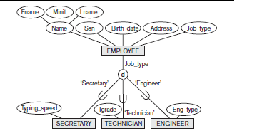

Slide 10
Completeness
The second constraint on specialization is called the completeness (or totalness) constraint,
which may be total or partial.
A total specialization constraint specifies
that every entity in the superclass must be a member of at least one subclass in the
specialization.
A partial specialisation which allows an entity not to belong to any of the subclasses.

Slide 11
Generalization
We can think of a reverse process of abstraction in which we suppress the differences
among several entity types, identify their common features, and generalize them
into a single superclass of which the original entity types are special subclasses.

Slide 12
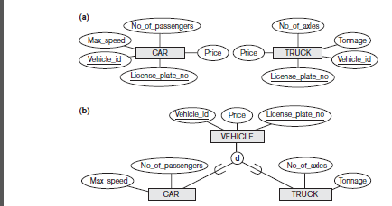

Slide 13
In Crow’s Foot model the representation of a parent child relationship is different.
We place the supertype entity set above the subtype entity sets, and use a circle with a line beneath it to denote a supertype-subtype relationship.
We use a solid line to represent an ID-dependent subtype entity, since each subtype is ID-dependent on the supertype.
There are two types of sub Entities:

Slide 14
Inclusive: The absence of an “X” in the circle denotes “inclusive” i.e., the supertype can relate to any of the subtypes. For example, a teacher can be either a full time teacher or part time teacher or both.

Slide 16
Exclusive:
The “X” in the circle denotes “exclusive” i.e., the supertype is “related” to at most one subtype.
For example, a particular shape can be any one of the Circle, Triangle or Rectangle.
Similarly an Account can be either a Savings or Credit_Card or Fixed_Deposit or Loan Account.
A particular Account Number cannot belong to more than one types of Account.

Slide 18
Inheritence
A class can inherit another class, which means that it includes all the members, public and private, of the original class,
plus the additional members that it defines.
The original class is called the base class and the new class is called the derived class.
we create a derived class to represent something that is a more specialized kind of the base class.
For example, we could define a class Cat that inherits from Animal.
A Cat can do everything an Animal can do, plus it can perform one additional unique action.

Slide 19
Types of inheritence
Single Inheritence:only one base class,one derived class
Hierarchial Inheritence:one base class,multiple derived classes
Multilevel Inheritence:derived classes again become base classes of derived classes
Multiple Inheritence:multiple base classes
Containment Inheritence:one class is contained in another class

Slide 20
Single Inheritence
class stud
{
int roll=1;
int age=20;
String name="Sunami";
}
class phys_stud extends stud
{
float height=5.6f;
float weight=(float)60.4;
}
A
B

Slide 21
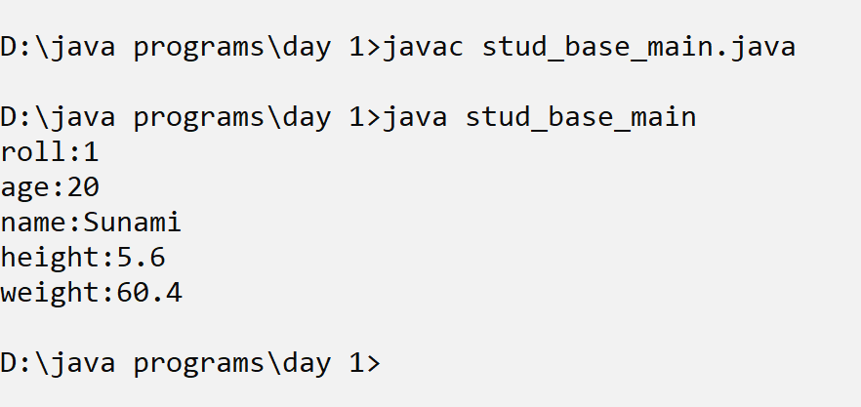
Single inheritance
class stud_base_main{
public static void main(String [] args){
phys_stud p=new phys_stud();
System.out.println("roll:"+p.roll);
System.out.println("age:"+p.age);
System.out.println("name:"+p.name);
System.out.println("height:"+p.height);
System.out.println("weight:"+p.weight);
}
}

Slide 22
Hierarchial Inheritence
shape
class Shape
{
int id=1;
String name="Shape";
}
class Circle extends Shape
{
int radius=4;
void areacirc(){
System.out.println("area circle:"+3.142*radius*radius);
}
}
circle
rectangle
square

Slide 23
class Rectangle extends Shape
{
int l=10,b=20;
void arearec(){
System.out.println("area rectangle:"+(l*b));
}
void perirec(){
System.out.println("perimeter recatngle:"+2*(l+b));
}
}

Slide 24
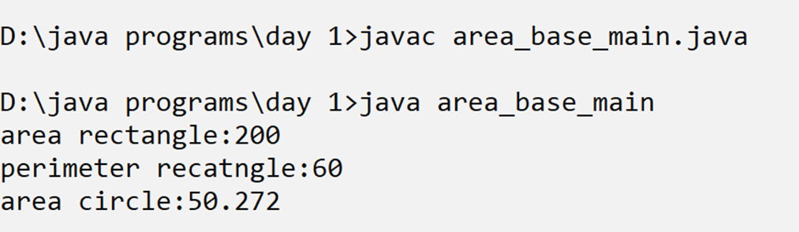
class Square extends Rectangle
{ int side;
void areasqr(){
System.out.println("area square:"+(side*side));
}}
class area_base_main{
public static void main(String [] args){
Rectangle r=new Rectangle();
r.arearec();
r.perirec();
Circle c=new Circle();
c.areacirc();
}
}

Slide 25
Multilevel Inheritence
class employee
{
int empid;
String name;
String addr;
}
class teacher extends employee
{
String qualification;
int exp;
String subject;
}
A
B
C

Slide 26
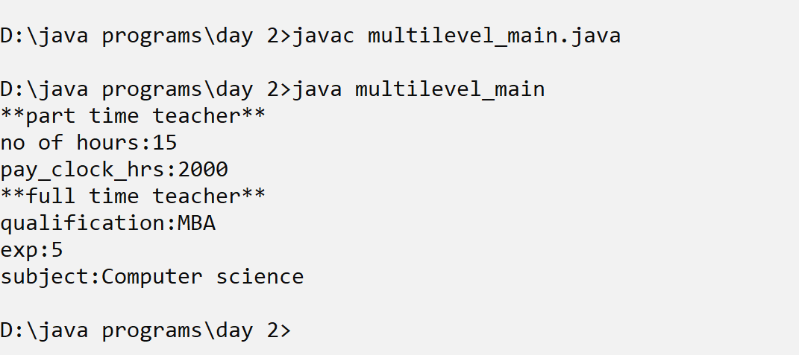
Multilevel inheritance
class full_time_teacher extends teacher
{
long salary;
}
class part_time_teacher extends teacher
{
int clock_hrs;0
int pay_clock_hrs;
}

Slide 27
Method overriding
If subclass (child class) has the same method as declared in the parent class, it is known as method overriding in Java.
In other words, If a subclass provides the specific implementation of the method
that has been declared by one of its parent class, it is known as method overriding.
Method overriding is one of the way by which java achieve Run Time Polymorphism.
The version of a method that is executed will be determined by the object that is used to invoke it.

Slide 28
Rules for Java Method Overriding
The method must have the same name as in the parent class
The method must have the same parameter as in the parent class.
There must be an IS-A relationship (inheritance).

Slide 29
State the difference between method overriding and method overloading

Slide 30
Base class employee
class employee{
int empid;
String name;
String addr;
employee(){
empid=1001;
name="rajashree";
addr="goregaon";
}
public void display(){
System.out.println("empid:"+empid);
System.out.println("name:"+name);
System.out.println("addr:"+addr);
}
}

Slide 31
Sub class teacher with overridden method
class teacher extends employee
{
String qualification;
int exp;
String subject;
teacher(){
qualification="MBA";
exp=5;
subject="Computer science";
}
public void display(){
super.display();
System.out.println("qualification:"+qualification);
System.out.println("exp:"+exp);
System.out.println("subject:"+subject);
}
}

Slide 32
Sub class full_time_teacher
class full_time_teacher extends teacher
{
long salary;
full_time_teacher(){
salary=150000;
}
public void display(){
super.display();
System.out.println("qualification:"+qualification);
System.out.println("exp:"+exp);
System.out.println("subject:"+subject);
}
}

Slide 33
Sub class part_time_teacher
class part_time_teacher extends teacher
{
int clock_hrs;
int pay_clock_hrs;
part_time_teacher(){
clock_hrs=15;
pay_clock_hrs=2000;
}
public void display(){
super.display();
System.out.println("no of hours:"+clock_hrs);
System.out.println("pay_clock_hrs:"+pay_clock_hrs);
}
}

Slide 34
Main class
class multilevel_override{
public static void main(String [] args){
System.out.println("**part time teacher**");
part_time_teacher t1=new part_time_teacher();
t1.display();
System.out.println("**full time teacher**");
full_time_teacher f1=new full_time_teacher();
f1.display();
}
}

Slide 35
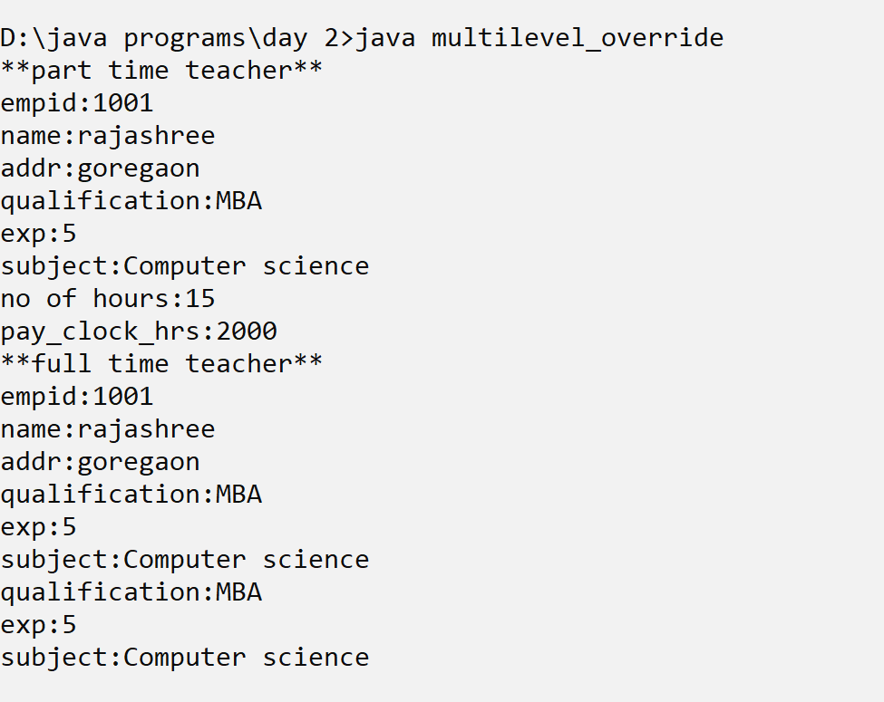
output

Slide 36
Super keyword
The super keyword in java is a reference variable that is used to refer parent class objects.
The keyword “super” came into the picture with the concept of Inheritance.
1. Use of super with variables:
2. Use of super with methods:
3. Use of super with constructors: super keyword can also be used to access the parent class constructor.

Slide 37
Constructor chaining
Constructor chaining is the process of calling one constructor from another constructor with respect to current object.
One of the main use of constructor chaining is to avoid duplicate codes while having multiple constructor (by means of constructor overloading) and make code more readable.
From base class: by using super() keyword to call the constructor from the base class.
Constructor chaining occurs through inheritance.
A sub-class constructor’s task is to call super class’s constructor first.

Slide 38
Constructor chaining
class employee
{
int empid;
String name;
String addr;
employee(int id, String n,String add){
empid=id;
name=n;
addr=add;
}
public void display(){
System.out.println("empid:"+empid);
System.out.println("name:"+name);
System.out.println("addr:"+addr);
}
}

Slide 39
Constructor chaining
class teacher extends employee
{
String qualification;
int exp;
String subject;
teacher(int id,String n,String add,String qual, int xp, String sub){
super(id,n,add);
qualification=qual;
exp=xp;
subject=sub;
}
}
public void display(){
super.display();
System.out.println("qualification:"+qualification);
System.out.println("exp:"+exp);
System.out.println("subject:"+subject);
}

Slide 40
Constructor chaining
class multilevel_chaining{
public static void main(String [] args){
System.out.println("**employee**");
employee e1=new employee(101,"Kapil","Bangalore");
e1.display();
System.out.println("**teacher**");
teacher t1=new teacher(102,"Romi","Assam","MCA",15,"Computer science");
t1.display();
}
}

Slide 41
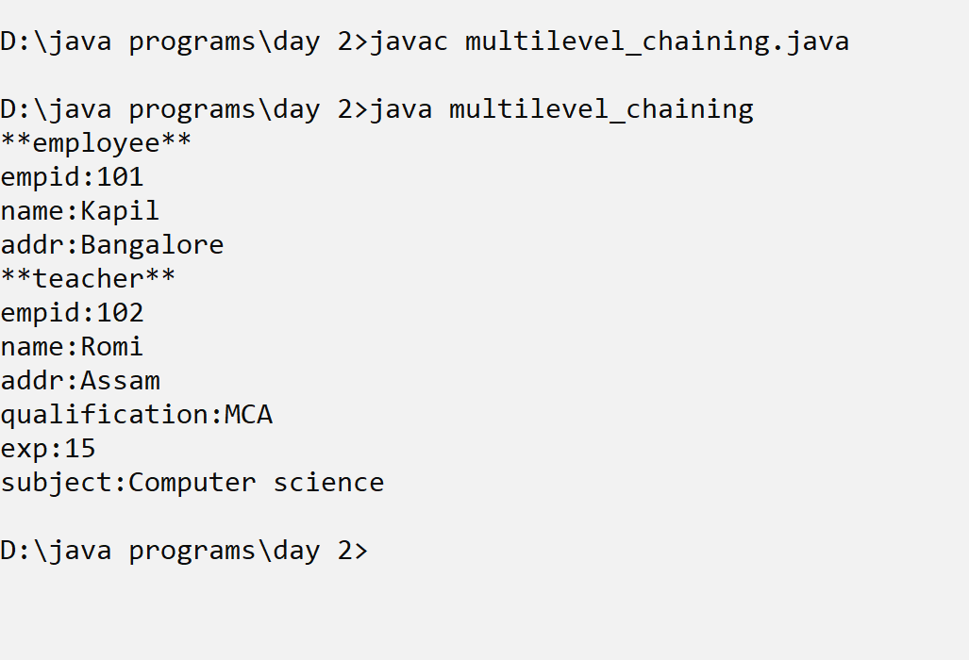
Constructor inheritance

Slide 42
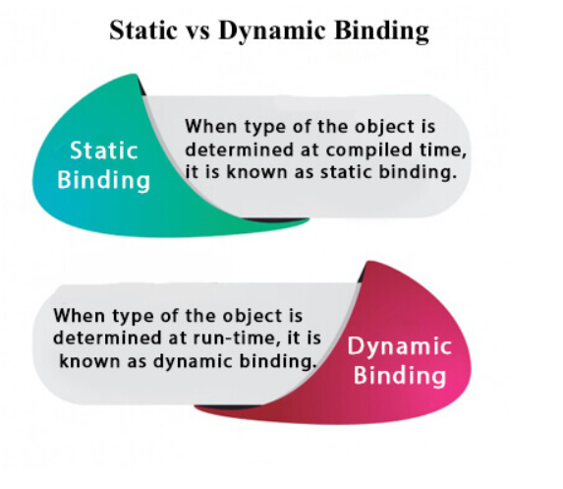
Static and dynamic binding in Java

Slide 43
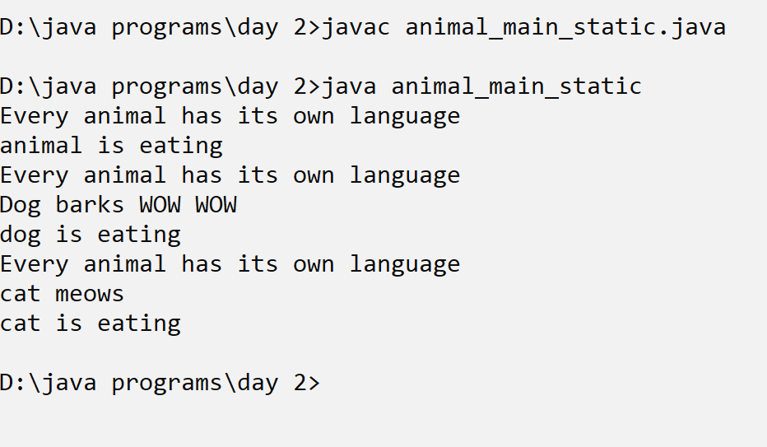
Static binding
class animal_main_static{
public static void main(String [] args){
animal a=new animal();
a.eat();
dog d=new dog();
d.eat();
cat c=new cat();
c.eat();
}
}

Slide 44
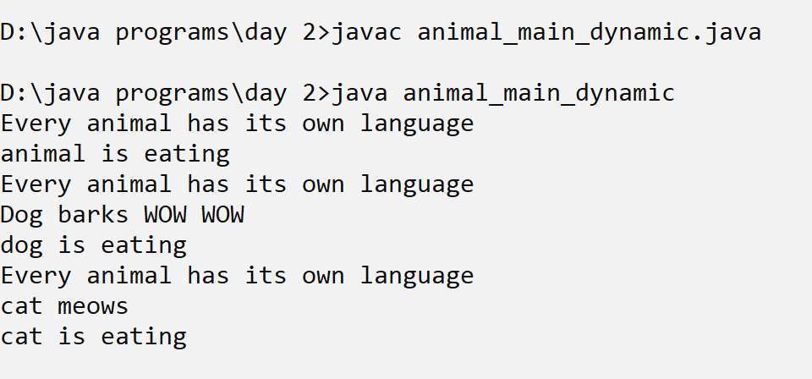
Dynamic binding
class animal_main_dynamic{
public static void main(String [] args){
animal a=new animal();
a.eat();
a=new dog();
a.eat();
a=new cat();
a.eat();
}
}

Slide 45
Java instanceof
The java instanceof operator is used to test whether the object is an instance of the specified type (class or subclass or interface).
The instanceof in java is also known as type comparison operator because it compares the instance with type.
It returns either true or false.
If we apply the instanceof operator with any variable that has null value, it returns false.

Slide 46
Printing the objects belongingness to a class
class animal_main_instanceof{
public static void main(String [] args){
animal a=new animal();
a.eat();
a=new dog();
a.eat();
a=new cat();
a.eat();
System.out.println("is **a** an instance of dog?");
System.out.println(a instanceof dog);
System.out.println("is **a** an instance of cat?");
System.out.println(a instanceof cat);
System.out.println("is **a** an instance of animal?");
System.out.println(a instanceof animal);
}

Slide 47
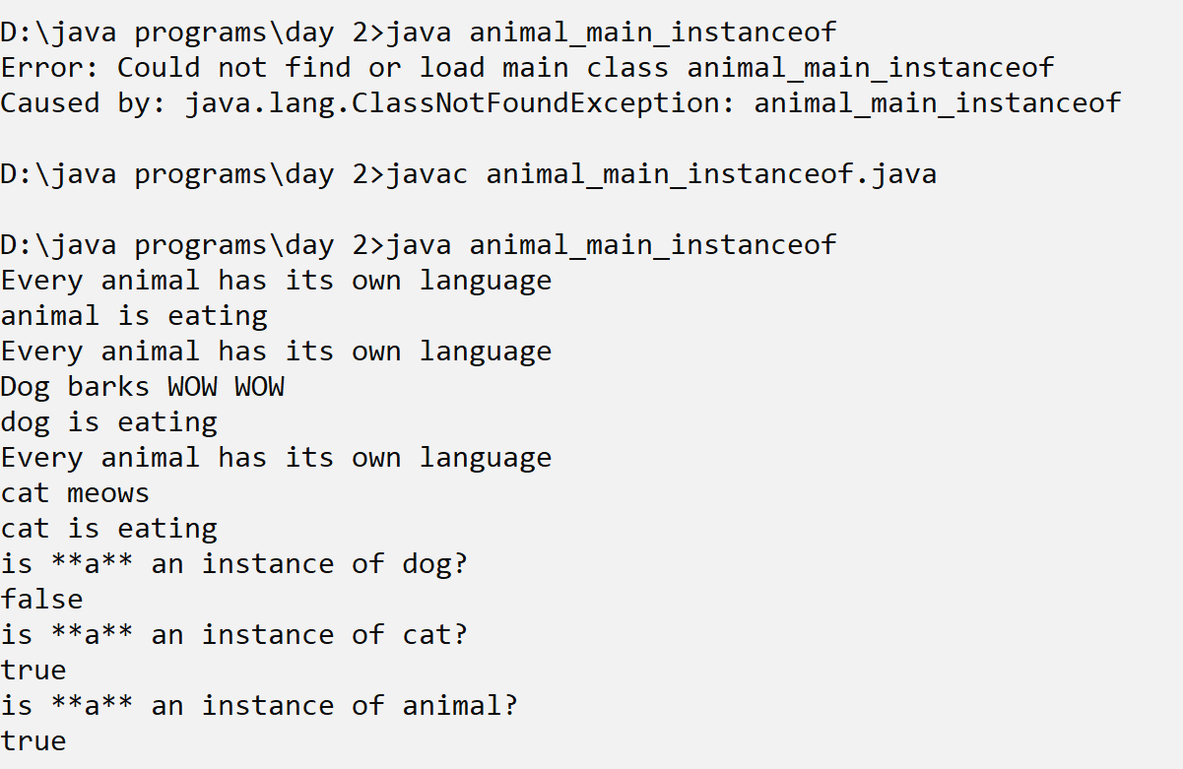
operator

Slide 48
Downcasting
Downcasting with java instanceof operator
When Subclass type refers to the object of Parent class, it is known as downcasting.
If we perform it directly, compiler gives Compilation error.
If you perform it by typecasting, ClassCastException is thrown at runtime.
But if we use instanceof operator, downcasting is possible.

Slide 49
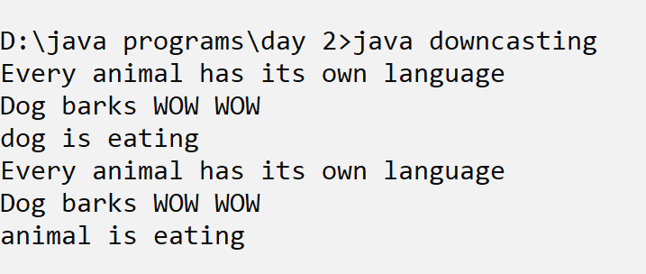
Downcasting
class downcasting{
public static void main(String [] args){
animal a=new dog();
animal b=(animal)a;
b.eat1();
}

Slide 50
Multiple Inheritence
Java does not support multiple inheritance. This means that a class cannot extend more than one class. Therefore, following is illegal
public class extends Animal, Mammal{}
However, a class can implement one or more interfaces, which has helped Java get rid of the impossibility of multiple inheritance.
The extends keyword is used once, and the parent interfaces are declared in a comma-separated list.

Slide 51
Multiple Inheritence
Interface basic_info
{
Int roll;
String name;
Int age;
}
Interface physical_fit
{
Float height;
Float weight;
}
A
B
C
D

Slide 52
Multiple inheritance
Class academic_info implements
basic_info,physical_fit
{
String course;
String sem;
Int rank;
}

Slide 53
What is an interface?
Prior to java 8, interface in java can only have abstract methods.
All the methods of interfaces are public & abstract by default.
Java 8 allows the interfaces to have default and static methods.
The reason we have default methods in interfaces is to allow the developers to add new methods to the interfaces without affecting the classes that implements these interfaces.

Slide 54
interface
interface interface_father{
String name="Suresh";
public void dispname();
}
interface interface_mother{
String name="Manju";
public void dispname();
}
class parent_main implements interface_father,interface_mother{
public void dispname(){
System.out.println("fathers name is "+ interface_father.name);
System.out.println("mothers name is "+ interface_mother.name);
}
public static void main(String [] args){
parent_main p=new parent_main();
p.dispname();
}
}

Slide 55
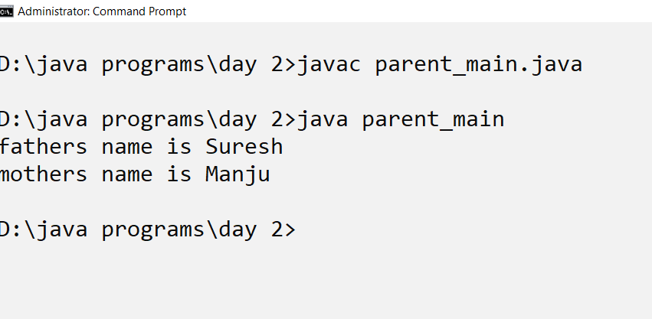
output

Slide 56
Why default method?
For example, if several classes such as A, B, C and D implements an interface I1 then if we add a new method to the I1, we have to change the code in all the classes(A, B, C and D) that
implements this interface. In this example we have only four classes that implements the interface which we want to change but imagine if there are hundreds of classes implementing an interface then it would be almost impossible to change the code in all those classes.
This is why in java 8, we have a new concept “default methods”.

Slide 57
Default method
interface MyInterface{
default void newMethod(){
System.out.println("Newly added default method");
}
static void anotherNewMethod(){
System.out.println("Newly added static method");
}
void existingMethod(String str);
}

Slide 58
Imterface implementations
public class Example implements MyInterface{
// implementing abstract method
public void existingMethod(String str){
System.out.println("String is: "+str);
}
public static void main(String[] args) {
Example obj = new Example();
obj.newMethod();
//calling the static method of interface
MyInterface.anotherNewMethod();
//calling the abstract method of interface
obj.existingMethod("Java 8 is easy to learn");
}
}

Slide 59
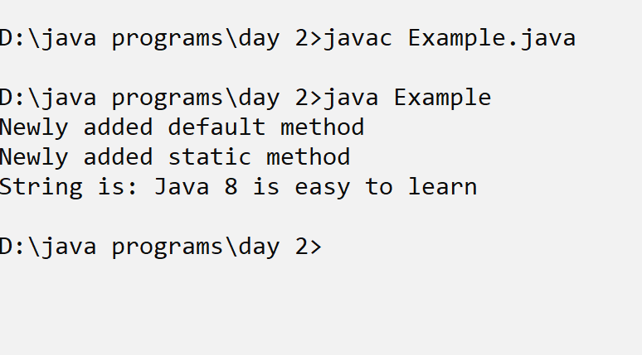
output

