Slide 1

Lesson 3 of 6
ML in TensorFlow
18/10/2017

Slide 2
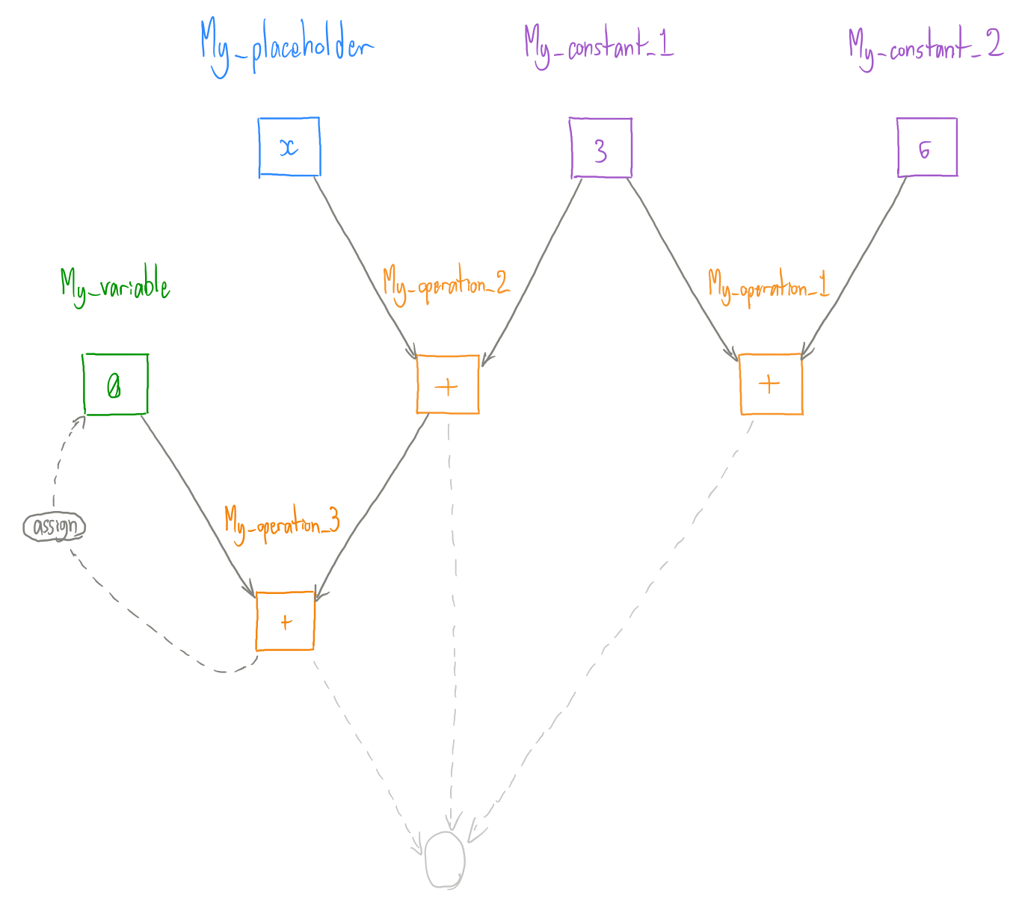
TensorFlow – It’s just a graph
Constant
Exactly that, a constant value
Placeholder
Placeholder for data you will pass at run-time
Variable
A value that “varies” each graph run
Operation
An operation on data

Slide 3
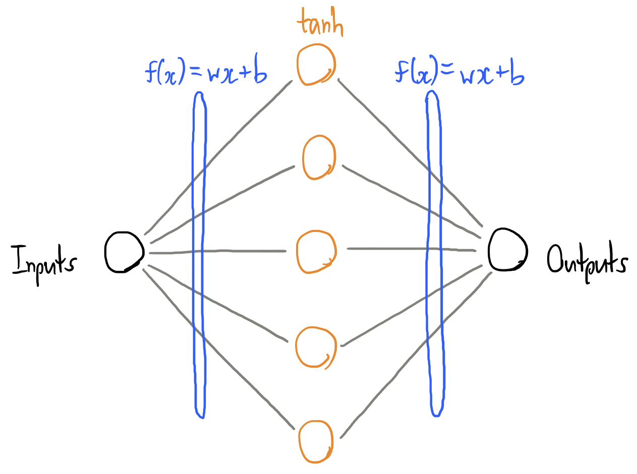
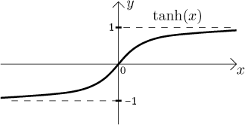
Neural Networks – Basically graphs... With math
Layers of “neurons”
Weights and biases
Activation functions
Optimizer

Slide 4
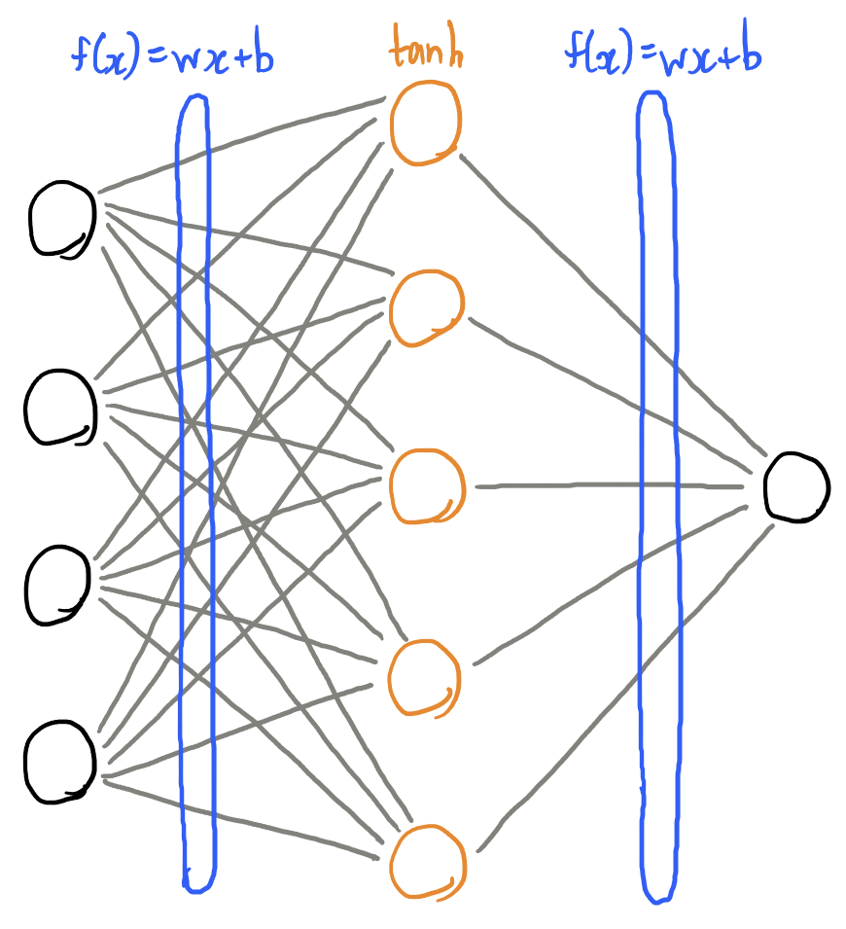
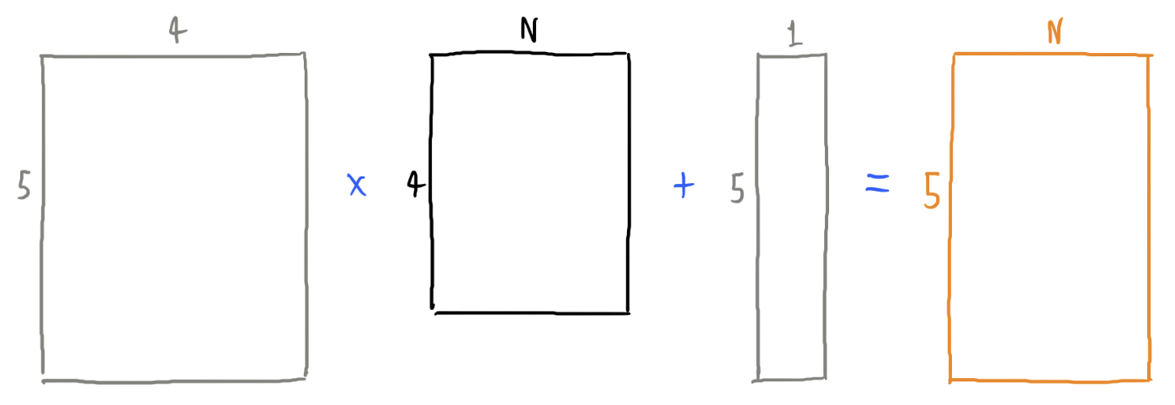
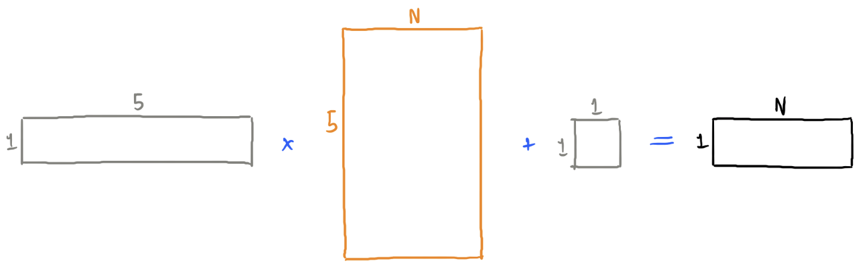
Neural Networks – Basically graphs… With math

Slide 5
How do we split data?
Training set
Usually 80% of dataset
Validation set
Usually 20% of dataset
Never trained on
Used to see how model is doing during training
Test set
Can split from full dataset (i.e. 80/10/10)
Done after training to test final net (reporting purposes)

Slide 6
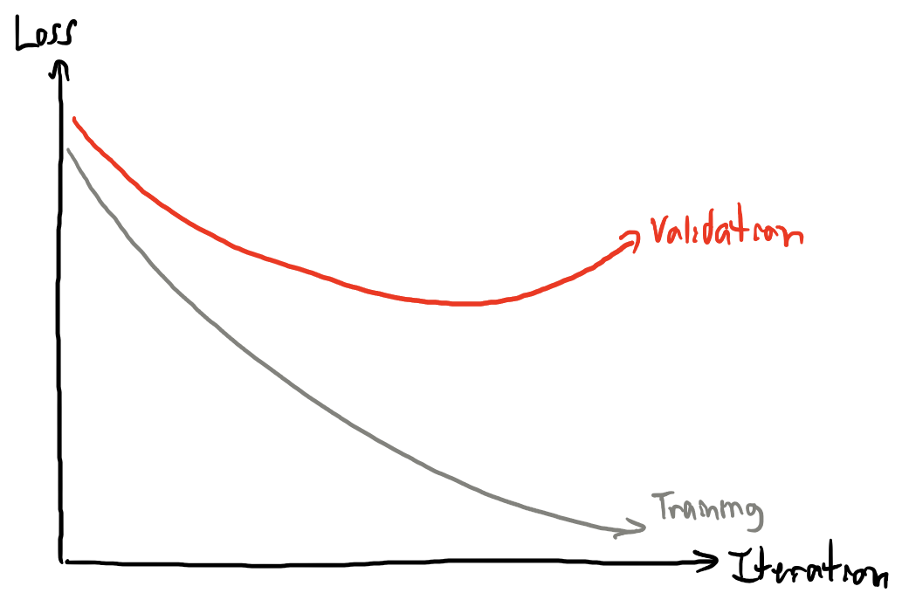
Why do we split data?
See how the model is doing

Slide 7

About DeepLearni.ng
Real-world results. In our flagship partnership with Scotiabank, we deployed one of the world’s first deep learning systems for retail banking. At Scotiabank and other enterprises, we build machine learning tools designed to rapidly generate business value.
Diverse leadership. Experienced leaders with a broad range of experience, including 3 PhDs, a former executive from one of Canada’s Big 5 banks, tech entrepreneurs and a McKinsey alum.
Applied machine learning experts. Our experts have hands-on experience developing solutions that thrive in complex enterprise environments.

Slide 8



Our Guiding Principles
Educate
Empower
Elevate
We help enterprises understand how machine earning can be optimized for their distinct business context
We build machine learning systems built to adapt well to existing enterprise
infrastructure and processes
We deploy machine learning systems that are designed to deliver sustainable business value and create IP
Notes:
Educate
Empower
Elevate

Slide 9

Contact us
10 Alcorn Avenue
Suite 303
Toronto, ON
M4V 3A9
www.deeplearni.ng
deploy@deeplearni.ng

