Slide 1
APPRESOURCE management Process improvement

Slide 2
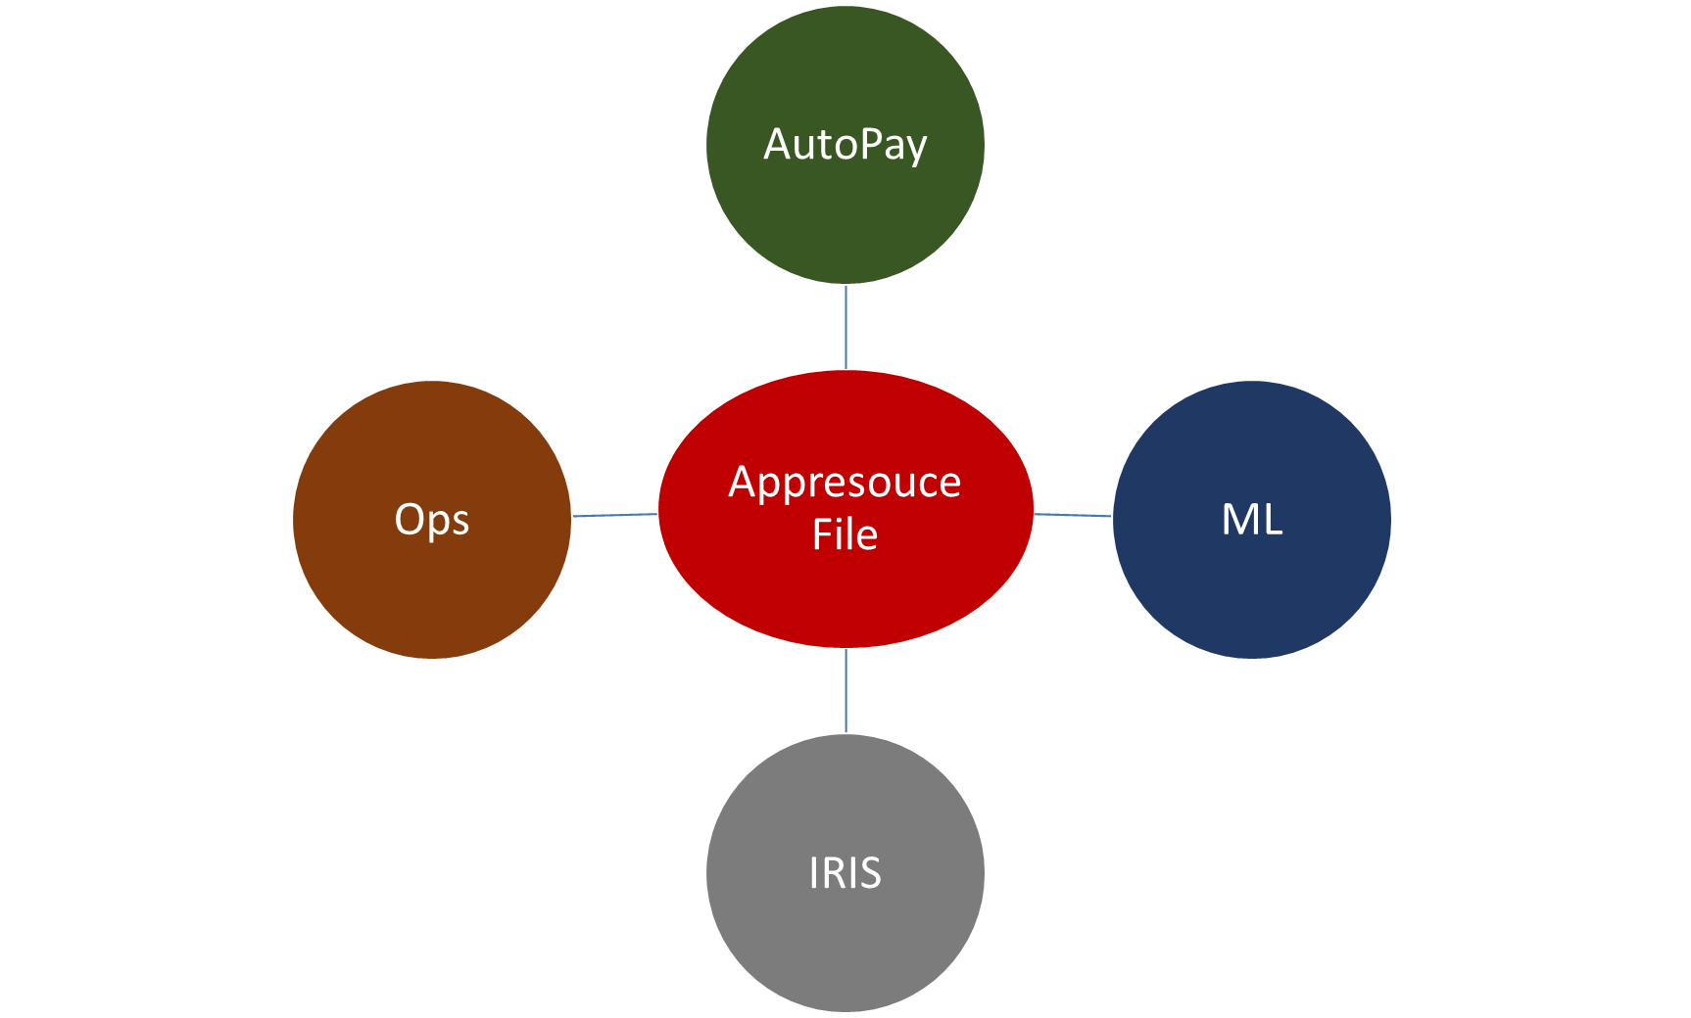
Current
process
Internal selfcare release does not include Operations changes.
2) 3rd May
3) 10th May
4) 17th May
1) May 1st
5) 24th May
In the past, direct changes resulted in garbage characters in Spanish files.
Consolidate all the changes from Ops with multiple feature changes (ML, AutoPay, IRIS)
6) 25th May

Slide 3
Current Process & Challenges
Based on AT&T need, Ops directly updates the keys/file in production.
Agile team updates the file having feature specific changes. The version that they are updating might/might not have Ops changes.
At IOT step; Anchor team collects all the changes from all the agile teams that have features planned to be released in particular milestone. They manually review Ops changes + feature changes. Appresource generator excel file is used to generate the app resource file at the beginning of the IOT.
App resource key values often get updated during IOT based on customer feedback. As pre-production deployment step, feature changes + Ops changes get reviewed again and fiel gets updated manually, if needed.
The file is currently not under any version controlled. No central repository to store the file or view the latest content.
No ability to track changes made for specific key(s).
Potential to corrupt the file, as changes are directly made in the production system.

Slide 4
PROPOSED SOLUTION
Streamline app resource management process. Provide easy access (thru GUI application) to view/add/update/promote keys.
Provide ability for Operation to view ALL existing keys and update any key based on AT&T request.
Provide ability for Developer to view/add/edit keys based on new feature development.
Provide ability to Ops/DevOps to promote feature specific keys as pre-deployment task.
Provide ability to view audit log of any key changed by multiple groups.
Perform validation as well as UTF conversion upfront while values are entered/updated.
Provide ability to publish and generate latest app resource file on on-demand basis. Developer/Testing team/Operation can generate app resource file either exact replica as production version or production version overwritten with changes introduced by new feature(s).

Slide 5






Architecture Diagram
Web App
Feature List
Users
HSQL Database
A&A

Slide 6
Use Case 1: AT&T requested CHANGE
Scenario:
Ops get request from AT&T to change the verbiage in SC.
Steps:
Login into new application (EUA?, AMA?)
Search for key or value. Identify the key (example: refill.sidebar).
Update the value (source is defaulted as “PROD”)
Promote the change. Promoted changes get stored in the database.
Publish the change. Publish generates language specific file(s) and stores in the central repository with supporting details.
Download the file.
View audit history, if case if there is any doubt.
Manually copy the file on the destination server. This step is not automated yet intentionally.

Slide 7
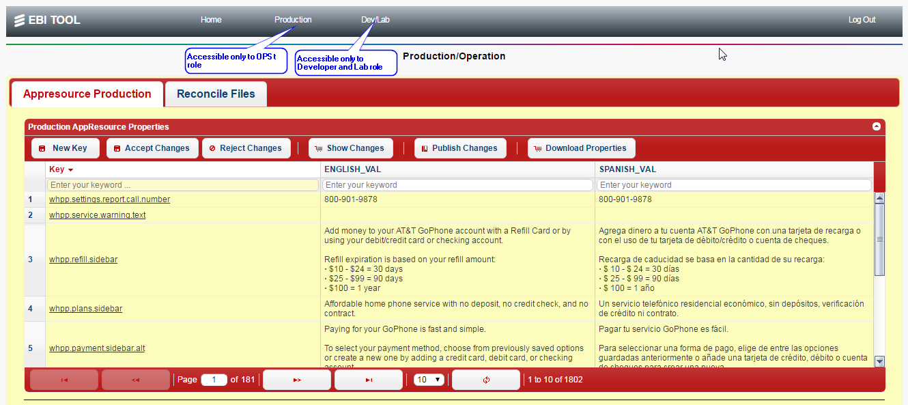

Slide 8
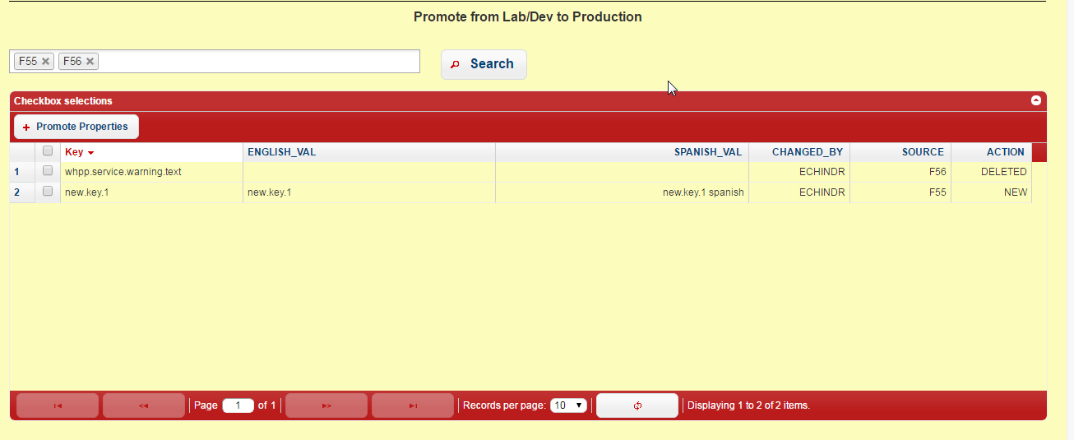

Slide 9
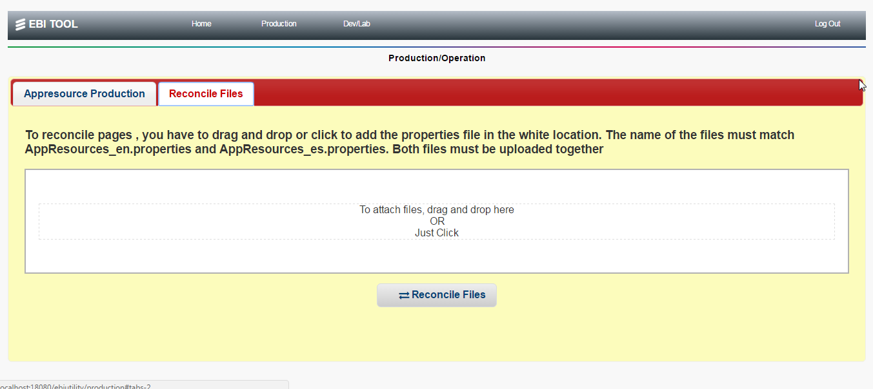

Slide 10
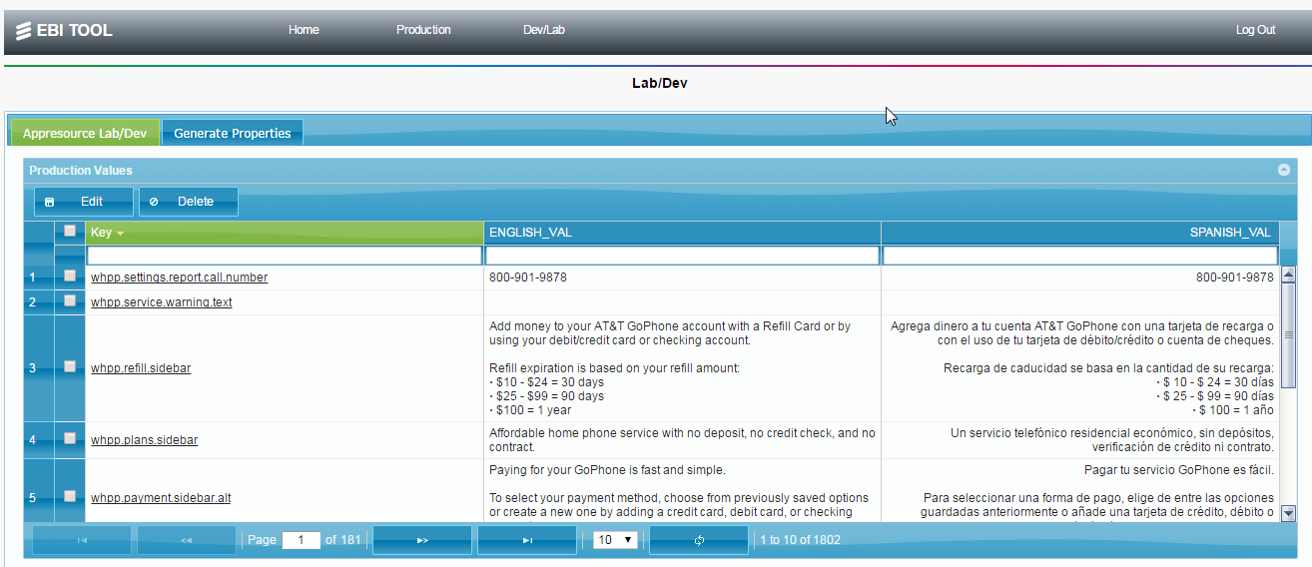

Slide 11
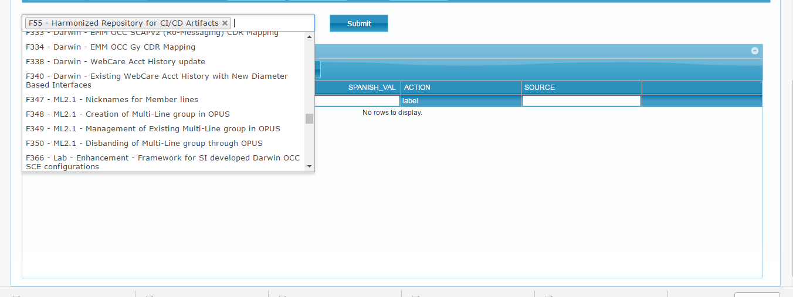

Slide 12
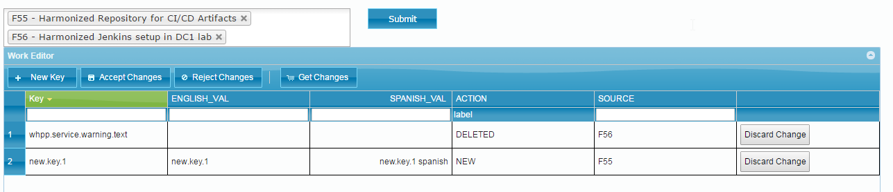
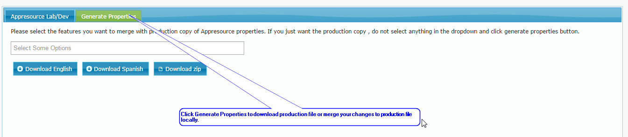

Slide 13
Use Case 2: New feature development
Scenario:
New feature (AutoPay P2) is being developed. PM/Agile team introduced new keys to keep SC verbiage configurable.
Steps:
As a Developer -
Login into new application (EUA?, AMA?)
Search for existing key or value. All production key/values are readily available. Identify the new key name (example: Autopay.sidebar).
Enter new key/values and associate it to Rally feature, available from the drop-down list.
Verify/validate the changes in the inline tool.
Submit the new key(s) and corresponding values using work editor. The submitted changes are stored in DB as staged but NOT promoted.

Slide 14
Use Case 2: New feature development (Cont)
As a DevOps person -
Review the eligible (staged) changes. DevOps has ability to select subset or all the changes based on the planned release.
Promote the change. Promoted changes get stored in the database.
Publish the change. Publish generates language specific file(s) and stores in the central repository with supporting details.
Download the file.
View audit history, if case if there is any doubt.
Manually copy the file on the destination server.
Steps 1-5 are using the tool. Only step-6 is kept as manual, until process if fully adopted.

Slide 15
Benefits & Risks
Benefits
Significantly reduced manual effort. No need to collect and manually compile changes coming from multiple sources.
Ability to audit trail/track any key changes with details. Currently this info is not available.
Ability to generate app resource file for any env at the click of the button.
Ability to promote subset/all changes as per release request.
Less time needed for Release note preparation/review.
Overall - reduced manual effort, increased efficiency, considerable productivity gain.
Risks
Tool must be available 24x7, Support becomes critical even though it’s for internal use.
New process must be fully verified and tested before it’s rolled-out for production use.

Slide 16
Technical Highlights
Web application
Sprint suite v4 (Sprint MVC, Sprint Security, Spring JDBC, Spring LDAP)
REST API based service framework
HSQL
Light-weight, Open source, Java based database (HSQL 2.3.4)
LDAP
Lab LDAP used for authentication and authorization
External Integration
Rally REST API integration

Slide 17
Database
HSQL DB has below tables to store the required information.
APPRESOURCE_PROPERTIES
Stores the changes done in non-production env (usually by Developer/tester)
APPRESOURCE_PROPERTIES_PROD
Stores the changes done in production env (usually by Ops/DevOps)
APPRESOURCE_PROPERTIES_PUBLISH
Stores the copy of all published files (version#, publish date/time etc)
APPRESOURCE_PROPERTIES_AUDIT
Keep history of key/value changes (what, who, when)

Slide 18
security
Lab LDAP is used for authentication and authorization. Application has implemented role-based authorization.
Production access
Only Individual having EBI_OPS role will be able to access “Production” tab. In other words, only they will be able to promote any keys or add/update any existing key in the production.
Development access
Individual having EBI_DEV or EBI_LAB role will be able to access “Dev/Lab” tab. They will be able to view/add/update keys ONLY in staging area, but will NOT be able to promote any key for the production system.
Admin access
Individual having EBI_ADMIN role will have full access to the system and will be superset of the roles mentioned above.

