Slide 1


y
$$ℋ\left(u;W_{20}\right)$$
$$φ=\tan^{−1}\left(\frac{2W_{20}}{λ}\right)$$
u

Slide 2

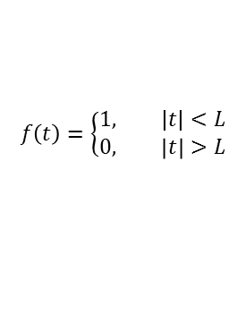


0
-a - L
0
a + L
a-L a a+L
a-L a+L
a > L
a = L⁻
-a-L a -a+L
-a-L -a+L
-a - L
a + L
a-L a a+L
a-L a+L
a = L
-L < a < 0
-a-L a -a+L
-a-L -a+L
a - L
-a + L
a-L a+L
a-L a a+L
0 < a < L
a = - L
$$f\left(t\right)=\left\{\begin{aligned}1, |t|<L \\ &0, \left|t\right|>L\end{aligned}\right.$$
-a-L -a+L
-a-L a -a+L
-L 0 +L
a - L
-a + L
$$f\left(t−a\right)$$
a-L a+L
a-L a a+L
$$f\left(t+a\right)$$
a = L⁺
a < -L
$$Region of overlap$$
-a-L -a+L
-a-L a -a+L

