Slide 1
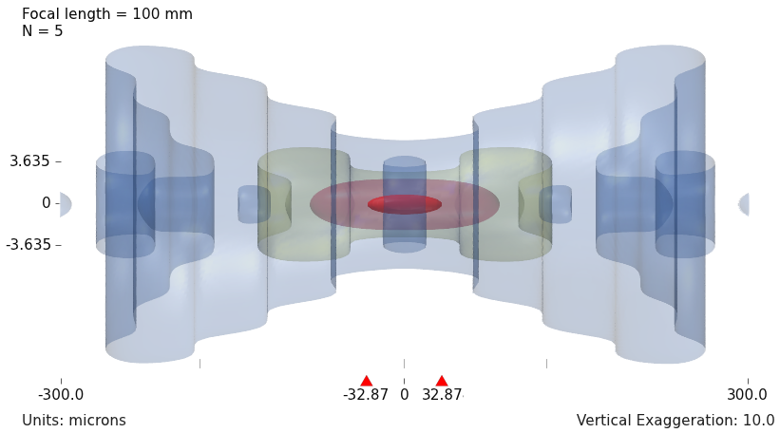
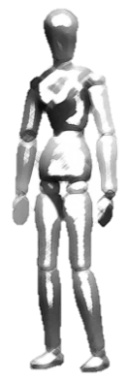
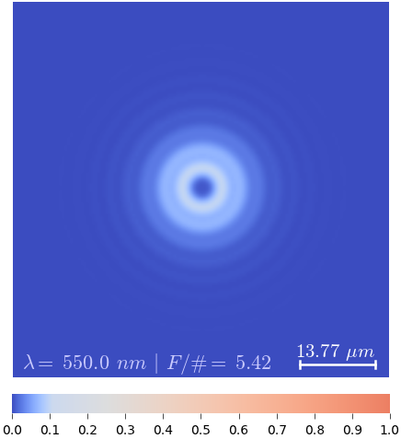
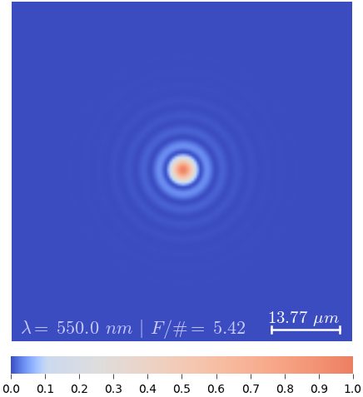
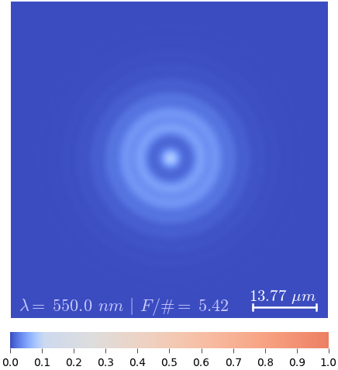
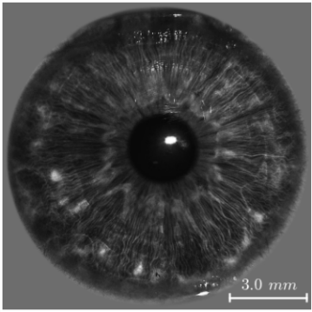
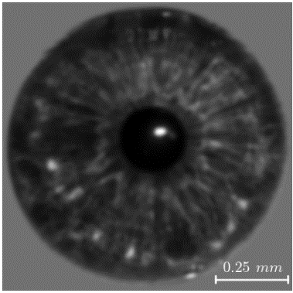

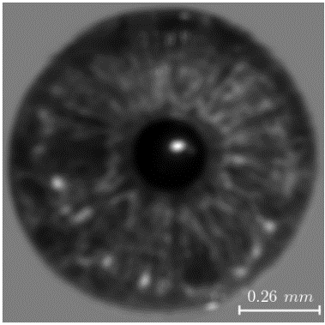
The DOF is a result of how the incoherent 3D PSF spreads out in space
5%
1%
1300 mm
108.33 mm
80%
18 mm
25 mm
20%
B
A
C
100 mm, F/5
C’
A’
B’
▴ Imaging system
▴ 3D Incoherent PSF
DOF
B’
A’
C’
▴ Object space
▾ 2D PSF
▾ Iris in object space
B/A/C
B’
A’
C’
▾ Image (simulation)
Notes:
Briefly explain what is the main cause of this limitation (DOF)
The impulse for the 3 configurations
Explain the 3-D incoherent PSF – distribution of intensity at the focal region for a particular system. Stress the fact that the “shape” (or nature) of the 3-D PSF is intimately tied to the optical systems’ performance both in terms of resolution and DOF.
The focal intensity distribution, as we shall see later, is strongly influenced by the characteristics of the aperture, which we shall call the pupil function.
Assuming a linear system model, tell how the impulse response is obtained (slices of the 3-D intensity distribution, which is the 3D incoherent PSF)
Explain, again, the idea of DOF – what does the “red” zone in the 3-D PSF correspond to? There is a corresponding zone in the object side where you can still get acceptable quality images.

Slide 2
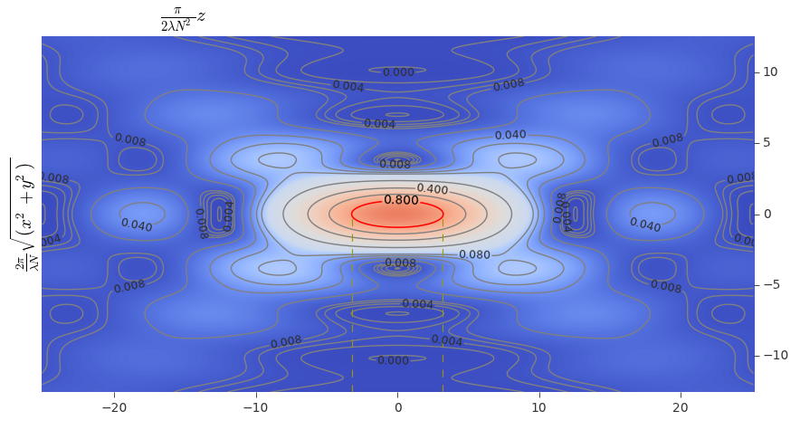
Visualizations of intensity distribution of light near the focal region

Slide 3
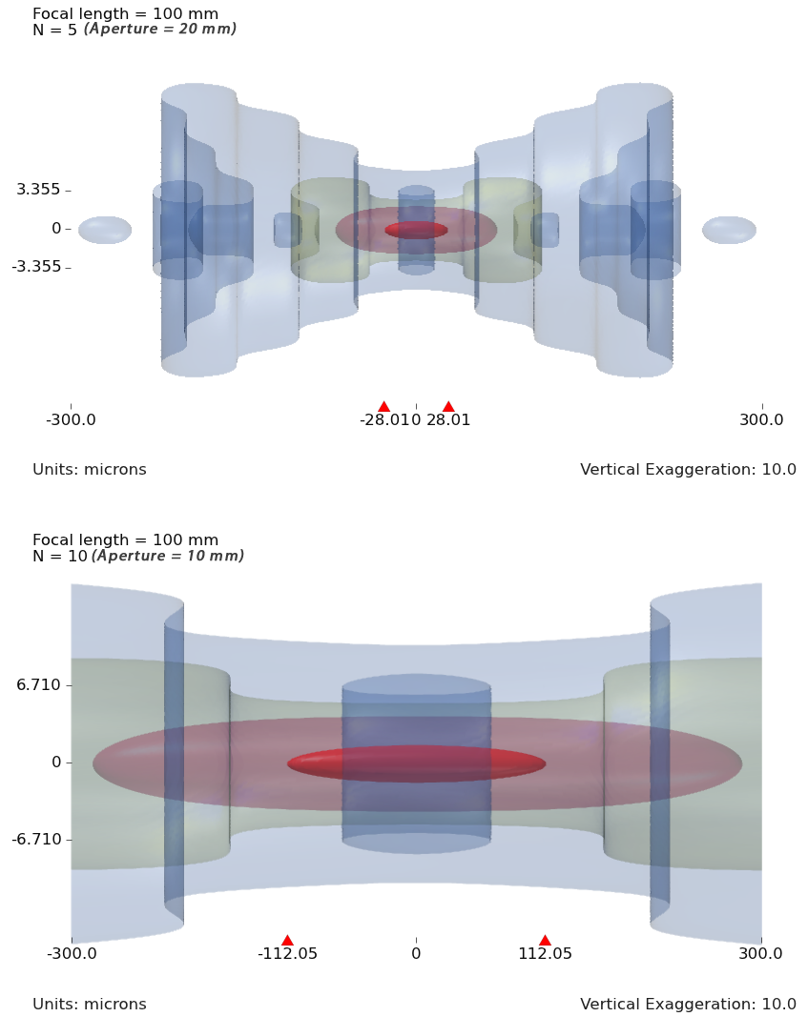
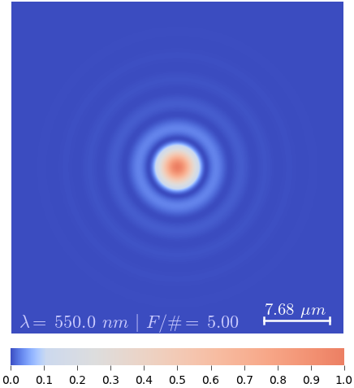
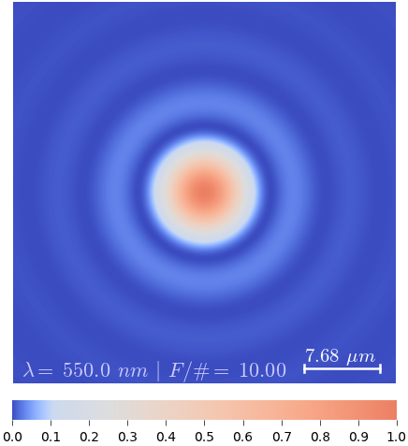
Controlling the DOF by aperture size is a classical (probably bygone) method
18 mm
25 mm
B
A
C
Focal length = 100 mm
F/# = 5 (aperture = 20 mm)
5%
1%
80%
20%
▴▾ Object space ▴▾ Aperture ▴▾ 3D Incoherent PSF ▴▾ 2D PSF at focus
(DOF indicated by hor. bar)
Focal length = 100 mm
F/# = 10 (aperture = 10 mm)
5%
1%
80%
20%
Notes:
It can be seen that by halving the aperture diameter (doubling the F-number, $F\#$) the DOF increased four folds, which are indicated by the red triangle markers on the horizontal axis; however, the diffraction spot-size also increased two folds consequently halving the spatial resolution.

Slide 4
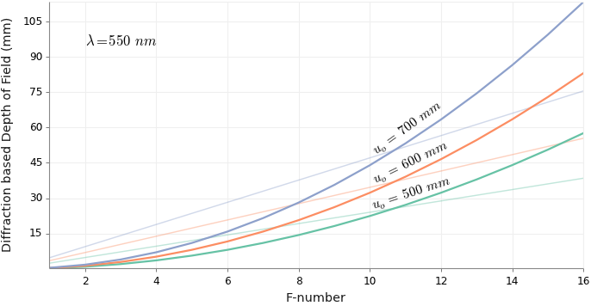
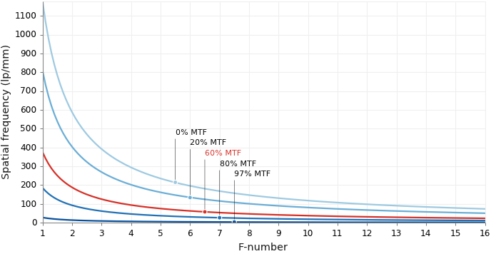
Extending the DOF by decreasing the aperture size is not a viable solution
◂ Variation of DOF with F/# (the curved lines are diffraction based DOF, the straight lines are geometric DOF)
◂ Spatial frequency response vs. F/#
Notes:
Loss of light implying low SNR
Loss of optical spatial resolution.

