Slide 1
Notes:
Now that we know how to orient the plane of sharp focus along a desired orientation,

Slide 2
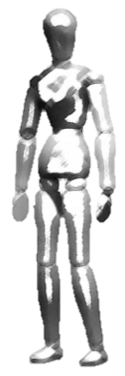
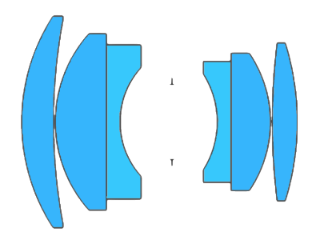



The DOF in traditional camera extends towards infinity in the directions
orthogonal to the optical axis, and beyond the field of view
Plane of sharp focus
$$F$$
$$\acute{H}$$
$$H$$
Field of view
Optical axis
Sensor
Depth of field (DOF)
Notes:
NOTE: I think that the wedge approximation is true for a set spatial frequency limit on the image plane …. However, if we desire a target spatial frequency in the object space, then the region is not really a wedge extending away from the camera, …. But the shape shrinks as we go from the camera. So would it be fair to suggest that the exact nature of the DOF depends on a set definition?

Slide 3



We can orient the plane of sharp focus & the DOF in Scheimpflug camera,
approximated as a wedge,
Depth of field (DOF)
$$F$$
$$\acute{H}$$
$$H$$
Sensor
Optical axis
Plane of sharp focus (PoSF)
Notes:
NOTE: I think that the wedge approximation is true for a set spatial frequency limit on the image plane …. However, if we desire a target spatial frequency in the object space, then the region is not really a wedge extending away from the camera, …. But the shape shrinks as we go from the camera.

Slide 4
Plane of sharp focus (PoSF)
Optical axis
Sensor
Depth of field (DOF)

Slide 5
Depth of field (DOF)
Sensor
Optical axis
Plane of sharp focus (PoSF)

Slide 6
C:\GIT_REPOSITORIES\phd-artifacts\chapters\chapter05_extending_imaging_volume\images\focus_stacking_schematic.ppt

Slide 7



Depth of field (DOF) in Scheimpflug camera
$$F$$
$$\acute{H}$$
$$H$$
Sensor
Depth of field (DOF)
Optical axis
Plane of sharp focus (PoSF)
Hinge line
[Merklinger, H. M. (1996). Focusing the view camera.]

