Slide 1
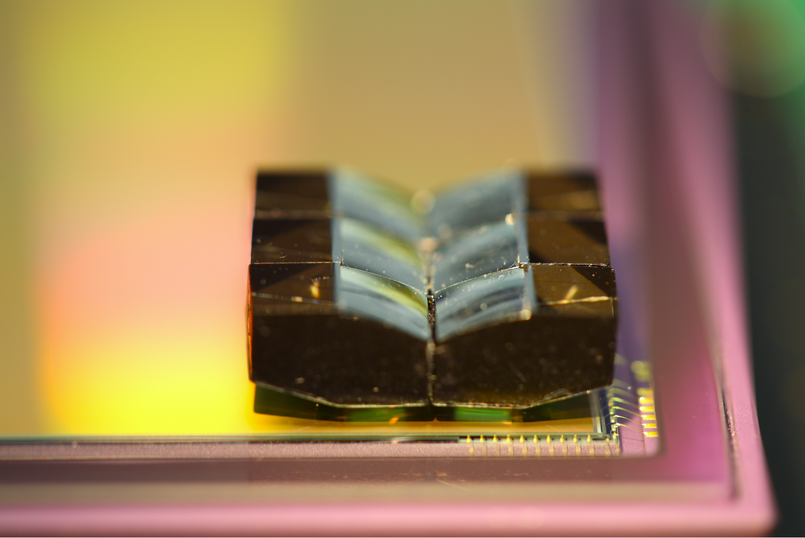
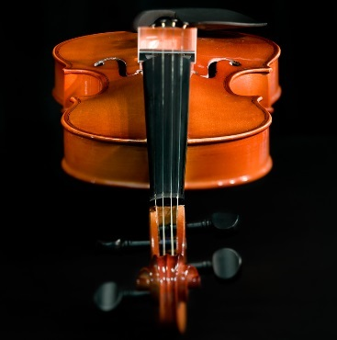
PLANE OF SHARP FOCUS
PLANE OF SHARP FOCUS
(a)
(b)

Slide 2
PLANE OF SHARP FOCUS
PLANE OF SHARP FOCUS
PLANE OF SHARP FOCUS
(a)
(b)

Slide 3
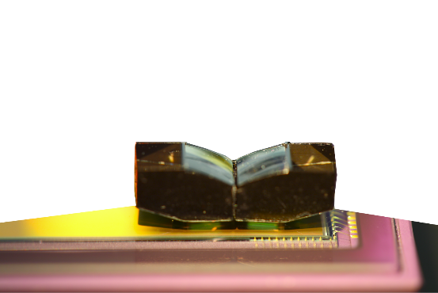
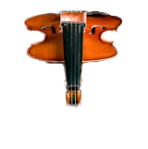
PLANE OF SHARP FOCUS
PLANE OF SHARP FOCUS
(a)
(b)

Slide 4
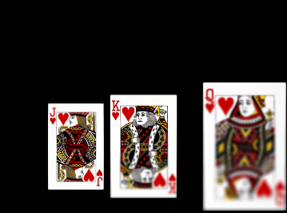



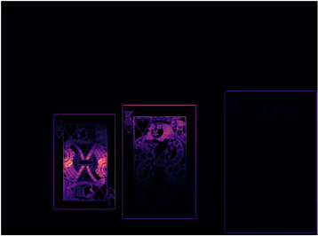
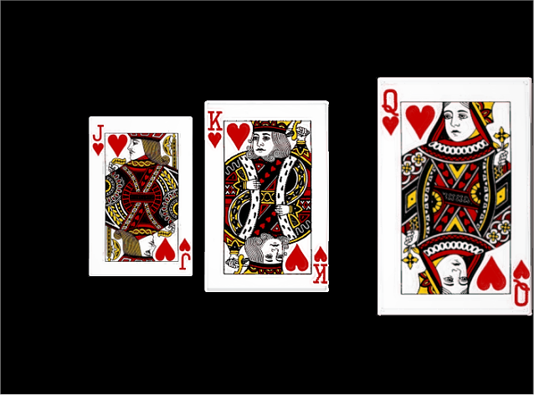
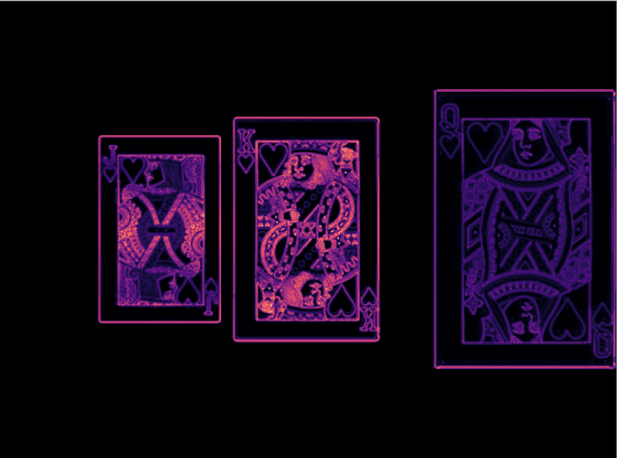




Setup of simulation in Zemax
LENS
Paraxial thick-lens model with spherical aberration;
$f$ = 24 mm, F/2.5, $d$* = 8
Sensor image 1/9 (simulated)
lens tilt = -6°
64 mm
1/2
SENSOR PLANE
$z$-axis
(b)
6.0 x 4.5 sq. mm, 1.78 $μm$
89 mm
Focus measure
(Laplacian of Gaussian)
200 mm
9 tilts
between -6° & +6°
y
x
1/2
200 mm
1000 mm
z
(a)
* $d$ is the separation between the pupils.
(c)
Composite image
Focus measure of the composite image
(using Laplacian of Gaussian)
1/2
1/2
(d)
(e)

Slide 5
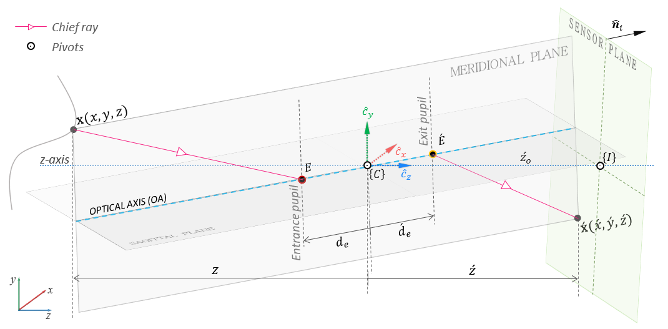






$E$ : Center of entrance pupil
$\acute{E}$: Center of exit pupil
$R_{ℓ}$: Rotation of lens plane (about the pivot at the origin of $\left\{C\right\}$
$r_{𝓁,3}$: 3rd column of $R_{ℓ}$(optical axis)
${\hat{n}}_{i}$: Normal to sensor plane
${\hat{c}}_{x}$, ${\hat{c}}_{y}$, ${\hat{c}}_{z}$: Standard basis of $\left\{C\right\}$
$E$ : Center of entrance pupil
$\acute{E}$: Center of exit pupil
$R_{ℓ}$: Rotation of lens plane (about the pivot at the origin of $\left\{C\right\}$
$r_{𝓁,3}$: 3rd column of $R_{ℓ}$(optical axis)
${\hat{n}}_{i}$: Normal to sensor plane
${\hat{c}}_{x}$, ${\hat{c}}_{y}$, ${\hat{c}}_{z}$: Standard basis of $\left\{C\right\}$

Slide 6
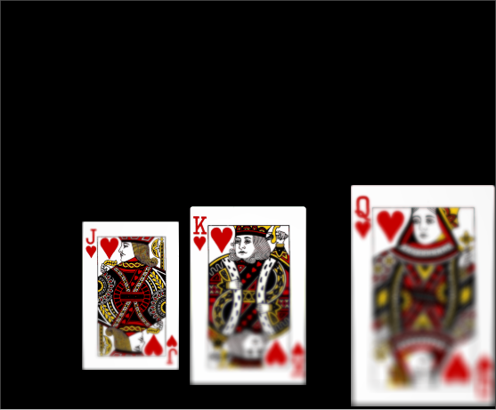
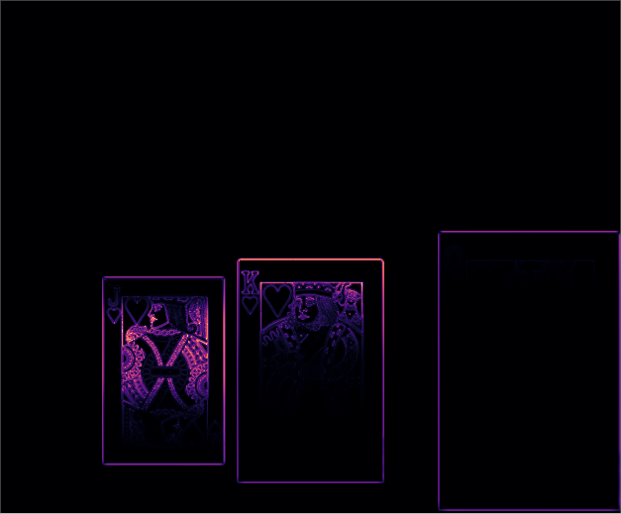
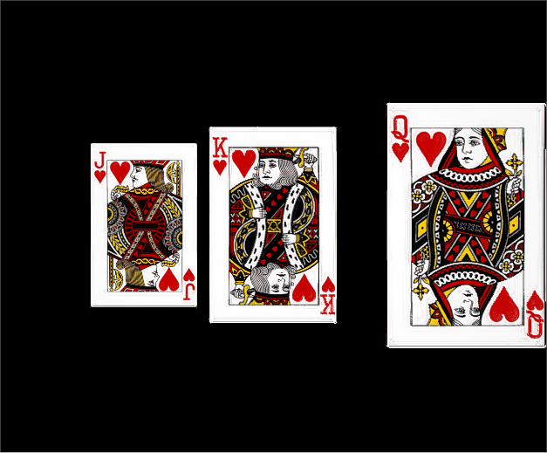
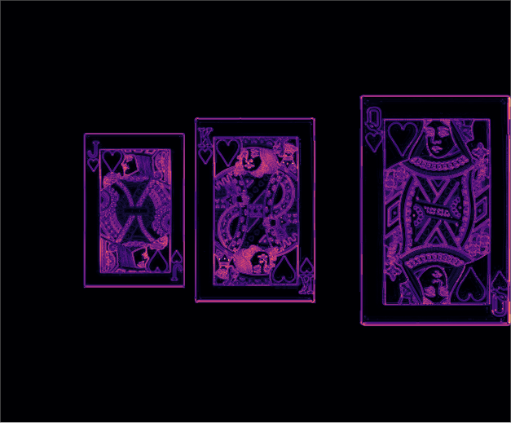




Setup of simulation in Zemax
LENS
Paraxial thick-lens model with spherical aberration;
$f$ = 24 mm, F/2.5, $d$*= 8 mm
Sensor image 1/13
lens tilt = -8°
64 mm
1/2
$z$-axis
SENSOR PLANE
(b)
6 x 5 sq. mm, 1.78 $μm$
89 mm
Focus measure (LoG)
200 mm
13 tilts
between -8° & +8°
y
x
1/2
200 mm
1000 mm
z
(a)
* $d$ is the separation between the pupils.
(c)
Composite image
Focus measure (LoG) of the composite image
1/2
1/2
(d)
(e)

