Slide 1
Cornucopia
SAGITTAL Plane
y
x
Meridional Plane
z
y
x
z

Slide 2





Cornucopia
Chief ray
$${\hat{c}}_{y}$$
Meridional Plane
$$α_{L}$$
$$\left\{C\right\}$$
$${\hat{c}}_{z}$$
y
x
y
x
SAGITTAL Plane
z
z
$$z$$

Slide 3
























Figure 3.3
Chief ray
Marginal ray
$$y$$
$$h_{e}$$
$${\acute{h}}_{e}^{ }$$
$$u$$
$$ω$$
OPTICAL AXIS (OA)
$$\acute{u}$$
$$z_{e}$$
$$E$$
$${\acute{E}}^{ }$$
$$\acute{ω}$$
y
$${\acute{y}}^{ }$$
x
$${\acute{z}}_{e}^{ }$$
z
Chief ray
Marginal ray
$$y$$
Meridional Plane
$$Ω$$
$$ω$$
$$h_{e}$$
$${\acute{h}}_{e}^{ }$$
$$\acute{Ω}$$
SAGITTAL Plane
$$E$$
OPTICAL AXIS (OA)
$$\acute{ω}$$
$${\acute{E}}^{ }$$
y
x
$${\acute{y}}^{ }$$
z
$$z_{e}$$
$${\acute{z}}_{e}^{ }$$

Slide 4
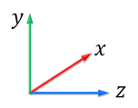


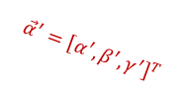






















Figure 3.4
$$\left[\begin{aligned}X \\ Y \\ Z\end{aligned}\right]$$
Chief ray
$$\vec{α}={\left[α, β,γ\right]}^{T}$$
$${\hat{y}}_{p}$$
OPTICAL AXIS
$$ω$$
$$E$$
$${\hat{z}}_{p}$$
$$E′$$
$$Z$$
$$\left\{C\right\},\left\{P\right\}$$
$$ω′$$
$$\left[\begin{aligned}X′ \\ Y′ \\ Z′\end{aligned}\right]$$
$${\vec{α}}^{′}={\left[α^{′}, β^{′},γ^{′}\right]}^{T}$$
$$Z_{ }^{′}$$
$$\text{x}(x, y, z)$$
Chief ray
$$l={\left[l, m,n\right]}^{T}$$
$${\hat{c}}_{y}$$
OPTICAL AXIS (OA)
$$ω$$
$$E$$
$${\hat{c}}_{z}$$
$$\acute{E}$$
$$z$$
$$\left\{C\right\}$$
$$\acute{ω}$$
y
x
$$\acute{l}={\left[\acute{l}, \acute{m},\acute{n}\right]}^{T}$$
z
$$\text{x}(x, y, z)$$
Chief ray
$$l={\left[l, m,n\right]}^{T}$$
$${\hat{c}}_{y}$$
Meridional Plane
OPTICAL AXIS (OA)
$$ω$$
$$E$$
$${\hat{c}}_{z}$$
$$\acute{E}$$
SAGITTAL Plane
$$\left\{C\right\}$$
$$\acute{ω}$$
y
x
$$z$$
$$\acute{l}={\left[\acute{l}, \acute{m},\acute{n}\right]}^{T}$$
z

Slide 5



















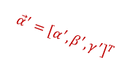






Figure 3.5
$$\left[\begin{aligned}X \\ Y \\ Z\end{aligned}\right]$$
Chief ray
$$\vec{α}={\left[α, β,γ\right]}^{T}$$
$${\hat{y}}_{p}$$
$${\hat{y}}_{c}$$
$$E′$$
$${\hat{z}}_{p}$$
$$ω$$
$$E$$
$$ω′$$
$${\hat{z}}_{c}$$
$$\left[\begin{aligned}X′ \\ Y′ \\ Z′\end{aligned}\right]$$
OPTICAL AXIS
$$\left\{C\right\},\left\{P\right\}$$
$${\hat{z}}_{c}$$
$$Z$$
$${\vec{α}}^{′}={\left[α^{′}, β^{′},γ^{′}\right]}^{T}$$
$$Z_{ }^{′}$$
$$\text{x}(x, y, z)$$
Chief ray
$$l={\left[l, m,n\right]}^{T}$$
$${\hat{c}}_{y}$$
$$\acute{E}$$
$$\acute{ω}$$
$$ω$$
$$E$$
$$\left\{C\right\}$$
$${\hat{c}}_{z}$$
OPTICAL AXIS (OA)
$$\acute{l}={\left[\acute{l}, \acute{m},\acute{n}\right]}^{T}$$
y
$$z$$
x
z
Chief ray
Pivot
$$\text{x}(x, y, z)$$
$${\hat{c}}_{y}$$
Meridional Plane
$$l={\left[l, m,n\right]}^{T}$$
$$\acute{E}$$
$$α_{L}$$
$$ω$$
$$\left\{C\right\}$$
$${\hat{c}}_{z}$$
$$\acute{ω}$$
OPTICAL AXIS (OA)
$$E$$
$$\acute{l}={\left[\acute{l}, \acute{m},\acute{n}\right]}^{T}$$
y
x
y
x
SAGITTAL Plane
z
z
$$z$$

Slide 6








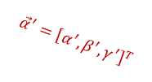





























Figure 3.6
$$\left[\begin{aligned}X \\ Y \\ Z\end{aligned}\right]$$
Chief ray
IMAGE PLANE
$$\vec{α}={\left[α, β,γ\right]}^{T}$$
$${\hat{y}}_{p}$$
$${\hat{y}}_{c}$$
$${\hat{y}}_{i}$$
$$E′$$
$${\hat{z}}_{p}$$
$$ω$$
$$E$$
$$ω′$$
$$\left\{I\right\}$$
$${\hat{z}}_{i}$$
OPTICAL AXIS
$$\left\{C\right\},\left\{P\right\}$$
$${\hat{z}}_{c}$$
$${\hat{n}}_{i}$$
$$Z$$
$${\vec{v}}_{p}$$
$${\vec{α}}^{′}={\left[α^{′}, β^{′},γ^{′}\right]}^{T}$$
$$Z_{ }^{′}$$
$$\left[\begin{aligned}X′ \\ Y′ \\ Z′\end{aligned}\right]$$
Chief ray
$${\hat{n}}_{i}$$
Pivots
IMAGE PLANE
$$\text{x}(x, y, z)$$
$${\hat{c}}_{y}$$
Meridional Plane
$$l$$
$${\hat{p}}_{y}$$
$$\acute{E}$$
$${\hat{i}}_{y}$$
$$\acute{ω}$$
$$\left\{I\right\}$$
$${\hat{i}}_{z}$$
$$α_{L}$$
$$ω$$
$$E$$
$${\hat{p}}_{z}$$
$$\left\{C\right\}$$
$${\hat{c}}_{z}$$
OPTICAL AXIS (OA)
$$\left\{P\right\}$$
$$\acute{l}$$
y
$${\acute{d}}_{e}^{ }$$
$$\acute{\text{x}}(\acute{x}, \acute{y},\acute{z})$$
x
$$d_{e}$$
y
x
SAGITTAL Plane
z
z
$$z$$
$$\acute{z}$$
$${\acute{z}}_{o}^{ }$$

Slide 7





















Figure 3.8
Chief ray
$${\hat{n}}_{i}$$
Pivots
IMAGE PLANE
$${\hat{n}}_{o}$$
OBJECT PLANE
$$\text{x}(x, y, z)$$
$${\hat{c}}_{y}$$
Meridional Plane
$$l$$
$${\hat{p}}_{y}$$
$$\acute{E}$$
$${\hat{i}}_{y}$$
$$\left\{O\right\}$$
$$\acute{ω}$$
$$\left\{I\right\}$$
$${\hat{i}}_{z}$$
$$α_{L}$$
$$ω$$
$$E$$
$${\hat{p}}_{z}$$
$$\left\{C\right\}$$
$${\hat{c}}_{z}$$
OPTICAL AXIS (OA)
$$\left\{P\right\}$$
$$\acute{l}$$
y
$${\acute{d}}_{e}^{ }$$
$$\acute{\text{x}}(\acute{x}, \acute{y},\acute{z})$$
x
$$d_{e}$$
y
x
SAGITTAL Plane
z
z
$$z$$
$$\acute{z}$$
$$z_{o}$$
$${\acute{z}}_{o}^{ }$$

Slide 8
Master for 2 figures (3.6 and 3.8)
Chief ray
$${\hat{n}}_{i}$$
Pivots
IMAGE PLANE
$${\hat{n}}_{o}$$
OBJECT PLANE
$$\text{x}(x, y, z)$$
$${\hat{c}}_{y}$$
Meridional Plane
$$l$$
$${\hat{p}}_{y}$$
$$\acute{E}$$
$${\hat{i}}_{y}$$
$$\left\{O\right\}$$
$$\acute{ω}$$
$$\left\{I\right\}$$
$${\hat{i}}_{z}$$
$$α_{L}$$
$$ω$$
$$E$$
$${\hat{p}}_{z}$$
$$\left\{C\right\}$$
$${\hat{c}}_{z}$$
OPTICAL AXIS (OA)
$$\left\{P\right\}$$
$$\acute{l}$$
y
$${\acute{d}}_{e}^{ }$$
$$\acute{\text{x}}(\acute{x}, \acute{y},\acute{z})$$
x
$$d_{e}$$
y
x
SAGITTAL Plane
z
z
$$z$$
$$\acute{z}$$
$$z_{o}$$
$${\acute{z}}_{o}^{ }$$

Slide 9
















Figure 3.7
$${\hat{y}}_{c}$$
IMAGE PLANE
$${\acute{z}}_{o}^{ }$$
$${\hat{z}}_{c}$$
$$\left(0, 0, {\acute{z}}_{o}^{ }\right)$$
$$\left\{C\right\}$$
$${\hat{n}}_{i}$$
$${\acute{z}}_{o⊥}^{ }$$
$${\hat{c}}_{y}$$
$${\hat{i}}_{y}$$
$${\acute{z}}_{o}^{ }$$
$$\left(0, 0, {\acute{z}}_{o}^{ }\right)$$
$${\hat{c}}_{z}$$
$${\hat{i}}_{z}$$
$$\left\{C\right\}$$
$$\left\{I\right\}$$
$${\hat{n}}_{i}$$
$${\acute{z}}_{o⊥}^{ }$$
IMAGE PLANE

Slide 10
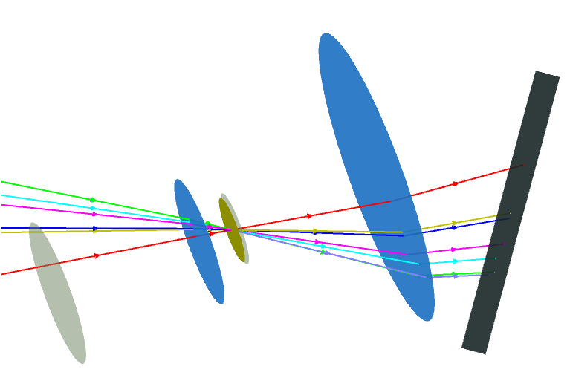
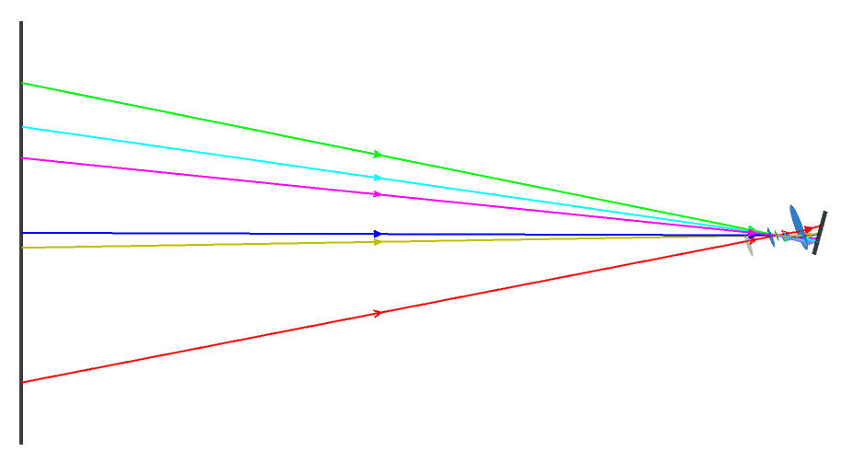
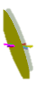








$f_{eff}$ = 24 mm, $m_{p}$= 2.
Lens 2, $f$ = 30 mm
Object plane
$α_{Lx}$ = -20°, $α_{Ly}$ = 10°,
$α_{Ix}$ = 15°, $α_{Iy}$ = -5°.
Image plane
Lens 1, $f$ = 40 mm
$${\hat{c}}_{y}$$
Optical axis
Chief rays
Stop
$$\left\{C\right\}$$
$${\hat{c}}_{z}$$
y
$z_{o}$= 509 mm
Entrance pupil
x
z
Exit pupil
$\acute{z_{o}}$ = 24.17 mm
Pivots

Slide 11
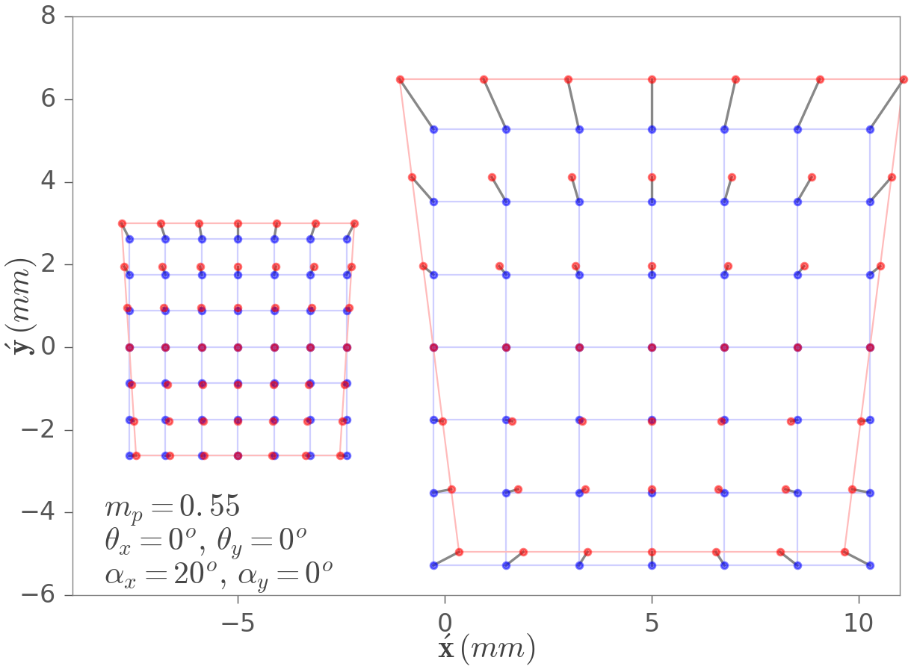
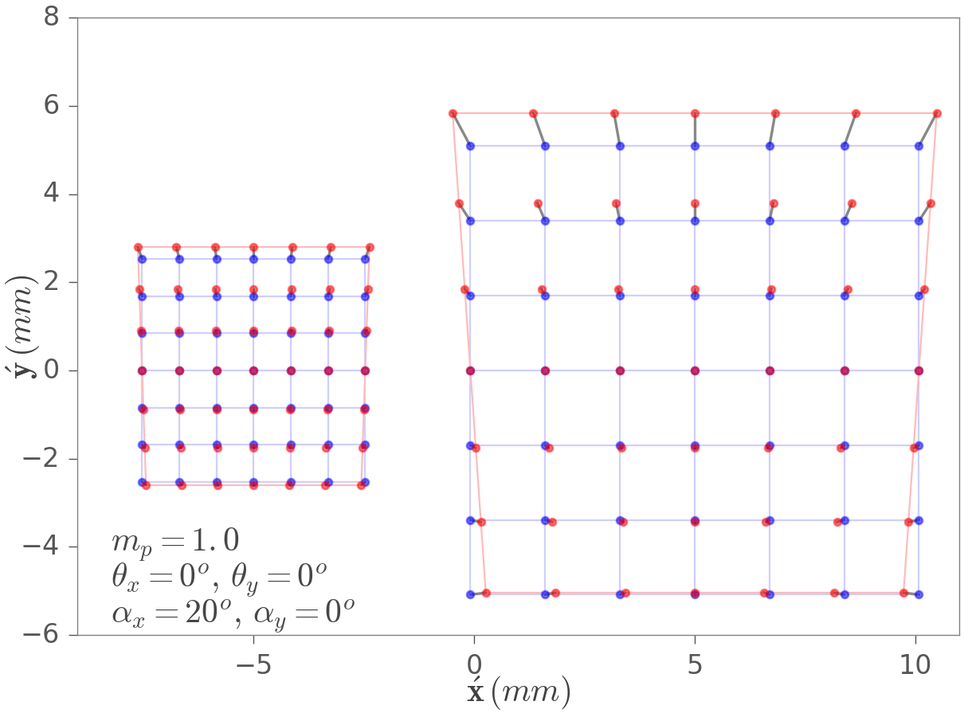
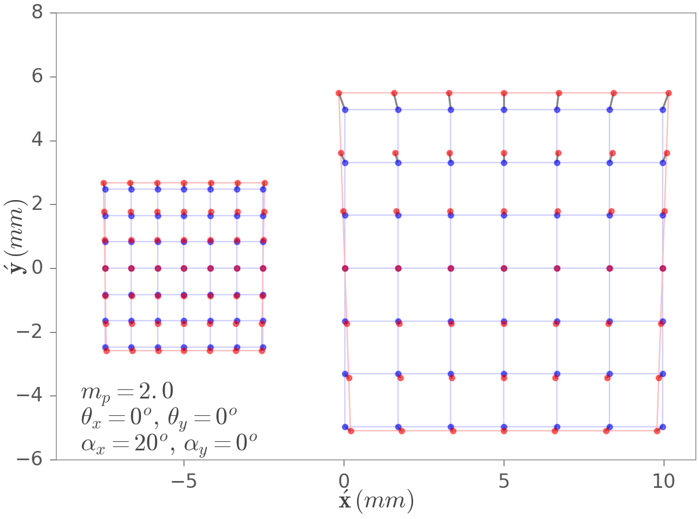
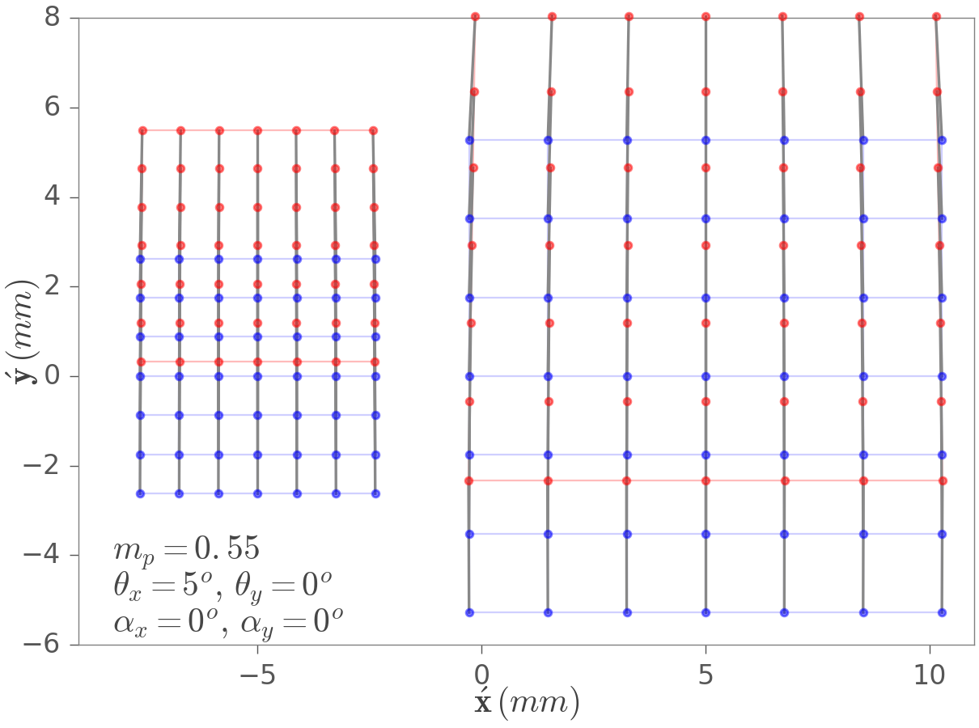
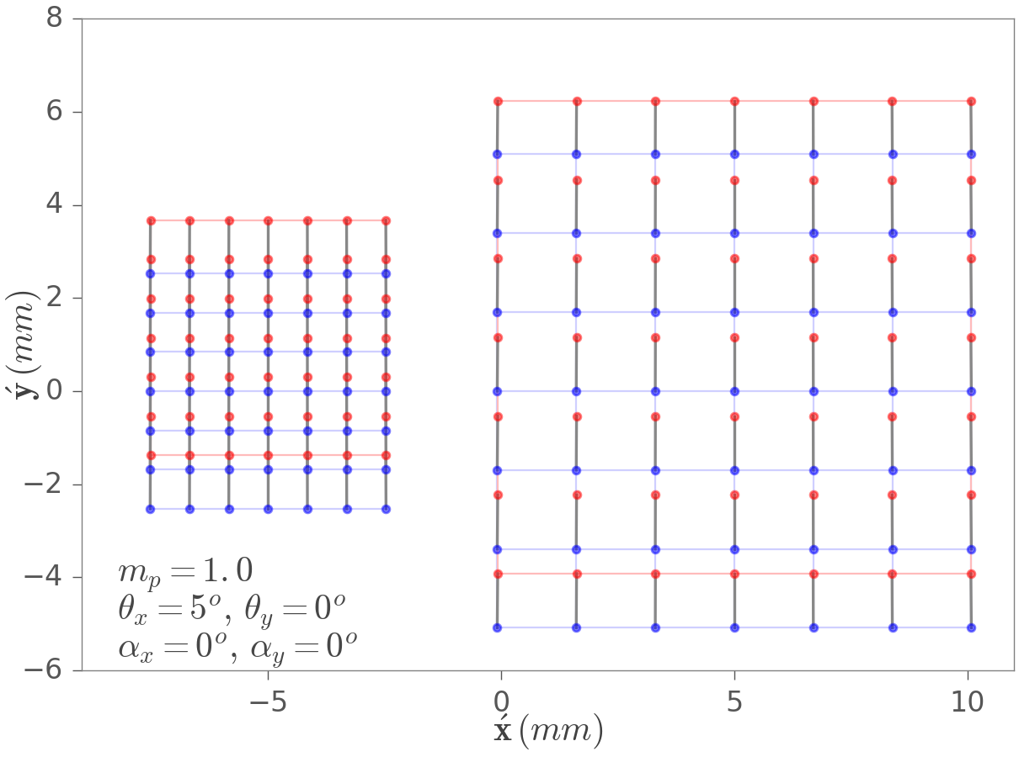
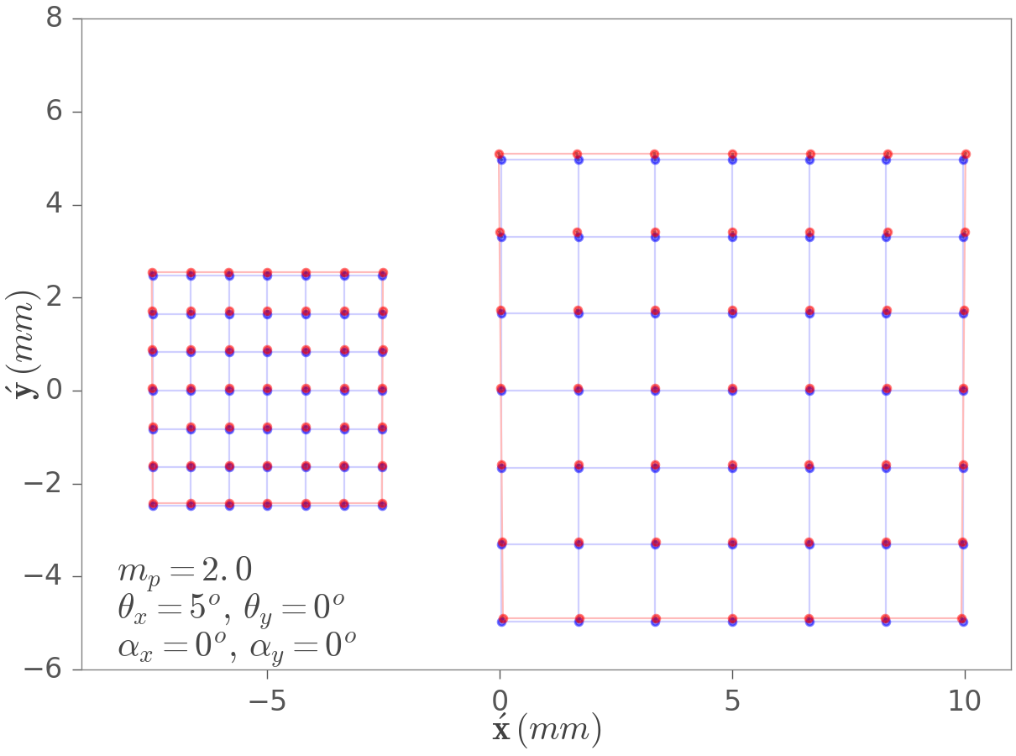
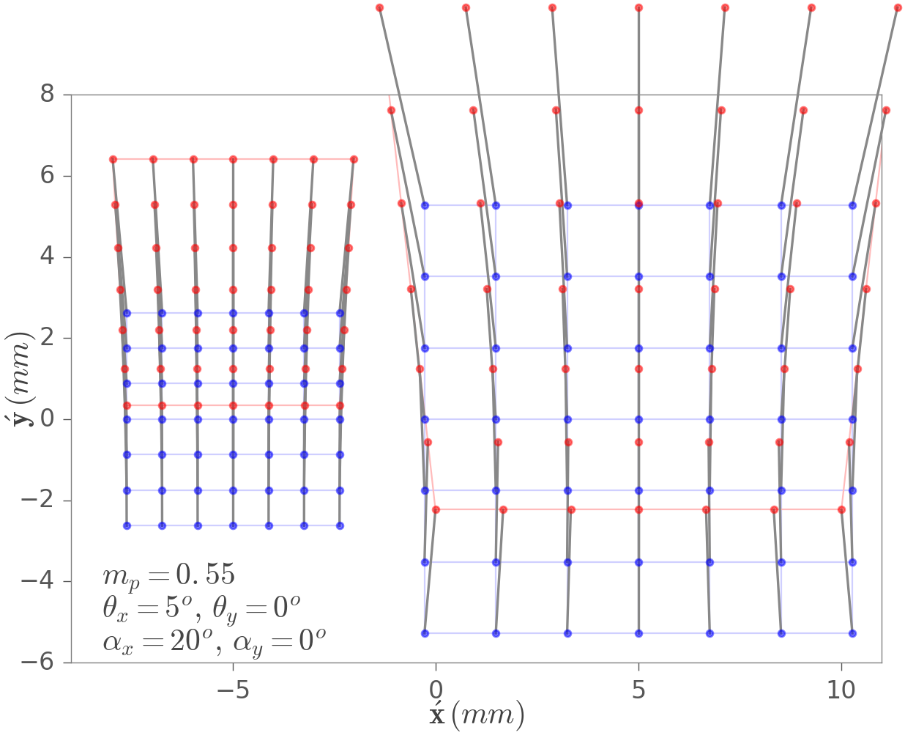
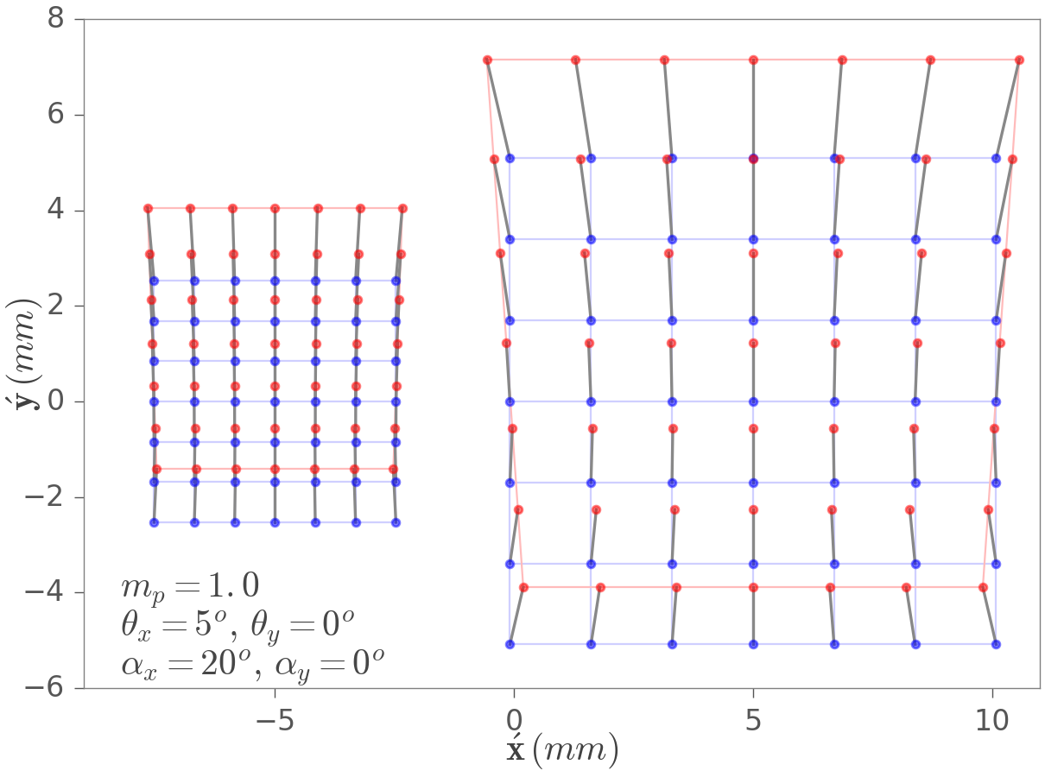
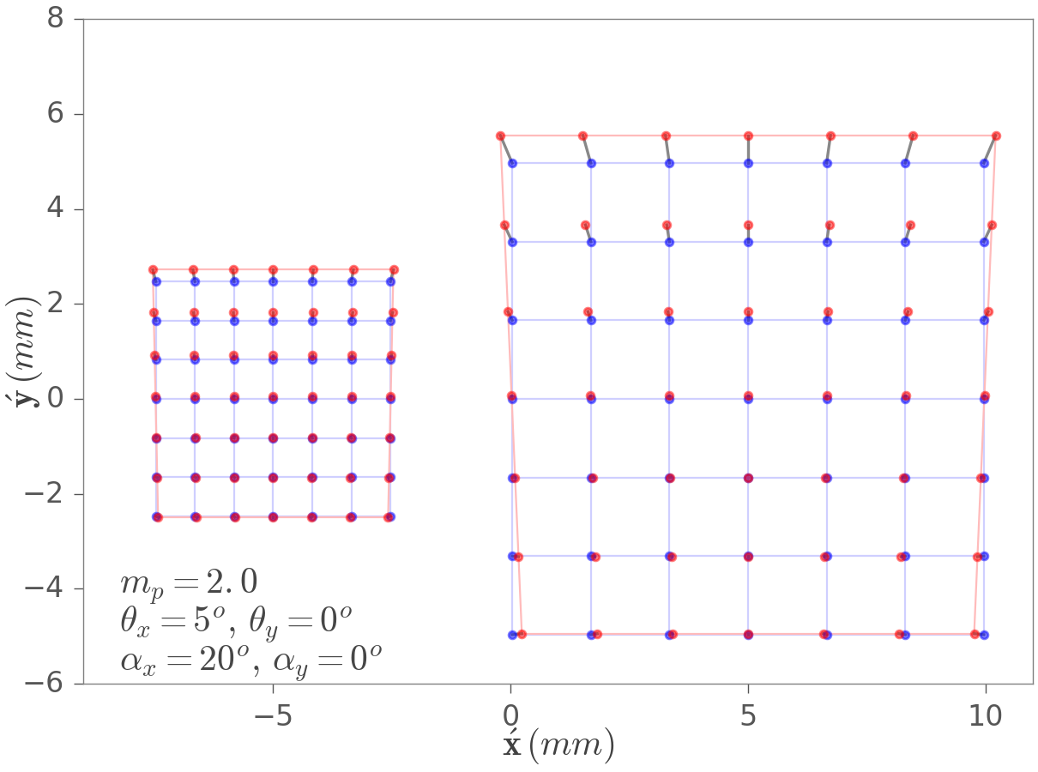

Slide 12











$$\text{x}$$
Chief ray
Nodal ray
$$\text{x}́$$
Pivots
$$β$$
$${\hat{c}}_{y}$$
$$α$$
OPTICAL AXIS (OA)
$$E$$
$$H$$
$${\acute{H}}^{ }$$
$${\hat{c}}_{z}$$
$$\acute{E}$$
$$\left\{C\right\}$$
y
$$z_{o}$$
$$\text{x}$$
$$\acute{z_{o}}$$
$$\text{x}́$$
x
z
Probably reproduce this figure in Zemax

Slide 13















LENS PLANE
OBJECT PLANE
IMAGE PLANE
$$(−)β$$
$α$ = ?
$${\hat{n}}_{o}$$
$${\hat{c}}_{y}$$
$$\left(−\right)β$$
$$E$$
$$H$$
$${\acute{H}}^{ }$$
$${\hat{c}}_{z}$$
$$\acute{E}$$
OPTICAL AXIS
$$\left\{C\right\}$$
$$α=?$$
y
$$\left(−\right)z_{o}$$
$${\hat{n}}_{i}$$
x
$\acute{z_{o}}$ = ?
z
Pivots
$$\text{x}$$
Chief ray
Pivots
$$\text{x}́$$
$$β$$
$${\hat{c}}_{y}$$
$$α$$
OPTICAL AXIS (OA)
$$E$$
$$H$$
$${\acute{H}}^{ }$$
$${\hat{c}}_{z}$$
$$\acute{E}$$
$$\left\{C\right\}$$
y
$$z_{o}$$
$$\text{x}$$
$$\acute{z_{o}}$$
$$\text{x}́$$
x
z

Slide 14









LENS PLANE
IMAGE PLANE
OBJECT PLANE
$$(−)β$$
$$\left(−\right)u_{o}$$
$${\hat{c}}_{y}$$
$$\acute{u_{o}}$$
$$α$$
OPTICAL AXIS
$$O$$
$$H$$
$${\acute{H}}^{ }$$
$${\hat{c}}_{z}$$
$$I$$
$$\left\{C\right\}$$
y
$$(−)β$$
$$α$$
x
z
Pivots
$$S$$
$$\acute{S}$$

Slide 15











Appendix Figure 3.1
$$\text{x}$$
$$−\frac{1}{u}+\frac{1}{\acute{u}}=−\frac{1}{m_{p}z_{e}}+\frac{m_{p}}{\acute{z_{e}}}=\frac{1}{f}$$
Chief ray
y
$$y$$
x
z
$$E$$
$$H$$
$${\acute{H}}^{ }$$
$${\acute{E}}^{ }$$
OPTICAL AXIS (OA)
$$e$$
$$\acute{e}$$
$${\acute{y}}^{ }$$
$$z_{e}$$
$$\acute{z_{e}}$$
$$\text{x}́$$
$$u$$
$$\acute{u}$$

