Slide 1
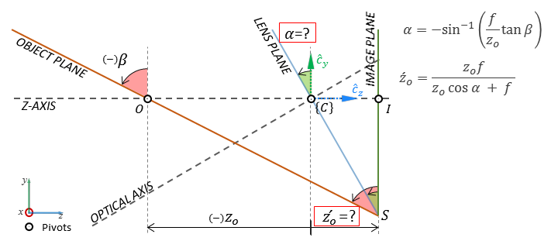
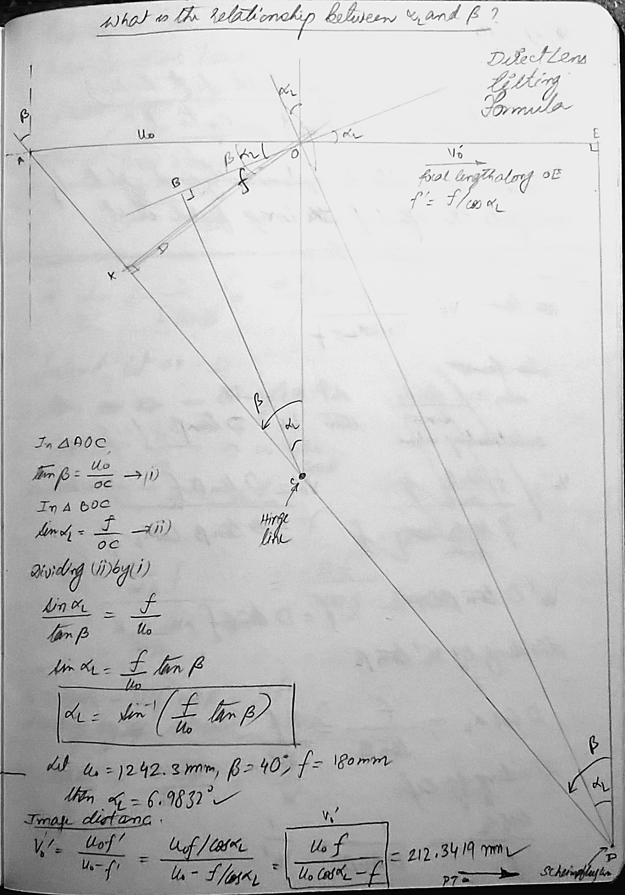
Focusing on tilted object plane using lens tilt (thin lens model)
Relationship between plane of sharp focus tilt angle ($β$) with lens tilt angle ($α$) for thin lens model:
The above expression can be derived geometrically. In the geometric construction we need to use the concepts of hinge line and scheimpflug lines. In the algebraic construction, the equation comes about naturally. Also, the hinge line and Scheimpflug lines comes out of the algebraic construction.

Slide 2
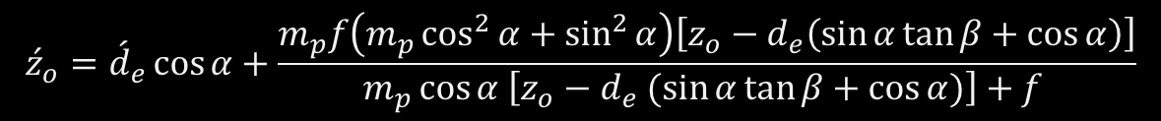
Focusing on tilted object plane using lens tilt (thick lens model)
Pivot point away from the ENPP:
Relationship between plane of sharp focus tilt angle ($β$) with lens tilt angle ($α$):
$$\tan{β}=−\frac{\sin{α}\left[m_{p} \left(z_{o}−d_{e}\cos{α}\right)+f\left(1−m_{p}\right)\cos{α}\right] }{\left(f −m_{p}d_{e}\sin^{2}{α}\right)\left(m_{p}\cos^{2}{α}+\sin^{2}{α}\right)+m_{p}\left(1−m_{p}\right)d_{e}\sin^{2}{α}\cos^{2}{α} }$$
Image plane distance (new after rotation of the lens):
$${\acute{z}}_{o}={\acute{d}}_{e}\cos{α}+\frac{m_{p}f\left(m_{p}\cos^{2}{α}+\sin^{2}{α}\right)\left[z_{o}−d_{e}\left(\sin{α}\tan{β}+\cos{α}\right)\right]}{m_{p}\cos{α \left[z_{o}−d_{e} (\sin{α}\tan{β}+\cos{α})\right]+f }}$$

Slide 3
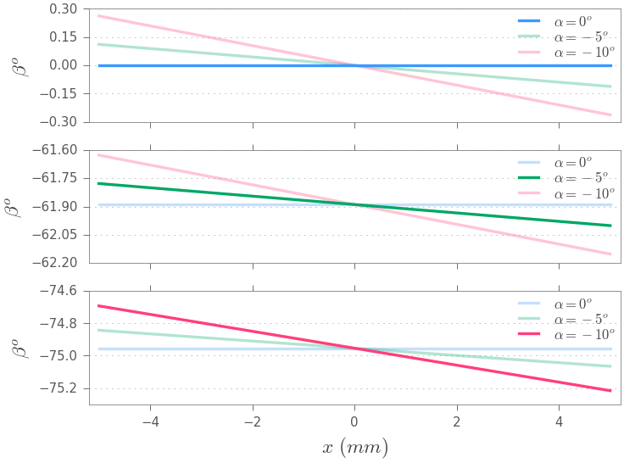

Focusing on tilted object plane using lens tilt (thick lens model)
Pivot point away from the ENPP:
Relationship between plane of sharp focus tilt angle ($β$) with lens tilt angle ($α$):
$$\tan{β}=−\frac{\sin{α}\left[m_{p} \left(z_{o}−d_{e}\cos{α}\right)+f\left(1−m_{p}\right)\cos{α}\right] }{\left(f −m_{p}d_{e}\sin^{2}{α}\right)\left(m_{p}\cos^{2}{α}+\sin^{2}{α}\right)+m_{p}\left(1−m_{p}\right)d_{e}\sin^{2}{α}\cos^{2}{α} }$$
The object plane tilt angle $β$ is different for the same lens tilt angle $α$ if the pivot point is moved!

Slide 4
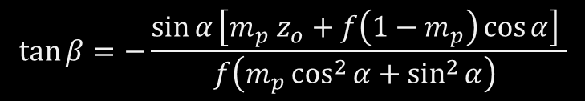
Focusing on tilted object plane using lens tilt (thick lens model)
Pivot point at the ENPP:
Relationship between plane of sharp focus tilt angle ($β$) with lens tilt angle ($α$):
$$\tan{β}=−\frac{\sin{α}\left[m_{p} z_{o}+f\left(1−m_{p}\right)\cos{α}\right] }{f\left(m_{p}\cos^{2}{α}+\sin^{2}{α}\right) }$$

Slide 5
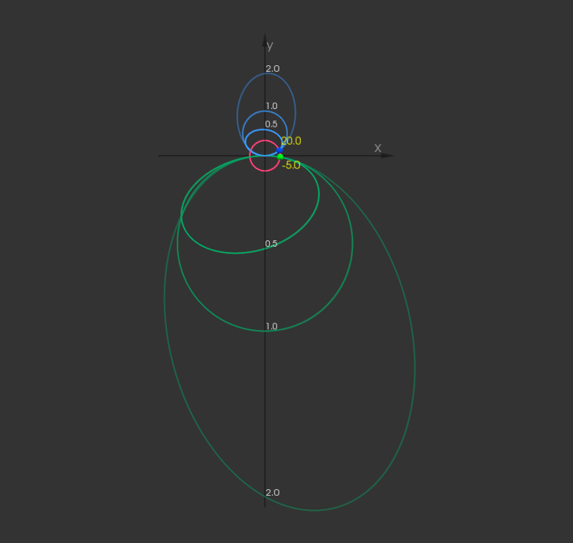
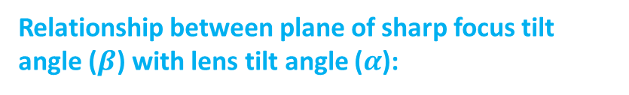

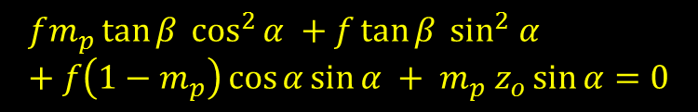
Focusing on tilted object plane using lens tilt (thick lens model)
Pivot point at the ENPP:
Relationship between plane of sharp focus tilt angle ($β$) with lens tilt angle ($α$):
$$\tan{β}=−\frac{\sin{α}\left[m_{p} z_{o}+f\left(1−m_{p}\right)\cos{α}\right] }{f\left(m_{p}\cos^{2}{α}+\sin^{2}{α}\right) }$$
$$fm_{p}\tan{β} \cos^{2}{α} +f\tan{β} \sin^{2} α +f\left(1−m_{p}\right)\cos{α}\sin{α} + m_{p} z_{o}\sin{α}=0$$

